Slide 1
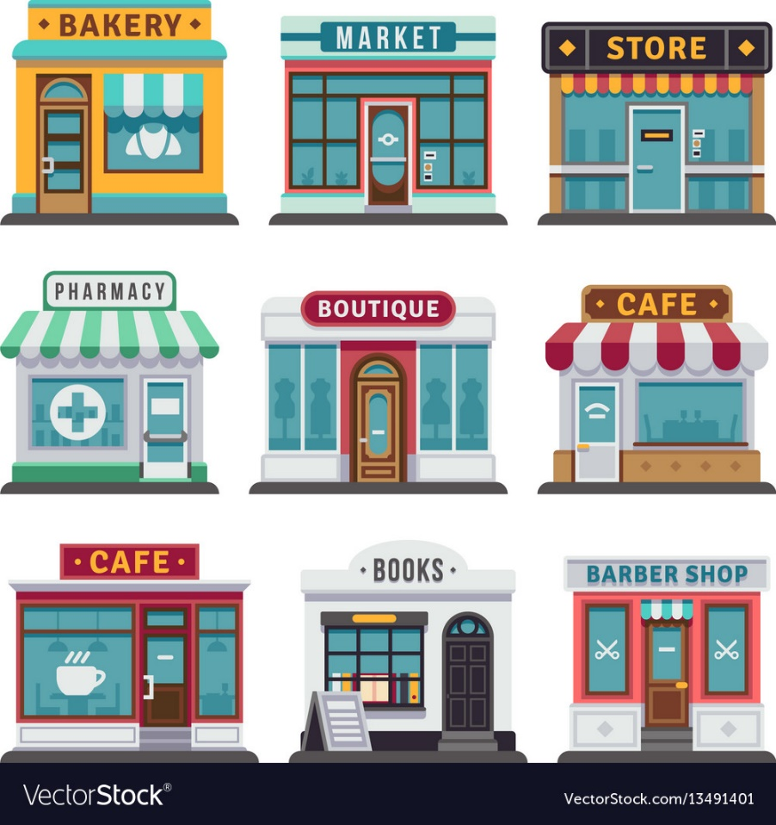
The Quick Screen to starting Retail Business

Slide 2
Questions to Answer:
Does it create or add significant value for customers?
Does it solve significant problem or meet significant demand or need in the marketplace for which someone is willing to pay a premium?
Is there a large enough market and sufficient margins to generate profits?
Is there a good fit between the skills of the management team and the skills required to operate the business?

