Slide 1

EE366/EE382 Economics of Services Sector
CHAPTER 2
Economic Impact of Service Sector
Dr. Nessara Sukpanich

Slide 2

Contents
Service in National Account
1
Economic Impact of service sector: The
case study of travel and tourism industry
2
Service sector and economic growth
3

Slide 3



1. Service in National Account
Two different approaches are based on the National Accounts !!
1.THE PRODUCER_SIDE APPROACH
2.THE FINAL USER_SIDE APPROACH
Method
Method
The value added (VA) of all products
(Total sale - Total purchase)
Adding up all expenditures both private
and public expenditures on final products
The summation of the VA of all
productions in the private and the
public sectors
C + I + G + X - M
Classification
Classification
1
The primary stage
1
Private consumption of service (C)
Raw material extraction and cultivation
2
Private investment of service (I)
2
The secondary stage
3
Gov’t consumption and investment (G_{C} + G_{I}) related to service
Manufacturing
3
The tertiary stage
4
Net export of service (X – M)
Service sector

Slide 4
1. Service in National Account
Two different approaches are based on the National Accounts !!
1.THE PRODUCER_SIDE APPROACH
2.THE FINAL USER_SIDE APPROACH
Various issues to be concerned. For example !!
1. Some firms produce both goods and services….shall we count those firms in service industry or manufacturing industry?
2. Will the two approaches always produce the same results?
Depends on measurement methods and what the researchers want to measure
C in User-side approach contains only final services (not include intermediate services), while in producer-side approach we measures value added of each firm in service industry (including firms providing intermediate services)
In producer-side approach, we can measures value added of each service industry. In user-side approach C is from final sales of each firm in service industry (that means it covers value of intermediate goods and services plus compensation of factors of production of that firm)

Slide 5
2. Economic Impact of Travel & Tourism
In this part we look at impact or contribution to
  Gross Domestic Product (GDP)
  Employment

Slide 6
2. Economic Impact of Travel & Tourism
Travel & Tourism contribution to GDP (can also apply to employment)
Direct effects: take into account only the immediate effects of the additional demand (tourism internal consumption or total tourism internal demand) on production processes and supply of goods and services in terms of additional goods and services, and additional value added and its components.
Indirect effects: this measures the supply chain impact (also called inter-industry linkages) for each sector.
“A chain of additional demand for different factors of production (that is,
inputs, labour and capital), a phenomenon that continues through several
rounds until exhausted by leakages”
Induced effects: the increase of income distributed to the labour force and to the owners of productive capital resulting from incremental visitor demand generates increased demand for goods and services through a rise in household consumption.
Source: World Travel & Tourism Council (2015) and United Nations (2008)

Slide 7
2. Economic Impact of Travel & Tourism
Source: World Travel & Tourism Council (2017), p. 2

Slide 8
2. Economic Impact of Travel & Tourism
Contribution to GDP of Thailand, compared to other sectors
Source: World Travel & Tourism Council (2015), p. 3

Slide 9
2. Economic Impact of Travel & Tourism
Contribution to Employment in Thailand, compared to other sectors
Source: World Travel & Tourism Council (2015), p. 3

Slide 10
2. Economic Impact of Travel & Tourism
Travel & Tourism direct industry GDP expanded 187% between 1995 and 2014 while the total economy expanded 6%.
The mining industry grew 146% over this 19-year period.
The banking industry grew just 48% over this 19-year period
Travel & Tourism GDP is expected to grow at an annual average of 6.2% over the next decade.
Source: World Travel & Tourism Council (2015), p. 2

Slide 11
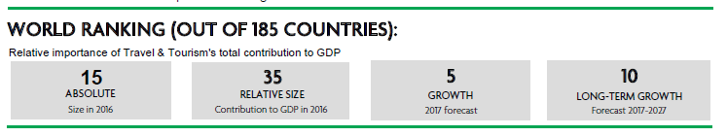
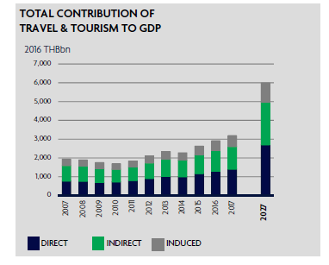
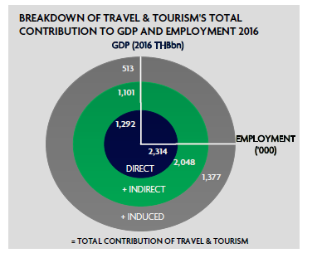
2. Economic Impact of Travel & Tourism
Source: World Travel & Tourism (2017), p. 1

Slide 12
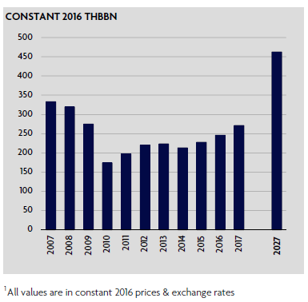
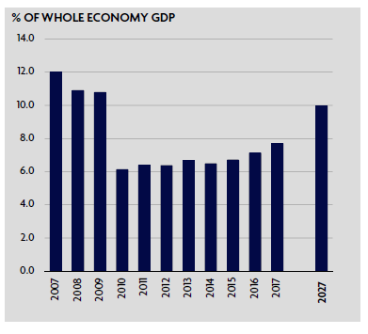
2. Economic Impact of Travel & Tourism
Source: World Travel & Tourism Council (2017), p. 3

Slide 13
2. Economic Impact of Travel & Tourism
Source: World Travel & Tourism Council (2017), p. 3

Slide 14
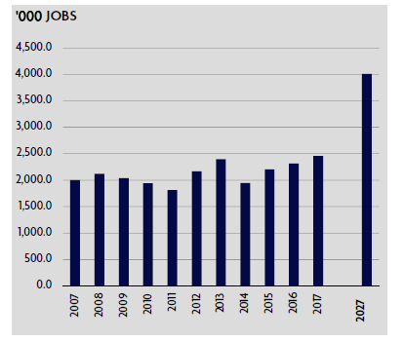
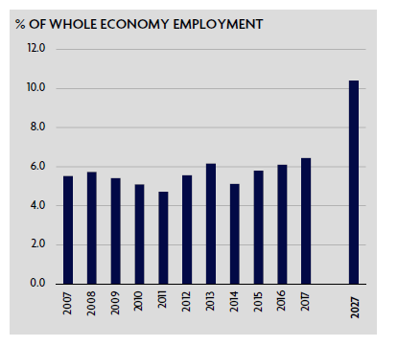
2. Economic Impact of Travel & Tourism
Source: World Travel & Tourism Council (2017), p. 4

Slide 15
2. Economic Impact of Travel & Tourism
Source: World Travel & Tourism (2017), p. 4

Slide 16
2. Economic Impact of Travel & Tourism
Source: World Travel & Tourism Council (2017), p. 5

Slide 17
2. Economic Impact of Travel & Tourism
Source: World Travel & Tourism Council (2017), p. 5

Slide 18
2. Economic Impact of Travel & Tourism
Source: World Travel & Tourism Council (2017), p. 5

Slide 19
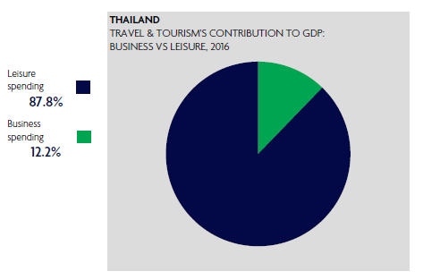
2. Economic Impact of Travel & Tourism
Source: World Travel & Tourism Council (2017), p. 6

Slide 20
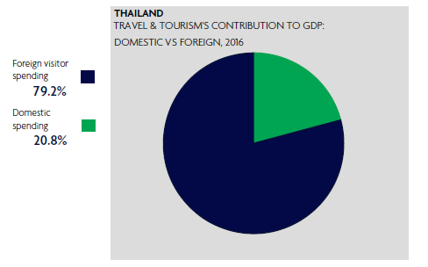
2. Economic Impact of Travel & Tourism
Source: World Travel & Tourism Council (2017), p. 6

Slide 21
2. Economic Impact of Travel & Tourism
Source: World Travel & Tourism Council (2017), p. 6

Slide 22
2. Economic Impact of Travel & Tourism
Source: World Travel & Tourism Council (2017), p. 11

Slide 23
2. Economic Impact of Travel & Tourism
Source: World Travel & Tourism Council (2017), p. 11

Slide 24
2. Economic Impact of Travel & Tourism
Key definition
Travel & Tourism
Relates to the activity of travellers on trips outside their usual environment with a duration of less than one year.
Source: World Travel & Tourism Council (2017)

Slide 25
2. Economic Impact of Travel & Tourism
Key definition
DIRECT CONTRIBUTION TO GDP
GDP generated by industries that deal directly with tourists, including hotels, travel agents, airlines and other passenger transport services, as well as the activities of restaurant and leisure industries that deal directly with tourists.
It is equivalent to total internal Travel & Tourism spending (see below) within a country less the purchases made by those industries (including imports).
Source: World Travel & Tourism Council (2017)

Slide 26
2. Economic Impact of Travel & Tourism
Key definition
DIRECT CONTRIBUTION TO EMPLOYMENT
The number of direct jobs within Travel & Tourism.
TOTAL CONTRIBUTION TO GDP
GDP generated directly by the Travel & Tourism sector plus its
indirect and induced impacts.
TOTAL CONTRIBUTION TO EMPLOYMENT
The number of jobs generated directly in the Travel & Tourism sector plus the indirect and induced contributions.
Source: World Travel & Tourism Council (2017)

Slide 27
2. Economic Impact of Travel & Tourism
Key definition (for DIRECT SPENDING IMPACT)
DOMESTIC TRAVEL & TOURISM SPENDING
Spending within a country by that country’s residents for both
business and leisure trips. Multi-use consumer durables are not included since they are not purchased solely for tourism purposes (total domestic tourism expenditure in TSA)
Outbound spending by residents abroad is not included here, but is separately identified
Source: World Travel & Tourism Council (2017)

Slide 28
2. Economic Impact of Travel & Tourism
Key definition (for DIRECT SPENDING IMPACT)
GOVERNMENT INDIVIDUAL SPENDING
Spending by government on Travel & Tourism services directly linked to visitors, such as cultural services (e.g. museums) or recreational services (e.g. national parks).
INTERNAL TOURISM CONSUMPTION
Total revenue generated within a country by industries that deal directly with tourists including visitor exports, domestic spending and government individual spending.
This does not include spending abroad by residents.
Source: World Travel & Tourism Council (2017)

Slide 29
2. Economic Impact of Travel & Tourism
Key definition (for DIRECT SPENDING IMPACT)
BUSINESS TRAVEL & TOURISM SPENDING
Spending on business travel within a country by residents and
international visitors.
LEISURE TRAVEL & TOURISM SPENDING
Spending on leisure travel within a country by residents and
international visitors.
Source: World Travel & Tourism Council (2017)

Slide 30
2. Economic Impact of Travel & Tourism
Key definition (for INDIRECT CONTRIBUTION IMPACT)
INDIRECT CONTRIBUTION
The contribution to GDP and jobs of the following three factors:
capital investment
government collective spending
supply-chain effects
Source: World Travel & Tourism Council (2017)

Slide 31
2. Economic Impact of Travel & Tourism
Key definition (for INDIRECT CONTRIBUTION IMPACT)
CAPITAL INVESTMENT
Includes capital investment spending by all industries directly involved in Travel & Tourism.
This also constitutes investment spending by other industries on specific tourism assets such as new visitor accommodation and passenger transport equipment, as well as restaurants and leisure facilities for specific tourism use
This is consistent with (total tourism gross fixed capital formation in TSA)
Source: World Travel & Tourism Council (2017)

Slide 32
2. Economic Impact of Travel & Tourism
Key definition (for INDIRECT CONTRIBUTION IMPACT)
GOVERNMENT COLLECTIVE SPENDING
Government spending in support of general tourism activity. This can include national as well as regional and local government spending.
For example, it includes tourism promotion, visitor information services, administrative services and other public services.
This is consistent with part of the total collective tourism consumption in TSA
Source: World Travel & Tourism Council (2017)

Slide 33
2. Economic Impact of Travel & Tourism
Key definition (for INDIRECT CONTRIBUTION IMPACT)
SUPPLY-CHAIN EFFECTS
Purchases of domestic goods and services directly by different industries within Travel & Tourism as inputs to their final tourism output.
Source: World Travel & Tourism Council (2017)

Slide 34
2. Economic Impact of Travel & Tourism
Key definition (for INDUCED CONTRIBUTION IMPACT)
INDUCED CONTRIBUTION
The broader contribution to GDP and employment of spending by those who are directly or indirectly employed by Travel & Tourism.
Source: World Travel & Tourism Council (2017)

Slide 35
2. Economic Impact of Travel & Tourism
Key definition (for OTHER INDICATORS)
OUTBOUND EXPENDITURE
Spending outside the country by residents on all trips abroad. (total outbound tourism expenditure in TSA).
FOREIGN VISITOR ARRIVALS
The number of arrivals of foreign visitors, including same-day and overnight visitors (tourists) to the country.
Source: World Travel & Tourism Council (2017)

Slide 36
2. Economic Impact of Travel & Tourism
Employment in the tourism industry
Single versus multiple job holders in the tourism industries
Source: United Nations (2008b)

Slide 37
2. Economic Impact of Travel & Tourism
Employment in the tourism industry
Employment in the tourism industries: basic categories of employed persons
Source: United Nations (2008b)

Slide 38
2. Economic Impact of Travel & Tourism
Employment in the tourism industry
Relationship between different measures of tourism employment in a given period
Source: United Nations (2008b)

Slide 39
3. Service sector growth and economic growth
Paper 1
Navarro, T. M. and Roura, D. R. (2010). Growth and Productivity in the Service Sector: The State of the Art. Working Papers, the Institute of Social and Economic Analysis.
Paper2
Park, D. and Shin, K. (2012). The Service Sector in Asia: Is it an Engine of Growth. ADB Economics Working Paper Series, No. 332.

Slide 40
3. Service sector growth and economic growth
Navarro, T. M. and Roura, D. R. (2010). Growth and Productivity in the Service Sector: The State of the Art. Working Papers, the Institute of Social and Economic Analysis.
What are three research questions or objectives of this paper?
To study …..
Factors affect growth of services and related employment
The impact of services on economic growth
3. Service productivity and measurement

Slide 41
3. Service sector growth and economic growth
Discussion
“Baumol’s Cost Disease”
  What is “Baumol’s Cost Disease” argument and its implication on the relationship between service sector growth and economic growth?
  What could be possible explanation to counter this argument?

Slide 42
3. Service sector growth and economic growth
Discussion
2. Based on the paper’s 3 key objectives. Analyze finding of each objective on service industry your group choose
  Factors affect that service industry growth
  Impact of that service industry on economic growth
  Labor productivity issues (and measurements) in that industry

Slide 43
Summarise
What is “Baumol’s Cost Disease” arguments?
In the 1960s, Baumol was trying to understand the economics of the arts.
He noticed something surprising !!!
“Musicians weren’t getting any more productive — playing a piece written for a string quartet took four musicians the same amount of time in 1965 as it did in 1865 — yet musicians in 1965 made a lot more money than musicians in 1865”
That means even labor productivity of musician does not increase over time --- musician still get much higher compensation
Source: Leetim (2017)

Slide 44
Summarise
What is “Baumol’s Cost Disease” arguments?
Baumol’s explanation
Since the performer’s labour is the output – the singer singing, the dancer dancing, the pianist playing – there is really no way to increase output per hour (Heilbrun, 2003)
Rising productivity in the manufacturing sector of the economy inevitably pushes up the cost of labor-intensive services like live musical performances.
Rising productivity allows factories to cut prices and raise wages at the same time. But when wages rise, music venues have no alternative but to raise ticket prices to cover the higher costs.
Source: Leetim (2017)

Slide 45
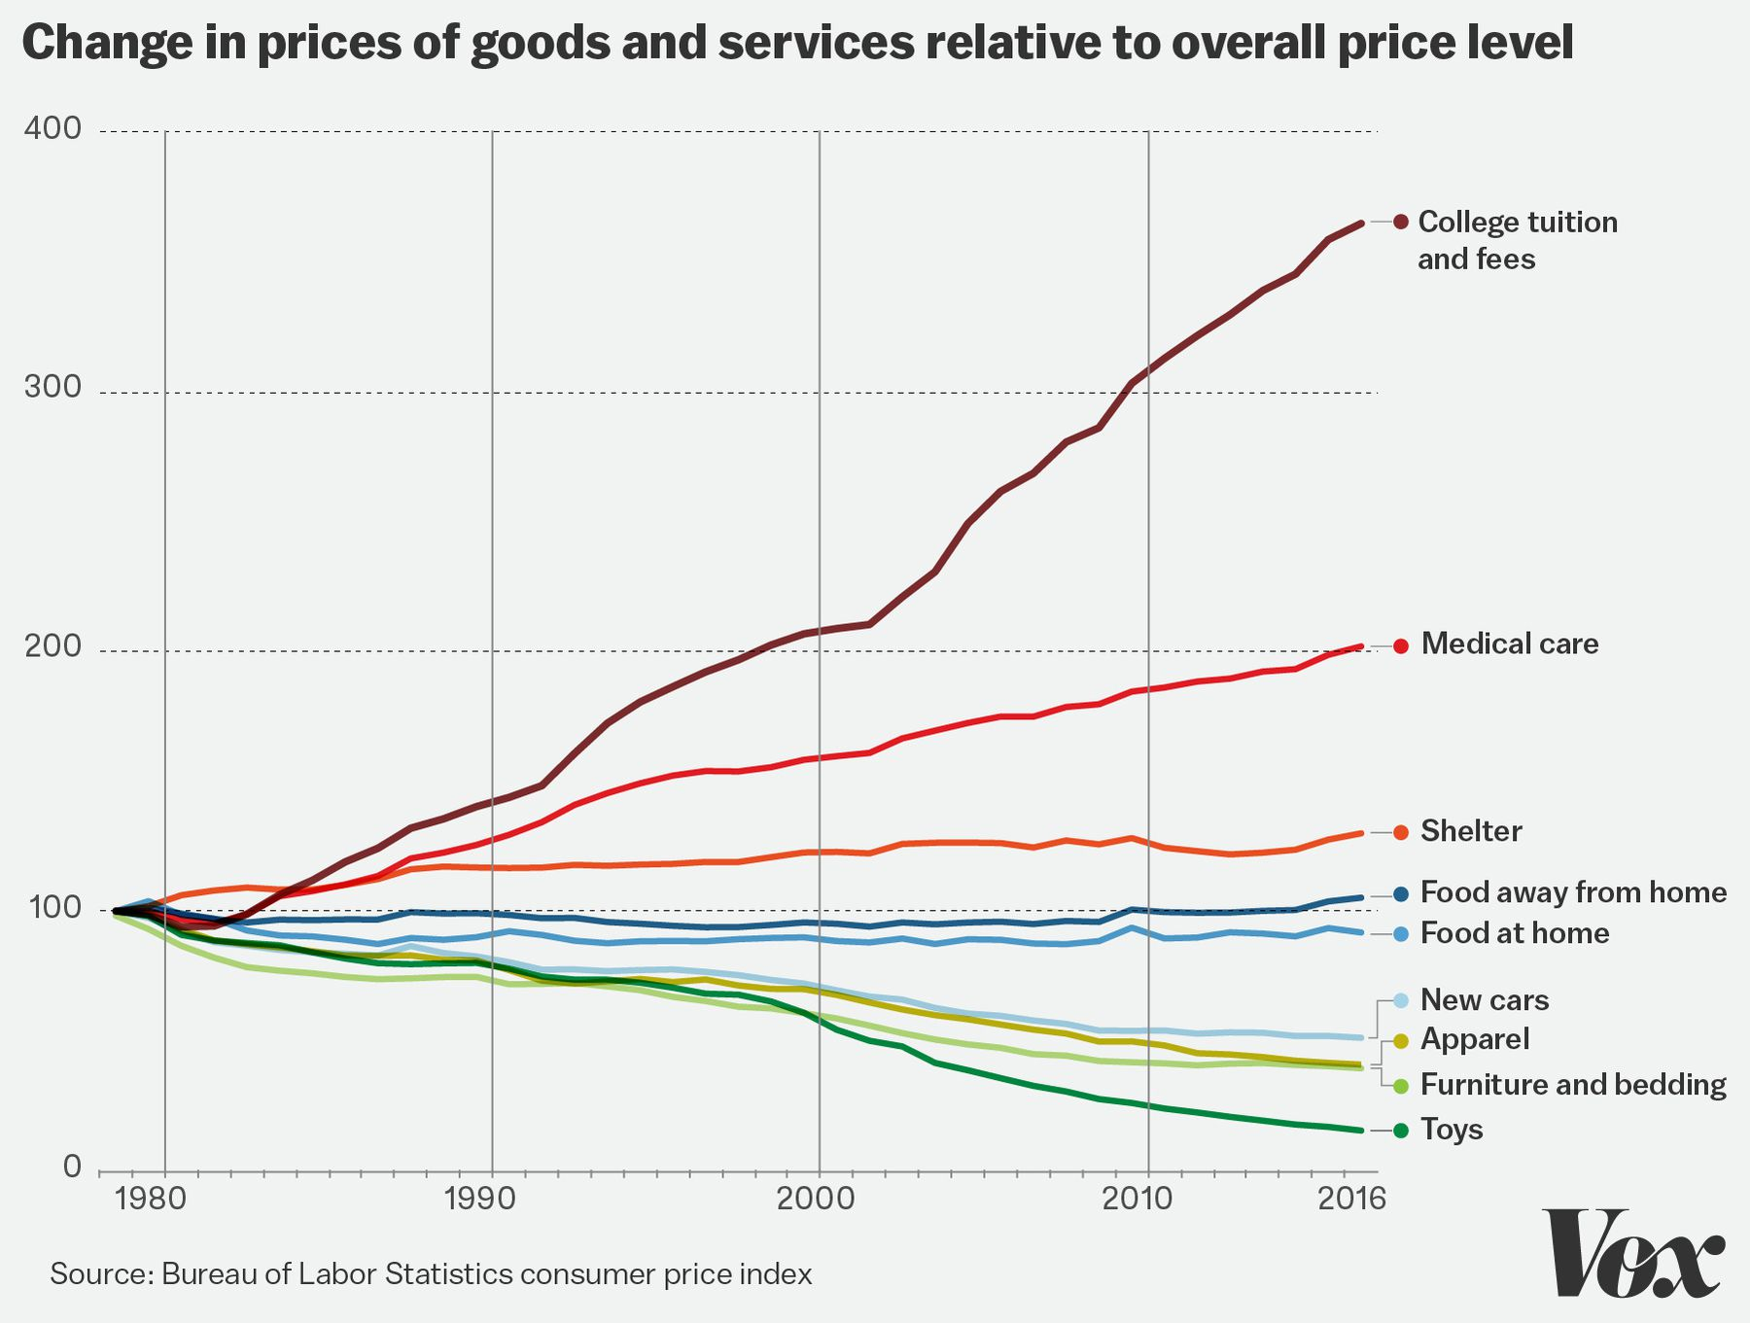
Summarise
Source: Leetim (2017)

Slide 46
Summarize
Possible “Baumol’s Cost Disease” counter arguments
The cost of many services is actually rising faster than growing wages in the sector. So, “Baumol’s Cost Disease” is not the whole story (Leetim, 2017) Why this is the case? Example?
Rising price of services might be associated with better quality of those services.
When economy of the country grows, income increase, demand for services tend to increase ---- Demand pull price of services up
As manufacturing has gotten more efficient, the price of manufactured goods like T-shirts and televisions has fallen. At some point, our living rooms and closets get full and we don’t need any more of this stuff, so we spend less and less on it as prices fall. What do we do with these savings? We spend it on stuff that’s not getting cheaper like many services (Leetim, 2017).

Slide 47
Summarize
Factors that might affect service sector growth
Relative productivity (Baumol’s Cost Disease)
Income (Engel’s law, hierarchy of needs)
Shift in intermediate demand (outsourcing)
Human capital and information society
Innovation and new technology
Institution issues (Regulation, public sector size)
Source: Navarro and Roura (2010), also look at Figure 1 in the paper

Slide 48
Summarize
Engel’s Law
Note: Engel’s law
  An observation in economics stating that as income rises, the proportion of income spent on food falls, even if absolute expenditure on food rises. In other words, the income elasticity of demand of food is between 0 and 1.
  The law was named after the statistician Ernst Engels (1821–1896).

Slide 49
Summarize
Impact of service sector on economic growth
Based on “Baumol’s Cost Disease”,
when service sector (low productivity sector) grows
Overall country labor productivity will be lower
Economic growth will be low
However, each service sector can contribute directly or indirectly to economy.
  It can have direct, indirect and induced impact to GDP.
  Each service industry (especially intermediate service) might also help promote development of other industries (in agricultural, manufacturing or service sectors) in the economy.

Slide 50
Summarize
Possible counter arguments of “Baumol’s Cost Disease” implication on relationship between service sector growth and economic growth
Dutt and Lee (1993) found that the effect of a service sector expansion is either positive or negative depending on how the expansion is measured, although there is a strong case that the effect is in fact usually negative
Wilber (2001, 2002) argue that the impact of service expansion will depend on the relative factor intensities in the economic sectors
New research shows that in some service industries, heavy IT investments since the 90s have begun to yield high productivity returns and to positively push economic growth – so the effect of the expansion of service sector depends on which services are expanding

Slide 51
Summarize
Possible counter arguments of “Baumol’s Cost Disease” implication on relationship between service sector growth and economic growth
According to U.S. Department of commerce (1996), deciding whether slow growth is a consequence of the shift to service is complicated by the absence of satisfactory performance measures for many service industries
  Traditionally, productivity is viewed mainly as an efficiency concept.
  It is now viewed increasingly as efficiency and effectiveness concept
  Effectiveness is being how the enterprise meets the dynamic needs and expectations of customers.
  Productivity is now depends on the value of the products and services (utility, uniqueness, quality, convenience, availability, etc.) and the efficiency with which they are produced and delivered to the customers (Tolentini, 2004)

Slide 52
Summarize
Labor productivity issues (and measurements)
Method to measure productivity
  Partial productivity measures
  (such as labor productivity, capital productivity)
  Multifactor productivity measures
  Total factor productivity measures (TFP)
Source: Navarro and Roura (2010), also look at Figure 2 in the paper

Slide 53
Summarize
Labor productivity issues (and measurements)
Measurement issues of productivity in service sector
  Choice of inputs:
    such as labor should be measured by number of total employed or hours worked
    The relationship between labor input and intermediate input
  Choice of output:
    Definition of output of some services (e.g. financial services) might not be the same across countries
    For several services it is difficult to isolate price effects that are due to changes in quality or mix of services from pure prices changes, and to adjust such quality changes in the price index
  Aggregate productivity growth: could have bias from
    The relative weight that is attributed to the mismeasured services in total value-added or employment of the economy
    The role of specific services as intermediate inputs for other industries

Slide 54
References
Heilbrun, J. (2003). “Chapter 11: Baumol’s Cost Disease” in A Handbook of Cultural Economics, Edward Elgar Publishing.
Navarro, T. M. and Roura, D. R. (2010). Growth and Productivity in the Service Sector: The State of the Art. Working Papers, the Institute of Social and Economic Analysis.
United Nations (2008a). Tourism Satellite Account: Recommended Methodological Framework 2008.
United Nations (2008b). International Recommendations for Tourism Statistics 2008.
World Travel & Tourism Council (2015). How Does Travel &Tourism Compare to Other Sectors, Benchmark Report.
World Travel & Tourism Council (2017). Travel & Tourism Economic Impact 2017 Thailand.
Leetim, T. B. (2017). William Baumol, whose famous economic theory explains the modern world, has died, Vox: Online available at
https://www.vox.com/new-money/2017/5/4/15547364/baumol-cost-disease-explained

