Slide 1
Health and education - 2
EE361/363 Economic development in CMLV
Faculty of economics
Thammasat university

Slide 2
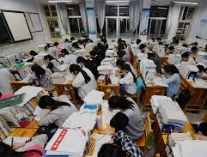
Education POLICY and allocative mechanism
Decisions on how education decisions: budget is allocated, how many school slots are provided, who gets access depend on :
Balance between economically motivated demands (based on needs) and politically responsive supply
The important distinctions of social and private benefits and costs of different levels of education

Slide 3

Educational systems and development
The amount of education one receives is largely determined by demand and supply
Demand side:
Prospects for higher income in the future through modern-sector employment
Direct and indirect educational costs
Supply side:
The quantity of school slots available at various educational levels
The political processes of allocation

Slide 4
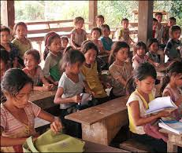
Economic determinants of demand
Schooling demanded is related to/determined by:
Wage or income differential
Probability of success finding modern-sector employment
Direct private cost of education
Indirect or opportunity cost of education

Slide 5
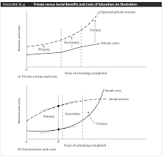
Expected private returns
Private returns and costs
Private costs
Social costs
Social returns
Social returns and costs

Slide 6
Health measurement and disease burden
WHO definition of health: “ a state of complete physical, mental and social well-being and not merely the absence of disease and infirmity”
Measure of health: disability-adjusted life year (DALY). This includes premature deaths and disabilities. However the measure is still controversial
One quarter of the disease burden is represented by diarrhea, childhood diseases (measles, respiratory infections, parasitic infections and malaria)
Health levels vary from country to country and even within countries.

Slide 7
Health Challenges facing Developing countries
Absolute poverty: limits access to health and health care facilities
Malnutrition: retards the immune system and causes stunting in children
AIDS: leading cause of deaths of working-age adults in developing countries
Malaria: making a comeback after years under control; 70% fatalities are children
Tuberculosis: claims about 2 million lives a year; 1/3 of world population infected
Acute lower respiratory infections: pneumonia is cause of 20% child deaths
Dengue: spreads rapidly with millions of cases reported each year
Parasitic infections (ascariasis, guinea worm disease, chagas disease, elephantiasis

Slide 8
HIV/AIDS
Acquired immunodeficiency syndrome (AIDS) is the final and fatal stage of infection of the human immunodeficiency virus (HIV)
Since the AIDS epidemic began in 2013, close to 70 million people have been infected with the virus of which half have died
Sub-Saharan region remains most severely affected, with nearly 1 in every 5 adults affected
In recent years steady progress has been made and the number of new infections has decreased steadily
Due to better health care and practices for women and children, the rate of decrease has been significant for this population group

Slide 9
Health, productivity and policy
Poor health conditions harm the productivity of adults; some measures include lost person work days because of illness and that healthier persons get better pay. In India, elimination of deformity from leprosy enabled workers to earn three times their original wages
Rapid increases in height were observed for developing countries, in comparison to two-three decades ago, and for developing countries at the beginning of the 20th century compared to the mid 18th century
In Brazil, taller people earn more that income, holding other factors such as education and experience constant

Slide 10
Health, productivity and policy
Health system includes: components of public health departments, hospitals, clinics, and offices of doctors, and paramedics, as well as an informal network of used by poorer citizens, such as traditional healers, midwives and acupuncture specialists
Performance indicators to measure health systems include
The overall health level of the population
health inequalities within the population, health system responsiveness
the distribution of responsiveness within the population, and
the distribution, or fairness, of the health system’s financial burden within the population

Slide 11
Government role
Government plays an important role in health systems:
Since health is central to poverty reduction, government must ensure good policies to ensure the overall health of the population
Households spend relatively little on health because they neglect externalities (such as contagion or spread of disease)
The market is unable and unwilling to invest in health infrastructure and research and development
Public health programs in developing countries have proven successes

