Slide 1
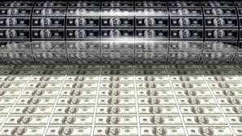
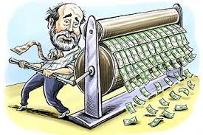
The Money Supply Process

Slide 2
Three Players in the Money Supply Process
Central bank (Federal Reserve System)
Banks (depository institutions; financial intermediaries)
Depositors (individuals and institutions)

Slide 3
The Fed’s Balance Sheet
Federal Reserve System
Assets | Liabilities
Securities | Currency in circulation
Loans to Financial Institutions | Reserves

Slide 4
Control of the Monetary Base

Slide 5
Open Market Purchase from a Bank
Banking System |  |  |  |  | Federal Reserve System
Assets |  | Liabilities |  |  | Assets |  | Liabilities
Securities | $100m |  |  |  | Securities | +$100m | Reserves | +$100m
Reserves | +$100m
Net result is that reserves have increased by $100
No change in currency
Monetary base has risen by $100

Slide 6
Open Market Purchase from a Bank
Banking System |  |  |  |  | Federal Reserve System
Assets |  | Liabilities |  |  | Assets |  | Liabilities
Securities | -$100m |  |  |  | Securities | +$100m

Slide 7
Open Market Purchase from a Bank
Banking System |  |  |  |  | Federal Reserve System
Assets |  | Liabilities |  |  | Assets |  | Liabilities
Securities | -$100m |  |  |  | Securities | +$100m | Reserves | +$100m
Reserves | +$100m

Slide 8
Open Market Purchase from the Nonbank Public
Banking System |  |  |  |  | Federal Reserve System
Assets |  | Liabilities |  |  | Assets |  | Liabilities
Reserves | +$100m | Checkable deposits | +$100m |  | Securities | +$100m | Reserves | +$100m
Person selling bonds to the Fed deposits the Fed’s check in the bank
Identical result as the purchase from a bank

Slide 9
Open Market Purchase from the Nonbank Public
Banking System |  |  |  |  | Federal Reserve System
Assets |  | Liabilities |  |  | Assets |  | Liabilities
 |  |  |  |  | Securities | +$100m
Fed buys bonds from the public

Slide 10
Open Market Purchase from the Nonbank Public
Banking System |  |  |  |  | Federal Reserve System
Assets |  | Liabilities |  |  | Assets |  | Liabilities
 |  | Checkable deposits | +$100m |  | Securities | +$100m
The public deposits the cheque with the banking system.

Slide 11
Open Market Purchase from the Nonbank Public
Banking System |  |  |  |  | Federal Reserve System
Assets |  | Liabilities |  |  | Assets |  | Liabilities
Reserves | +$100m | Checkable deposits | +$100m |  | Securities | +$100m | Reserves | +$100m
The Banking system receives credit as reserves
The Fed ,simultaneously, created reserves in its liability

Slide 12
Open Market Purchase from the Nonbank Public (cont’d)
Nonbank Public |  |  |  |  | Federal Reserve System
Assets |  | Liabilities |  |  | Assets |  | Liabilities
Securities | -$100m |  |  |  | Securities | +$100m | Currency in circulation | +$100m
Currency | +$100m
The person selling the bonds cashes the Fed’s check
Reserves are unchanged
Currency in circulation increases by the amount of the open market purchase
Monetary base increases by the amount of the open market purchase

Slide 13
Open Market Purchase from the Nonbank Public (cont’d)
Nonbank Public |  |  |  |  | Federal Reserve System
Assets |  | Liabilities |  |  | Assets |  | Liabilities
Securities | -$100m |  |  |  | Securities | +$100m

Slide 14
Open Market Purchase from the Nonbank Public (cont’d)
Nonbank Public |  |  |  |  | Federal Reserve System
Assets |  | Liabilities |  |  | Assets |  | Liabilities
Securities | -$100m |  |  |  | Securities | +$100m | Currency in circulation | +$100m
Currency | +$100m

Slide 15
Open Market Purchase: Summary
The effect of an open market purchase on reserves depends on whether the seller of the bonds keeps the proceeds from the sale in currency or in deposits
The effect of an open market purchase on the monetary base always increases the monetary base by the amount of the purchase

Slide 16
Shifts from Deposits into Currency
Nonbank Public |  |  |  |  | Banking System
Assets |  | Liabilities |  |  | Assets |  | Liabilities
Checkable deposits | -$100m |  |  |  | Reserves | -$100m | Checkable deposits | -$100m
Currency | +$100m
Federal Reserve System
Assets |  | Liabilities
 |  | Currency in circulation | +$100m
 |  | Reserves | -$100m
Net effect on monetary liabilities is zero; Reserves are changed by random fluctuations; Monetary base is a more stable variable

Slide 17
Shifts from Deposits into Currency
Nonbank Public |  |  |  |  | Banking System
Assets |  | Liabilities |  |  | Assets |  | Liabilities
Currency | +$100m
Federal Reserve System
Assets |  | Liabilities

Slide 18
Shifts from Deposits into Currency
Nonbank Public |  |  |  |  | Banking System
Assets |  | Liabilities |  |  | Assets |  | Liabilities
Checkable deposits | -$100m |  |  |  |  |  | Checkable deposits | -$100m
Currency | +$100m
Federal Reserve System
Assets |  | Liabilities

Slide 19
Shifts from Deposits into Currency
Nonbank Public |  |  |  |  | Banking System
Assets |  | Liabilities |  |  | Assets |  | Liabilities
Checkable deposits | -$100m |  |  |  | Reserves | -$100m | Checkable deposits | -$100m
Currency | +$100m
Federal Reserve System
Assets |  | Liabilities
 |  | Currency in circulation | +$100m
 |  | Reserves | -$100m

Slide 20
Loans to Financial Institutions
Banking System |  |  |  |  | Federal Reserve System
Assets |  | Liabilities |  |  | Assets |  | Liabilities
Reserves | +$100m | Loans | +$100m |  | Loans | +$100m | Reserves | +$100m
 |  | (borrowing from Fed) |  |  | (borrowing from Fed)
Monetary liabilities of the Fed have increased by $100
Monetary base also increases by this amount

Slide 21
R= BR+ NBR
MBn= C+ NBR

Slide 22
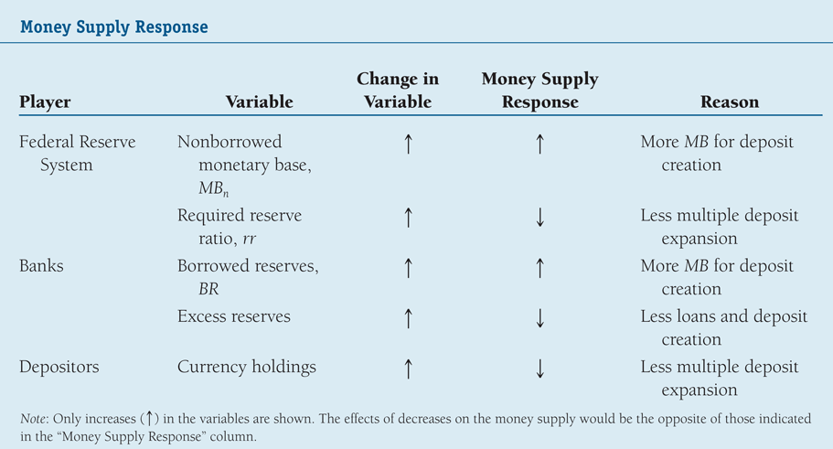
Overview of the Money Supply Process
Summary Table 1 Money Supply Response

Slide 23
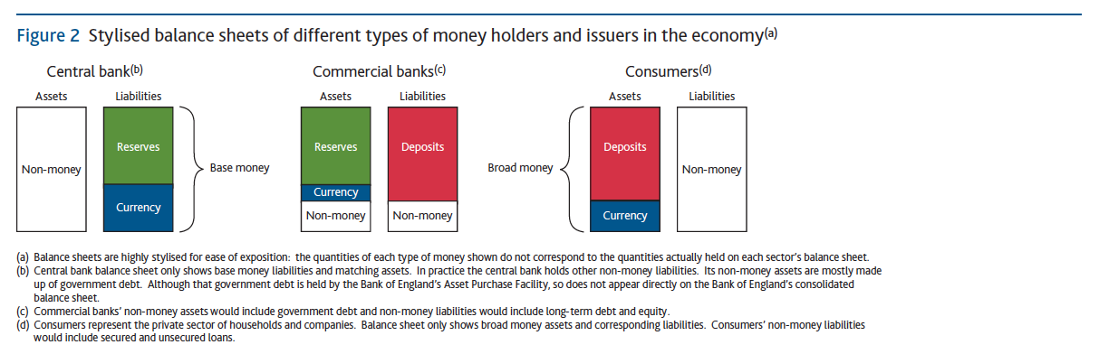

Slide 24
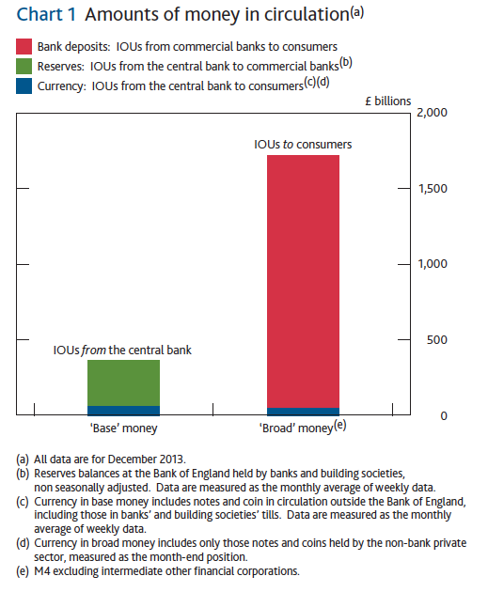

Slide 25
In the modern economy, most money takes the form of bank
deposits. But how those bank deposits are created is often
misunderstood: the principal way is through commercial
banks making loans. Whenever a bank makes a loan, it
simultaneously creates a matching deposit in the
borrower’s bank account, thereby creating new money.

Slide 26
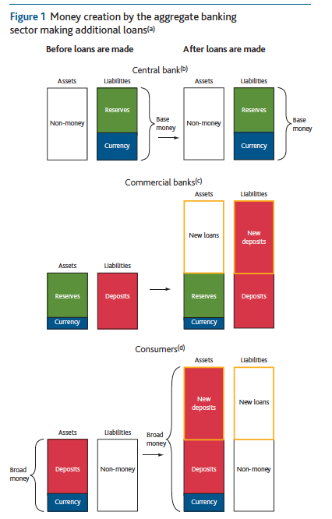

Slide 27
money introduction

Slide 28
Tools of Monetary Policy

Slide 29
http://www.federalreserve.gov/newsevents/press/monetary/20140917a.htm
Current Fed Funds Target Rate = 0- 0.25
The Discount Rate= 0.75

Slide 30
Tools VS Target
The focus is on federal funds rate (Target)
The primary instrument of monetary policy
Since 1994, the fed has announced the target at each FOMC meeting.
The four tools of monetary policy
  Open market operations
  Discount policy
  Reserve requirements
  Interest paid on reserves

Slide 31
http://www.youtube.com/watch?v=mw4-hW_LEeI

Slide 32
The Market For Reserves and the Federal Funds Rate
Demand and Supply in the Market for Reserves
What happens to the quantity of reserves demanded by banks, holding everything else constant, as the federal funds rate changes?
Excess reserves are insurance against deposit outflows
  The cost of holding these (opportunity cost) is the interest rate that could have been earned minus the interest rate that is paid on these reserves, i_{er}

Slide 33
Demand in the Market for Reserves
Since the fall of 2008 the Fed has paid interest on reserves at a level that is set at a fixed amount below the federal funds rate target.
When the federal funds rate is above the rate paid on excess reserves, i_{er}, as the federal funds rate decreases, the opportunity cost of holding excess reserves falls and the quantity of reserves demanded rises
Downward sloping demand curve that becomes flat (infinitely elastic) at i_{er}

Slide 34
Supply in the Market for Reserves
Two components: non-borrowed and borrowed reserves
Cost of borrowing from the Fed is the discount rate
Borrowing from the Fed is a substitute for borrowing from other banks
If i_{ff} < i_{d}, then banks will not borrow from the Fed and borrowed reserves are zero
The supply curve will be vertical
As i_{ff} rises above i_{d}, banks will borrow more and more at i_{d}, and re-lend at i_{ff}
The supply curve is horizontal (perfectly elastic) at i_{d}

Slide 35
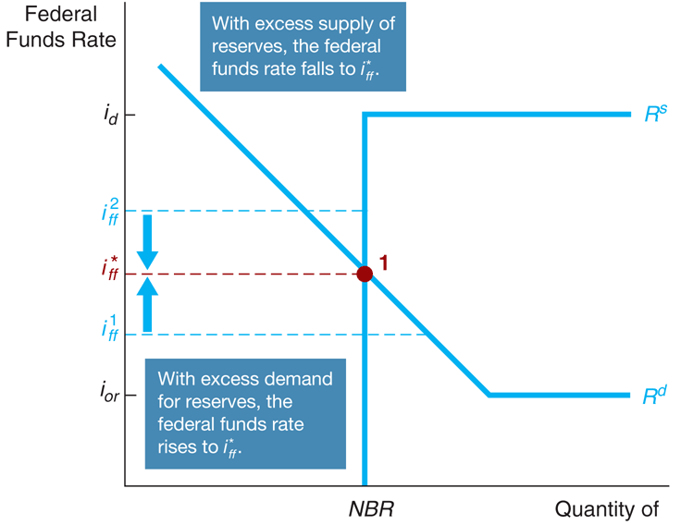
Figure 1 Equilibrium in the Market for Reserves

Slide 36
How Changes in the Tools of Monetary Policy Affect the Federal Funds Rate
Effects of open an market operation depends on whether the supply curve initially intersects the demand curve in its downward sloped section versus its flat section.
An open market purchase causes the federal funds rate to fall whereas an open market sale causes the federal funds rate to rise (when intersection occurs at the downward sloped section).

Slide 37
How Changes in the Tools of Monetary Policy Affect the Federal Funds Rate (cont’d)
Open market operations have no effect on the federal funds rate when intersection occurs at the flat section of the demand curve.

Slide 38
How Changes in the Tools of Monetary Policy Affect the Federal Funds Rate (cont’d)
If the intersection of supply and demand occurs on the vertical section of the supply curve, a change in the discount rate will have no effect on the federal funds rate.
If the intersection of supply and demand occurs on the horizontal section of the supply curve, a change in the discount rate shifts that portion of the supply curve and the federal funds rate may either rise or fall depending on the change in the discount rate

Slide 39
How Changes in the Tools of Monetary Policy Affect the Federal Funds Rate (cont’d)
When the Fed raises reserve requirement, the federal funds rate rises and when the Fed decreases reserve requirement, the federal funds rate falls.

Slide 40
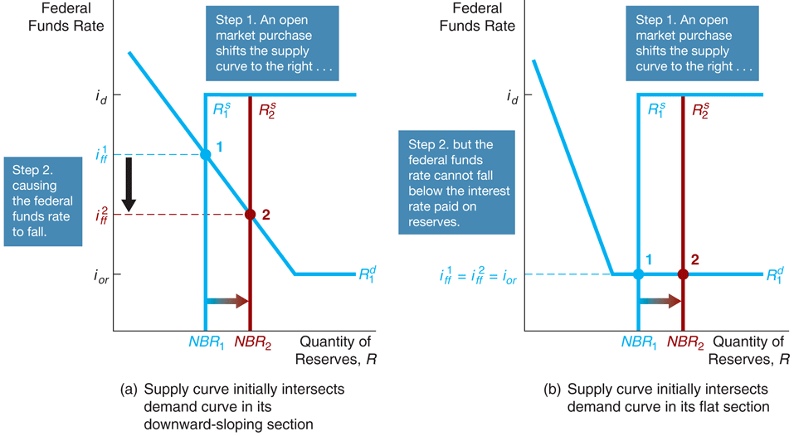
Figure 2 Response to an Open Market Operation

Slide 41
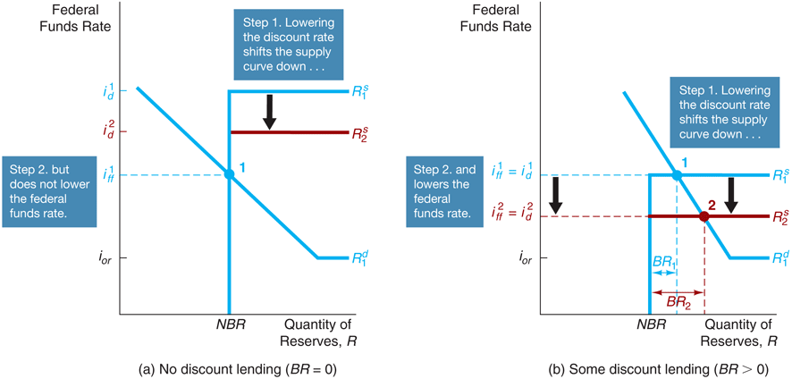
Figure 3 Response to a Change in the Discount Rate

Slide 42
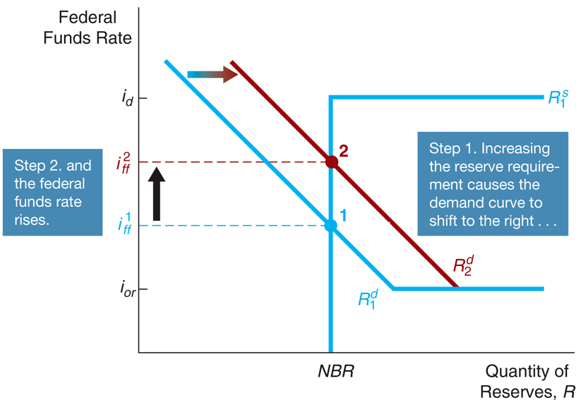
Figure 4 Response to a Change in Required Reserves

Slide 43
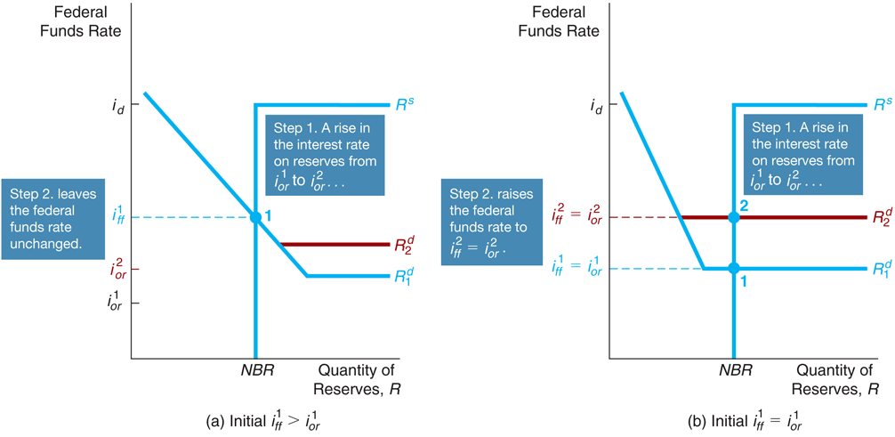
Figure 5 Response to a Change in the Interest Rate on Reserves

Slide 44
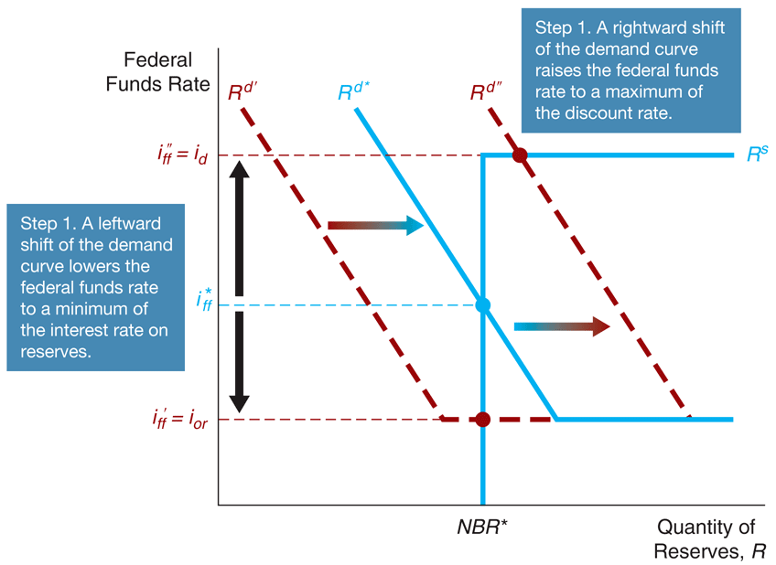
Figure 6 How the Federal Reserve’s Operating Procedures Limit Fluctuations in the Federal Funds Rate

Slide 45
Conventional Monetary Policy Tools
During normal times, the Federal Reserve uses three tools of monetary policy—open market operations, discount lending, and reserve requirements—to control the money supply and interest rates, and these are referred to as conventional monetary policy tools.

Slide 46
Open Market Operations
Dynamic open market operations
  To change the level of reserves and MB
Defensive open market operations
  To offset movements in other factors that affect reserves and the monetary base.
Primary dealers
  (salomon brothers scandal)
TRAPS (Trading Room Automated Processing System)
Repurchase agreements
Matched sale-purchase agreements

Slide 47
What is a repurchase agreement
It is a collateralised lending.
To mop up liquidity or provide liquidity in the overnight market
Often known as repo.

Slide 48
Advantages of Open Market Operations
The Fed has complete control over the volume
Flexible and precise
Easily reversed
Quickly implemented

Slide 49
Discount Policy and the Lender of Last Resort
Discount window
Primary credit: standing lending facility
  Lombard facility
  Effectively setting a ceiling for the Federal Funds rate.
Secondary credit
  Given to banks in financial trouble and set at 50 bps over the discount rate. ( reflecting a penalty rate to less sound banks.
Seasonal credit
Lender of last resort to prevent financial panics
  Creates moral hazard problem

Slide 50
Advantages and Disadvantages of Discount Policy
Used to perform role of lender of last resort
  Important during the subprime financial crisis of 2007-2008.
Cannot be controlled by the Fed; the decision maker is the bank
Discount facility is used as a backup facility to prevent the federal funds rate from rising too far above the target

Slide 51
Lender of last resort: necessary
FDIC insures deposits up to 250,000 usd per account.
It may seem unnecessary to have the discount window
However , only 1% of the total amount of deposits is FDIC insured
Therefore, the FED is ready to stand behind the banking system to prevent banking panics.

Slide 52
Reserve Requirements
Depository Institutions Deregulation and Monetary Control Act of 1980 sets the
reserve requirement the same for all depository institutions
3% of the first $48.3 million of checkable deposits; 10% of checkable deposits over $48.3 million
The Fed can vary the 10% requirement between 8% to 14%

Slide 53
Disadvantages of Reserve Requirements
No longer binding for most banks
Can cause liquidity problems
Increases uncertainty for banks

Slide 54
Interest on Reserves
Fed only started to pay interest on reserves only in 2008
A very short history
IOER is below the fed funds target
Provide a floor under the federal funds rate
Now banks have accumulated huge quantities of excess reserves.
If the FED were to increase the Fed Funds Target Rate then it would involves massive amounts of open market operations to remove reserves
How would an increase in IOER help achieve the new higher Fed Funds Target rate?

Slide 55
Nonconventional Monetary Policy Tools During the Global Financial Crisis
Liquidity provision: The Federal Reserve implemented unprecedented increases in its lending facilities to provide liquidity to the financial markets
  Discount Window Expansion
  Term Auction Facility
  New Lending Programs
Asset Purchases: During the crisis the Fed started two new asset purchase programs to lower interest rates for particular types of credit: Government Sponsored Entities Purchase Program; QE2

Slide 56
BOE QE explanation

Slide 57
Monetary Policy Tools of the European Central Bank
Open market operations
  Main refinancing operations
    Weekly reverse transactions
  Longer-term refinancing operations
Lending to banks
  Marginal lending facility/marginal lending rate
  Deposit facility

Slide 58
Monetary Policy Tools of the European Central Bank (cont’d)
Reserve Requirements
  2% of the total amount of checking deposits and other short-term deposits
  Pays interest on those deposits so cost of complying is low

Slide 59
http://www.youtube.com/watch?v=CvRAqR2pAgw

Slide 60
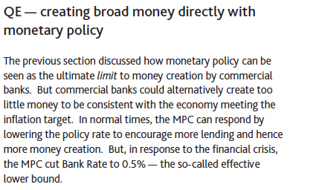

Slide 61
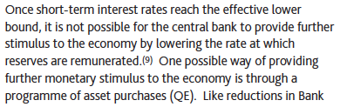

Slide 62
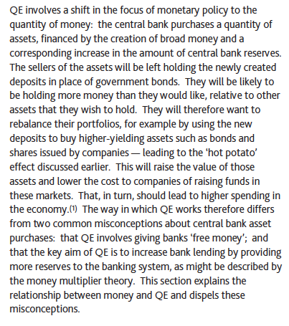

Slide 63
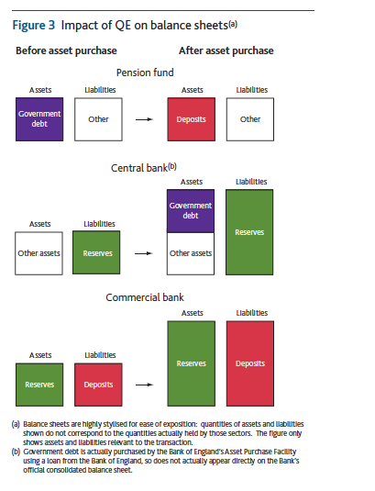

Slide 64
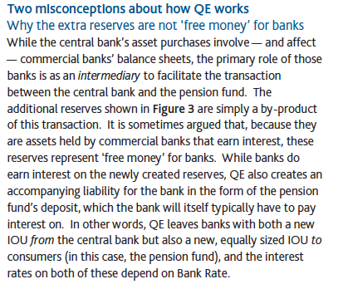

Slide 65
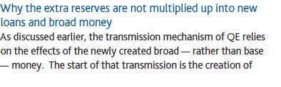

Slide 66
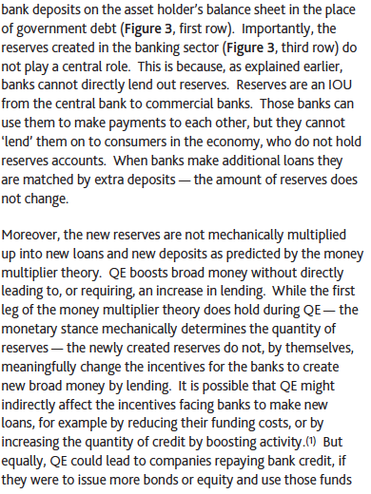

Slide 67


