Slide 1
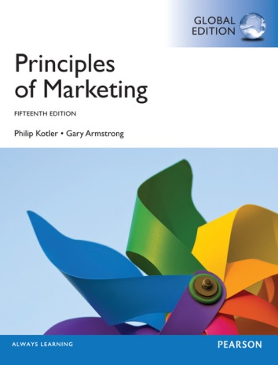
Products & Service Strategy II
CHAPTER 9
MK 202 Fundamentals of Marketing
By Aj.Suwalya Khemvaraporn

Slide 2


Slide 3
Objective Outline
Objective 1: Explain how companies find and develop new product ideas.
Objective 2: List and define the steps in the new product development process and the major considerations in managing this process.
Objective 3: Describe the stages of the product life cycle and how marketing strategies change during a product’s life cycle.
Objective 4: Discuss two additional product issues: socially responsible product decisions and international product and services marketing.

Slide 4


Google
Google’s famously chaotic innovation process has unleashed a seemingly unending flurry of diverse new products. But at Google, innovation is more than a process. It’s part of the company’s DNA. “Where does innovation happen at Google? It happens everywhere.”

Slide 5
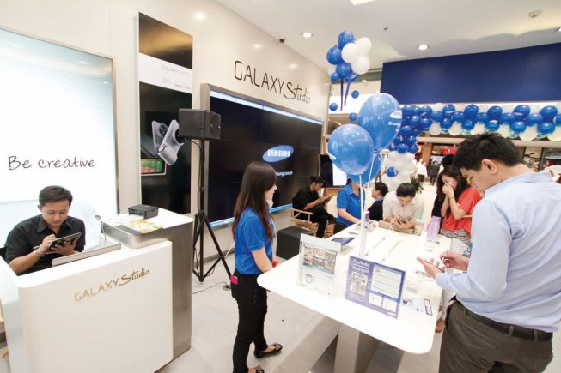
Samsung
Beyond cutting-edge technology and stylish design, Samsung puts the customer at the core of its innovation movement. It’s new products “bring genuine change to people’s lives.”

Slide 6
Objective 1:Explain how companies find and develop new product ideas.

Slide 7
New Product Development Strategy
Obtained in 2 ways
  Acquisitions – by buying a whole company, patent, or license to product someone’s else’s product
  The firm’s new-product development efforts
  New-product development: The development of original
  product improvements, product modifications and new brands
  through the firm’s own product development efforts.

Slide 8
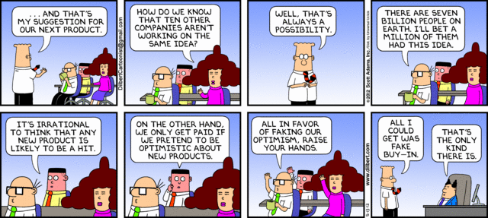
Objective 2: List and define the steps in the new product development process and the major considerations in managing this process.

Slide 9
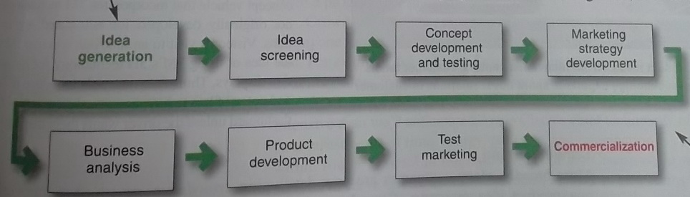
The New-Product Development Process
Figure 9.1 Major Stages in New Product Development
New-product development starts with good new-product ideas-lots of them. For example, Cisco’s I-Prize crowdsourcing challenge attracted 824 ideas from 2,900 innovators representing more than 156 countries.
The remaining steps reduce the number of ideas and develop only the best ones into profitable products. Of the 824 ideas from Cisco’s I-Prize challenge, only a handful are being developed

Slide 10
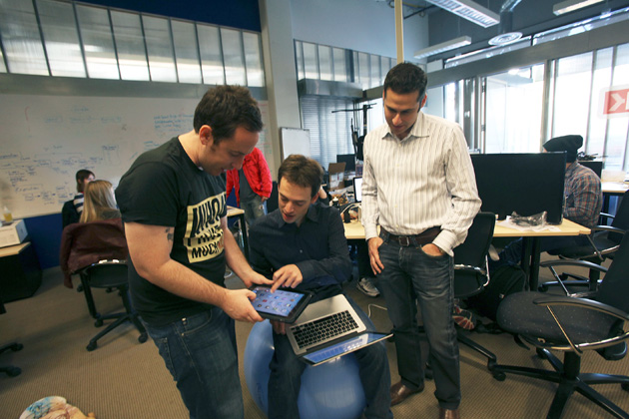
1. Idea Generation
Idea Generation: The systematic search for new- product ideas
  Internal Idea Sources
Internal product ideas: Twitter hosts and annual “Hack Week: Let’s Hack Together” event, which actively promotes internal innovation through experimentation around the company.

Slide 11

1. Idea Generation
  External Idea Sources
Customer-driven new product ideas: At 3M innovation centers, customer teams meet with 3M marketing and technology experts to spark novel solutions to customer problems.

Slide 12
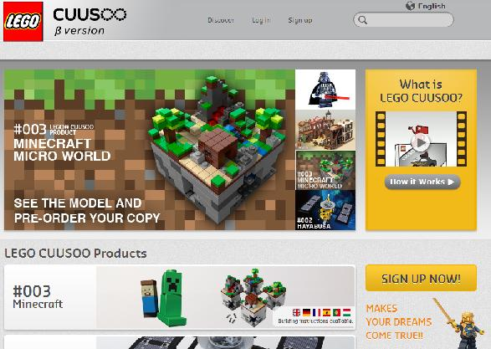
New-product ideas from customers: LEGO’s CUUSOO Web site invites users to submit and vote on product ideas. LEGO Minecraft Micro World racked up the required 10,000 votes in less than 48 hours.

Slide 13
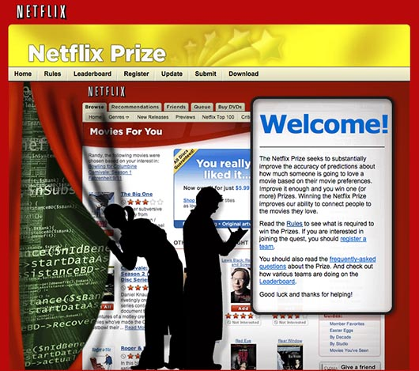
1. Idea Generation
Crowdsourcing: Inviting broad communities of people-customers, employees, independent scientists and researchers, and even the public at large-into the new-product innovation process.
Crowdsourcing: When Netflix wanted ideas for improving the accuracy of its Cinematch online recommendation system, it decided to “open it up to the world,” promising a $1million prize for best solution

Slide 14
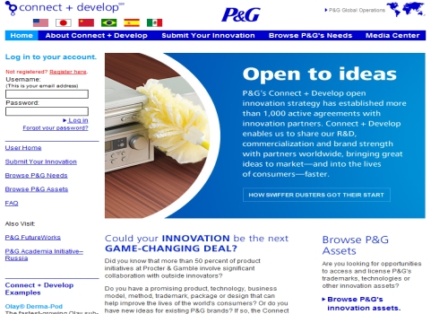
Real Marketing 9.1
Crowdsourcing: P&G’s Connect and Develop
P&G’s highly successful Connect & Develop crowdsourcing program invites outside innovation partners to help develop new technologies and products that will delight customers.

Slide 15
2. Idea Screening
Idea Screening: Screening new-product ideas to spot good ideas and drop poor ones as soon as possible.
R-W-W
  Is it real?
  Can we win?
  Is it worth doing?

Slide 16
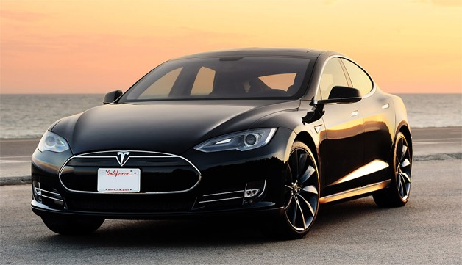
3. Concept Development and Testing
This is Tesla’s initial all-electric roadster. Later, more affordable mass-market models will travel more than 300 miles on a single charge, recharge in 45 minutes from a normal 120 –volt electrical outlet, and cost about one penny per mile to power.

Slide 17
3. Concept Development and Testing
Concept Development
Product Concept: A detail version of the new-product idea stated in meaningful consumer terms.
Develop to find the most attractive one:
Concept 1: An affordably priced midsize car designed as a second family car to be used around town for running errands and visiting friends.
Concept 2: A mid-priced sporty compact appealing to young singles and couples.
Concept 3: A “green “car appealing to environmentally conscious people who want practical, low-polluting transportation.
Concept 4: A high-end midsize utility vehicle appealing to those who love the space SUV’s provide but lament the poor gas mileage.

Slide 18

3. Concept Development and Testing
Concept Development
Concept Testing: Testing new-product concepts with a group of target consumers to find out if the concepts have strong consumer appeal.

Slide 19
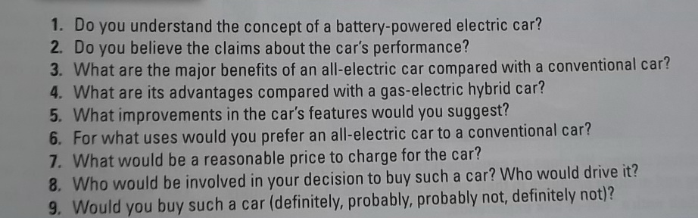
3. Concept Development and Testing
Concept Testing
Table 9.1 Questions for the All-Electric Car Concept Test

Slide 20
3. Concept Development and Testing
Concept Development
Winning :Concept 3
An efficient, fun-to-drive, battery-powered compact car that seats four. This 100 percent electric wonder provides practical and reliable transportation with no pollution. It goes 300 miles on a single charge and costs pennies per mile to operate. It is a sensible, responsible alternative to today’s pollution-producing gas-guzzlers. Its fully equipped price is $25,000.

Slide 21
4. Market Strategy Development
Marketing strategy development: Designing an initial marketing strategy for a new product based on the product concept
The marketing strategy statement consists of three parts
The first part describes:
  Target market
  Planned value proposition
  Sales, market share and profit goals for the first few years

Slide 22
4. Market Strategy Development
The first part:
  Describes the target market
The target market is younger, well-educated, moderate-to-high-income individuals, couples, or small families seeking practical, environmentally responsible transportation. The car will be positioned as more fun to drive and less polluting than today’s internal combustion engine or hybrid cars. The company will aim to sell 50,000 cars in the first year at a loss of not more than $15 million. In the second year, the company will aim for sales of 90,000 cars and a profit of $25 million.

Slide 23
4. Market Strategy Development
The second part:
  Outlines the product’s planned price, distribution, and marketing budget for the first year:
The battery-powered electric car will be offered in three colors-red, white, blue-and will have a full set of accessories as standard features. It will sell at a retail price of $25,000, with 15 percent off the list price to dealers. Dealers who sell more than 10 cars per month will get an additional discount of 5 percent on each car sold that month. A marketing budget of $50 million will be split 50-50 between a national media campaign and local event marketing. Advertising and the Web site will emphasize the car’s fun spirit and low emissions. During the first year, $100,000 will be spent on marketing research to find out who is buying the car and what their satisfaction levels are.

Slide 24
4. Market Strategy Development
The third part:
  Describes the planned long-run sales, profit goals and marketing mix strategy:
We intend to capture a 3 percent long-run share of the total auto market and realize an after-tax return on investment of 15 percent. To achieve this, product quality will start high and be improved over time. Price will be raised in the second and third years if competition and the economy permit. The total marketing budget will be raised each year by about 10 percent. Marketing research will be reduced to $60,000 per year after the first year.

Slide 25
5. Business Analysis
Business Analysis: A review of sales, costs and profit projections for a new product to find out whether these factors satisfy the company’s objectives.
Do objectives meet?
1. Sales forecast – estimate sales..then..
2. Estimate expected costs and profits for the product, including marketing, R&D, operations, accounting, and financial costs.

Slide 26
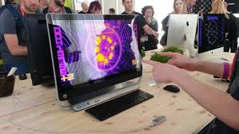
6. Product Development
Product Development: Developing the product concept into a physical product to ensure that the product idea can be turned into a workable market offering.
Product Testing:
HP signs up consumers to evaluate prototype imaging and printing products in their homes and offices to gain insights about their entire “out-of-box experience.”

Slide 27


Product testing: New Balance’s “Weartest Program engages consumers to field test new designs under real world conditions.

Slide 28
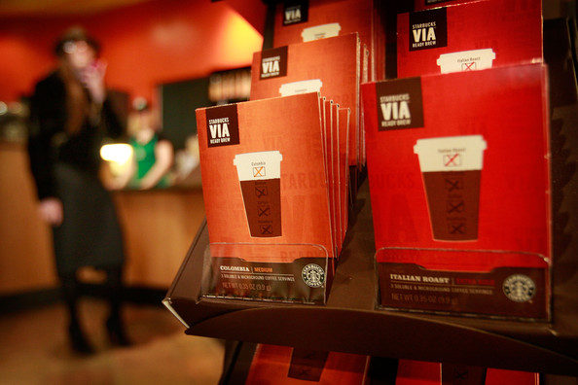
7. Test Marketing
Test Marketing: The stage of new-product development in which the product and its proposed marketing program are tested in realistic market settings.
Starbucks tested its VIA instant coffee extensively before launching new-product nationally. “We knew it could undermine the company if we didn’t do it right”

Slide 29
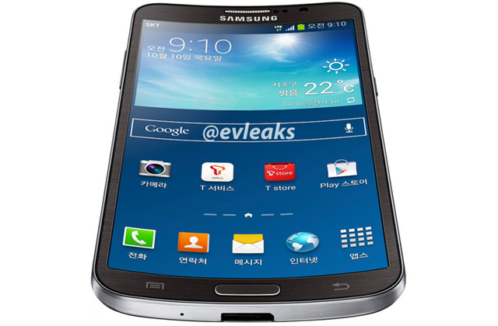
8. Commercialization
Commercialization: Introducing a new product into the market

Slide 30
Managing New-Product Development
Customer-centered new product development
New-product development that focused on finding new ways to solve customer problems and create more customer-satisfying experiences.
Team-based new product development
An approach to developing new products in which various company departments work closely together, overlapping the steps in the product development process to save time and increase effectiveness.
Systematic new-product development
A company can install an innovation management system to collect, review, evaluate and manage new product ideas.

Slide 31
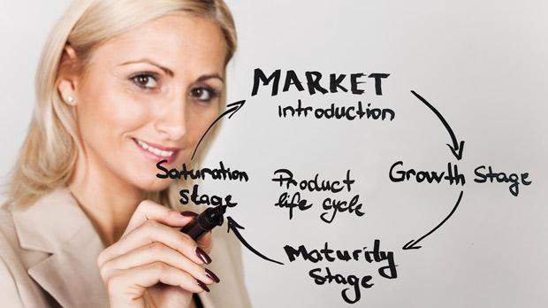
Objective 3:Decribe the stages of the product life cycle and how marketing strategies change during a product’s life cycle.

Slide 32
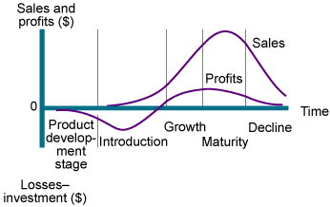
Product Life Cycle Strategies
Product Life Cycle (PLC): The course of a product’s sales and profits over its lifetime.
Figure 9.2 Sales and profits over the Product’s Life from Inception to Decline

Slide 33
Product Life Cycle Strategies
Product Development: begins when the company finds and develops a new product idea. During product development, sales are zero, and the company’s investment costs mount.
Introduction: is a period of slow sales growth as the product is introduced in the market. Profits are nonexistent in this stage because of the heavy expenses of product introduction.
Growth: is a period of rapid market acceptance and increasing profits.
Maturity: is a period of slowdown in sales growth because the product has achieved acceptance by most potential buyers. Profits level off or decline because of increased marketing outlays to defend the product against competition.
Decline: is the period when sales fall off and profits drop.

Slide 34
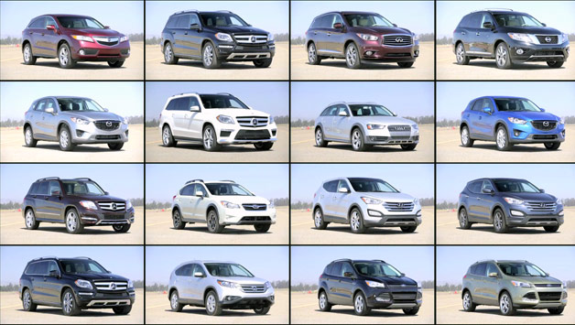
Product Life Cycle Strategies
The PLC can describe:
1. Product class: gasoline –powered automobiles
2. Product form: SUV’s
3. Brand: Ford Escape

Slide 35
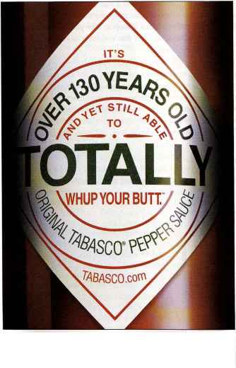
Product Life Cycle: Some products die quickly; others stay in the mature stage for a long, long time. TABASCO sauce is over “140 years old and yet still able to totally whup your butt!”
Some products die quickly, others stay in the mature stage for a long time. For example, TABASCO sauce has been around for more than 140 years. Even then to keep the product young, the company has added a full line of flavors (such as Sweet & Spicy and Chipotle) and a kitchen cabinet full of new TABASCO products(such as spicy beans, a chill mix and jalapena nacho slices)

Slide 36
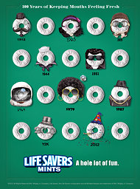
Product life cycle: Some brands stay in the mature stage for a long time. Life Savers mints recently celebrated “ 100 years of keeping your mouth fresh.”

Slide 37
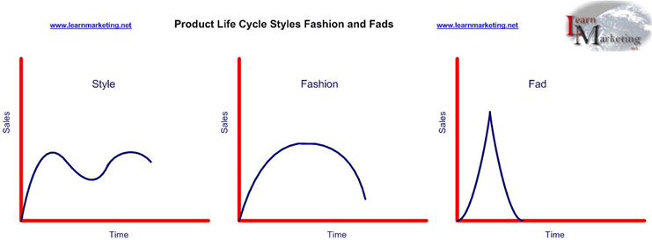
Product Life Cycle Strategies
PLC Concept
PLC concept could be applied to :
Figure 9.3 Styles, Fashion,Fad

Slide 38
Product Life Cycle Strategies
PLC Concept
Style: A basic and distinctive mode of expression
(once invented may last for generations)
  Homes: colonial, ranch, transitional
  Clothing: formal, casual
  Art: realist, surrealist, abstract
Fashion: A currently accepted or popular style in a given field.
(tends to grow slowly for a while and decline slowly)
  1980’-1990’s -> Business Attire
  2000’s -> Business Casual
Fad: A temporary period of unusually high sales driven by consumer enthusiasm and immediate product or brand popularity.
  Pet Rock
  Low Carb Diets

Slide 39
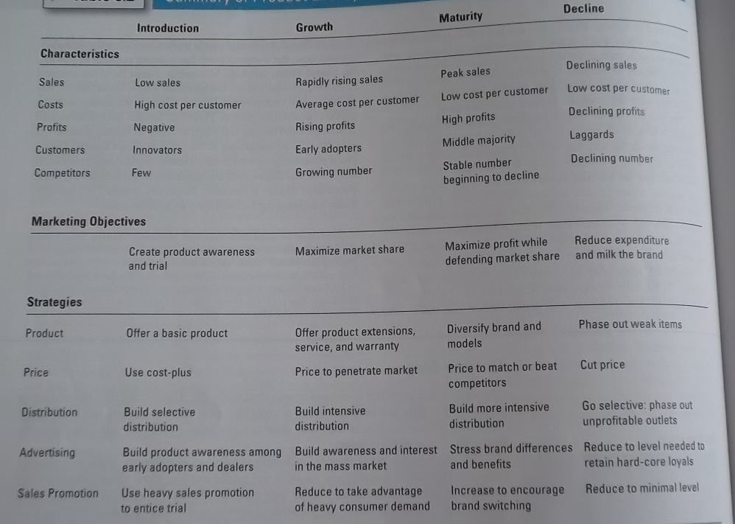
Table 9.2: Summary of PLC Characteristics, Objectives and Strategies

Slide 40
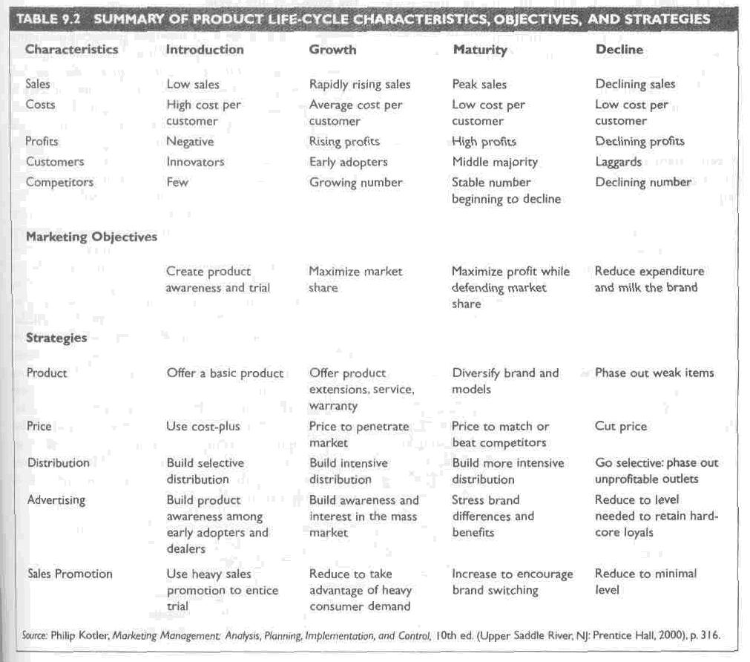

Slide 41
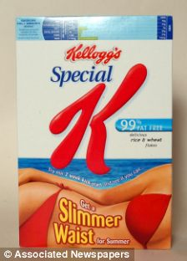
Reinvigorating the mature brand: Kellogg’s kept its 55-year old Special K brand growing by turning it into a healthful, slimming lifestyle brand.

Slide 42

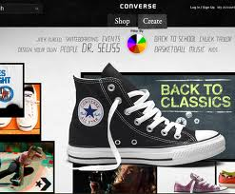
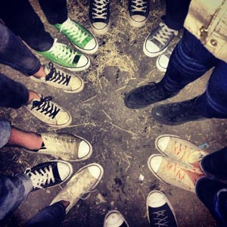
Real Marketing 9.2
Converse: An Old Brand Story with a New Beginning
Product life cycle: The venerable old Converse brand has begun a new life as a small but thriving lifestyle brand. Consumers themselves are helping write the new Converse story.

Slide 43
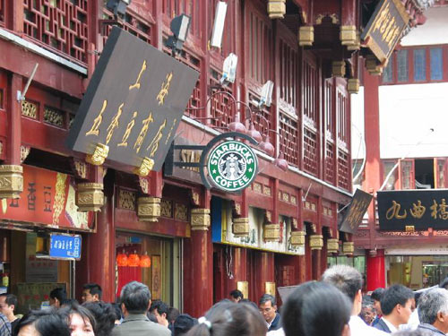
Objective 4: Discuss two additional product issues: socially responsible product decisions and international product and services marketing.

Slide 44


Product Decisions and Social Responsibility
The Federal Food Drug and Cosmetic Act
The Consumer Product Safety Act of 1972 (USA)
  Consumer protection on product safety
  WHAT ABOUT THAILAND?

Slide 45
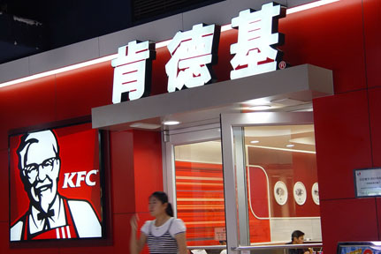
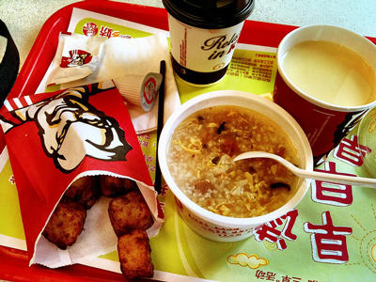
International Product and Services Marketing
Global product adaptation: By adapting to local tastes and eating styles KFC has achieved finger-linkin’ good success in China
(“dragon twister, chicken with Sichuan spicy sauce and rice and egg soups have become popular)

