Slide 1
Introduction to psychology
Health, Stress, and coping

Slide 2
Overview
Health Psychology
  Health Behaviours & Health Promotion
Stress
  Definition & Types of stress
  Theories about Stress
  Causes of Stress
  Psychological Moderators of Stress
  Coping with Stress

Slide 3
Health psychology
Health Psychology studies the relationship between psych factors and prevention and treatment of physical health problems
Health Psychology use behavioural principles to prevent illness and death and to promote health
Behavioural medicine apply psychology to manage medical problems, such as diabetes, asthma, pain control and helping people coping with chronic illness, stress-related diseases, and self-screening for diseases (such as a breast cancer).

Slide 4
Health Psychology
How psych factors lead to illness or make it worse.
How to deal with stress.
How stress and pathogens interact to affect the immune system.
Pathogen: a microscopic organism that can cause disease
How people decide whether to seek health care or not.
How psychological interventions help physical health
**The mind body connection

Slide 5
Behavioural risk factors
Lifestyle diseases: Health-damaging personal habits
Heart disease, stroke, HIV/ AIDS, lung cancer
Some lifestyles promote health, whereas others lead to illness and death
Behavioral risk factors: Behaviors that increase the chances of disease, injury, or premature death.

Slide 6
Behavioral risk factors
High levels of stress,
Untreated high blood pressure
Cigarette smoking**
Abuse of alcohol or other drugs**
Overeating/ Poor diet**
Inadequate exercise**
Unsafe/ risky sexual behavior**
Exposure to toxic substances, violence, excess sun exposure,
Reckless driving, and disregarding personal safety (avoidable accidents)
Notes:
70 percent of all medical costs are related to just six of the listed factors—smoking, alcohol abuse, drug abuse, poor diet, insufficient exercise, and risky sexual practices

Slide 7
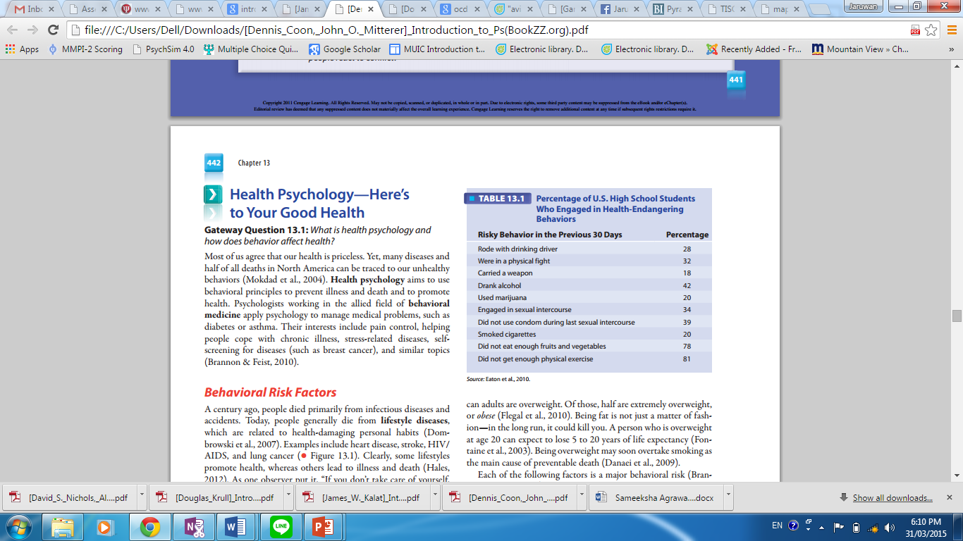

Slide 8
Disease-prone personality
A personality type associated with poor health; marked by persistent negative emotions, including anxiety, depression, and hostility.
Depression, in particular, is likely to damage health (Luppa et al., 2007).
People who are depressed eat poorly, sleep poorly, rarely exercise, fail to use seat belts in cars, smoke more, and so on.

Slide 9
Health promoting behaviour
Prevention
Reduce behavioural risk factors
  High blood pressure → consuming less sodium, losing weight, drink less, getting more exercise
Increase behaviours that promote health
Notes:
community health campaigns. These are community-wide education projects designed to lessen major risk factors

Slide 10
Early prevention
Community health campaigns
Community-wide education projects designed to lessen major risk factors
Smoking is the largest preventable cause of death and the single most lethal factor (National Center for Chronic Disease Prevention and Health Promotion, 2010)
Only 1 smoker in 10 has long-term success at quitting
prevention programs in schools discourage smoking with quizzes about smoking, multimedia presentations, antismoking art contests, poster and T-shirt giveaways, antismoking pamphlets for parents, and questions for students to ask their parents
Messages – smoking is dangerous & ‘uncool’
Attitudes toward smoking are now more negative than they were 20 years ago.
Notes:
prevention programs in schools discourage smoking with quizzes about smoking, multiimedia presentations, antismoking art contests, poster and T-shirt giveaways, antismoking pamphlets for parents, and questions for students to ask their parents (Prokhorov et al., 2010; Zarcadoolas, Pleasant, & Greer, 2006). Such efforts are designed to persuade kids that smoking is dangerous and “uncool.” Apparently, many teens are getting the message, as attitudes toward smoking are now more negative than they were 20 years ago (Chassin et al., 2003).

Slide 11
stress

Slide 12
Stress: Definition
Stress is the mental and physical condition that occurs when we adjust or adapt to the environment that we perceive to be threatening or challenging
Stressor = stressful events
Types of stress
Eustress (Good Stress)
  Activities that provoke “good stress” are usually challenging, rewarding, and energizing
Distress (Bad Stress)
  Not helpful & Unhealthy

Slide 13
Theories about stress: Canon
Many types of threatening events tended to produce an increase in physiological arousal
Fight-or-flight response
The stress associated with the fight-or-flight response had negative effects on the body

Slide 14
Theories about stress: Hans Selye
General Adaptation Syndrome (GAS)
Describes three stages of reactions to stressful events
Alarm
Resistance
Exhaustion
Notes:
Shortly after Cannon, an endocrinologist named Hans Selye was seeking a new hormone (Straub, 2007, gives an excellent account on which I relied heavily). Selye’s research involved injecting rats with an ovarian extract. As you might guess, rats don’t like that much, so sometimes they would bite Selye and escape and he would have to chase them around the lab before catching them and injecting them. Selye found that his rats developed bleeding ulcers and enlarged adrenal glands. Was this due to the ovarian extract? No. Selye discovered that control rats that were dropped, chased, and injected (but not with the ovarian extract) developed the same problems. Selye concluded that his rats were suffering from stress, and, like Cannon, he reasoned that stress was unhealthy.

Slide 15
GAS: Alarm Reaction
Triggered by perception of a stressor
Arouses the body
When we are surprised or threatened, we have an immediate physical reaction, often called the Fight-or-Flight reaction.
This prepares the body for life-threatening situations, channeling away resources from such as the digestive and immune system to more immediate muscular and emotional needs.
This leads to the immune system being depressed, making us susceptible to disease.
The sympathetic ANS activation leads to an increased adrenaline and noradrenalin being secreted from the adrenal medulla
Corticosteroids help protect the body - Combat allergic reactions and produce inflammation
Notes:
Adrenaline is released which provides fuel for the fight-or-flight reaction

Slide 16
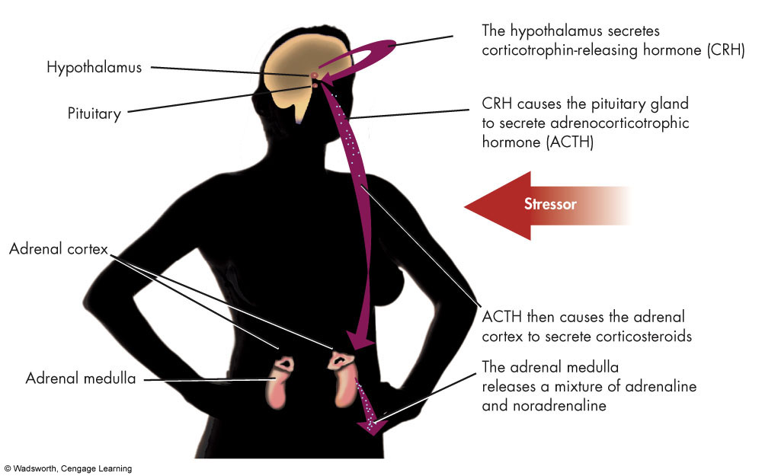
Stress and the Endocrine System
Notes:
Figure 10.5 Stress and the Endocrine System. Stress has a domino effect on the endocrine system, leading to the release of corticosteroids and a mixture of adrenaline and noradrenaline. Corticosteroids combat allergic reactions (such as difficulty in breathing) and cause inflammation. Adrenaline and noradrenaline arouse the body to cope by accelerating the heart rate and providing energy for the fight-or flight reaction.

Slide 17
GAD: Resistance Stage
If alarm reaction mobilizes the body and the stressor is not removed
Endocrine and sympathetic activity continues higher than normal
As we become used to the stress levels, we initially become more resistance to disease, which leads us to believe we can easily adapt to these more stressful situations.
However, this is only the immune system fighting to keep up with demands and expectations, but requires it to work at abnormally high levels.

Slide 18
GAD: Exhaustion Stage
This only happens when the stressor is long lasting or chronic.
Eventually reality kicks in and our bodies give up on trying to maintain a high level of stress. Parts of the body literally start to break down
Muscles become fatigued
Shrinkage of parts of the immune system, raised blood pressure, ulcers and anxiety’s may develop
Parasympathetic division of ANS dominates
Continued stress may lead to diseases of adaptation - Allergies, hives, coronary heart disease, ultimately death
Notes:
Stressor is not dealt with adequately

Slide 19
GAD: Exhaustion Stage
Emotional signs: Anxiety, apathy, irritability, mental fatigue.
Behavioral signs: Avoidance of responsibilities and relationships, extreme or self-destructive behavior, self-neglect, poor judgment.
Physical signs: Excessive worry about illness, frequent illness, exhaustion, overuse of medicines, physical ailments and complaints.

Slide 20
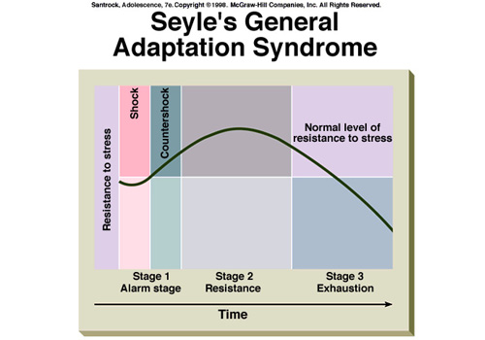
General Adaptation Syndrome (GAD)
3 stage response to stress

Slide 21
Theories about Stress (Taylor, et. al., 2000)
Tend-and-befriend
In times of stress we take care of one another (tend) and also seek social connections (befriend)
Especially women
Female university students are more likely to display tend-and-befriend behaviors in response to stress (Turton & Campbell, 2005)
Female infants in the strange situation are more likely than male infants to return to their mothers when their mothers display frightening behavior (David & Lyons-Ruth, 2005)
Oxytocin, a hormone associated with social affiliation and maternal behavior, seems to be involved in tend-and-befriend behaviors (Taylor, 2006a)
Notes:
people, especially women, might also display a pattern of behavior called tend-and-befriend. That is, in times of stress we take care of one another (tend) and also seek social connections (befriend). Consistent with this, female university students are more likely to display tend-and-befriend behaviors in response to stress (Turton & Campbell, 2005). In addition, female infants in the strange situation (you might remember this from the material on development) are more likely than male infants to return to their mothers when their mothers display frightening behavior (David & Lyons-Ruth, 2005). Oxytocin, a hormone associated with social affiliation and maternal behavior, seems to be involved in tend-and-befriend behaviors (Taylor, 2006a).

Slide 22
Theories about stress: Lazarus & Folkman
Transactional theory - When we encounter a potentially stressful event, the degree to which we feel stress depends on how we appraise the event and our ability to cope
Primary appraisal we evaluate a potential stressor with regard to whether it is positive, neutral, or negative, and if it is judged to be negative we evaluate whether it is challenging, harmful right now, or threatening with regard to the future
Secondary appraisal we evaluate our ability to cope with the event
Reappraisal we reevaluate our appraisal of the event and whether we are coping successfully

Slide 23
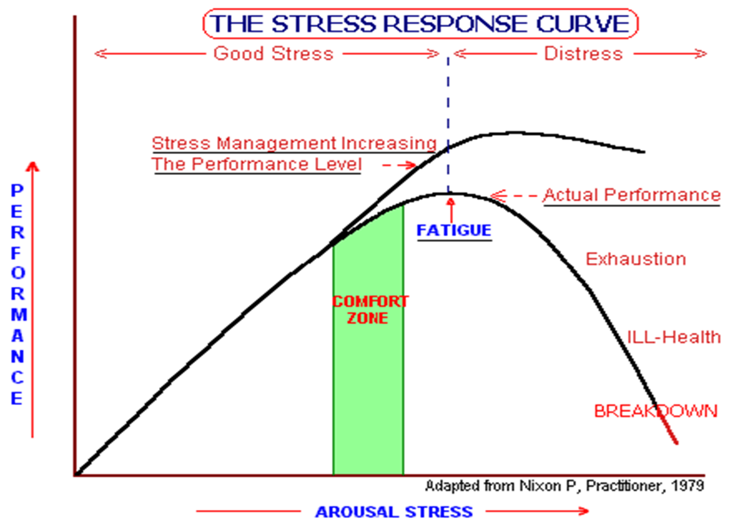
Stress and Performance

Slide 24
What causes stress?
Daily Hassles
Life Changes
Conflict
Irrational Beliefs
Type A Behavior

Slide 25
Stress: Daily Hassles
We have many things to deal with on a daily basis:
  Household issues
  Health
  Time pressures
  Inner concerns
  Environment
  Money
  School/work
  Future
  *All are related to psychological problems: nervousness, worry, lethargy, sadness

Slide 26
Stress: Life changes
Life changes can be negative.
  Death of family, unplanned pregnancy, jail
Or positive
  Marriage, graduation, vacation
  Occur regularly

Slide 27
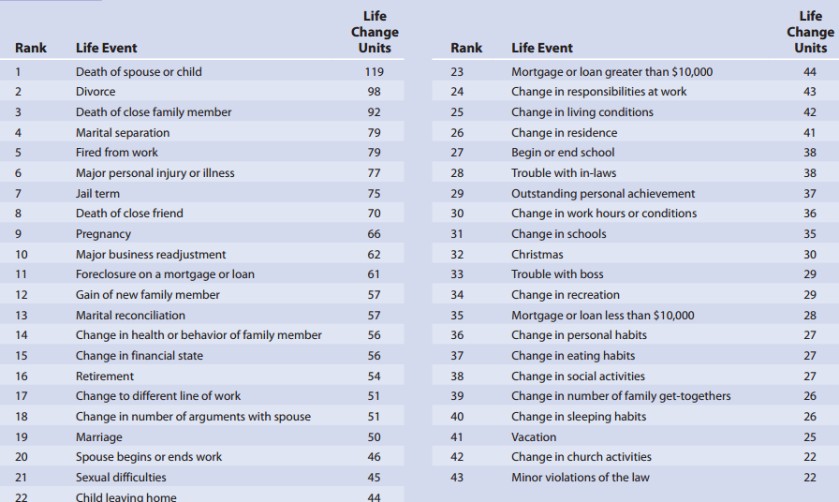

Slide 28
Daily Hassles & Life Changes
Differ from daily hassles in that life changes
  Are often positive and desirable
  Occur at irregular intervals
Life changes, even positive ones, require adjustment
Notes:
Truth or Fiction? Because variety is the spice of life, the more changes the better. Although variety adds spice to life, too much variety might lead to physical illness.
Truth or Fiction? Going on vacation is stressful. True. Although vacations can be good for your health, they are life changes, and changes require adjustment.

Slide 29
Conflict
Conflict is a state of opposition, disagreement or incompatibility between two or more people or groups of people, which is sometimes characterized by physical violence.
The course of action that will resolve them
4 Types of Conflicts:
  Approach-approach
  Avoidance-Avoidance
  Approach-avoidance
  Multiple approach - avoidance
Notes:
being pulled in different directions by opposing motives.

Slide 30
Approach-approach conflict
people are attracted about equally to goals. But, carrying out one goal means abandoning the other.
For example, you have to choose between buying a car or traveling to Europe.
On the same night you want to attend a party and a movie.
Research suggest that approach-approach conflicts are easier to resolve than any other type. As you tentatively near one, its attractiveness rises. As you emphasize the advantages you are closer to your choice. At the same time, the appeal of the other goal decrease, and the conflict ends.
People generally resolve approach-approach conflicts easily because they always result in something pleasant. Also, the alternatives can be achieved in turn.

Slide 31
Avoidance-avoidance conflict
When a person is simultaneously repelled by two goals (objects, actions, or whatever) and obliged to select one
For example, you must choose to clean your room or do the dishes.
Research shows that as organisms approach an unattractive choice, it becomes more repellent.
Avoidance-avoidance conflicts arouse a great deal of anxiety, and they are difficult to resolve. People are likely to waver between the unpleasant alternatives and attempt to escape from the conflict altogether.

Slide 32
Single approach-avoidance conflict
When a person is attracted to and repelled by one goal .
A single option has a bittersweet quality.
For example, an otherwise appealing career may require a lot of education.
A luxurious car is costly.
Should I have the dentist take care of my cavity?
These conflicts also are difficult to resolve and generates much anxiety.

Slide 33
Multiple approach-avoidance conflict
Have two goals or more, each with good and bad points.
Should I go out with Jane or Jones? Jane is intelligent but hard to talk while Jones is talkative but simple.
Like single approach-avoidance conflicts, multiple approach-avoidance conflicts are anxiety-provoking and hard to resolve.

Slide 34
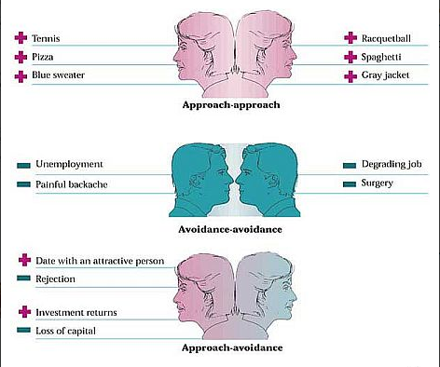

Slide 35
Irrational Beliefs
Activating event → Beliefs → Consequences
Albert Ellis
Belief = Personal schema and view of the world
Catastrophize- to interpret negative events as being disastrous, to blow things out of proportion
Notes:
Truth or Fiction? Searching for social approval or perfection is an excellent way of making yourself miserable. True. Research findings confirm the connections between irrational beliefs (e.g., excessive dependence on social approval and perfectionism) and feelings of anxiety and depression (Ciarrochi, 2004; Rice & Dellwo, 2001; Wiebe & McCabe, 2002).

Slide 36
What type are you?
Are you pressed for time at and after work?
Do you always take work home with you?
Do you eat rapidly?
Do you have a strong need to excel?
Do you have trouble finding time to get your hair cut/styled?
Do you feel or act impatient when you have to wait in line?
Do you get irritated easily?
Are you bossy and domineering?
When you were younger was your temper fiery and difficult to control?
Notes:
Hostility related items
(Affirmative responses suggest Type A personality)

Slide 37
Type a & Type B behaviour
Type A
Type B
Competitive, aggressive
Impatient, unable to relax easily
Outwardly confident but often plagued with self-doubt
Ambitious, driven by the need to success
Intolerant of change, rigid
Fast-paced lifestyle
Muscle tension
Rapid and emphatic speech
Noncompetitive
Patient, able to relax without feeling guilty
Self-assured
Take pleasure in the processes involved in performing a task
Friendly, accepting, easy going
Flexible
Unhurried lifestyle
Relaxed posture and gestures
Even, unhurried speech

Slide 38
Type A and B Behaviour Patterns
Type A people are highly driven, competitive, impatient, hostile, and aggressive
Type B people relax more readily and focus more on the quality of life; are less ambitious and less impatient
Notes:
Truth or Fiction? Type A people achieve more than Type B people, but they are less satisfied with themselves. True. It is true that Type A people achieve more than Type B people but are less satisfied with themselves. Type B people relax more readily than Type A people and focus more on the quality of life.
On a more positive note, and not surprisingly, Type As do appear to be more successful in terms of work accomplishments, but Type Bs are better able to enjoy the moment (and there are plenty of successful Type Bs). In reality, however, the Type A-B personality is a normally-distributed continuum, with relatively few people being strongly driven and competitive (As) or totally laid back (Bs). Most of us are probably slightly on one side or the other of the A-B divide.

Slide 39
Psychological moderators of stress
Predictability & Control
Self-efficacy expectations
Hardiness
Social Support
Sense of Humour

Slide 40
Predictability and Control
Perceived control is the belief that we can influence our environment in ways that determine whether we experience positive or negative outcomes.
Predictability allows us to prepare and cope
  Greater benefit to internals than externals
Control, even the illusion of control, allows us to plan
The less control people feel they have the more likely it is that the event will cause physical and psychological problems.
For example, the loss of control experienced by many older people in nursing homes can have negative effects on their health and mortality (Rodin and Langer,1977).
Notes:
What exactly is it that makes people perceive a situation as stressful?
One important variable is the amount of control they believe they have over the event.
Internals – People who want to exercise control over their situations

Slide 41
Predictability and Control
Even when the illness is terminal, there is a way people can maintain a sense of control
although they cannot control the disease, people can exercise control over the consequences of the disease (their emotional reactions).
Research shows that these perceptions of control are highly related to people’s psychological adjustment the more control, the better the adjustment.

Slide 42
Predictability and Control
The effects of lack of perceived control are not limited to physical health.
For Example: A study conducted with clients at sexual assault centres in southern Ontario found that rape victims who believed that they generally had control over outcomes in their lives experienced less depression and showed fewer symptoms of post-traumatic stress 6 months or more after the event.

Slide 43
Self Efficacy
Self-efficacy is belief in one’s capacity to succeed at tasks.
General self-efficacy is belief in one’s general capacity to handle tasks.
Specific self-efficacy refers to beliefs about one’s ability to perform specific tasks.
Notes:
Having control is a good thing, but it is also important for people to have high self-efficacy for postive results to emerge.
Self-efficacy is the ability to make things happen

Slide 44
Self-efficacy expectations
People’s level of self-efficacy has been found to predict a number of important health behaviours, such as likelihood that they will
  quit smoking
  lose weight
  lower their cholesterol
  exercise regularly

Slide 45
Self-efficacy expectations
Self-efficacy increases the likelihood that people will engage in healthier behaviour in 2 ways:
It influences people’s persistence and effort at a task;
It influences the way our bodies react while we are working towards our goals (people with high self-efficacy experience less anxiety and their immune system functions more optimally).
Notes:
Allow one to persist in difficult tasks and endure discomfort
High self-efficacy expectations – less adrenaline and noradrenaline secreted when under stress
Moderates body’s stress

Slide 46
Psychological Hardiness
Dion and colleagues (2002) recently examined the personality variable of hardiness in relation to a particular kind of stress, namely the stress of being a victim of prejudice and discrimination.
Hardiness is a personality trait defined as a combination of self-esteem and a sense of control.
Hardiness helps people deal with stress in a positive, effective manner.

Slide 47
Psychological Hardiness
Dion and colleagues (2002) found that discrimination was correlated with psychological stress, but only for those who were low in hardiness.
People with hardy personalities reported just as much discrimination, but much less stress.
Why do hardy persons experience less stress in the face of discrimination?

Slide 48
Psychological Hardiness
Because, hardy persons, unlike their less hardy counterparts, treated the discrimination they experience as an isolated event
They make different attributions than those who are less hardy.
They attribute discrimination to specific, unstable factors rather than to global, stable factors.

Slide 49
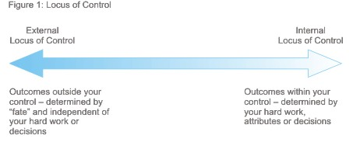
Psychological Hardiness
Hardy people are more resistant to stress
Hardy business executives were found to be high in commitment/ Challenge/ perceived control over their life
High in Internal locus of control

Slide 50
Social Support
Social support is the perception that others are responsive and receptive to one’s needs.
Social support acts as a buffer against effects of stress
  It makes us less likely to interpret an event as stressful.
  It helps us cope with the stressful event.
  Shown to help people resist infectious diseases
Notes:
Acculturation: a process in which members of one cultural group adopt the beliefs and behaviors of another group

Slide 51
Social Support
  Helps people cope with stress of acculturation and/or health problems
    Emotional concern – listen and sympathize
    Instrumental aid – money, place to stay
    Information – advice, guidance
    Appraisal – feedback on progress
    Socializing – conversation, recreation
Notes:
Acculturation: a process in which members of one cultural group adopt the beliefs and behaviors of another group

Slide 52
Social Support
Several studies show that opening up, which involves writing or talking about one’s problems, has long-term health benefits. Why?
Pennebaker (1990) argues that actively trying inhibit or not think about a traumatic event takes mental and physical energy, which is itself stressful.
Moreover, suppressing negative thoughts can lead to an obsession with those thoughts such that people think about them more and more, thereby creating more and more stress.
Finally, talking about an event can lead to a better understanding of the event, which can lessen the associated stress.
Notes:
Confiding in others

Slide 53
Sense of Humor
Research demonstrating value of sense of humor
Laughter stimulates endorphin output
Positive cognitive shifts
Notes:
Truth or Fiction? Humor helps us cope with stress. True. Research suggest that humor can indeed moderate the effects of stress (Godfrey, 2004)

Slide 54
How should we cope with stress?
Emotion-focused coping
  Managing or controlling one’s emotional reaction to a stressful or threatening situation. (Out of control)
  Listening to music, taking a walk to relax, or seeking emotional support from others
Problem-focused coping
  Directly managing or remedying a stressful or threatening situation. (Can control)
  Making a plan of action or concentrating on your next step

Slide 55
How should we cope with stress?
Lower level of Arousal
  Relaxation techniques
Manage Irrational thoughts
  Be realistic
Seek Social Support
Exercise
  Boosts immune system and endorphins
  Self esteem

