Slide 1

C H A P T E R 10
Market Power: Monopoly and Monopsony
CHAPTER OUTLINE
10.1 Monopoly
10.2 Monopoly Power
10.3 Sources of Monopoly Power
10.4 The Social Costs of Monopoly Power
10.5 Monopsony
10.6 Monopsony Power
10.7 Limiting Market Power:
The Antitrust Laws
Prepared by:
Fernando Quijano, Illustrator

Slide 2
● monopoly Market with only one seller.
● monopsony Market with only one buyer.
● market power Ability of a seller or buyer to affect the price of a good.

Slide 3
10.1
Monopoly
Average Revenue and Marginal Revenue
● marginal revenue Change in revenue resulting from a one-unit increase in output.
Consider a firm facing the following demand curve: P = 6 − Q
TABLE 10.1 |  | TOTAL, MARGINAL, AND AVERAGE REVENUE
PRICE (P) | QUANTITY (Q) |  | TOTAL REVENUE (R) | MARGINAL REVENUE (MR) | AVERAGE REVENUE (AR)
$6 | 0 |  | $0 | — | —
5 | 1 |  | 5 | $5 | $5
4 | 2 |  | 8 | 3 | 4
3 | 3 |  | 9 | 1 | 3
2 | 4 |  | 8 | −1 | 2
1 | 5 |  | 5 | −3 | 1

Slide 4
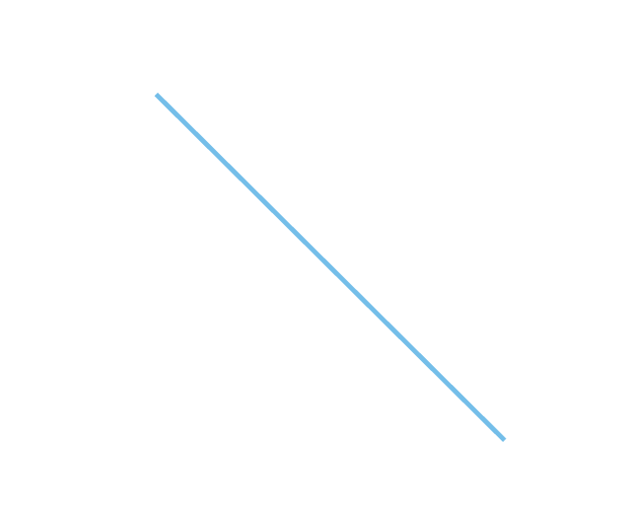
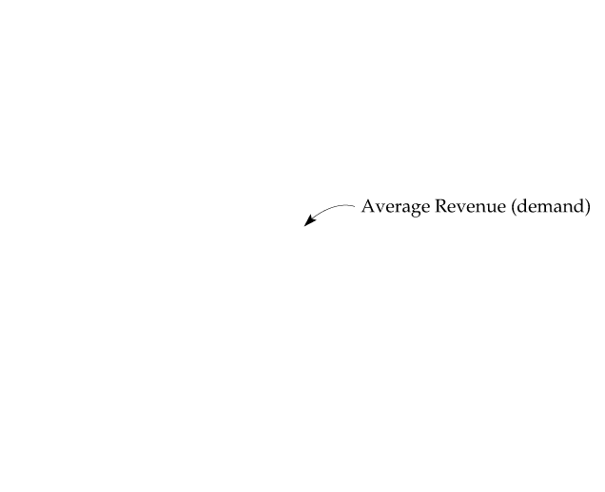

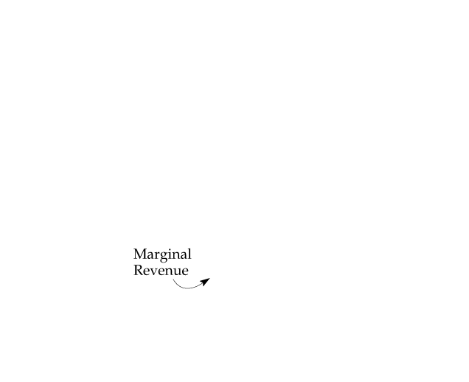
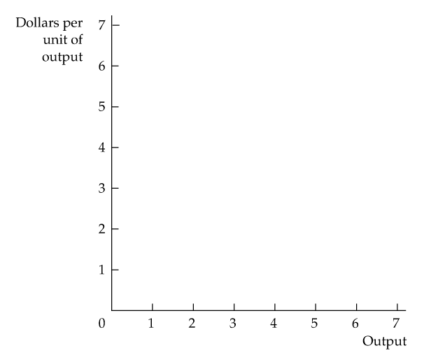
FIGURE 10.1
AVERAGE AND MARGINAL REVENUE
Average and marginal revenue are shown for the demand curve
P = 6 − Q.

Slide 5

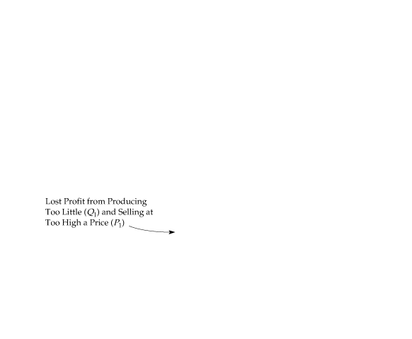

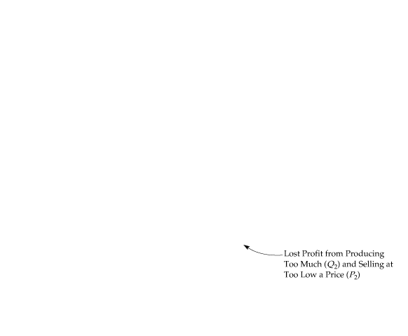
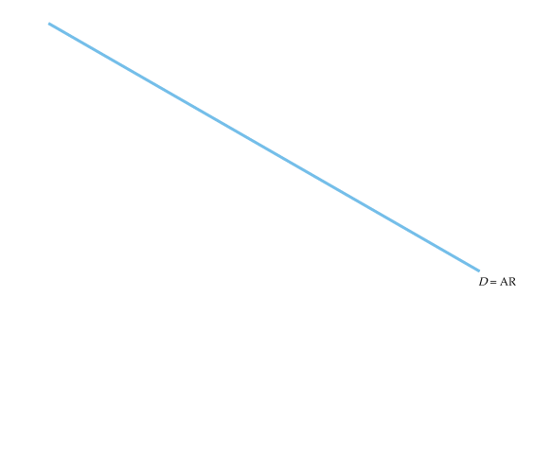
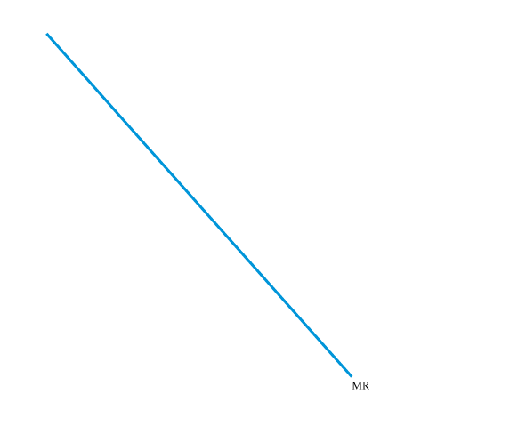
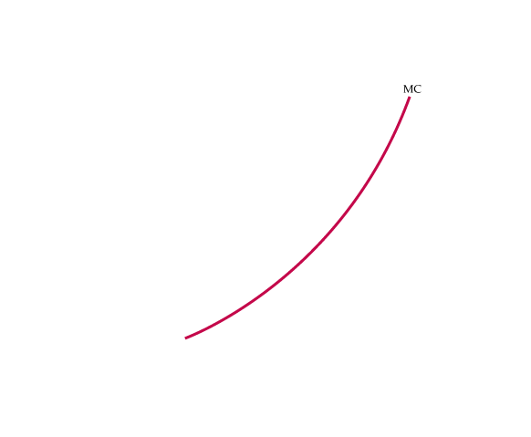
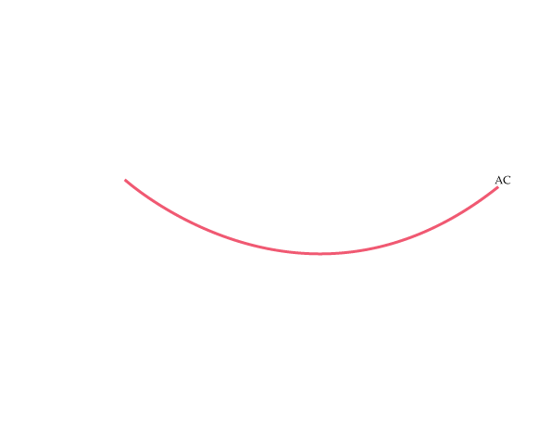
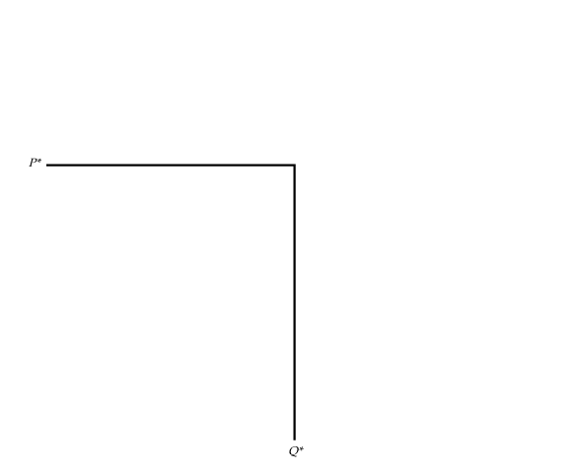
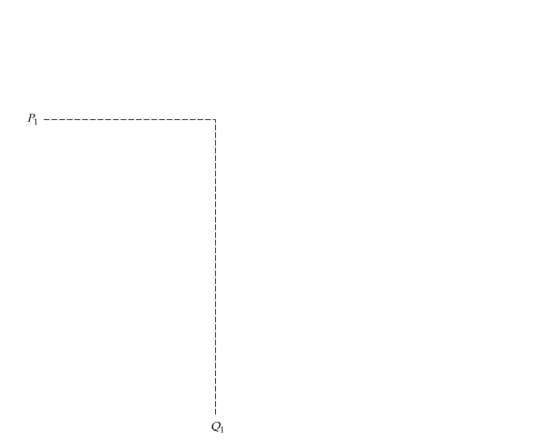
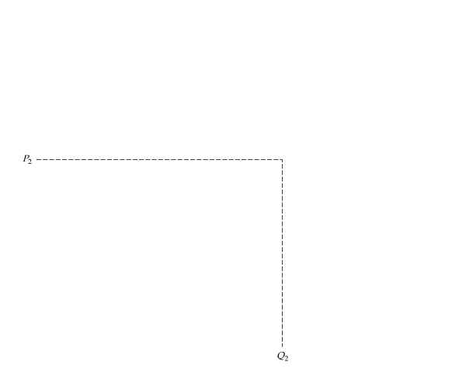
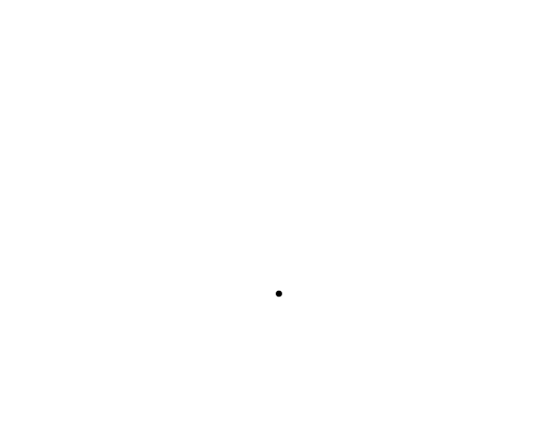
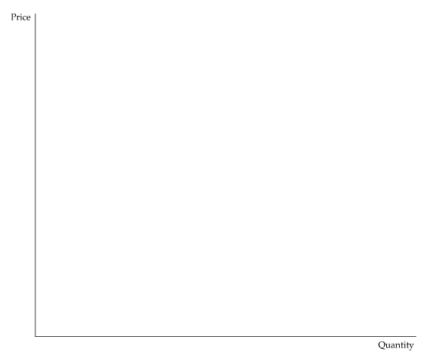
The Monopolist’s Output Decision
FIGURE 10.2
PROFIT IS MAXIMIZED WHEN MARGINAL REVENUE EQUALS MARGINAL COST
Q* is the output level at which MR = MC.
If the firm produces a smaller output—say, Q₁—it sacrifices some profit because the extra revenue that could be earned from producing and selling the units between Q₁ and Q* exceeds the cost of producing them.
Similarly, expanding output from Q* to Q₂ would reduce profit because the additional cost would exceed the additional revenue.

Slide 6

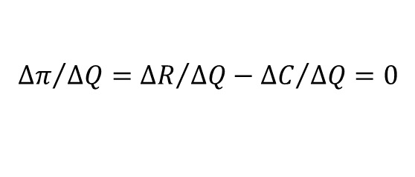

We can also see algebraically that Q* maximizes profit. Profit π is the difference between revenue and cost, both of which depend on Q:
$$π\left(Q\right)=R\left(Q\right)−C\left(Q\right)$$
As Q is increased from zero, profit will increase until it reaches a maximum and then begin to decrease. Thus the profit-maximizing Q is such that the incremental profit resulting from a small increase in Q is just zero (i.e., Δπ /ΔQ = 0). Then
$${∆π}/{∆Q={∆R}/{∆Q−{∆C}/{∆Q=0}}}$$
But ΔR/ΔQ is marginal revenue and ΔC/ΔQ is marginal cost. Thus the profit-maximizing condition is that
$$\text{MR}−\text{MC}=0\text{, }\text{or} \text{MR}=\text{MC}$$

Slide 7

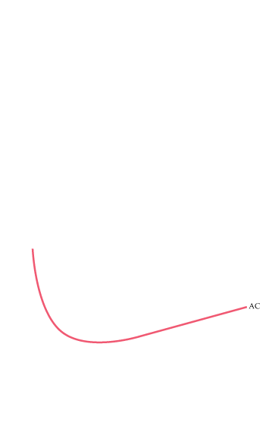
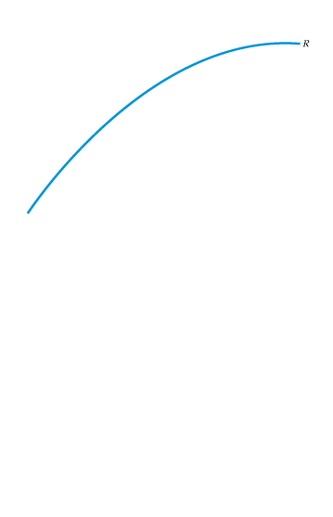
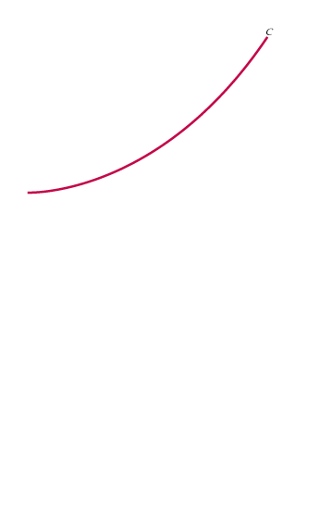
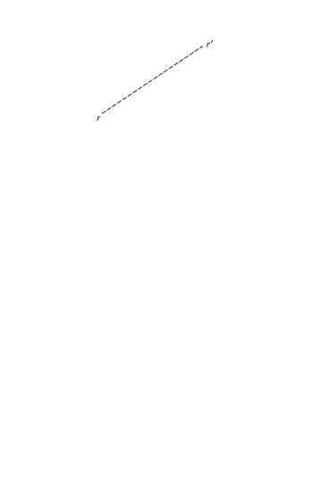
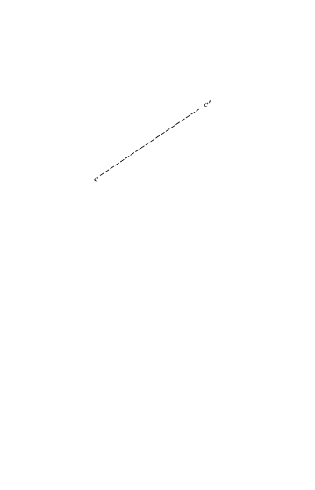
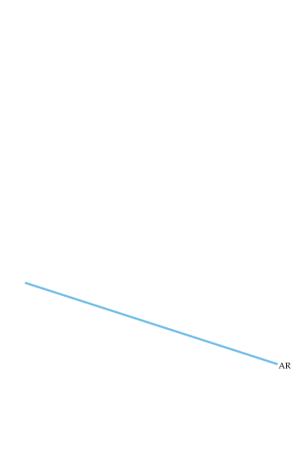
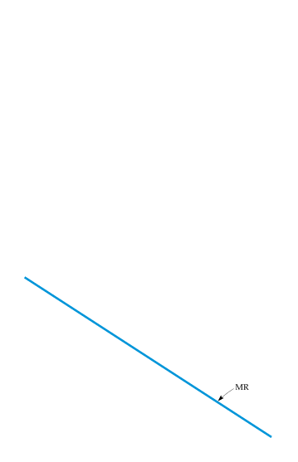
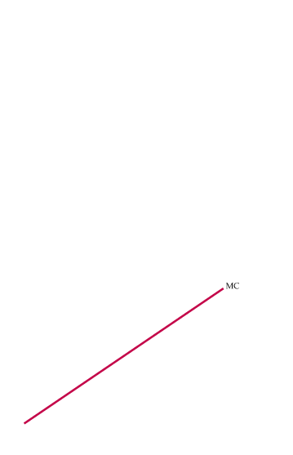
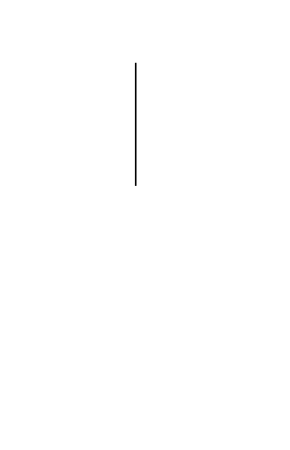
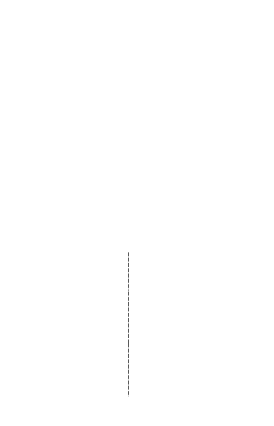
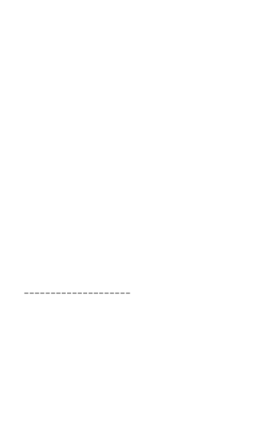
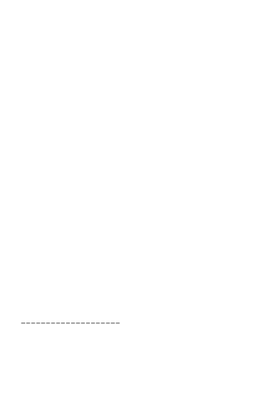

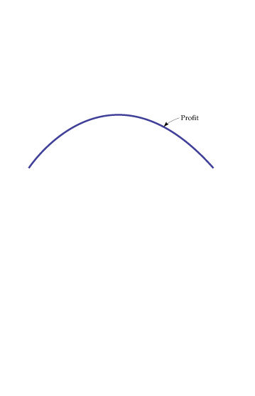
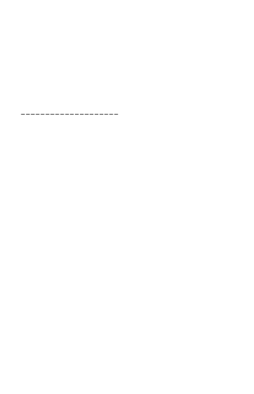
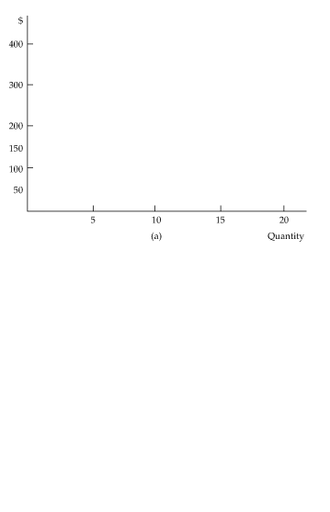
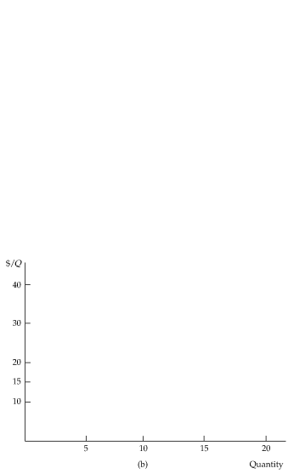

An Example
$$Cost of production: C\left(Q\right)=50+ Q^{2}$$
$$Demand: P\left(Q\right)=40−Q$$
FIGURE 10.3
EXAMPLE OF PROFIT MAXIMIZATION
Part (a) shows total revenue R, total cost C, and profit, the difference between the two.
Part (b) shows average and marginal revenue and average and marginal cost.
Marginal revenue is the slope of the total revenue curve, and marginal cost is the slope of the total cost curve.
The profit-maximizing output is Q* = 10, the point where marginal revenue equals marginal cost.
At this output level, the slope of the profit curve is zero, and the slopes of the total revenue and total cost curves are equal.
The profit per unit is $15, the difference between average revenue and average cost. Because 10 units are produced, total profit is $150.

Slide 8
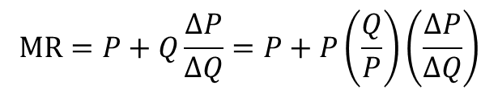
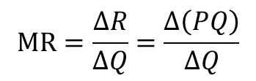
A Rule of Thumb for Pricing
With limited knowledge of average and marginal revenue, we can derive a rule of thump that can be more easily applied in practice. First, write the expression for marginal revenue:
$$\text{MR}=\frac{∆R}{∆Q}=\frac{∆\left(PQ\right)}{∆Q}$$
Note that the extra revenue from an incremental unit of quantity, Δ(PQ)/ΔQ, has two components:
  1. Producing one extra unit and selling it at price P brings in revenue (1)(P) = P.
  2. But because the firm faces a downward-sloping demand curve, producing and selling this extra unit also results in a small drop in price ΔP/ΔQ, which reduces the revenue from all units sold (i.e., a change in revenue Q[ΔP/ΔQ]).
Thus,
$$\text{MR}=P+Q\frac{∆P}{∆Q}=P+P\left(\frac{Q}{P}\right)\left(\frac{∆P}{∆Q}\right)$$

Slide 9
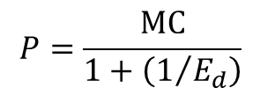
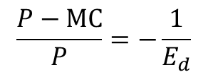
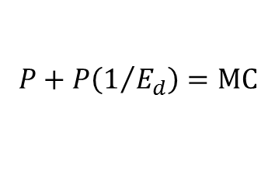
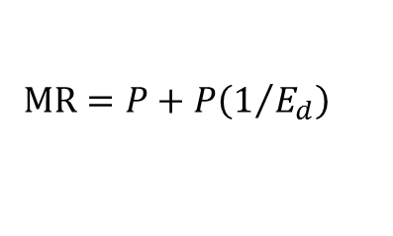
(Q/P)(ΔP/ΔQ) is the reciprocal of the elasticity of demand, 1/E_{d}, measured at the profit-maximizing output, and
$$\text{MR}=P+P\left(1/{E_{d}}\right)$$
Now, because the firm’s objective is to maximize profit, we can set marginal revenue equal to marginal cost:
$$P+P\left(1/{E_{d}}\right)=\text{MC}$$
which can be rearranged to give us
$$\frac{P−\text{MC}}{P}=−\frac{1}{E_{d}}$$
(10.1)
Equivalently, we can rearrange this equation to express price directly as a markup over marginal cost:
$$P=\frac{\text{MC}}{1+\left(1/{E_{d}}\right)}$$
(10.2)

Slide 10
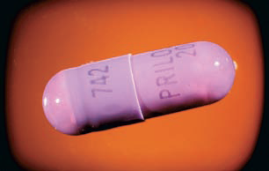
EXAMPLE 10.1
ASTRA-MERCK PRICES PRILOSEC
  In 1995, Prilosec, represented a new generation of
  antiulcer medication. Prilosec was based on a very
  different biochemical mechanism and was much
  more effective than earlier drugs.
  By 1996, it had become the best-selling drug in
  the world and faced no major competitor.
Astra-Merck was pricing Prilosec at about $3.50 per daily dose.
The marginal cost of producing and packaging Prilosec is only about 30 to 40 cents per daily dose.
The price elasticity of demand, E_{D}, should be in the range of roughly −1.0 to −1.2.
Setting the price at a markup exceeding 400 percent over marginal cost is consistent with our rule of thumb for pricing.

Slide 11
Shifts in Demand
A monopolistic market has no supply curve. In other words, there is no one-to-one relationship between price and the quantity produced.
The reason is that the monopolist’s output decision depends not only on marginal cost but also on the shape of the demand curve.
As a result, shifts in demand do not trace out the series of prices and quantities that correspond to a competitive supply curve. Instead, shifts in demand can lead to changes in price with no change in output, changes in output with no change in price, or changes in both price and output.
Shifts in demand usually cause changes in both price and quantity. A competitive industry supplies a specific quantity at every price. No such relationship exists for a monopolist, which, depending on how demand shifts, might supply several different quantities at the same price, or the same quantity at different prices.

Slide 12
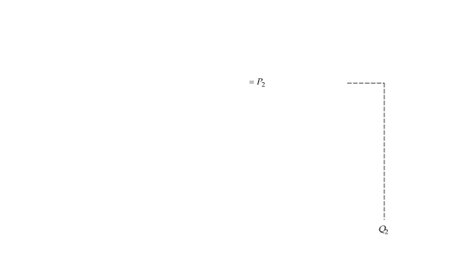
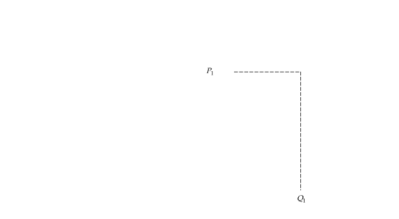
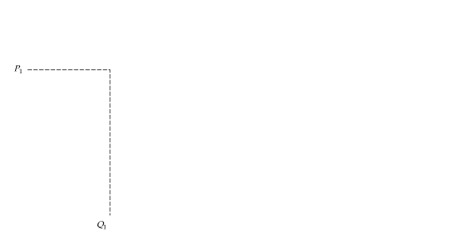
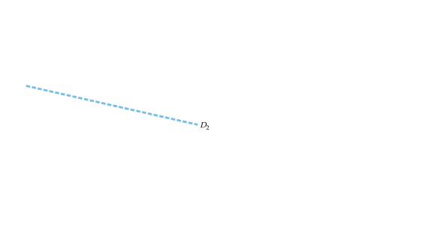
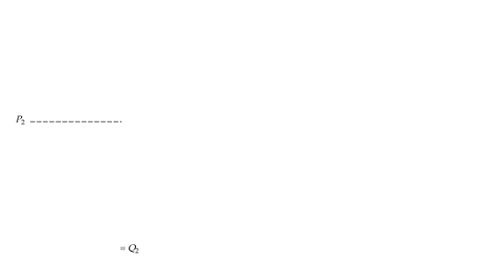
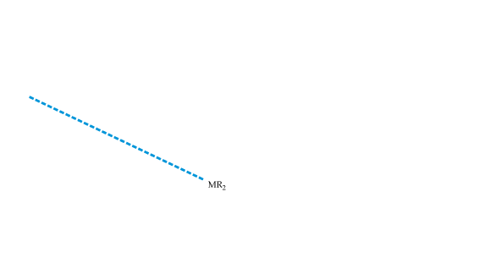
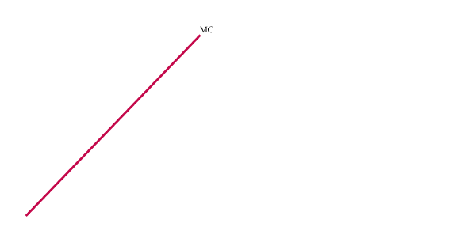
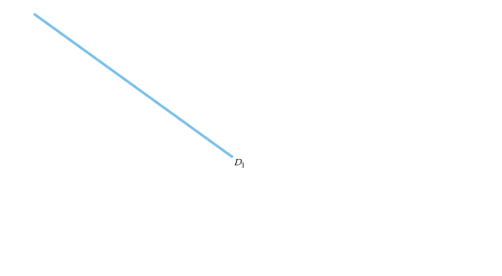
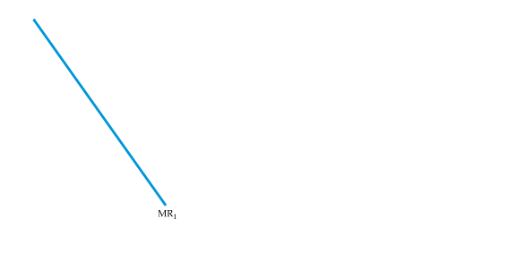
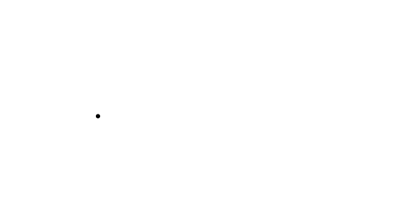
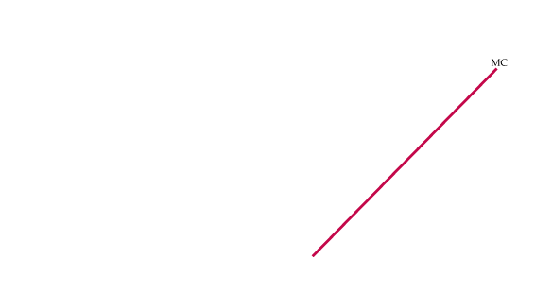








FIGURE 10.4
SHIFTS IN DEMAND
Shifting the demand curve shows that a monopolistic market has no supply curve—i.e., there is no one-to-one relationship between price and quantity produced.
In (a), the demand curve D₁ shifts to new demand curve D₂.
But the new marginal revenue curve MR₂ intersects marginal cost at the same point as the old marginal revenue curve MR₁.
The profit-maximizing output therefore remains the same, although price falls from P₁ to P₂.
In (b), the new marginal revenue curve MR₂ intersects marginal cost at a higher output level Q₂.
But because demand is now more elastic, price remains the same.

Slide 13












The Effect of a Tax
Suppose a specific tax of t dollars per unit is levied, so that the
monopolist must remit t dollars to the government for every unit it sells. If MC was the firm’s original marginal cost, its optimal production decision is now given by
$$\text{MR}=\text{MC}+T$$
FIGURE 10.5
EFFECT OF EXCISE TAX ON MONOPOLIST
With a tax t per unit, the firm’s effective marginal cost is increased by the amount t to MC + t.
In this example, the increase in price ΔP is larger than the tax t.

Slide 14
The Multiplant Firm
Suppose a firm has two plants. What should its total output be, and how much of that output should each plant produce? We can find the answer intuitively in two steps.
● Step 1. Whatever the total output, it should be divided between the two plants so that marginal cost is the same in each plant. Otherwise, the firm could reduce its costs and increase its profit by reallocating production.
● Step 2. We know that total output must be such that marginal revenue equals marginal cost. Otherwise, the firm could increase its profit by raising or lowering total output.

Slide 15


We can also derive this result algebraically. Let Q₁ and C₁ be the output and cost of production for Plant 1, Q₂ and C₂ be the output and cost of production for Plant 2, and Q_{T} = Q₁ + Q₂ be total output. Then profit is
$$π=PQ_{T}−C_{1}\left(Q_{1}\right)−C_{2}\left(Q_{2}\right)$$
The firm should increase output from each plant until the incremental profit from the last unit produced is zero. Start by setting incremental profit from output at Plant 1 to zero:
$$\frac{∆π}{∆Q_{1}}=\frac{∆\left(PQ_{T}\right)}{∆Q_{1}}−\frac{∆C_{1}}{∆Q_{1}}=0$$
Here Δ(PQ_{T})/ΔQ₁ is the revenue from producing and selling one more unit—i.e., marginal revenue, MR, for all of the firm’s output.

Slide 16



The next term, ΔC₁/ΔQ₁, is marginal cost at Plant 1, MC₁. We thus have
MR − MC₁ = 0, or
$$\text{MR}={\text{MC}}_{1}$$
Similarly, we can set incremental profit from output at Plant 2 to zero,
$$\text{MR}={\text{MC}}_{2}$$
Putting these relations together, we see that the firm should produce so that
$$\text{MR}={\text{MC}}_{1}={\text{MC}}_{2}$$
(10.3)

Slide 17











FIGURE 10.6
PRODUCING WITH TWO PLANTS
A firm with two plants maximizes profits by choosing output levels Q₁ and Q₂ so that marginal revenue MR (which depends on total output) equals marginal costs for each plant, MC₁ and MC₂.

Slide 18









10.2
Monopoly Power
FIGURE 10.7
THE DEMAND FOR TOOTHBRUSHES
Part (a) shows the market demand for toothbrushes.
Part (b) shows the demand for toothbrushes as seen by Firm A.
At a market price of $1.50, elasticity of market demand is −1.5.
Firm A, however, sees a much more elastic demand curve D_{A} because of competition from other firms.
At a price of $1.50, Firm A’s demand elasticity is −6.
Still, Firm A has some monopoly power: Its profit-maximizing price is $1.50, which exceeds marginal cost.

Slide 19
EXAMPLE 10.2
ELASTICITIES OF DEMAND FOR SOFT DRINKS
Soft drinks provide a good example of the difference between a market elasticity of demand and a firm’s elasticity of demand.
In addition, soft drinks are important because their consumption has been linked to childhood obesity; there could be health benefits from taxing them.
A recent review of several statistical studies found that the market elasticity of demand for soft drinks is between −0.8 and −1.0.6 That means that if all soft drink producers increased the prices of all of their brands by 1 percent, the quantity of soft drinks demanded would fall by 0.8 to 1.0 percent.
The demand for any individual soft drink, however, will be much more elastic, because consumers can readily substitute one drink for another.
Although elasticities will differ across different brands, studies have shown that the elasticity of demand for, say, Coca Cola is around −5.7 In other words, if the price of Coke were increased by 1 percent but the prices of all other soft drinks remained unchanged, the quantity of Coke demanded would fall by about 5 percent.
Students—and business people—sometimes confuse the market elasticity of demand with the firm (or brand) elasticity of demand. Make sure you understand the difference.

Slide 20
Production, Price, and Monopoly Power
In figure 10.7, although Firm A is not a pure monopolist, it does have
monopoly power—it can profitably charge a price greater than marginal cost.
Of course, its monopoly power is less than it would be if it had driven away the competition and monopolized the market, but it might still be substantial.
This raises two questions.
How can we measure monopoly power in order to compare one firm with another? (So far we have been talking about monopoly power only in qualitative terms.)
2. What are the sources of monopoly power, and why do some firms have more monopoly power than others?
We address both these questions below, although a more complete answer to the second question will be provided in Chapters 12 and 13.

Slide 21


Measuring Monopoly Power
Remember the important distinction between a perfectly competitive firm and a firm with monopoly power: For the competitive firm, price equals marginal cost; for the firm with monopoly power, price exceeds marginal cost.
● Lerner Index of Monopoly Power Measure of monopoly power calculated as excess of price over marginal cost as a fraction of price.
Mathematically:
$$L={\left(P−\text{MC}\right)}/P$$
This index of monopoly power can also be expressed in terms of the elasticity of demand facing the firm.
$$L={\left(P−\text{MC}\right)}/P={−1}/{E_{d}}$$
(10.4)

Slide 22

















The Rule of Thumb for Pricing
$$P=\frac{\text{MC}}{1+\left(1/{E_{d}}\right)}$$
FIGURE 10.8
ELASTICITY OF DEMAND AND PRICE MARKUP
The markup (P − MC)/P is equal to minus the inverse of the elasticity of demand.
If the firm’s demand is elastic, as in (a), the markup is small and the firm has little monopoly power.
The opposite is true if demand is relatively inelastic, as in (b).

Slide 23

EXAMPLE 10.3
MARKUP PRICING: SUPERMARKETS TO DESIGNER JEANS
  Although the elasticity of market demand for food is
  small (about −1), no single supermarket can raise its
  prices very much without losing customers to other
  stores.
  The elasticity of demand for any one supermarket is
  often as large as −10. We find P = MC/(1 − 0.1) =
  MC/(0.9) = (1.11)MC.
The manager of a typical supermarket should set prices about 11 percent above marginal cost.
Small convenience stores typically charge higher prices because its customers are generally less price sensitive.
Because the elasticity of demand for a convenience store is about −5, the markup equation implies that its prices should be about 25 percent above marginal cost.
With designer jeans, demand elasticities in the range of −2 to −3 are typical. This means that price should be 50 to 100 percent higher than marginal cost.

Slide 24
EXAMPLE 10.4
THE PRICING OF VIDEOS
When the market for videos was young, producers had no good estimates of the elasticity of demand. As the market matured, however, sales data and market research studies put pricing decisions on firmer ground. By the 1990s, most producers had lowered prices across the board.
TABLE 10.2 | RETAIL PRICES OF VIDEOS IN 1985 AND 2011
1985 |  |  | 2011
TITLE |  | RETAIL PRICE ($) | TITLE | RETAIL PRICE ($)
 |  | VHS |  | DVD
Purple Rain |  | $29.98 | Tangled | $20.60
Raiders of the Lost Ark |  | $24.95 | Harry Potter and the Deathly Hallows, Part 1 | $20.58
Jane Fonda Workout |  | $59.95 | Megamind | $18.74
The Empire Strikes Back |  | $79.98 | Despicable Me | $14.99
An Officer and a Gentleman |  | $24.95 | Red | $27.14
Star Trek: The Motion Picture |  | $24.95 | The King’s Speech | $14.99
Star Wars |  | $39.98 | Secretariat | $20.60

Slide 25







EXAMPLE 10.4
THE PRICING OF VIDEOS
FIGURE 10.9
VIDEO SALES
Between 1990 and 1998, lower prices induced consumers to buy many more videos.
By 2001, sales of DVDs overtook sales of VHS videocassettes.
High-definition DVDs were introduced in 2006, and are expected to displace sales of conventional DVDs. All DVDs, however, are now being displaced by streaming video.

Slide 26
10.3
Sources of Monopoly Power
As equation (10.4) shows, the less elastic its demand curve, the more monopoly power a firm has. The ultimate determinant of monopoly power is therefore the firm’s elasticity of demand.
Three factors determine a firm’s elasticity of demand.
1. The elasticity of market demand. Because the firm’s own demand will be at least as elastic as market demand, the elasticity of market demand limits the potential for monopoly power.
2. The number of firms in the market. If there are many firms, it is unlikely that any one firm will be able to affect price significantly.
3. The interaction among firms. Even if only two or three firms are in the market, each firm will be unable to profitably raise price very much if the rivalry among them is aggressive, with each firm trying to capture as much of the market as it can.

Slide 27
The Elasticity of Market Demand
If there is only one firm—a pure monopolist—its demand curve is the market demand curve. In this case, the firm’s degree of monopoly power depends completely on the elasticity of market demand.
When several firms compete with one another, the elasticity of market demand sets a lower limit on the magnitude of the elasticity of demand for each firm.
A particular firm’s elasticity depends on how the firms compete with one another, and the elasticity of market demand limits the potential monopoly power of individual producers.
Because the demand for oil is fairly inelastic (at least in the short run), OPEC could raise oil prices far above marginal production cost during the 1970s and early 1980s. Because the demands for such commodities as coffee, cocoa, tin, and copper are much more elastic, attempts by producers to cartelize these markets and raise prices have largely failed. In each case, the elasticity of market demand limits the potential monopoly power of individual producers.

Slide 28
The Number of Firms
Other things being equal, the monopoly power of each firm will fall as the number of firms increases.
When only a few firms account for most of the sales in a market, we say that the market is highly concentrated.
● barrier to entry Condition that impedes entry by new competitors.
Sometimes there are natural barriers to entry:
Patents, copyrights, and licenses
Economies of scale may make it too costly for more than a few firms to supply the entire market. In some cases, economies of scale may be so large that it is most efficient for a single firm—a natural monopoly—to supply the entire market.

Slide 29
The Interaction Among Firms
Firms might compete aggressively, undercutting one another’s prices to capture more market share, or they might not compete much. They might even collude (in violation of the antitrust laws), agreeing to limit output and raise prices.
Other things being equal, monopoly power is smaller when firms compete aggressively and is larger when they cooperate. Because raising prices in concert rather than individually is more likely to be profitable, collusion can generate substantial monopoly power.
Remember that a firm’s monopoly power often changes over time, as its
operating conditions (market demand and cost), its behavior, and the behavior
of its competitors change. Monopoly power must therefore be thought of
in a dynamic context.
Furthermore, real or potential monopoly power in the short run can make an industry more competitive in the long run: Large short-run profits can induce new firms to enter an industry, thereby reducing monopoly power over the longer term.

Slide 30













10.4
The Social Costs of Monopoly Power
FIGURE 10.10
DEADWEIGHT LOSS FROM MONOPOLY POWER
The shaded rectangle and triangles show changes in consumer and producer surplus when moving from competitive price and quantity, P_{c} and Q_{c},
to a monopolist’s price and quantity, P_{m} and Q_{m}.
Because of the higher price, consumers lose A + B
and producer gains A − C. The deadweight loss is B + C.
Rent Seeking
● rent seeking Spending money in socially unproductive efforts to acquire, maintain, or exercise monopoly.
We would expect the economic incentive to incur rent-seeking costs to bear a direct relation to the gains from monopoly power (i.e., rectangle A minus triangle C.)

Slide 31











Price Regulation
FIGURE 10.11 (1 of 2)
PRICE REGULATION
If left alone, a monopolist produces Q_{m} and charges P_{m}.
When the government imposes a price ceiling of P₁ the firm’s average and marginal revenue are constant and equal to P₁ for output levels up to Q₁.
For larger output levels, the original average and marginal revenue curves apply.
The new marginal revenue curve is, therefore, the dark purple line, which intersects the marginal cost curve at Q₁.

Slide 32




FIGURE 10.11 (2 of 2)
PRICE REGULATION
When price is lowered to P_{c}, at the point where marginal cost intersects average revenue, output increases to its maximum Q_{c}. This is the output that would be produced by a competitive industry.
Lowering price further, to P₃, reduces output to Q₃ and causes a shortage,
Q’₃ − Q₃.

Slide 33











Natural Monopoly
● natural monopoly Firm that can produce the entire output of the market at a cost lower than what it would be if there were several firms.
FIGURE 10.12
REGULATING THE PRICE OF A NATURAL MONOPOLY
A firm is a natural monopoly because it has economies of scale (declining average and marginal costs) over its entire output range.
If price were regulated to be P_{c} the firm would lose money and go out of business.
Setting the price at P_{r} yields the largest possible output consistent with the firm’s remaining in business; excess profit is zero.

Slide 34
Regulation in Practice
The regulation of a monopoly is sometimes based on the rate of return
that it earns on its capital. The regulatory agency determines an allowed price, so that this rate of return is in some sense “competitive” or “fair.”
Although it is a key element in determining the firm’s rate of return, a firm’s capital stock is difficult to value. While a “fair” rate of return must be based on the firm’s actual cost of capital, that cost depends in turn on the behavior of the regulatory agency. Regulatory lag is a term associated with delays in changing regulated prices.
Another approach to regulation is setting price caps based on the firm’s variable costs. A price cap can allow for more flexibility than rate-of-return regulation. Under price cap regulation, for example, a firm would typically be allowed to raise its prices each year (without having to get approval from the regulatory agency) by an amount equal to the actual rate of inflation, minus expected productivity growth.
● rate-of-return regulation Maximum price allowed by a regulatory agency is based on the (expected) rate of return that a firm will earn.

Slide 35
10.5
Monopsony
● oligopsony Market with only a few buyers.
● monopsony power Buyer’s ability to affect the price of a good.
● marginal value Additional benefit derived from purchasing one more unit of a good.
● marginal expenditure Additional cost of buying one more unit of a good.
● average expenditure Price paid per unit of a good.

Slide 36








FIGURE 10.13
COMPETITIVE BUYER COMPARED TO COMPETITIVE SELLER
In (a), the competitive buyer takes market price P* as given. Therefore, marginal expenditure and average expenditure are constant and equal;
quantity purchased is found by equating price to marginal value (demand).
In (b), the competitive seller also takes price as given. Marginal revenue and average revenue are constant and equal;
quantity sold is found by equating price to marginal cost.

Slide 37







FIGURE 10.14
MONOPSONIST BUYER
The market supply curve is monopsonist’s average expenditure curve AE.
Because average expenditure is rising, marginal expenditure lies above it.
The monopsonist purchases quantity Q*_{m}, where marginal expenditure and marginal value (demand) intersect.
The price paid per unit P*_{m} is then found from the average expenditure (supply) curve.
In a competitive market, price and quantity, P_{c} and Q_{c}, are both higher.
They are found at the point where average expenditure (supply) and marginal value (demand) intersect.

Slide 38













Monopsony and Monopoly Compared
FIGURE 10.15
MONOPOLY AND MONOPSONY
These diagrams show the close analogy between monopoly and monopsony.
(a) The monopolist produces where marginal revenue intersects marginal cost.
Average revenue exceeds marginal revenue, so that price exceeds marginal cost.
(b) The monopsonist purchases up to the point where marginal expenditure intersects marginal value.
Marginal expenditure exceeds average expenditure, so that marginal value exceeds price.

Slide 39












10.6
Monopsony Power
FIGURE 10.16
MONOPSONY POWER: ELASTIC VERSUS INELASTIC SUPPLY
Monopsony power depends on the elasticity of supply.
When supply is elastic, as in (a), marginal expenditure and average expenditure do not differ by much, so price is close to what it would be in a competitive market.
The opposite is true when supply is inelastic, as in (b).

Slide 40
Sources of Monopsony Power
ELASTICITY OF MARKET SUPPLY
If only one buyer is in the market—a pure monopsonist—its monopsony power is completely determined by the elasticity of market supply. If supply is highly elastic, monopsony power is small and there is little gain in being the only buyer.
NUMBER OF BUYERS
When the number of buyers is very large, no single buyer can have much influence over price. Thus each buyer faces an extremely elastic supply curve, so that the market is almost completely competitive.
INTERACTION AMONG BUYERS
If four buyers in a market compete aggressively, they will bid up the price close to their marginal value of the product, and will thus have little monopsony power. On the other hand, if those buyers compete less aggressively, or even collude, prices will not be bid up very much, and the buyers’ degree of monopsony power might be nearly as high as if there were only one buyer.

Slide 41










The Social Costs of Monopsony Power
FIGURE 10.17
DEADWEIGHT LOSS FROM MONOPSONY POWER
The shaded rectangle and triangles show changes in buyer and seller surplus when moving from competitive price and quantity, P_{c} and Q_{c},
to the monopsonist’s price and quantity, P_{m} and Q_{m}.
Because both price and quantity are lower, there is an increase in buyer (consumer) surplus given by A − B.
Producer surplus falls by
A + C, so there is a deadweight loss given by triangles B and C.

Slide 42
Bilateral Monopoly
● bilateral monopoly Market with only one seller and one buyer.
It is difficult to predict the price and quantity in a bilateral monopoly. Both the buyer and the seller are in a bargaining situation.
Bilateral monopoly is rare. Although bargaining may still be involved, we can apply a rough principle here: Monopsony power and monopoly power will tend to counteract each other. In other words, the monopsony power of buyers will reduce the effective monopoly power of sellers, and vice versa.
This tendency does not mean that the market will end up looking perfectly competitive, but in general, monopsony power will push price closer to marginal cost, and monopoly power will push price closer to marginal value.

Slide 43

EXAMPLE 10.5
MONOPSONY POWER IN U.S. MANUFACTURING
  The role of monopsony power was investigated to
  determine the extent to which variations in price-
  cost margins could be attributed to variations in
  monopsony power.
  The study found that buyers’ monopsony power had
  an important effect on the price-cost margins of
  sellers.
In industries where only four or five buyers account for all or nearly all sales, the price-cost margins of sellers would on average be as much as 10 percentage points lower than in comparable industries with hundreds of buyers accounting for sales.
Each major car producer in the United States typically buys an individual part from at least three, and often as many as a dozen, suppliers.
For a specialized part, a single auto company may be the only buyer.
As a result, the automobile companies have considerable monopsony power. Not surprisingly, producers of parts and components usually have little or no monopoly power.

Slide 44
10.7
Limiting Market Power:
The Antitrust Laws
Excessive market power harms potential purchasers and raises problems of equity and fairness. In addition, market power reduces output, which leads to a deadweight loss.
In theory, a firm’s excess profits could be taxed away, but redistribution of the firm’s profits is often impractical.
To limit the market power of a natural monopoly, such as an electric utility company, direct price regulation is the answer.
● antitrust laws Rules and regulations prohibiting actions that restrain, or are likely to restrain, competition.
It is important to stress that, while there are limitations (such as colluding with other firms), in general, it is not illegal to be a monopolist or to have market power. On the contrary, we have seen that patent and copyright laws protect the monopoly positions of firms that developed unique innovations.

Slide 45
Restricting what Firms can do
● parallel conduct Form of implicit collusion in which one firm consistently follows actions of another.
● predatory pricing Practice of pricing to drive current competitors out of business and to discourage new entrants in a market so that a firm can enjoy higher future profits.

Slide 46
Enforcement of the Antitrust Laws
The antitrust laws are enforced in three ways:
1. Through the Antitrust Division of the Department of Justice.
2. Through the administrative procedures of the Federal Trade Commission.
3. Through private proceedings.
Antitrust in Europe
At first glance, the antitrust laws of the European Union are quite similar to those of the United States. Article 101 of the Treaty of the European Community concerns restraints of trade, much like Section 1 of the Sherman Act. Article 102, which focuses on abuses of market power by dominant firms, is similar in many ways to Section 2 of the Sherman Act. Finally, with respect to mergers, the European Merger Control Act is similar in spirit to Section 7 of the Clayton Act.
Nevertheless, there remain a number of procedural and substantive differences between antitrust laws in Europe and the United States. Merger evaluations typically are conducted more quickly in Europe.
Antitrust enforcement has grown rapidly through the world in the past decade.

Slide 47
EXAMPLE 10.6
A PHONE CALL ABOUT PRICES
Robert Crandall, president and CEO of American, made a phone call to Howard Putnam, president and chief executive of Braniff. It went like this:
Crandall: I think it’s dumb as hell for Christ’s sake, all right, to sit here and pound the @!#$%&! out of each other and neither one of us making a @!#$%&! dime.
Putnam: Well . . .
Crandall: I mean, you know, @!#$%&!, what the hell is the point of it?
Putnam: But if you’re going to overlay every route of American’s on top of every route that Braniff has—I just can’t sit here and allow you to bury us without giving our best effort.
Crandall: Oh sure, but Eastern and Delta do the same thing in Atlanta and have for years.
Putnam: Do you have a suggestion for me?

Slide 48
EXAMPLE 10.6
A PHONE CALL ABOUT PRICES
Crandall: Yes, I have a suggestion for you. Raise your @!#$%&! fares 20 percent. I’ll raise mine the next morning.
Putnam: Robert, we. . .
Crandall: You’ll make more money and I will, too.
Putnam: We can’t talk about pricing!
Crandall: Oh @!#$%&!, Howard. We can talk about any @!#$%&! thing we want to talk about.
Crandall was wrong. Talking about prices and agreeing to fix them is a clear violation of Section 1 of the Sherman Act.
However, proposing to fix prices is not enough to violate Section 1 of the Sherman Act: For the law to be violated, the two parties must agree to collude.
Therefore, because Putnam had rejected Crandall’s proposal, Section 1 was not violated.

Slide 49

EXAMPLE 10.7
GO DIRECTLY TO JAIL. DON’T PASS GO
If you become a successful business executive, think
twice before picking up the phone. And if your
company happens to be located in Europe or Asia,
don’t think that will keep you out of a U.S. jail.
For example:
In 1996 Archer Daniels Midland (ADM) and two other producers of lysine (an animal feed additive) pled guilty to charges of price fixing. In 1999 three ADM executives were sentenced to prison terms of two to three years.
In 1999 four of the world’s largest drug and chemical companies—Hoffman-La Roche of Switzerland, BASF of Germany, Rhone Poulenc of France, and Takeda of Japan—pled guilty to fixing the prices of vitamins sold in the U.S. and Europe. The companies paid about $1.5 billion in penalties to the U.S. Department of Justice (DOJ), $1 billion to the European Commission, and over $4 billion to settle civil suits. Executives from each of the companies did prison time in the U.S.

Slide 50
EXAMPLE 10.7
GO DIRECTLY TO JAIL. DON’T PASS GO
If you become a successful business executive, think
twice before picking up the phone. And if your
company happens to be located in Europe or Asia,
don’t think that will keep you out of a U.S. jail.
For example:
During 2002 to 2009, Horizon Lines engaged in price fixing with Sea Star Lines (Puerto Rico-based shipping companies). Five executives got prison terms ranging from one to four years.
Eight companies, mostly in Korea and Japan, fixed DRAM (memory chip) prices from 1998 to 2002. In 2007, 18 executives from these companies were sentenced to prison terms in the United States.
In 2009, five companies pled guilty to fixing prices of LCD displays during 2001 to 2006. 22 executives received prison sentences in the United States (on top of $1 billion in fines).
In 2011, two companies were convicted of fixing prices and rigging bids for ready-mix concrete in Iowa. One executive was sentenced to one year in prison, another to four years.

Slide 51

EXAMPLE 10.8
THE UNITED STATES AND THE EUROPEAN UNION VERSUS MICROSOFT
Over the past two decades Microsoft has grown to become the
largest computer software company in the world, and has
dominated the office productivity market.
Under the antitrust laws of the United States and the European
Union, efforts by firms to restrain trade or to engage in
activities that inappropriately maintain monopolies are illegal.
Did Microsoft engage in anticompetitive, illegal practices?
In 1998, the U.S. government said yes; Microsoft disagreed.
The Antitrust Division of the U.S. DOJ filed suit, claiming that Microsoft had illegally bundled its Internet browser, Internet Explorer, with its operating system for the purpose of maintaining its dominant operating system monopoly.
Following an eight-month trial that was hard-fought on a range of economic issues, the District Court found that Microsoft did have monopoly power in the market for PC operating systems, which it had maintained illegally in violation of Section 2 of the Sherman Act.
The U.S. case was ultimately settled in 2004, with (among other things) Microsoft agreeing to give computer manufacturers (1) the ability to offer an operating system without Internet Explorer and (2) the option of loading competing browser Programs on the PCs that they sell.

Slide 52
EXAMPLE 10.8
THE UNITED STATES AND THE EUROPEAN UNION VERSUS MICROSOFT
Microsoft’s problems did not end with the U.S. settlement,
however. In 2004, the European Commission ordered Microsoft
to pay $794 million in fines for its anticompetitive practices, to
produce a version of Windows without the Windows Media
Player to be sold alongside its standard editions.
In 2008, the European Commission levied an additional fine of
$1.44 billion, claiming that Microsoft had not complied with the
earlier decision. Even more recently, in response to a concern
relating to the bundling of browsers, Microsoft agreed to offer
customers a choice of browsers when first booting up their new operating system.
As of 2011, the European case against Microsoft remains on appeal. There is strong evidence that the European-imposed remedies have had little impact on the market for media players or browsers. However, Microsoft is facing an even stronger threat than U.S. or E.U. enforcement, such as competition from the powerful Google search engine and social media sites such as Facebook.

