Slide 1
Topic 4
Risk and Information
(Chapter 15)

Slide 2
Tools for Describing Risky Outcomes
Definition: A lottery is any event with an uncertain outcome.
Examples: Investment, Roulette, Football Game.
Definition: A probability of an outcome (of a lottery) is the likelihood that this outcome occurs.
Example: The probability often is estimated by the historical frequency of the outcome.

Slide 3
Tools for Describing Risky Outcomes
Definition: The probability distribution of the lottery depicts all possible payoffs in the lottery and their associated probabilities.
Property:
The probability of any particular outcome is between 0 and 1.
The sum of the probabilities of all possible outcomes equals 1.
Definition: Probabilities that reflect subjective beliefs about risky events are called subjective probabilities.

Slide 4
Probability Distribution
Probability
1
.90
.80
.70
.60
.50
.40
.30
.20
.10
0
67% chance of losing
33% chance of winning
Payoff
$25 $100

Slide 5
Expected Value and Expected Utility
Definition: The expected value of a lottery is a measure of the average payoff that the lottery will generate.
Let X be a lottery with three possible outcomes A, B, and C.
E[X] = Pr(A)∙A + Pr(B)∙B + Pr(C)∙C
Definition: The expected utility of a lottery is the average value of the utility levels that the lottery will generate.
E[U(X)] = Pr(A)∙U(A) + Pr(B)∙U(B) + Pr(C)∙U(C)

Slide 6
Expected Value
Probability
EV = (0.67)($25) + (0.33)($100) = $49.75
1
.90
.80
.70
.60
.50
.40
.30
.20
.10
0
67% chance of losing
33% chance of winning
Payoff
$25 $100

Slide 7
Variance & Standard Deviation
Definition: The variance of a lottery is a measure of the lottery's riskiness.
Var[X] = E[X²] – (E[X])²
Var[X] = (x – E[X])² ∙ Pr(X = x)
Definition: The standard deviation of a lottery is the square root of the variance. It is an alternative measure of risk.

Slide 8
Example
X = x | X = 0 | X = 1 | X = 2 | X = 3
Pr(X = x) | 0.1 | 0.2 | 0.4 | 0.3
E[X] = 0(0.1) + 1(0.2) + 2(0.4) + 3(0.3) = 1.9
Var[X] = (x – E[X])² ∙ Pr(X = x)
= (0.1)(0–1.9)² + (0.2)(1–1.9)² + (0.4)(2–1.9)² + (0.3)(3–1.9)
= 0.89
Var[X] = E[X²] – (E[X])²
E[X²] = (0²)(0.1) + (1²)(0.2) + (2²)(0.4) + (3²)(0.3) = 4.5
Var[X] = 4.5 – 1.9² = 0.89

Slide 9
Risk Preferences
Notes:
Utility as a function of income only
Definition: The risk preferences can be classified as follows:
An individual who prefers a sure thing to a lottery with the same expected value is risk-averse.
An individual who is indifferent about a sure thing or a lottery with the same expected value is risk-neutral.
An individual who prefers a lottery to a sure thing that equals the expected value of the lottery is risk-loving.

Slide 10
Risk-Averse Individuals
Utility
0
Income

Slide 11
Risk-Neutral Individuals
Utility
0
Income

Slide 12
Risk-Loving Individuals
Utility
0
Income

Slide 13
Risk Preferences
Let X be a lottery.
U(E[X]) denotes Utility of the EV (sure thing) of the lottery X.
E[U(X)] denotes Expected Utility of the lottery X.
risk-averse: U(E[X]) > E[U(X)]
happiness from sure thing > expected happiness from lottery
risk-neutral: U(E[X]) = E[U(X)]
happiness from sure thing = expected happiness from lottery
risk-loving: U(E[X]) < E[U(X)]
happiness from sure thing < expected happiness from lottery

Slide 15
Risk Premium
Most people are risk-averse, but some are willing to take risks if they are fairly compensated. The money needed as the compensation is called the risk premium.
Definition: The certainty equivalent (CE) is the guaranteed amount of money (sure thing) such that an individual is indifferent between the lottery and the said money.
U(CE) = E[U(X)]
Definition: The risk premium (RP) of a lottery is the difference between the EV of the lottery and its CE.
RP = E[X] – CE

Slide 16
Risk Premium
Utility
Risk Premium = B – A = E[X] – CE
Utility Function
U(X₂)
U(E[X])
A
•
•
E[U(X)]
B
U(X₁)
Income
0
X₁
CE
E[X]
X₂

Slide 17
Risk Premium
Risk-Averse: CE < E[X] Risk Premium is positive
They are willing to accept a smaller sure thing rather than the lottery.
Risk-Loving: CE > E[X] Risk Premium is negative
They require a larger sure thing because they love the lottery.
Risk-Neutral: CE = E[X] Risk Premium is zero
They are indifferent between the sure thing and the lottery.
The larger the variance of the lottery, the riskier the lottery, and the larger the risk premium

Slide 18
Risk Premium – Example
Utility
Suppose X is a lottery with 50% to win 100 and 50% to win 16. Calculate EV, CE, and RP.
Utility Function
U = √I
A
•
•
B
Income (I)
0
16
CE
EV
100

Slide 19
Measuring Risk Aversion

Slide 20
Measuring Risk Aversion
The larger the coefficient, the more risk-averse the agent.
RRA is better than ARA when the agent’s preference to risk varies as his wealth changes, e.g. he is risk-averse when poor and risk-loving when rich..
Example: U = √W
ARA = (1/2)W
RRA = 1/2

Slide 21
Insurance
Risk Premium is the money that risk-averse people accept to take risks.
Insurance Premium is the “price” of the insurance that risk-averse people buy in order to eliminate the risks.
Fairly-Priced Insurance Policy is a policy where the insurance premium is equal to the expected value of the insurance payment.

Slide 22
Fairly-Priced Insurance – Example
Example
Insurance Premium (price) = $500
It promises to pay $10,000 if Bad Thing happens.
It promises to pay $0 if Nothing happens.
Pr(BadThings) = 5% Pr(Nothing) = 95%
500 = .05(10,000) + .95(0)
That is, insurance premium = expected payment.
Thus, this insurance is fairly priced.

Slide 24
Adverse Selection & Moral Hazard
Definition: Asymmetric Information is a situation in which one party knows more about its own actions or characteristics than another party.
Definition: Adverse Selection is opportunism characterized by an informed person's taking advantage of a less informed person who does not know about an unobserved characteristic of the informed person.
Definition: Moral Hazard is opportunism characterized by an informed person's taking advantage of a less informed person through an unobserved action.

Slide 25
Adverse Selection & Moral Hazard
Adverse Selection / Hidden Information:
Good and Bad cars in second-hand garages.
Healthy and Unhealthy people in health insurance markets.
Moral Hazard / Hidden Action:
People drive carelessly after buying car insurances.
Employers fails to observe lazing employees.
Doctors over-prescribe treatments for patients with health insurances.

Slide 26
Decision Trees
Definition: A decision tree is a diagram that describes the options available to a decision maker, as well as the risky events that can occur at each point in time.
Decision Tree has the following elements:
1. Decision Nodes
2. Chance Nodes
3. Probabilities
4. Payoffs
We analyze decision problems by working backward along the decision tree to decide the optimal decision.

Slide 27
Decision Trees
An oil company is considering whether it should build a large facility (good if the oil reservoir is large) or a small facility (good if the oil reservoir is small).
Pr(Small Reservoir) = 0.5 and Pr(Large Reservoir) = 0.5.
However, it can implement “free seismic test” before building a facility to determine if the reservoir is large or small.

Slide 28
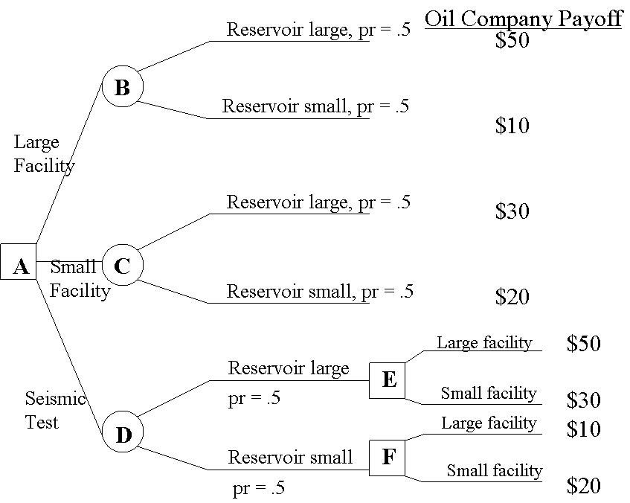
Decision Trees
EV = 30
EV = 25
Without Seismic Test, the company would build a large facility, and its expected payoff is 30.

Slide 29
Decision Trees
EV = 30
EV = 25
EV = 35
With Seismic Test, the expected payoff is 35.

Slide 30
Perfect Information
Definition: The value of perfect information is the increase in the decision maker's expected payoff when the decision maker can -- at no cost -- obtain information that reveals the outcome of the risky event.
Example:
Expected payoff to conducting test: $35M
Expected payoff to not conducting test: $30M
The value of information: $5M

