Slide 1
FN 281: Personal Finance
Thanachote Rungsitivat, CFA, FRM

Slide 2
Agenda
Understanding Different Types of Securities Market
Understand the Basics of Brokers and Investment Advisors
Buying and Selling Securities
Different Types of Stocks
Characteristics of Stocks
Identifying and Evaluating Stocks
The Situation into Practice

Slide 3
Understand the Different Types of Securities Markets
What are securities markets?
  Securities markets are where securities, i.e., financial assets, are traded
What are the two different types of securities markets?
  1. Primary markets
    Markets for trading newly issued securities
  2. Secondary markets
    Markets for trading already issued securities

Slide 4
Types of Securities Markets
What is traded in the primary markets?
  There are two main forms of primary issues:
    1. Initial public offerings (IPOs)
      These are the very first shares ever issued by a company
        Investment bankers serve as underwriters or intermediaries for these IPOs
    2. Seasoned new issues
      These are new shares being issued by a company that is already publicly traded

Slide 5
Types of Securities Markets
What is traded in the secondary markets, i.e., markets where existing securities trade?
    Secondary markets trade previously owned shares of stocks, bonds, and other securities
  What do secondary markets consist of?
    Secondary markets consist of organized exchanges and over-the-counter or electronic markets where existing shares are traded

Slide 6
Secondary Markets: Organized Exchanges
What are organized stock exchanges?
  Areas used to facilitate trading of financial instruments
What are the major organized exchanges?
  Stock Exchange of Thailand
Are there other exchanges?
  Yes, TFEX, AFET, THAIBMA

Slide 7
Understand the Basics of Brokers and Investment Advisors
What is a stockbroker?
  A stockbroker is a person who is employed by and solicits business for a commission house or merchant
What is an investment advisor?
  A person or an organization that helps makes the day-to-day decisions regarding a portfolio’s investments for investors
What do they do?
  They both want to be responsible for making your investment trades and decisions

Slide 8
Brokers and Investment Advisors
How do you pay them?
  They are generally paid by:
    1. Commission
      You pay either a percentage of every buy or sell order (e.g., 80 bps per trade), or a specific charge for a trade (e.g., $9.99)
    2. A percent of assets under management
      You pay a percent of your assets under management (i.e., if you have $500,000 with them and their fee is 1.0% per year, they are paid $5,000 per year)
    3. A combination of both
      You may be charged other fees as well

Slide 9
Brokers and Investment Advisors
What are the major brokerage account types?
  Cash accounts
    Money with the broker which you use to pay for purchases or receive any cash. There is a specific time between notification of purchases and when the purchases must be paid
  Cash Balance accounts
    Accounts where you are required to deposit with brokers prior to making any purchase. These funds are segregated from brokers’ assets

Slide 10
Brokers and Investment Advisors
Margin accounts
  Accounts where you borrow from the brokerage firm to purchase financial assets. This is debt, and can amplify both gains and losses.
    Maintenance margin
      Money you put up to buy on margin
    Margin call
      A call by the broker to put up more money when your margin declines below a certain level
  DO NOT BUY ON MARGIN! You can lose more than your original investment doing this.

Slide 11
Buying and Selling Stocks and Bonds
Stock Exchange
3. Confirms execution
Brokerage Operations and Accounting
2. Submits Order
3. Confirms Execution
2. Confirms execution
Broker
4. Confirms trade
You
1. Place order, regardless of type, to the broker directly through the computer or by fax or phone
5. Mails/emails conformation statement

Slide 12
ระบบที่เกี่ยวข้องกับการซื้อขาย
ระบบการซื้อขาย
ใช้ระบบคอมพิวเตอร์เต็มรูปแบบตั้งแต่ปี 2534 เรียกว่าระบบ ASSET (Automated System for the Stock Exchange of Thailand )
ระบบ Clearing &
settlement
ตราสารทุน | ตราสารหนี้ | ตราสารอนุพันธ์
วันที่ซื้อขาย+2 | วันที่ซื้อขาย+2 | วันที่ซื้อขาย+1

Slide 13
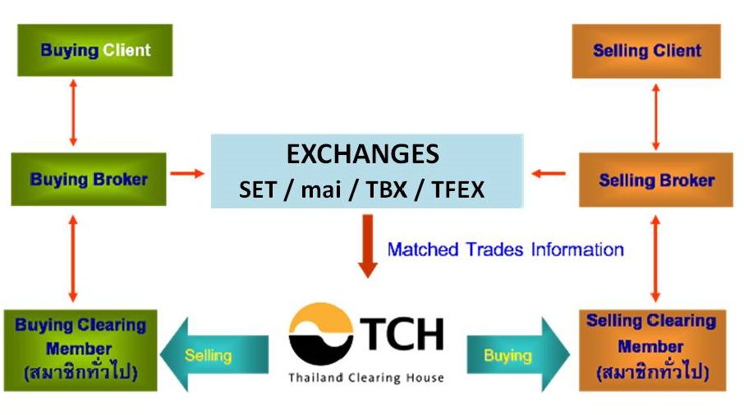
Settlement Process in Thailand

Slide 14
กระบวนการซื้อขายและส่งมอบหลักทรัพย์
T
ผู้ขาย
ผู้ซื้อ
ASSET
EXECUTION
คำสั่งขาย
คำสั่งซื้อ
BROKER
BROKER
TSD
T+1
รายงานการซื้อขาย
T+3
TSD
ยอดซื้อสุทธิ
BROKER
ยอดขายสุทธิ
BROKER

Slide 15
วัน - เวลาทำการซื้อขายหลักทรัพย์
วันทำการ : วันจันทร์ – ศุกร์
เวลาทำการ : 9.30 – 17.00 น.
9.30
T1
12.30
14.00
T2
16.30
T3
17.00
Pre -Opening I
Trading Session I
Intermission
Pre -Opening II
Afternoon Trading Session
Call Market
Off-hour Trading and Market Runoff Period
T1
เป็นเวลาที่ได้รับการสุ่มเพื่อเลือกหาเวลาเปิดในช่วง 9.55 – 10.00 น.
T2
เป็นเวลาที่ได้รับการสุ่มเพื่อเลือกหาเวลาเปิดในช่วง 14.25 – 14.30 น.
T3
เป็นเวลาที่ได้รับการสุ่มเพื่อเลือกหาเวลาปิดในช่วง 16.35 – 16.40 น.

Slide 16
การจดทะเบียนหลักทรัพย์
หุ้นสามัญ หุ้นบุริมสิทธิ หุ้นกู้
หุ้นกู้แปลงสภาพ ใบสำคัญแสดงสิทธิในการซื้อหุ้นสามัญ ใบสำคัญแสดงสิทธิอนุพันธ์
หน่วยลงทุน
ประเภทหลักทรัพย์
การเปิดเผยข้อมูล
ตามรอบเวลา
งบการเงินประจำปี | 2 | เดือน
งบไตรมาส | 45 | วัน
รายงานการเปิดเผยข้อมูลประจำปี (56-1) | 3 | เดือน
รายงานประจำปีที่เสนอต่อผู้ถือหุ้น(56-2) | 110 | วัน
การเปิดเผยข้อมูล
ตามเหตุการณ์
รายงานกรณีความขัดแย้งทางผลประโยชน์ การครอบงำกิจการ และเหตุการณ์ที่อาจมีผลต่อราคาหลักทรัพย์

Slide 17
Buying and Selling Securities
How are the orders placed with the broker?
  Orders are placed through buy and sell orders
What are Buy and Sell Orders?
  Orders to purchase or sell a specific quantity of a specific security at either a specific or market price
Does size make a difference on buy and sell orders?
  Yes. Round lots are easier to sell than odd lots
    Round lots are generally orders of 100 shares, and odd lots are orders of 1 to 99 shares
  You will get better execution and price with round lots

Slide 18
Buying and Selling Securities
What are the major kinds of orders used?
  Day orders
    Orders to buy and sell which are good only until the end of the trading day.
  Open orders (GTC: good till canceled, GTD: good till date specified)
    Orders which are good until filled or canceled.
      Be very careful with open or GTC /GTD orders. If you fail to cancel specific orders, you might have orders filled that you forgot to close out

Slide 19
Buying and Selling Securities
Market orders
  Orders to sell or buy a specific number of shares at the currently available or market price.
    Be careful as the market can move quickly and dramatically between when you place the order and order execution time
Fill or kill orders
  Orders which must be either filled or canceled immediately. Most often these are market orders

Slide 20
Buying and Selling Securities
Stop (or stop-loss) orders
  Orders to sell a specific number of shares if the stock price falls below a certain price or buy a specific number of shares if the stock price rises above a certain price
    Use care to set prices to safeguard against major fluctuations
Limit orders (this is the least risky method)
  Orders to sell or buy a specific number of shares at a specific price or better. This is generally the best method in working with brokers

Slide 21
Why Consider Stocks?
Over time, common stocks outperform all other investments.
Stocks reduce risk through diversification.
Stocks are liquid.
Growth of investment is determined by more than just interest rates.

Slide 22
Basic Common Stock Terminology and Features
Limited liability -- as a shareholder you are a part owner. But, if the company goes broke, you can only lose the amount you invested.

Slide 23
Common Stock Terminology and Features (cont’d)
Claim on income -- as a shareholder you have a right to any earnings of the company after all other obligations are met. Dividends are declared and then paid quarterly if any earnings remain.
  Declaration date
  Ex-dividend date
  Payment date

Slide 24
Common Stock Terminology and Features (cont’d)
Claims on assets -- remember the hierarchy of payments. Common shareholders can claim their assets only after debtors and preferred stock holders have been paid.

Slide 25
Terminology and Features (cont’d)
Voting rights -- as a common shareholder you have the right to vote; however, because of the large number of shareholders this right is normally executed through a proxy.
Proxy -- an agreement allowing a designated party to “vote your shares.”

Slide 26
Terminology and Features (cont’d)
Stock splits -- a tactic used to keep the price of the stock in the “buying range.” Basically, the company cuts the stock price and you get more shares, but retain the same total investment.
Stock repurchases -- companies buying back their own stock. Each stockholder owns a larger proportion of the firm.

Slide 27
Terminology and Features (cont’d)
Book value -- calculated by subtracting the firm’s liabilities from the assets, as given on a balance sheet. A historical number based on the value of assets when purchased.

Slide 28
Terminology and Features (cont’d)
Dividend yield -- is the annual dividend divided by the market price. Indicator of return, should price and dividend remain constant.

Slide 29
General Classifications of Common Stock
Blue-chip stocks
Growth stocks
Income stocks
Speculative stocks
Cyclical stocks
Defensive stocks
Large-caps, mid-caps, and small-caps

Slide 30
Blue-Chip Stocks
Stock issued by large well-known companies
Normally have sound financial histories
Normally have solid dividend and growth records
Examples – General Electric, Texaco, and Proctor & Gamble

Slide 31
Growth Stocks
Stock issued by companies whose sales and earnings growth have outpaced the market
Often are newly formed, smaller companies
Example -- Microsoft

Slide 32
Income Stocks
Stock issued by mature firms that normally pays high dividends
Usually have low growth rates
Examples -- Utility companies

Slide 33
Speculative Stocks
Stock issued by higher risk companies and generally sold on the OTC market
Difficult to forecast future earnings
Some are associated with astronomical gains and losses
Examples -- companies with new innovations or technology stocks

Slide 34
Cyclical Stocks
Stock issued by companies whose earnings tend to follow the economy
Examples -- Ford and General Motors

Slide 35
Defensive Stocks
Stock issued by companies whose earnings tend to move inversely to the broader economy and may actually increase during economic downturns
Examples – manufacturers or sellers of repair parts

Slide 36
Large-Caps, Mid-Caps, and Small-Caps
Stock classifications that refer to the level of capitalization or market value – the size of the firm

Slide 37
Return from Stocks
Investors make money in stocks in two ways:
  Dividends
    Companies may make payment to shareholders as part of the profits. Different types of companies have different dividend policies, which may change over time
  Capital Gains (CG)
    Investors purchase shares in companies with the expectation that the price of the shares will increase. This increase in share value is a capital gain

Slide 38
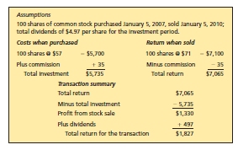
Sample Stock Transaction

Slide 39
Understanding Why Stocks Fluctuate in Value
Interest rates and stock valuation
  an inverse relationship
Risk and stock valuation
  an inverse relationship
Earnings (and dividend) growth and stock valuation
  a positive relationship

Slide 40
Why Stocks Fluctuate in Value?
Why do stocks change in value?
  There are many different reasons why stocks fluctuate in value. A few of the more common reasons are due to changes in:
    Interest rates
    Perceived risk of the company
    Expected company earnings, dividends, and cash flow
    Supply and demand
    Investor sentiment and the market

Slide 41
Why Stocks Fluctuate in Value
Interest rates
  Investors require a certain “expected return” or discount rate to invest in stocks. A major component of this discount rate is interest rates
    As interest rates decrease, shareholder’s discount rate also decreases (which is tied to interest rates), and future earnings are discounted by this lower rate, increasing the value of the firm
    As interest rates increase, shareholders require a higher discount rate, with all future earnings discounted at this higher rate, reducing the value of the firm

Slide 42
Why Stocks Fluctuate in Value
Perceived Risk of the Company
  There is an inverse relationship between perceived risk of the firm and price
    As the perceived riskiness of a firm decreases, investors are willing to pay more for the company stock, resulting in an increase in stock price
    As the perceived riskiness of a firm increases, investors are willing to pay less for the stock, resulting in a decrease in stock price

Slide 43
Why Stocks Fluctuate in Value
Expected Earnings, dividends, and cash flow
  As earnings, dividends, and cash flow per share increase beyond what was expected, generally investors are willing to pay more for the stock, and the stock price increases
  As earnings, dividends, and cash flow per share decreases beyond what was expected by the market, investors are less willing to pay for the stock, and hence the stock price declines

Slide 44
Why Stocks Fluctuate in Value
Supply and demand
  Stock prices may rise or fall based on supply and demand for their shares
    If a large shareholder needs to sell shares of a stock to meet cash needs, supply increases and the price is likely to decline
    Likewise, if a large investor gets new money into their account, and decides to increase their holding in the stock, the price of that stock will likely rise as the investor must pay a higher price to encourage others to sell the stock

Slide 45
Why Stocks Fluctuate in Value
Investor sentiment and the market
  Stock prices may rise or fall based on general investor sentiment and how the overall market is performing
    If investors are generally positive on stocks, and the market is performing well, investors will likely bid up the price of all stocks
    If investors sentiment is negative, and the market is performing poorly, investors will likely reduce their willingness to purchase the stock, resulting in a lower stock price

Slide 46
Stock Indexes: Measuring the Movements in the Market
SET
MAI
SET50
SETHD
Other market indexes
Using indexes to monitor a bear or bull market

Slide 47
Short Selling
Short selling—the more the price drops, the more money your make.
Borrow stock from the broker and then sell it.
Margin requirement—collateral
Sell high and later buy low and return stock to broker.
If price increases, you buy back for more than the sold price, and lose money.

Slide 48
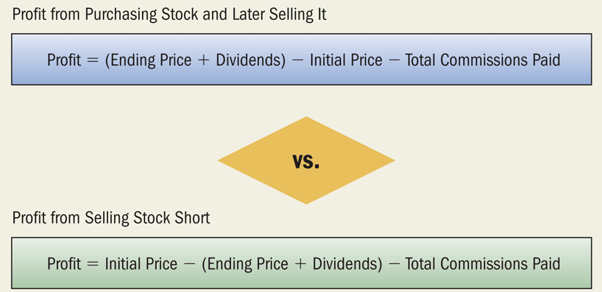
Profits from Purchasing Versus Selling Short

Slide 49
Dollar Cost Averaging
Purchasing a fixed dollar amount of stock at specified intervals.
Same dollar amount each period will average out the fluctuations.
Buy more shares at a lower price, fewer shares at higher prices.
Keeps you from trying to time the market.

Slide 50
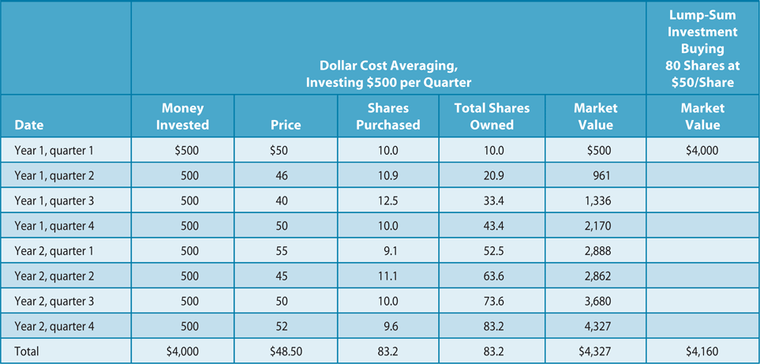
Dollar Cost Averaging

Slide 51
Buy-and-Hold Strategy
Involves buying stock and holding it for a period of years.
Avoids timing the market.
Minimizes brokerage fees, transaction costs.
Postpones capital gains taxes.
Gains taxed as long-term capital gains.

Slide 52
Valuation of Common Stock
The technical analysis approach
The price/earnings ratio approach
The discounted dividends valuation model

Slide 53
The Technical Analysis Approach
Focuses on supply and demand to project stock price or market trends
Focuses on the psychological factors (greed and fear) as well as economic factors
Of little value in predicting the market

Slide 54
The Price/Earnings Ratio Approach
Measures the stock’s relative value, or is it overpriced or underpriced?
Factors that drive the P/E ratio up and down
  The higher the firm’s earnings growth rate, the higher the firm’s P/E ratio.
  The higher the investor’s required rate of return, the lower the P/E ratio.
Recent market P/E ratio: 15 – 30 range
Considered a type of fundamental analysis

Slide 55
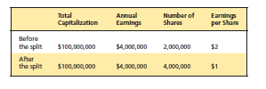
Earnings Per Share
Earnings per share -- level of earnings of each share of stock, not necessarily what will be paid as dividends. Used to compare financial performance of companies.
Earnings per share =
net income – preferred stock dividends number of common stock shares outstanding

Slide 56
Multiples Approach
Market-to-book or price-to-book ratio -- is a measure of the firm’s value, typically ranging from 1 to 2.5.
Market-to-book ratio =
stock price
book value per share

Slide 57
The Discounted Dividends Valuation Model
Considers the value of a share of stock to be the present value of all future dividends earned from holding that stock
Value of common stock = D₁
k - g
Impossible to accurately determine because you can’t predict the dollar amount of future dividends

Slide 58
Stock Investing Strategies
Dollar-cost averaging
Buy and hold
Dividend reinvestment plans (DRIPs)

Slide 59
Investment Theories
Fundamental Analysis
  Based on the idea that the stock price is determined by future earnings. If earnings are going to be higher in the future, the stock price should rise and visa versa.
Technical Analysis
  Based on the idea that the stock price should be a function of supply and demand in the stock market as a whole.
Efficient Market Hypothesis
  Based on the idea that the stock market is completely efficient and since new information arrives in the ,market in a random manner, the stock price moves in a random manner.

Slide 60
Dollar-Cost Averaging
Is purchasing a fixed dollar amount of a security at regular intervals
Averages out fluctuations in the market and concentrates on the general trend
Takes luck and market timing out of the equation – adds discipline.

Slide 61
Buy and Hold Strategy
Involves buying a stock and not selling it for an extended period of time.
Helps investor avoid market timing.
Minimizes brokerage fees.
Postpones capital gains.
Gains are taxed as long-term capital gains.

Slide 62
Dividend Reinvestment Plans (DRIPs)
Additional shares of stock are purchased with the dividend payment.
Avoids brokerage fees.
One major disadvantage is determining your cost basis for tax purposes.
Eliminates other appealing investment options.

Slide 63
Risks Associated with Common Stocks
The Risk-Return Trade-Off
Diversification Reduces Risk

Slide 64
Risks Associated with Common Stocks (cont’d)
Diversification and Risk--All Risk Is Not Equal
  Beta
  Remember:
    A diversified portfolio moves with the market. There is less effect from one company.
    Diversify by owning a broad array of stocks and bonds (domestic and international).
    Track the beta of your portfolio.

Slide 65
Risks Associated with Common Stocks (cont’d)
The Time Dimension of Investing
It’s hard to beat the long-term return from common stock investing.

Slide 66
Understanding the Concept of Leverage
Increases purchasing power by borrowing part of what you invest.
Magnifies capital gains and losses because the rate of return on the loan is fixed but the rate of return on the investment is not.

Slide 67
The Situation
Drew Davis has just graduated form college and has received $5,000 from his parents as his graduation gift. He wants to invest this money in the stock market, but he does not know much about the stock market and wants to learn more.

Slide 68
Why Corporations Issue Common Stock
A Form of Equity - Corporation don’t have to repay equity
Dividends Not Mandatory – While many corporations pay dividends, they are not required to do so.
Voting Rights and Control – Corporations give up some control because stockholders elect the board of directors and have some say in how the company is run.

Slide 69
Why Investors Purchase Common Stock
Income form Dividends – Companies like to keep stockholders happy and pay a quarterly dividend.
Dollar Appreciation of Stock Value – Investors profit from the growth in value of stock over time.
Stock splits – Investors may have short term gains that occur because of stock splits.

Slide 70
Preferred Stock
Dividends
  Known before purchase and are paid to preferred stockholders before they are paid to common stockholders
  Set dollar amount
  Percentage of par value
Cumulative preferred stock
  Unpaid dividends form prior periods accumulate and are paid before any common stock dividends are paid
Convertible preferred stock
  It can be converted into a set number of shares of common stock

Slide 71
The Internet
Many corporations have Websites which can provide timely data to help in the evaluation of a stock investment. Yahoo and other search engine can be useful as well.
In addition, the internet can be used to access professional advisory services like Standard & Poor’s Financial Information Services, Value Line, and Morningstar in the evaluation of investments

Slide 72
Numerical Measures That Influence Investment Decisions
Earning Per Share (EPS)
Price – Earning Ration ( PE)
Price / Earning to Growth Ratio(PEG)
Dividend Payout
Dividend Yield
Total Return
Annualized Holding Period Yield
Beta
Book value
Market-to-Book Ratio

Slide 73
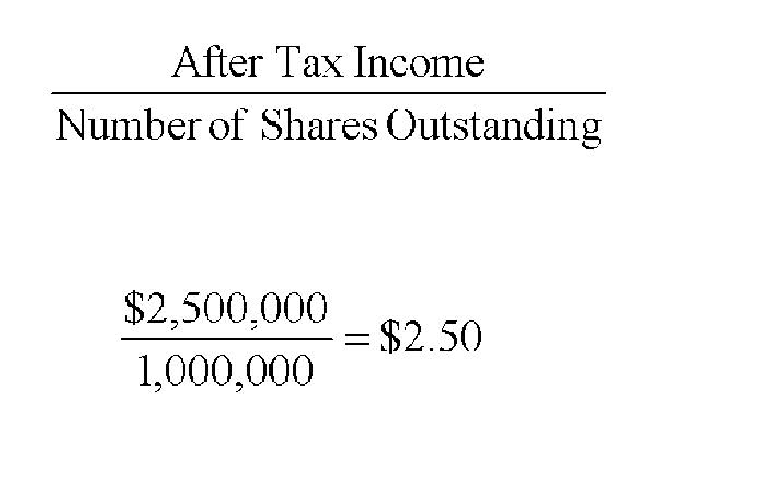
Earnings Per Share

Slide 74
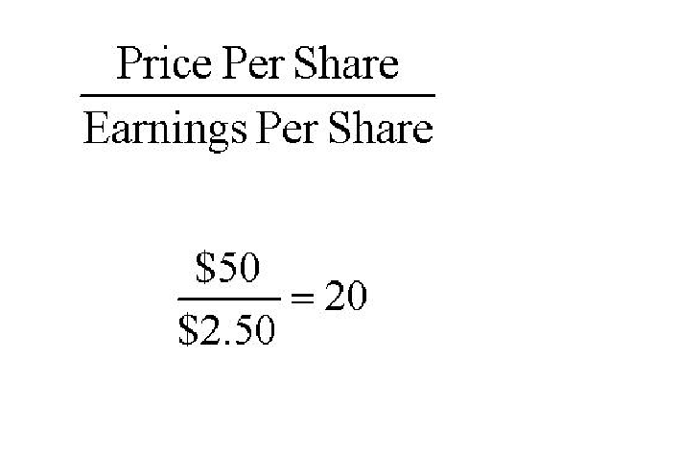
Price/Earning or P/E ratio

Slide 75
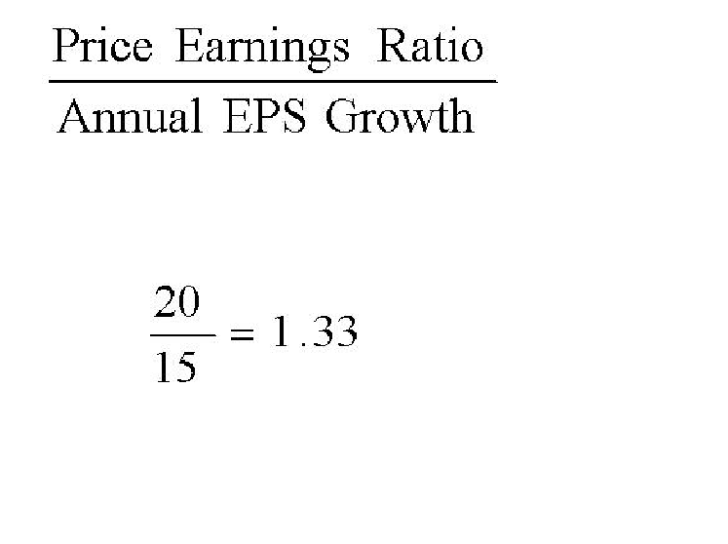
Price/Earnings to Growth Ratio

Slide 76
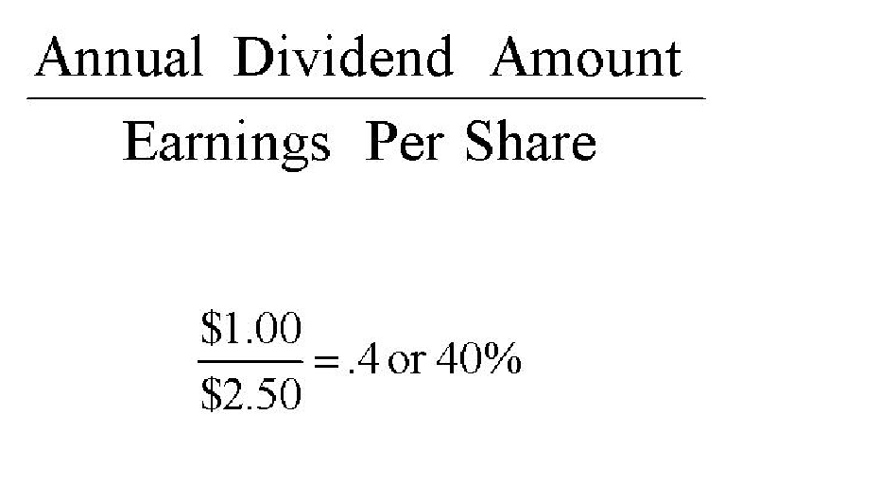
Dividend Payout Ratio

Slide 77
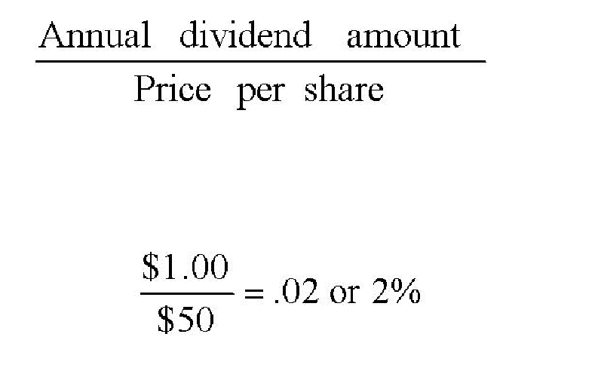
Dividend Yield

Slide 78
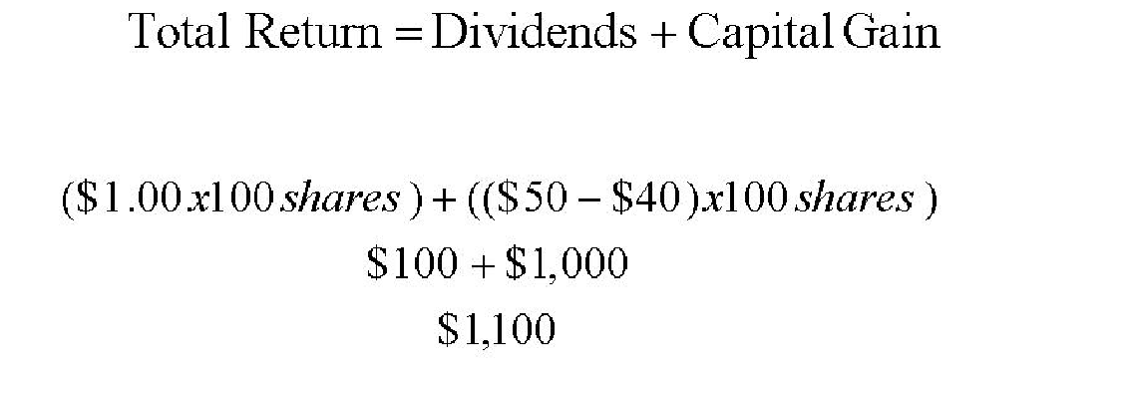
Total Return

Slide 79
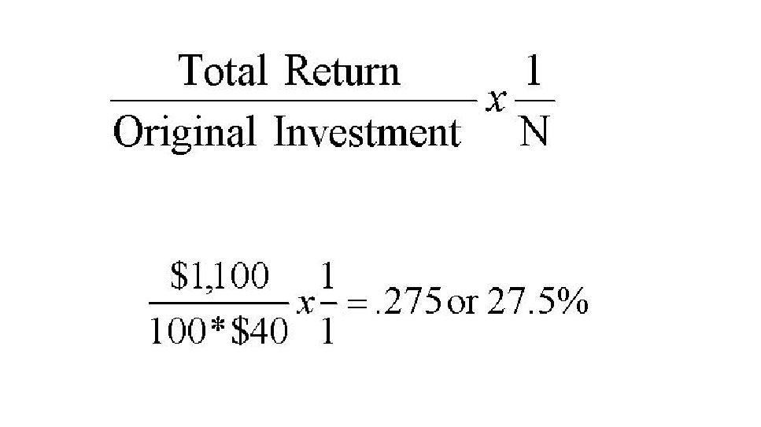
Annualized Holding Period Yield

Slide 80
Beta
Beta is a number reported in many publications that gives an indication of how volatile the stock is relative to the volatility of the market as a whole using the Standard & Poor’s 500 Stock Index.

Slide 81
Long-Term Investment Techniques
Buy and Hold – investors purchases the stock and hold onto it for a number of years in hopes that the price of the stock may go up.
Dollar Cost Averaging – investors purchase an equal dollar amount of the same stock at equal intervals for a number of years
Direct Investment – investors are allowed to purchase stock directly from a corporation without a broker.
Dividend Reinvestment Plans- investors are allowed the option to reinvest cash dividends by purchasing stock of the corporation.

Slide 82
Short-Term Investment Techniques
Day Trading – an investor buys stocks and sells them in a short period of time
Buying Stocks on Margin- an investor borrows part of the money needed to buy a particular stock. The Federal Reserve currently allows 50% to be borrowed
Selling Short – an investor sells stock that has been borrowed from a brokerage firm and must later purchase stock ( hopefully at a lower price) to replace the stock that was sold.
Trading in Options – an investor has the right to buy or sell a stock at predetermined price during a specified period of time.

Slide 83
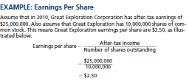
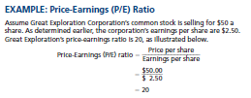
Appendix

Slide 84
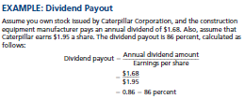

Appendix

Slide 85
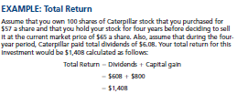
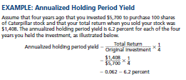
Appendix

Slide 86

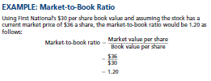
Appendix

Slide 87
Appendix:
Over-the-Counter Market
The over-the-counter market is a communications network of dealers who maintain an inventory in certain securities and stand ready to buy and sell those securities. Dealers make their money on the difference in the price the buy the securities at, and the price they sell the securities at.

Slide 88
Thank you

