Slide 1
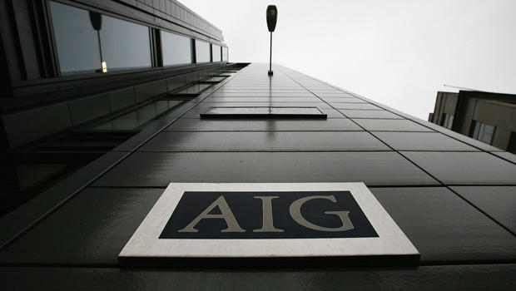
American International Group, Inc.
FN 323 Group7

Slide 2
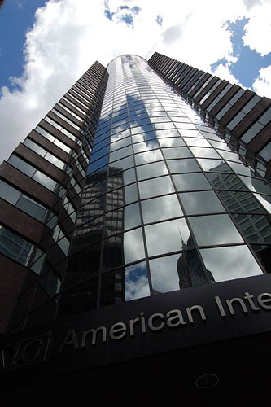
O V E R V I E W
AIG was a world leader in insurance and financial services
Listed in NYSE
Has operations in more than 130 countries
Main business activities are
1. General insurance (commercial property)
2. Life insurance (accident and health policies)
3. Financial services (aircraft leasing, CDS)
4. Asset management
AIG Building, New York

Slide 3
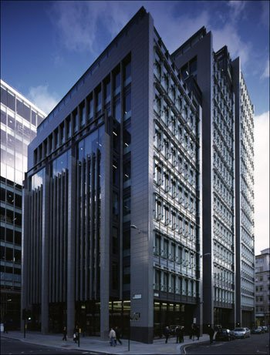
O V E R V I E W
In 2007 and 2008, AIG had some major problems within its Financial Services Unit in London
The staggering $32.4 billion in losses the unit racked up from January 2007 through September 2008 stem almost entirely from the unit’s CDS activities.
AIG Building, London

Slide 4
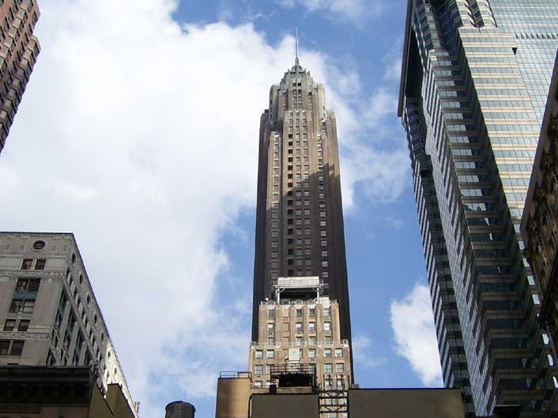
O V E R V I E W
AIG operates its CDS business through its subsidiaries,
AIG Financial Products (AIGFP)
whose focus is principally on OTC derivative markets

Slide 5
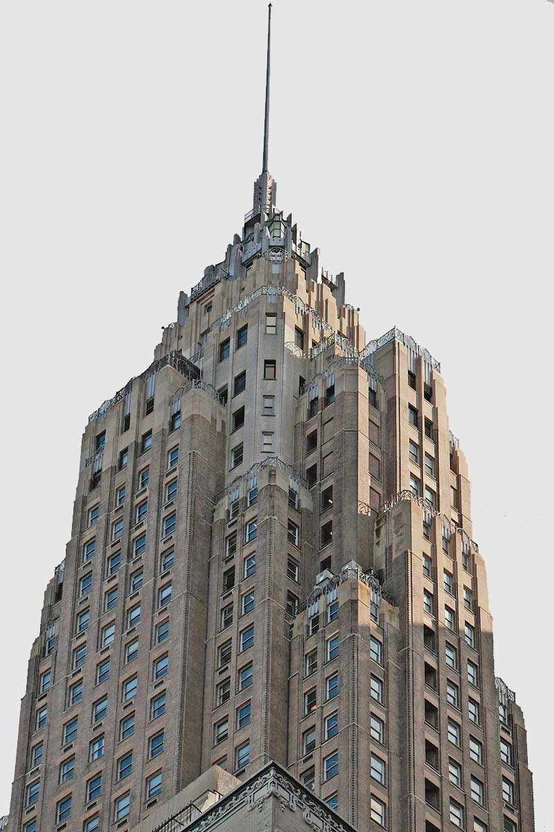
O V E R V I E W
AIG’s Balanced Sheet, 2005-Nine months Ended 2008.
 |  |  |  | Nine
 |  | (In Millions) |  | Months
 |  |  |  | Ended |  | 2007 | 2006 |  | 2005
 |  |  |  | 9/30/08
 |  | Revenues
 |  | General Insurance | $ | 35,854 | $ | 51,708 | $ 49,206 | $ | 45,174
 |  | Life Insurance & |  | 14,271 |  | 53,570 | 50,878 |  | 48,020
 |  | Retirement
 |  | Financial Services |  | (16,016) |  | (1,309) | 7,777 |  | 10,677
 |  | Asset Management |  | 658 |  | 5,625 | 4,543 |  | 4,582
 |  | Other |  | 531 |  | 457 | 483 |  | 344
 |  | Consolidation & |  | (436) |  | 13 | 500 |  | (16)
 |  | Eliminations
 |  | Total | $ | 34,862 | $ | 110,064 | $113,387 | $ | 108,781
 |  | Operating Income
 |  | (Loss)
 |  | General Insurance | $ | (393) | $ | 10,562 | $ 10,412 | $ | 2,315
 |  | Life Insurance & |  | (19,561) |  | 8,186 | 10,121 |  | 8,965
 |  | Retirement
 |  | Financial Services |  | (22,880) |  | (9,515) | 383 |  | 4,424
 |  | Asset Management |  | (2,709) |  | 1,164 | 1,538 |  | 1,963
 |  | Other |  | (2,899) |  | (2,140) | (1,435) |  | (2,765)
 |  | Consolidation & |  | 237 |  | 722 | 668 |  | 311
 |  | Eliminations
 |  | Total | $ | (48,205) | $ | 8,943 | $ 21,687 | $ | 15,213

Slide 6
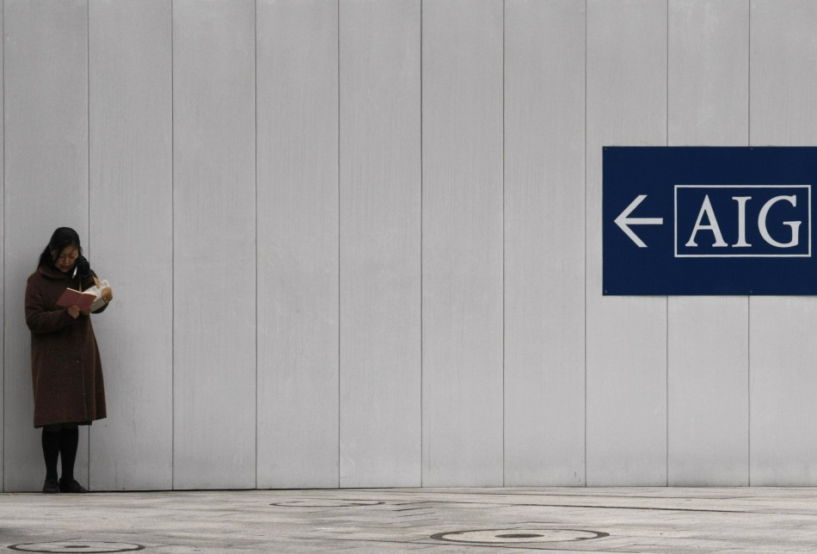
O V E R V I E W
AIG’s collapse was caused largely by its $526 billion portfolio of credit default swaps (CDS).
After that, AIG was on the verge of bankruptcy and had to be rescued by the Federal Reserves which reached to $182.5 billions.

Slide 7

What is Credit Default Swap?
“A CDS is a privately negotiated contract where one party (the "protection seller"), in exchange for a premium, agrees to compensate another party (the "protection buyer") if a specified credit event (such as bankruptcy or failure to pay) occurs with respect to a company or debt obligation.”

Slide 8
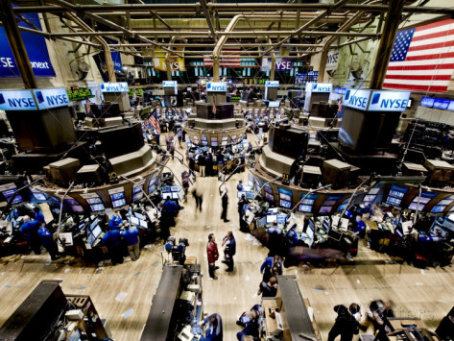
What is Credit Default Swap?
Used for a variety of purposes including
- Hedging
- Speculation
- Arbitrage

Slide 9

Contract specification
Company name
Bond name and type and maturity
Credit event : bankruptcy, payment default on its bonds, etc
Premium : bps per annum, paid quarterly

Slide 10
Settlement Method
Compensation | Parties | Not occur | Occur
Cash-settlement | Protection seller | - | compensate loss value = Par – Mkt. P.
 | Protection buyer | Pay premium until maturity | Pay premium up to credit event
Physical settlement | Protection seller | - | Buy CDOs @ Par value from protection buyer
 | Protection buyer | Pay premium until maturity | Pay premium up to credit event

Slide 11
What is Credit Default Swap?
Cash Flows before a Credit Event
Protection Buyer
Protection Seller
Quarterly Swap Premium
Cash Flows after a Credit Event
Swap Premium up to Date of a Credit Event
Protection Buyer
Protection Seller
Face amount of bonds
Cash equal to face value of bonds

Slide 12
EX. ABC bonds with $100 mill. par value matured in 5 years.
“Buy 5-year $100 mill. notional amt. 100bps cash-settled ABC CDS”
Credit event : if price drops to 20%
- not occur -> protection buyer pay $250,000 premium quarterly until maturity.
- occurs -> protection seller must pay $80mill. cash to protection buyer.

Slide 13
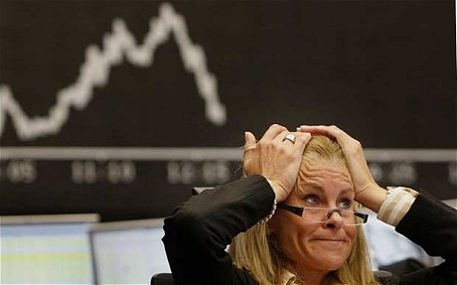
WHAT HAPPENED TO AIG?

Slide 14


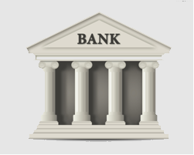
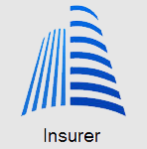
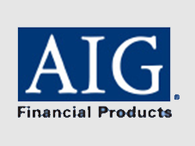
What happened to AIG?
$
$
$
$
“MBS”
$
Premium
Debt obligation
CDOs
CDS
Insured $440 Bil of CDOs
Exceeded what it could
pay if the CDOs it
insured default

Slide 15
What happened to AIG?
Credit Rating Agency
$
$
$
$
“MBS”
$
Premium
Downgraded
Debt obligation
CDOs
CDS
Insured $440 Bil of CDOs
Exceeded what it could
pay if the CDOs it
insured default

Slide 16

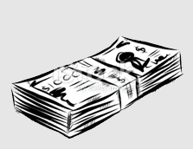
What happened to AIG?
1. Claim for payout on defaulted CDOs
AIG
Investors
Defaulted CDO holders
The rest CDO holders

Slide 17
What happened to AIG?
1. Claim for payout on defaulted CDOs
AIG
Defaulted CDO holders
2. Require more collateral due to AIG’s credit downgrade
The rest CDO holders

Slide 18
What happened to AIG?
1. Claim for payout on defaulted CDOs
AIG
Defaulted CDO holders
2. Require more collateral due to AIG’s credit downgrade
The rest CDO holders
“Liquidity Crunch”

Slide 19
What happened to AIG?
1. Claim for payout on defaulted CDOs
AIG
Defaulted CDO holders
2. Require more collateral due to AIG’s credit downgrade
The rest CDO holders
$180 billion
bailout
Fed

Slide 20
What happened to AIG?
1. Claim for payout on defaulted CDOs
AIG
Defaulted CDO holders
2. Require more collateral due to AIG’s credit downgrade
The rest CDO holders
$180 billion
bailout
Fed

Slide 21
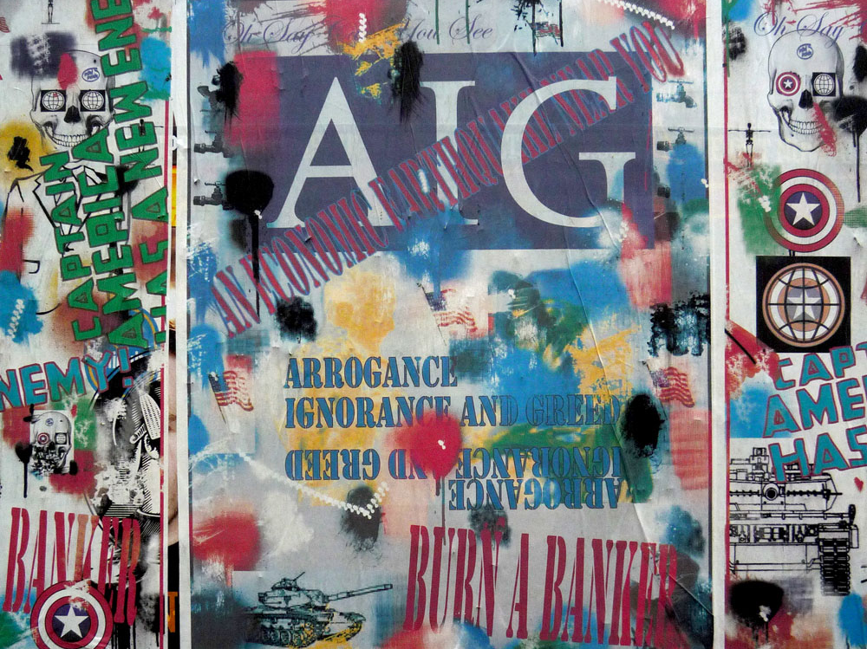
UNDERLYING CAUSES OF CRISIS

Slide 22

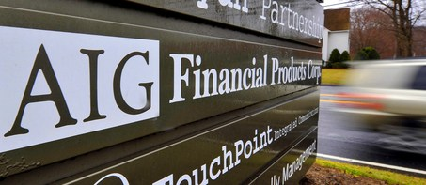
Underlying Causes of the Crisis
1. Intensive Writing of CDS by AIGFP
AIG Financial Products Corp, London
CDS’s exposure
$440 billion
$57.8 Billion was insured on
‘subprime’ mortgage
80% are “naked CDS”

Slide 23
“Subprime Mortgage”
Risky Borrowers
$
“MBS”
$
Premium
Debt obligation
CDOs
CDS

Slide 24
Underlying Causes of the Crisis
1. Intensive Writing of CDS by AIGFP
AIG Financial Products Corp, London
CDS’s exposure
$440 billion
$57.8 Billion was insured on
‘subprime’ mortgage
80% are “naked CDS”

Slide 25
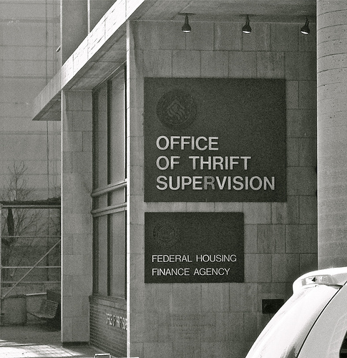
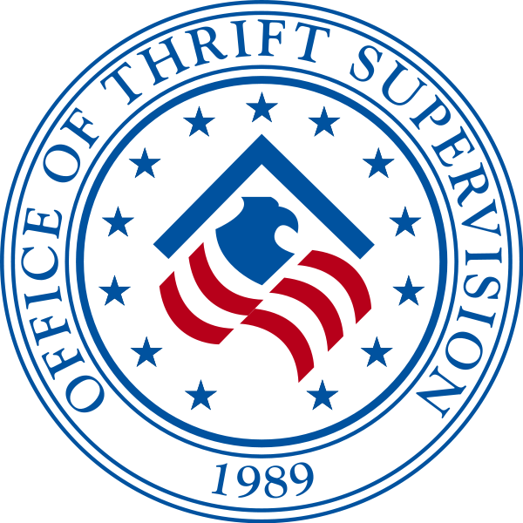
Underlying Causes of the Crisis
2. Inadequate regulatory monitoring of credit derivatives
The US Office of Thrift Supervisors (OTS) confessed that they themselves did not have the expertise to effectively monitor the CDS markets.

Slide 26

Underlying Causes of the Crisis
3. Moral Hazard from CDS existence
The ability to “pass on” the credit risk to AIG encouraged financial institutions to make loan funds easily to the US mortgage market even if they were risky

Slide 27
“Moral Hazard”
$
“MBS”
$
Premium
Debt obligation
CDOs
CDS

Slide 28
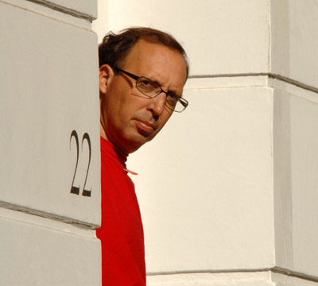
Underlying Causes of the Crisis
4. AIG’s flawed management
Joseph Cassano built up AIG FP on what's been described as regulatory arbitrage.
Autocratic Leadership
Interfere with the works of the internal audit
Unsophisticated model used to evaluate the CDS
“The man who crashed the world”

Slide 29
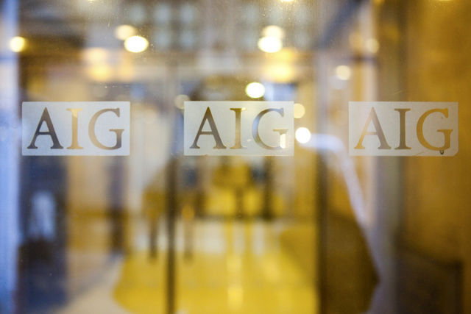
SOLUTIONS

Slide 30
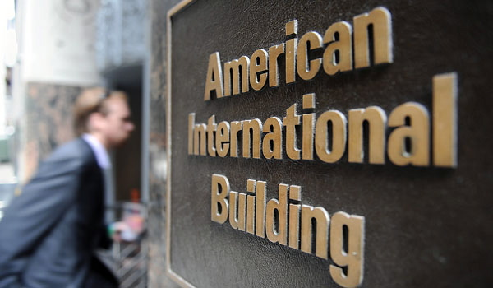
SHORT RUN
SOLUTIONS

Slide 31
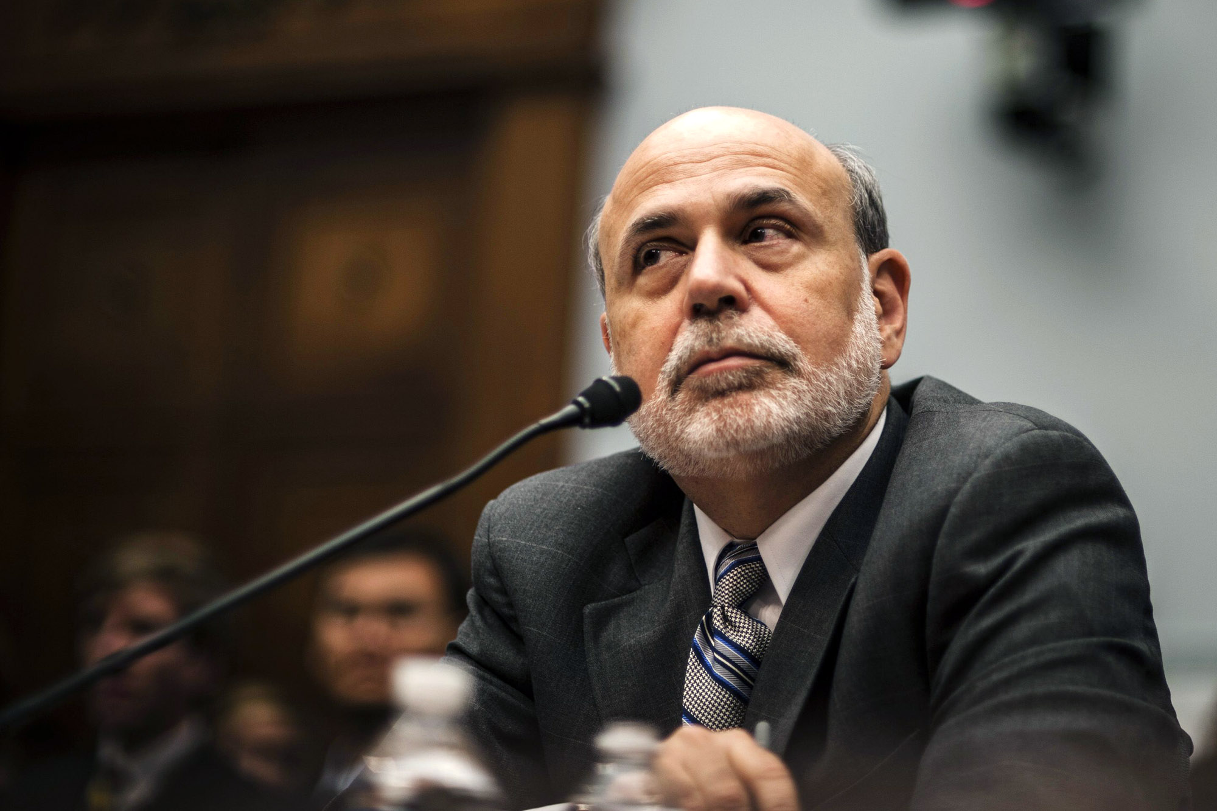
“In current circumstances, a disorderly failure of AIG could add to already significant levels of financial market fragility and lead to substantially higher borrowing costs, reduced household wealth, and materially weaker economic performance."
FED PRESS RELEASE
SEP16, 2008
FED Chairman, Ben Bernanke

Slide 32
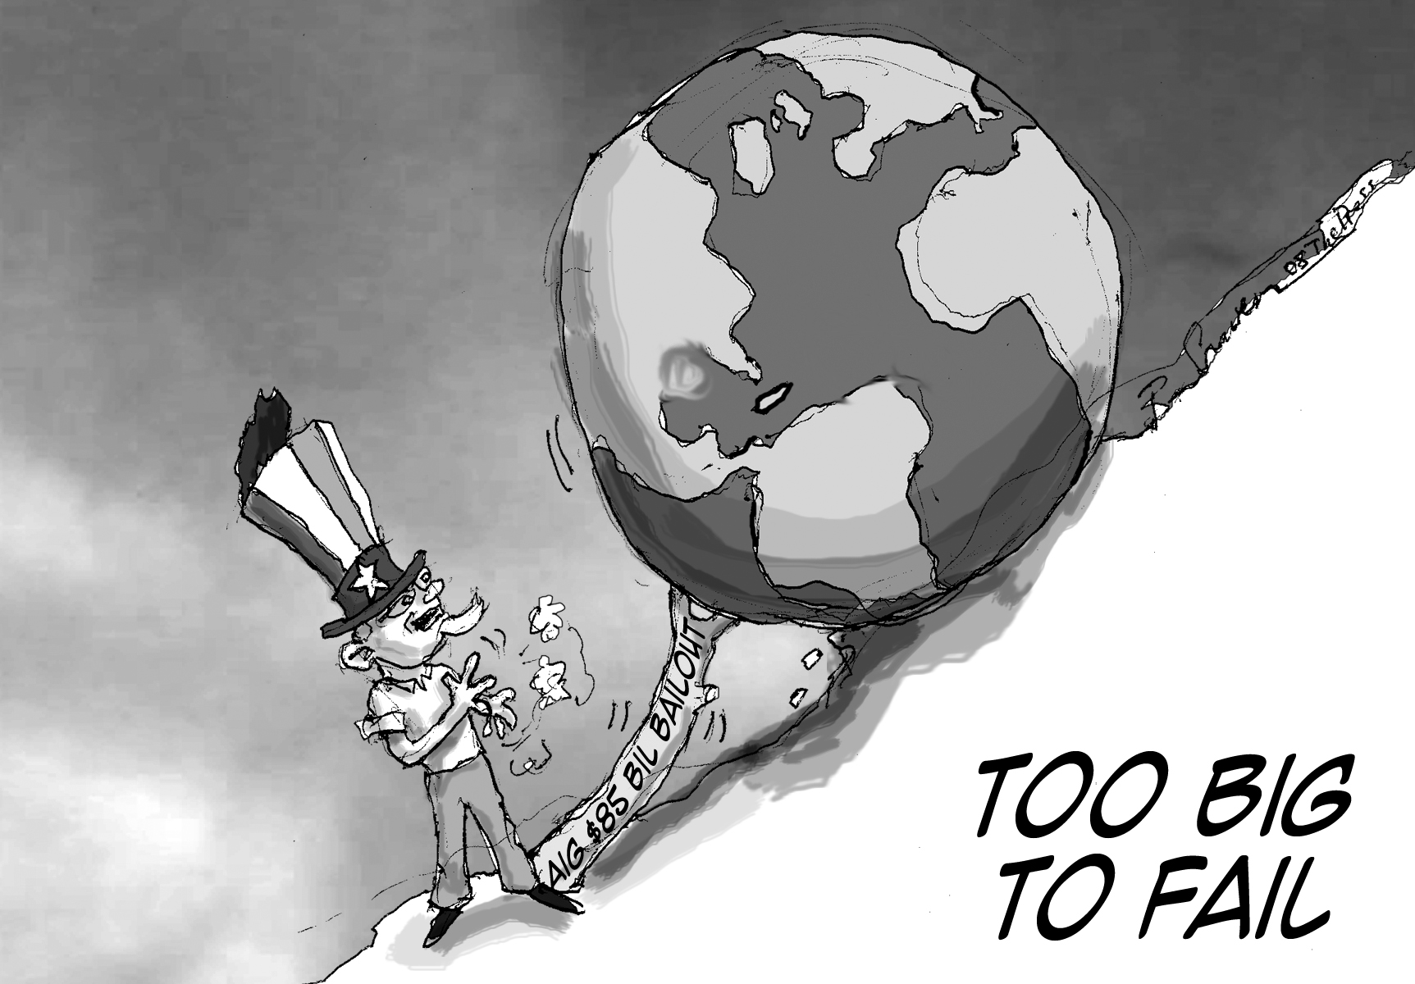
FED stepped in and created a secured credit facility of up to US$85 billion to prevent the company's collapse.
Gov held 79.9% of equity stake
2 year loan, LIBOR+8.5% interest

Slide 33
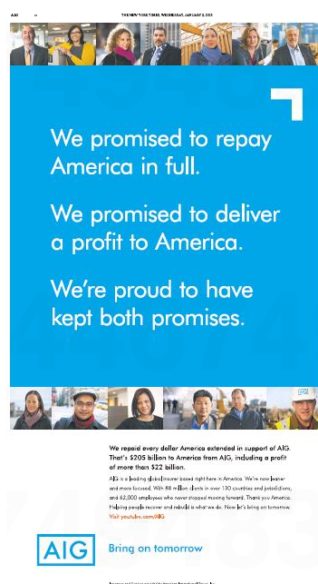
Repayment
On December 31, 2012, AIG launched an ads campaign “Thank You America” to thank the tax payer for the overall $182.3 billion.
Government fully received their investment in AIG, plus a total combined positive return of more than $22 billion.

Slide 34
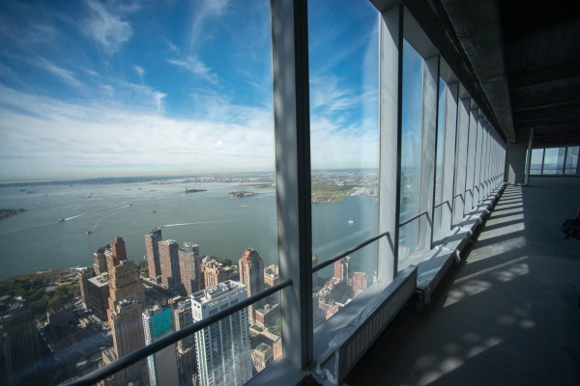
LONG RUN PREVENTION

Slide 35
Long Run Prevention
Regulators
AIG

Slide 36
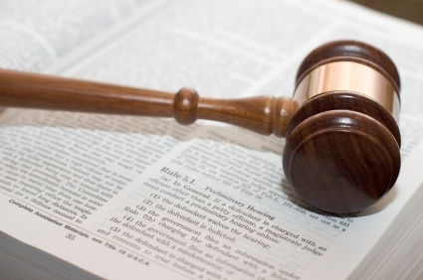
Regulatory Reform
Greater degree of regulation over the OTC derivatives
Standard for monitoring capital adequacy and risk exposure of insurers
Proper assignment of credit rating
- Increase regulatory controls on CRAs
- “Issuer Pay” to “Subscriber Pay”
- Use CDS spreads in compliment with CRAs

Slide 37
Regulatory Reform
Credit Rating Agency
Subscriber pay
$
$
Issuer pay
Rate (AAA)
CDS
Clearing House
CDS
Margin
Margin
BASEL III
1) Greater degree of regulation over the OTC derivatives
2) Standard for monitoring capital
adequacy and risk exposure of insurers
3) Proper assignment of credit rating
- Increase regulatory controls on CRAs
- “Issuer Pay” to “Subscriber Pay”
- Use CDS spreads in compliment with CRAs

Slide 38
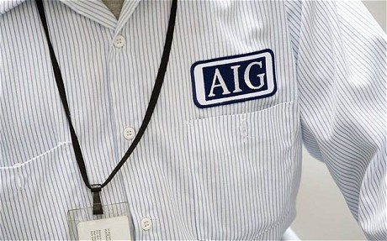
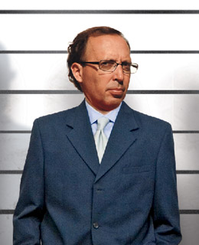
Company Reform (AIG)
Improvement of risk model
Fat-tailed risk hedging
Decentralize power within the organization

Slide 39
Thank you for your attention

