Slide 1

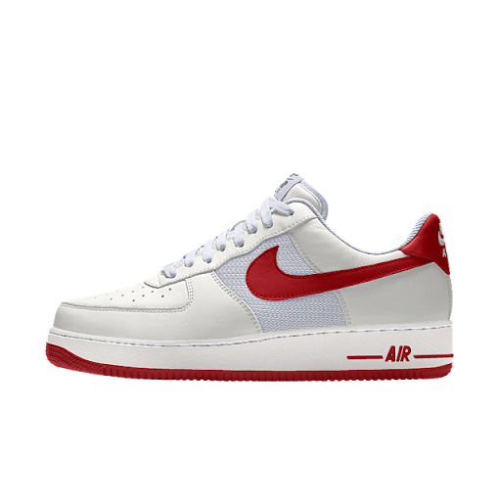
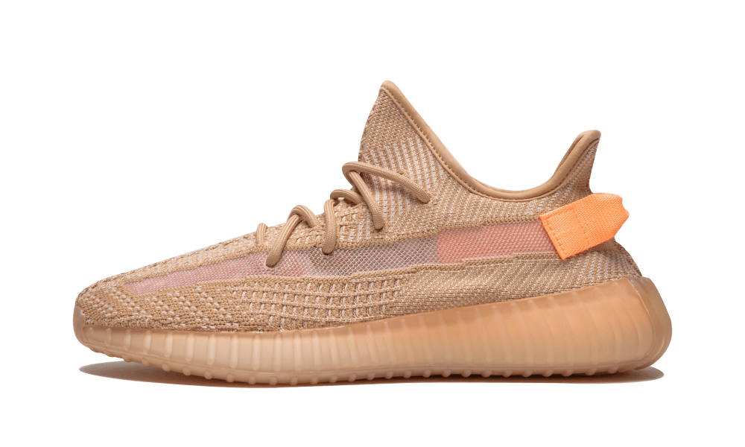
“Why people love to buy expensive sneakers?”
AND
“How resale sneakers market work?”
Janista Thanakarnjanasuth
6004640121
By: Krit Tayakeepisuth 5704640720

Slide 2

01
Introduction & Objective
Theory
02
TABLE OF CONTENTS
Methodology
03
Result
04

Slide 3
conclusion
05
TABLE OF CONTENTS
Comments & Recommendations
06
04

Slide 4

Introduction
&
Objective
Introduction
As we all known that people gave a lot of attention to the resale market of sneakers in Thailand. It became very popular and booming during the last decade.
We can say that this era is the busiest era of the Thai sneakers. Therefore, shoes market is becoming a massive market. So, there are many ways that create opportunities for those sellers and buyers to step into this market to make money.
Objective
the objective had been set as “the reason that people put their money on the sneaker and how the sneaker resale market actually works”.

Slide 5
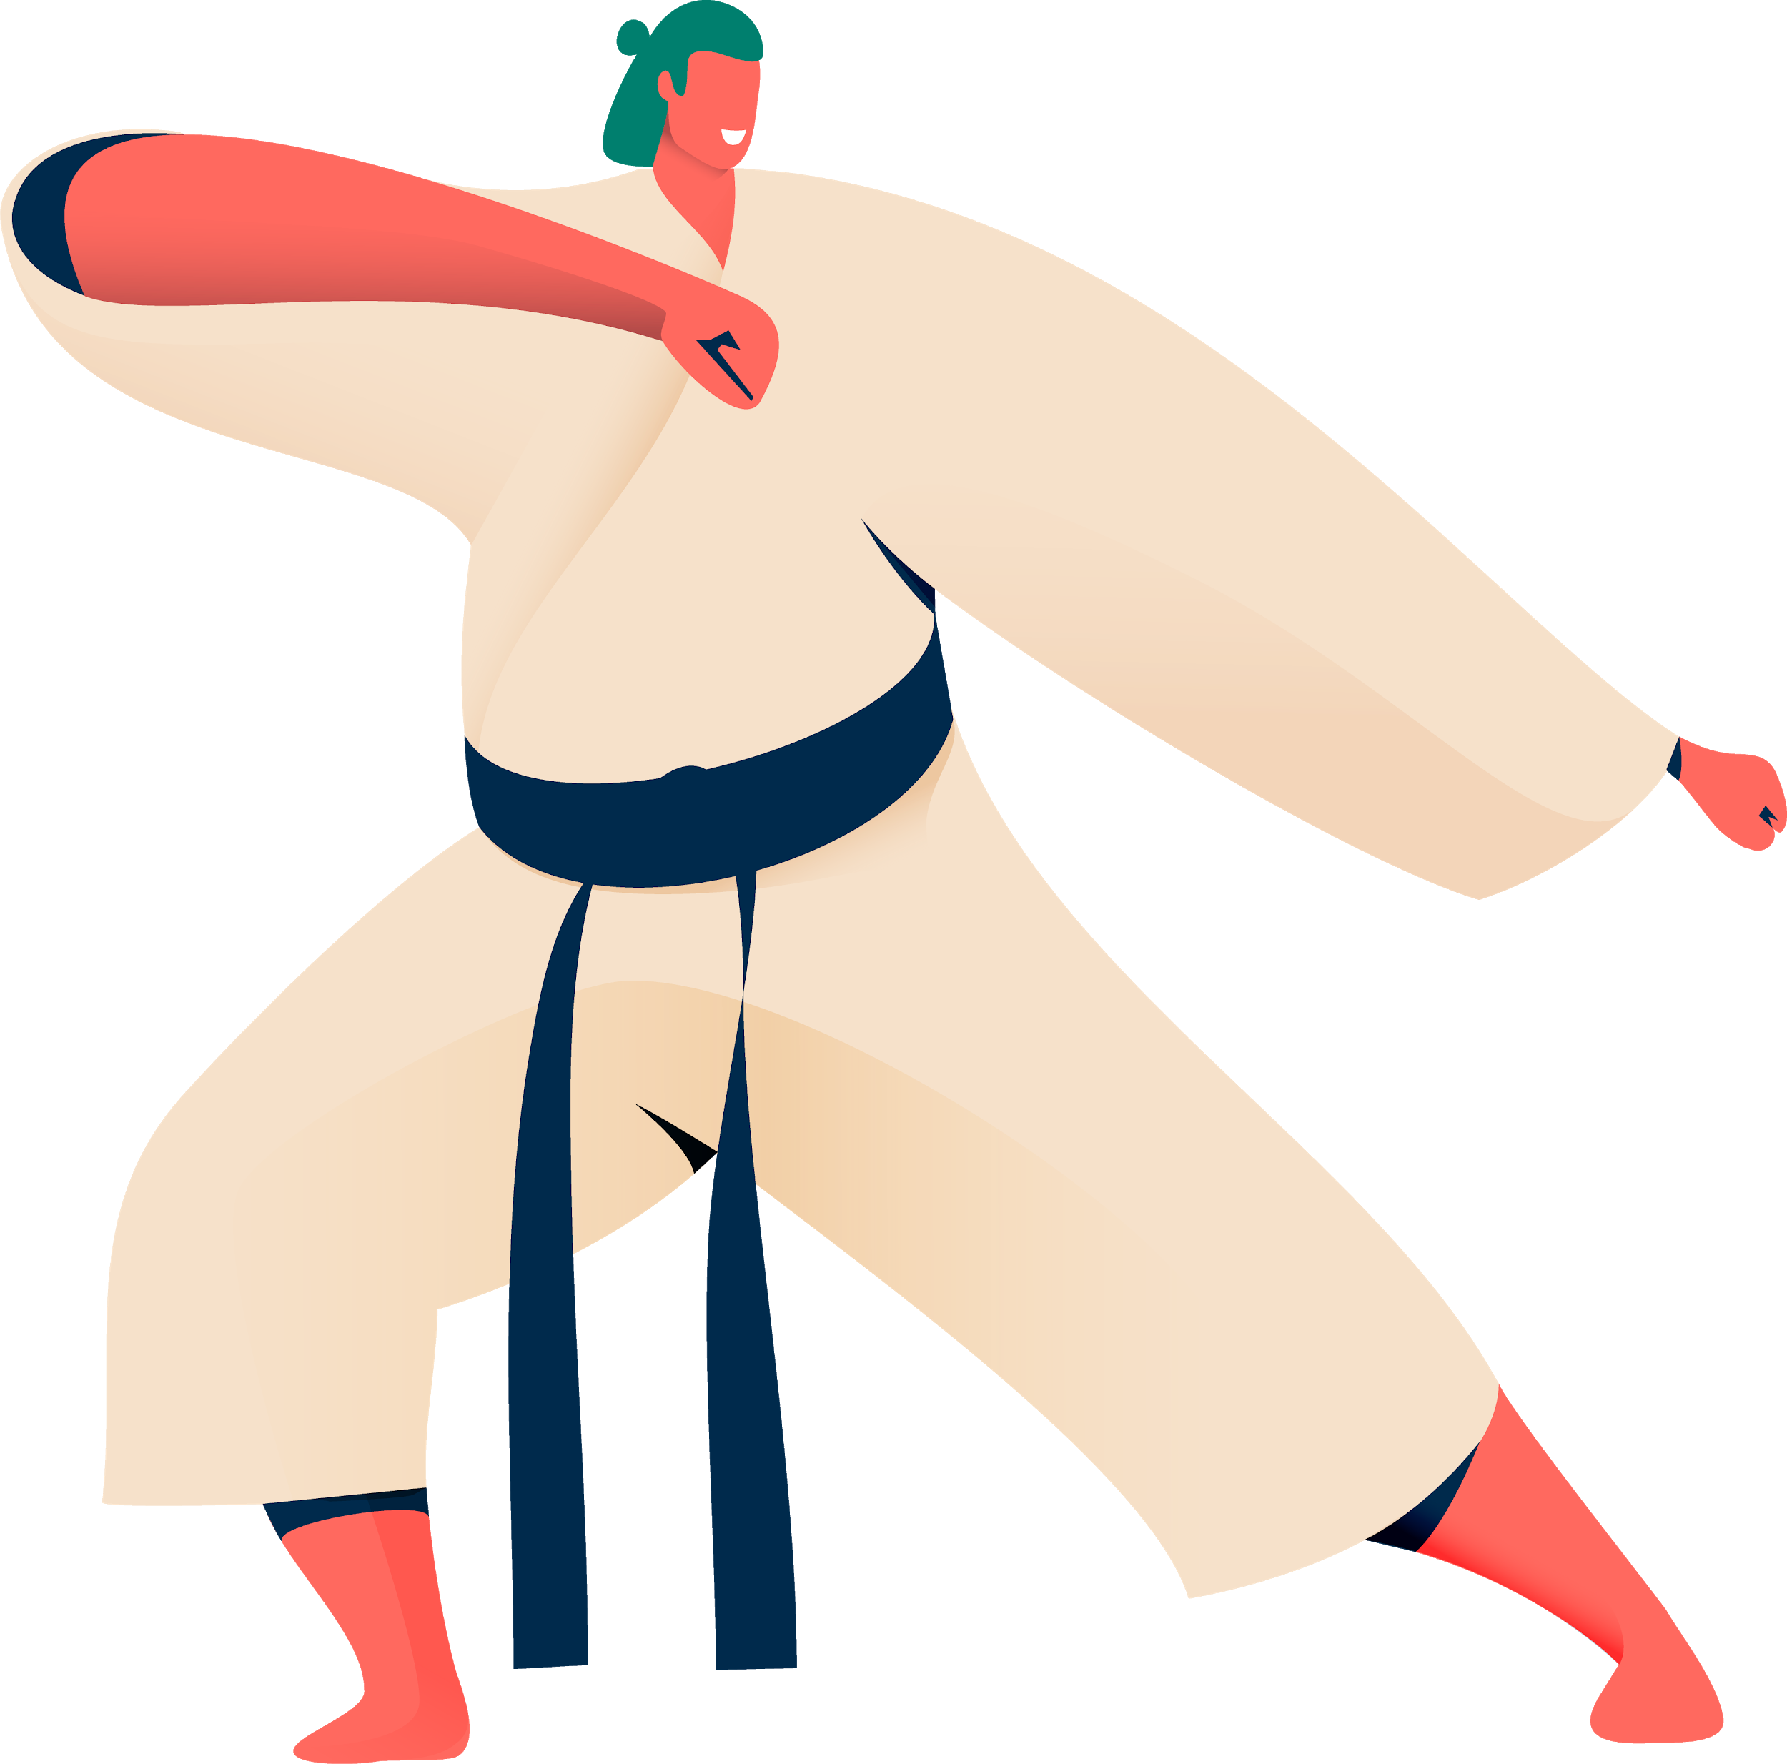


Theory
the sneakers resale market could not be constructed without the law of demand and supply.
In this case : the resale of sneakers occurs when there is a limited number of sneakers produced by the companies. But the demand is unlimited.
- Discriminating monopoly
- The markup pricing

Slide 6


Methodology
The methodology for this seminar paper is to get the information from the survey of both supplier and consumer sides.
2 sections for the data collection
-The interview of the stores
-the online survey from google form from sneaker communities in Thailand on Facebook and from the adults that wearing expensive sneakers.

Slide 7


Result
1.the online questionnaire
-total 143 responses
-13 main questions
Question 1 : the gender
Question 2 : the respondents’ ages
Question 3 : the occupations
Question 4 : the monthly income
Question 5,6 : asking about what brand and series of your favourite shoes is? And ask the place and that you bought
Question 7 : what is the factors that play an important role in the decision making
Question 8,9,10 : are to examine the value of 3 different sneakers from different brands and asks the respondents to tell us the price that they willing to spend on these sneakers.
Question 11,12 : are about the channels that the respondents willing to buy those sneakers from
Question 13 : is asking about what factors that causing the overall present price of sneakers to go up compare to the past?

Slide 8
Result
2. the interview of the resale stores in Thailand
The information is from 2 resale stores that famous in Thailand :
1.Outcast store
The pricing strategy :
-depends on products and tax.
-the Outcast store conduct the prices by averaging all prices of this sneaker in every country that sell this sneaker and conduct just one price for his store.
2.Grow Up store
The pricing strategy :
-the store will look around for other stores around them about what prices for those sneakers they are selling, then the store will conduct own prices.
-the price must cover their costs of the store and received profits.

Slide 9


Conclusion
In conclusion :
Question 1
-the items on your body which can tell and indicate their status publicly.
- All Thai and foreign celebrities have high effects on preferences to some groups of people.
-Thai people face new trend, the sneaker fever.
Question 2
divided into two types of resellers, online and store.
-For resale stores, there are many strategies to conduct the price
-it has been proved that most of the buyers would like to buy sneakers from stores rather than online stores.

Slide 10

Comments
& recommendations
Based on my opinion, there is a weakness in this seminar paper which is the connection between the first question of the study and the conclusion.
-The first question: “Why people love to buy expensive sneakers?”
-My recommendation: “What is the factor that is most influence people to buy expensive sneakers?”
The methodology part
mentioned that the respondents in the online survey from google form will be the people who joined the sneaker communities in Thailand on Facebook, and also from the adults that wearing expensive sneakers
-In my opinion : The teenagers that age between 16-25 years old

