Slide 1

Chapter 1
Chapter 12
ORGANIZING AND IMPLEMENTING THE
MARKETING PLAN
Introduction
MK 312 Marketing Management
By
Suwalya Khemvaraporn

Slide 2
Ch. 12 - Learning objectives
After studying this chapter you should be able to:
■ examine a typical conceptual framework for a marketing plan
■ describe the structure of the marketing planning process
■ explain the main contents of a marketing plan
■ understand why the implementation part of the marketing plan is so important
■ describe and evaluate the different ways of organizing the marketing department as part of the internationalization process of the company
■ understand the important issues involved in implementing the marketing plan.

Slide 3
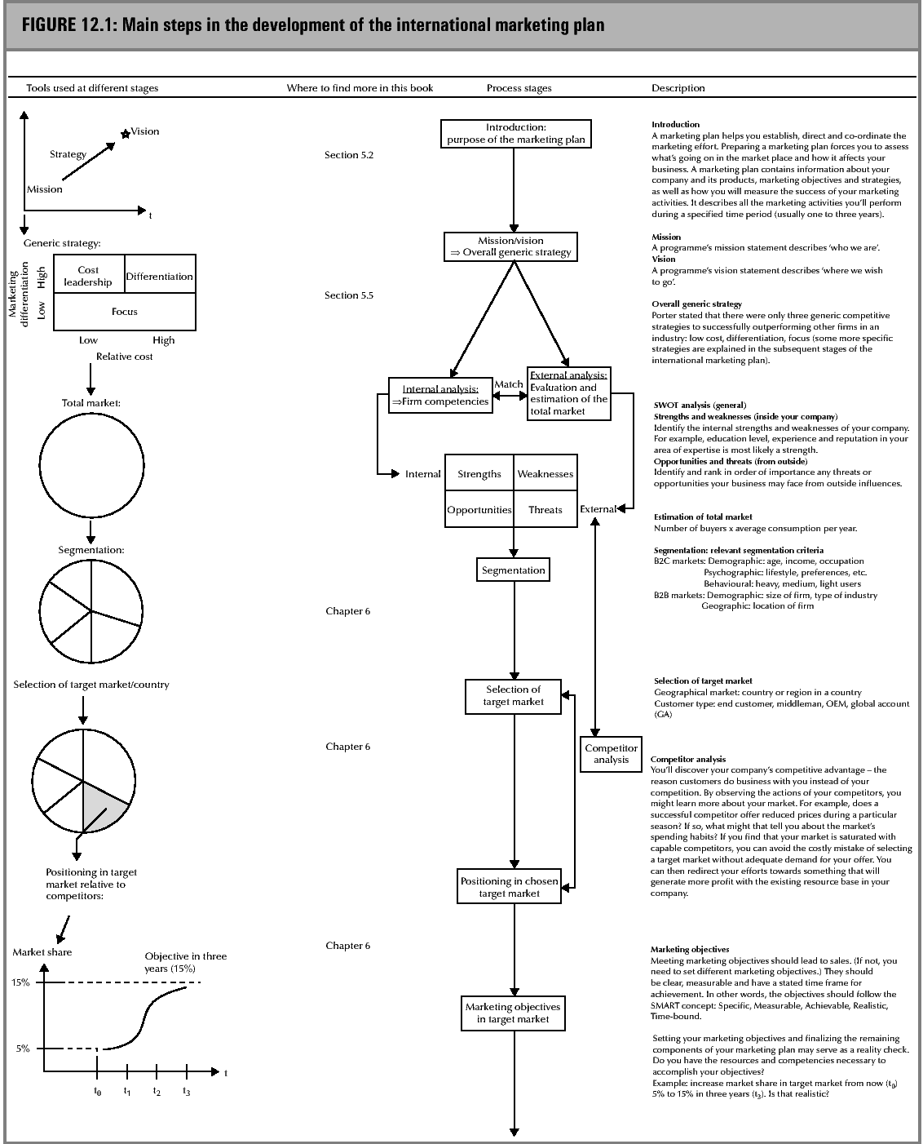
Main steps in the development of the international marketing plan (1)

Slide 4
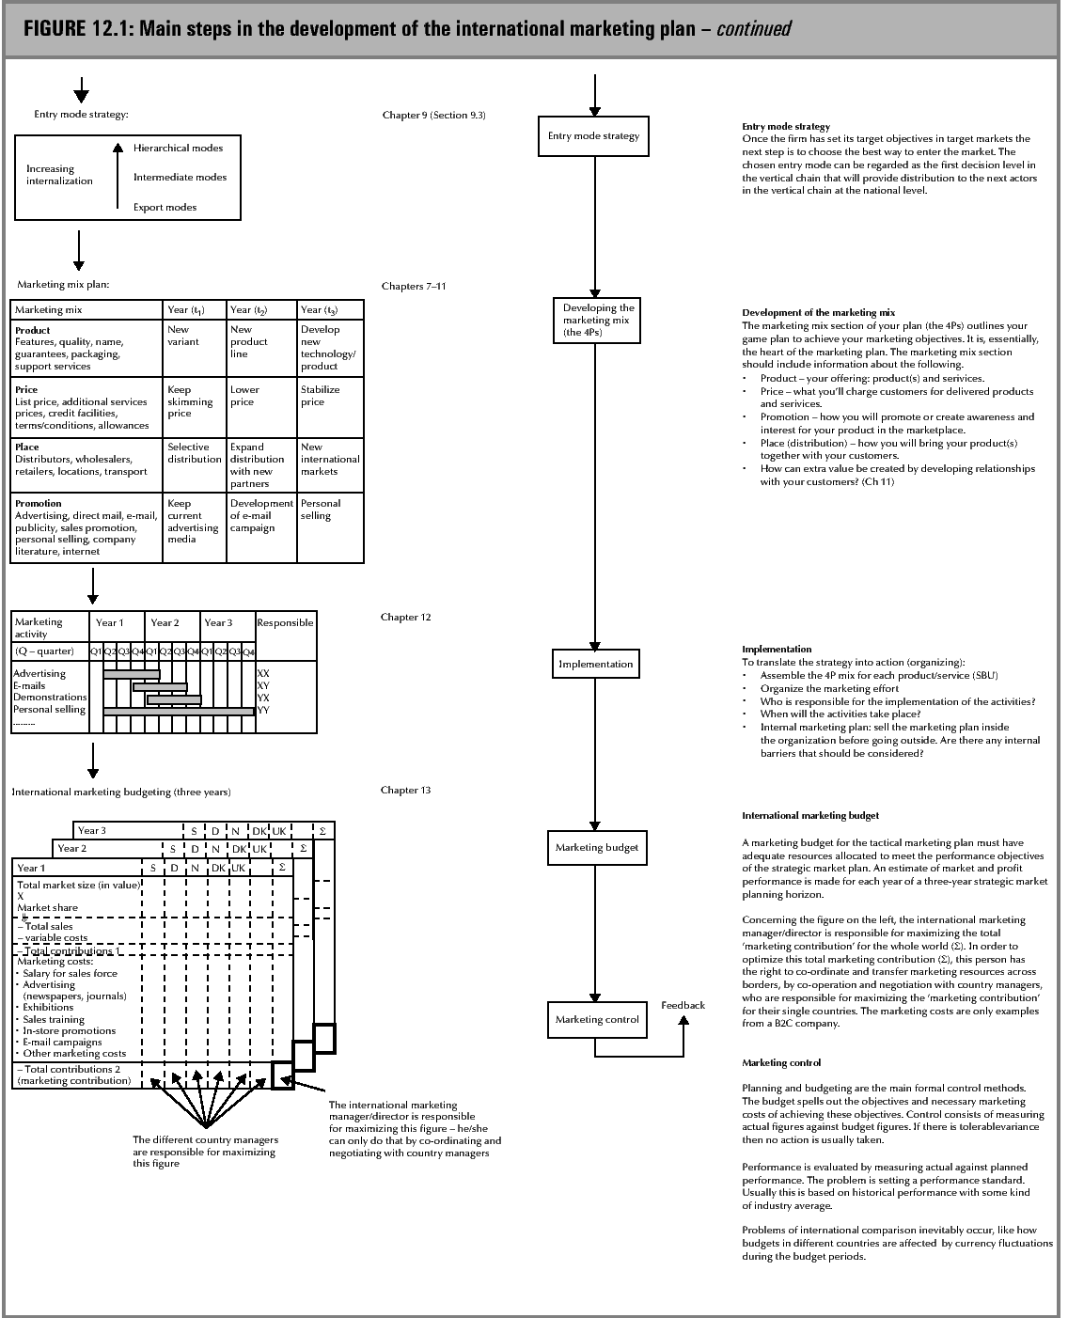
Main steps in the development of the international marketing plan (2)

Slide 5
Effect of internet on International marketing planning
Evans and Wurster have argued that the Internet has made it possible for companies to reach a very wide audience, while at the same time doing so with richness of information through the enhanced volume, design and interactivity of content that is feasible on a website. Evans and Wurster identified three bases of competitive advantage:
reach (referring to access and connection)
richness (referring to detail and depth of information provided to customers)
affiliation (referring to whose interests the business represents).

Slide 6
Writing the marketing plan

Slide 7

I.Title Page
The title page is an identification document that provides the reader with the following essential information:
  Legal name of business
  Name of document (Marketing plan for…)
  Date of preparation or modification of the document
  Name, address, e-mail and phone number of the business or contact person
  Name, address, e-mail and phone number of the individual or business who prepared the plan
  The planning period

Slide 8

II.Table of contents
This is the list of subjects covered in the marketing plan and where in the document to find them.

Slide 9


III.Executive Summary
This gives busy executives and managers a quick overview, in the form of a concise summary, or key points in the marketing plan

Slide 10
IV.Introduction and Problem statement
The identification and clear presentation of the problem(s) or issue(s) facing the company is the most critical part of the introduction. Only a problem that has been properly defined can be adressed.

Slide 11

V.Situation analysis
Based on comprehensive audit of the market environment, competitors, the market, products and the company itself, this section provides a condensed view of the market (size, structure and dynamics), prior to a detailed analysis of the individual market segments, which form the heart of the marketing plan.
It is necessary to summarize the unit’s present position in the major markets, in the form of SWOT analysis for each major market segment, product or business group.

Slide 12
V.Situation analysis
o
SWOT includes the following issues:
  The firm and its market
    Identification and evaluation of the competencies in the company (key personnel experience, skills, capabilities, and resources) in comparison with those of your competitors.
    The structure of your marketing organization(lines of authority, functions and responsibilities).
    Description of your total potential market (ie. potential customers)
    How does your product/service satisfy the needs in this market?

Slide 13

V.Situation analysis
    Describe the particular customers that you will target.
    Size of (i) total potential market (number of potential customers) and (ii) your target market. Support estimates with factual data.
    Growth potential of (i) total potential market, and (ii) your target market. Look at local, national and international markets. Support estimates with factual data.
    Your current market share (firm’s sales divided by the total market sales in percent).

Slide 14


V.Situation analysis
Competitive environment
  Major competitors:name, location and market share.
  Compare you product/service with that of your major competitors (brand name, quality, image, price,etc.).
  Compare your firm with that of your major competitors (reputation, size, distribution channels, location,etc).
  How easy is it for new competition to enter this market?
  What have you learned from watching your competition?
  Are competitors’ sales increasing, decreasing, steady? Why?

Slide 15

V.Situation analysis
o
Technological environment
  How is technology affecting this product/service?
  How soon can it be expected to become obsolete?
  Is your company equipped to adapt quickly to changes?

Slide 16
V.Situation analysis
Socio-political environment
  Describe changing attitudes and trends. How flexible and responsive is your firm?
  New laws and regulations that may affect your business. What might be their financial impact?
  Use SWOT analyses to assess the key issues that must be addressed. Summarize your internal and external assessment in form of a SWOT matrix using the key points from the situation analysis.

Slide 17

VI. Marketing objectives and goals
This states precisely the marketing objectives and goals in terms of sales volume, market share, return on investment, or other objectives or goals for your marketing plan.
What is the difference between a goal and an objective?
  An objective is an overall goal. It is more general and may not be quantified. ‘To establish our product as leader in the market place’
  Goals are quantified ‘ To sell 50,000 units next year’ is a goal.

Slide 18

VII. Marketing strategies
How will you reach your objectives and goals? That is what is covered in Chapter 5. Which strategic models from Chapter 5 should be used (new market penetration, penetration, market development, etc).

Slide 19

VIII Marketing programs/ action plan
Marketing programs are the actionable means of achieving desired ends. They outline what needs to be done, how it will be done, when it will be done, and who will do it.
  How will you implement the above strategy
  Product/service quality,branding, packaging, modifications, location of service, etc.
  Pricing: how will you price the product/service so that it will be competitive yet profitable?
  Promotion/advertising: how, where, when,etc.
  Selling methods: personal selling, mail order, etc. Include number of sales people, training required, etc.
  Distribution methods.
  Servicing the product.
  Necessary organizational development in the company.
  Other: add any other relevant information.

Slide 20
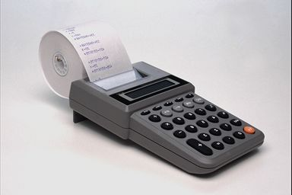
IX Budgets
There are variety of ways of determining the marketing budget. The ideal would clearly be to specify the strategy and tactics that are felt necessary to achieve the marketing objectives, and then to cost these to arrive to an overall budget.
Budgets tend to be set up by using following methods.
  Percentage of last year’s sales
  Competitor matching
  What can be afforded

Slide 21

X Implementation and Control
As soon as the plan has been implemented, the marketing management will then have to take responsibility for monitoring the progress of the organization towards a goal specified.
Managers will also need to concern themselves with the costs that have been incurred at each stage of implementation and monitor these against the budget. Thus, control mechanisms need to be put into place to monitor.

Slide 22


X Implementation and Control
The actual sales achieved, against the budget.
The actual costs incurred against those budgeted.
The performance of individual services against budget.
The overall strategic direction that the organization is taking – that is, will the overall corporate objectives be achieved in a manner commensurate with the organization’s mission?
If variances are detected in any of these areas, corrective action can be initiated, if necessary by utilizing resources allocated in the budget for contingency.

Slide 23

XI Conclusion
This section briefly concludes the problems stated at the beginning of the report, based on the analysis in the marketing plan.
The conclusion is not a summary. The executive summary will normally also include the key results of the market analysis.

Slide 24

Success of the Marketing plan
Success of a marketing plan depends on three areas:
  The process that is followed.
  The infrastructure that is established prior to and throughout the process.
  The implementation controls that are put to place; it is self-evident that effective marketing planning must be based on a clearly structured and well-articulated process; those involved in planning must understand the expectations that are being placed upon them and be provided with clear guidance as to what they must do; however, putting the process in place is not enough on its own to ensure success.

Slide 25
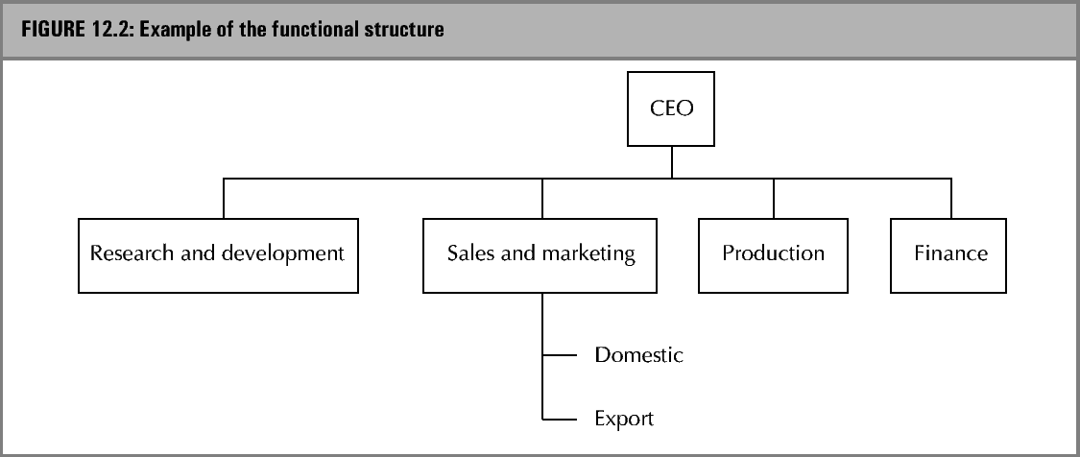
Organizational structures: Functional

Slide 26
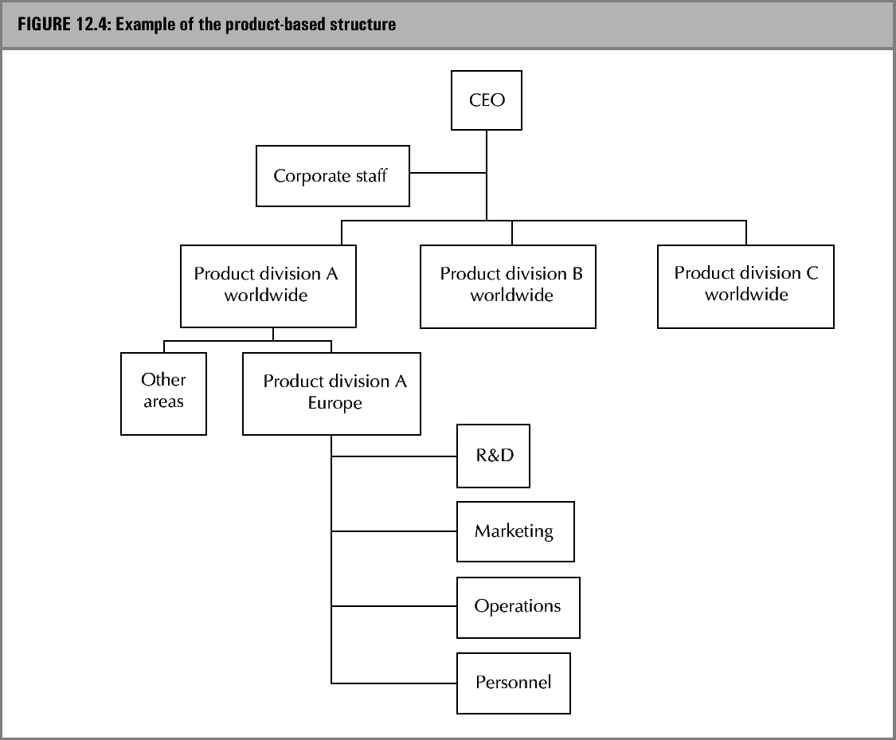
Organizational structures: Product

Slide 27
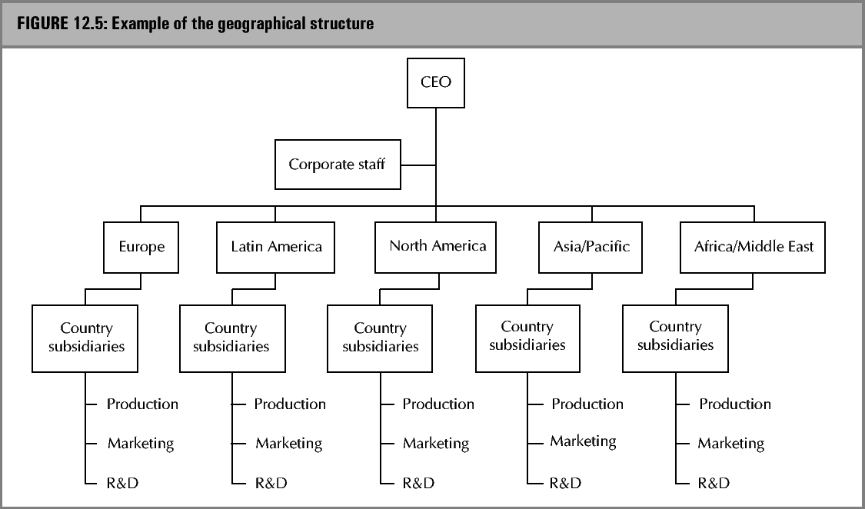
Organizational structures: Geographical

Slide 28
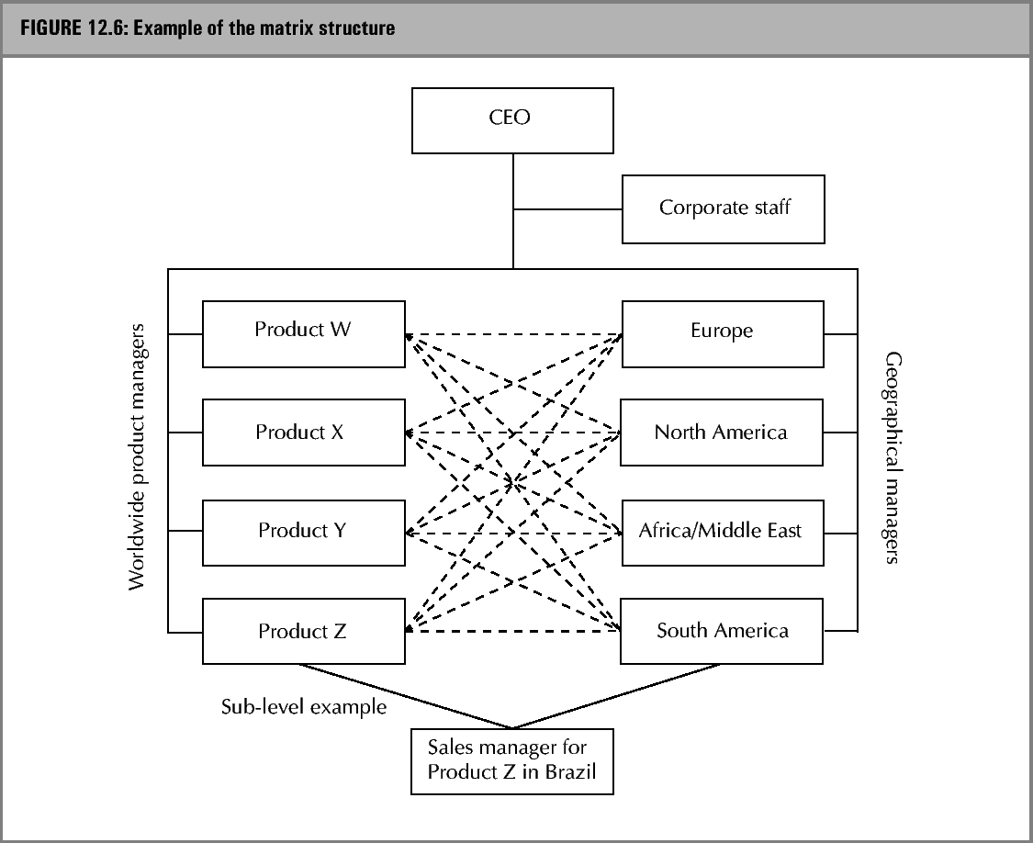
Organizational structures: Matrix

Slide 29
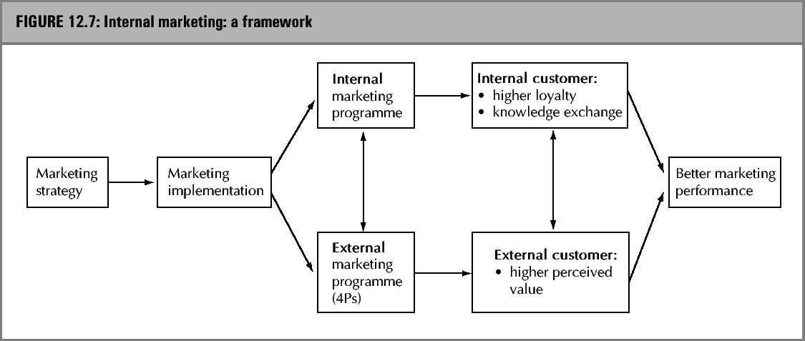
Internal marketing framework

