Slide 1
Topic 3
The Nervous System and Psychology

Slide 2
Why do psychologists study the brain and nervous system?

Slide 3
Neurons – Building a “Biocomputer”
Parts of Neuron
Neurons are the most basic elements of the nervous system, allow nerve impulse to pass from one part of the body to another.

Slide 4
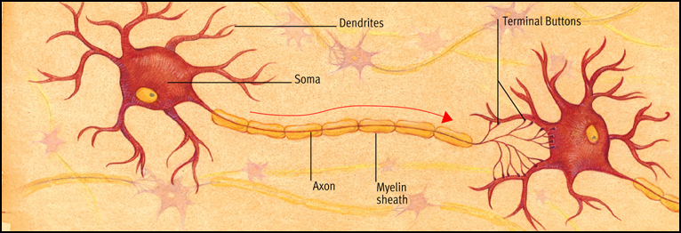
Figure 3.1
Structure of the neuron. Neurons are the communication links of the nervous system. This diagram highlights the key parts of a neuron, including specialized receptor areas (dendrites), the cell body (soma), the fiber along which impulses are transmitted (axon), and the junctions across which chemical messengers carry signals to other neurons (synapses). Neurons vary considerably in size and shape and are usually densely interconnected.

Slide 5
Neurons – Building a “Biocomputer”
The Nerve Impulse
How does the nervous system communicate electrical and chemical messages from one part to another?

Slide 6
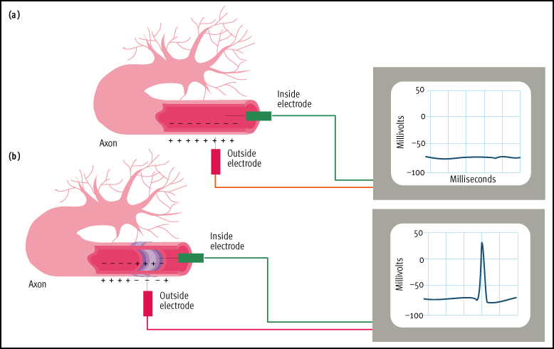
1. Communication inside the neuron
Figure 3.2 The neural impulse. The electrochemical properties of the neuron allow it to transmit signals. The electric charge of a neuron can be measured with a pair of electrodes connected to a device called an oscilloscope, as Hodgkin and Huxley showed with a squid axon. Because of its exceptionally thick axons, the squid has frequently been used by scientists studying the neural impulse. (a) At rest, the neuron is like a tiny wet battery with a resting potential of about –70 millivolts. (b) When a neuron is stimulated, a brief jump in its electric potential occurs, resulting in a spike on the oscilloscope recording of the neuron’s electrical activity. This change in voltage, called an action potential, travels along the axon like a spark traveling along a trail of gunpowder.

Slide 7
1. Communication inside the neuron (cont.)
A strong stimuli causes many more neurons to fire and to fire much more rapidly than a weak stimuli will.

Slide 8
Neurons – Building a “Biocomputer”
The Nerve Impulse (cont.)
2. Communication between the neurons
Synapses and Neurotransmitters

Slide 9
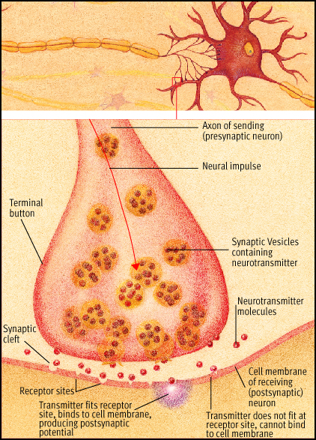
Figre 3.3
The synapse. When a neural impulse reaches an axon’s terminal buttons, it triggers the release of chemical messengers called neurotransmitters. The neurotransmitter molecules diffuse across the synaptic cleft and bind to receptor sites on the postsynaptic neuron. A specific neurotransmitter can bind only to receptor sites that its molecular structure will fit into, much like a key must fit a lock.

Slide 10
Neurons – Building a “Biocomputer”
Synapses and Neurotransmitters
There are more than 100 neurotransmitter chemicals found in the brain.
Slight variations in neurotransmitter function may relate to personality difference and too much or too little neurotransmitter can have serious consequence such as:
Excessive Dopamine may lead to schizophrenia.
Excessive Norepinephrine may lead to anxiety .

Slide 11
Neurons – Building a “Biocomputer”
Synapses and Neurotransmitters (cont.)
Deficient of Acetylcholine may lead to Alzheimer disease.
Deficient of Dopamine may lead to Parkinson’s disease, reduce feeling of pleasure.
Deficient of GABA or Serotonin will lead to anxiety and/or depression

Slide 12
The Nervous System -
Wired for Action
The Major Parts of the Nervous System

Slide 13
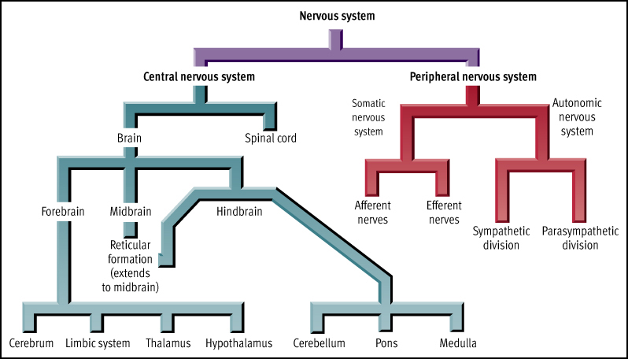
.

Slide 14
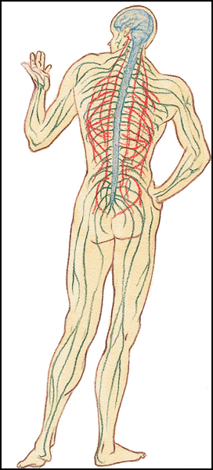
Figure 3.6
The central and peripheral nervous systems. The human nervous system is divided into the central nervous system, which consists of the brain and the spinal cord, and the peripheral nervous system, which consists of the remaining nerves that fan out throughout the body. The peripheral nervous system is divided into the somatic nervous system, shown in green, and the autonomic nervous system, shown in red.

Slide 15
Central nervous system (CNS) – brain and spinal cord

Slide 16
Peripheral nervous system nerves that lie outside the central nervous system
1. Somatic Nervous System
2. Autonomic Nervous System

Slide 17
Somatic nervous system voluntary muscles and sensory receptors
Afferent = toward the CNS
Efferent = away from the CNS

Slide 18
Autonomic nervous system (ANS)
– controls automatic, involuntary functions
  Sympathetic – Go (fight-or-flight)
  Parasympathetic – Stop

Slide 19
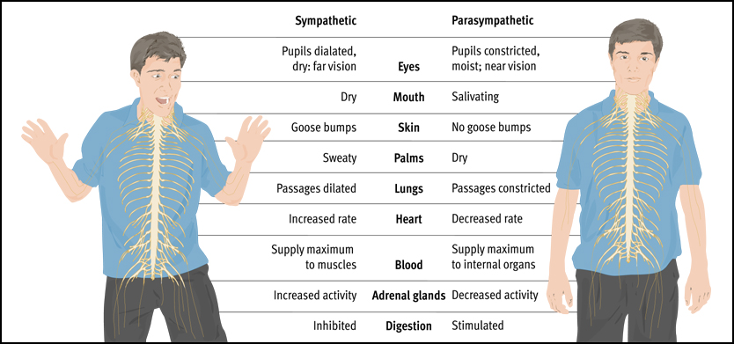

Slide 20
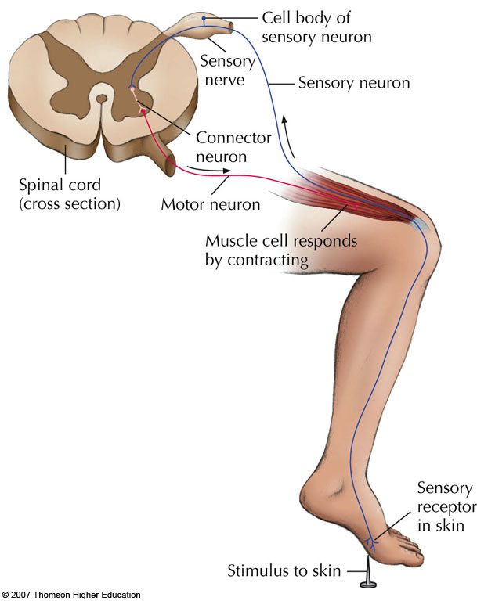

Slide 21
Research Methods – Charting the Brain’s Inner Realms
Exploring Brain Function
1. Damage studies
Lateral Hypothalamus (LH)
Ventromedial Hypothalamus (VH)
Amygdala
2. Electrical stimulation of the brain (ESB)
3. Brain imaging
  Computerized tomography (CT)
  Positron emission tomography (PET)
  Magnetic resonance imaging (MRI)

Slide 22
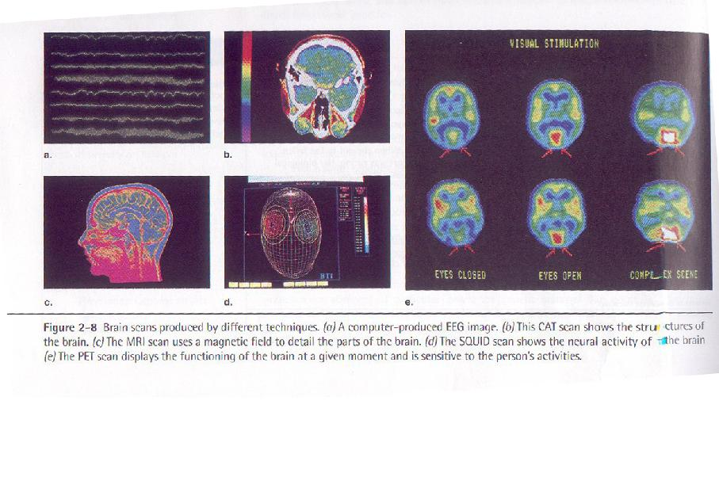

Slide 23
The Cerebral Cortex
Cerebral Hemisphere
Cerebral cortex
is the outer layer of the cerebrum.
Cerebrum is the largest and most complex portion of the human brain responsible for complex mental activities such as learning, remembering, thinking, and consciousness.
Cerebral cortex is composed of two sides, Cerebral Hemisphere

Slide 24
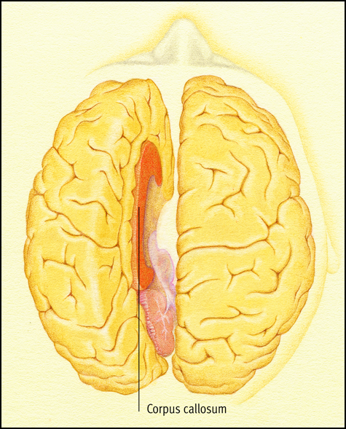
The Cerebral Hemispheres
Figure 3.14
The cerebral hemispheres and the corpus callosum. In this drawing the cerebral hemispheres have been “pulled apart” to reveal the corpus callosum. This band of fibers is the communication bridge between the right and left halves of the human brain

Slide 25
Cerebral Cortex (cont.)
Hemispheric Specialization
Are you a right brain or left brain person?

Slide 26
The Left and right hemisphere
A. Logical C. Manipulative-Spatial
B. Verbal D. Creative
Left Right
Left or right brain?
- Economist
- Teacher
- nurses

Slide 27
LEFT RIGHT
- more cheerful - more easily stressed
- sociable -upset
- self-confident - depressed
- more + thinking - suspicious
Right Brain/Left Brain: Cerebral Specialization
Two specialized halves connected by the corpus callosum

Slide 28
Cerebral Cortex (cont.)
  Hemispheric Specialization (cont.)
  Split-brain surgery
  Left hemisphere – verbal processing: language, speech, reading, writing, logical thinking
  Right hemisphere – nonverbal processing: creative, spatial, musical, visual recognition

Slide 29
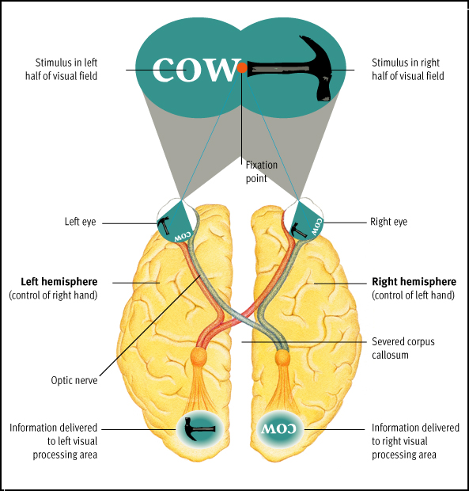
Visual input in the split brain. If a subject stares at a fixation point, the point divides the subject’s visual field into right and left halves. Input from the right visual field strikes the left side of each eye and is transmitted to the left hemisphere. Input from the left visual field strikes the right side of each eye and is transmitted to the right hemisphere. Normally, the hemispheres share the information from the two halves of the visual field, but in split-brain patients, the corpus callosum is severed, and the two hemispheres cannot communicate. Hence, the experimenter can present a visual stimulus to just one hemisphere at a time.

Slide 30
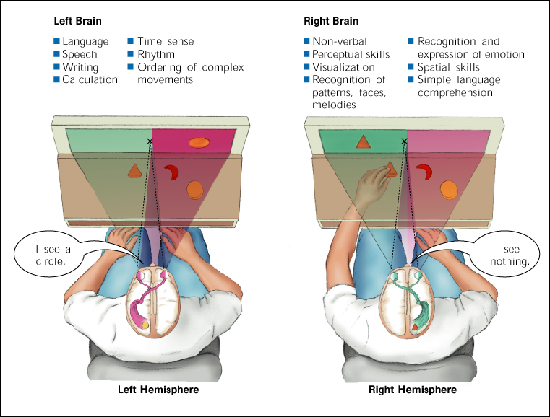

Slide 31
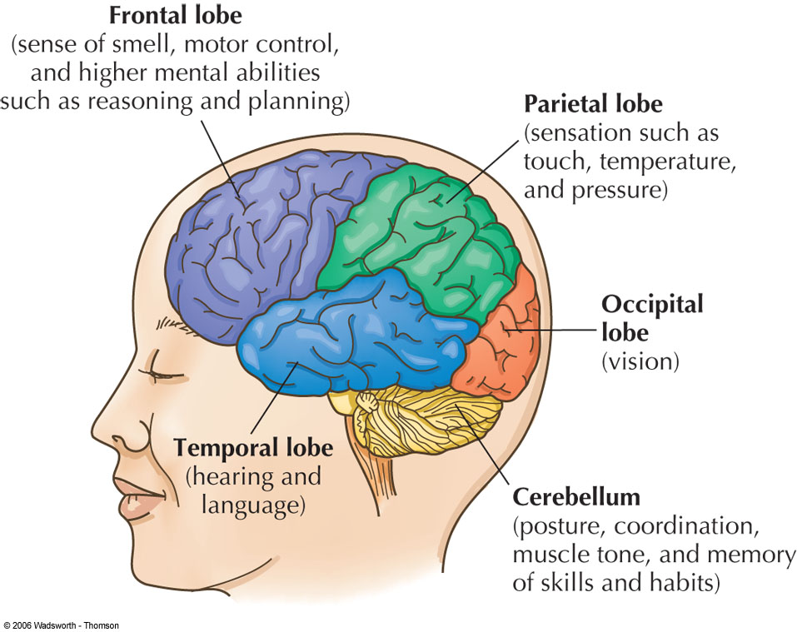
The Four Lobes of
cerebral cortex
Figure 2.23
Notes:
Figure 2.23

Slide 32
The Subcortex – At the Core of the (Brain) Matter
Three Major Parts of Subcortex
1. Hindbrain
2. Midbrain
3. Forebrain

Slide 33
Subcortex (conts.)
HINDBRAIN
Hindbrain is located at the lower end of the brain, where the spinal cord joins the brainstem.
1.1 Medulla is in charge of circulation, breathing, muscle tone, and regulating reflexes

Slide 34
Subcortex (conts.)
HINDBRAIN (cont.)
1.2 Pons is important in sleep and arousal
1.3 Cerebellum is critical in the coordination of movement and equilibrium, or physical balance.

Slide 35
Subcortex (conts.)
HINDBRAIN (cont)
1.4 The reticular formation
Lies inside medulla and brainstem
important in sleep and wakefulness, attention,as well as breathing, muscle reflexes, and pain perception.

Slide 36
Subcortex (cont.)
MIDBRAIN
Conduction and switching center
lies between the hindbrain and the forebrain
it is involved in sensory functions such as locating where things are in space.
contains structures which are important for voluntary movement (Parkinson’s disease is due to degeneration of the substantia nigra, a structure in the midbrain).

Slide 37
The Subcortex (cont.)
FOREBRAIN
the largest and most complex region of the brain
3.1 Thalamus –the relay station for all incoming sensory information before it is passed on to appropriate higher brain regions

Slide 38
The Subcortex (cont.)
FOREBRAIN
3.2 Hypothalamus
– the regulator of basic biological needs…the four F’s – fighting, feeding, fleeing, and mating

Slide 39
The Subcortex (cont.)
FOREBRAIN
3.3 Limbic system
– a loosely connected network of structures involved in emotion, motivation, memory, and other aspects of behavior.
- The limbic system composes of parts of thalamus, amygdala, hippocampus, and other structures.

Slide 40
Endocrine System – My Hormones Made Me Do It
Endocrine System
Glands that secrete hormones directly into blood stream.

Slide 41
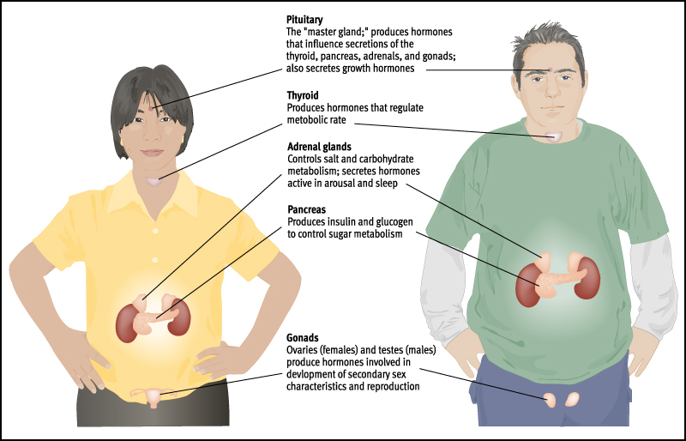
The Endocrine System
Figure 3.18
The endocrine system. The endocrine glands secrete hormones into the bloodstream. These hormones regulate physical functions and may affect behavior.

Slide 42
Reading Assignment
Psychology in Action: Handedness –
Are You Sinister or Dexterous? p. 65 – 67.

