Slide 1
Personality
PY211/ PY200 General Psychology

Slide 2
Outlines
How do psychologists define and use the concept of personality?
  Psychodynamic approach
  Trait approach
  Behaviourism
  Humanistic approach

Slide 3
Personality
Personality is
  the pattern of thoughts, feelings, and behaviours
  that persist over time and
  that distinguish one person from another

Slide 4
Introduction
Psychodynamic approaches to personality: Assume that personality is primarily unconscious
  Motivated by inner forces and conflicts about which people have little awareness
  Unconscious forces act as determinants of personality
  Drives: instinctual wishes, desires, demands, and needs hidden from awareness because of the conflict and pain they would cause

Slide 5
Freud’s Psychoanalytic Theory
Instincts
  Life instinct
    Serve survival, oriented toward growth and development
    Libido
    Sex – primary motivator
  Death instinct
    Unconscious wish to die
    Aggression

Slide 6
Freud’s Psychoanalytic Theory
3 Levels of Consciousness
  Conscious
  Preconscious: non-threatening material that is easily brought to mind
  Unconscious: Part of the personality that contains the memories, knowledge, beliefs, feelings, urges, drives, and instincts of which the individual is not aware

Slide 7
Freud’s Psychoanalytic Theory
Structure of personality: Id, ego, & superego
  Id
    instinctual, unorganized, inborn part of personality
    Sole purpose is to reduce tension created by primitive drives related to hunger, sex, aggression, and irrational impulses
    Pleasure principle

Slide 8
Freud’s Psychoanalytic Theory
  Ego
    Part of the personality that provides a buffer between the id and the realities of the objective, outside world
    Reality principle
    Executive of personality

Slide 9
Freud’s Psychoanalytic Theory
  Superego
    Personality structure that harshly judges the morality of our behavior
    Includes the conscience, which prevents us from behaving in a morally improper way
      Makes us feel guilty if we do wrong

Slide 10
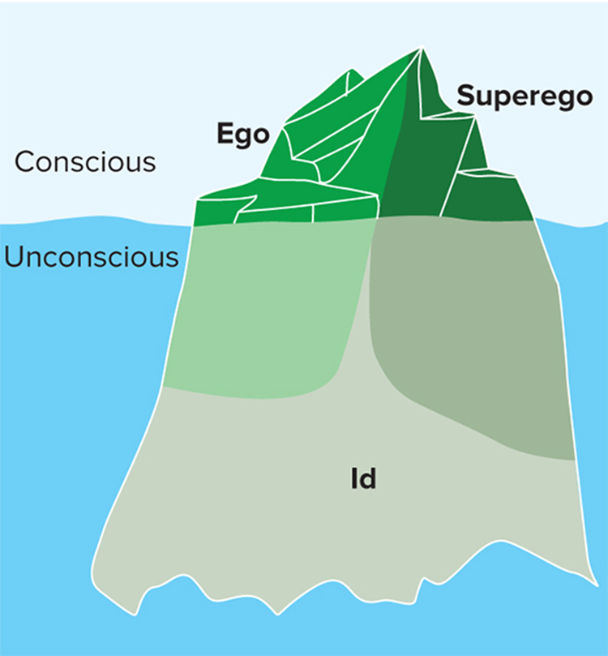
Figure 1: Iceberg Analogy

Slide 11
Freud’s Psychoanalytic Theory
Defense mechanisms
Unconscious strategies that people use to reduce anxiety
distorting reality and concealing the source of the anxiety from themselves

Slide 12
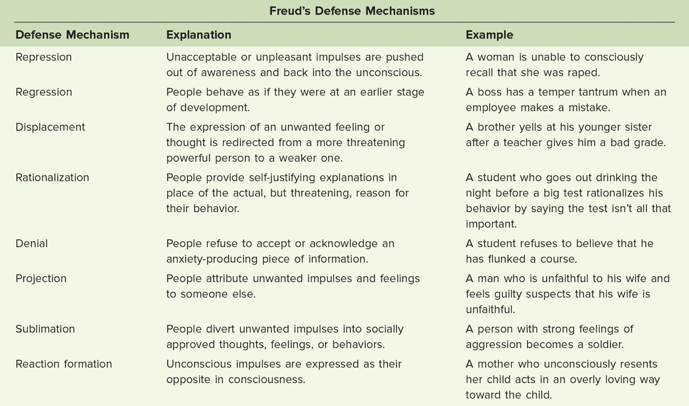

Slide 13
Freud’s Psychoanalytic Theory
Developing personality: Psychosexual stages
  Developmental periods that children pass through during which they encounter conflicts between the demands of society and their own sexual urges
  Erogenous zones
  Fixations: Concerns or conflicts that persist beyond the developmental period in which they first occur
    Too much or too little gratification

Slide 14
Freud’s Psychoanalytic Theory
Oral stage (0-1)
Anal stage (1-3)
Phallic stage (3-5)
  Oedipal conflict: Child’s sexual interest in his or her opposite-sex parent, typically resolved through identification with the same-sex parent
  Identification: Process of wanting to be like another person
  Imitating that person’s behavior and adopting similar beliefs and values
Latency stage (5- puberty)
Genital stage (puberty ++)

Slide 15
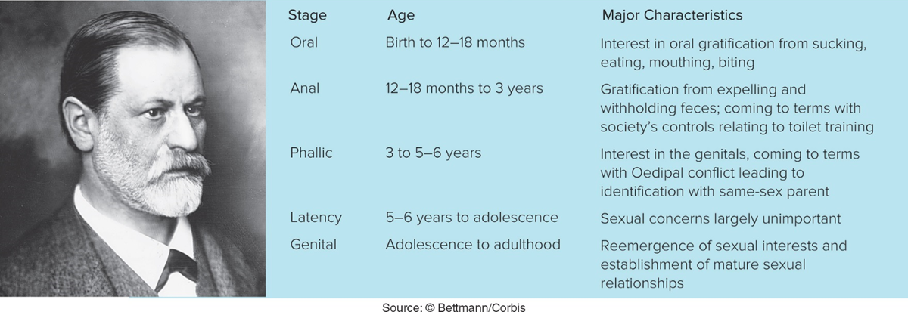
Figure 2: Psychosexual Stages

Slide 16
Neo-Freudian Psychoanalysts
Carl Jung, Karen Horney, Alfred Adler

Slide 17
Carl Jung
Jung’s collective unconscious: Inherited set of ideas, feelings, images, and symbols that are shared with all humans because of our common ancestral past
Contains archetypes
  Archetypes: Universal symbolic representations of particular types of people, objects, ideas, or experiences

Slide 18
Karen Horney
Suggested that personality develops in the context of social relationships
    Depends on the relationship between parents and child
    Rejected Freud’s notion of penis envy in women
  Stressed the importance of cultural factors in the determination of personality
  Basic Anxiety and Neurotic needs

Slide 19
Alfred Adler
Adler proposed that the primary human motivation is striving for superiority in a quest for self-improvement and perfection
Inferiority feeling
Creative self
Style of life
Inferiority complex – Describes adults who have not been able to overcome the feelings of inadequacy they developed as children

Slide 20
Trait Approach

Slide 21
Trait Approaches
Trait theory: Model of personality that seeks to identify the basic traits necessary to describe personality
Traits: Consistent, habitual personality characteristics and behaviors displayed across different situations

Slide 22
Allport’s Trait Theory
Cardinal trait
  Single characteristic that directs most of a person’s activities (ruling passion)
Central trait – honesty and sociability
  Major characteristics of an individual
Secondary trait
  Affect behavior in fewer situations
  preferences

Slide 23
Cattell: Factoring Out Personality
Factor analysis - Statistical method of identifying patterns among a large number of variables
  Factors - Fundamental patterns of traits that are found together in the same person
Cattell
  Suggested that 16 pairs of traits represent the basic dimensions of personality
  Developed the Sixteen Personality Factor Questionnaire (16PF)

Slide 24
Eysenck: Factoring Out Personality
Three major dimensions
Extraversion
  Describes level of sociability
  Sociable and outgoing and readily connect with others
  Need to be alone, limited social interaction with others
Neuroticism
  Encompasses emotional stability
  Anxious, overactive sympathetic nervous system
Psychoticism
  Independent thinkers, cold, nonconformist, impulsive, antisocial, and hostile
  High impulse control—they are more altruistic, empathetic, cooperative, and conventional

Slide 25
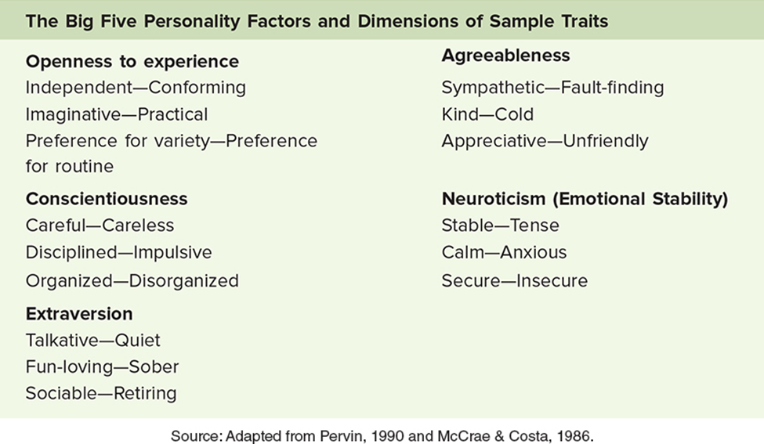
Big Five Personality Traits

Slide 26
Behavioural Approach

Slide 27
Learning Approaches
B. F. Skinner’s behaviorist approach
  Personality is a collection of learned behavior patterns
  Humans are infinitely changeable through the process of learning new behavior patterns

Slide 28
Learning Approaches: We are What We’ve Learned
Social cognitive approaches
  Theories that emphasize the influence of a person’s cognitions and observation of others’ behavior, in determining personality
  Self-efficacy: Belief that we can master a situation and produce positive outcomes

Slide 29
Learning Approaches
How much consistency exists in personality?
Walter Mischel
  Views personality as variable from one situation to another
  Situationism – View that personality cannot be considered without taking the particular context of the situation into account
  Cognitive-affective processing system theory (CAPS)
    People’s thoughts and emotions about themselves and the world determine how they view, and then react, in situations
Notes:
Cognitive-affective theorists argue that behavior is not the result of some global personality trait; instead, it arises from individual's perceptions of themself in a particular situation. However, inconsistencies in behavior are not due solely to the situation; inconsistent behaviors reflect stable patterns of variation within the person. These stable variations in behavior present themselves in the following framework: If A, then X; but if B, then Y. People's pattern of variability is the behavioral signature of their personality, or their stable pattern of behaving differently in various situations. According to this model, personality depends on situation variables, and consists of cognitive-affective units (all those psychological, social, and physiological aspects of people that allow them to interact with their environment in a relatively stable manner).

Slide 30
Biological and Evolutionary Approaches: Are We Born with Personality?
  Temperament: Individual’s behavioral style and characteristic way of responding that emerges early in life
Genes are found to be linked to specific personality characteristics
  Adopted children more similar to biological parents than adopted parents
  Identical twin studies: identical twins raised apart show marked similarities in personality
  But cannot be viewed as the sole cause of personality

Slide 31
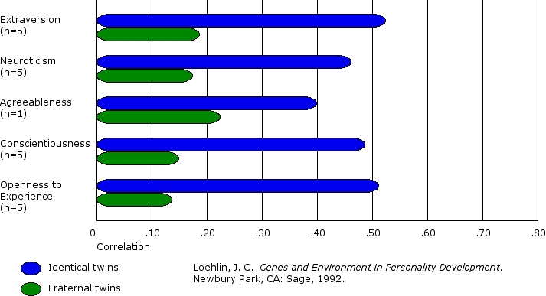

Slide 32
Humanistic Approach

Slide 33
Humanistic Approaches
Emphasise people’s innate goodness and desire to achieve higher levels of functioning
Rogers and the need for self-actualization
  Self-actualization: State of self-fulfillment in which people realize their highest potential, each in a unique way
    Self-concepts: Set of beliefs and perceptions people hold about their own abilities, behavior, and personality

Slide 34
Humanistic Approaches:
  Unconditional positive regard: Attitude of acceptance and respect on the part of an observer, no matter what a person says or does
  Conditional positive regard depends on one’s behavior

Slide 35
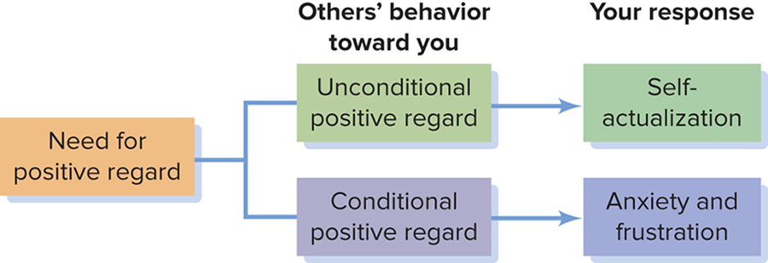
Humanistic View of Carl Rogers

Slide 36
Assessing Personality

Slide 37
Psychological Tests
Standard measures devised to assess behavior objectively
Used by psychologists to help people make decisions about their lives and understand more about themselves
  Reliability - Test’s measurement consistency
    A reliable test yields the same result each time it is administered to a specific person
  Validity - When a test measures what it is designed to measure

Slide 38
Self-Report Measures of Personality
Method of gathering data about people by asking them questions about their own behavior and traits
Minnesota Multiphasic Personality Inventory-2-Restructured Form (MMPI-2-RF )
  Identifies people with psychological difficulties
  Employed to predict some everyday behaviors
Test standardization
  Criterion Keying - Technique used to validate questions in personality tests by studying the responses of people with known diagnoses

Slide 39
Projective Methods
Projective personality test: A test in which a person is shown an ambiguous, vague stimulus and asked to describe it or tell a story about it
  Rorschach test: Involves showing a series of symmetrical visual stimuli to people who then are asked what the figures represent to them
  Thematic Apperception Test (TAT): Consists of a series of pictures about which a person is asked to write a story

Slide 40
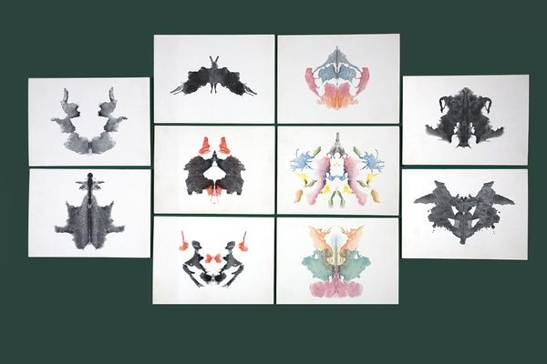

Slide 41
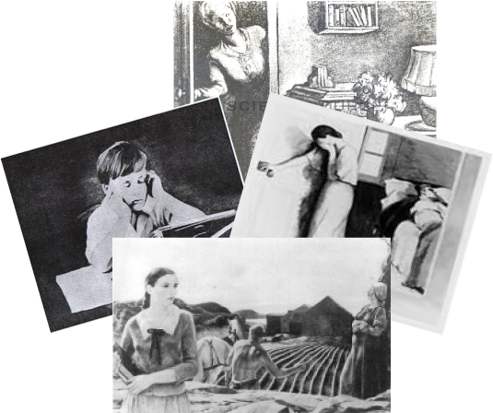

Slide 42
Behavioral Assessment
Direct measures of an individual’s behavior used to describe personality characteristics
Appropriate for observing and eventually remedying specific behavioral difficulties
  Shyness in children

