Slide 1

INTEGRATED BRAND COMMUNICATION
Massimiliano La Franca
Lesson 3
YAWP

Slide 2
Recap from last lesson
Marketing process:
  Opportunity
  Target market
  Marketing mix dev
Agencies: who does what

Slide 3
Influencing decisions through communication

Slide 4
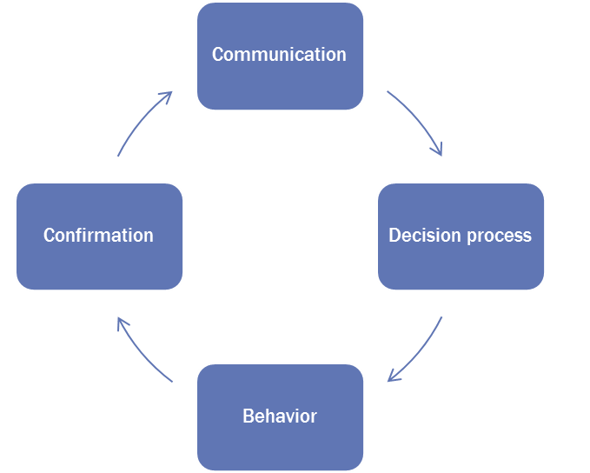
How does it work?
Communication is a tool that attempts to influence people’s behaviors
Behavior:
  is the total collection of actions and reactions exhibited by a person that can be measured objectively (ex. Purchasing, consumption behaviors)
  the consequence of a conscious or unconscious decision (ex. I need to by a new toothbrush)
  Influenced by attitudes but different as it is clearly visible
  Influence the decision process to influence behaviors

Slide 5
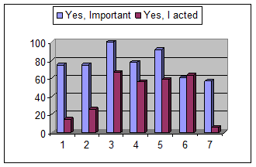
why so much on behaviors…
There’s a gap between what we say and what we do. What we do is the only thing we can actually see and influence
However in order to influence we need to know what’s the decision process that leads to this behavior and what attitudes influence our behaviors.
1. Students should read
2. Homelessness is a problem
3. I should exercise
4 I should recycle
5. I should designate a driver
6. I should vote
7. Should change strategy to fight terrorism

Slide 6
The decision-making process
Problem recognition
MOTIVATION
Alternative evaluation
ATTITUDE
Post-purchase evaluation
Information search
PERCEPTION
Purchase decision
AKA: path to purchase
Notes:
A tool to simplfy the decision making process in people mind. Being a mind-process, it involves a series of psychological processes that are behind each stage
Sowe will look at each one of those in details

Slide 7
The decision-making process
Problem recognition
MOTIVATION
Alternative evaluation
ATTITUDE
Post-purchase evaluation
Information search
PERCEPTION
Purchase decision
AKA: path to purchase
Notes:
A tool to simplfy the decision making process in people mind. Being a mind-process, it involves a series of psychological processes that are behind each stage
Sowe will look at each one of those in details

Slide 8
Problem recognition
Problem recognition
Alternative evaluation
Post-purchase evaluation
Information search
Purchase decision
When people realize a need
Different sources:
  Out of stock
  Dissatisfaction
  New needs because of changes in their conditions
  Marketing generated needs
  Curiosity vs new products
Marketing tries to influence this stage; in order to effectively do this, it needs to know people’s motivations.
IMPLICATION: If we know what the underlying reason for a specific purchase we can develop the right tools to influence the decision process

Slide 9
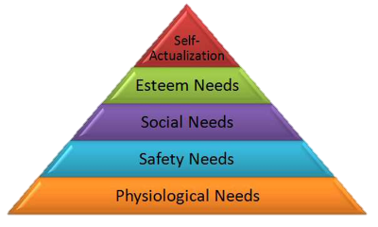
Motivations
Problem recognition
Alternative evaluation
Post-purchase evaluation
Information search
Purchase decision
From Latin “movere” what moves you taking a specific decision. Different people are motivated differently in solving the same problem (ex. Buying a car)
The most famous framework is Maslow’s Hierarchy of needs
We all have different needs according to the situations we live in; until the basic needs are satisfied the others are less relevant
IMPLICATIONS for mktg
  For existing product it forces to think of what is the key needstate of a specific target group, this way mktg can be focused on communicating the relevant messages: (VOLVO – BMW)
  For new products it forces marketers to think, what need do we want to satisfy?

Slide 10

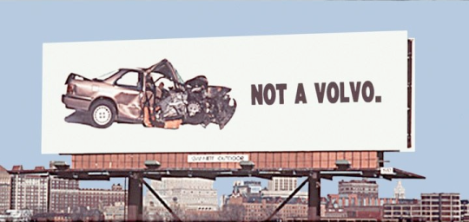


Slide 11





How do we learn about motivations
Problem recognition
Alternative evaluation
Post-purchase evaluation
Information search
Purchase decision
Marketing researches, mainly qualitative
In-depth interviews
Focus groups
Association tests
Projective techniques

Slide 12
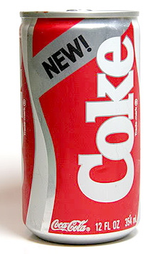
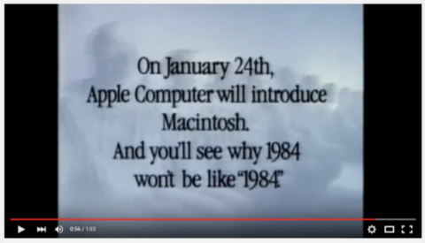
A very famous research flop…
https://www.youtube.com/watch?v=2zfqw8nhUwA

Slide 13
The decision-making process
Problem recognition
MOTIVATION
Alternative evaluation
ATTITUDE
Post-purchase evaluation
Information search
PERCEPTION
Purchase decision
AKA: path to purchase

Slide 14
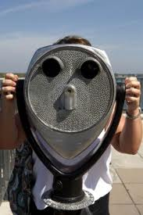
Information search
Problem recognition
Alternative evaluation
Post-purchase evaluation
Information search
Purchase decision
Once realised a need, we start searching for info on how to solve it
  Internal research: what do I know about it? Internal auto-pilot (Pack re-design cases Fruit d’or – Jif)
  External researches: the importance of the “influencers”, peers, public institutions and marketing activities
When it comes to information, it is crucial to understand: 1) how people sense external info; 2) how they select the relevant ones and 3) how they interpret info. This is the psychological process behind information: “perception”.

Slide 15

Selecting marketing information
We sense information, select, interpret and retain the relevant ones:
  We process info through sensation first; audio-visual is most important but increasing importance of sense-marketing (think perfumes section in Central)
  Select what we need and what we don’t
  Retain only what we need
IMPLICATION: how do you make yourself visible and relevant – the power of disrupting
Problem recognition
Alternative evaluation
Post-purchase evaluation
Information search
Purchase decision
Notes:
Exposed to 1500-4000 messages per day but only perceive about 80

Slide 16
A famous case study
Problem recognition
Alternative evaluation
Post-purchase evaluation
Information search
Purchase decision
Selective attention
https://www.youtube.com/watch?v=vJG698U2Mvo

Slide 17
Subliminal a tricky example
Problem recognition
Alternative evaluation
Post-purchase evaluation
Information search
Purchase decision
US elections: republicans AD that projects the word RATS when presenting the program of opponent democrats
https://www.youtube.com/watch?v=2NPKxhfFQMs

Slide 18
A cool one
Problem recognition
Alternative evaluation
Post-purchase evaluation
Information search
Purchase decision
BMW flashes logo
https://www.youtube.com/watch?v=GR_vDq2iXJ4

Slide 19
The decision-making process
Problem recognition
MOTIVATION
Alternative evaluation
ATTITUDE
Post-purchase evaluation
Information search
PERCEPTION
Purchase decision
AKA: path to purchase

Slide 20
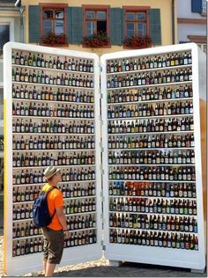
Alternative evaluation
Problem recognition
Alternative evaluation
Post-purchase evaluation
Information search
Purchase decision
Ok, I know what I need and I have gathered some info…what’s available?
  Reduce complexity, remember a small number
  Top-of-mind brands: the set of brands that spontaneously come to mind in a specific category
Ok I know the brands, how do I choose?
  Attitudes towards a brand
  Product benefits (rational – emotional)
  Availability
  Price
Attitude the psychological process
Notes:
Attitude: A learned predisposition towards something or someone

Slide 21
The paradox of choice
Suggested book - Berry Schwartz: the paradox of choice
https://www.youtube.com/watch?v=4matGzkYN0w
TED https://www.youtube.com/watch?v=VO6XEQIsCoM

Slide 22
The decision-making process
Problem recognition
MOTIVATION
Alternative evaluation
ATTITUDE
Post-purchase evaluation
Information search
PERCEPTION
Purchase decision
AKA: path to purchase

Slide 23

Purchase decision
Yep, we’re finally there, we have:
  influenced their needstate
  passed through the gates of their selective attention
  influenced their attitudes towards the brand
  Created “purchase intention”
Now it’s time to buy…but things can still go wrong; for purchase to happen there’s a need to match intent with the characteristics of the brand we selected at right time in the right place (i.e. what happens on the point of purchase - supermarket, car salon..?)

Slide 24
The decision-making process
Problem recognition
MOTIVATION
Alternative evaluation
ATTITUDE
Post-purchase evaluation
Information search
PERCEPTION
Purchase decision
AKA: path to purchase

Slide 25
Post-purchase evaluation
learning process which helps people adjusting their behaviors over time
Fundamental to build “loyalty” expressed as both:
  FREQUENCY: How many times consumers choose my brand when they shop the category (ex. Dove – shampoo)
  PRECENTAGE: % of volumes of a specific brand that the same consumer buy in a specific category
This stage is often neglected by FMCG marketers but is getting more and more crucial through of social media (Social search – google plus your world)

Slide 26
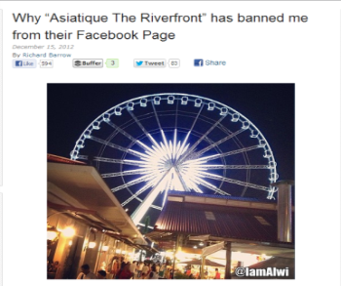
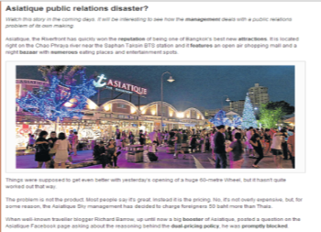
Asiatique PR disaster
Asiatique launches their new attraction: the wheel. They decide to double price charging farangs 50baht more and announce it on their FB page.
A famous travel blogger, Richard Barrow, posts a question on why they decide to double charge. As response the social media manager (!) deletes the post and bans him from their FB page.
The blogger reports this on his blog, twitter and FB. Thousands of people start posting on Asiatique FB page shouting against the discriminating policy, bombarding with complaints and calls for a boycott.
Asiatique FB page is now active after months of being shot down.
http://www.richardbarrow.com/2012/12/why-asiatique-the-riverfront-has-banned-me-from-their-facebook-page/
http://www.bangkokpost.com/learning/easier-stuff/326441/asiatique-public-relations-disaster

Slide 27
United breaks guitars
https://www.youtube.com/watch?v=5YGc4zOqozo

Slide 28
Decision process - Path to purchase:
Summary and learning points

Slide 29
Problem recognition
Alternative evaluation
Post-purchase evaluation
Information search
Purchase decision
Decision making process – path to purchase: it is fundamental to understand how people take decision in order to develop the best IMC plan to influence them
5 main stages; in each phase consumers are influenced by many factors as their beliefs, friends, opinion leaders, media…in different ways
Our brains filters out things that are not relevant, “stand out” is important as much as communicating in the right channels
This tool it is a simplification of reality to help developing strategies, not reality itself

Slide 30
WHY is this so relevant?
Once we have laid down the process we will be able to answer critical questions that allow us to focus all the marketing activities.
In specific: How important is this stage? How relevant is for the purchase decision?
Is this stage an opportunity to bring people in or a risk of losing them?
Problem recognition
Alternative evaluation
Post-purchase evaluation
Information search
Purchase decision
Who does influence each of those stages? Friends, family, advertisers, officials, government… Can we influence them? How? What are the best channels we can use?

Slide 31
1. Realization
I need an hotel
2. Search and confirmation
Ask friends, check offers and compare prices
3. Booking
I’ve decided
4. Experience and Post- experience
1. Improve Awareness
2. Stimulate the need and make clear what is IBIS offer
3. Creative use of channels (integrated communication)
1. Word of Mouth is crucial.
2. Online aggressive comms & price promotions
3. Build on great current IBIS work on customer relation online
Ensure smooth booking process
Careful management of WOM: emphasize positive comments and neutralize negatives
Online: blogs, social network
Data: Quant Research for IBIS Inspire Research
Notes:
- Internet transactions in Thailand: Accommodation was the major source of income through Internet transactions. Flight only was the second most popular reason to go online
- Booking process: The technology of online booking in Thailand is up to date and customers are able to get instant
confirmation after making a room booking. The most important thing for Internet booking services are
accuracy and speed. It is necessary for hotels to check up all inquiries every minute. If they provide
impressive services, hotels establish credibility and create loyalty amongst customers who will reward the
hotels by becoming regular visitors

Slide 32
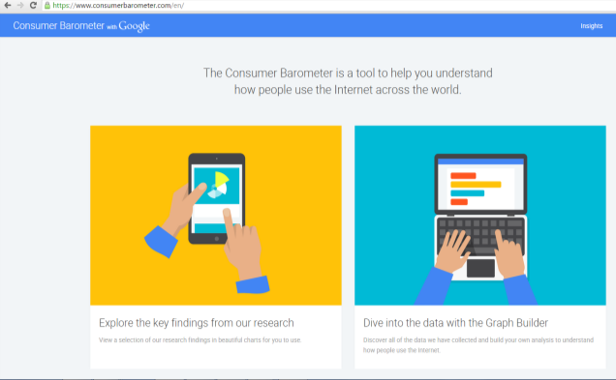
A great online tool
An online tool that allows you to define the path to purchase of selected categories of product.
It contains data coming from a research done in most of the countries in the world.

Slide 33
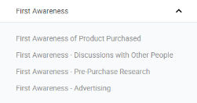
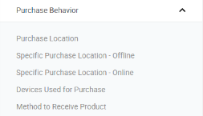

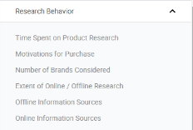
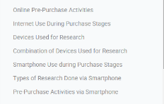
How to use it?
Problem recognition
Alternative evaluation
Post-purchase evaluation
Information search
Purchase decision

Slide 34
Your time to work…EXERCISE
Exercise: divide in group and use consumer barometer to define the path to purchase for a specific target in a specific category
  GROUP 1: couple selecting a restaurant
  GROUP 2: couple selecting airline to buy to travel to London
  GROUP 3: first jobber deciding to buy a haircare product
  GROUP 4: girl buying her first expensive make up
Output: 1 flowchart describing the whole process.
  What happens at each stage?
  What are the most important channels per each stage?
  Who and what will influence decision and in what channel
  You have to allocate your budget, at what stage do you invest and why (think % of budget)?
45 mins to discuss in the group – each group presents back to class for discussion 5 min

Slide 35
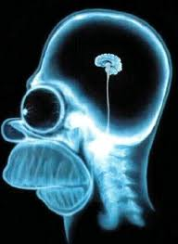
Last, watch out…we’re not rational

Slide 36

How does our brain take decisions?
Plato theory: 2 horses, one rational to let run and the other emotional to tame
Neurologists have shown that we need both the left (rational) and right (emotional) side of the brain to take any decision
We feel like a choice is the right one it is because our mind is telling so
A constant battle at emotional level happens between positive and negative emotions in different parts of our brain; the one which wins determines the decision

Slide 37
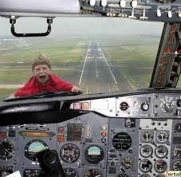
What’s the implication?
There’s no such a thing as rational consumers
People don’t take decisions on the basis of rational information only
That’s why you can’t convince someone who’s scared to flight through data only…

