Slide 1
Globalization & the Multinational Firm
Chapter One
Notes:
Chapter Objectives:
Understand why it is important to study international finance.
Distinguish international finance from domestic finance.

Slide 2
Chapter One Outline
What’s Special about “International” Finance?
Goals for International Financial Management
Globalization of the World Economy
Multinational Corporations
Summary
1-2

Slide 3
What’s Special about “International” Finance?
Foreign Exchange Risk and Political Risks
Market Imperfections
Expanded Opportunity Set
1-3

Slide 4


What’s Special about “International” Finance: Foreign Exchange Risk
Foreign Exchange Risk
  This is risk that foreign currency profits may evaporate in local currency terms due to unanticipated unfavorable exchange rate movements.
  Suppose $1 = ¥100 and you buy 10 shares of Toyota at ¥10,000 per share. (cost USD1,000)
  When you sell the shares, the investment is worth ten percent more in yen: ¥110,000.
  But, if the yen has depreciated to $1 = ¥120, your investment has actually lost money in U.S. dollar terms:
USD cost of shares
USD value of shares at sale:
$$\$1,000=¥100,000×\frac{\$1}{¥100}$$
$$\$916.67=¥110,000×\frac{\$1}{¥120}$$
1-4
Notes:
At year-end, your $1,000 investment is only worth $916.67 = ¥110,000 × $1/¥120

Slide 5
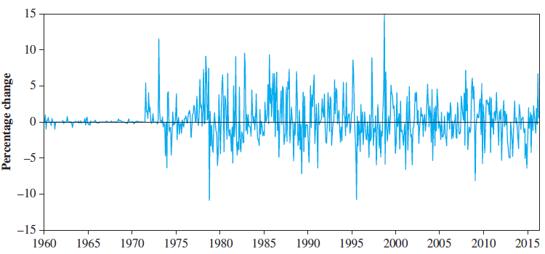
Exhibit 1.1: Monthly Percentage Change in Japanese Yen—U.S. Dollar Exchange Rate
1-5

Slide 6
What’s Special about “International” Finance: Political Risk
Political Risk
  Sovereign governments have the right to regulate the movement of goods, capital, and people across their borders. These laws sometimes change in unexpected ways.
1-6

Slide 7
What’s Special about “International” Finance: Market Imperfections
Market Imperfections
  Legal restrictions on the movement of goods, people, and money.
  Transactions costs
  Shipping costs
  Tax arbitrage
1-7

Slide 8
The Example of Nestlé’s Market Imperfection
Nestlé used to issue two different classes of common stock bearer shares and registered shares.
  Foreigners were only allowed to buy bearer shares.
  Swiss citizens could buy registered shares.
  The bearer stock was more expensive.
On November 18, 1988, Nestlé lifted restrictions imposed on foreigners, allowing them to hold registered shares as well as bearer shares.
1-8

Slide 9
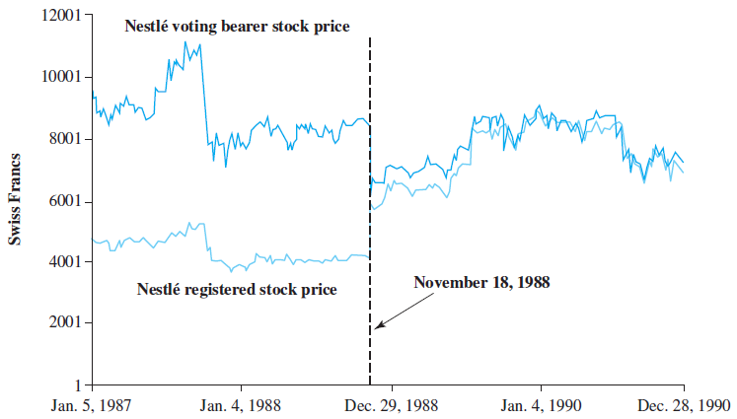
Exhibit 1.2 Daily Prices of Nestlé’s Bearer and Registered Shares
1-9

Slide 10
The Example of Nestlé’s Market Imperfection Concluded
Following this, the price spread between the two types of shares narrowed dramatically.
  This implies that there was a major transfer of wealth from foreign shareholders to Swiss shareholders.
Foreigners holding Nestlé bearer shares were exposed to political risk in a country that is widely viewed as a haven from such risk.
The Nestlé episode illustrates both the importance of considering market imperfections and the peril of political risk.
1-10
Notes:
The Bearer and Registered shares of Nestlé had the same claims on dividends but differential voting rights. Chapter 17 provides a detailed discussion of the Nestlé case.

Slide 11
What’s Special about “International” Finance: Expanded Opportunity Set
Expanded Opportunity Set
  It doesn’t make sense to play in only one corner of the sandbox.
  Firms can gain from greater economies of scale when their tangible and intangible assets are deployed on a global basis.
  True for corporations as well as individual investors.
1-11

Slide 12
Goals for International Financial Management
The focus of the text is to equip the reader with the “intellectual toolbox” of an effective global manager—but what goal should this effective global manager be working toward?
Maximization of shareholder wealth?
or
Other goals?
1-12

Slide 13
Maximization of Shareholder Wealth
Long accepted as a goal in the Anglo-Saxon countries, but complications arise.
  Who are and where are the shareholders?
  In what currency should we maximize their wealth?
1-13

Slide 14
Other Goals: Stakeholders
In other countries shareholders are viewed as merely one among many “stakeholders” of the firm including:
  Employees
  Suppliers
  Customers
In Japan, managers have typically sought to maximize the value of the keiretsu—a family of firms to which the individual firms belongs.
1-14

Slide 15
Other Goals: Principal Agent Conflict
As shown by a series of recent corporate scandals at companies like Enron, WorldCom, and Global Crossing, managers may pursue their own private interests at the expense of shareholders when they are not closely monitored.
These calamities have painfully reinforced the importance of corporate governance, i.e., the financial and legal framework for regulating the relationship between a firm’s management and its shareholders.
1-15

Slide 16
Other Goals: Business Culture
These types of issues can be much more serious in many other parts of the world, especially emerging and transitional economies, such as Indonesia, Korea, and Russia, where legal protection of shareholders is weak or virtually non-existing.
No matter what the other goals, they cannot be achieved in the long term if the maximization of shareholder wealth is not given due consideration.
1-16

Slide 17
Globalization of the World Economy: Major Trends and Developments
Emergence of Globalized Financial Markets
Emergence of the Euro as a Global Currency
Europe’s Sovereign Debt Crisis of 2010
Trade Liberalization and Economic Integration
Privatization
Global Financial Crisis of 2008-2009
1-17

Slide 18
Emergence of Globalized Financial Markets
Deregulation of Financial Markets
coupled with
Advances in Technology
  have greatly reduced information and transaction costs, which has led to:
Financial Innovations, such as
  Currency futures and options
  Multi-currency bonds
  Cross-border stock listings
  International mutual funds
  Exchange-Traded Funds (ETFs)
1-18

Slide 19
Emergence of the Euro as a Global Currency
A momentous event in the history of world financial systems.
Currently more than 300 million Europeans in 19 countries are using the common currency on a daily basis.
  Austria, Belgium, Cyprus, Estonia, Finland, France, Germany, Greece, Ireland, Italy, Latvia, Lithuania, Luxembourg, Malta, the Netherlands, Portugal, Slovenia, Slovakia and Spain.
The “transaction domain” of the euro may become larger than the U.S. dollar’s in the near future.
1-19

Slide 20
Europe’s Sovereign-Debt Crisis of 2010
In December of 2009 the new Greek government revealed that its budget deficit for the year would be 12.7% of GDP, not the 3.7% forecast.
Investors sold off Greek government bonds and the ratings agencies downgraded them to “junk.”
While Greece represents only 2.5% of euro-zone GDP, the crisis became a Europe-wide debt crisis.
The challenge remains that fiscal indiscipline of one euro-zone country can escalate to a Europe-wide crisis.
1-20

Slide 21
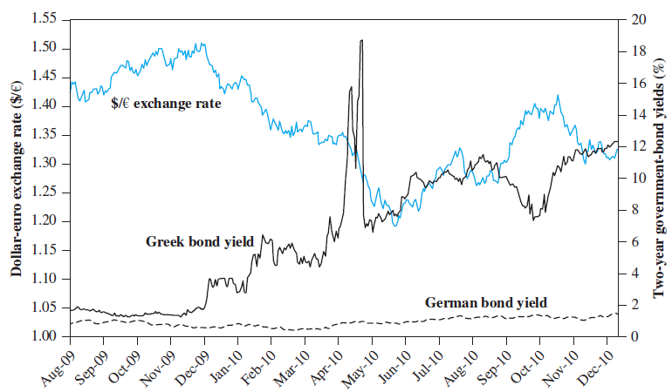
The Greek Drama
Greece paid no premium above the German rate until late fall 2009.
The Greek interest rate rose until the bailout package on May 9.
1-21

Slide 22
Trade Liberalization and Economic Integration
Over the past 50 years, international trade increased about twice as fast as world GDP.
There has been a change in the attitudes of many of the world’s governments, who have abandoned mercantilist views and embraced free trade as the surest route to prosperity for their citizenry.
The principal argument for international trade is based on the theory of comparative advantage.
1-22
Notes:
See the appendix to this chapter for a more complete discussion of the theory of comparative advantage.

Slide 23
Liberalization of Protectionist Legislation
The General Agreement on Tariffs and Trade (GATT) is a multilateral agreement among member countries that has reduced many barriers to trade.
The World Trade Organization has the power to enforce the rules of international trade.
On January 1, 2005, the era of quotas on imported textiles ended.
This is an event of historic proportions.
1-23

Slide 24
NAFTA
The North American Free Trade Agreement (NAFTA) called for phasing out impediments to trade between Canada, Mexico, and the United States over a 15-year period beginning in 1994. (Full implementation occurred in 2009.)
For Mexico, the ratio of export to GDP has increased dramatically from 2.2% in 1973 to 31.7% in 2011.
The increased trade has resulted in increased numbers of jobs and a higher standard of living for all member nations.
1-24

Slide 25
Brexit
The unexpected outcome of a British referendum held on June 23, 2016.
Britons voted to leave the EU.
Likely outcome is a weakening of both the United Kingdom and the European Union.
Brexit revealed some of the difficulties with free trade and global economic integration.
  The free movement of goods, capital and people leads to economic growth, but also leads to political opposition.
1-25

Slide 26
Privatization
The selling of state-run enterprises to investors is also known as “denationalization.”
Privatization is often seen in socialist economies in transition to market economies.
By most estimates, this increases the efficiency of the enterprise.
It also often spurs a tremendous increase in cross-border investment.
1-26

Slide 27
Chinese Privatization
State-owned enterprises have been listed on organized stock exchanges.
More than 1,500 companies are currently listed on China’s stock exchanges.
The Chinese government still retains the majority stakes in most public firms.
Chinese citizens can buy “A” shares, while foreigners are limited to “B” shares.
1-27

Slide 28
Global Financial Crisis of 2008—2009
The “Great Recession” was the most serious, synchronized economic downturn since the Great Depression of the 1930s.
Factors included:
  Households and financial institutions borrowed too much and took too much risk.
  This risk was repackaged with securitization, and so defaults on subprime mortgages in the U.S. came to threaten the solvency of a teacher’s retirement plans in Norway.
1-28

Slide 29
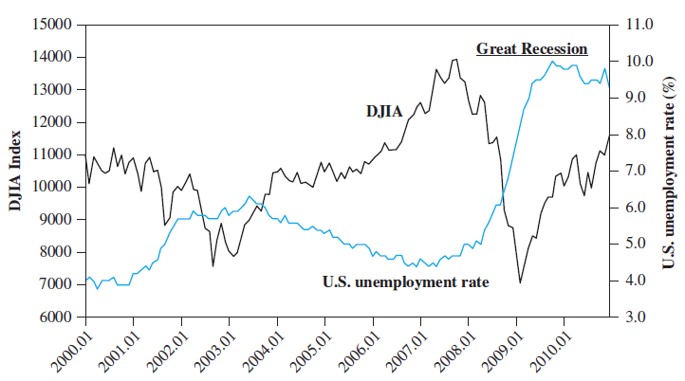
Exhibit 1.5: U.S. Unemployment Rate and Dow Jones Industrial Average
During the course of the crisis, the G-20 emerged as the premier forum for discussing international economic issues and coordinating financial regulations and macroeconomic policies
1-29

Slide 30
Multinational Corporations
A multinational corporation (MNC) is a firm that has been incorporated in one country and has production and sales operations in other countries.
There are about 60,000 MNCs in the world.
Many MNCs obtain raw materials from one nation, financial capital from another, produce goods with labor and capital equipment in a third country, and sell their output in various other national markets.
1-30

Slide 31
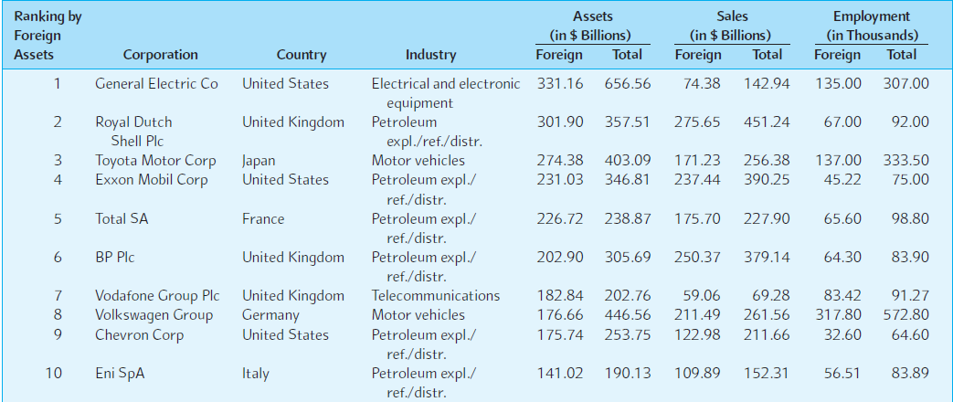
Exhibit 1.6: Top Nonfinancial MNCs
1-31

Slide 32
Summary
It is important to study international finance since we are living in a globalized and integrated world economy.
Three things distinguish international finance from domestic finance:
  Foreign Exchange and Political Risk
  Market Imperfections
  Expanded Opportunity Set
1-32

Slide 33
Summary (continued)
The theory of comparative advantage states that economic well-being is enhanced if countries produce goods and services for which they have a comparative advantage and trade for other goods.
The Global Financial Crisis of 2009 may be attributable to several factors:
  Excessive borrowing and risk taking
  Failure of government regulation
1-33

Slide 34
Summary (concluded)
Privatization has placed a new demand on international capital markets to finance former state enterprises.
Multinational corporations often produce merchandise in one country, obtain capital in another country, and sell the finished product to consumers all over the world.
1-34

Slide 35
The following slides cover the Appendix to Chapter 1.
1-35

Slide 36
The Theory of Comparative Advantage
A comparative advantage exists when one party can produce a good or service at a lower opportunity cost than another party.
The opportunity cost of making one additional unit of a good (or service) can be defined as the value of some other good that you have to give up in order to produce this additional unit.
  For example, if you can work as many hours as you like at your current employer and get paid $10 per hour, then the opportunity cost of your leisure is $10 per hour.
1-36

Slide 37
The Geometry of Comparative Advantage
Consider the example where there are two countries, A and B, who can each produce only food and textiles.
Initially they do not trade with one another.
The graph on the next slide shows the increase in consumption available to the citizens of countries A and B with trade arising from the differences in their opportunity costs of production.
1-37

Slide 38
The Geometry of Comparative Advantage
A production possibilities curve shows quantities of food or textiles each country can make.
Textiles
The production possibilities of Country A are such that if they concentrated 100% of their resources into the production of textiles, they could produce 180 million yards of textiles.
If Country A chose to concentrate 100% of their resources into the production of food, they could produce as much as 300 million pounds of food.
Country A can produce any combination of food and textiles between these two points.
As a practical matter, the citizens of Country A must choose a point along their production possibilities curve.
180
60
Suppose they initially choose 200m pounds of food and 60m yards of textiles.
Food
200
300
1-38

Slide 39
The Geometry of Comparative Advantage
If Country B chose to concentrate 100% of their resources into the production of textiles, they could produce 240 million yards of textiles.
Textiles
If Country B chose to concentrate 100% of their resources into the production of food, they could produce 900 million pounds of food.
The citizens of Country B must also choose a point along their production possibilities curve;
Initially they choose 600 million pounds of food, and 80 million yards of textiles.
240
180
80
60
Food
200
300
600
900
1,200
1-39

Slide 40
The Geometry of Comparative Advantage
Textiles
Put another way, country B enjoys a comparative advantage in food because they have to give up textiles at a lower rate than A when making more food.
Geometrically, a comparative advantage exists because the slopes of the production possibilities differ.
If the countries specialize according to their comparative advantage, then Country A should make textiles and trade for food, while Country B should grow food and trade for textiles.
Country A enjoys a comparative advantage in textiles because they have to give up food at a lower rate than B when making textiles.
240
180
80
60
Food
200
300
600
900
1-40

Slide 41
The Geometry of Comparative Advantage
Textiles
Without trade, if both countries make only food, the combined production would be 1,200 million pounds of food = 900 + 300.
420
The combined production possibilities curve of country A and B without trade are shown in the green line.
Before trade, combined consumption is 800 million lbs of food (= 200 + 600) and 140 million yards of textiles (= 60 + 80).
240
180
140
80
60
Food
200
300
600
800
900
1,200
Without trade, if both countries make only textiles, the combined production would be 420 million yards of textiles = 240 + 180.
1-41

Slide 42
The Geometry of Comparative Advantage
The production possibilities of country A are such that if they concentrated 100% of their resources into the production of textiles, they could produce 180 million yards of textiles.
Textiles
Textiles
Textiles
If country B chose to concentrate 100% of their resources into the production of food, they could produce 900 million pounds of food.
If country A chose to concentrate 100% of their resources into the production of food, they could produce as much as 300 million pounds of food.
Country A can produce textiles at a lower opportunity cost, so let them produce the first 180 million yards of textiles.
420
The combined production possibilities curve with trade is composed of the original curves joined as shown.
The citizens of country B must also choose a point along their production possibilities curve;
initially they choose 600 million pounds of food, and 80 million yards of textiles.
The gains from trade are shown by the increase in consumption available.
Country A can produce any combination of food and textiles between these two points.
240
240
180
180
180
140
As a practical matter, the citizens of country A must choose a point along their production possibilities curve
80
80
60
60
60
Food
Food
200
300
600
800
900
1,200
Food
200
300
200
300
Suppose that initially they choose 200 million pounds of food, and 60 million yards of textiles.
600
900
1,200
County B can produce food at a lower opportunity cost, so let B produce the first 900 million pounds of food.
1-42

Slide 43
Arguments in Favor of Free Trade
Both partners gain from trade; we have more material goods.
“Freedom” is a good thing in and of itself.
  In this case, consumers have the freedom to choose imported goods and producers have the freedom to choose to sell to foreigners.
1-43

