Slide 1
Health sector development
EE463 Globalization and international development
Faculty of economics
Thammasat university

Slide 2


What is health?
Health is a state of complete mental, physical, and social well-being and not merely the absence of disease (World Health Organization)
Measures of health
Mortality: deaths in a population
Morbidity: rates of disease and illness

Slide 3
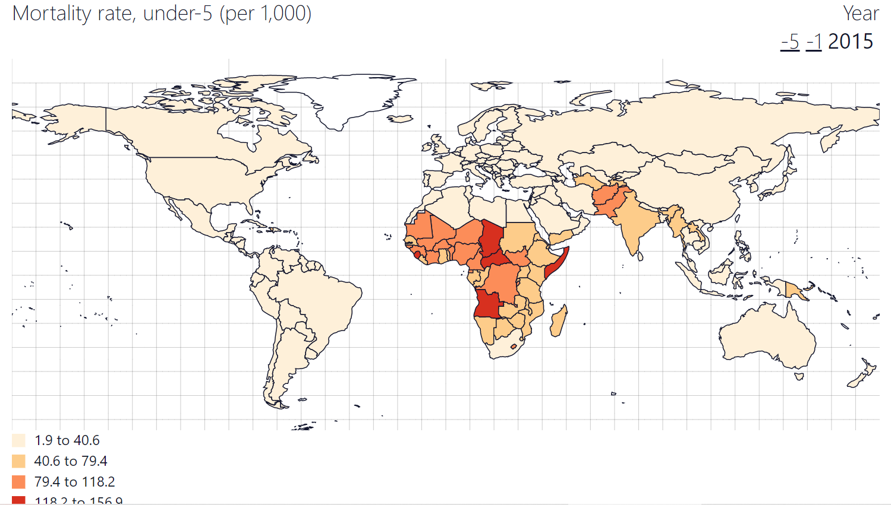
Under-5 mortality rate
Under-five mortality rate is the probability per 1,000 that a newborn baby will die before reaching age five, if subject to age-specific mortality rates of the specified year
MR is a good indicator of public health

Slide 4
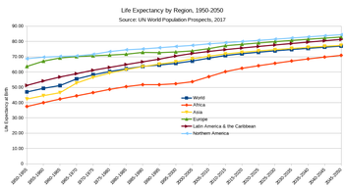
Life expectancy
Life expectancy: the number of years a person can expect to live. It is based on an estimate of the average age that members of a particular population group will be when they die.

Slide 5


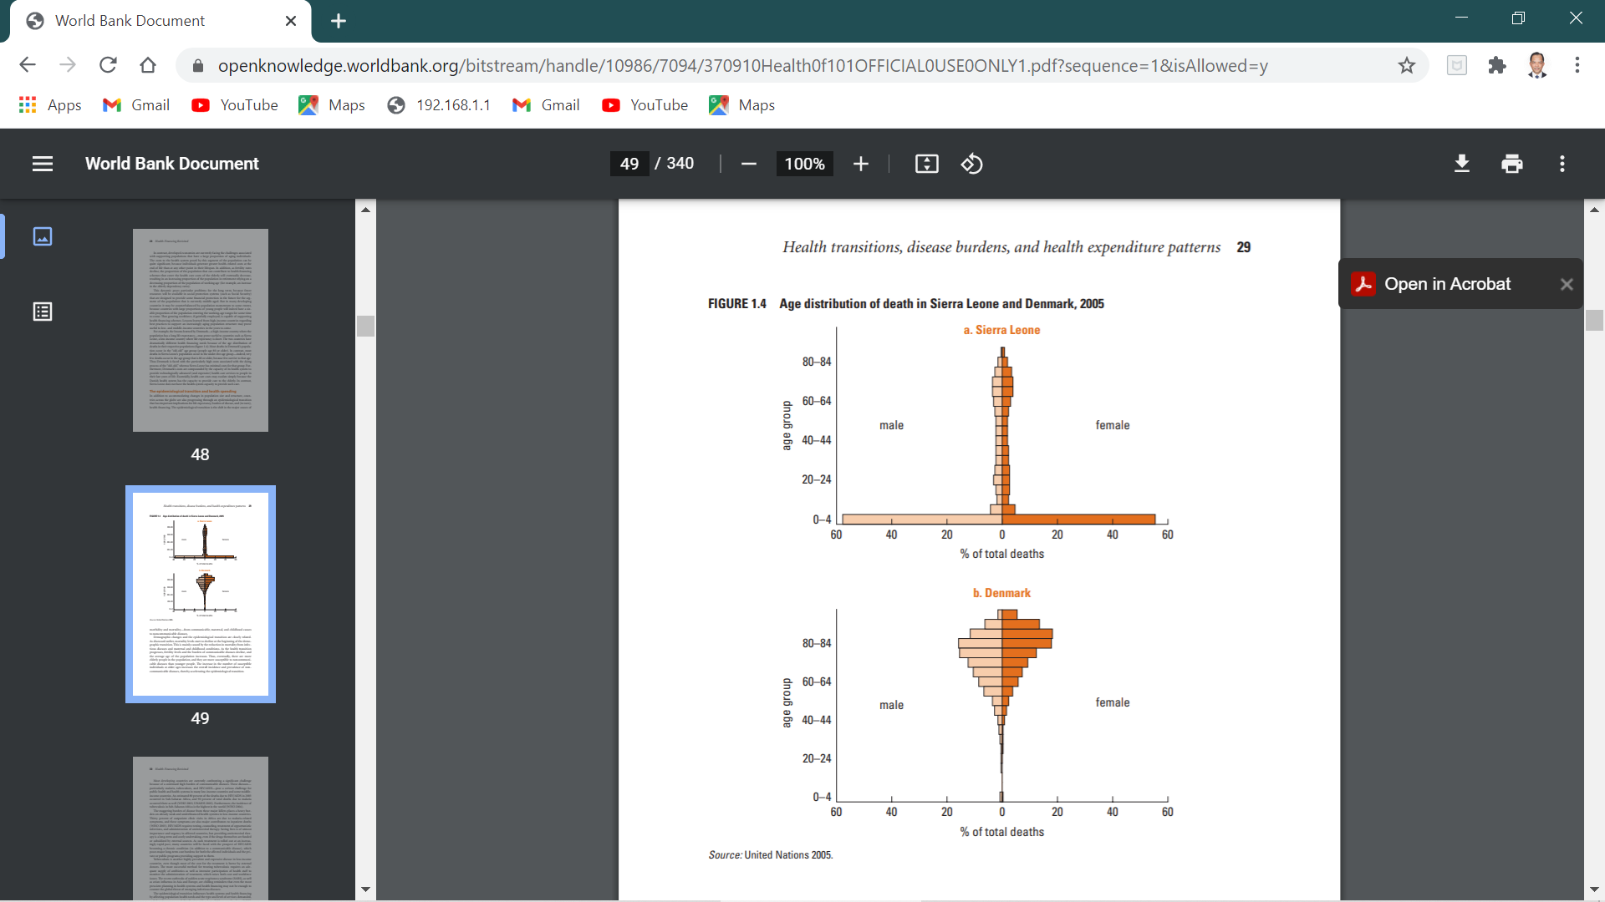
Two Countries, Contrasting statistics
Sierra Leone Denmark
Population Pyramid
Sierra Leone Denmark
Distribution of Age at Death

Slide 6
Two Countries, Contrasting statistics
Sierra Leone
Deaths occur in the first 4 years
Median age of death: 4 years old
Under-5 mortality rate: 269 deaths/1,000 births
Life expectancy: 40 years
Access to improved water sources: 83%
Per capita health expenditure: $41
Denmark
Child deaths rarely occur
Median age of death: 77 years old
Under-5 mortality rate: 4 deaths/1,000 births
Life expectancy: 79 years
Access to improved water sources: 100%
Per capita health expenditure: $3,349

Slide 7
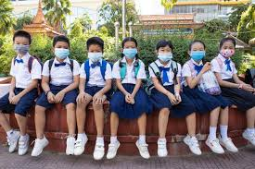
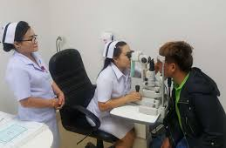
Transitions in global health
Remarkable improvements in health and life expectancy occurred from 1800s to 1960s
In 1800s, life expectancy at birth was 30 years; many people died in infancy or early childhood
From1960 to 2008, life expectancy worldwide increased from 50 to 69 years. For low income countries the increase was from 44 to 67 years
However HIV/AIDS decreased life expectancy in Africa. Other decline in life expectancy: Russia in 1990s (64 years to 58 years)

Slide 8
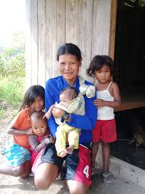
Epidemiologic transition
Dramatic improvements in life expectancy and reductions in infant and child mortality during the past century resulted in dramatic demographic and socioeconomic changes (e.g., lower fertility rates, decline in death rates and slower rates of population growth)
As societies age and health improves the pattern of disease and causes of death shift in a predictable pattern.

Slide 9
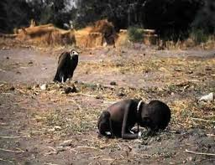
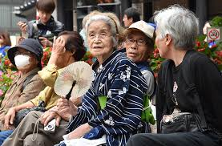
Epidemiologic transition
Age of pestilence and famine: Common throughout human history, with wars and conflict, characterized by malnutrition, and diseases associated with unsanitary and unhygienic conditions
Age of receding pandemics: pestilence and famine declined, death rates decline, life expectancy increased. Heart disease and cancer become common
Age of degenerative and man-made diseases: mortality rates are low; heart disease, diabetes, hypertension, cancer as well environmental; diseases such as those caused by pollution

Slide 10

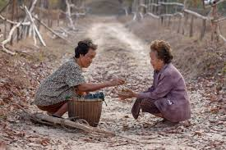
Determinants of improved health
Improved health and increases in life expectancy are due to several factors.
Major improvements in agriculture and food distribution in Europe led to the disappearance of famine and starvation
As incomes increase, people are able to increase spending on a range of goods and services that directly or indirectly improve health (fitness, healthy living, knowledge). Government are able to build hospitals and other health facilities.
Improved health leads to improved productivity.

Slide 11
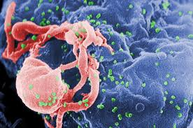
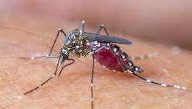
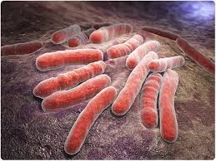
THREE CRITICAL DIseases
HIV/AIDS
Malaria
Tuberculosis

Slide 12
HIV/AIDS
Acquired immunodeficiency syndrome (AIDS) is the final and fatal stage of infection of the human immunodeficiency virus (HIV)
Since the AIDS epidemic began in 2013, close to 70 million people have been infected with the virus of which half have died. Sub-Saharan region remains most severely affected, with nearly 1 in every 5 adults affected
In recent years steady progress has been made and the number of new infections has decreased steadily
Due to better health care and practices for women and children, the rate of decrease has been significant

Slide 13

Government role in health
Government plays an important role in health systems:
Since health is central to poverty reduction, government must ensure good policies to ensure the overall health of the population
Households spend relatively little on health because they neglect externalities (such as contagion or spread of disease)
The market is unable and unwilling to invest in health infrastructure and research and development
Public health programs in developing countries have proven successes

Slide 14
summary
Life expectancy is among the most common measures for assessing health outcomes
Since the 1950s the gap in life expectancy between nations, unlike the gap in per capita outcomes has fallen rapidly
In many developing countries where life expectancy has risen and fertility fallen, the age structure has structure of population has changed, and so has the pattern in disease.
An epidemiologic transition has occurred whereby in developed nations, heart disease, noncommunicable disease are leading causes of death, replacing communicable diseases. Developing countries are following this pattern.

Slide 15
summary
Improving health and rising levels of per capita income are strongly correlated. Access to clean water and sanitation, vaccination programs, and awareness education programs for women, significantly improve public health
Infectious diseases continue to plague less developed countries. Most common are HIV/AIDS, malaria and tuberculosis
The challenge of the 21st century will be for low and middle income countries to win the battle against both old and new infectious diseases, address the prevalence of chronic noncommunicable diseases associated with higher incomes

