Slide 1
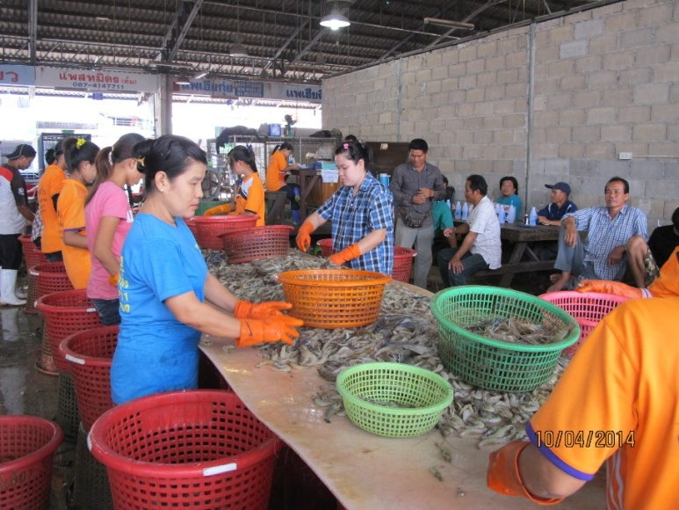
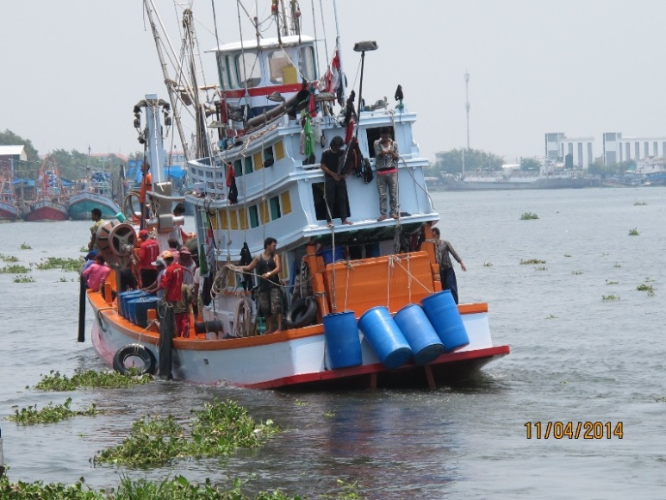
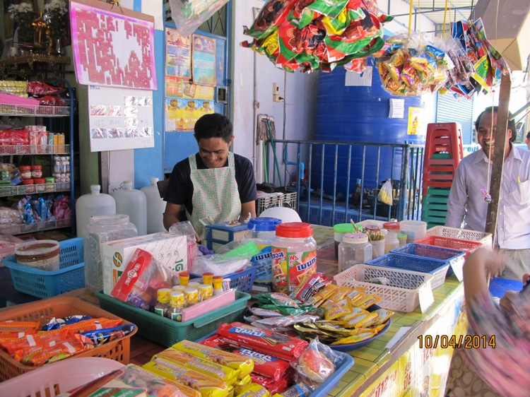
1 August 2016, Economics Department, Thammasart
CLMV Migrant Workers in Thailand
Migration structure & trends
Situation of migrant workers
Srawooth Paitoonpong, Ph. D.

Slide 2
Typology of CLM MWs in Thailand
Irregular – Migrant workers enter the Kingdom without immigration documents
Registration – irregular MWs who are pardoned by Cabinet decision (A-13)
MOU – MWs who come to work in Thailand under MOU between Thailand and C, L, M
NV – Irregular MWs whose registration expire and are allowed to stay and work through national verification
OSSC – MWs who are registered at One Stop Service Center under the order of NCPO (National Committee for Peace and Order) in June-October 2014
(Border pass holders: daily crossing)
Minorities: Hill tribes, refugees, Chinese Yunnan (Haw) etc.
Notes:
MOU = Memorandum of Understanding. With Laos in October 2002, with Cambodia and Myanmar in 2003, May and June.

Slide 3
Low-skilled workers from CLMV
C L M
V
THAILAND
Tourist passport/ work illegally
Irregular
Registration/OSSC
Repatriated/ return home
MOU
Irregular
National verification
Irregular
Repatriated/ return home

Slide 4
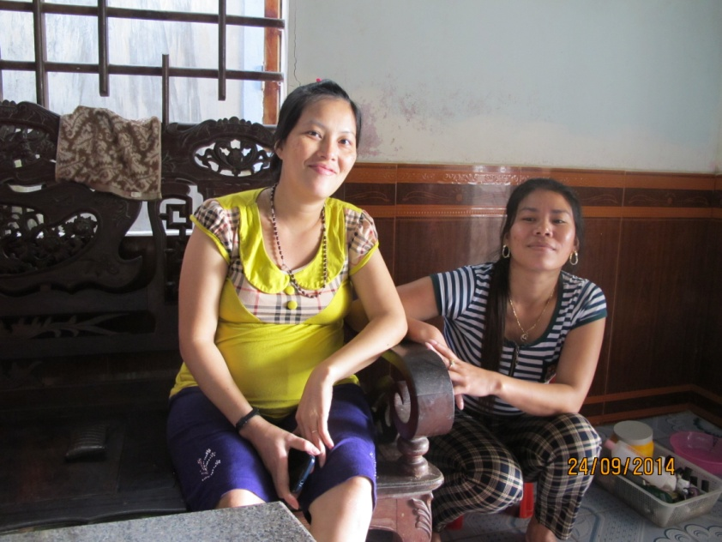
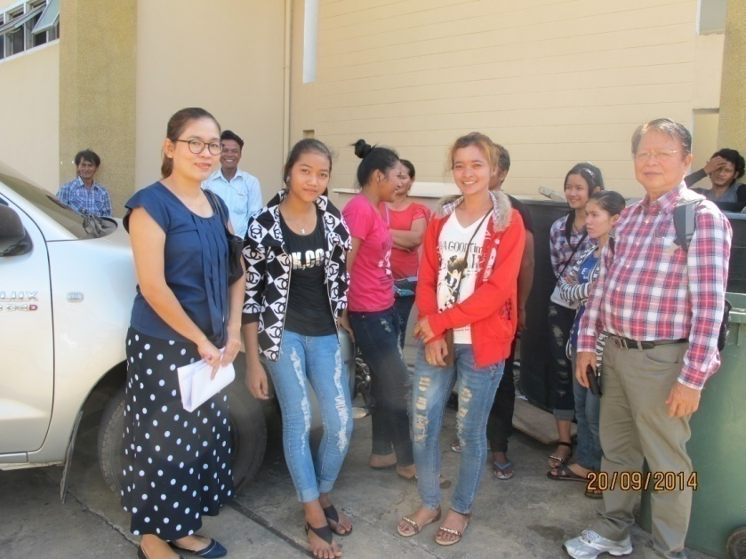
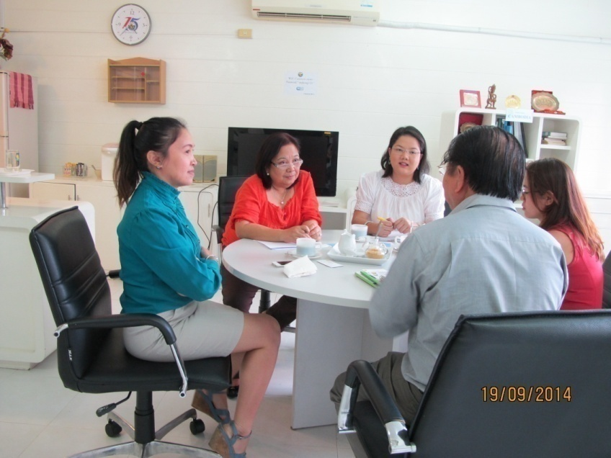
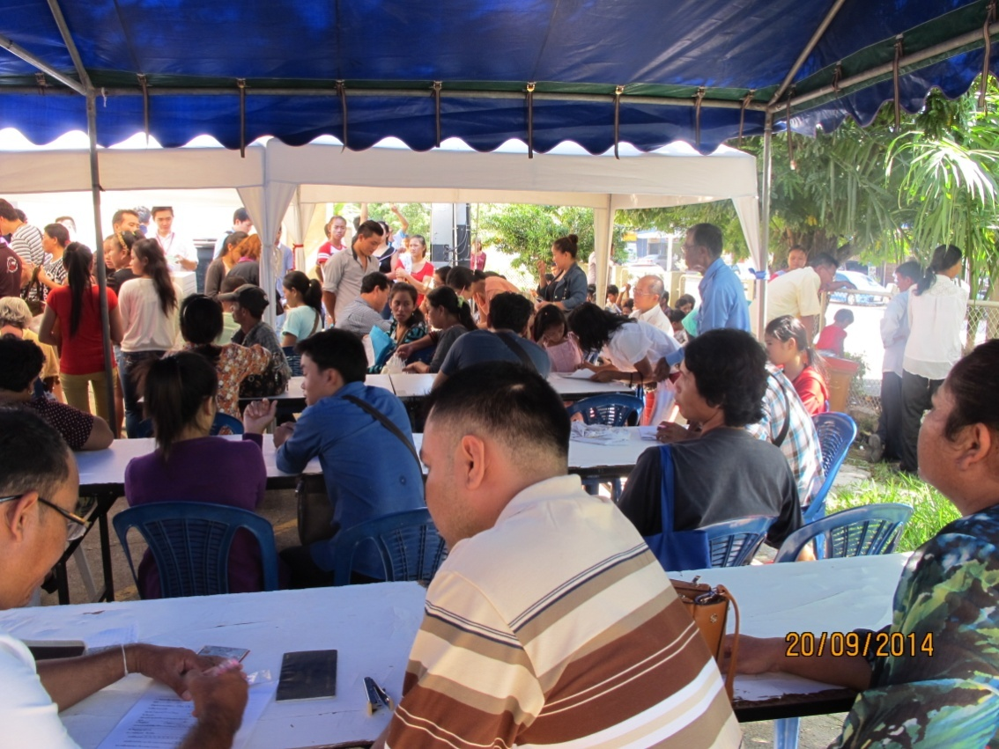

Slide 5
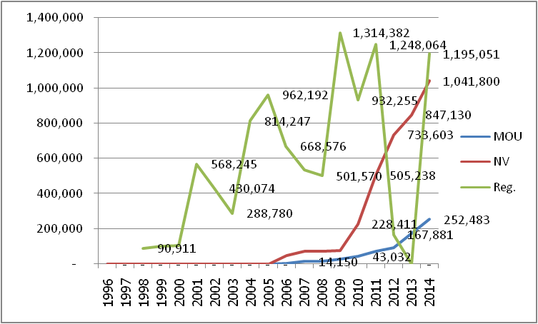
TRENDS of Mekong migrant workers
Registered MW 1.25 million in 2011 dropped to 0 in Dec/2013 ????
228,365 became NV in 2012 . Where are 1.02 mil.?
Repatriated + Undergrounded + returned home (flood crisis)
Became NV in 2014: 308,197 and (252,483 MOU)
OSSC (new registration) 1.53 million (31 October 14)
Notes:
228,365 = 733,603 in Dec 2012 – 505,238 in Dec 2011

Slide 6
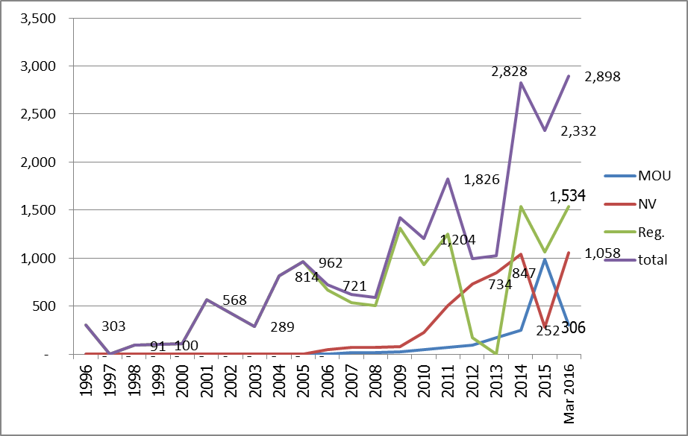
TRENDS of Mekong migrant workers
Registered MW 1.25 million in 2011 dropped to 0 in Dec/2013 ????
228,365 became NV in 2012 . Where are 1.02 mil.?
Repatriated + Undergrounded + returned home (flood crisis)
Became NV in 2014: 308,197 and (252,483 MOU)
OSSC (new registration) 1.53 million (31 October 14)
Notes:
228,365 = 733,603 in Dec 2012 – 505,238 in Dec 2011

Slide 7
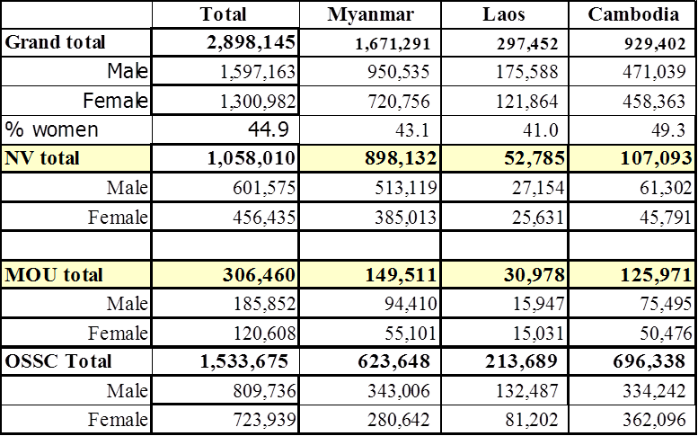
CLM migrant workers in Thailand, 2016

Slide 8
Note:*Numbers of NV and MOU are as of March 2016 (OFFA March 2016); Number of OSSC is as of 31 March 2016 (OSSC 2016). The grand total is less than the DOE figure (Matichon, March 02, 2016) of 3,450,743 because the latter includes forecast number not yet realized.
** Grand total from (OSSC 2016 ) nationality breakdown using proportion of OSSC June 2015.
*** Estimated from average proportion of women migrant workers to the total number of migrant workers under Article 13 (Registration), 2009-2011.
The number of registered migrant workers released by OSSC as of 31 March 2016 was 1,626,235 for pink card holders of which 1,533,675 are workers. This is the same number as those registered at OSSC during 26 June – 31 October 2014 but the government uses this figure as the number of CLM migrants who are expected to come for registration at OSSC during 1 April – 29 July 2016.
Sources: NV and MOU (OFWA 2016. Foreign Workers Statistical Report March 2016; OSSC (OSSC 2016).

Slide 9
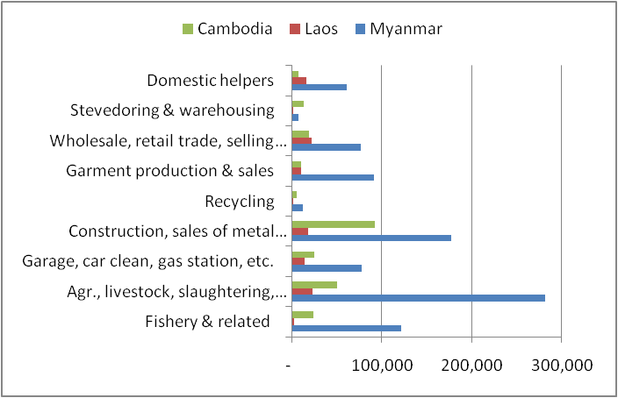
Skill demand: Low-skilled, manual labour, domestic work, work literacy in related activities
Number of registered CLM MW 2011 by activities
Notes:
Migrant workers are everywhere, in so many occupations, jobs.
After 2011, no occupational classification of the NV.

Slide 10
Vietnam
At present, there are about 50,000 Vietnamese migrants working in Thailand illegally (Matichon 15/6/2014).
Unlike CLM migrant workers, Vietnamese migrants come to Thailand with passport which allows them to stay as tourists in Thailand for 30 days (arrival by air and 15 days for arrival by land).
After entry, they illegally work without work permit and renew their visa before it expires. The fine for overstay for THB 500/day.
The penalty for violation of the Foreign Workers Employment Act 2008 is a fine of THB 2,000 – 100,000 (US$ 62.5-3,125) or an imprisonment of not more than 5 years or both fine and imprisonment. In practice, an arrested migrant is fined THB 2,000 (Ibid.).
There are increasing flows of Vietnamese irregular migration to China, Lao PDR, Cambodia, Thailand and beyond (ILO Vietnam2014).
Notes:
The previous graph does not include VN migrant workers.
Fine for overstay is immigration; Fine for working illegally is FEW Act 2008. (FEW Act is the same as Alien Employment Act)

Slide 11
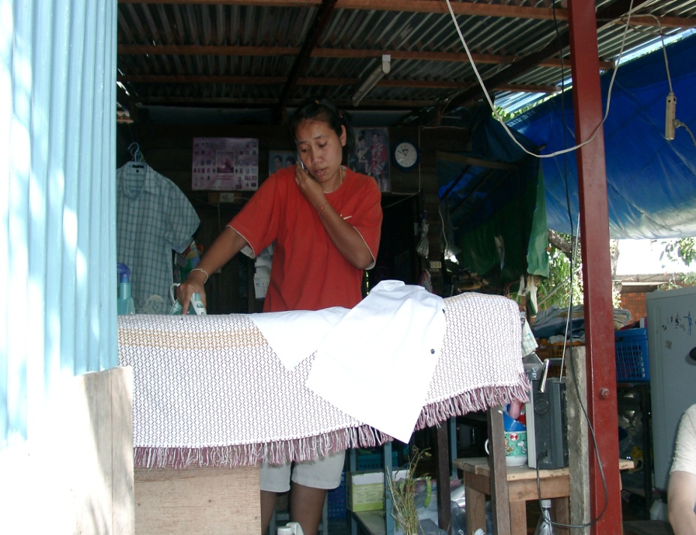
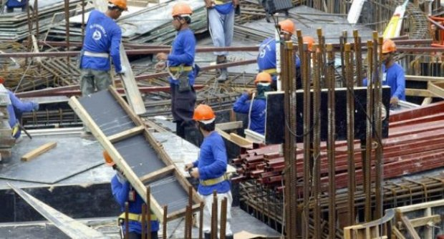
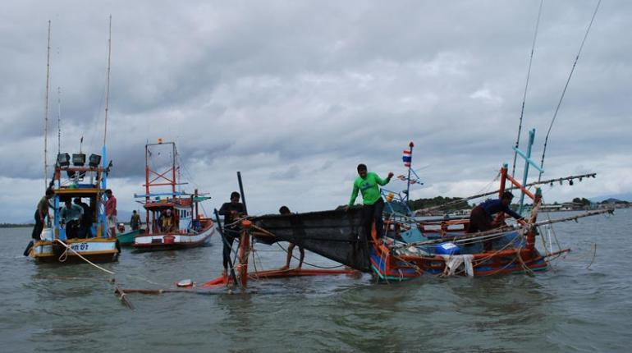
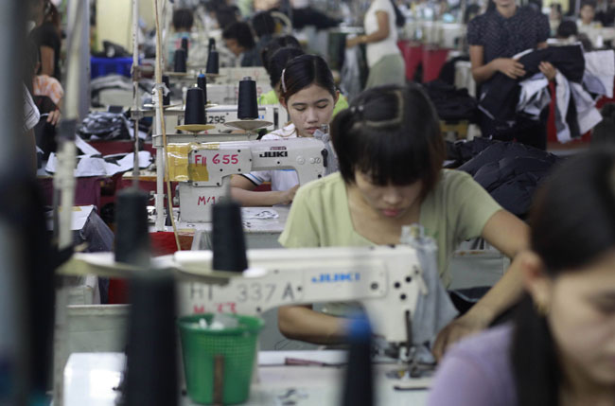
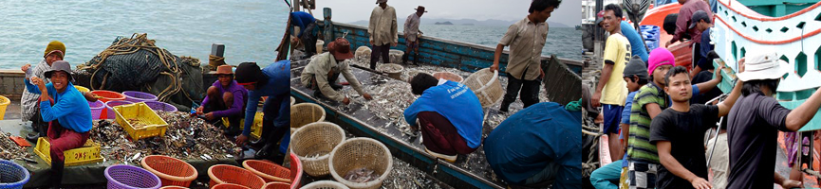
Domestic work
Construction
Garment
Fishery
Work in Thailand

Slide 12
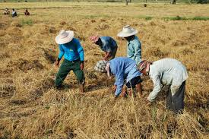
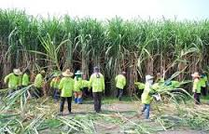
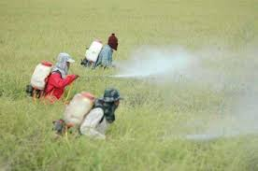
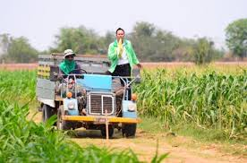
Farming
Pesticide

Slide 13
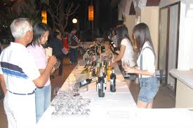
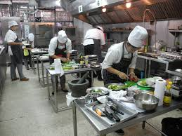
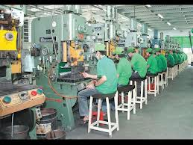
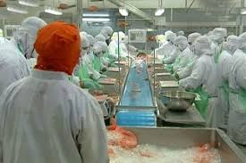
Sales
Cooking
Machine operator
Food processing

Slide 14
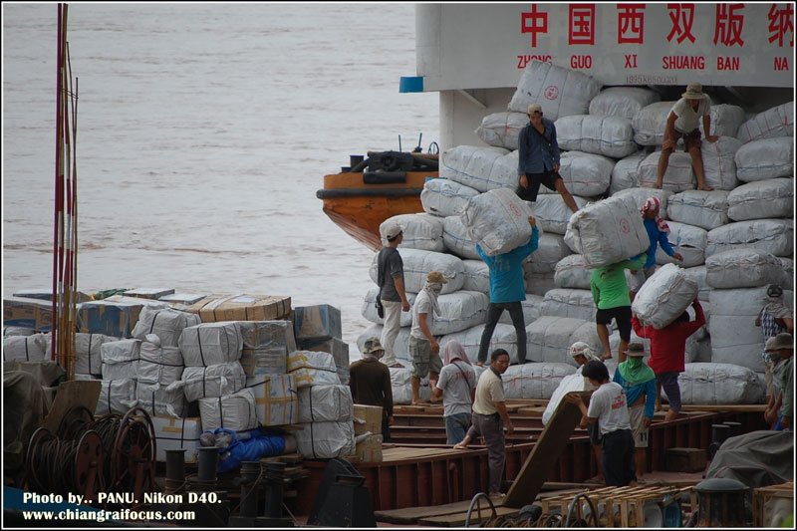
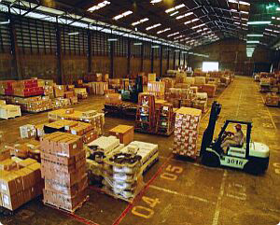
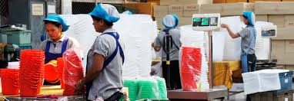
Stevedore
Manufacturing

Slide 15
Regulatory framework
Immigration Act B.E.2522 (1979, 1992)
Alien Employment Act B.E. 2521 amended in 2551 (1978, 2008)
Labor Protection Act B.E. 2541 amended 2551 (1998, 2008)
Relevant acts
  Social Security Act 1990
  Workmen’s Compensation Act 1994
  Labour Relation Act B.E. 2518 (1975)
  Investment Promotion Act B.E. 2520 (1977)
  Industrial Estate Authority of Thailand Act B.E. 2522 or The Industrial Act 1979
  Foreign Business Act B.E. 2532 (1999)
  The Petroleum Enterprise Act 1971
Notes:
How does Thailand regulate/integrate CLMV migrant workers?
Alien employment Act is the same as Alien Working Act due to translation

Slide 16
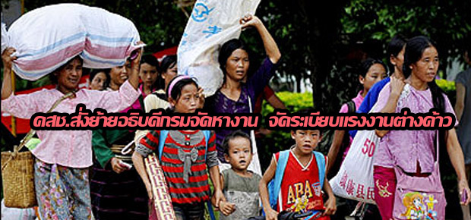
Management
From 2001- June 2014: Committee on Illegal Migrant Workers Administration
25 June 2014: Committee on Management Policies on Migrant Workers Problems (CMP-MWP) by chaired by Vice Chairman of NCPO
General management: Office of Foreign Workers Administration (OFWA)
June 2014, NCPO sacked Director General of Department of Employment & Director of OFWA
Notes:
25 June 2014 is after 22 May 2014.

Slide 17
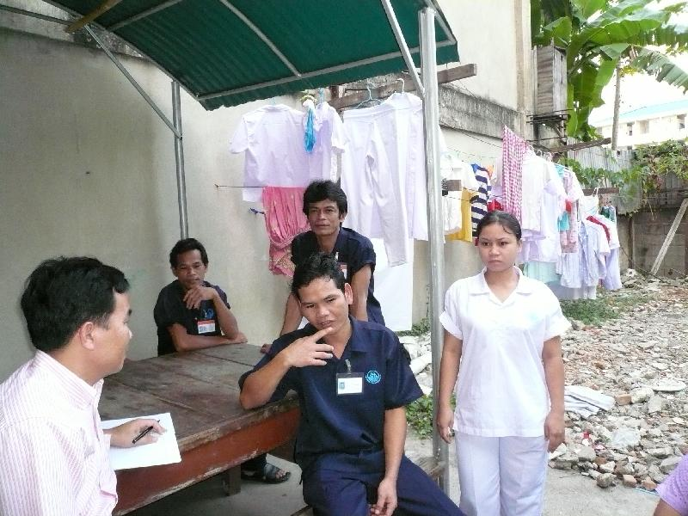
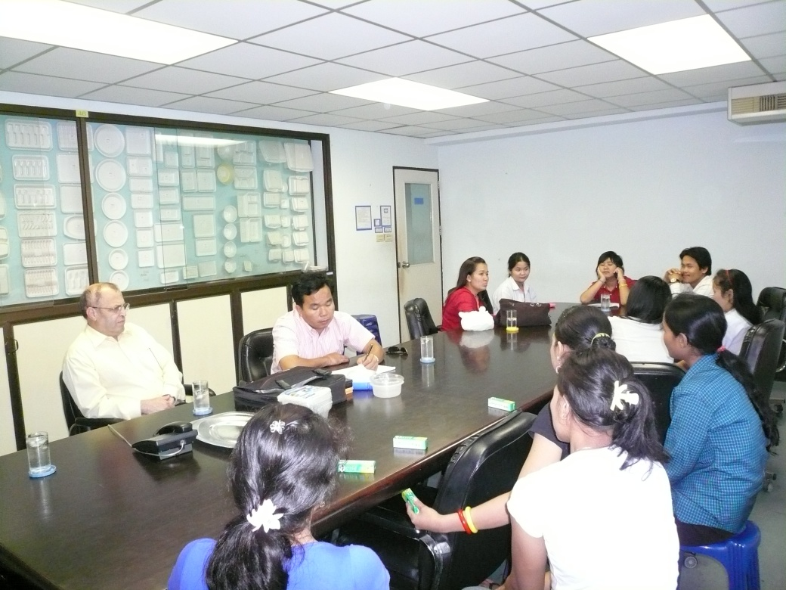
Management – Brokers
two types of brokers: Do document business with government agencies for MWs and recruitment agencies (export/import workers) (and informal brokers);
210 recruitment agencies in 2014;
Some RAs are not efficient and not honest
Missing spouse
Unqualified MWs

Slide 18
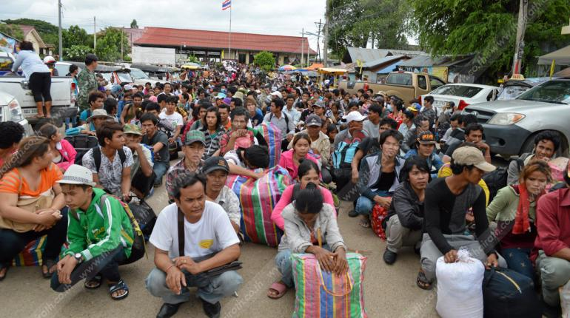
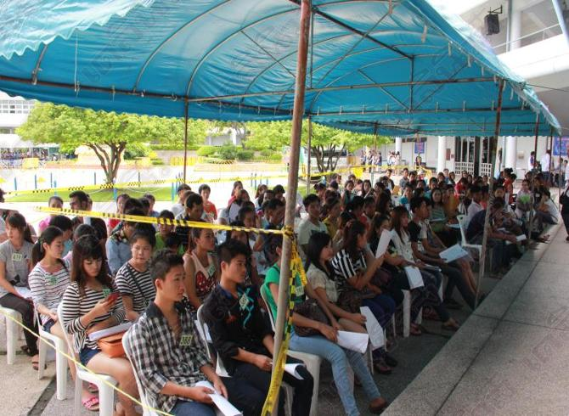
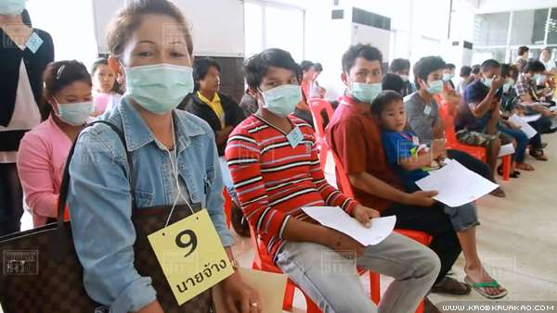
Panic of NCPO
Exodus of Cambodian migrant workers
Open registration at OSSC, 26 June-31 October 2014
Notes:
Inconsistent policy, driving out and taking in

Slide 19
Situation of migrant workers in Thailand
Poverty: Income poverty & Non-income poverty (lack of basic needs, rights and integration in destination)
Income : wage and OT; good wages that comply with laws and overtime of THB 51-54 per hour ???; (have savings and remittances).
Livelihood: language, participation in cultural activities, consultation with Thai people, awareness of rights and protection, children’s education, and security in life and assets, healthcare, housing, etc.
Vary by work location, nationality, and type

Slide 20
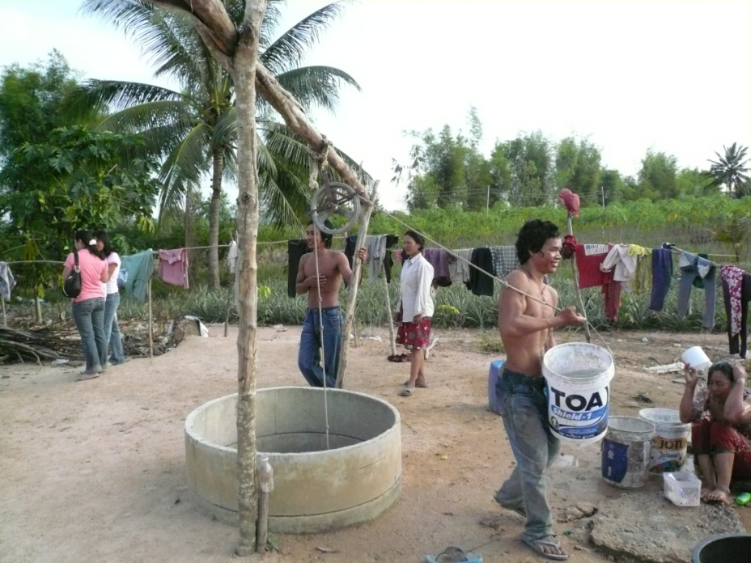
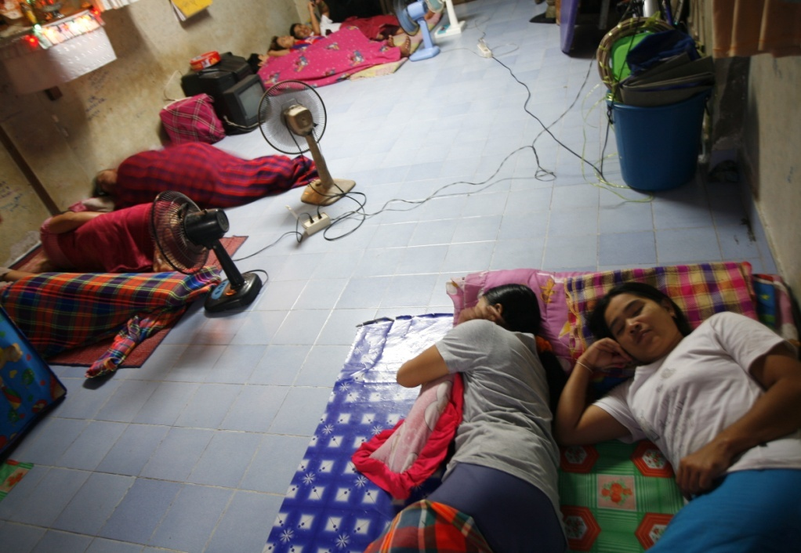
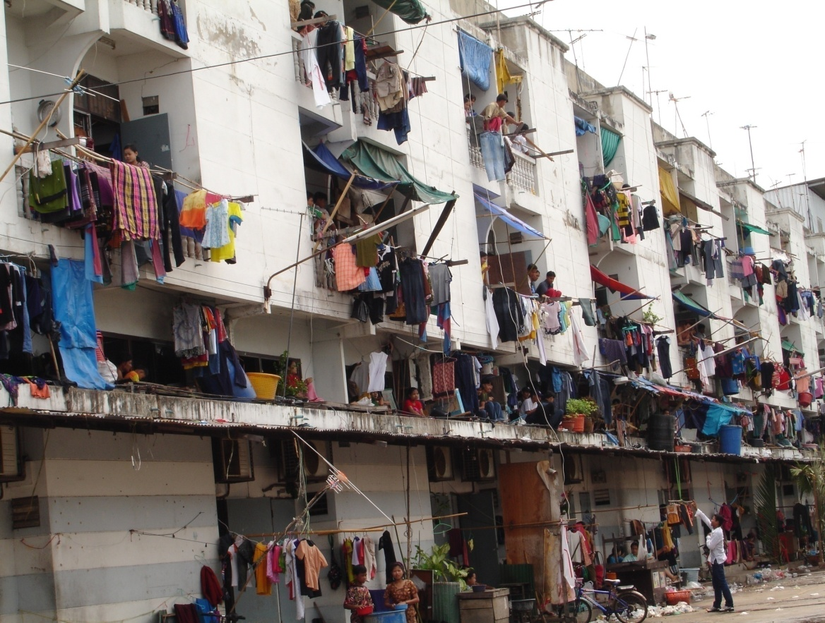
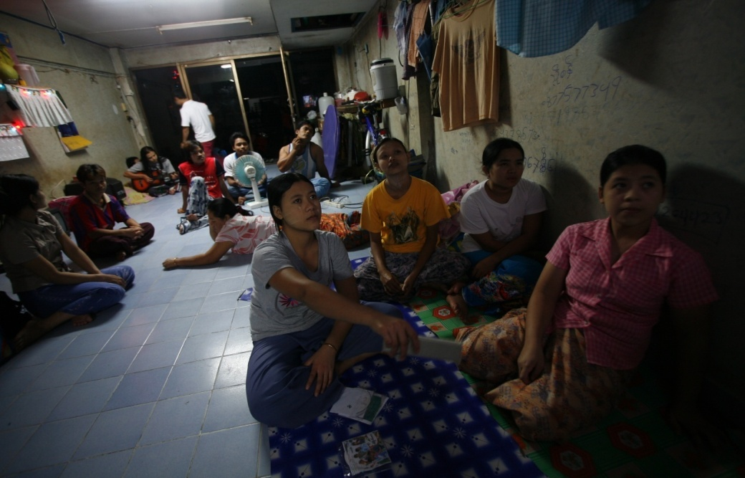
Living conditions
Burmese town
20

Slide 21
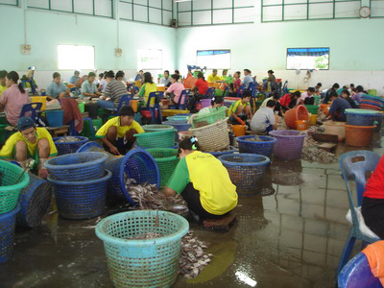
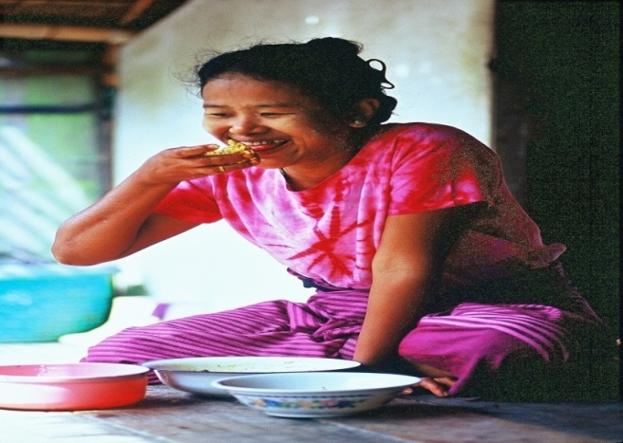
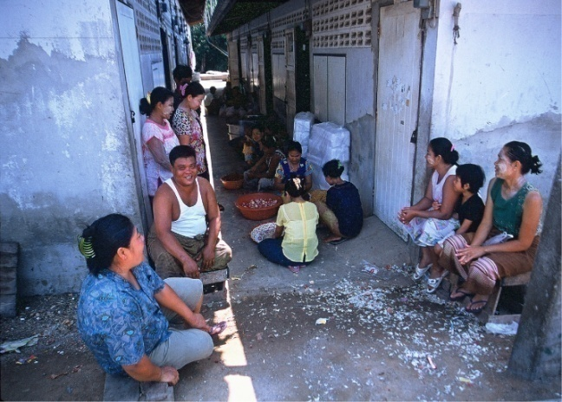
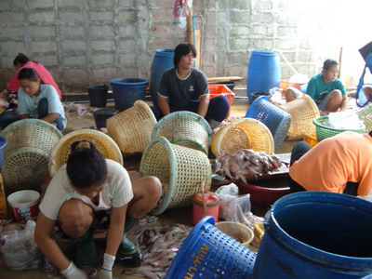
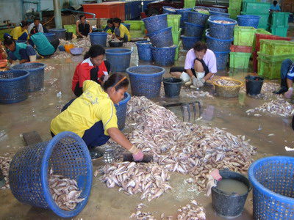
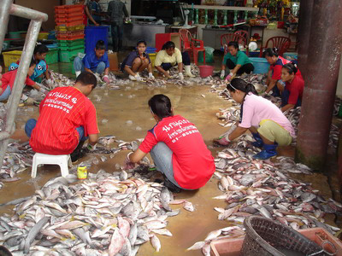
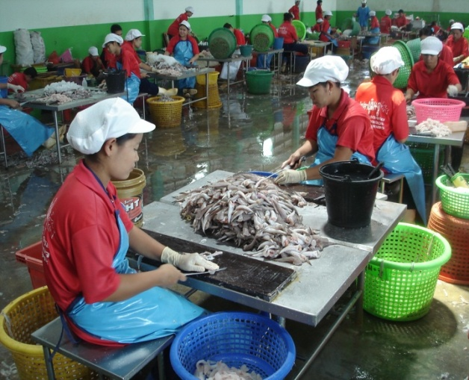
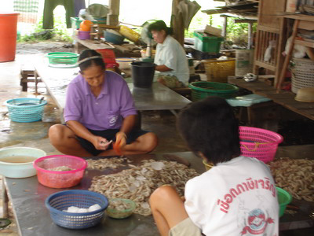
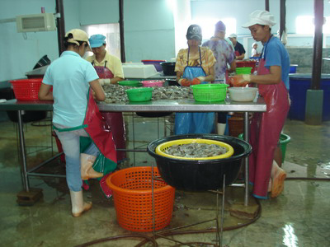
21

Slide 22
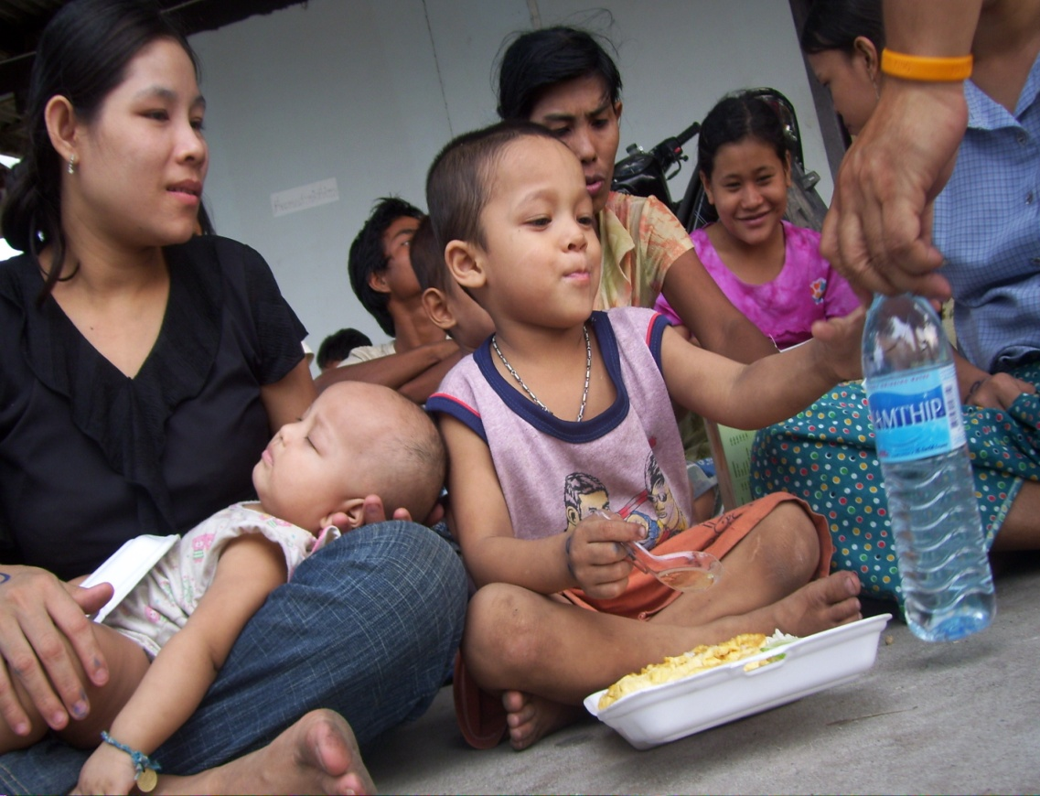
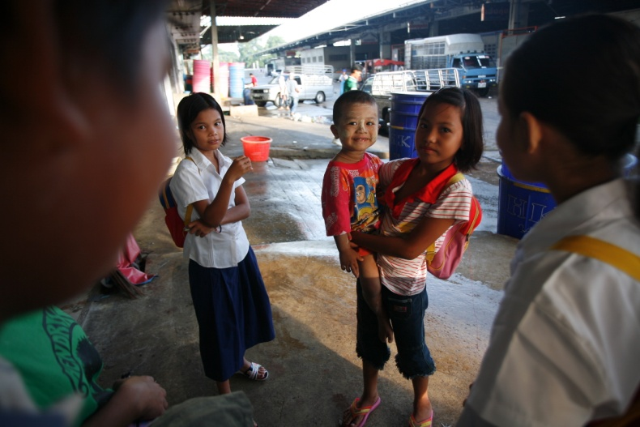
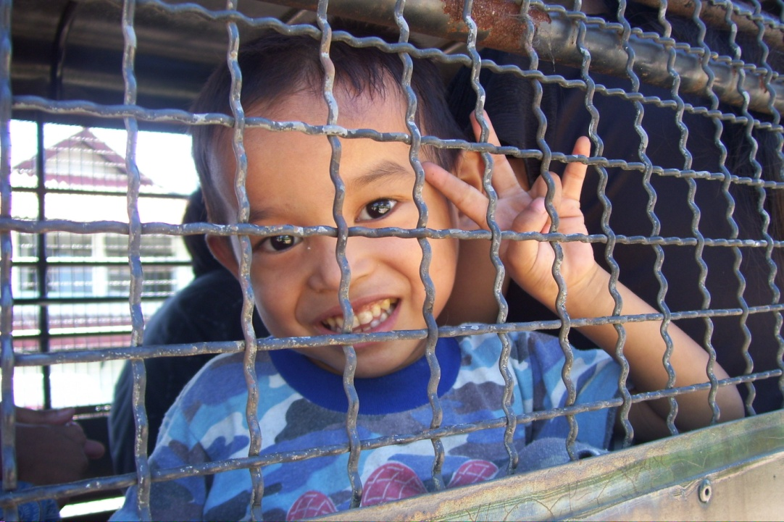
Thailand unseen
Migrant children

Slide 23
Rights and protection needs of migrants: access to social protection, health services, education
MW are vulnerable to exploitation and abuse by employers, landlords, officials, and criminals;
Undocumented workers are even more at risk;
Regulatory:
Wage and workplace: Labour Protection Act 1998, 2008
Social protection: SSA 1990 and WCF 1994 for legal MW;
Health services: SSA; Compulsory Migrant Health Insurance Scheme (CMHIS)
Children education: Learning centers, formal education

Slide 24
Integration institutions & programs
Integration institutions & programs varies according to the group, the irregular and regular MWs.
temporary MWS are expected to return home at the end of their contract so no long-term integration is envisaged for them.
they are not expected to bring dependents with them, there is no provision for the integration of their dependents.

Slide 25
Integration institutions & programs
Social protection
  Immigration law 1979
  Alien Employment Act 1978
  Social Security Act 1990
  Workmen’s Compensation Act 1994
Protect or regulate? How?

Slide 26
Immigration law
Immigration law determines MWs’ legal status (regular/irregular) as well as their entitlement to resources;
Including a constraining factor affecting MWs’ opportunities in labor market by determining who can/cannot do certain kind of jobs and for how long (by visa type).
MW’s legal status is a factor which is as important as jobs available in labor market.
Notes:
Many Thai work illegally in the State. They are called “Robin Hood” or the Outlaw.

Slide 27
Alien Employment Act 1978, 2008
Defines immigrants’ eligibility for engaging in employment;
Determines occupations that MWs are allowed to engage in;
Sets the repatriation fund;
Collect levies from employers;
Regulates migrants’ conditions to change employers and workplaces;
Provide for the involvement of trade unions and employers in the reviewing the employment of MWs and for appealing;
Regulates the hiring of low-skilled MWs from CLM, structuring their contract employment through dependency ceiling, sector-specific restrictions,
Notes:
Mosr regulations fail!.

Slide 28
Social Security Act 1990
Contributions: 5% of the monthly salary by employer and worker and additional contribution of between 2-3% by the government
Benefits:
  illness or injury (not related to work),
  maternity,
  disability,
  death,
  child allowance,
  old age pension and
  unemployment.
Eligibility: Only legal MW with work permit
Some benefits not applicable for MW (the SSA just amended in 2015 allowing MW to receive lump sum pension when they leave Thailand)

Slide 29
Workmen’s Compensation Act 1994
Cover work injuries and sickness;
Compulsory, employers pay a minimal contribution, 0.2-1.0 percent of the worker’s wage with adjustment by “experience rate”;
For MWs, Thailand has MOU with Cambodia and Lao PDR regarding their MWs in Thailand, covering them with work injury insurance.
MOUs apply only to legal MWs from the two countries.

Slide 30
Workmen’s Compensation Act 1994
Compensation benefits:
1. Compensation amount or indemnity
  in case of injuries, disability or death at 60% of monthly wages, from 3 days to 15 years depending on the case.
2. Medical expenses
  up to THB 45,000 to 300,000 depending on the severity of the cases as prescribed in the Ministerial Regulations.
3. Industrial rehabilitation expenses
  as necessary, up to Baht 20,000.
4. Funeral expenses
  at a minimum amount equal to 100 times the minimum daily wage rate.

Slide 31
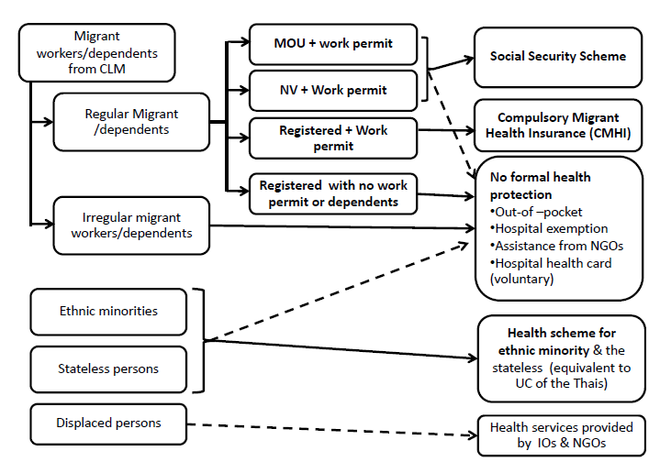
Healthcare for MWs
Medical benefits under SSA 1990 and WCA 1994
Universal Health Scheme
Compulsory Migrant Health Insurance (CMHI)

Slide 32
Education for MWs’ children
2 types
  public school or formal education and
  migrants’ learning centers or informal education. (MLC)
Public education for children of MWs through a cabinet resolution, July 2005
MLC -- uncertified schools starting appearing in the 1990s.
  run by members of the children's ethnic community
  Some -- like school, teaching basic education, in some cases extends from kindergarten to post ten levels.
  Mainly use Burmese as the medium of instruction (some use Karen, Shan and other regional languages at the lower grades) and curricula based on the Burma national curriculum.
  Some have lessons in basic Thai language, social and cultural orientation, basic legal knowledge, heath care and vocational training in skills like using computers.
Notes:
opposed to the Burmese military regime and sympathetic with opposition groups in Karen and Shan states.

Slide 33
Human trafficking
Legal measures in Thailand, such as
Prevention and Suppression of Trafficking in Persons Act 2008 (PSTPA 2008)),
Penal Code,
Criminal Procedure Code 1934,
Child Protection Act, B.E. 2546 (2003)
Prevention and Suppression of Prostitution Act B.E. 2539 (1996), the Anti-Money Laundering Act B.E. 2542 (1999), the Witness Protection Act B.E. 2546 (2003),
Labor Protection Act B.E. 2541 (1998, amended 2008),
Extradition Act B.E. 2551 (2008), and
International Cooperation in Criminal Matters Act B.E. 2535 (1992).
Notes:
Penal code – Civil code ประมวลกฎหมายอาญา

Slide 34
Situation of migrant workers in Thailand
Integration of MWs varies
  MWs from Myanmar and Cambodia are more men than women.
  Most male Myanmar migrants are in Surathani while Myanmar women are concentrated in Tak due to different types of work.
Average age of migrant is 28 years old. Older workers was in Ranong (aged 35-39 and 40-50) have higher proportion than in other provinces.
Average time of stay: Myanmar and Cambodian migrants is 4-5 years, Lao migrants is 6.5 years.
(Chamrathrithirong et al., 2011)
Notes:
The study is in 2011 by Apichart et al., after which situation changes

Slide 35


Situation of migrant workers in Thailand
Living conditions:
Participation in cultural
& social activities

Slide 36



Working & living environment
36

Slide 37
Social security issues:
Informal sectors are excluded (60% of migrants work as domestic workers, in the fisheries, or in agriculture).
Compliance problems associated with the SSS. Employers might not make regular monthly contributions, thus rendering migrants unable to access the SSS.
4 types of SS benefits not assessable by MWs: maternity benefits, child allowances, unemployment insurance and old-age benefits.
Year | Number of CLM migrant workers with work permit |  |  |  | Number of migrant workers in SSS | % of migrant worker in SSS
 | Registration | National verification | MOU | Total
2012 | 167,881 | 733,603 | 93,265 | 994,749 | 249,961 | 25.1
2013 | n.a. | 174,042 | 847,130 | 1,021,172 | 397,246 | 38.9
2014 (July) | n.a. | 1,149,088 | 251,373 | 1,400,461 | 415,588 | 29.7

Slide 38


WCF
MWs have work injuries;
Many employers refuse to pay the compensation.
WCF officials fail to order employers to pay the compensations to the injured migrants;
Irregular MWs are denied the right to be protected by WCF.

Slide 39


Labor protection
Thailand has a few laws to protect workers, some are not applied to MWs
A study by ARMC finds that MWs are well protected but the findings was challenged (by Andy Hall) that it is not correct.
Collapse of building under construction, Patumthani 2015

Slide 40

Health of MWs
Illnesses and death of MWs are often results of unsanitary living conditions, unhealthy diets and unsafe work environments.
MWs may arrive healthy but develop severe health problems because of poor living and working environment.
During 2004-2008, the most common illness is diarrhoea, malaria, pyrexia (fever with unknown cause), pneumonia and dengue fever.
Most common cause of death among MWs was NCD, followed by accidents, infectious diseases and homicide/suicide.
Notes:
NCD=Non-communicable diseases; dengue fever ไข้เลือดออก

Slide 41




Health services & prevention

Slide 42



At least 8,000- 10,000 MWs’ children in Samutsakorn
Pictures courtesy of LPN

Slide 43
Number of migrants’ children in Thai schools by nationalities 2011 academic year
 | Myanmar | Cambodia | Lao PDR | Total
Kindergarten | 11,543 | 1,953 | 915 | 14,411
Primary school | 32,228 | 3,820 | 2,245 | 38,293
Lower secondary school | 4,247 | 637 | 300 | 5,184
Upper secondary school | 536 | 170 | 81 | 787
Vocational school | 11 | 0 | 1 | 12
Total | 48,565 | 6,580 | 3,542 | 58,687

Slide 44
Concluding remarks
Still a large number of MWs from CLM/V to Thailand;
MWs from Vietnam to Thailand is increasing not only the illegal but also the legal;
Thailand will need MWs in the near future depending on its structural change and development process of CLM/V;
Skill structure is changing to more skilled than manual labour, more women than men in domestic work;
Lack of data on number and details of MWs because a large number of MWs are undocumented; yet, even with data on NV and MOU, no detailed breakdown s are available;
Notes:
Some not mentioned in text and needs to be proved

Slide 45
Concluding remarks
6. IOs, NGOs, have played key roles on MW issues, therefore their roles are imperative and need strong and sustainable supports;
7. Living conditions of MWs in Thailand though not so bad is not so good, only legal MWs have rights to access social protection, health and education services but not undocumented MWs; MWs are subject to exploitation and extortion;
8. Network access has improved (because of continued migration and scale and modern IT, MWs can connect to each other and are better informed about their peers);
9. Sending countries are still mostly poor, probably except one;

Slide 46
Concluding remarks
10. Most returned MWs have sent remittances and use them productively;
11. Some MWs’ children have education in Thailand; many MWs benefits from health services in Thailand;
12. Some of skill learned are useful, some are not if they do not migrate (over-qualified);
13. Many MW become self-confident because of going abroad – experience.
14. AEC free flow of labour does not have implications on CLM low-skilled migrants.

Slide 47
End Part 2 A (slide1-44)

Slide 48
How illegal migrants come
From Myanmar mainly by land in various channels from Chiangrai through Tak and Ranong, through jungles and small river; a large number under arrangement of brokers;
From Cambodia by land through formal and informal check points and forest;
From Laos by Mekong River through formal and informal check points;
Some CL migrants enter on their own or through connection with relatives or friends.

Slide 49



From Myanmar: a long border of about 1,960 kilometers with Myanmar, from Chiang Rai to Ranong.
3 Pagodas, Kanjanaburi
Crossing border in jungle

Slide 50

Mon state
3 Pagoda Pass
Thong Pha Phum
Karnchanaburi
Andaman Sea

Slide 51
a long border of about 1,810 kilometers with Lao PDR, from Chiang Rai to Ubonratcha-thani.
covers 10 provinces: Chiang Rai, Payao, Nan, Uttaradit, Lei, Nongkhai, Nakorn Panom, Mukdaharn, Amnaj-charern, and Ubonratchathani.
36 crossing points, 13 of which are permanent, 2 temporary and 21 informal.

Slide 52
The border with Cambodia is about 800 kilometers.
covers 7 provinces: Sa Kaeo, Trad, Surin, Chanthaburi, Srisaket, Buri Ram and Ubonratchathani.
There are 1 international checkpoint and 4 temporary checkpoints.

Slide 53

The Mekong River

Slide 54




From Laos ;
border about 1,810 km.
2nd Friendship Bridge, Mukdahan
Immigration Office, Chiang Khong

Slide 55




From Cambodia:
border about 800 km.long
Natural border
Informal gate, Sakeao

Slide 56

International Gate,
Aranyaprathet

Slide 57




Arrested migrants
Resting spot, Banteay Meanchey
Repatriated migrants at Poi Pet

Slide 58
Case study: Myanmar migrant at Vita Food Factory, Kanchanaburi
13 April 2012
Man, leaving Myanmar end of 2008
Broker fees 25,000 baht
Broker’s name (Zaw Min) a Mon soldier ( anti govt ) DKBA card holder
250 people brought to the border by Zaw Min, including men & women, from Kyainsatekyi by boat to come to Three Pagoda Pass, Sangklaburi Thai Burma border.
One boat for 50 people
on the way to border in Myanmar side, they met with Karen robbers. The robbers demanded 20, 000 kyat per person, everybody has to pay for their life.
3 young women can’t pay and they took them into the jungle and not allow them to travel
(From WB teleconference 2013 file)

Slide 59
They stayed at Three pagoda pass town for 7 days, then walked in jungle in Thailand (for 3 days to avoid check point) to Thongpaphoom.
After that 5 pick up trucks were waiting for them at Thongphapoom. The broker let 50 persons sit in 1 truck and took them direct to Vita Food factory, Kanchanaburi.
After working at Vita factory for 1 year, the migrant went to Mahachai, working in the fishing boat.
After working in a fishing boat for 2 years he left Mahachai and came back to Vita food factory. When he was in Mahachai he has a work permit issued by Thai govt. now expired and not renewed.
(To be continued in slide 67)
Notes:
Moving to Mahachai implies that migrant are mobile. NGOs many times exaggerate the situation.

Slide 60
Integration institutions reform
From 2001- June 2014: Committee on Illegal Migrant Workers Administration
25 June 2014: Committee on Management Policies on Migrant Workers Problems (CMP-MWP) by chaired by Vice Chairman of NCPO
General management: Office of Foreign Workers Administration (OFWA)
Same as slide 13
NCPO sacked Director General of Department of Employment & Director of OFWA
Notes:
Same as slide 13

