Slide 1

C H A P T E R 11
Pricing with Market Power
CHAPTER OUTLINE
11.1 Capturing Consumer Surplus
11.2 Price Discrimination
11.3 Intertemporal Price Discrimination and Peak-Load Pricing
11.4 The Two-Part Tariff
11.5 Bundling
11.6 Advertising
Appendix: The Vertically Integrated Firm
Prepared by:
Fernando Quijano, Illustrator

Slide 2
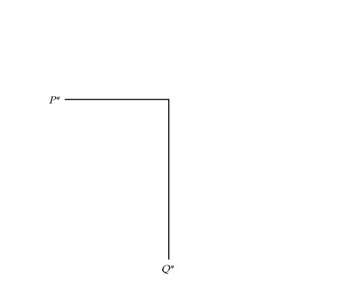
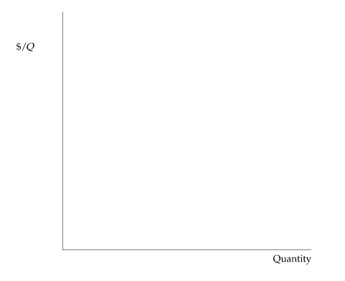
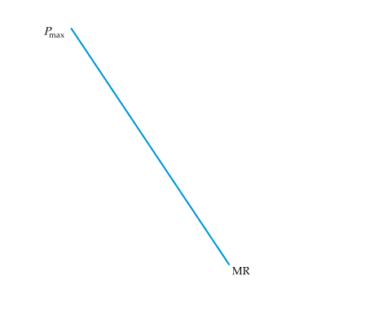
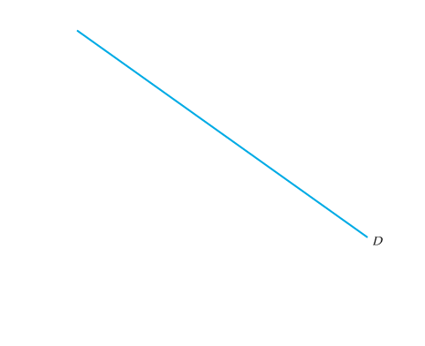
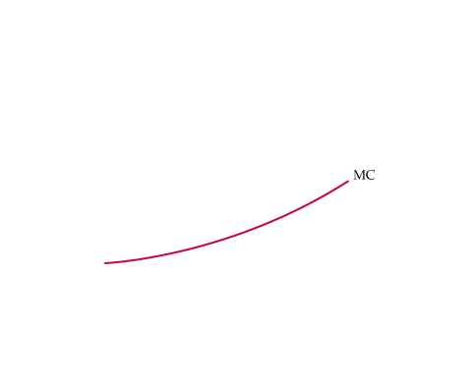

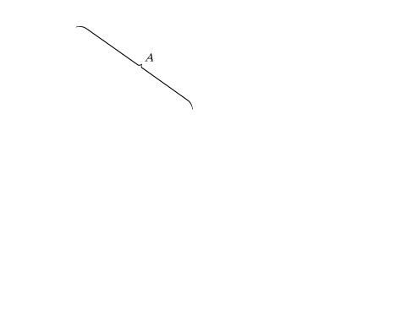
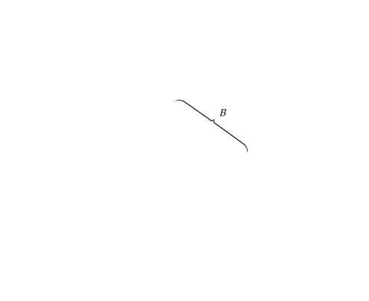
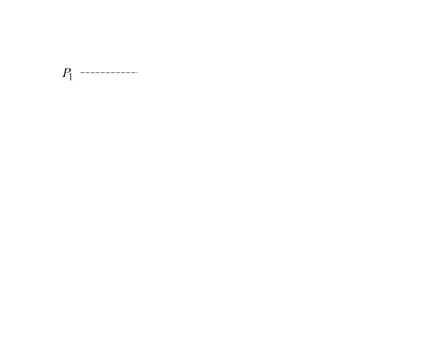
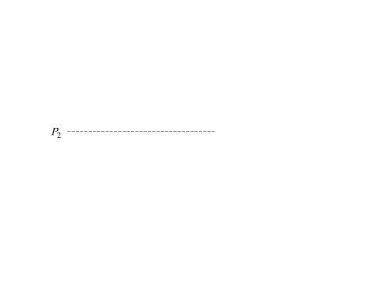
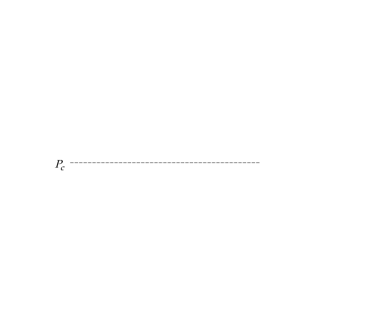
11.1
Capturing Consumer Surplus
FIGURE 11.1
CAPTURING CONSUMER SURPLUS
If a firm can charge only one price for all its customers, that price will be P* and the quantity produced will be Q*.
Ideally, the firm would like to charge a higher price to consumers willing to pay more than P*, thereby capturing some of the consumer surplus under region A of the demand curve.
The firm would also like to sell to consumers willing to pay prices lower than P*, but only if doing so does not entail lowering the price to other consumers.
In that way, the firm could also capture some of the surplus under region B of the demand curve.
● price discrimination Practice of charging different prices to different consumers for similar goods.

Slide 3
11.2
Price Discrimination
First-Degree Price Discrimination
● reservation price Maximum price that a customer is willing to pay
for a good.
● first degree price discrimination Practice of charging each customer her reservation price.
● variable profit Sum of profits on each incremental unit produced by a firm; i.e., profit ignoring fixed costs.

Slide 4


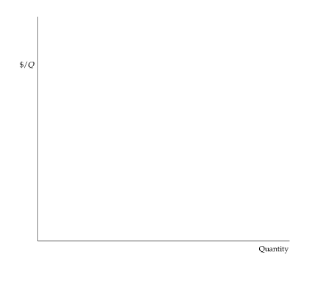
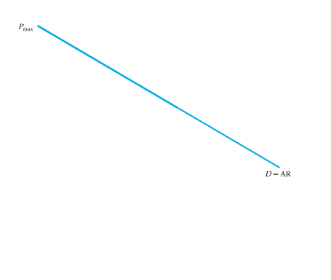
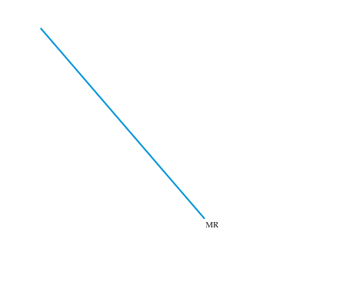
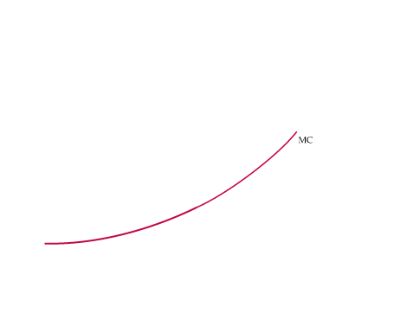
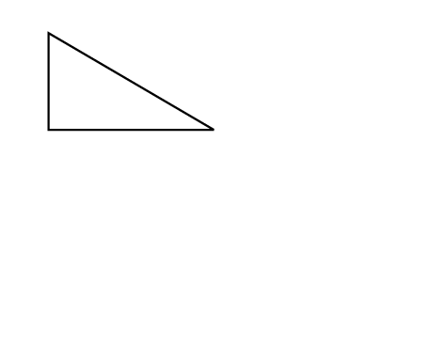
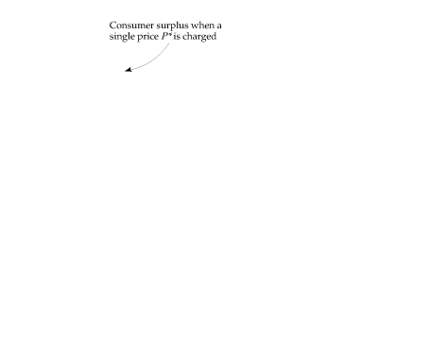
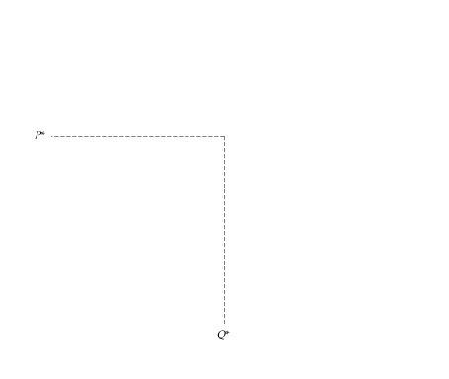
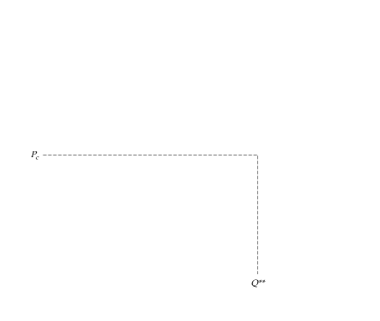
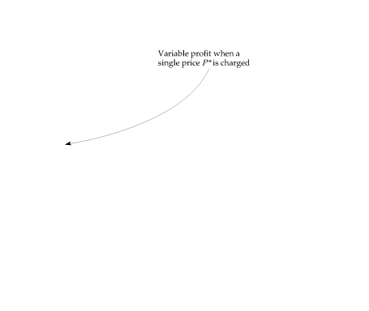
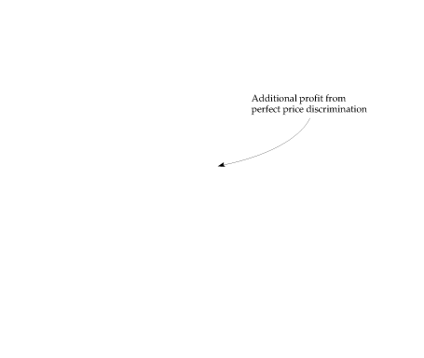
FIGURE 11.2
ADDITIONAL PROFIT FROM PERFECT FIRST-DEGREE PRICE DISCRIMINATION
Because the firm charges each consumer her reservation price, it is profitable to expand output to Q**.
When only a single price, P*, is charged, the firm’s variable profit is the area between the marginal revenue and marginal cost curves.
With perfect price discrimination, this profit expands to the area between the demand curve and the marginal cost curve.

Slide 5
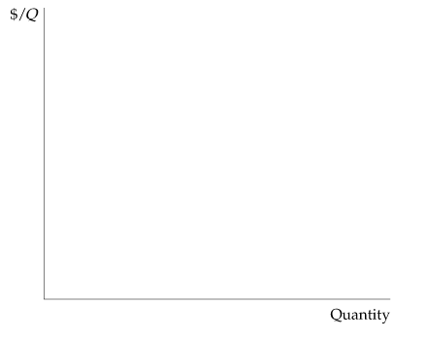
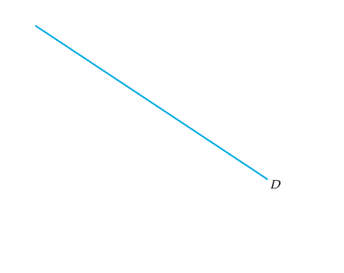
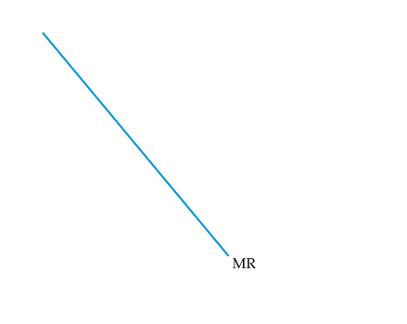
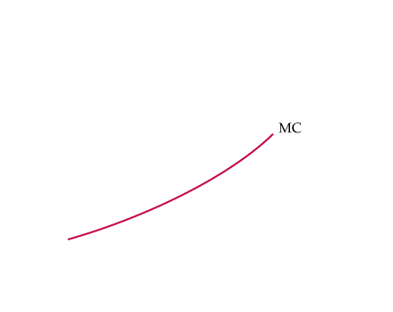
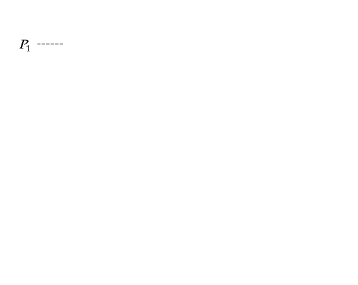
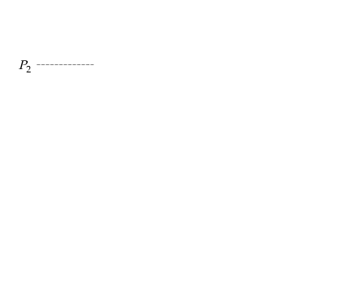
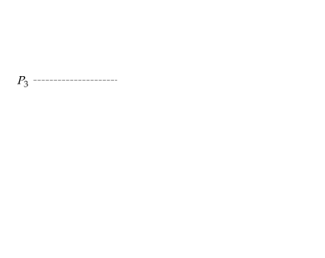
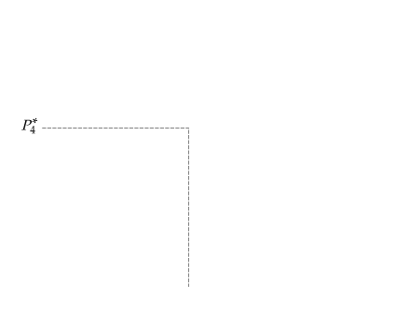
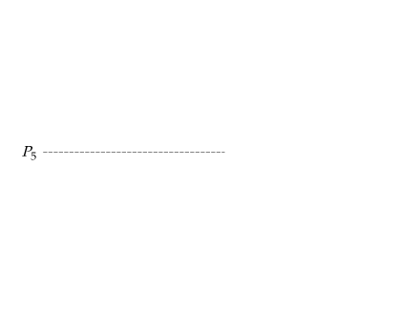
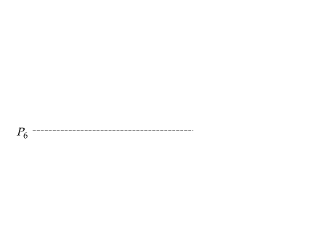
PERFECT PRICE DISCRIMINATION
The additional profit from producing and selling an incremental unit is the difference between demand and marginal cost.
IMPERFECT PRICE DISCRIMINATION
FIGURE 11.3
FIRST-DEGREE PRICE DISCRIMINATION IN PRACTICE
Firms usually don’t know the reservation price of every consumer, but sometimes reservation prices can be roughly identified.
Here, six different prices are charged. The firm earns higher profits, but some consumers may also benefit.
With a single price P₄, there are fewer consumers.
The consumers who now pay P₅ or P₆ enjoy a surplus.

Slide 6
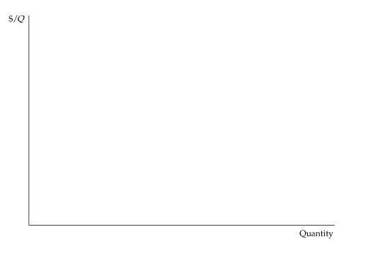
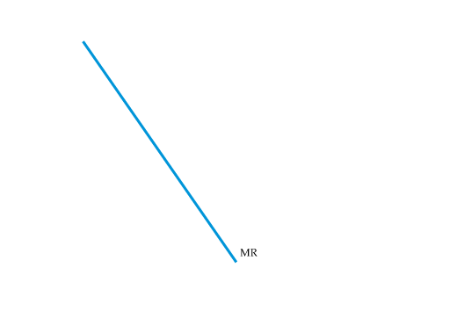
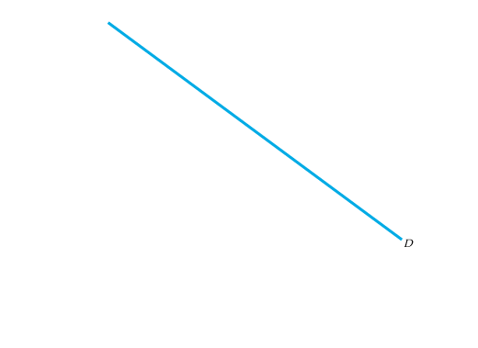
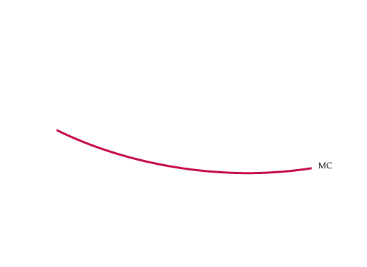
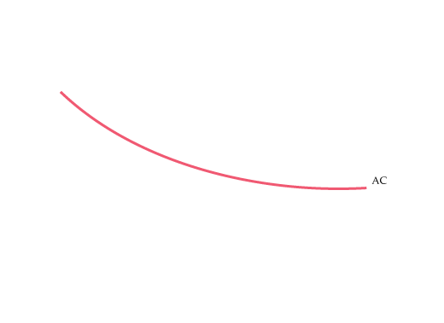
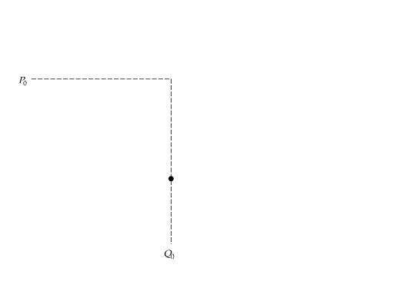
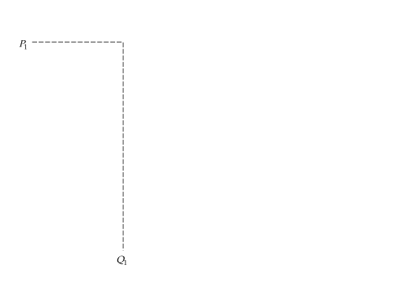
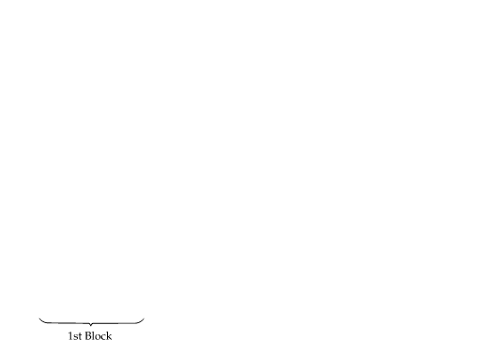
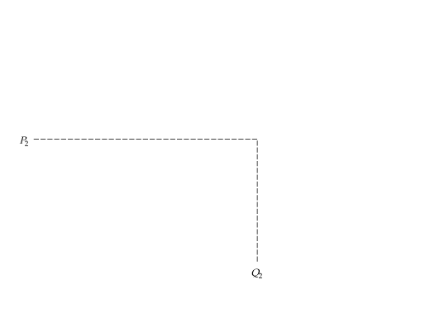
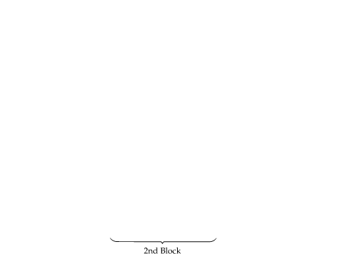
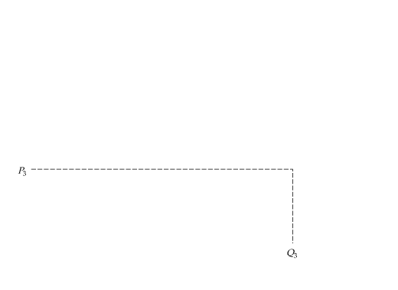
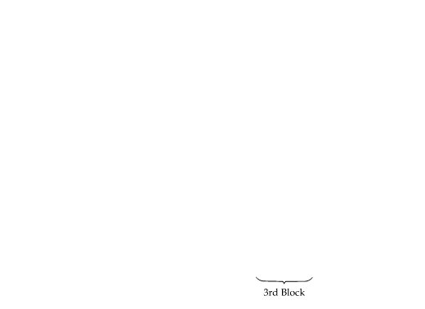
Second-Degree Price Discrimination
● second-degree price discrimination Practice of charging different prices per unit for different quantities of the same good or service.
● block pricing Practice of charging different prices for different quantities or “blocks” of a good.
FIGURE 11.4
SECOND-DEGREE PRICE DISCRIMINATION
Different prices are charged for different quantities, or “blocks,” of the same good. Here, there are three blocks, with corresponding prices P₁, P₂, and P₃.
There are also economies of scale, and average and marginal costs are declining. Second-degree price discrimination can then make consumers better off by expanding output and lowering cost.

Slide 7
Third-Degree Price Discrimination
● third-degree price discrimination Practice of dividing consumers into two or more groups with separate demand curves and charging different prices to each group.
CREATING CONSUMER GROUPS
If third-degree price discrimination is feasible, how should the firm decide what price to charge each group of consumers?
We know that however much is produced, total output should be divided
between the groups of customers so that marginal revenues for each
group are equal.
We know that total output must be such that the marginal revenue for each
group of consumers is equal to the marginal cost of production.

Slide 8



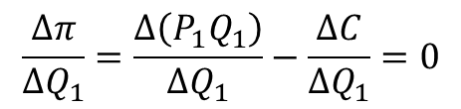
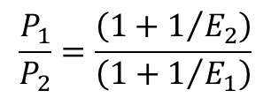

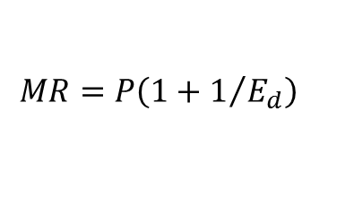
Let P₁ be the price charged to the first group of consumers, P2 the
price charged to the second group, and C(QT) the total cost of
producing output Q_{T} = Q₁ + Q₂. Total profit is then
$$π=P_{1}Q_{1}+P_{2}Q_{2}−C\left(Q_{T}\right)$$
$$\frac{∆π}{∆Q_{1}}=\frac{∆\left(P_{1}Q_{1}\right)}{∆Q_{1}}−\frac{∆C}{∆Q_{1}}=0$$
$${\text{MR}}_{1}=\text{MC}$$
$${\text{MR}}_{2}=\text{MC}$$
(11.1)
$${\text{MR}}_{1}={\text{MR}}_{2}=\text{MC}$$
DETERMINING RELATIVE PRICES
$$MR=P\left(1+1/{E_{d}}\right)$$
(11.2)
$$\frac{P_{1}}{P_{2}}=\frac{\left(1+1/{E_{2}}\right)}{\left(1+1/{E_{1}}\right)}$$

Slide 9
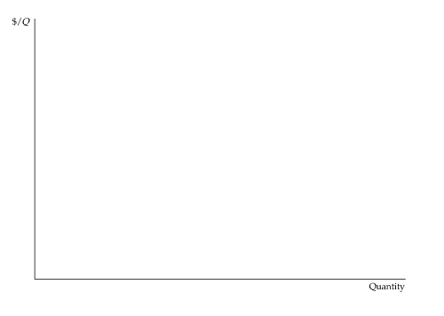
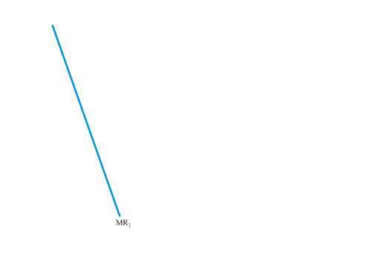
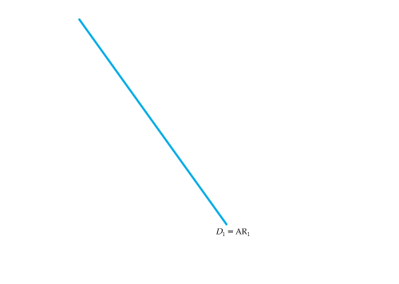
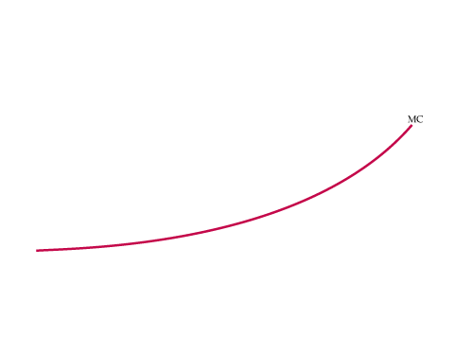
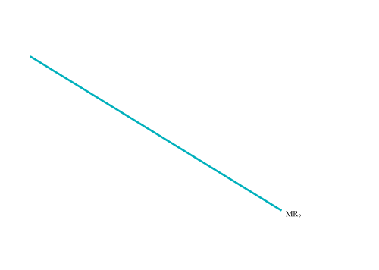





FIGURE 11.5
THIRD-DEGREE PRICE DISCRIMINATION
Consumers are divided into two groups, with separate demand curves for each group. The optimal prices and quantities are such that the marginal revenue from each group is the same and equal to marginal cost.
Here group 1, with demand curve D₁, is charged P₁,
and group 2, with the more elastic demand curve D₂, is charged the lower price P₂.
Marginal cost depends on the total quantity produced Q_{T}.
Note that Q₁ and Q₂ are chosen so that MR₁ = MR₂ = MC.

Slide 10








FIGURE 11.6
NO SALES TO SMALLER MARKETS
Even if third-degree price discrimination is feasible, it may not pay to sell to both groups of consumers if marginal cost is rising.
Here the first group of consumers, with demand D₁, are not willing to pay much for the product.
It is unprofitable to sell to them because the price would have to be too low to compensate for the resulting increase in marginal cost.

Slide 11

EXAMPLE 11.1
THE ECONOMICS OF COUPONS AND REBATES
  Coupons provide a means of price discrimination.
TABLE 11.1 | PRICE ELASTICITIES OF DEMAND FOR USERS VERSUS NONUSERS OF COUPONS
 |  | PRICE ELASTICITY
PRODUCT |  | NONUSERS | USERS
Toilet tissue |  | – 0.60 | –0.66
Stuffing/dressing |  | –0.71 | –0.96
Shampoo |  | –0.84 | –1.04
Cooking/salad oil |  | –1.22 | –1.32
Dry mix dinners |  | –0.88 | –1.09
Cake mix |  | –0.21 | –0.43
Cat food |  | –0.49 | –1.13
Frozen entrees |  | –0.60 | –0.95
Gelatin |  | –0.97 | –1.25
Spaghetti sauce |  | –1.65 | –1.81
Crème rinse/conditioner |  | –0.82 | –1.12
Soups |  | –1.05 | –1.22
Hot dogs |  | –0.59 | –0.77

Slide 12
EXAMPLE 11.2
AIRLINE FARES
Travelers are often amazed at the variety of fares available for round-trip flights from New York to Los Angeles.
Recently, for example, the first-class fare was above $2000; the regular (unrestricted) economy fare was about $1000, and special discount fares (often requiring the purchase of a ticket two weeks in advance and/or a Saturday night stayover) could be bought for as little as $200. These fares provide a profitable form of price discrimination. The gains from discriminating are large because different types of customers, with very different elasticities of demand, purchase these different types of tickets.
Airline price discrimination has become increasingly sophisticated. A wide variety of fares is available.
TABLE 11.2 | ELASTICITIES OF DEMAND FOR AIR TRAVEL
 |  | FARE CATEGORY
ELASTICITY |  | FIRST CLASS | UNRESTRICTED COACH | DISCOUNTED
Price |  | –0.3 | –0.4 | –0.9
Income |  | 1.2 | 1.2 | 1.8

Slide 13








11.3
Intertemporal Price Discrimination
and Peak-Load Pricing
● intertemporal price discrimination Spending money in socially unproductive efforts to acquire, maintain, or exercise monopoly.
● peak-load pricing Spending money in socially unproductive efforts to acquire, maintain, or exercise monopoly.
Intertemporal Price Discrimination
FIGURE 11.7
INTERTEMPORAL PRICE DISCRIMINATION
Consumers are divided into groups by changing the price over time.
Initially, the price is high. The firm captures surplus from consumers who have a high demand for the good and who are unwilling to wait to buy it.
Later the price is reduced to appeal to the mass market.

Slide 14








Peak-Load Pricing
FIGURE 11.8
PEAK-LOAD PRICING
Demands for some goods and services increase sharply during particular times of the day or year.
Charging a higher price P₁ during the peak periods is more profitable for the firm than charging a single price at all times.
It is also more efficient because marginal cost is higher during peak periods.

Slide 15

EXAMPLE 11.3
HOW TO PRICE A BEST-SELLING NOVEL
  Publishing both hardbound and paperback
  editions of a book allows publishers to price
  discriminate.
  Some consumers want to buy a new bestseller
  as soon as it is released, even if the price is $25.
  Other consumers, however, will wait a year until
  the book is available in paperback for $10.
The key is to divide consumers into two groups, so that those who are willing to pay a high price do so and only those unwilling to pay a high price wait and buy the paperback.
It is clear, however, that those consumers willing to wait for the paperback edition have demands that are far more elastic than those of bibliophiles.
It is not surprising, then, that paperback editions sell for so much less than hardbacks.

Slide 16





11.4
The Two-Part Tariff
● two-part tariff Form of pricing in which consumers are charged both an entry and a usage fee.
SINGLE CONSUMER
FIGURE 11.9
TWO-PART TARIFF WITH A SINGLE CONSUMER
The consumer has demand curve D.
The firm maximizes profit by setting usage fee P equal to marginal cost
and entry fee T* equal to the entire surplus of the consumer.

Slide 17









TWO CONSUMERS
FIGURE 11.10
TWO-PART TARIFF WITH TWO CONSUMERS
The profit-maximizing usage fee P* will exceed marginal cost.
The entry fee T* is equal to the surplus of the consumer with the smaller demand.
The resulting profit is 2T* + (P* − MC)(Q₁ + Q₂). Note that this profit is larger than twice the area of triangle ABC.

Slide 18





MANY CONSUMERS
FIGURE 11.11
TWO-PART TARIFF WITH MANY DIFFERENT CONSUMERS
Total profit π is the sum of the profit from the entry fee π_{a} and the profit from sales π_{s}. Both π_{a} and π_{s} depend on T, the entry fee.
Therefore
π = π_{a} + π_{s} = n(T)T + (P − MC)Q(n)
where n is the number of entrants, which depends on the entry fee T, and Q is the rate of sales, which is greater the larger is n.
Here T* is the profit-maximizing entry fee, given P. To calculate optimum values for P and T, we can start with a number for P, find the optimum T, and then estimate the resulting profit.
P is then changed and the corresponding T recalculated, along with the new profit level.

Slide 19

EXAMPLE 11.4
PRICING CELLULAR PHONE SERVICE
Most telephone service is priced using a two-part tariff:
a monthly access fee, which may include some free
minutes, plus a per-minute charge for additional
minutes. This is also true for cellular phone service,
which has grown explosively, both in the United States
and around the world.
In the case of cellular service, providers have taken the
two-part tariff and turned it into an art form.
In most parts of the United States, consumers can choose among four national network providers—Verizon, T-Mobile, AT&T, and Sprint. These providers compete among themselves for customers, but each has some market power. Market power arises in part from oligopolistic pricing and output decisions, but also because consumers face switching costs: Most service providers impose a penalty upwards of $200 for early termination. Because providers have market power, they must think carefully about profit-maximizing pricing strategies. The two-part tariff provides an ideal means by which cellular providers can capture consumer surplus and turn it into profit.
The two-part tariff works best when consumers have identical or very similar demands.

Slide 20
EXAMPLE 11.4
PRICING CELLULAR PHONE SERVICE
TABLE 11.3 | CELLULAR RATE PLANS (2011)
ANYTIME MINUNTES | MONTHLY ACCESS CHARGES | NIGHT & WEEKEND MINUTES | PER-MINUTE RATE AFTER ALLOWANCE
A. VERIZON: AMERICA’S CHOICE BASIC
450 | $39.99 | Unlimited | $0.45
900 | $59.99 | Unlimited | $0.40
Unlimited | $69.99 | Unlimited | Included
B. SPRINT: BASIC TALK PLANS
200 | $29.99 | Unlimited | $0.45
450 | $39.99 | Unlimited | $0.45
900 | $59.99 | Unlimited | $0.40
C. AT&T INDIVIDUAL PLANS
450 | $39.99 | 5000 | $0.45
900 | $59.99 | Unlimited | $0.40
Unlimited | $69.99 | Unlimited | Included

Slide 21
EXAMPLE 11.4
PRICING CELLULAR PHONE SERVICE
TABLE 11.3 | CELLULAR RATE PLANS (2011) (continued)
ANYTIME MINUNTES | MONTHLY ACCESS CHARGES | NIGHT & WEEKEND MINUTES | PER-MINUTE RATE AFTER ALLOWANCE
D. ORANGE (UK)
100 | £10.00 | None | 2.5 pence
200 | £15.00 | None | 2.5 pence
300 | £20.00 | None | 2.5 pence
E. ORANGE (ISRAEL)
None | 28.00 NIS | None | 0.59 NIS
100 | 38.00 NIS | None | 0.59 NIS
400 | 61.90 NIS | None | 0.59 NIS
F. CHINA MOBILE
150 | 58 RMB | None | 0.40 RMB
450 | 158 RMB | None | 0.35 RMB
800 | 258 RMB | None | 0.32 RMB
1200 | 358 RMB | None | 0.30 RMB
1800 | 458 RMB | None | 0.25 RMB
To convert the international prices to U.S. dollars (as of August 2011), use the following conversion factors: 1£ = $1.60, 1 NIS = $0.30, and 1 RMB = $0.13.
TABLE 11.3 | CELLULAR RATE PLANS (2011) (continued)
ANYTIME MINUNTES | MONTHLY ACCESS CHARGES | NIGHT & WEEKEND MINUTES | PER-MINUTE RATE AFTER ALLOWANCE

Slide 22
11.5
Bundling
● bundling Practice of selling two or more products as a package.
To see how a film company can use customer heterogeneity to its advantage, suppose that there are two movie theaters and that their reservation prices for our two films are as follows:
 | GONE WITH THE WIND |  |  | GETTING GERTIE’S GARTER
Theater A |  | $12,000 | $3000
Theater B |  | $10,000 | $4000
If the films are rented separately, the maximum price that could be charged for Wind is $10,000 because charging more would exclude Theater B. Similarly, the maximum price that could be charged for Gertie is $3000.
But suppose the films are bundled. Theater A values the pair of films at $15,000 ($12,000 + $3000), and Theater B values the pair at $14,000
($10,000 + $4000). Therefore, we can charge each theater $14,000 for the pair of films and earn a total revenue of $28,000.

Slide 23
Relative Valuations
Why is bundling more profitable than selling the films separately? Because the relative valuations of the two films are reversed.
The demands are negatively correlated—the customer willing to pay the most for Wind is willing to pay the least for Gertie.
Suppose demands were positively correlated—that is, Theater A would pay more for both films:
 | GONE WITH THE WIND |  |  | GETTING GERTIE’S GARTER
Theater A |  | $12,000 | $4000
Theater B |  | $10,000 | $3000
If we bundled the films, the maximum price that could be charged for the package is $13,000, yielding a total revenue of $26,000, the same as by renting the films separately.

Slide 24







FIGURE 11.12
RESERVATION PRICES
Reservation prices r₁ and r₂ for two goods are shown for three consumers, labeled A, B, and C.
Consumer A is willing to pay up to $3.25 for good 1 and up to $6 for good 2.

Slide 25







FIGURE 11.13
CONSUMPTION DECISIONS WHEN PRODUCTS ARE SOLD SEPARATELY
The reservation prices of consumers in region I exceed the prices P₁ and P₂ for the two goods, so these consumers buy both goods.
Consumers in regions II and IV buy only one of the goods,
and consumers in region III buy neither good.

Slide 26





FIGURE 11.14
CONSUMPTION DECISIONS WHEN PRODUCTS ARE BUNDLED
Consumers compare the sum of their reservation prices r₁ + r₂, with the price of the bundle P_{B}.
They buy the bundle only if r₁ + r₂ is at least as large as P_{B}.

Slide 27







FIGURE 11.15
RESERVATION PRICES
In (a), because demands are perfectly positively correlated, the firm does not gain by bundling: It would earn the same profit by selling the goods separately.
In (b), demands are perfectly negatively correlated. Bundling is the ideal strategy—all the consumer surplus can be extracted.

Slide 28




FIGURE 11.16
MOVIE EXAMPLE
Consumers A and B are two movie theaters. The diagram shows their reservation prices for the films Gone with the Wind and Getting Gertie’s Garter.
Because the demands are negatively correlated, bundling pays.

Slide 29








Mixed Bundling
● mixed bundling Selling two or more goods both as a package and individually.
● pure bundling Selling products only as a package.
FIGURE 11.17
MIXED VERSUS PURE BUNDLING
With positive marginal costs, mixed bundling may be more profitable than pure bundling.
Consumer A has a reservation price for good 1 that is below marginal cost c₁,
and consumer D has a reservation price for good 2 that is below marginal cost c₂.
With mixed bundling, consumer A is induced to buy only good 2, and consumer D is induced to buy only good 1, thus reducing the firm’s cost.

Slide 30
Let’s compare three strategies:
1. Selling the goods separately at prices P₁ = $50 and P₂ = $90.
2. Selling the goods only as a bundle at a price of $100.
3. Mixed bundling, whereby the goods are offered separately at prices P₁ = P₂ = $89.95, or as a bundle at a price of $100.
TABLE 11.4 | BUNDLING EXAMPLE
 |  | P₁ | P₂ | P₃ | PROFIT
Sold separately |  | $50 | $90 | — | $150
Pure bundling |  | — | — | $100 | $200
Mixed bundling |  | $89.95 | $89.95 | $100 | $229.90
As we should expect, pure bundling is better than selling the goods separately because consumers’ demands are negatively correlated. But what about mixed bundling?

Slide 31







FIGURE 11.18
MIXED BUNDLING WITH ZERO MARGINAL COSTS
If marginal costs are zero, and if consumers’ demands are not perfectly negatively correlated, mixed bundling is still more profitable than pure bundling.
In this example, consumers B and C are willing to pay $20 more for the bundle than are consumers A and D.
With pure bundling, the price of the bundle is $100. With mixed bundling, the price of the bundle can be increased to $120 and consumers A and D can still be charged $90 for a single good.
TABLE 11.5 | MIXED BUNDLING WITH ZERO MARGINAL COSTS
 |  | P₁ | P₂ | P₃ | PROFIT
Sold separately |  | $80 | $80 | — | $320
Pure bundling |  | — | — | $100 | $400
Mixed bundling |  | $90 | $90 | $120 | $420

Slide 32









Bundling in Practice
FIGURE 11.19
MIXED BUNDLING IN PRACTICE
The dots in this figure are estimates of reservation prices for a representative sample of consumers.
A company could first choose a price for the bundle, P_{B}, such that a diagonal line connecting these prices passes roughly midway through the dots.
The company could then try individual prices P₁ and P₂.
Given P₁, P₂, and P_{B}, profits can be calculated for this sample of consumers. Managers can then raise or lower P₁, P₂, and P_{B} and see whether the new pricing leads to higher profits. This procedure is repeated until total profit is roughly maximized.

Slide 33

EXAMPLE 11.5
THE COMPLETE DINNER VERSUS À LA CARTE: A RESTAURANT PRICING PROBLEM
  For a restaurant, mixed bundling means offering
  both complete dinners (the appetizer, main
  course, and dessert come as a package) and
  an à la carte menu (the customer buys the
  appetizer, main course, and dessert separately).
This strategy allows the à la carte menu to be
priced to capture consumer surplus from customers who value some dishes much more highly than others.
At the same time, the complete dinner retains those customers who have lower variations in their reservation prices for different dishes (e.g., customers who attach moderate values to both appetizers and desserts).

Slide 34
EXAMPLE 11.5
THE COMPLETE DINNER VERSUS À LA CARTE: A RESTAURANT PRICING PROBLEM
  For a restaurant, mixed bundling means offering complete dinners and an à la carte menu. This strategy allows the à la carte menu to be priced to capture consumer surplus from customers who value some dishes much more highly than others. Successful restaurateurs know their customers’ demand characteristics and use that knowledge to design a pricing strategy that extracts as much consumer surplus as possible.
TABLE 11.6 | MIXED BUNDLING AT MCDONALD’S (2011)
INDIVIDUAL ITEM |  | PRICE | MEAL (INCLUDES SODA AND FRIES) | UNBUNDLED PRICE | PRICE OF BUNDLE | SAVINGS
Chicken Sandwich |  | $5.49 | Chicken Sandwich | $10.07 | $7.89 | $2.18
Filet-O-Fish |  | $4.39 | Filet-O-Fish | $8.97 | $6.79 | $2.18
Big Mac |  | $4.69 | Big Mac | $9.27 | $6.99 | $2.28
Quarter Pounder |  | $4.69 | Quarter Pounder | $9.27 | $7.19 | $2.08
Double Quarter Pounder |  | $6.09 | Double Quarter Pounder | $10.67 | $8.39 | $2.28
10-piece Chicken McNuggets |  | $5.19 | 10-piece Chicken McNuggets | $9.77 | $7.59 | $2.18
Large French Fries |  | $2.59
Large Soda |  | $1.99

Slide 35
Tying
● tying Practice of requiring a customer to purchase one good in order to purchase another.
Why might firms use this kind of pricing practice?
One of the main benefits of tying is that it often allows a firm to meter demand and thereby practice price discrimination more effectively.
Tying can also be used to extend a firm’s market power.
Tying can have other uses. An important one is to protect customer goodwill connected with a brand name.
This is why franchises are often required to purchase inputs from the franchiser.

Slide 36


















11.6
Advertising
FIGURE 11.20
EFFECTS OF ADVERTISING
AR and MR are average and marginal revenue when the firm doesn’t advertise,
and AC and MC are average and marginal cost.
The firm produces Q₀ and receives a price P₀.
Its total profit π₀ is given by the gray-shaded rectangle.
If the firm advertises, its average and marginal revenue curves shift to the right.
Average cost rises (to AC′) but marginal cost remains the same.
The firm now produces Q₁ (where MR′ = MC), and receives a price P₁.
Its total profit, π₁, is now larger.

Slide 37


The price P and advertising expenditure A to maximize profit, is given by:
$$π=PQ\left(P, A\right)−C\left(Q\right)−A$$
Advertising leads to increased output.
But increased output in turn means increased production costs, and this must be taken into account when comparing the costs and benefits of an extra dollar of advertising.
The firm should advertise up to the point that
$${\text{MR}}_{Ads}=P\frac{∆Q}{∆A}=1+\text{MC}\frac{∆Q}{∆A}$$
(11.3)
= full marginal cost of advertising

Slide 38



A Rule of Thumb for Advertising
First, rewrite equation (11.3) as follows:
$$\left(P−\text{MC}\right)\frac{∆Q}{∆A}=1$$
Now multiply both sides of this equation by A/PQ, the advertising-to-sales ratio.
● advertising-to-sales ratio Ratio of a firm’s advertising expenditures to its sales.
$$\frac{P−\text{MC}}{P}\left[\frac{A}{Q}\frac{∆Q}{∆A}\right]=\frac{A}{PQ}$$
● advertising elasticity of demand Percentage change in quantity demanded resulting from a 1-percent increase in advertising expenditures.
$$A/{PQ=−\left({E_{A}}/{E_{P}}\right)}$$
(11.4)

Slide 39

EXAMPLE 11.6
ADVERTISING IN PRACTICE
  Convenience stores have lower price elasticities of
  demand (around −5), but their advertising-to-sales
  ratios are usually less than those for supermarkets
  (and are often zero). Why?
Because convenience stores mostly serve customers who live nearby; they may need a few items late at night or may simply not want to drive to the supermarket.
Advertising is quite important for makers of designer jeans, who will have advertising-to-sales ratios as high as 10 or 20 percent.
Laundry detergents have among the highest advertising-to-sales ratios of all products, sometimes exceeding 30 percent, even though demand for any one brand is at least as price elastic as it is for designer jeans. What justifies all the advertising? A very large advertising elasticity.

Slide 40
EXAMPLE 11.6
ADVERTISING IN PRACTICE
TABLE 11.7 | SALES AND ADVERTISING EXPENDITURES FOR LEADING BRANDS OF OVER-THE-COUNTER DRUGS (IN MILLIONS OF DOLLARS)
 |  | SALES | ADVERTISING | RATIO (%)
Pain Medications
Tylenol |  | 855 | 143.8 | 17
Advil |  | 360 | 91.7 | 26
Bayer |  | 170 | 43.8 | 26
Excedrin |  | 130 | 26.7 | 21
Antacids
Alka-Seltzer |  | 160 | 52.2 | 33
Mylanta |  | 135 | 32.8 | 24
Tums |  | 135 | 27.6 | 20

Slide 41
EXAMPLE 11.6
ADVERTISING IN PRACTICE
TABLE 11.4 | SALES AND ADVERTISING EXPENDITURES FOR LEADING BRANDS OF OVER-THE-COUNTER DRUGS (IN MILLIONS OF DOLLARS) (continued)
 |  | SALES | ADVERTISING |  | RATIO (%)
Cold Remedies (decongestants)
Benadryl |  | 130 |  | 30.9 | 24
Sudafed |  | 115 |  | 28.6 | 25
Cough Medicine
Vicks |  | 350 |  | 26.6 | 8
Robitussin |  | 205 |  | 37.7 | 19
Halls |  | 130 |  | 17.4 | 13
TABLE 11.7 | SALES AND ADVERTISING EXPENDITURES FOR LEADING BRANDS OF OVER-THE-COUNTER DRUGS (IN MILLIONS OF DOLLARS) (continued)

Slide 42
Appendix to Chapter 11
The Vertically Integrated Firm
● horizontal integration Organizational form in which several plants produce the same or related products for a firm.
● vertical integration Organizational form in which a firm contains several divisions, with some producing parts and components that others use to produce finished products.
● transfer prices Internal prices at which parts and components from upstream divisions are “sold” to downstream divisions within a firm..

Slide 43
Why Vertically Integrate?
Market Power and Double Marginalization
How do firms along a vertical chain exercise such monopoly power, and how are prices and output affected? Would the firms benefit from a vertical merger that integrates an upstream and a related downstream business? Would consumers?
Suppose an engine manufacturer has monopoly power in the market for engines, and an automobile manufacturer that buys these engines has monopoly power in the market for its cars. Would this market power cause these two firms to benefit in any way if they were to merge? Would consumers of the final product—automobiles—be better or worse off if the two companies merged?
When there is market power of this sort, a vertical merger can be beneficial to the two firms, and also beneficial to consumers.

Slide 44



SEPARATE FIRMS
Suppose a monopolist producer of specialty engines produces those engines at a constant marginal cost c_{E}, and sells the engines at a price P_{E}. The engines are bought by a monopolist producer of sports cars, which sells the cars at the price P. Demand for the cars is given by
(A11.1)
$$Q=A−P$$
with the constant A > c_{E}.
If the two companies are independent of each other, the automobile manufacturer will take the price of engines as given, and choose a price for its cars to maximize its profits:
(A11.2)
$$π_{A}=\left(P−P_{E}\right)\left(A−P\right)$$
You can check that given P_{E}, the profit maximizing price of cars is:
(A11.3)
$$P^{∗}=\frac{1}{2}\left(A+P_{E}\right)$$

Slide 45




SEPARATE FIRMS
Then the number of cars sold and the automobile company’s profit are:
(A11.4)
$$Q=\frac{1}{2}(A−P_{E})$$
and
(A11.5)
$$π_{A}=\frac{1}{4}{\left(A−P_{E}\right)}^{2}$$
What about the engine manufacturer? It chooses the price of engines, P_{E}, to maximize its profit:
$$π_{E}=\left(P_{E}−c_{E}\right)Q\left(P_{E}\right)$$
$$=\left(P_{E}−c_{E}\right)\frac{1}{2}\left(A−P_{E}\right)$$
(A11.6)

Slide 46





You can confirm that the profit-maximizing price of engines is:
$$P_{E}^{∗}=\frac{1}{2}(A+c_{E})$$
(A11.7)
The profit to the engine manufacturer is then equal to:
$$π_{E}^{∗}+\frac{1}{8}{\left(A−c_{E}\right)}^{2}$$
(A11.8)
In Equation (A11.5), substitute for the price of engines from equation (A11.7) . You will see that the automobile company’s profit is then:
$$π_{A}^{∗}+\frac{1}{16}{\left(A−c_{E}\right)}^{2}$$
(A11.9)
Hence the total profit for the two companies is:
$$π_{TOT}^{∗}=π_{A}^{∗}+π_{E}^{∗}=\frac{3}{16}{\left(A−c_{E}\right)}^{2}$$
(A11.10)
Also, the price paid by consumers is:
$$P^{∗}=\frac{1}{4}\left(3A+c_{E}\right)$$
(A11.11)

Slide 47



VERTICAL INTEGRATION
Now suppose that the engine company and the automobile company merge to form a vertically integrated firm. The management of this firm would choose a price of automobiles to maximize the firm’s profit:
$$π=\left(P−c_{E}\right)\left(A−P\right)$$
(A11.12)
The profit-maximizing price of cars is now:
$$P^{∗}=\left(A+c_{E}\right)/2$$
(A11.13)
which yields a profit of:
$$π^{∗}=\frac{1}{4}{\left(A+c_{E}\right)}^{2}$$
(A11.14)
Observe that the profit for the integrated firm is greater than the total profit for the two individual firms that operate independently. Furthermore, the price to consumers for automobiles is lower.
DOUBLE MARGINALIZATION
● double marginalization When each firm in a vertical chain marks up its price above its marginal cost, thereby increasing the price of the final product.

Slide 48







FIGURE A11.1 (1 of 2)
EXAMPLE OF DOUBLE MARGINALIZATION
For the automobile company, the marginal revenue curve for cars is the demand curve for engines (the net marginal revenue for engines).
Corresponding to that demand curve is the engine company’s marginal revenue curve, MR_{E}.
If the engine company and automobile company are separate entities, the engine company will produce a quantity of engines Q ′_{E} at the point where its marginal revenue curve intersects its marginal cost curve.
The automobile maker will buy those engines and produce an equal number of cars. Hence, the price of cars will be P ′_{A}.

Slide 49

FIGURE A11.1 (2 of 2)
EXAMPLE OF DOUBLE MARGINALIZATION
But if the firms merge, the integrated company will have the demand curve AR_{CARS} and marginal revenue curve MR_{CARS}.
It produces a number of engines and equal number of cars at the point where MR_{CARS} equals the marginal cost of producing cars, which is MC_{E}. Thus more engines and cars are produced, and the price of cars is lower.
ALTERNATIVES TO VERTICAL INTEGRATION
● quantity forcing Use of a sales quota or other incentives to make downstream firms sell as much as possible.

Slide 50

Transfer Pricing in the Integrated Firm
Transfer Pricing When There Is No Outside Market
Suppose the downstream automobile division had to “pay” the upstream engine division a transfer price for each engine it used. What should that transfer price be? It should equal the marginal cost of producing engines, i.e., MC_{E}. Why? Because then the automobile division will have a marginal cost of producing cars equal to MC_{E}, so that even if it is left to maximize its own divisional profit, it will produce the correct number of cars.
Another way to see this is in terms of opportunity cost. The opportunity cost to the integrated firm of utilizing one more engine is the marginal cost of engines. Thus we have a simple rule: Set the transfer price of any upstream parts and components equal to the marginal cost of producing those parts and components.
Now consider a firm with three divisions: Two upstream divisions produce inputs to a downstream processing division. The two upstream divisions produce quantities Q₁ and Q₂ and have total costs C₁(Q₁) and C₂(Q₂). The downstream division produces a quantity Q using the production function
$$Q=f\left(K, L, Q_{1}, Q_{2}\right)$$

Slide 51


We assume there are no outside markets for the intermediate inputs
Q₁ and Q₂; they can be used only by the downstream division.
Then the firm has two problems:
1. What quantities Q₁, Q₂, and Q will maximize its profit?
2. Is there an incentive scheme that will decentralize the firm’s management?
In particular, is there a set of transfer prices P₁ and P₂, so that if each division maximizes its own divisional profit, the profit of the overall firm will also be maximized?
To solve these problems, we note that the firm’s total profit is
$$π\left(Q\right)=R\left(Q\right)−C_{d}\left(Q\right)−C_{1}\left(Q_{1}\right)−C_{2}\left(Q_{2}\right)$$
(A11.15)
The net marginal revenue NMR₁ that the firm earns from an extra unit of Q₁ is (MR − MC_{d})MP₁. Setting this equal to the marginal cost of the unit, we obtain the following rule for profit maximization
$${NMR}_{1}=\left(MR−{MC}_{d}\right){MP}_{1}={MC}_{1}$$
(A11.16)
Going through the same steps for the second intermediate input gives
$${NMR}_{2}=\left(MR−{MC}_{d}\right){MP}_{2}={MC}_{2}$$
(A11.17)

Slide 52




If each of the three divisions uses these transfer prices to maximize its
own divisional profit, the profit of the overall firm should be maximized.
The two upstream divisions will maximize their divisional profits, π₁ and π₂, which are given by
$$π_{1}=P_{1}Q_{1}−C_{1}\left(Q_{1}\right)$$
and
$$π_{2}=P_{2}Q_{2}−C_{2}\left(Q_{2}\right)$$
Because the upstream divisions take P₁ and P₂ as given, they will choose Q₁ and Q₂ so that P₁ = MC₁ and P₂ = MC₂. Similarly, the downstream division will maximize
$$π\left(Q\right)=R\left(Q\right)−C_{d}\left(Q\right)−P_{1}\left(Q_{1}\right)−P_{2}\left(Q_{2}\right)$$
Because the downstream division also takes P₁ and P₂ as given, it will choose Q₁ and Q₂ so that
$$\left(\text{MR}−{\text{MC}}_{d}\right){\text{MP}}_{1}={{\text{NMR}}_{1}=P}_{1}$$
(A11.18)
and
$$\left(\text{MR}−{\text{MC}}_{d}\right){\text{MP}}_{2}={{\text{NMR}}_{2}=P}_{2}$$
(A11.19)
A simple solution to the transfer pricing problem is as follows: Set each transfer price equal to the marginal cost of the respective upstream division.

Slide 53










FIGURE A11.2
RACE CAR MOTORS, INC.
The firm’s upstream division should produce a quantity of engines Q_{E} that equates its marginal cost of engine production MC_{E} with the downstream division’s net marginal revenue of engines NMR_{E}.
Because the firm uses one engine in every car, NMR_{E} is the difference between the marginal revenue from selling cars and the marginal cost of assembling them, i.e., MR – MC_{A}.
The optimal transfer price for engines P_{E} equals the marginal cost of producing them.
Finished cars are sold at price P_{A}.
$${\text{NMR}}_{E}=\left(\text{MR}−{\text{MC}}_{A}\right){\text{MP}}_{E}=\text{MR}−{\text{MC}}_{A}$$

Slide 54










Transfer Pricing with a Competitive Outside Market
FIGURE A11.3
BUYING ENGINES IN A COMPETITIVE OUTSIDE MARKET
Race Car Motors’ marginal cost of engines MC_{E}* is the upstream division’s marginal cost for quantities up to Q_{E,1} and the market price P_{E},_{M} for quantities above Q_{E,1}.
The downstream division should use a total of Q_{E,2} engines to produce an equal number of cars; in that case, the marginal cost of engines equals net marginal revenue.
Q_{E,2} − Q_{E,1} of these engines are bought in the outside market. The downstream division “pays” the upstream division the transfer price P_{E},_{M} for the remaining Q_{E,1} engines.

Slide 55









FIGURE A11.4
SELLING ENGINES IN A COMPETITIVE OUTSIDE MARKET
The optimal transfer price for Race Car Motors is again the market price P_{E,M}. This price is above the point at which MC_{E} intersects NMR_{E}, so the upstream division sells some of its engines in the outside market.
The upstream division produces Q_{E,1} engines, the quantity at which MC_{E} equals P_{E,M}.
The downstream division uses only Q_{E,2} of these engines, the quantity at which NMR_{E} equals P_{E,M}.
Compared with Figure A11.2, in which there is no outside market, more engines but fewer cars are produced.

Slide 56
Transfer Pricing with a Noncompetitive Outside Market
Now suppose there is an outside market for the output of the upstream division, but that market is not competitive. Suppose that Race Car Motors can be a monopoly supplier to that outside market while also producing engines for its own use.
In this case, the transfer price paid to the Engine Division will be below the price at which engines are bought in the outside market. The reason is that the opportunity cost of utilizing an engine internally is just the marginal cost of producing the engine, whereas the opportunity cost of selling it outside is higher, because it includes a monopoly markup.
Sometimes a vertically integrated firm can buy components in an outside market in which it has monopsony power.
Suppose that Race Car Motors can obtain its engines from its upstream Engine Division, or can purchase them as a monopsonist in the outside market. In this case, the transfer price paid to the Engine Division will be above the price at which engines are bought in the outside market. The reason is that, with monopsony power, purchasing one additional engine in the outside market incurs a marginal expenditure that is greater than the actual price paid in that market.
Notes:
(The marginal expenditure is higher because purchasing an additional unit raises the average expenditure paid for all units bought in the outside market.) The marginal expenditure is the opportunity cost of buying an engine outside, and therefore should equal the transfer price paid to the Engine Division, so the transfer price will be greater than the price paid outside.

Slide 57
Taxes and Transfer Pricing
Taxes can play an important role in determining transfer prices when
the objective is to maximize the after-tax profits of the integrated firm.
This is especially the case when the upstream and downstream divisions of the firm operate in different countries.
To see this, suppose that the upstream Engine Division of Race Car Motors happens to be located in an Asian country with a low corporate profits tax rate, while the downstream Assembly Division is located in the United States, with a higher tax rate. Suppose that in the absence of taxes, the marginal cost and thus the optimal transfer price for an engine is $5000. How would this transfer price be affected by taxes?
In our example, the difference in tax rates will cause the opportunity cost of using an engine downstream to exceed $5000. Why? Because the downstream profit generated by the use of the engine will be taxed at a relatively high rate.
Thus, taking taxes into account, the firm will want to set a higher transfer price, perhaps $7000. This will reduce the downstream profits in the United States (so that the firm will pay less in taxes) and increase the profits of the upstream division, which faces a lower tax rate.

Slide 58





A Numerical Example
Suppose Race Car Motors has the following demand for its automobiles:
$$P=20,000−Q$$
Its marginal revenue is thus
$$\text{MR}=20,000−2Q$$
The downstream division’s cost of assembling cars is
$$C_{A}\left(Q\right)=8000Q$$
so that the division’s marginal cost is MC_{A} = 8000. The upstream division’s cost
of producing engines is
$$C_{E}\left(Q_{E}\right)=2Q_{E}^{2}$$
The division’s marginal cost is thus
$${\text{MC}}_{E}\left(Q_{E}\right)=4Q_{E}.$$

Slide 59



First, suppose there is no outside market for the engines. How many
engines and cars should the firm produce? What should be the transfer
price for engines?
To solve this problem, we set the net marginal revenue for engines equal to the marginal cost of producing engines. Because each car has one engine,
Q_{E} = Q. The net marginal revenue of engines is thus
$${\text{NMR}}_{E}=\text{MR}−{\text{MC}}_{A}=12,000−2Q_{E}$$
Now set NMR_{E} equal to MC_{E}:
$$12,000−2Q_{E}=4Q_{E}$$
Thus 6Q_{E} = 12,000 and Q_{E} = 2000. The firm should therefore produce 2000 engines and 2000 cars. The optimal transfer price is the marginal cost of these 2000 engines:
$$P_{E}=4Q_{E}=\$8000$$

Slide 60

Second, suppose that engines can be bought or sold for $6000 in an outside competitive market. This is below the $8000 transfer price that is optimal when there is no outside market, so the firm should buy some engines outside. Its marginal cost of engines, and the optimal transfer price, is now $6000. Set this $6000 marginal cost equal to the net marginal revenue of engines:
$$6000={\text{NMR}}_{E}=12,000−2Q_{E}$$
Thus the total quantity of engines and cars is now 3000. The company now produces more cars (and sells them at a lower price) because its cost of engines is lower. Also, since the transfer price for the engines is now $6000, the upstream Engine Division supplies only 1500 engines (because
MC_{E}(1500) = $6000). The remaining 1500 engines are bought in the outside market.

