Slide 1
MK422: Marketing for Entreprenuers
Midterm: 3 Business Ideas
By
Member#1
Member#2
Member#3
Member#4
Member#5

Slide 2
Problem
What is customer problem? (the problem you want your Business Idea#1 to solve)
What are the customer pain and gain?
What will happen if this problem left unsolved

Slide 3
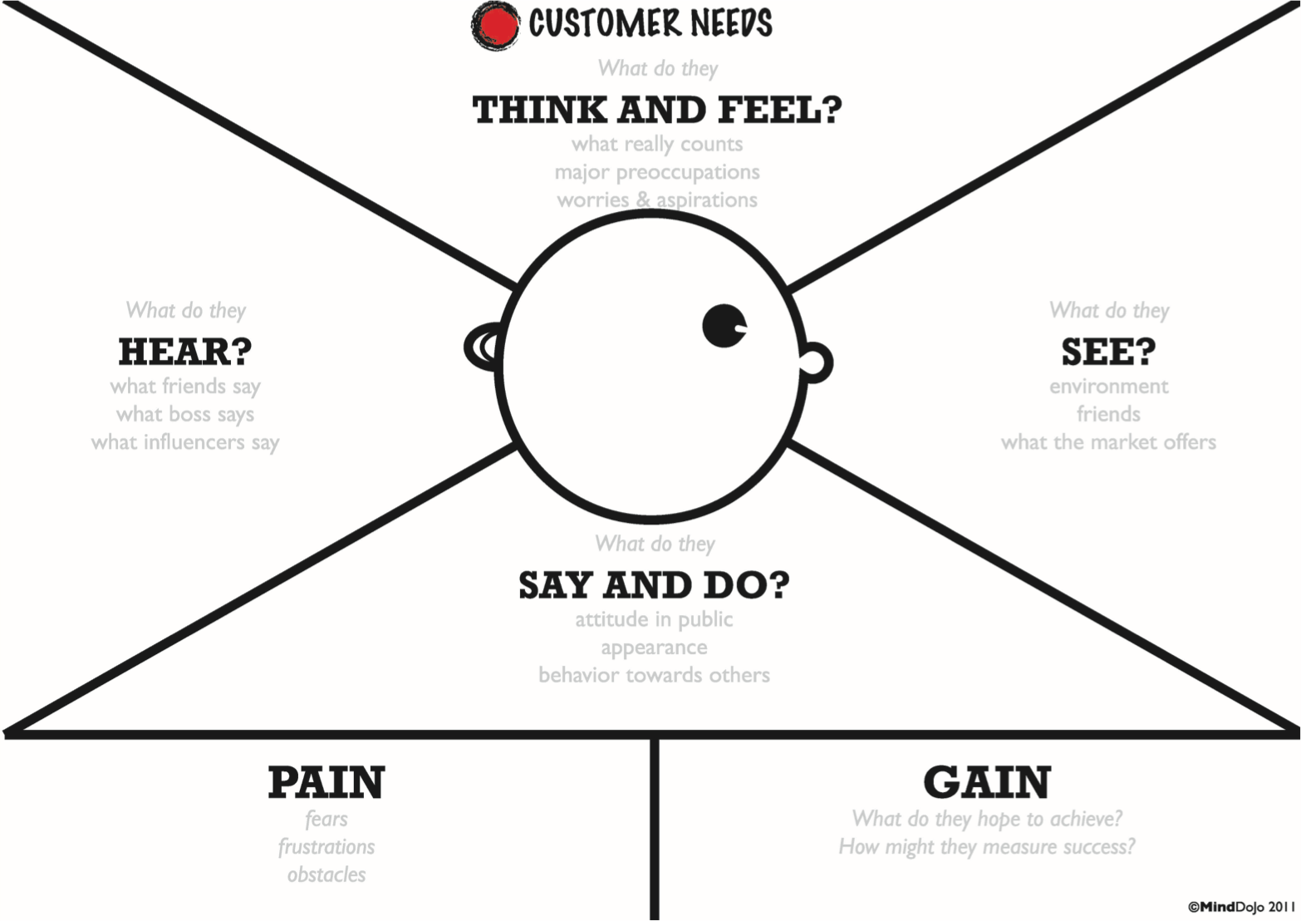
Create Customer Empathy Map of your potential customer
What are his/her pain or gain?

Slide 4
Cause
What is the root cause of the problem?

Slide 5
Opportunity
How can you create opportunity from the customer problem?
Why it has to be you solving this problem? (Your strengths or advantages over competitors)

Slide 6
What is your Business Idea#1
Explain what is your business idea #1
How can it solve customer problem?
What it is designed to do?
How does it work?

Slide 7
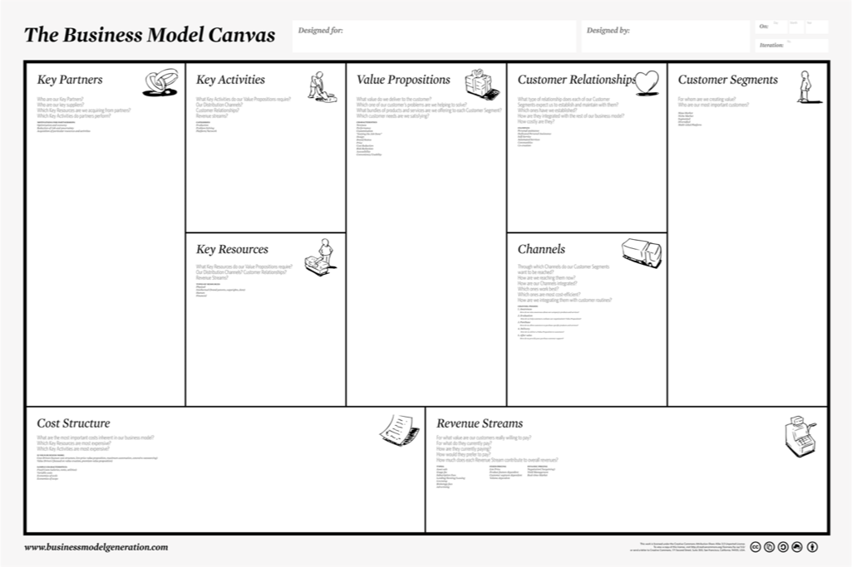
Create Business Model Canvas for your Business Idea #1

Slide 8
Mega Trend
What macro-trend? (such as AEC, aging population, health conscious or Green) is your Business Idea#1 is taking advantage of?
Consumer Trends (Status Seeker? Playsumer? Betterment?) is your business idea#1 is taking advantage of?

Slide 10
Strategy Canvas
Create Strategy Canvas for your Business Idea#1, explaining how your idea is better than the competition or the next best alternative

Slide 11
Prototype
How are you going to test desirability, feasibility and viability?
The cheapest and simplest way to get customer feedback?
A prototype can be anything!!! Be creative

Slide 12
Net Benefits for Customers
What “values” customer will get from using your business?

Slide 13
Net Benefits for You
What you will gain from implementing this business (what are the expected financial gain and other non-financial benefits)

Slide 14
Your Business Idea#1
Customer Problem
Opportunity
Megatrends
Blue Ocean Paths

Slide 15
Problem
What is customer problem? (the problem you want your Business Idea#2 to solve)
What are customer pain and gain?
What could happen if this problem left unsolved

Slide 16
Create Customer Empathy Map of your potential customer
What are his/her pain or gain?

Slide 17
Cause
What is the root cause of the problem?

Slide 18
Opportunity
How can you create opportunity from the customer problem?
Why it has to be you solving this problem? (Your strengths or advantages over competitors)

Slide 19
What is your Business Idea#2
Explain what is your Business Idea #2
How can it solve customer problem?
What it is designed to do?
How does it work?

Slide 20
Create Business Model Canvas for your Business Idea #2

Slide 22
Mega Trend
What macro-trend? (such as AEC, aging population, health conscious or Green) is your Business Idea#2 is taking advantage of?
Consumer Trends (Status Seeker? Playsumer? Betterment?) is your Business Idea#2 is taking advantage of?

Slide 23
Strategy Canvas
Create Strategy Canvas for your Business Idea#2, explaining how your idea is better than the competition or the next best alternative

Slide 24
Prototype
How are you going to test desirability, feasibility and viability?
The cheapest and simplest way to get customer feedback?
A prototype can be anything!!! Be creative

Slide 25
Net Benefits for Customers
What “values” customer will get from using your business?

Slide 26
Net Benefits for You
What you will gain from implementing this business (what are the expected financial gain and other non-financial benefits)

Slide 27
Your Business Idea#1
Customer Problem
Opportunity
Megatrends
Blue Ocean Paths

Slide 28
Problem
What is customer problem? (the problem you want your Business Idea#3 to solve)
What are customer pain and gain?
What could happen if this problem left unsolved

Slide 29
Create Customer Empathy Map of your potential customer
What are his/her pain or gain?

Slide 30
Cause
What is the root cause of the problem?

Slide 31
Opportunity
How can you create opportunity from the customer problem?
Why it has to be you solving this problem? (Your strengths or advantages over competitors)

Slide 32
What is your Business Idea#3
Explain what is your Business Idea #3
How can it solve customer problem?
What it is designed to do?
How does it work?

Slide 33
Create Business Model Canvas for your Business Idea #3

Slide 34
Mega Trend
What macro-trend? (such as AEC, aging population, health conscious or Green) is your Business Idea#3 is taking advantage of?
Consumer Trends (Status Seeker? Playsumer? Betterment?) is your Business Idea#3 is taking advantage of?

Slide 36
Strategy Canvas
Create Strategy Canvas for your Business Idea#3, explaining how your idea is better than the competition or the next best alternative

Slide 37
Prototype
How are you going to test desirability, feasibility and viability?
The cheapest and simplest way to get customer feedback?
A prototype can be anything!!! Be creative

Slide 38
Net Benefits for Customers
What “values” customer will get from using your business?

Slide 39
Net Benefits for You
What you will gain from implementing this business (what are the expected financial gain and other non-financial benefits)

Slide 40
Your Business Idea#1
Customer Problem
Opportunity
Megatrends
Blue Ocean Paths

Slide 41
Midterm
Friday, June 27, 2014 (9AM-noon)
20 minutes to present all 3 business ideas followed by 5-10 minute Q&A (manage your presenting time wisely!!!)
Pretending you’ll be presenting for investors, not ajarn!!!
3-5 presenters per team
Presenting order will be posted on FB
Feel free to be creative with your slides (we don’t want to see just text on your slides)

Slide 42
Grading Criteria
50% on how well you apply what you have learned to your business ideas
30% on the creativity of your prototypes (remember cheapest and simplest)
20% on quality of your presentation/slide design
Good luck and have fun!!!

