Slide 1

MK 322 Retail Management
Chapter 4: Consumer Buying Behavior Part I
By Ajarn Suwalya K.

Slide 2

The Buying Process

Slide 3
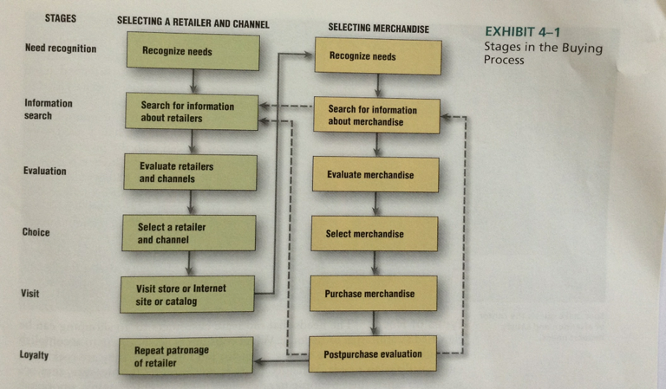
Buying Process
Notes:
1

Slide 4
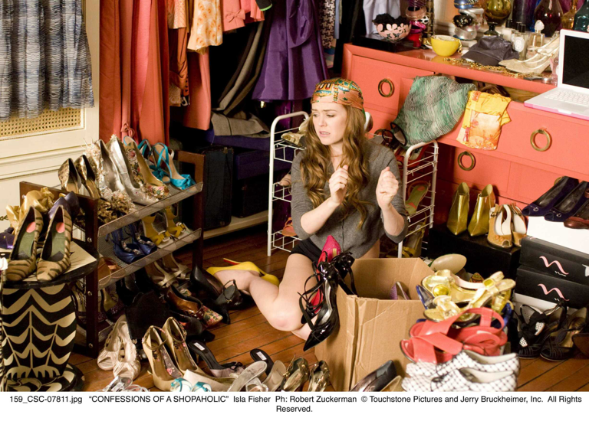
Need Recognition
An unsatisfied need arises when customers' desired level of satisfaction differs from their present level of satisfaction.
Notes:
1

Slide 5
Need Recognition-Types of Needs
Types of Needs
Utilitarian needs: when consumers are going shopping to accomplish a specific task….are associated with work, etc.
Hedonic needs: when consumers go shopping for pleasure.. Their needs for entertaining, emotional, and recreational experiences.
Notes:
1

Slide 6
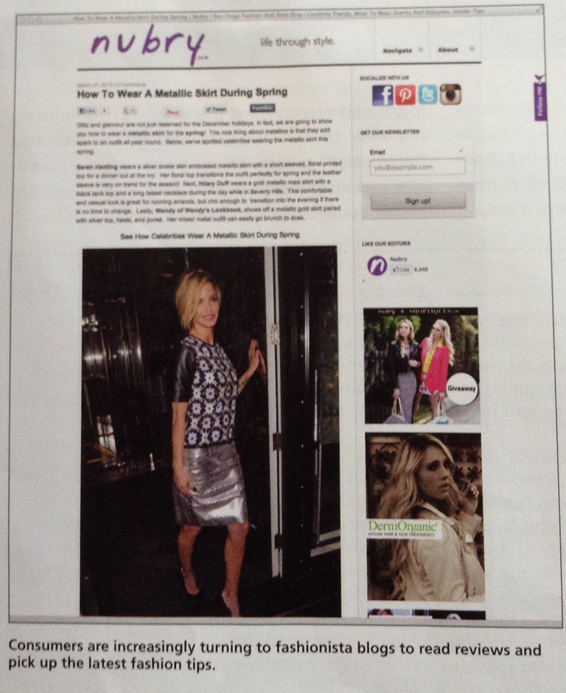
Need Recognition-Types of Needs
Notes:
1

Slide 7

Need Recognition-Types of Needs
Spas make guests the center of attention and satisfy hedonic needs
Notes:
1

Slide 8
Need Recognition-Types of needs
Successful retailers attempt to satisfy both the utilitarian and hedonic needs for their customers.
Retailers need to provide adequate information and effortless shopping experience for utilitarian shoppers.
Retailers need to provide shoppers with hedonic needs with excitement, status and power, recreation and adventure.
Notes:
1

Slide 9
Need Recognition
How retailers satisfy hedonic needs?
Stimulation: using background music, visual displays, scents, demonstration in stores, malls
Status and Power:some people choose retailers based on the attention and respect they receive
Adventure: Often consumers go shopping because they enjoy finding bargains, looking for sales, and finding discounts or low prices. They treat shopping as a game to be "won"
Notes:
1

Slide 10
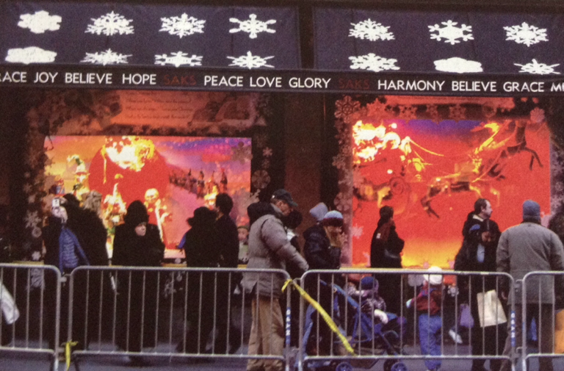
Need Recognition
Saks Fifth Avenue uses its exciting window display to stimulate need recognition.
Notes:
1

Slide 11
Need Recognition-Conflicting Needs
Most consumers have multiple needs
These needs are often in conflict
Cross-shopping: pattern of buying both premium and low-priced merchandise or patronizing both expensive, status-oriented retailers and price-oriented retailers
For example a skier may purchase expensive Spyder googles but wear inexpensive snowsuit from Target.
Notes:
1

Slide 12
Need Recognition-
Stimulating Need Recognition
Customers must first recognize unsatisfied needs before they are motivated to visit a store or go online to buy merchandise,
Sometimes they are stimulated by an event in a person's life event
Retailers use a variety of approaches to stimulate unmet needs via Advertising, e-mails, direct mail, public relations, special events,etc...
Notes:
1

Slide 13
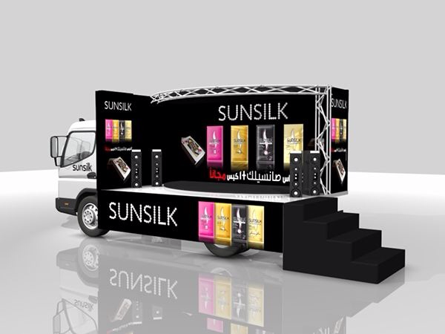
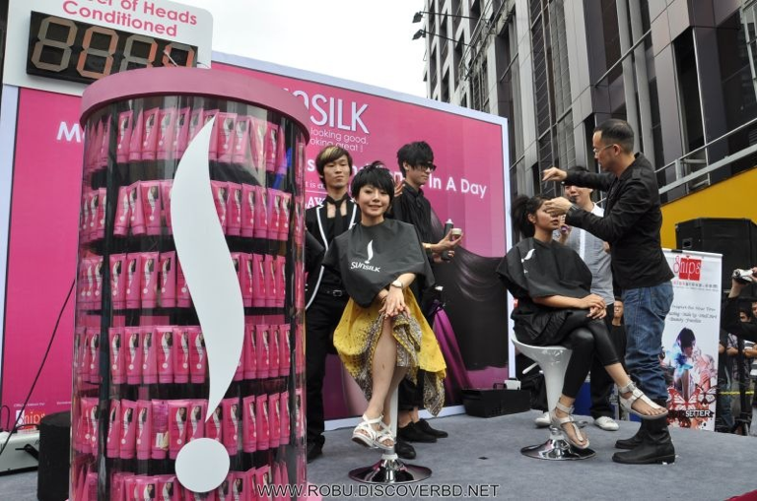
Need Recognition-
Stimulating Need Recognition
Notes:
1

Slide 14
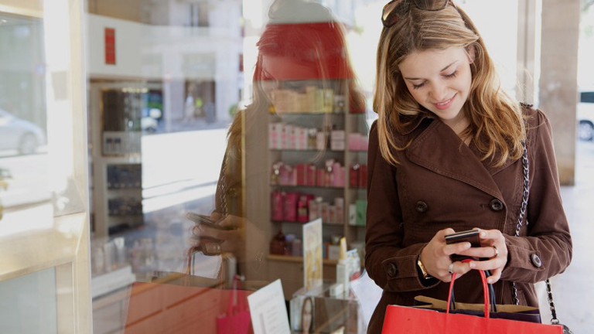
Information Search
Once customers identify a need, they typically seek information about retailers, channels, or products to help them satisfy that need
Notes:
1

Slide 15
Information Search-
Sources of Information
Internal sources:are information in a customer's memory such as names, images, and past experiences with different stores.
External sources:consist of information provided by a host of sources. Searching information from google, websites, from traditional media including advertising, product demonstrations from youtube.
Notes:
1

Slide 16

Information Search-
Amount of Information Searched
Information search undertaken depends on the value customers believe they can gain from searching versus cost of searching.
Notes:
1

Slide 17
Information Search-
Amount of Information Searched
The amount of information search is affected by
1. Characteristics of individual customers
2.Aspects of the market and buying situation in which the purchase is made
Two marketplace and situational factors affecting information search are
1. The number of competing brands and retail outlets
2. The time pressure under which the purchase must be made
Notes:
1

Slide 18
Information Search-
Reducing Information Search
The retailer's objective for customers in the information search stage is to limit the customers's search to its store or website
One measure of a retailer's performance on this objective is the conversion rate: the percentage of customers who enter a store or access a website and then buy a product from that same store or website
Each element of the retailing mix can be used to increase a retailer's conversion rate, ie, deep assortment of merchandise
Notes:
1

Slide 19
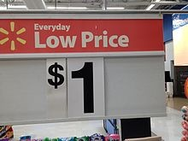
Information Search-
Reducing Information Search
Walmart, Tesco Lotus uses everyday low pricing( EDLP) stategy
Stressing continuity of retail prices at a level somewhere between the regular nonsale price and deep discount sale price of its competitors.
This strategy helps assure customers that they won't find a lower price for these products elsewhere
Notes:
1

Slide 20
Information Search- Internet, Information Search, and Price Competition
The internet and smartphones have had a profound impact on consumers'ability to gather external information
Concerns that ease of collecting price information via internet increases price competition
Internet also gives information on quality and performance apart from price
Notes:
1

Slide 21
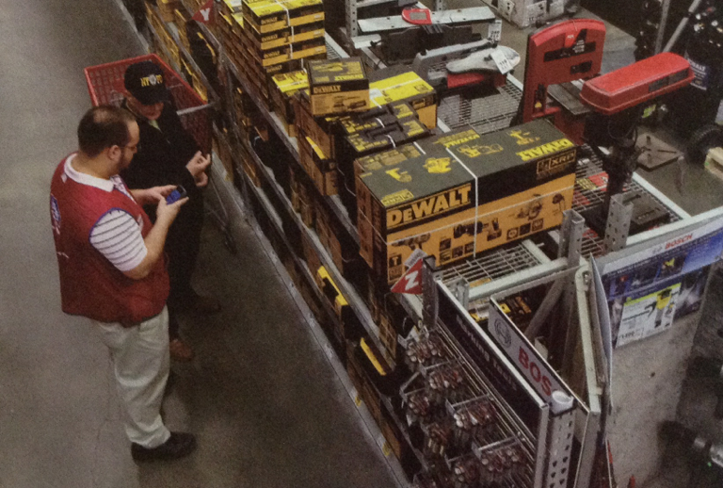
Information Search- Internet, Information Search, and Price Competition
Lowe's uses iPhones to help customers with their shopping
Notes:
1

Slide 22
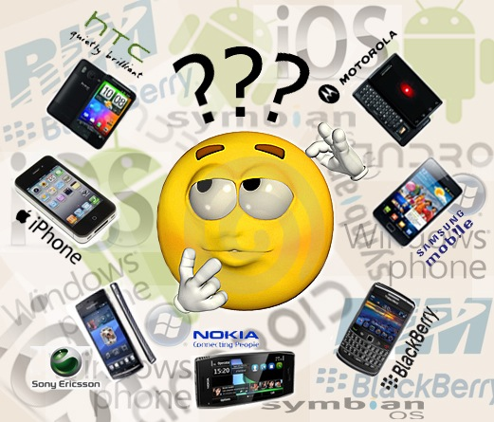
Information Search- Internet, Information Search, and Price Competition
What Apps in Thailand?
Notes:
1

Slide 23
Evaluation of Alternatives:The Multiattribute Model
This model is based on the notion that customers see a retailer, a product, or channel as a collection of a product, retailer, or channel on the basis of
1. Its performance on relevant attributes
2. The importance of those attributes to the customer
Notes:
1

Slide 24
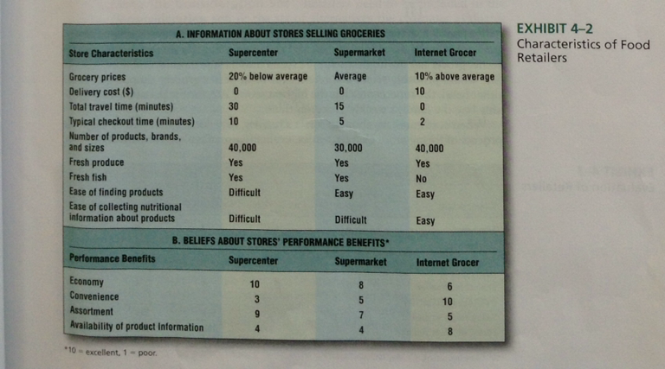
The Multiattribute Model: Beliefs about Performance
Notes:
1

Slide 25
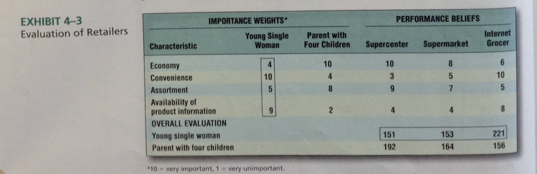
The Multiattribute Model: Importance Weights and Evaluating Retailers
Notes:
1

Slide 26
The Multiattribute Model: Implications for retailers
To develop a program for attracting customers, retailers need to do market research to collect the following information:
1. Alternative retailers that customers consider
2. Characteristics or benefits that customers consider when evaluating and choosing a retailer
3. Customers' rating of each retailer's performance on the characteristics
4. The importance weights of each retailer's performance on the characteristics
Notes:
1

Slide 27
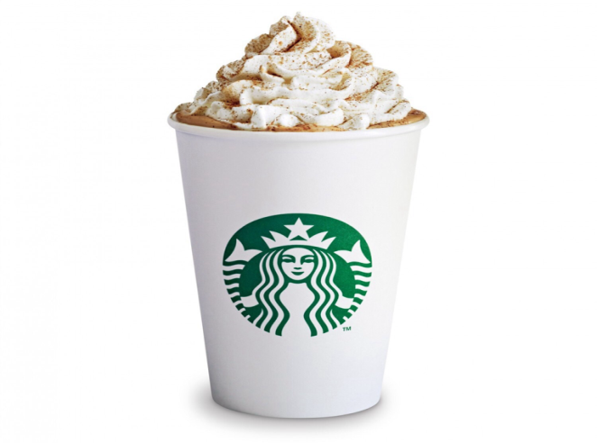
The Multiattribute Model: Getting into the Consideration Set
Retailers need to be included in the customer's consideration set, or set of alternatives the customer evaluates when making a choice of a retailer to patronize
For example Starbucks locates several stores in same area, for customers to be exposed to the store name
Notes:
1

Slide 28
The Multiattribute Model: Getting into the Consideration Set
After ensuring that it is in consumers' consideration set, a retailer can use three methods to increase the chances that customers will select it for a visit
1. Increase beliefs about the store's performance
2. Change cutomers' importance weights
3. Add a new benefit
Notes:
1

Slide 29
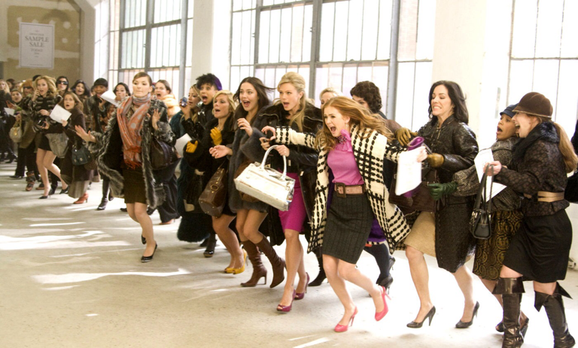
Purchasing the Merchandise or service
Customers do not always patronize a store or purchase a brand or item of merchandise with the highest overall evaluation
Notes:
1

Slide 30
Purchasing the Merchandise or service
Retailers use various tactics to increase chances that customers will convert their positive evaluations into purchases
1. Attempt to make it easy for purchase, ie. Mobile friendly websites
2.Sufficient information that reinforces positive evaluation, ie salesperson feedback
3.Reducing risk of making purchase mistake, ie money-back guarantees, refunds
4.Create sense of urgency or scarcity, ie. Flash sales
Notes:
1

Slide 31
Postpurchase Evaluation
After making a purchase, the customer evaluates the experience to determine whether it was satisfactory or unsatisfactory, or even Delighted
Satisfaction:how well a store or product meets customer expectations
Delight: how well a store or product exceeds or go beyond customer expectations
Postpurchase evaluation then becomes part of customer's internal information and affects store and product evaluations and purchase decisions
Notes:
1

Slide 32
Buying Process
Notes:
1

Slide 33


