Slide 1
Measuring growth and development
Januar Hakim, phd
Visiting instructor
Faculty of economics, Thammasat university

Slide 2
Indicators OF ECONOMIC GROWTH
Gross National Product (GNP): sum of value of finished goods and services produced by society in a given year
Gross National Income (GN1): similar to GNP but includes product taxes (less subsidies) and net receipts of primary income from abroad
Gross Domestic Product (GDP): output produced within the borders of a country (including those by foreigners) in a given year
GDP per capita: Total output divided by number of population
Real GDP: adjusted for domestic price inflation

Slide 3
difference between gnp, gdp and GNI
GNP
GDP
GNI
Total value of goods/services produced by society (citizens of a country); includes remittances from abroad; excludes foreign investments
Total value of goods/services produced within the country
(includes foreigners but excludes citizens living abroad)
GNP + product taxes (minus subsidies) not included in the valuation of output + net receipts of primary income from abroad

Slide 4

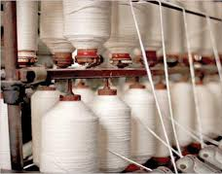


Value Added
Incremental gain to the price of a product at a particular stage of production.
Cotton balls
Cotton threads
Cotton shirts
Packaged product
tax
tax
tax

Slide 5
How is gdp calculated?
GDP = C + I + G + (X – M)
whereby:
GDP = gross domestic product (national income)
C = consumption
I = investment
G = government spending
X = exports
M = imports
GDP is not a perfect measure of national economic output. Despite its limitations it is still the most widely used measure of economic growth

Slide 6
Limitations of GDP
Does not measure non-market activities: unpaid labor such as housework
Does not measure negative externalities: pollution
Does not take into account the informal economy
Does not measure the quality of life

Slide 7
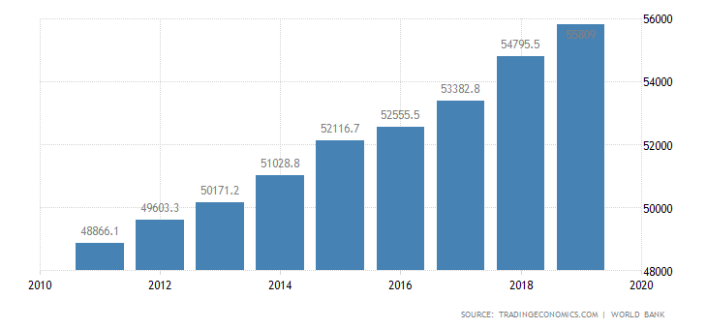
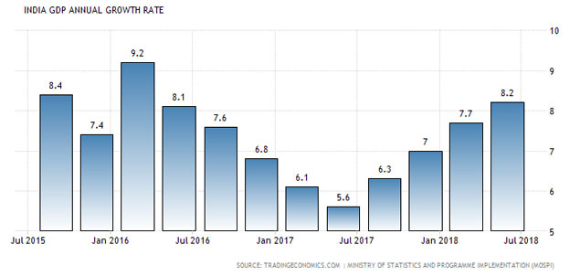
Economic growth = change in GDP over time
Rising GDP = increasing economic growth
Chart: United States GDP/capita, 2010-2020
Fluctuating GDP = decline and rebound in economic growth
Chart: India GDP annual growth rate 2015-2018

Slide 8
Comparisons of gdp/capita*
* in US $
Country
Norway
Japan
South Korea
United Kingdom
United States
China
Botswana
Viet Nam
Ethiopia
India
Year 1970
3,306
3,308
279
2,348
5,234
113
153
231
204
108
Year 2009
79,089
39,738
27,578
35,165
45,989
3,744
6,064
1,113
344
1,192
High GDP per capita during the period
Extraordinary growth
Stagnant growth

Slide 9
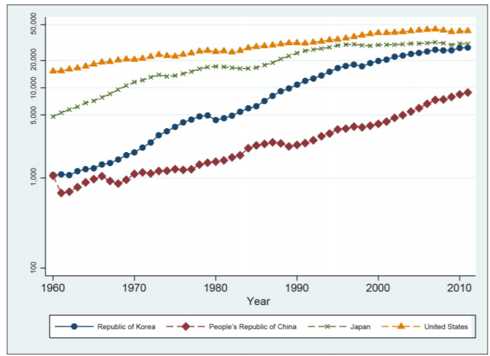
Comparison of GDP /capita of selected countries, 1960-2010*
* in US$

Slide 10
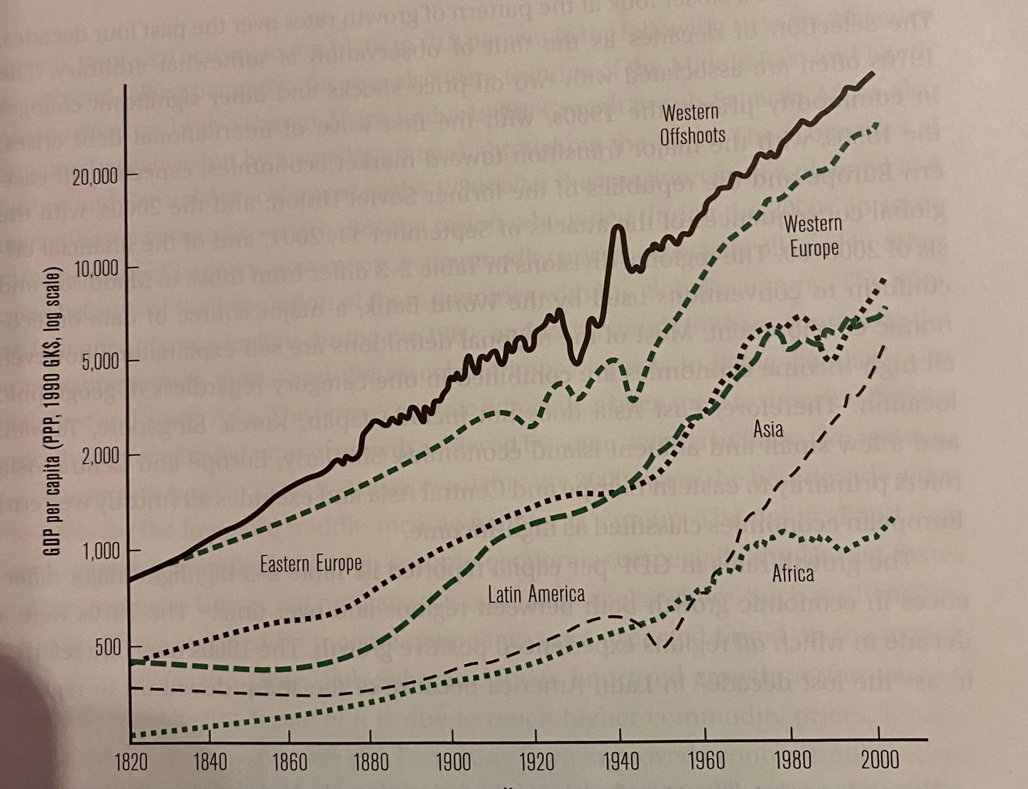
Comparison of GDP /capita of selected regions, 1820-2000*
* in US$

Slide 11
ECONOMIC DEVELOPMENT
Economic growth is a necessary but not sufficient condition for economic development
Development should not only measure income and wealth; it should also focus on people such as: expanding the capabilities of people to live the lives people choose to lead. This means: having education, a healthy life, not being poor, being safe from crime, being involved in the community

Slide 12
Human development index (HDI)
Developed by the United Nations to quantify the essential elements of human development: to have a healthy life, to acquire knowledge, and have access to resources that are essential to lead a long and healthy life. GDP alone does not capture this.
Long and healthy life: life expectancy, mortality rate
Acquire knowledge: years of schooling, enrollment rate, literacy rate
Access to resources: transforming GNI per capita values into rankings

Slide 13
Limitations of hdi
Unlike GDP, HDI is difficult to measure and comparisons across country data may be difficult
HDI captures only three 3 dimensions of human development

Slide 14
conclusion
Economic growth is measured by increase or decrease in national economic output. Several indicators are GNP, GDP and GNI
Although economic growth is desirable, it alone is not sufficient for economic development. Development does not deal only with income; it should also focus on people
Human Development Index is an effort to capture non-monetary aspects of development. However there are difficulties in measurement.

