Slide 1

Group Assignment 4
Consumer Buying Process & Retail STP

Slide 2
4.1 Group Assignment: Please refer the assignment to your group project category on Buying Process
Please analyze the Buying Process in your project group retail business by using specific merchandise/examples in your retail. Also focus on the hedonic and utilitarian aspects in your retail.
Please create maximum 3 page ppt. slide and prepare/find 1 short vdo clip of the shopping experience in your retail. due next Tuesday Feb.23. Please design the one page by using photos, graphs, charts, visuals to make one page interesting ka.
Notes:
1

Slide 3
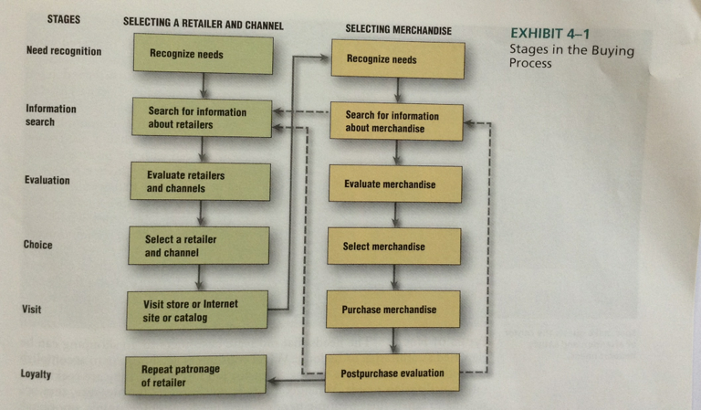
4.1 Buying Process
Notes:
1

Slide 4
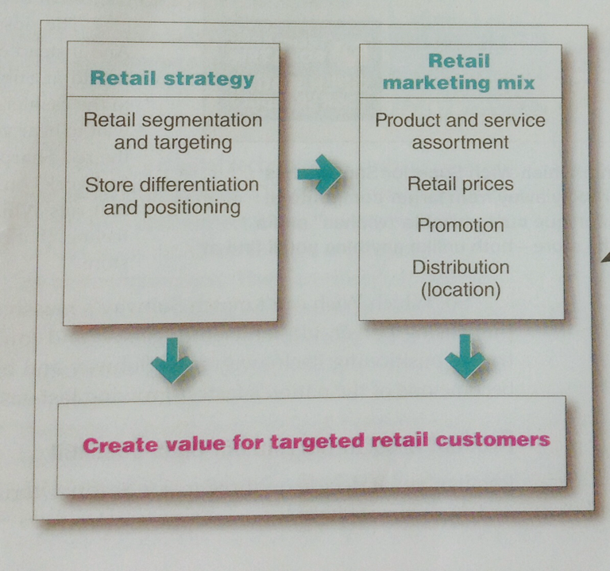
4.2 Group Assignment: Please refer the assignment to your group project category on STP/Retailer Marketing Strategies
Analyze the STP for your retail.
Then plot out in detail the Retailer
Marketing strategies diagram by
Using specific merchandise/examples
in your retail. Remember the STP needs
Facts and figures to support.
Please create one page ppt. slide to be due next Tuesday Feb.23. Please design the one page by using photos, graphs, charts, visuals to make one page interesting ka.
Notes:
1

Slide 5
4.2 Retailing from MK 201/202
Figure 13.1 Retailer Marketing Strategies
As with other types of marketers, the name of the game for retailers is to find the customer-driven marketing strategy and mix that will let them create value for customers and capture value in return. Remember Target’s “Expect more. Pay Less “value proposition? And Olive Garden’s “When you’re here, you’re family.

