Slide 1
Issues in Thailand’s agriculture
Lecture 12(A)
Bhanupong

Slide 2
Course Syllabus
Lecture 12
Farm households’ debt
Declining agricultural prices
The rice-mortgage scheme
Populism policy: agriculture subsidies
A case study of cassava exports

Slide 3
Which crops require subsidies?

Slide 5
Rising household debt level

Slide 6
Farm household debt
Thai farmers’ debt remains high since they have to borrow money to buy staple goods since the drought in late 2013.
Loan for cultivation and consumption are needed while waiting for income generated from a new growing season (Q2 and Q3).
Default risk is high because of high debt-service coverage ratio.
Rubber prices depend on China’s growth, while rice prices are depressed due to high inventory.
Household debt was 81% in 2015--11 trillion baht

Slide 7
Rice farmers begin their main crop in June harvest in late November and December
Q1
Jan-March
Q2
April-June
Start planting in June
Q3
July- August
September
Q4
Late November and December Harvesting
Low paddy prices and servicing high debt affect farmers’
consumption and borrowing.
They need to borrow while waiting for harvesting in late November and December.
The second crop begins in the dry season, requiring ample supply
of water from irrigated cannels.

Slide 8
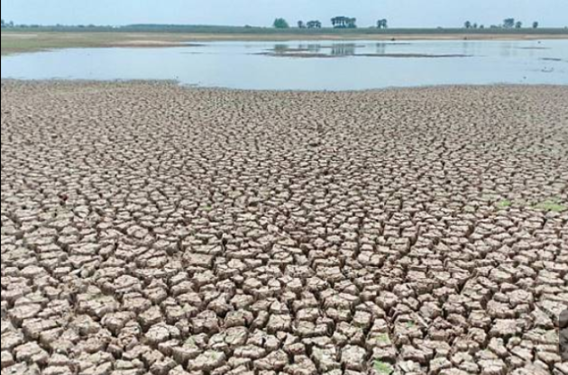
Surin Reservoir
Record driest in 50 years
May 2019

Slide 10
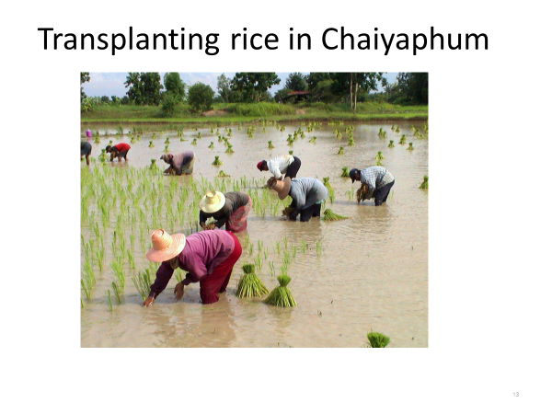
Since we cannot control farm prices, we must control production cost
Total cost of farm products is dictated by variable costs.
What are fixed and variable cost in rice production?

Slide 12
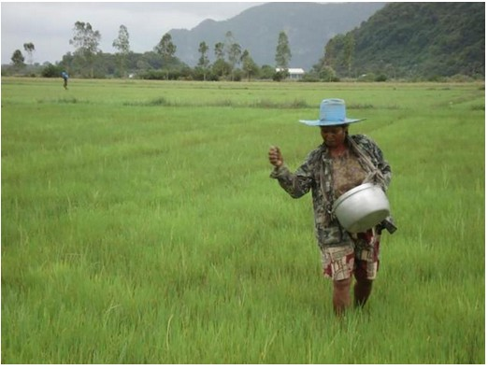
Fertilizer application

Slide 13
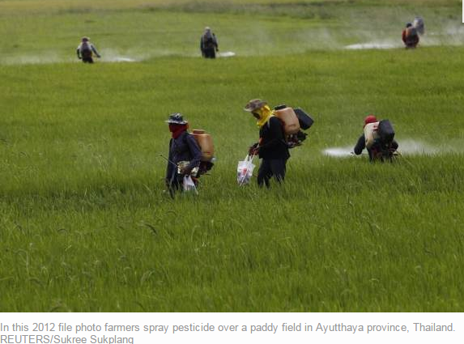
Pesticide spraying

Slide 15
Threaten by innovation
Thailand’s Jasmine rice exports will soon run into fierce competition in the United States, which has successfully grown and registered a new type of fragrant rice called "Jazzman".
Louisiana State University's Agricultural Centre has come up with a new variety of aromatic rice, known as LA2125 , with a very similar fragrance, soft grain and quality as Thai jasmine rice.
The LSU rice breeding took 12 years to obtain a long-grain rice with good milling quality, high yield and the correct Jasmine aroma and flavor.

Slide 16
Jasmine vs. jazzman
Consumers and Asian restaurants in the U.S. may shift to serving Jazzman rice as it tastes the same as Thailand’s jasmine rice and it is cheaper.
Another challenge is the yield differences:
1260 kilograms per rai of Jazzman rice, compared to
400 kilograms of Thai jasmine rice.
What will be the impact on the elasticity of Thailand’s export demand for Jasmine rice?

Slide 17
“Jasmine” rice from Vietnam and Cambodia
Vietnam has already come up with rice that tastes similar to Jasmine.
It is now on sales in supermarkets in London at 1,000 baht for 20 kg bag, compared with 1,500 baht Jasmine rice from Thailand.
Recall the learning curve effect
The recent dong devaluation has enabled Vietnam to offer 50% lower price than Thailand.
In 2014, because of cheap jasmine rice from Cambodia, the share of Thai jasmine rice in Hong Kong dropped from 90% to 45 %.

Slide 18
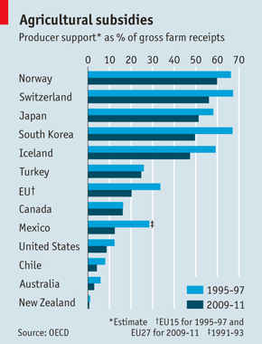
Agricultural subsidies

Slide 19
Paddy Mortgage Policy
Rice exports declined after the government of Prime Minister Yingluck Shinawatra introduced a price support program in October 2011.
The government bought the grains from farmers above market prices to boost domestic prices to lift rural incomes.
Analytical diagram (Area ABCD)

Slide 20
Mortgage Price Support Program for paddy rice
S
P_{M}
_{B15,000}
A
B
P_{e}
_{B8,000}
E
D
In 2014, inventory stock
of milled rice increased to 14.7 million MT
C
D

Slide 21
Consequences of the rice mortgage scheme
The government spent 689 billion baht in 2011 and 2012 buying rice from farmers at prices that were as much as 76 % higher than market prices.
The government rice inventories reached 14.7 million tons in 2014, compared with 6.1 million in 2010.
There were storage cost and steep depreciation rate of old rice stock
Smuggled rice from neighboring countries
Loss of international competitiveness

Slide 22
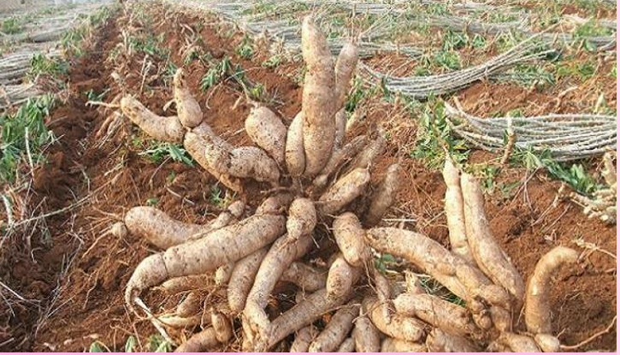
Cassava: Another subsidized crop

Slide 23
Subsidies for cassava farmers in 2015 low interest rate
In January 2015, the cabinet approved 2,760 million baht to subsidize 3 % interest rate for BAAC’s 50,000 baht loan for each farmers who postpones harvesting in order to push up the price to 2.80 baht/kg at the beginning harvest season.
The interest subsidy at 3% also goes to processing factories, exporters, and ethanol producers to purchase tapioca at the high supply seasons to shore up the price and to farmers who adopt the water dripping system and sand and soil-separated screening system for clean and high quality tapioca.

Slide 24
Subsidized inputs for cassava growers
S ₁
S ₂
P_{M}
If demand is price elastic,
Growers should receive
Higher income
P_{e}
E
F
Ps
Ceteris Paribus
Q ₁
Q ₂

Slide 25
Bad news for cassava growers
In 2016, the export price of tapioca decreased 10 per cent from $289 per ton in 2015 to $264.
The government had asked tapioca traders to purchase cassava at Bt1.90 per kilo to protect farmers from the falling prices.
Cassava is currently traded at Bt1.60 to Bt1.70 per kilogram, lower than last year's price of Bt2.50 per kilo.
It is estimated that cassava production in 2016 reached 31 million tons, of which 21 million tons grown from November to April.
But more supply does not mean higher export revenues.

Slide 26
But other things do not remain unchanged: No more Ceteris Paribus assumption
Xd1
S ₁
S ₂
P_{M}
Xd2
China’s slowdown
spells troubles
P_{e}
E
F
P _{F}
Pg
G
Q3
Q ₁
Q ₂

Slide 27
Review Questions
Discuss the costs and benefits of the rice-pledging program in short-run and long-run impact on the Thai economy.
Should the government intervene to support commodity prices such as cassava?
How should the government subsidize farm inputs?
What should be a sustainable scheme to help farmers in the long run?

