Slide 1
Topic 1 Part 2
Consumer Preferences
and the Concept of Utility
(Chapter 3)

Slide 2
Summary
THREE Assumptions on Preference
Completeness
  a consumer can rank any two bundles
Transitivity
  if A is preferred to B and B is preferred to C,
  then A is preferred to C
Monotonicity
  more is better

Slide 3
Summary
TWO Assumptions on Utility Function
Monotonicity (more gives higher utility)
  MU of each good is positive
  U’ is positive
Diminishing MU
  MU of each good is decreasing in the good
  U’’ is negative

Slide 4
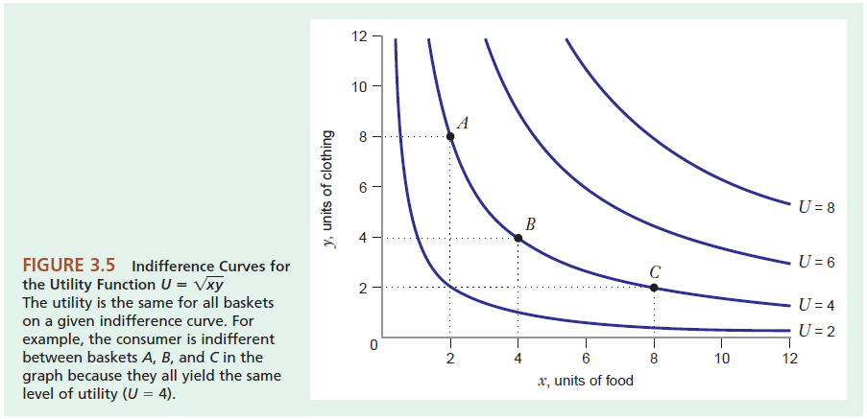
Indifference Curves
Preference direction

Slide 5
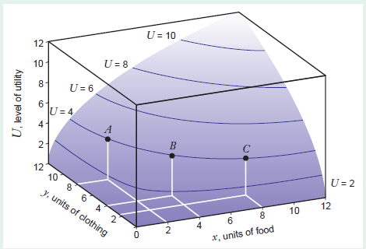
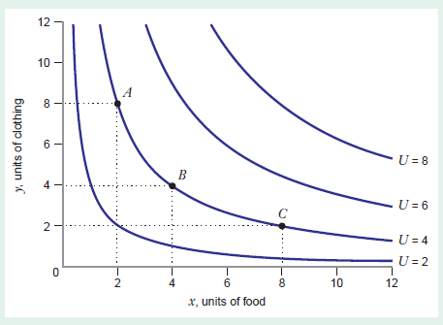

Slide 6
Indifference Curves
Example
U = xy²
Check that underlying preferences are complete, transitive, and monotonic.
x | y | xy^2
8 | 4.24 | 143.8
4 | 6 | 144
3 | 6.93 | 144.07
1 | 12 | 144
Notes:
We show later that the diminishing MRS implies averages are preferred to extremes for indifference curves.

Slide 7
Indifference Curves
This IC tells us about ALL baskets of goods that give U = 144.

Slide 8
Indifference Curves
IC (U=144) tells us about how much of good Y we are willing to sacrifice in exchange for one more unit of good X in order to maintain utility level of 144

Slide 9
Indifference Curves
IC (U=144) tells us about how much of good Y we are willing to sacrifice in exchange for one more unit of good X in order to maintain utility level of 144
The Slope of IC tells us the same thing.

Slide 10
Marginal Rate of Substitution
The slope of IC is the “negative” Marginal Rate of Substitution (MRS).
Formally speaking, it is the rate at which the consumer will give up one good to get more of another, while maintaining the same level of utility.
Mathematically speaking, the slope of any curve, including IC, tells us the same thing: how Y will change when X increases by one unit.
Simply speaking, it tell us how much Y the consumer is willing to give up in exchange for one more unit of X.
For example, when –MRS = –5 (remember IC has negative slope), this means that the consumer is willing to give up 5 units of Y (i.e. Y decreases by 5 units) for one more unit of X.

Slide 11
Marginal Rate of Substitution
The slope of IC is the derivative of the equation that describes IC.
For example, for utility function U = XY², we can write the equation for IC where U = 144 as follows:
144 = XY² Y² = 144/X Y = 12/√X Y = 12X^{(-1/2)}
Slope of IC = dY/dX = –6X^{(-3/2)}
Alternatively, MRS_{XY} = MU_{X}/MU_{Y} .
Note that MU_{X} = Y² and MU_{Y} = 2XY , so MRS_{XY} = Y/2X .
Recall that Y = 12X^{(-1/2)} , so MRS_{XY} = 6X^{(-3/2)}
Beware of negative sign!

Slide 12
Marginal Rate of Substitution
Observe that –MRS_{XY} = dY/dX = –6X^{(-3/2)}
Hence, the slope of IC is given by
1) –MRS_{XY} OR 2) dY/dX
Proof

Slide 13
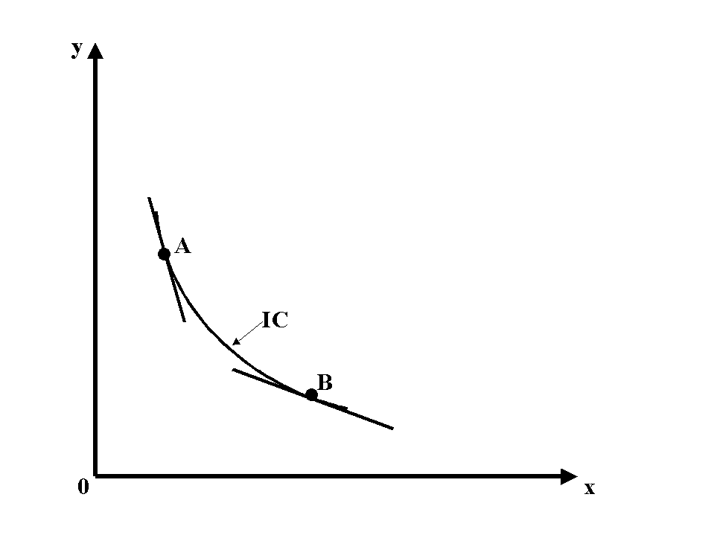
Marginal Rate of Substitution
Note that MRSxy = MUx/MUy.
Since goods X and Y have diminishing MU, when the consumer eats more X (from A to B), MUx (the numerator in the above equation) falls.
As a result, moving from A to B causes MRSxy to fall, which represents Diminishing MRSxy.

Slide 14
Marginal Rate of Substitution
The Diminishing Marginal
Rate of Substitution
If the more of good x you have, the more you are willing to give up to get a little of good y.
The ICs get flatter as we move out along the horizontal axis and steeper as we move up along the vertical axis.

Slide 15
Marginal Rate of Substitution
IC Slope = –MRS_{XY} = dY/dX
Key Points about the shape of IC
Monotonicity implies positive MU. When MUx and MUy are positive, MRS is positive, which implies that IC has a negative slope.
When MRS is diminishing (due to diminishing MUx and MUy), ICs are convex to the origin. This implies that average bundles are preferred to extreme bundles.
(Read Slide 13)

Slide 16
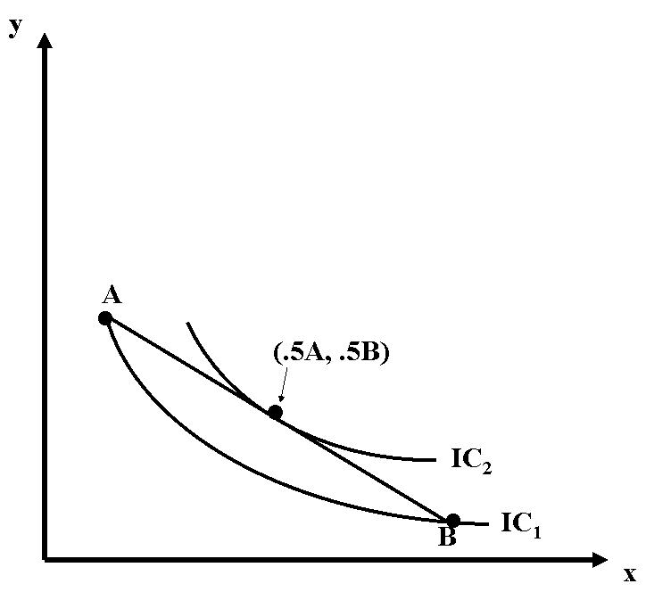
Indifference Curves
Key Property
Indifference curves are convex to the origin implies that average bundle C is preferred to extreme bundles A and B.
C
That is, it lies on a higher IC.

Slide 17
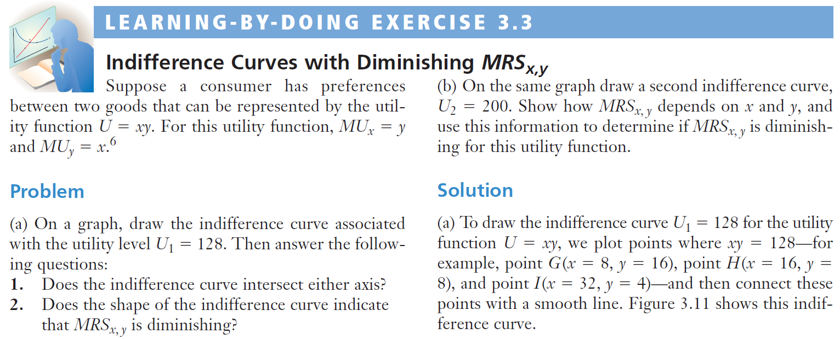

Slide 18
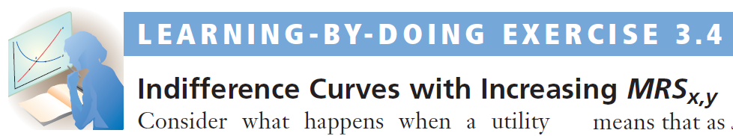
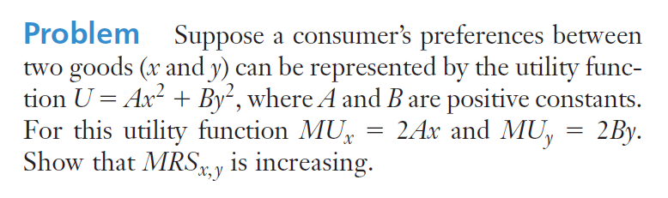

Slide 19
Special Functional Forms
A consumer’s willingness to substitute one good for another will depend on the goods in question.
For example, one consumer may view Coke and Pepsi as perfect substitutes, right shoes and left shoes as perfect complements, etc.

Slide 20
Special Functional Forms
Perfect Substitutes: U = Ax + By
Where: A and B are positive constants.
MUx = A MUy = B MRSx,y = A/B (constant)
For example, let A = 2 and B = 1.
MRSx,y = MUx/MUy = 2 MUx = 2MUy
This means that each X always gives twice MU of each Y.
Therefore, the consumer is always willing to give up
2 units of Y for 1 more unit of X.

Slide 21
Special Functional Forms
y
Example: Perfect Substitutes
    (Tylenol, Extra-Strength Tylenol)
Slope = -A/B
IC₁
IC₂
IC₃
0
x

Slide 22
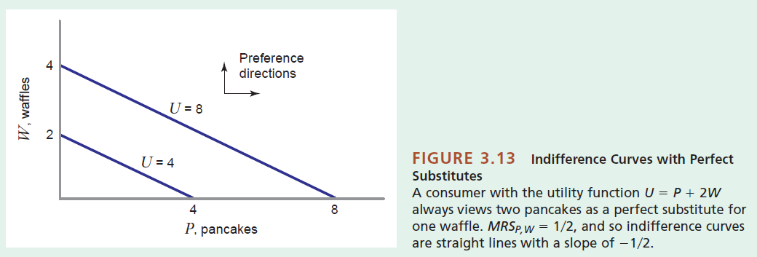

Slide 23
Special Functional Forms
Perfect Complements: U = A min(X, Y)
Where: A is a positive constant.
MUx = 0 or A
MUy = 0 or A
MRSx,y is 0 or infinite or undefined (corner)

Slide 24
Special Functional Forms
y
Example: Perfect Complements
  (nuts and bolts)
Slope = ∞
IC₂
Slope = undefined
IC₁
Slope = 0
0
x

Slide 25
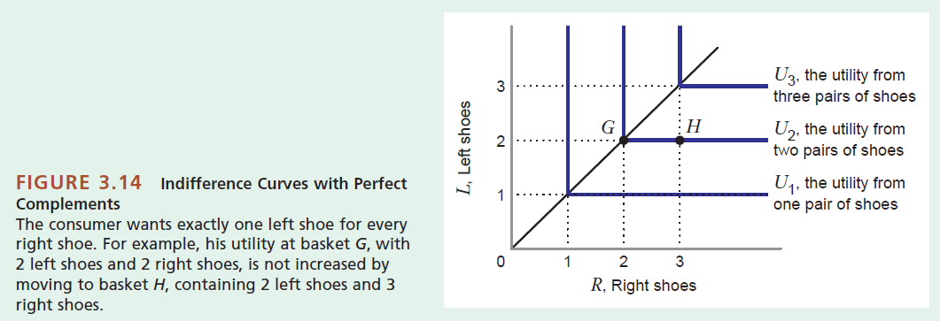

Slide 26
Special Functional Forms
Cobb-Douglas: U = Ax^{α}y^{β}
where: α + β = 1; A, α, β are positive constants.
MU_{X} = αAx^{α-1}y^{β}
MU_{Y} = β Ax ^{α}y^{β-1}
MRSx,y = (αy)/(βx)

Slide 27
Special Functional Forms
WHY Cobb-Douglas: U = Ax^{α}y^{β} ??
MU_{X} = αAx^{α-1}y^{β} MU_{Y} = β Ax ^{α}y^{β-1}
MUx and MUy are positive >>> more is better
MUx is decreasing in X >>> diminishing MUx
MUy is decreasing in Y >>> diminishing Muy
That is, Cobb-Douglas satisfies two assumptions on Utility Function.

Slide 28
Special Functional Forms
y
Example: Cobb-Douglas (speed vs. maneuverability)
Preference Direction
IC₂
IC₁
x

Slide 29
Special Functional Forms
Quasi-Linear Preferences:
U = v(x) + Ay
i.e. sum of a linear function and a non-linear function
Where: A is a positive constant.
MU_{x} = v’(x) = ΔV(x)/Δx, where MU_{y} = A

Slide 30
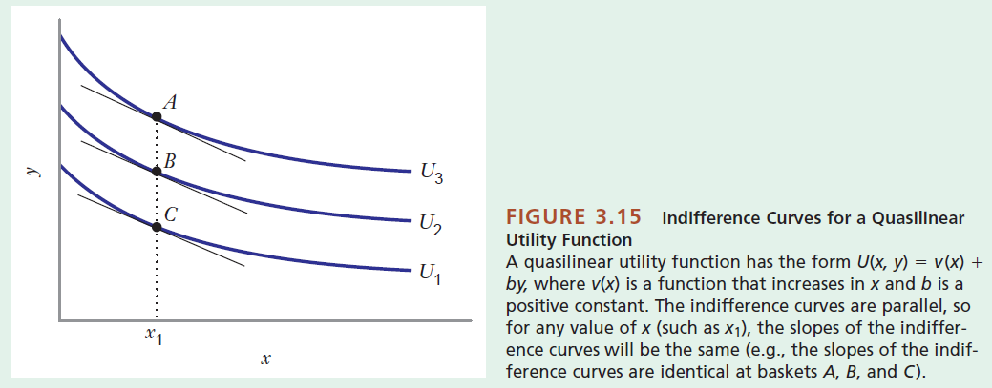
Special Functional Forms

Slide 31


