Slide 1



EE 366 Economics of Services Sector
Chapter 6: Service Market Analysis (Structure, Conduct and Performance)
Dr. Nessara Sukpanich

Slide 2
1
Market Structure
 | Perfect Competition | Monopolistic Competition | Oligopoly | Monopoly
Number of firm | Very Many | Many/ Several | Few | One
Freedom of entry | Unrestricted | Unrestricted | Restricted | Completely blocked
Nature of product | Homogeneous | Differentiated | Homogeneous or Differentiated | Unique
Implications for demand curve faced by firm | Horizontal (Price taker) | Downward sloping, but relatively elastic | Downward sloping, relatively inelastic | Downward sloping, more inelastic than oligopoly.
Firm size | Small firms | Small firms | Few large firms | One big firm
Possible consumer demand | Highly elastic | Elastic | Inelastic | Highly inelastic
Firm Profit | Normal profits | Economic profits in short run; normal profits over long run | Losses to normal and economic profits in short run and long run | Economic profits in short run and long run
Government Intervention | Minimal | Minimal | Moderate to highly | Highly to nationalization
Example | Agricultural products | Retail stores and restaurant | Automobiles | Public utilities
Source: Pindyck and Rubinfeld (2013): Microeconomics

Slide 3
1
Market Structure
Market Power (examples of measures)
  The Lerner Index
  The Concentration Ratio
  Herfindahl Index

Slide 4
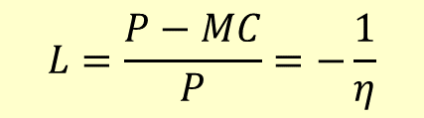
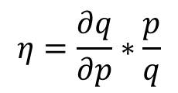
1
Market Power Measures: The Lerner Index
Lerner Index (L): Firm’s ability to set its’ product price (P) above marginal cost (MC). It measures firm’s market power
$$L=\frac{P−MC}{P}=−\frac{1}{η}$$
$$η=\frac{∂q}{∂p}∗\frac{p}{q}$$
where
ɳ = Price elasticity
Perfect competition market
Firm is price taker
When firm has some market power
When L close to 1

Slide 5
1
Market Power Measures: The Concentration Ratio
Concentration Ratio (CR): The sum of market share of large firms in the industry. It measures the industry’s market power
$$CR−4=Total market share of four largest firms in the industry$$
$CR−8, CR−12$, $CR−15, ……………….$
The higher CR the higher industry market power and the higher monopoly level
Limitation of CR
  No information about number of firms in the market
  Markets with the same level of CR-4 do not have the same level of monopoly if number of firms and market share of those 4 firms are different

Slide 6

1
Market Power Measures: Herfindahl Index
Herfindahl Index (HI) or Herfindahl-Hirschman Index (HHI): The sum of square of market share of each firm competing in the market
$$HI or HHI=S_{1}^{2}+S_{1}^{2}+S_{1}^{2}+...+S_{n}^{2}$$
$S_{i}^{2}$ = Market share of firm i. Suppose there are n firms in the market
Unlike Concentration Ratio, HI employs market share of all firms in the market in the calculation
If there is one firm in the market
If there are two firms in the market with the same market share
If there are n firms in the market with the same market share
So if n is large and each firm does not have market share larger than others
So 0 < HI < 1

Slide 7
2
Strategy
Price strategy
For example
Two-part tariff pricing
Bundling strategy
Non-price strategy
For example
Product differentiation

Slide 8
2
Strategy: Two-Part Tariff Strategy
The Two-Part Tariff is related to price discrimination and provides another means of extracting consumer surplus.
This price strategy can be divided into two parts: The entry fee (or membership fee) and the usage fee (or a fee of each unit used )
Example: Tennis and golf club, Telephone service, Credit card services, and Disneyland ticket.

Slide 9
2.1
Strategy: Two-Part Tariff Strategy (Cont.)
Case1: When consumers have homogeneous demand (one consumer is representative of the market. (MC is assumed to be constant)
Price
 | Uniform pricing | Two-part Tariff
Price
Quantity
CS
PS
Total surplus
DWL
A
P_{m}
B
C
The usage fee =
P_{c}
MC
An entry fee =
MR
Demand
In this case, firm takes all consumer surpluses (Area ABC).
Q_{m}
Q_{c}
Quantity
Source: Adapted from Pindyck and Rubinfeld (2012)

Slide 10
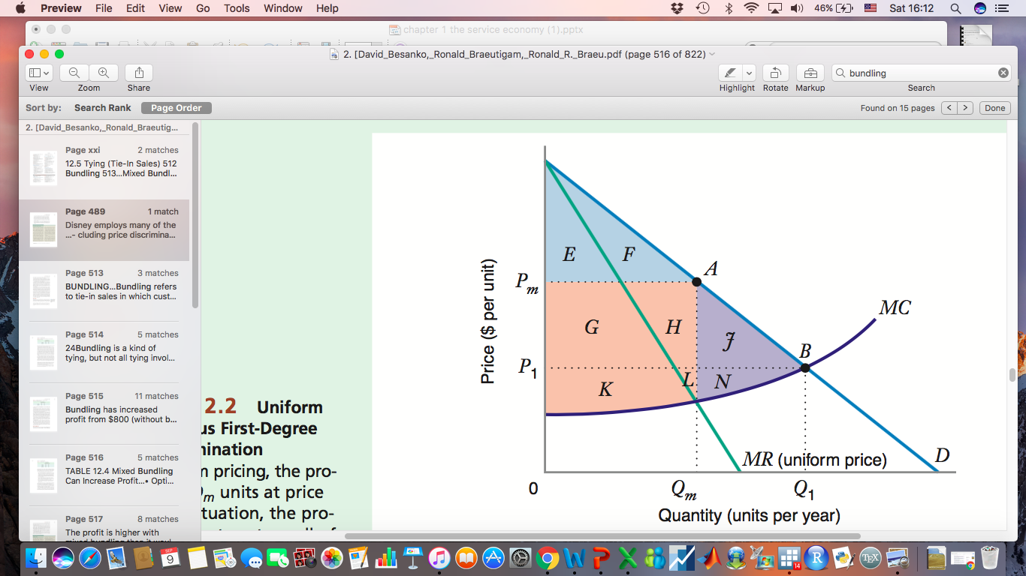
2.1
Strategy: Two-Part Tariff Strategy (Cont.)
Case1: When consumers have homogeneous demand (one consumer is representative of the market.
The producer captures all the surplus and there is no deadweight loss
 | Uniform pricing | Two-part Tariff
Price
Quantity
CS
PS
Total surplus
DWL
The usage fee =
A entry fee =
Source: Besanko and Braeutigam (2011)

Slide 11
2.1
Strategy: Two-Part Tariff Strategy (Cont.)
Case2: When consumers have heterogeneous demand.
(MC is assumed to be constant)
Price
Strategies
The entry fee
The usage price = P_{m} (P>MC)
B
A
The entry fee= area A (Surplus of consumer with the smaller demand.)
P_{m}
C
E
D
F
P_{c}
MC
Profit = 2A+(P_{m}-MC)(Q₁+Q₂)
D₂
D₁
Q₁
Q₂
Q_{c}
Quantity
Source: Pindyck and Rubinfeld (2012)

Slide 12




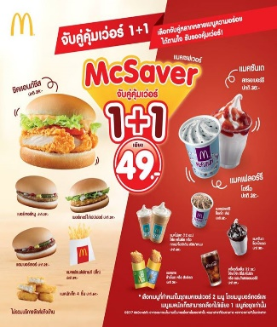


2.2
Strategy: Bundling Strategy
Bundling refers to sales in which customers are required to either purchase goods in a package or purchase goods separately.
Bundling can increase profits when customers have different tastes (different willingness to pay) for the two products and when the firm cannot price discriminate.
Example
Restaurant
Vacation Package
Insurance
+
+
Source: Besanko and Braeutigam (2011)

Slide 13


2.2
Strategy: Bundling Strategy (Cont.)
Ex.1
 | Reservation price (Maximum willingness to pay)
 | Hotel | Airline Ticket
Customer 1 | $1,200 | $600
Customer 2 | $1,500 | $400
Marginal Cost | $1,000 | $300
Bundling can not increase profit when customer preferences are negatively correlated
Without bundling
Price =$1,200
Price =$1,500
Price =$400
Price =$600
With bundling
+
Price =$1,800
Source: Besanko and Braeutigam (2011)

Slide 14
2.2
Strategy: Bundling Strategy (Cont.)
^{Bundling can not} increase profit when customer preferences are positively correlated
 | Reservation price (Maximum willingness to pay)
 | House Insurance | Car Insurance
Customer 1 | $1,200 | $400
Customer 2 | $1,500 | $600
Marginal Cost | $1,000 | $300
Ex.2
Without bundling
With bundling
+
Sale only
2
Sale only
2
Sale= $1,500
Sale= $600
Sale = $2,100
Profit = $500
Profit = $300
Profit = $800
Total profit
$800
Total profit
$800
Source: Besanko and Braeutigam (2011)

Slide 15
2.2
Strategy: Bundling Strategy (Cont.)
Firms often allow customers to purchase components individually, as well as offering a bundle.
Ex.3: Mixed Bundling
 | Reservation price (Maximum willingness to pay) (Per year)
 | Fitness | Boxing
Customer 1 | $900 | $800
Customer 2 | $1,100 | $600
Customer 3 | $1,300 | $400
Customer 4 | $1,500 | $200
Marginal Cost | $1,000 | $300
The preference of consumer 2 and 3 is negatively correlated
Source: Besanko and Braeutigam (2011)

Slide 16
2.2
Strategy: Bundling Strategy (Cont.)
Ex.3: Mixed Bundling
Option | Price | Sale for customer | Profit
1.No bundling | Fitness: $1,300 Boxing: $600 | + + | (1,300-1,000)*2 = $600 (600-300)*2 = $300 Total profit = $1,200
2.Pure bundling | Fitness & Boxing $1,700 | + + + | Total profit (1,700-1,300)*4 = $1,600
3.Mixed bundling | Fitness:$ 1,499 Boxing: $799 Fitness & Boxing (negative relationship) | + | 1,499-1,000 = $499 799-300 = $499 (1,700-1,300)*2 = $800 Total profit = $1,798
3
4
1
2
1
2
3
4
4
1
2
3
Source: Besanko and Braeutigam (2011)

Slide 17
2.2
Strategy: Bundling Strategy (Cont.)
Ex.3: Mixed Bundling
Option | Price | Sale for customer | Profit
1.No bundling | Fitness: $1,300 Boxing: $600 | + + | (1,300-1,000)*2=$600 (600-300)*2=$300 Total profit= 1,200
2.Pure bundling | Fitness & Boxing $1,700 | + + + | Total profit (1,700-1,300)*4=$1,600
3.Mixed bundling | Fitness:$ 1,499 Boxing: $799 Fitness & Boxing (negative relationship) | + | 1,499-1,000=$499 799-300=$499 (1,700-1,300)*2=$800 Total profit=1,798
3
4
1
2
1
2
3
4
4
1
2
3
Source: Besanko and Braeutigam (2011)

Slide 18




2.3
Strategy: Product Differentiation
Definition: Two goods are differentiated good if they are substitutes but not perfect substitutes.
Horizontal Differentiation
Vertical Differentiation
Goods are different but at the same price some consumers will buy one and some will buy other, it really depends on their preferences.
Goods are different and all consumers would prefer one to the other if they were sold at the same price. Goods are of different qualities.
Source: Besanko and Braeutigam (2011)

Slide 19
2.3
Strategy: Product Differentiation (Cont.)
Horizontal differentiation is an important concept for the theory of oligopoly and monopolistic competition.
This is because some consumers have loyalties toward one brand over the other, and thus do not regard the products as perfect substitutes.
Figure A: Weak horizontal differentiation
Figure B: Strong horizontal differentiation
P ($)
P ($)
35
35
30
D
30
D’
D
D’
Q
Q
20
40
38
40
The firm’s demand is quite sensitive to a change in its own price and the prices of its rivals.
The firm’s demand is much less sensitive to a change in its own price and the prices of its rivals.
Source: Besanko and Braeutigam (2011)
Notes:
In Figure 13.9(a), where horizontal differentiation is weak, the firm’s demand is quite sensitive to a change in its own price and the prices of its rivals. A relatively small increase in the firm’s own price (from $30 to $35) results in a relatively large decrease in quantity (from 40 to 20 units), and a small decrease in the price charged by a com- petitor also results in a large decrease in the quantity sold by the firm, illustrated by the large leftward shift in the demand curve from D to D .
In Figure 13.9(b), where horizontal differentiation is strong, the firm’s demand is much less sensitive to a change in its own price and the prices of its rivals. A small increase in the firm’s own price (from $30 to $35) results in only a small decrease in quantity (from 40 to 38 units), and a small decrease in the price charged by a competi- tor also results in only a small decrease in the quantity sold by the firm, illustrated by the small leftward shift in the demand curve from D to D .
the firm’s demand is much less sensitive to a change in its own price and the prices of its rivals.

Slide 20
2.3
Strategy: Product Differentiation (Cont.)
Figure A: Weak horizontal differentiation
Figure B: Strong horizontal differentiation
P, costs
P, costs
MC
MC
Economic Profit
Economic Profit
P₁
P₁
ATC₁
ATC
ATC₁
ATC
D=AR=P
D=AR=P
MR
Q₁
Q
Q₁
Q
MR

Slide 21
3
Performance
Performance measures might depend on a firm’s short term goals and/or long term goals. Might include for example,

Slide 22

Reference
David Besanko, and Ronald Braeutigam,
Microeconomics, 4th edition
Robert Pindyck and Daniel Rubinfeld (2012),
Microeconomics, 8th edition

