Slide 1

Channel 3

Slide 2



What is Digital TV?
Advantage
- More consumer
base
- Better signal
- More choices
NBTC
Disadvantage
-Higher cost

Slide 3
Thai Digital TV
24 commercial
Family Channel
SD variety
HD variety
NEWS
48 Channels
24 government
- Public Channel
- Local Channel

Slide 4
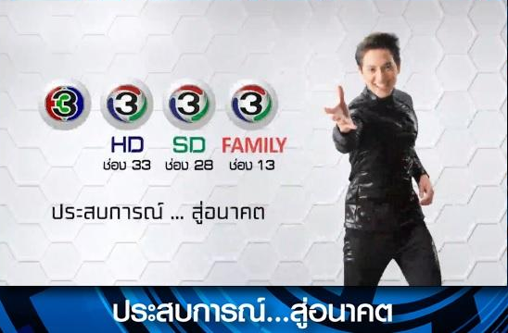
How to get Digital TV??
Bid on 26 dec-27 dec in 2013
Total Amount - 6471 millions baht
Breakeven around 2 year(according to income statement of 2013Q3)

Slide 5
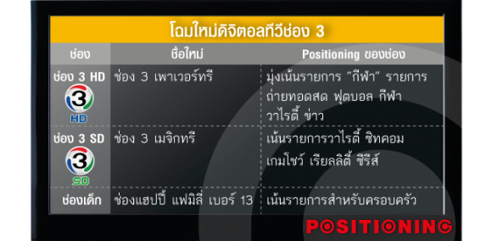

Slide 6
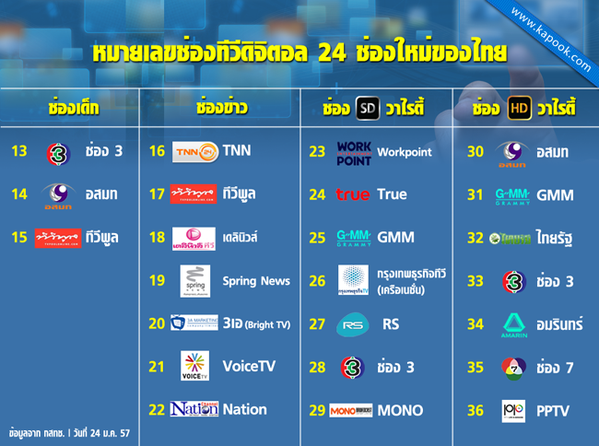

Slide 7
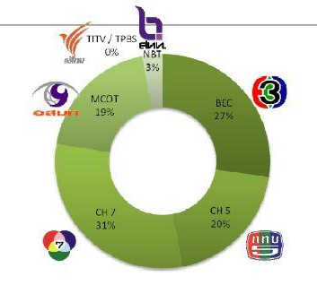
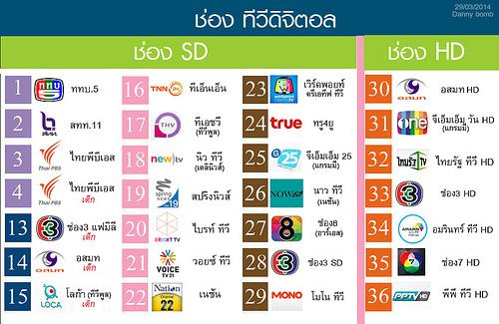
BEFORE
AFTER
During a Dialog, TV rating between channel 3 and 7 were 70%, and the rest of 30% were from the other channels or Cable T.V. ---> Oligopoly
There are 48 channels, 700% more than before. ---> More competitive
After 3 months of broadcasting digital T.V., the rating was only 13% which is low.
Notes:
ที่สำคัญช่องอนาล็อกของช่อง 3 ยังมีบทบาทสำคัญต่ออุตสาหกรรมทีวี เพราะครองฐานคนดู การที่ช่องดิจิตอลใหม่ๆ จะมาแข่งผลิตละครช่อง 3 เพื่อดึงคนดูไปที่ทีวีดิจิตอลย่อมไม่ง่าย เมื่อช่อง 3 อนาล็อกยังออกอากาศได้เหมือนเดิม การเปลี่ยนผ่านไปสู่ดิจิตอลย่อมเป็นเรื่องยาก
** http://www.siamintelligence.com/thai-digital-tv-analysis/

Slide 8


Problems
VS
• Refused to do a simulcast broadcasting for the same program on analog in digital platform

Slide 9

Reasons
•People still watching Analogue
•The income from advertising is decreasing comparing to Analogue
•Have no ability to produce tv program for 24 hours
• High cost
Hard to recruit new skilled personnel /team

Slide 10
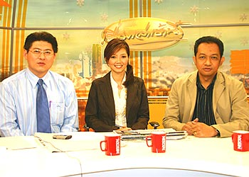
Interview from management team
•They not ready for Digital TV yet
“Even though channel 3 has been in this industry for 40 years, but we still not ready yet”
Mr.Surin Krittayaphongphun Executive Vice president, channel3

Slide 11
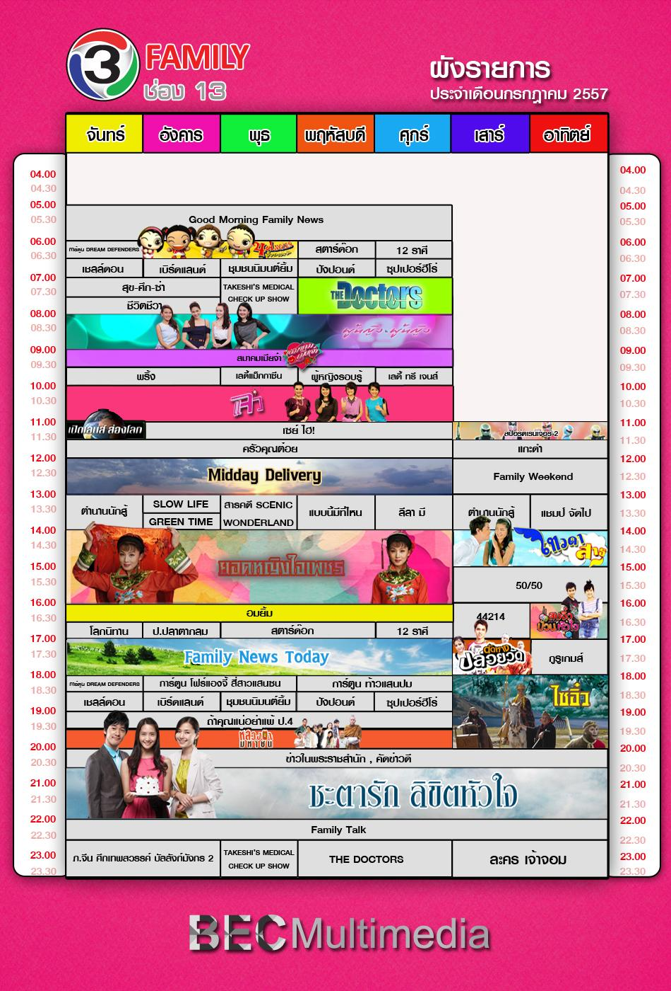
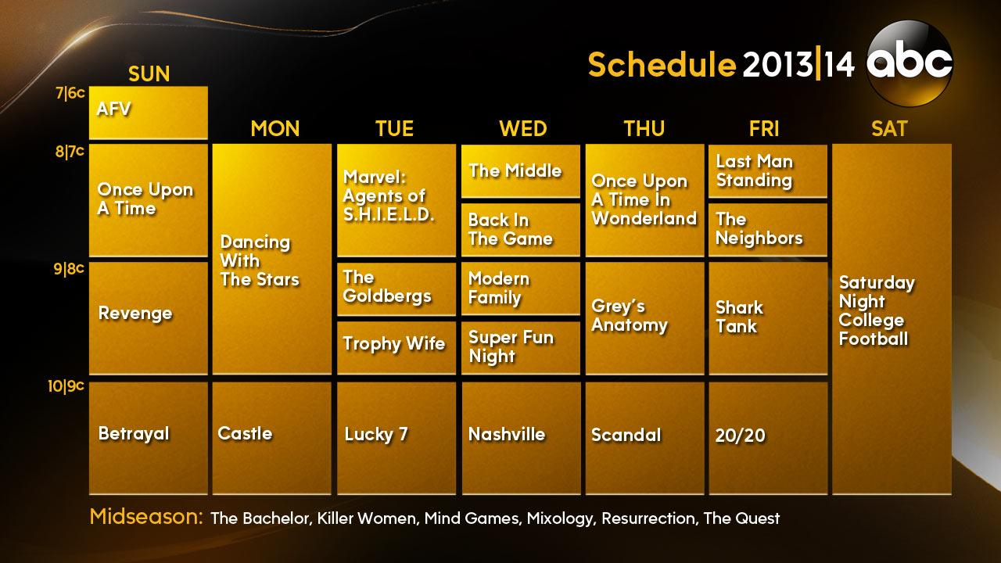
Schedule Compare
•A lot of rerun tv program on the digital channel
Channel 3 Family
VS
ABC(USA)

Slide 12
What Channel 3 did….
Channel 3 lodges complaint to Central Administrative Court
Use media in hand
Audience Perspective
Negative feedbacks

Slide 13
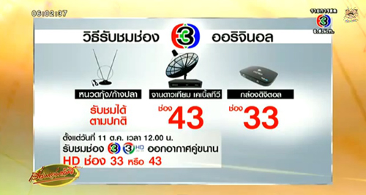
Finally

Slide 14
Original Strategies:
Have Clear Characteristics provide service to precise target
Find the new path reach more viewers in wider and deeper aspect.
  Ex. Creating new TV channels
Use business extension and new channel production ; an opportunity to recruit a new skilled team
New Strategies adopted :
When the contents are ready, the advertising of channel 3 digital channels will intensely active. And it will also do branded content.
Channel 3 have prepared 100 million baht for advertising and promoting all its 3 digital channels.

Slide 15
Long run Strategies
Goals: Rating → Ads Revenue → Leader in Digital TV
→ Market Share
Production Improvement
Product differentiation
→ find outstanding TV hosts/ Reporters.
→ Create Characters of the Channel
Three Channels → Three types of focus groups.
→ To reduce customers’ confusion
→ capture new market → new group of customers

Slide 16
Long run Strategies
Goals: Rating → Ads Revenue → Leader in Digital TV
→ Market Share
Production Improvement
More Creative and Acknowledged TV Programs
→ Series and Movies
→ increase welfare of a society
Sponsor Corporate Social Responsibilities(CSR)
→ to make good branding
Distributes the advertisement time properly to the eye of consumer and optimize number and time of advertisements.

Slide 17
Long run Strategies
Goals: Cost → to cope with newcomers (in the future)
Investment and Funding
Make Joint Venture to reduce marginal cost
Try to make programs that co-operated with other channels
→ make a good relationship with other channels
→ can gain benefit in both parties.

Slide 18
Q&A

