Slide 1
Production and Costs in the Long run
EE311
Chayun Tantivasadakarn
Faculty of Economics, Thammasat University

Slide 2
Production: Two Variable Inputs
In the long-run, capital and labor are both variable.
We can look at the output we can achieve with different combinations of capital and labor
Notes:
53

Slide 3
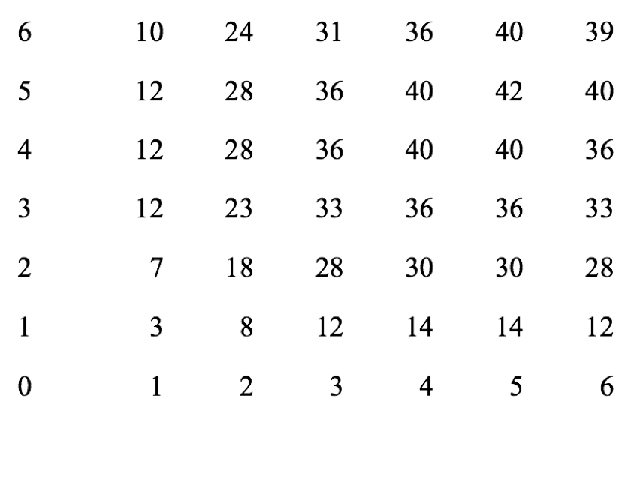
Production: Two Variable Inputs
K
q = 40
L

Slide 4
Isoquant Map
K
5
4
A
3
B
C
2
q₃ = 36
1
D
q₂ = 28
q₁ = 12
1
2
3
4
5
L

Slide 5
Derivation of an Isoquant
From a production function Q = K^{0.5}L^{0.5}
A a fixed Q, K = Q²/L
Suppose Q = 100, the function for this isoquant is: K = 10000/L
Any combination of K & L according to the above function will always give Q = 100 and the slope is declining as L increases

Slide 6
Production: Two Variable Inputs
Substituting Among Inputs
  Negative slope is the marginal rate of technical substitution (MRTS) = dK/dL
  MRTS: amount by which the quantity of one input can be reduced when one extra unit of another input is used, so that output remains constant.
Notes:
58

Slide 7
Marginal Rate of
Technical Substitution
Capital
per year
5
Slope measures MRTS
MRTS decreases as move down the isoquant
2
4
3
1
1
2
1
2/3
Q₃ =90
1
1
1/3
Q₂ =75
1
Q₁ =55
1
2
3
4
5
Labor per month

Slide 8
MRTS and Isoquants
We assume there is diminishing MRTS
  Increasing labor in one unit increments from 1 to 5 results in a decreasing MRTS from 1 to 1/2.
  Productivity of any one input is limited
Diminishing MRTS occurs because of diminishing returns and implies isoquants are convex.
There is a relationship between MRTS and marginal products of inputs
Notes:
61

Slide 9
MRTS and Marginal Products
As we move down the isoquant, MP_{L} decreases while MP_{K} increases. Hence MRTS = MP_{L}/ MP_{K} decreases
MP_{L}
MP_{K}
A
B
B
A
L
K

Slide 10
Perfect Substitutes
Same output can be reached with mostly one input (A or C) or with equal amount of both (B)
MRTS is constant at all points on isoquant
σ = infinity
LPG
A
B
Q₁
Q₂
Q₃
C
Fuel oil

Slide 11
Fixed-Proportions
Production Function
Same output can only be produced with one set of inputs.
There is no substitution available between inputs.
The output can be made with only a specific proportion of capital and labor
σ = 0
Bicycle
frames
Q₂
B
1
Q₁
A
Bicycle
wheels
2

Slide 12
Returns to Scale
Long-run production is characterized by Returns to Scale (RTS).
Rate at which output increases as inputs are increased proportionately
  Constant returns to scale
  Increasing returns to scale
  Decreasing returns to scale
Notes:
74

Slide 13
Returns to Scale
Constant returns to scale: output doubles when all inputs are doubled
  Size does not affect productivity
  May have a large number of producers
  Isoquants are equidistant apart
Notes:
76

Slide 14
Returns to Scale
Capital
(machine
hours)
A
6
30
4
Constant Returns: Isoquants are equally spaced
20
2
10
5
10
15
Labor (hours)

Slide 15
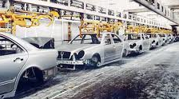
Returns to Scale
Increasing returns to scale: output more than doubles when all inputs are doubled
  Larger output associated with lower cost (cars)
  One firm is more efficient than many (utilities)
  The isoquants get closer together
Reasons
  Specialization and division of labor
  Technical increasing returns to scale
It leads to a declining cost per unit

Slide 16
Increasing Returns to Scale
Capital
(machine
hours)
A
The isoquants move closer together.
4
30
2
20
10
5
10
Labor (hours)

Slide 17
Returns to Scale
Decreasing returns to scale: output less than doubles when all inputs are doubled
  Decreasing efficiency with large size
  Reduction of entrepreneurial abilities
  Isoquants become farther apart
Reasons
  Coordination problems, limitation of manager
Notes:
78

Slide 18
Returns to Scale
Capital
(machine
hours)
A
4
20
18
Decreasing Returns:
Isoquants get further
apart
2
10
5
10
Labor (hours)

Slide 19
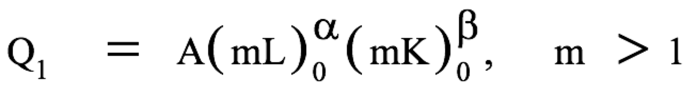
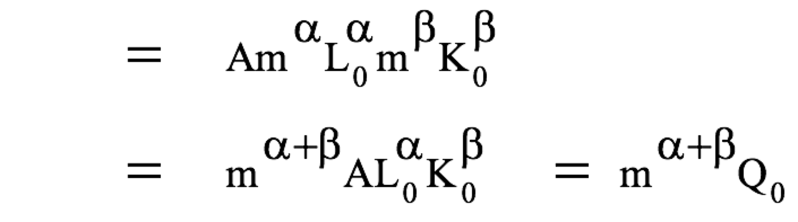
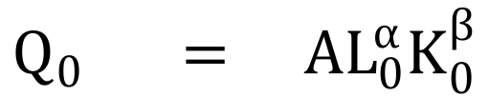
Returns to Scale: Example
$$Q_{0 } = AL_{0}^{α}K_{0}^{β}$$
α + β > 1, Increasing returns to scale
α + β = 1, Constant returns to scale
α + β < 1, Decreasing returns to scale

Slide 20
Cost in the Long Run
In the long run a firm can change all of its inputs
Assumptions
  Two Inputs: Labor (L) & capital (K)
  Price of input: wage rate (w), rental rate (r)
The Isocost Line
  A line showing all combinations of L & K that can be purchased for the same cost
  Total cost of production is sum of firm’s labor cost, wL and its capital cost rK
TC = wL + rK

Slide 21

Cost in the Long Run
Rewriting TC as an equation for a straight line:
  K = TC/r - (w/r)L
  Slope of the isocost:
    - w/r is the ratio of the wage rate to rental cost of capital.
    This shows the rate at which capital can be substituted for labor with no change in cost.

Slide 22
Least Cost Combination of Inputs
We will address how to minimize cost for a given level of output by combining isocosts with isoquants
We choose the output we wish to produce and then determine how to do that at minimum cost
  Isoquant is the quantity we wish to produce
  Isocost is the combination of K and L that gives a set cost

Slide 23
Least Cost Combination of Inputs
Capital
per
year
Q₁ is an isoquant for output Q_{1.}
There are three isocost lines, of which 2 are possible choices in which to produce Q₁
B
K₂
Isocost C₂ shows quantity Q₁ can be produced with combination K₂L₂ or K₃L₃.
However, both of these are higher cost combinations than K₁L₁.
A
K₁
C
Q₁
K₃
C₀
C₁
C₂
L₂
L₁
L₃
Labor per year

Slide 24

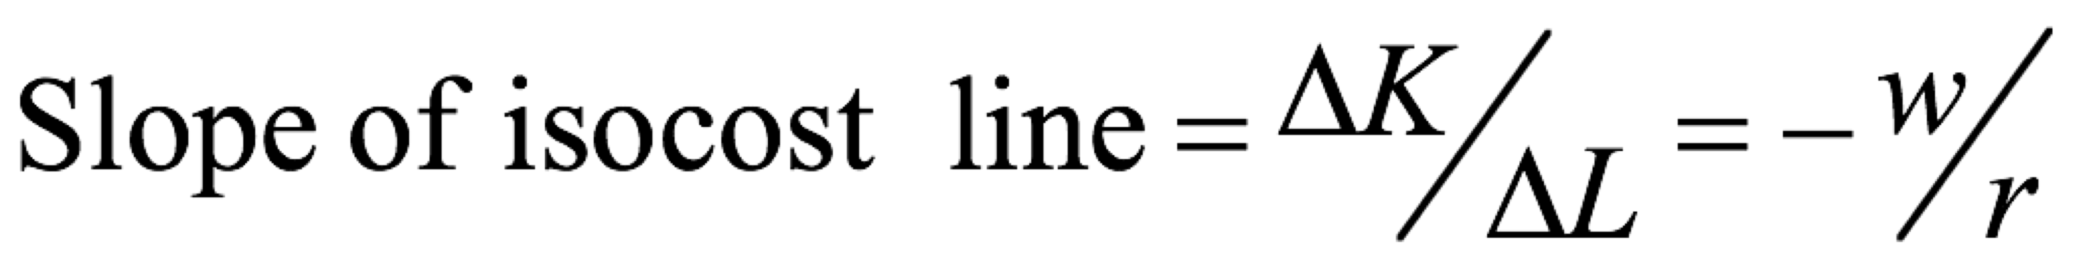
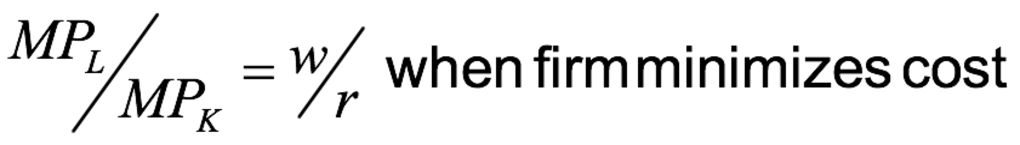
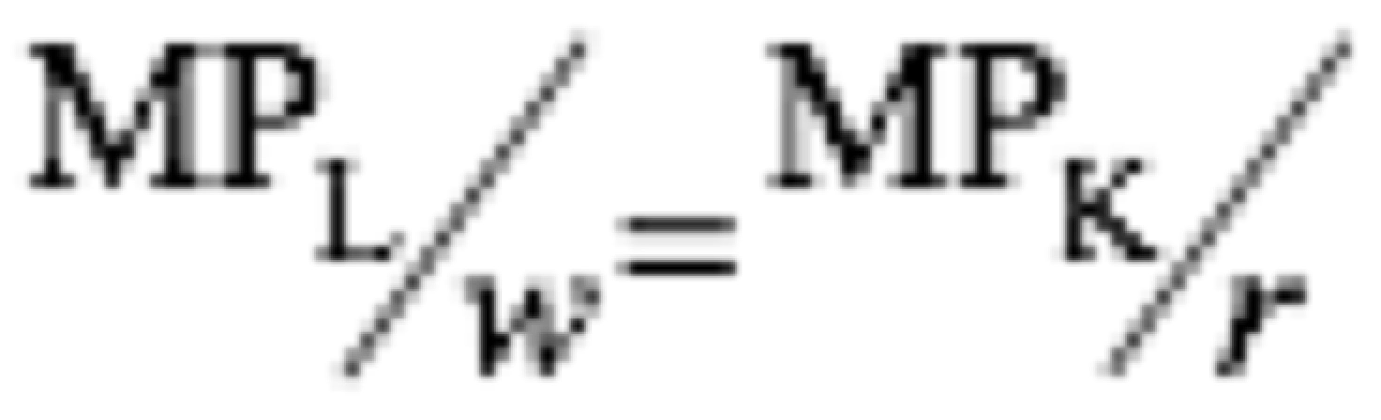
Cost in the Long Run
The minimum cost combination can then be written as:
Minimum cost for a given output will occur when each dollar of input added to the production process will add an equivalent amount of output.

Slide 25
Input Substitution When an Input Price Change
If the price of labor changes, then the slope of the isocost line change, w/r
It now takes a new quantity of labor and capital to produce the output
If price of labor increases relative to price of capital, and capital is substituted for labor

Slide 26
Input Substitution When an Input Price Change
Capital
per
year
If the price of labor rises, the isocost curve becomes steeper due to
the change in the slope -(w/r).
K₂/L₂
B
The new combination of K and L is used to produce Q₁.
Combination B is used in place of combination A.
K₂
K₁/L₁
A
K₁
Q₁
C₂
C₁
L₂
L₁
Labor per year

Slide 27
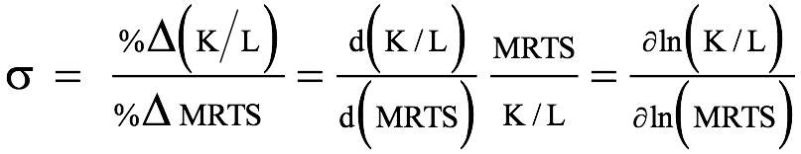
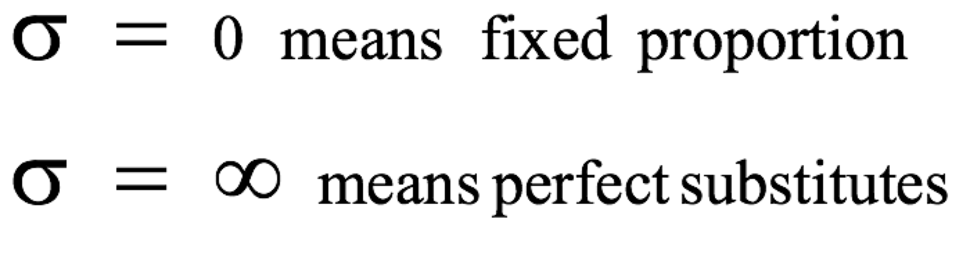
Elasticity of substitution
%Δ in capital-labor ratio divided by the %Δ in the slope of the isoquant

Slide 28
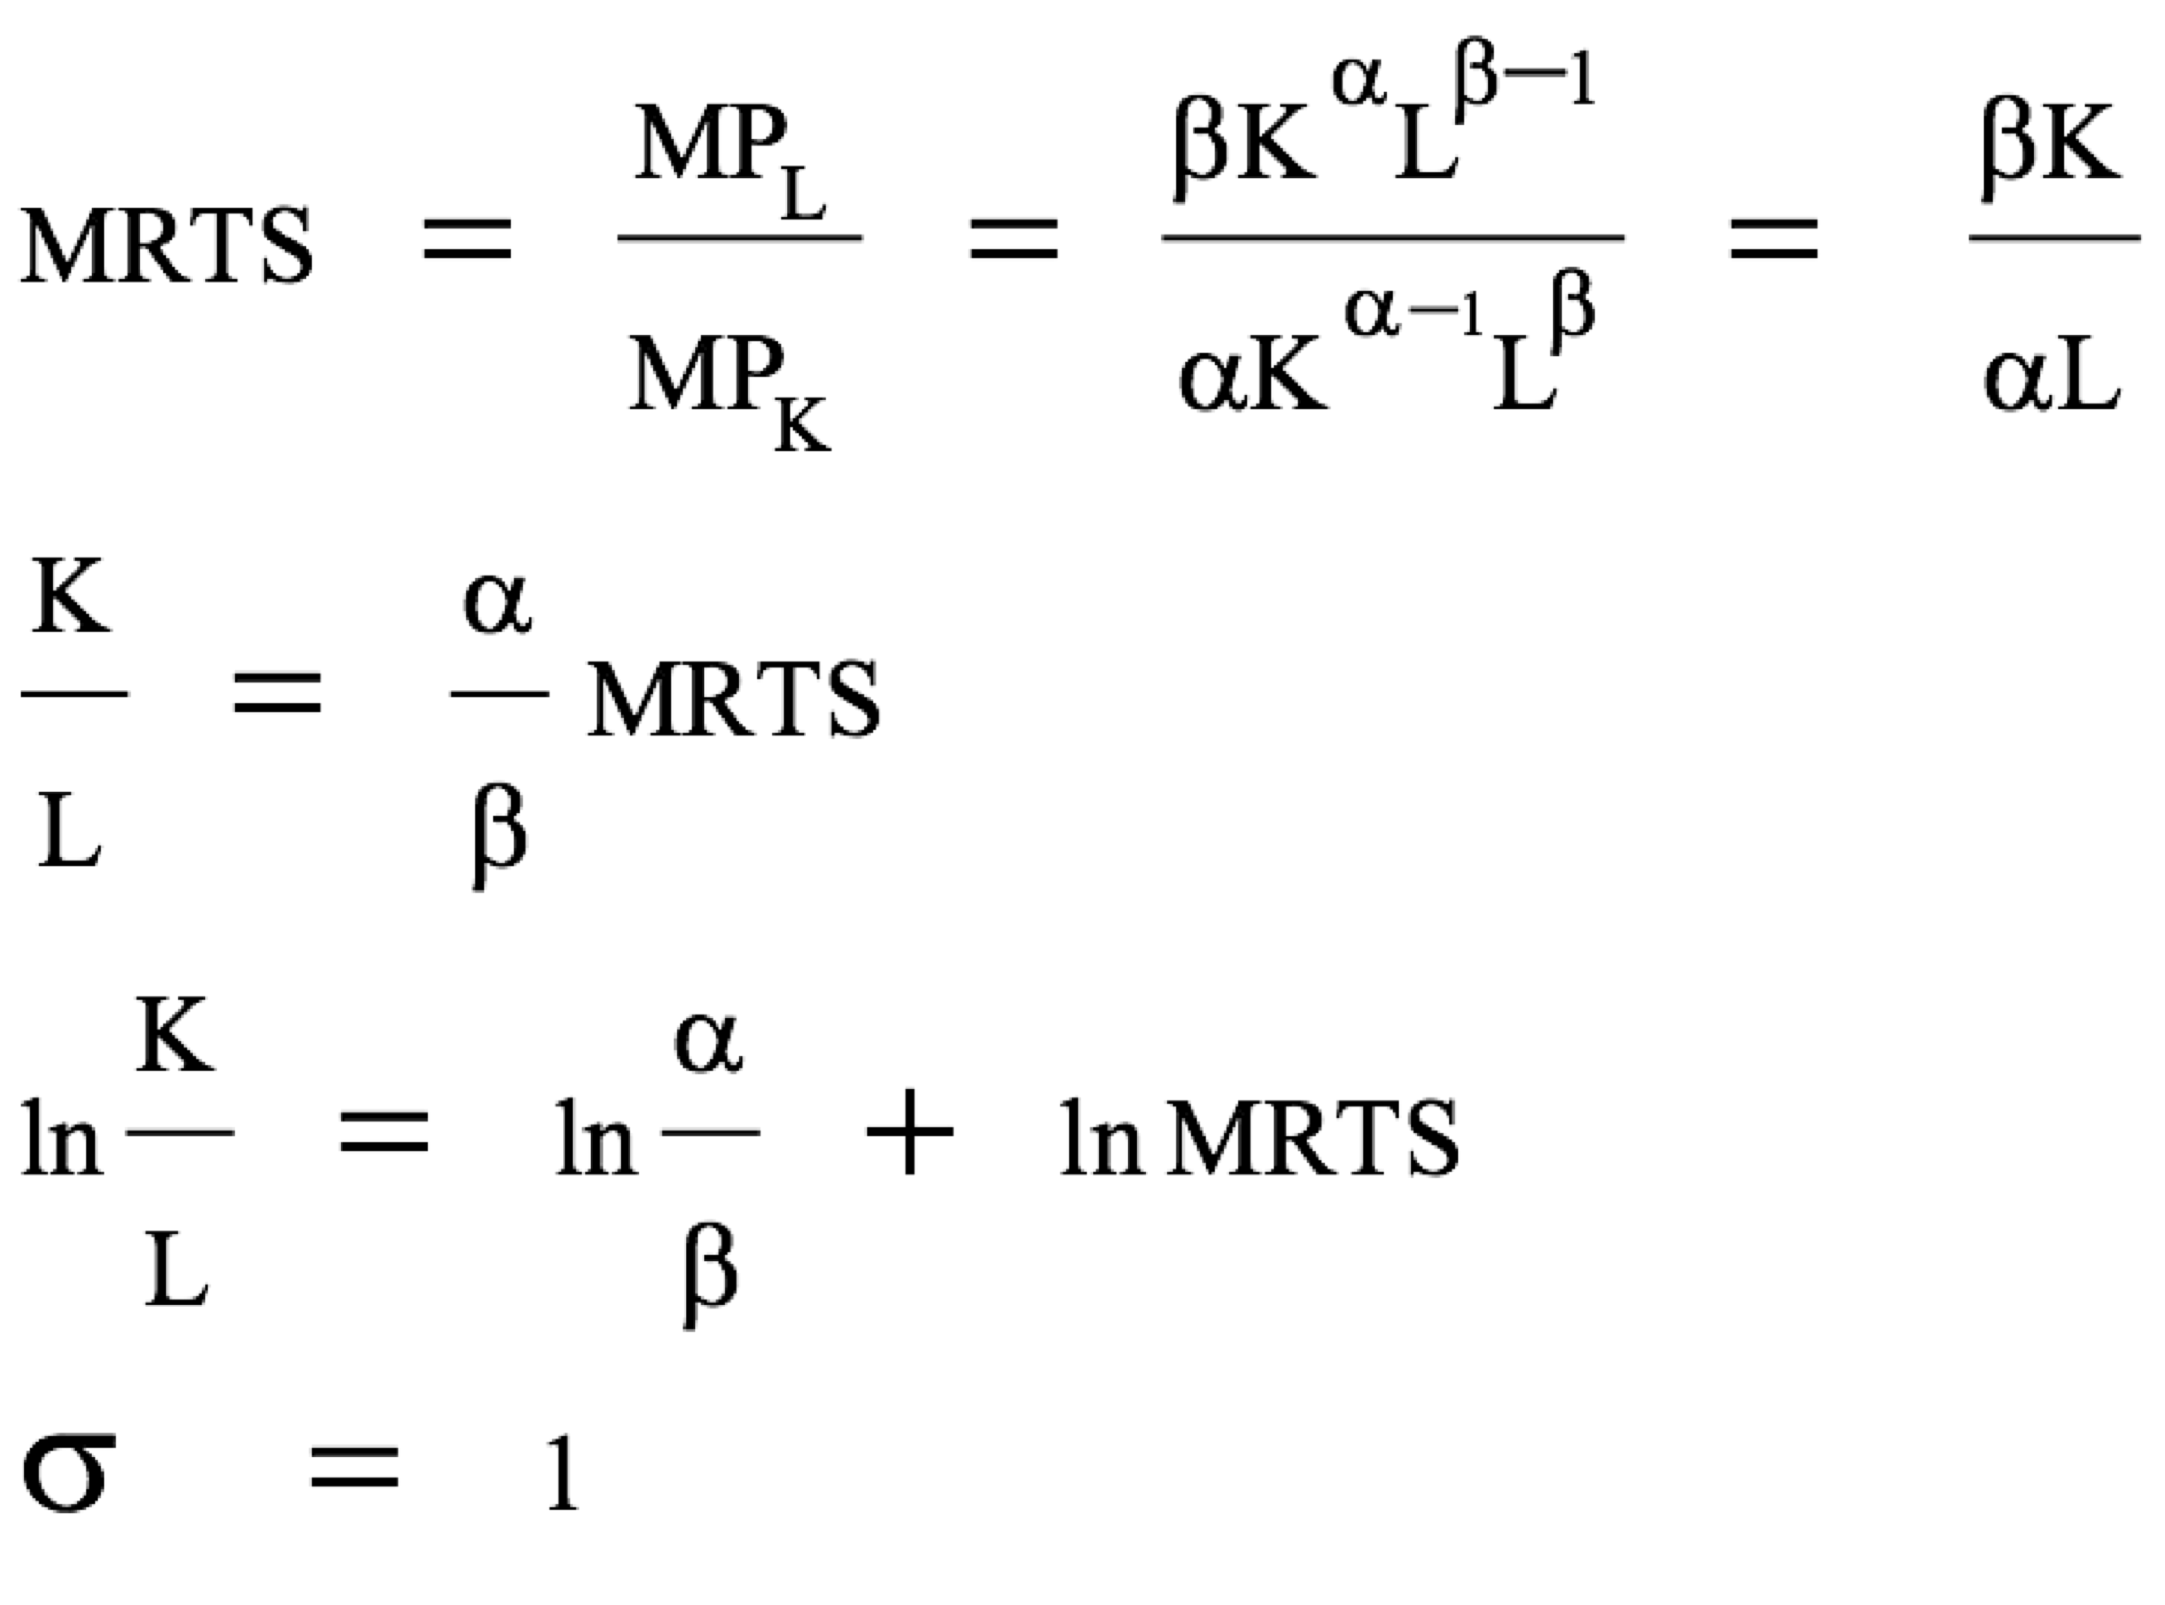
Example
From Cobb-Douglas production function: Q = K^{α}L^{β},

Slide 29
Elasticity of substitution
Point A is more capital-intensive, and B is more labor-intensive.
Moving from A to B, K/L decreases by 80% and MRTS also decreases by 80% --> σ = 1
K/L = 20/5 = 4
Capital
MRTS = 2
20
A
K/L = 8/10 = 0.8
8
B
MRTS = 0.4
5
10
Labor

Slide 30
Cost in the Long Run
Cost minimization with Varying Output Levels
  For each level of output, there is an isocost curve showing minimum cost for that output level
  A firm’s expansion path shows the minimum cost combinations of labor and capital at each level of output.

Slide 31
A Firm’s Expansion Path
Capital
per
year
The expansion path illustrates the least-cost combinations of labor and capital that can be used to produce each level of output in the long-run.
150
$3000
Expansion Path
100
$2000
C
75
$1000
B
50
A
300 Units
25
100 Units
200 Units
100
150
200
300
Labor per year
50

Slide 32
A Firm’s Long-Run Total Cost Curve: CRTS case
Cost/ Year
Long Run Total Cost
F
3000
E
2000
D
1000
100
200
300
Output, Units/yr

Slide 33
Expansion Path & Long-run Costs
Firms expansion path has same information as long-run total cost curve
To move from expansion path to LR cost curve
  Find tangency with isoquant and isocost
  Determine min cost of producing the output level selected
  Graph output-cost combination

Slide 34
Long-Run Versus Short-Run Cost Curves
In the short run some costs are fixed
In the long run firm can change anything including plant size
  Can produce at a lower average cost in long run than in short run
  Capital and labor are both flexible
We can show this by holding capital fixed in the short run and flexible in long run

Slide 35
The Inflexibility of Short-Run Production
Capital
per
year
E
Capital is fixed at K₁.
To produce Q₁, min cost at K₁ and L₁
If increase output to Q₂, min cost
is K₁ and L₃ in short run
C
Long-Run
Expansion Path
In LR, can change capital and min costs falls to K₂ and L₂
A
K₂
E
Short-Run
Expansion Path
P
K₁
Q₂
Q₁
Labor per year
L₁
L₂
B
L₃
D
F

Slide 36
Long-Run Versus Short-Run Cost Curves
Long-Run Average Cost (LAC)
  Most important determinant of the shape of the LR AC and MC curves is relationship between scale of the firm’s operation and inputs required to min cost
Constant Returns to Scale
  If input is doubled, output will double
  AC cost is constant at all levels of output.

Slide 37
Long-Run Versus Short-Run Cost Curves
Increasing Returns to Scale
  If input is doubled, output will more than double
  AC decreases at all levels of output.
Decreasing Returns to Scale
  If input is doubled, output will less than double
  AC increases at all levels of output

Slide 38
Short and Long-run Average Cost Curves
Cost
LMC
SMC₃
LAC
SMC₁
SMC₂
SAC₁
SAC₃
SAC₂
Q
Q₁
Q₂
Q₃

Slide 39
Long-Run Versus Short-Run Cost Curves
Long-run marginal cost leads long-run average cost:
  If LMC < LAC, LAC will fall
  If LMC > LAC, LAC will rise
  Therefore, LMC = LAC at the minimum of LAC
In special case where LAC if constant, LAC and LMC are equal

Slide 40
Long Run Costs
Economies of Scale: a situation when LAC declines with a larger output due to
  increasing returns to scale
  On a larger scale, workers can better specialize
  Firm can use more efficient machine
  Lumpiness in investment
  Scale can provide flexibility – managers can organize production more effectively
  Firm may be able to get inputs at lower cost if can get quantity discounts. Lower prices might lead to different input mix

Slide 41
Long Run Costs
Diseconomies of scale: a situation when LAC increases with a larger output due to
  Factory space and machinery may make it more difficult for workers to do their job efficiently
  Managing a larger firm may become more complex and inefficient as the number of tasks increase
  Bulk discounts can no longer be utilized. Limited availability of inputs may cause price to rise

Slide 42
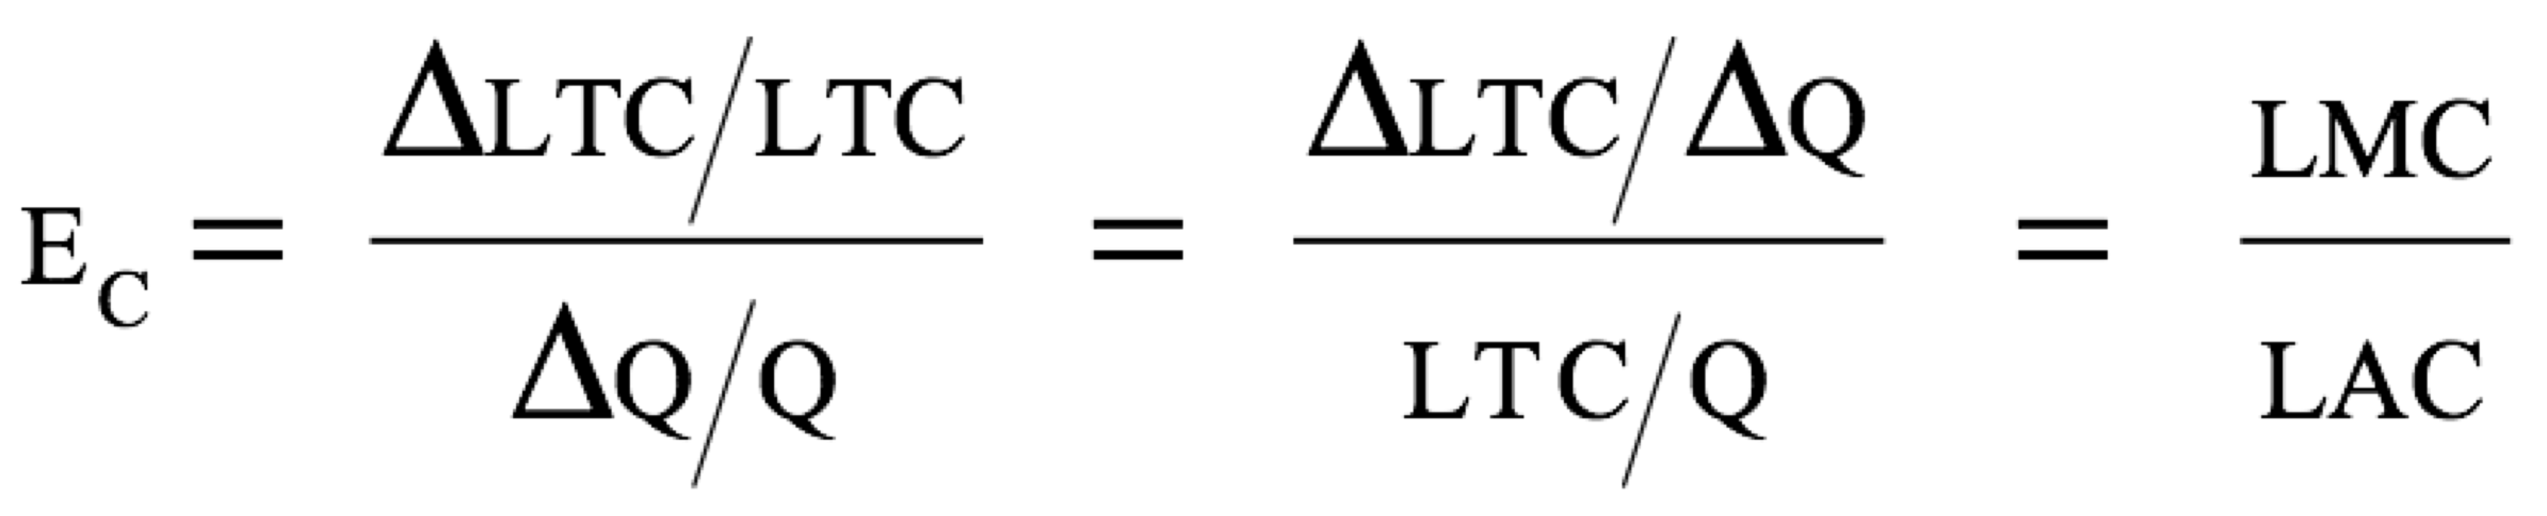
Long Run Costs
Economies of scale are measured in terms of cost-output elasticity, E_{C}
E_{C} is the percentage change in the cost of production resulting from a 1-percent increase in output

Slide 43
Long Run Costs
E_{C} is equal to 1, LMC = LAC
  Costs increase proportionately with output
  Neither economies nor diseconomies of scale
E_{C} < 1 when LMC < LAC
  Economies of scale
  LAC are declining
E_{C} > 1 when LMC > LAC
  Diseconomies of scale
  Both LMC and LAC are rising

Slide 44
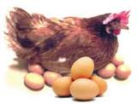

Production with Two Outputs: Economies of Scope
Many firms produce more than one product and those product are closely linked
Examples:
  Chicken farm--poultry and eggs
  Automobile company--cars and trucks
  University--Teaching and research
  Nation Group
  Choke Chai Farm

Slide 45
Production with Two Outputs: Economies of Scope
Advantages
Both use capital and labor.
The firms share management resources.
Both use the same labor skills and type of machinery.
Economies of Scope means that the production of one good reduces the cost of producing another related good.

Slide 46
Production with Two Outputs: Economies of Scope
There is no direct relationship between economies of scope and economies of scale.
  May experience economies of scope and diseconomies of scale
  May have economies of scale and not have economies of scope

Slide 47
Dynamic Changes in Costs: The Learning Curve
Firms may lower their costs not only due to economies of scope, but also due to managers and workers become more experienced at their jobs
As management and labor gain experience with production, the firm’s marginal and average costs may fall

Slide 48
Dynamic Changes in Costs: The Learning Curve
Reasons
  Speed of work increases with experience
  Managers learn to schedule production processes more efficiently
  More flexibility is allowed with experience. May include more specialized tools and plant organization
  Suppliers become more efficient passing savings to company

Slide 49
Dynamic Changes in Costs: The Learning Curve
The learning curve measures the impact of worker’s experience on the costs of production.
It describes the relationship between a firm’s cumulative output and amount of inputs needed to produce a unit of output.
Notes:
120

Slide 50

The Learning Curve
Hours of labor
per machine lot
10
8
6
4
2
Cumulative number of
machine lots produced
0
10
20
30
40
50
Notes:
122

Slide 51
Dynamic Changes in Costs: The Learning Curve
Observations
  New firms may experience a learning curve, not economies of scale.
    Should increase production of many lots regardless of individual lot size
  Older firms have relatively small gains from learning.
    Should produce its machines in very large lots to take advantage of lower costs associated with size
Notes:
129

Slide 52
Economies of Scale Versus Learning
Cost
($ per unit
of output)
Economies of Scale
A
B
AC₁
Learning
C
AC₂
Output
Notes:
132

