Slide 1
Poverty And
Income Distribution

Slide 2
References:
สมชัย จิตสุชน ความยากจนคืออะไร วัดได้อย่างไร รายงานทีดีอาร์ไอ ฉบับที่ 32 พฤษภาคม 2545 (Somchai Jitsuchon, What is Poverty, and how to measure it, 2002)
http://www.tdri.or.th/download/quarterly/white-pp/wb32.pdf

Slide 3
References:
อัมมาร สยามวาลา และ สมชัย จิตสุชน แนวทางการแก้ไขปัญหาความยากจน เสรีนิยม ประชานิยม หรือรัฐสวัสดิการ เอกสารประกอบการสัมมนาวิชาการประจำปี 2550 ของ TDRI (Ammar Siamwalla and Somchai Jitsuchon, Solving the Poverty Problem, 2007) http://202.43.34.55/tdriorth/download/year-end/ye_07/Ammar&Somchai.pdf

Slide 4
References:
THAILAND: POVERTY ASSESSMENT UPDATE By Medhi Krongkaew
ALIENATED LIFE: SOCIO-ECONOMIC CHARACTERISTICS OF THE ULTRA POOR IN THAILAND By Medhi Krongkaew

Slide 5
Poverty And
Income Distribution
A . Poverty
B. Income Distribution
C. Policies Affecting Poverty and Income Distribution

Slide 6
A . Poverty

Slide 7
A . Poverty
A standard of living below which individuals are “ Poor”
Absolute poverty : bare subsistence or “poverty line”– level of income that allows one to attain minimum standard of living. Those whose income below PL are classified as poor.
Relative poverty : compared with some determined level of living standard

Slide 8
Poverty Measurement Problems :
Which measure of resources ? Income, education, expenditure
  Normally, expenditure survey data are more reliable than income (not regular and underestimated)

Slide 9
Poverty Measurement Problems :
Appropriate income unit : individuals or families or households (most commonly used)
Indicator of “being poor”: poverty line

Slide 10
Poverty Measurement Problems :
Poverty line: the lowest income level for bare subsistence, minimum standard of living
Food, shelter, clothing, medical service, education, transport, recreation, etc.

Slide 11
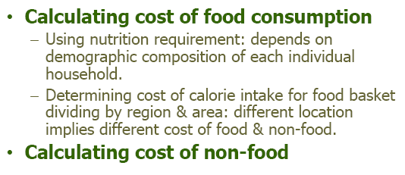
Constructing Poverty Line

Slide 12
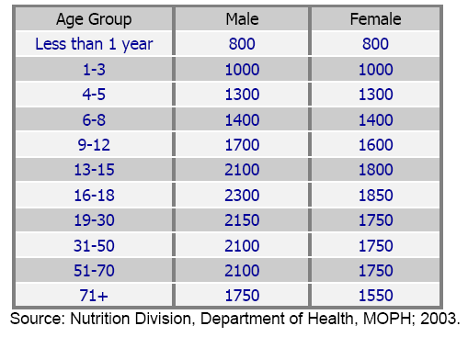
Recommended Dietary Allowance for Thai People, calorie/day 2003

Slide 13
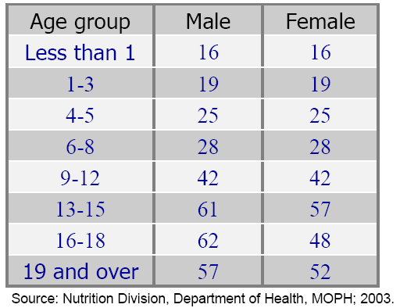
New Protein Requirement: gram/day, 2003

Slide 14
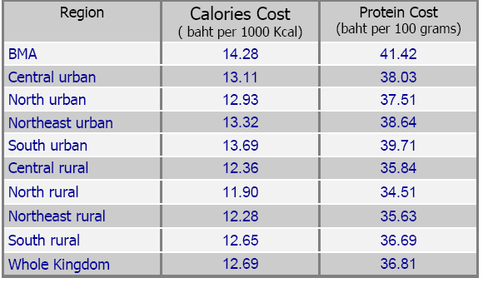
Cost of Calories & Protein in 2002 by Region

Slide 15
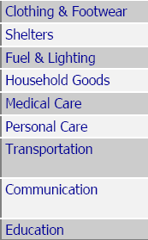
Non-food items

Slide 16
Table 1(A) : Poverty lines (Baht Per Person Per Month)
Region | 1990 | 1992 | 1994 | 1996 | 1998 | 2000 | 2002 | 2004
Bangkok | 1,105 | 1,227 | 1,346 | 1,502 | 1,696 | 1,736 | 1,801 | 1,853
Central | 760 | 854 | 894 | 1,013 | 1,211 | 1,211 | 1,277 | 1,339
North | 652 | 737 | 767 | 874 | 1,023 | 1,019 | 1,078 | 1,131
North - east | 560 | 667 | 707 | 811 | 998 | 993 | 1,040 | 1,078
South | 644 | 724 | 778 | 897 | 1,033 | 1,034 | 1,096 | 1,164
Thailand | 692 | 790 | 838 | 953 | 1,130 | 1,135 | 1,190 | 1,242

Slide 17
17

Slide 18
18

Slide 19
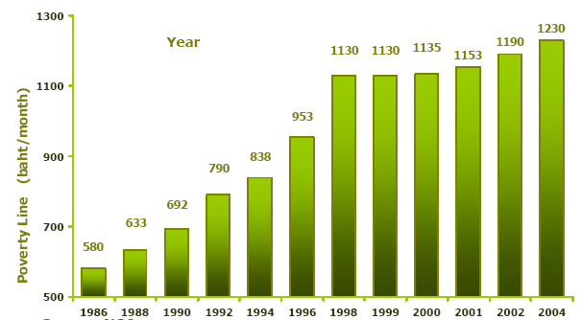
National Poverty Line 1986-2004

Slide 20
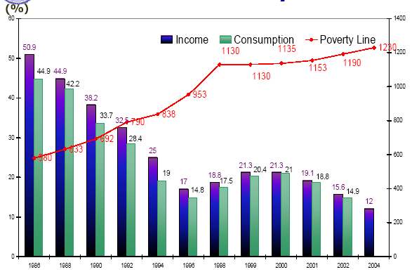
Poverty Incidence 1986 - 2004

Slide 21
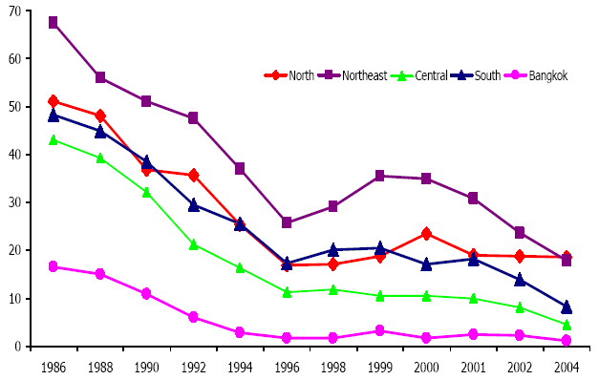
Poverty Incidence by Region (income)

Slide 22
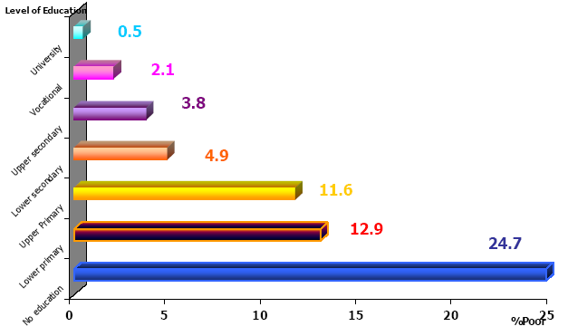
Percentage of Head of Poor HH by Education Level 2004

Slide 23
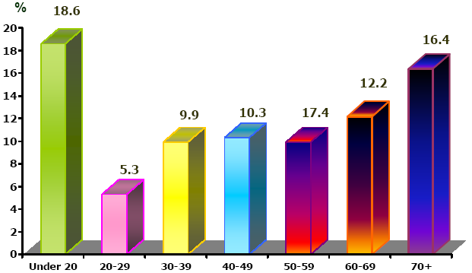
Proportion of Head of the Poor Household
By Age, 2004

Slide 24
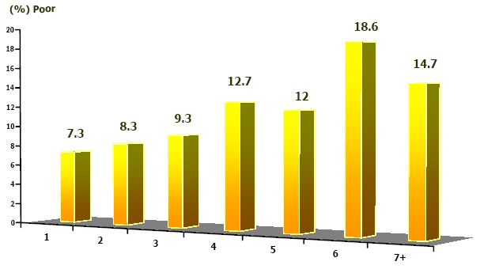
Household Size of the Poor 2004

Slide 25
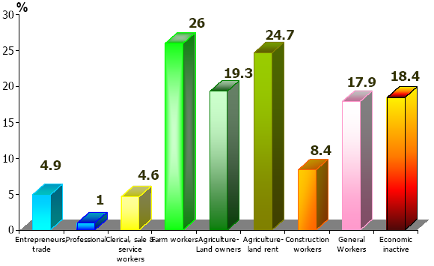
Proportion of Head of the Poor Household
By Occupation 2004

Slide 26
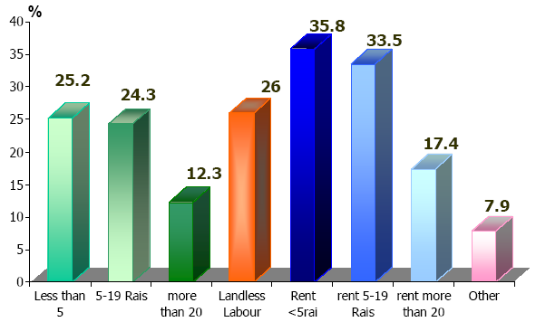
Proportion of Land Entitlement of the
Poor in Agriculture Sector 2004

Slide 27
Characteristic of the Poor in 2004
• Limit education—low earning ability,
un-affordable for higher education;
• High dependency (family size & age
profile), family with disadvantaged
characteristic;
• Majority of the poor are in agricultural sector and landless farmers.

Slide 28
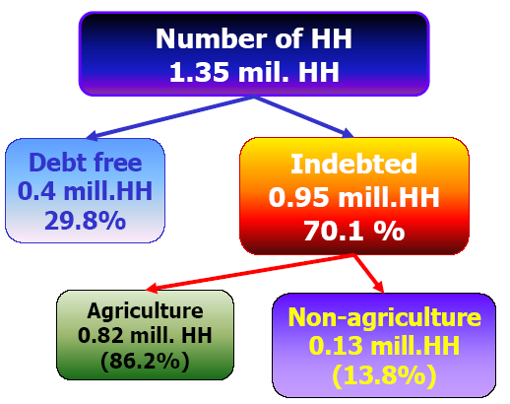
Indebted Household below Poverty Line 2002

Slide 29
Study on the Ultra Poor in 1999
Ultra Poor: Hard-core poor
“Jon Dak Darn”
The poorest in the villages
Samples of about 350 households
    North
    Northeast (1998)
    Northeast (1999)
    Centre
    South

Slide 30
Study on the Ultra Poor in 1999
Socio-economic Characteristics:
Large family size (3.7 – 5.1)
High dependency ratio (54% - 78%)
HH heads with no or low education
> 60% are landless, except
the North (19%)
Majority are laborers, some are farmers

Slide 31
Study on the Ultra Poor in 1999
Socio-economic Characteristics:
Greater incidence of widows as
heads of HH
Small number of working days
90% never receive assistance from
government

Slide 32
National poverty line
 | Population below the poverty line |  |  |  | Population below the poverty line
 | Survey year | Rural | Urban | National | Survey year | Rural | Urban | National
 |  | % | % | % |  | % | % | %
Bolivia | 1997 | 77.3 | 53.8 | 63.2 | 1999 | 81.7 | 50.6 | 62.7
Bangladesh | 1995-96 | 55.2 | 29.4 | 51.0 | 2000 | 53 | 36.6 | 49.8
Ethiopia | 1995-96 | 47 | 33.3 | 45.5 | 1999-00 | 45 | 37 | 44.2
Lao PDR | 1993 | 48.7 | 33.1 | 45.0 | 1997-98 | 41 | 26.9 | 38.6
Philippines | 1994 | 53.1 | 28 | 40.6 | 1997 | 50.7 | 21.5 | 36.8
Kenya | 1994 | 47 | 29 | 40.0 | 1997 | 53 | 49 | 52.0
Vietnam | 1998 | 45.5 | 9.2 | 37.4 | 2002 | 35.6 | 6.6 | 28.9
Cambodia | 1997 | 40.1 | 21.1 | 36.1 | 1999 | 40.1 | 13.9 | 35.9
India | 1993-94 | 37.3 | 32.4 | 36.0 | 1999-00 | 30.2 | 24.7 | 28.6
Pakistan | 1993 | 33.4 | 17.2 | 28.6 | 1998-99 | 35.9 | 24.2 | 32.6
Brazil | 1996 | 54 | 15.4 | 23.9 | 1998 | 51.4 | 14.7 | 22.0
Egypt, Arab Rep. | 1995-96 | 23.3 | 22.5 | 22.9 | 1999-00 | .. | .. | 16.7
Sri Lanka | 1990-91 | 22 | 15 | 20.0 | 1995-96 | 27 | 15 | 25.0
Chile | 1996 | .. | .. | 19.9 | 1998 | .. | .. | 17.0
Thailand | 1990 | .. | .. | 18.0 | 1992 | 15.5 | 10.2 | 13.1
Indonesia | 1996 | .. | .. | 15.7 | 1999 |  |  | 27.1
Malaysia | 1989 | .. | .. | 15.5 |  | .. | .. | ..
Mexico | 1988 | .. | .. | 10.1 |  | .. | .. | ..
China | 1996 | 7.9 | <2 | 6.0 | 1998 | 4.6 | <2 | 4.6

Slide 33
Causes of Poverty
Complex and structural problem, with different dimensions
Social factors:
Family – large size, with sick, old and young members
Low level of education, lack of skills

Slide 34
Causes of Poverty
Social factors:
Lack of information
Social attitude is negative towards the poor
Material-oriented consuming culture, leading to overspending and indebtedness

Slide 35
Causes of Poverty
Economic factors:
Imbalance in economic policy: promote industries, at the expense of farmers and natural resources
Unequal access to infrastructure and social services

Slide 36
Causes of Poverty
Economic factors:
Deterioration of natural resources
Landlessness in agriculture
Lack of access to capital, particularly formal financial institutions

Slide 37
Causes of Poverty
Government administrative factors:
Laws and regulations as obstacle to poverty eradication
Partial approach in problem solving
Not promote participation by all stakeholders

