Slide 1
States of Consciousness
PY 211 General Psychology

Slide 2
Nature of Consciousness
= a state of awareness of the sensations (external & internal) , thoughts and feelings we experience at a given moment
2 aspects of consciousness
  Awareness: being conscious of what is going on
    Association areas and frontal lobes
  Arousal: a psychological state determined by the reticular activating system (RAS)

Slide 3
5 Levels of Awareness
Higher-level consciousness
  = controlled processes, in which individuals actively focus their efforts toward a goal (attention)
Lower-level consciousness
  Automatic processes
    States of consciousness that require little attention and do not interfere with other ongoing activities
  Daydreaming

Slide 4
5 Levels of Awareness
  Daydreaming
    A little like dreaming while we are awake
    Begin spontaneously when we are doing something that requires less than our full attention
    Daydream can remind us of important things ahead or can be about daily events.
    Daydreams create tension (in contrast to what Freud claimed).

Slide 5
5 Levels of Awareness
3. Altered states of consciousness
  Drugs
  Meditation
  Hypnosis
4. Subconscious awareness
  Insight
  Visual processing in people with blindsight
  Sleeping and dreaming
5. No awareness
  Knocked out by a blow, anesthetized, or fallen into a deep and prolonged unconscious
  Unconscious thought (Freud) or nonconscious

Slide 6
Sleep Cycles
Sleep claims about 1/3 of time in our lives.
Sleep is a combination of states, not a single state.
As we fall asleep, we pass from waking consciousness to a semiwakeful state, then to a deeper state and shift to a stage in which dreaming occurs. Which bring a kind of conscious awareness.
During a night, we pass through about 4-6 cycles of sleep, each last 90-100 minutes.
A normal cycle of sleep contains 5 stages.

Slide 7
Stages of Sleep
Stages of sleep
  Hypnagogic state
  Stage 1-4 (non-REM sleep)
    Light sleep (stage 1 and 2)
    Deep sleep (stage 3 and 4)
  REM sleep

Slide 8
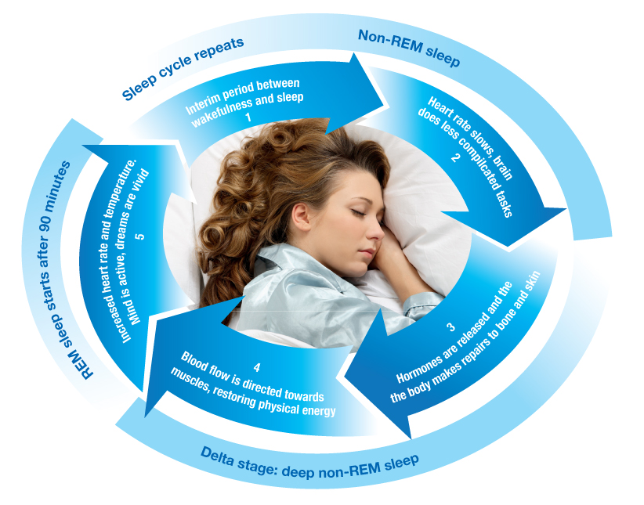
Stages of Sleep

Slide 9
1. Hypnagogic State
Hypnagogic state
  Twilight state, highly relaxed
  We begin to lose voluntary control of body movements.
  Sensitivity to outside stimuli diminishes.
  Thoughts are less bound by reality.
  Myoclonia: A sudden jerk
    Caused by brief and completely normal seizure-like states of the brain

Slide 10
2. Light Sleep & Deep Sleep
Stages of sleep are characterized by brain waves, detected by electroencephalography (EEG).
Stage 1 & 2: light sleep
  If awakened during these stages, they report not having been asleep at all
Stage 3 & 4: deep sleep
  Most difficult to wake sleepers
  If awakened, they are usually confused and disoriented

Slide 11
3. REM Sleep
REM sleep
  An active stage of sleep during which dreaming occurs
  Pattern of brain waves is similar to those of relaxed wakefulness (=conscious awareness).
  The sleeper’s eyeballs rapidly move up and down and left to right.
  If awakened, they report having dreamed.
  1st REM stage lasts for 10 minutes and increases toward morning, final REM stage might last an hour.

Slide 12
3. REM Sleep
  In addition to eyeballs, ANS and PNS also active during dreams, called “autonomic storms”
    Blood flow to the brain increases.
    Heartbeat becomes irregular.
    Muscles of face and fingers twitch.
    Breathing becomes irregular.
    Voluntary control of the large body muscles is lost.
    Vaginal lubrication and erection of the penis.

Slide 13
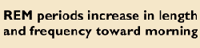
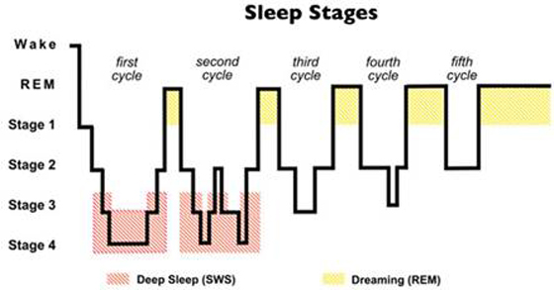
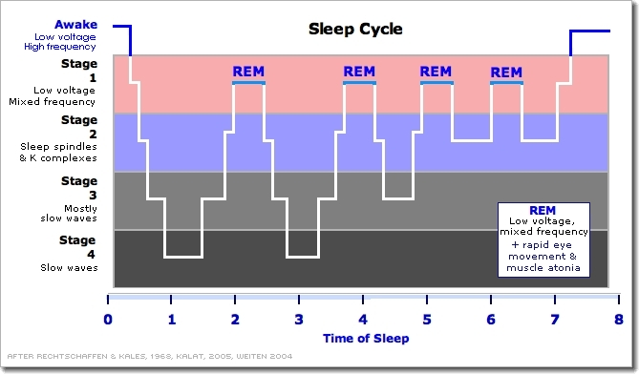
Stages of Sleep
Hours of Sleep

Slide 14
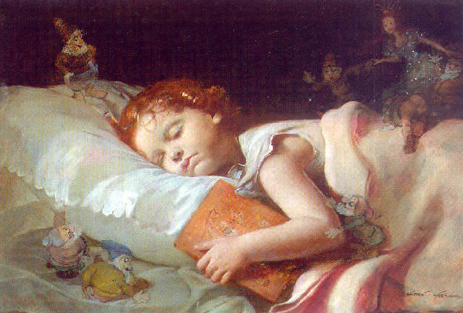
Dreams
  On average, we spend about 2 hours a night in REM sleep.
  We dream about 80% of REM sleep.
  Dream usually occurs during the last past of sleep cycle.
  We forget dreams quickly unless we awaken during or soon after the dream.

Slide 15
Dreams
  Reports of dreaming during REM sleep are longer, more vivid, more emotionally, more motorically animated and less related to waking life than during non-REM sleep.
  If awakened during non-REM sleep, they report dreaming about half of the time.
  Non-REM dreams are less bizarre and filled with less negative emotions than REM dreams.
  In addition to 2 hours of REM dreaming, non-REM dreaming occurs 2-3 hours per night.

Slide 16
Contents of Dreams
Images and characters
  Most of the conscious experiences in dreams is visual.
    ¼ of dream images include auditory sensations.
    20% include body sensations.
    < 1% of dreams include tastes or smells.
  Visual images are usually bright and clear, but drab in color, with blurry background.
  ¾ of our dreams, we have an active role.
    ½ of other characters are people we are familiar with.
    The other half are who we do not recognize.

Slide 17
Contents of Dreams
Emotional content of dreams
  Most dreams contain positive emotions.
  But negative dreams are more likely to wake us up.
  Therefore we are more likely to be aware of the negative dreams that awaken us.
Creative and bizarre aspects of dreams
  ¾ of dreams contain at least one bizarre and unrealistic element, or mixed into realistic dream.
  10% of dreams → nonsensical story lines
  Another 10% are completely fantastic and bizarre.

Slide 18
Meaning of Dreams
The majority of content of dreams is related to day residue - things going on in our lives during the day.
A study compared the content of dreams of college student in San Francisco (earthquake happened) with in Arizona.
  40% of first group report at least one dream about earthquake, compared with 5% of students in Arizona

Slide 19
Meaning of Dreams
Functions of dreams
  Symbolizing and fulfilling wishes
  Solving problems and creative thinking
  Making sense of neural activity during sleep (Activation-synthesis theory)

Slide 20
Circadian Rhythm
A daily behavioral/psychological cycle, regulate the sleep and wakefulness cycle, secretion of some hormone, body temperature etc.
Parts of the brain stem and hypothalamus = internal clock.
Light (through the retina) allows the hypothalamus to regulate daily rhythms.
In addition to brain, melatonin is a key factor in regulating sleepiness (high at night).
The rhythm (without the influence of light) is a cycle of approximately 25 hours.

Slide 21
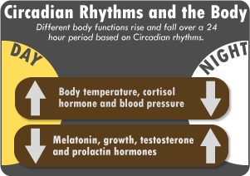
Circadian Rhythms
Some hormones secreted follow the pattern of the sleep-wake cycle.
  Growth hormone; released the first 2 hours of sleep => sleeps play in normal growth and health maintenance
  Cortisol; rise after fall asleep and throughout the night, peak before the awakening (longest REM sleep)
Body temperature falls when beginning to feel sleepy and continues to fall until the mid of the sleep period.

Slide 22
Desynchronisation of the Clock
The jet lag occurs because the body time is desynchronized with clock time.
  Fly to west (BKK→LDN) → longer period of daylight → stay awake longer
  Fly to east (LDN →BKK) → very short first night →not enough sleep
  Travelling from west to east requires longer time to readjust to local time (harder to adjust).

Slide 23
Desynchronisation of the Clock
Work-shift rotation
  It is less disruptive to rotate from the night shift to the day shift and from the day shift to the swing shift than to rotate in opposite direction.

Slide 24
Resetting the Biological Clock
Spend as much time as possible outside in the daylight.
Small dosage of melatonin can reduce jet lag.

Slide 25
Functions of Sleep
Restorative function
  During deep sleep many body’s cells show increased production and reduced breakdown of protein, needed for cell growth and for repair of damages.
  Deep sleep is beneficial to physical growth and increased brain development in infants and children by releasing growth hormone.
Adaptive evolutionary function

Slide 26
Effects of Sleep Deprivation
2 hours after usual bedtime: irritable, fatigued, inattentive, inefficient and fall asleep quicker and sleep longer at the next night.
After 53 hours of wakefulness: Subjects had more difficulty making moral decision and were more likely to agree with decisions that violated their personal standard.
After 11 days without sleep: Some hallucination, and speech and movement problems
Sleep deprivation affects decision making esp. the unexpected, innovation, revising plans and effective communication.
60-90 mins less sleep than you need can harm your ability to perform optimally the next day.
Optimal performance is enhanced by sleeping > 8 hours a night

Slide 27
Effects of Sleep Deprivation
Pattern of hormone secretion by the adrenal gland and thyroid is altered.
  Metabolism of sugar less efficient
  Slow down the body’s immune system
Stress hormones (from lack of sleep) may interfere the creation of neurons in the hippocampus.
  Sleep is important in the consolidation, storage and maintenance of LTM
Increase rate of accidental death
Depriving of 2 hours of REM sleep had the same affect as the deprivation of sleep in general.
REM sleep plays an essential role in the consolidation of newly learned information from the day before.

Slide 28
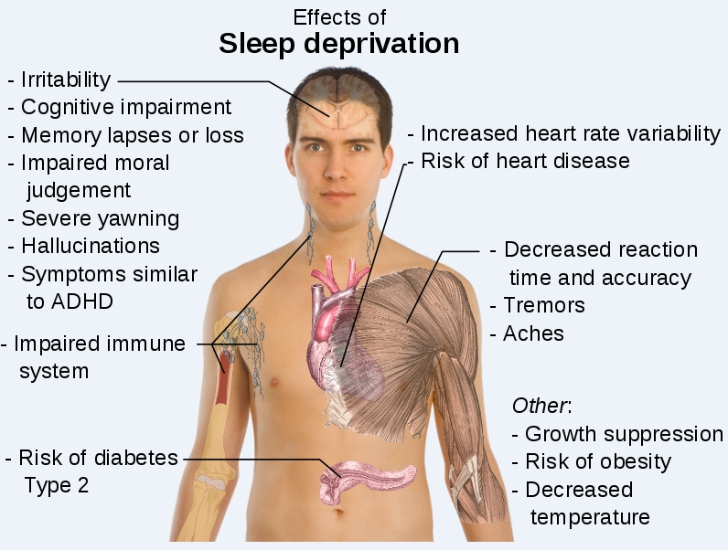

Slide 29
Sleep Phenomena
Nightmares
  Occur during REM sleep
  Often upsetting or frightening enough to wake us up during the dream, so vividly remember the nightmares
  More common in people with psychological stress

Slide 30
Sleep Phenomena
Night terrors
  Occur during the deepest phase of non-REM sleep
  Awaken suddenly in a state of panic and fear, sometimes screaming
  Rapid heart rate and breathing, heavy sweating and movements
  No clear recollection of an accompanying dream

Slide 31
Sleep Phenomena
Sleep walking
  Occur during the deepest part of non-REM sleep
  Most common in children
  In adults only during period of stress
Sleep talking and eating

Slide 32
Sleep Disorders
Insomnia
  A problem in falling asleep or waking up during the night or waking up too early
  Common in individuals undergoing periods of stress, anxiety or depression
  Solution: Get out of bed in the morning, stay awake during the day and not taking a nap

Slide 33
Sleep Disorders
Sleep apnea
  Sudden and temporary interruption of breathing during sleep (>20s)
  Common sign is loud snoring , paused by silence
  Common in adults who snore and overweight
Narcolepsy
  Immediately enter REM sleep while talking or standing-up esp. when upset or stress
  Loss of muscle tone and lack of body movement

Slide 34
Altered States of Consciousness
Meditation
  Produce a deep relaxation
  Involve a reduction in the arousal of some brain system and sympathetic ANS
  Natural remedy for stress-related medical problems e.g. high BP, insomnia

Slide 35
Altered States of Consciousness
Hypnosis
  = a psychological state of altered attention and expectation, which the individual is unusually receptive to suggestions
  The Austrian physician Franz Anton Mesmer cures his patient with what he called “animal magnetism”.
  His treatment was to rebalance the magnetic forces by passing his hand, which become magnetized over the patients.
  In reality, the cures were due to hypnotic suggestion that their problem would go away.

Slide 36
4 Steps in Hypnosis
Distractions are minimized, made the person comfortable.
The hypnotist tells the person to concentrate on something specific.
The hypnotist tells the person what to expect in the hypnotic state e.g. relaxation.
The hypnotist suggests certain events or feelings he/she knows will occur or observes occurring e.g. your eyes are getting tired → the person interpret this caused by the hypnosis → make him/her more suggestible.

Slide 37
Individual Variations in Hypnosis
65% of individuals are moderately hypnotizable.
15% are highly susceptible to hypnosis.
10% can not be hypnotized at all.
Individuals with capacity to absorb themselves in imaginative activities e.g. listen to favorite songs, reading a novel are likely to be hypnotizable.
Though in a state of hypnotic people follow the suggestion, they are unlikely to do anything against their moral or dangerous.

Slide 38
Psychoactive Drugs
Substances that act on the NS to alter consciousness, modify perception and change moods
Depressants
Stimulants
Hallucinogens

Slide 39
Depressants
Reduce the activity of inhibitory centers of CNS
  Leading to a sense of relaxation and lowered inhibition
  Slow down mental and physical activities
Alcohol
Barbiturates
Tranquilizers e.g. valium

Slide 40
Effects of Depressants
Alcohol
  Drinkers become “loosen up” and judgment impaired
  Activities requiring intellectual function and motor skills are harder to perform e.g. driving
  Extreme intoxication may cause coma and die
  Alcoholics may have a genetic predisposition

Slide 41
Effects of Depressants
Barbiturates
  Decrease CNS activity and impair memory and decision making
  Heavy dose can cause death → used in suicide attempts
Tranquilizers
  e.g. valium
  Reduce anxiety and induce relaxation

Slide 42
Stimulants
Increase the activity of the motivational centers and of CNS
  Providing a sense of energy and well-beings
Caffeine
Nicotine
Amphetamines
cocaine

Slide 43
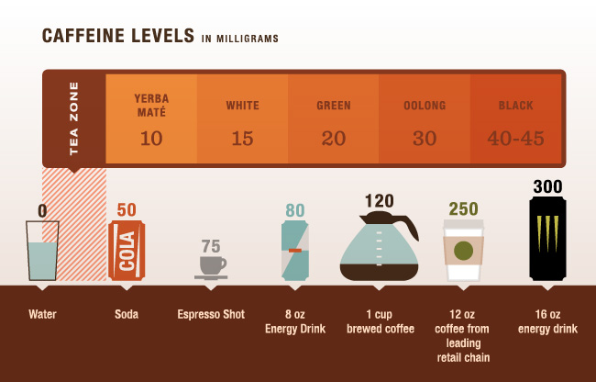
Effects of Stimulants
Caffeine
  Boost energy and alertness
  Caffeinism: mood changes, anxiety, insomnia, dry mouth
  Withdrawal symptoms: headaches, concentration difficulties

Slide 44
Effects of Stimulants
Nicotine
  Raising dopamine level (reward center)
  Improve attention and alertness, reduce anger and anxiety, pain relief
  Withdrawal symptoms: craving, irritability, inability to focus, sleep disturbance
  Forever increase the risk of lung cancer, even quit

Slide 45
Effects of Stimulants
Amphetamine
  Used to boost energy, stay awake or lose weight (diet pills)
  Increase the release of dopamine → pleasurable feeling or even feeling euphoria
Cocaine
  The most addictive substance
  Rush of euphoria feeling for 15-30 mins
  The treatment has not been successful

Slide 46
Hallucinogens
  Produce dreamlike alternations in perceptual experience
Marijuana
Ecstasy
LSD

Slide 47
Effects of Hallucinogens
Marijuana
  Mixture of excitatory, depressive and mild hallucination, distorted perception of time and place
Ecstasy
  Cognitive deficit persist up to 2 years after the 1st use
LSD
  Perceptual changes
    Object change their shapes and glow.
    Colors become kaleidoscopic.
    Perceived time is slower.
  Even trigger extreme anxiety, paranoia, suicidal impulses
  Rapid mood swing, impaired attention and memory

