Slide 1
QE 1 2 3 Operational Twist

Slide 2
What is QE 1
Quantitative Easing
  Measure from the Federal Reserve to counter 2008 subprime mortgage crisis
  Last from December 2008 until March 2010

Slide 3
Why QE1
Fed other monetary tools was reaching their limit
  Fed Fund Rate
  Discount Rate
  Giving Interest to reserve requirement

Slide 4
How QE1
In Nov 2008, Fed began buying $600 billion in MBS, and $100 billion in other debt, all of which were backed by Fannie Mae, Freddie Mac, Ginnie Mae and the Federal Home Loan Banks.
In March 2009,It announced it would buy $750 billion more in MBS, $100 billion in Fannie and Freddie debt, and $300 billion of longer-term Treasuries over the next six months.

Slide 5
Drawback & Result
the bank did not lend as much as Fed expected
Lower interest rate from 6.33% in November 2010 to 5.23% in March 2011 in housing market
Low interest rate give fuel for US economy to recover

Slide 6
Why Qe2
The Economy was doing better as a result of QE1 but the Fed saw that the bank was not lending that much and they saw opportunity to increase the opportunity even further

Slide 7
What QE2
It lasted seven months, from November 2010 to June 2011. When it was launched, the Fed announced it would buy $600 billion of Treasury bills, bonds and notes by March 2011

Slide 8
Differences
Fed bought $30 billion a month in longer-term denominations, such as the 10 year treasury notes to decrease interest rate and force investor back to mortgages
Setting inflation target of 2%, Fed focus was to spur mild inflation to increase demand, since a deflation economy nobody wants to buy since the price would keep decreasing

Slide 9
result
Many investor fear that the Fed would overshoot their inflation target this make many investor as a result, gold prices set new records to $1,825 an ounce

Slide 10
What QE3
Third round of quantitative easing begun by the Federal Reserve on September 13, 2012 to December, 2012
-maintain until jobs improved substantially
-buy $40 billion mortgage-backed securities (MBS) from member Federal Reserve banks.
-buy $45 billion of longer-dated Treasuries every month until employment and/or inflation reach an acceptable level.

Slide 11
Why QE3
-Fed chair shifted their focus from repairing damage from subprime mortgage crisis to boosting economic growth and job improvement

Slide 12
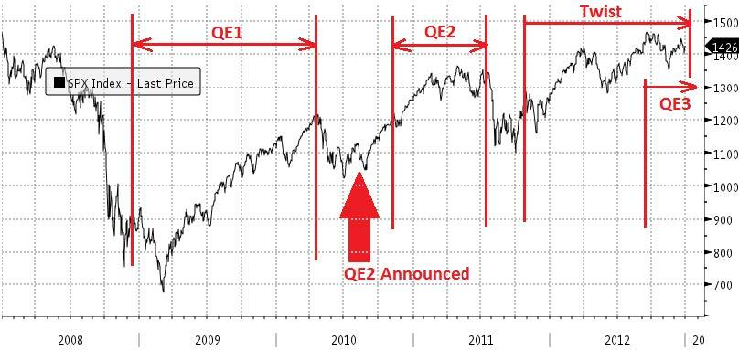
Result
-The extra funds allowed the banks to increase lending.
-This expansion in the money supply had the added benefit of keeping the value of the dollar low.
-ultimately increased U.S. exports

Slide 13
Operation Twist
-a program of QE used by the Federal Reserve
-sales of short-term Treasury Bills to buy long-term Treasury Notes
-to lower long-term Treasury yields, and interest rates
-to make loans more affordable

Slide 14
Operation Twist in 2011
-The Fed Chair announced the $400 billion Operation Twist program in September 2011.
-The Fed also announced it would keep the Fed fund rate at zero until 2015.
-The Fed was forcing investors to consider other investments.
-It ended in December 2012, when QE4 was announced.

Slide 15
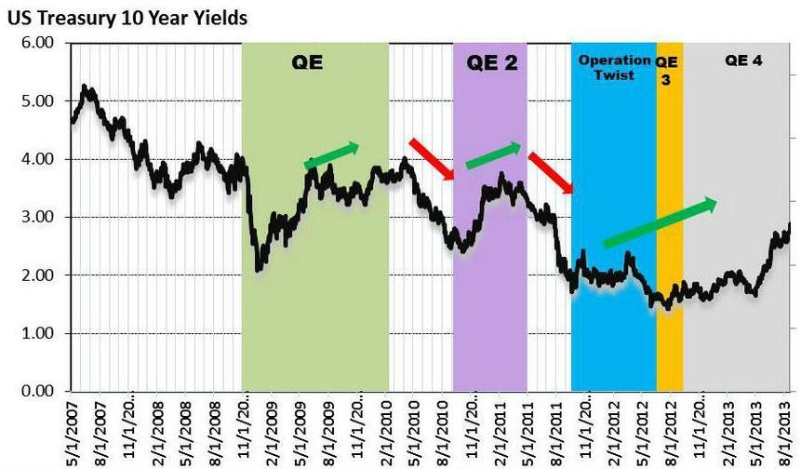
Operation Twist in 2011(2)

Slide 16
THANK YOU FOR YOUR ATTENTION

Slide 17
QE1 is a measure from the FED to boost the economy from subprime mortgage crisis in 2008. The FED need to use QE1 since other monetary tools were reaching there limit. The bank loan rate or the Fed Fund Rate and the discount rate was already zero. Fed was even paying interest to bank reserve requirement.
The FED spend about $600 billion dollar buying mortgage back security in order to spur the decline housing market and $100 billion dollar in other debt.
The QE1 provide a good result, interest rate decline from 6.33 to 5.23 for a 30 years fixed mortgage. There was also drawback since the bank was not lending. They say that there is not enough credit worthy individual since the bank raise their standard for lending after the crisis.

Slide 18
It lasted seven months, from November 2010 to June 2011. When it was launched, the Fed announced it would buy $600 billion of Treasury bills, bonds and notes by March 2011.
In QE2 the Fed bought $30 billion a month in longer-term denominations, such as the 10 year treasury notes, to keep interest rate low and force investor back in mortgage.
With QE2, the Fed was trying to actually spur mild inflation. Why? It wanted to stimulate the economy by increasing demand. When prices rise slowly and consistently over time, people are more likely to buy now to avoid the future price increase. In other words, expectation of inflation is a powerful driver of demand.
Many investor fear that the Fed would overshoot their inflation target this make many investor as a result, gold prices set new records to $1,825 an ounce

Slide 19
What is
Operational twist
Operation Twist is a program of quantitative easing used by the Federal Reserve. The so-called "twist" in the operation occurs whenever the Fed uses the proceeds of its sales from short-term Treasury bills to buy long-term Treasury notes. Normally, the central bank replaces its purchases of short-term bills with the same. This program should put downward pressure on longer-term interest rates and help make broader financial conditions more accommodative
The purpose of Operation Twist is to lower long-term Treasury yields, and therefore interest rates
The 10-year Treasury note yield is the benchmark for interest rates on all fixed-rate loans, including mortgages. The Fed uses Operation Twist to make loans more affordable, encouraging borrowers to purchase real estate, cars and furniture. This also allows businesses to expand more cheaply.

Slide 20
Operation twist in 2011
$400 billion Operation Twist program in September 2011. As Treasury short-term (3 years or less) bills and notes matured, the Fed would use the proceeds to buy longer-term (6-30 years) Treasury notes and bonds. The Fed would also buy new mortgage-backed securities (MBS) as the old ones became due.
The twist showed that Bernanke was shifting the central bank's focus from repairing the damage from the subprime mortgage crisis to supporting lending in general. The Fed also announced it would keep the Fed funds rate at zero until 2015.
The policy worked. In June 2012, the yield on the 10-year Treasury fell to 200-year lows. As a result, the housing market started to come back, as did bank lending. Other factors helped, but the Fed's leadership through Operation Twist was a consistent guiding light.

