Slide 1
Migrating to opportunity overcoming barriers to labor mobility in southeast asia

Slide 2
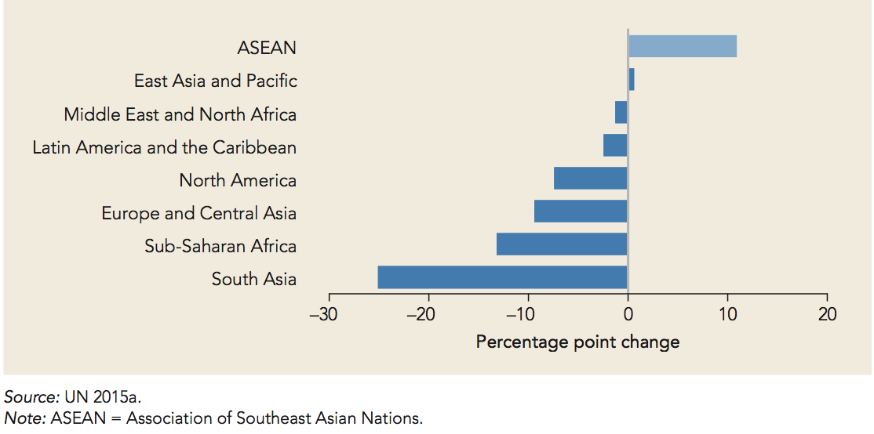
Change in share of intraregional migration, 1995-2015

Slide 3
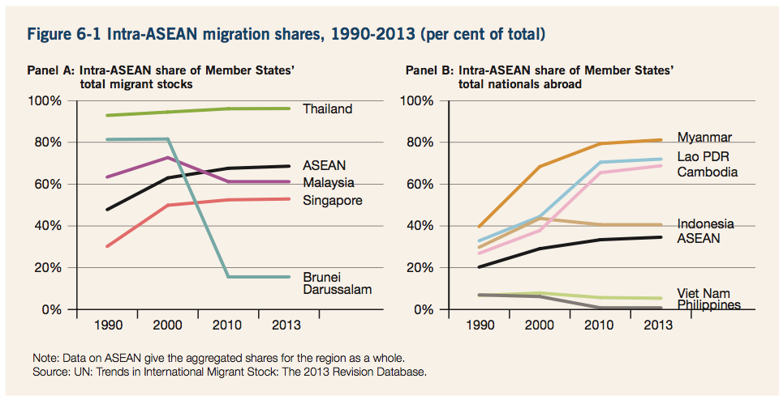
INTRA-ASEAN MIGRATION SHARE, 1990-2013 (PER CENT OF TOTAL)

Slide 5
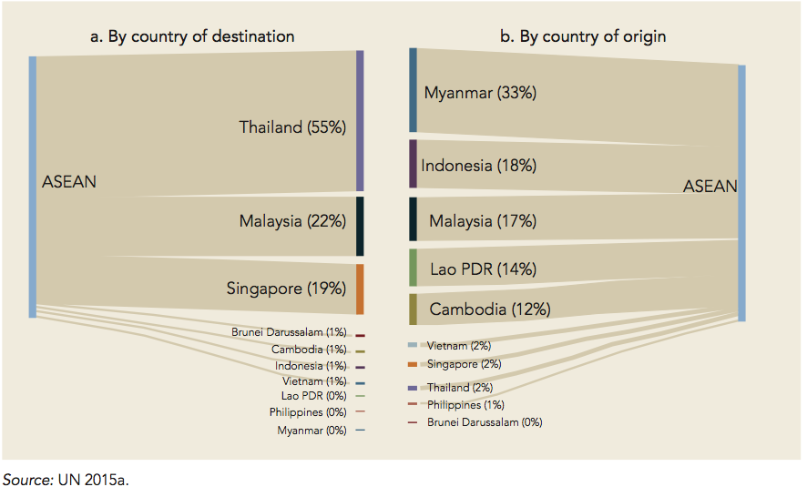
Intra-Asean migration Stock, 2015

Slide 6
Overarching themes of this report
ASEAN countries are significant senders of migrants globally, but also important destinations for migrants from the region
Large intra-ASEAN migration flows are the result of significant diversity in economic development within the region
Significant costs of international and domestic labor mobility in ASEAN limit the ability of workers to change firms, sectors, and locations
The impacts of migration in the region are generally positive, although some groups lose out, and domestic policies play an important role in shaping these impacts

Slide 7
Making movement between and within ASEAN countries less costly would improve the welfare of ASEAN workers
Weaknesses in migration systems increase the costs of international labor mobility, but policy reforms can help to resolve these problems

Slide 8
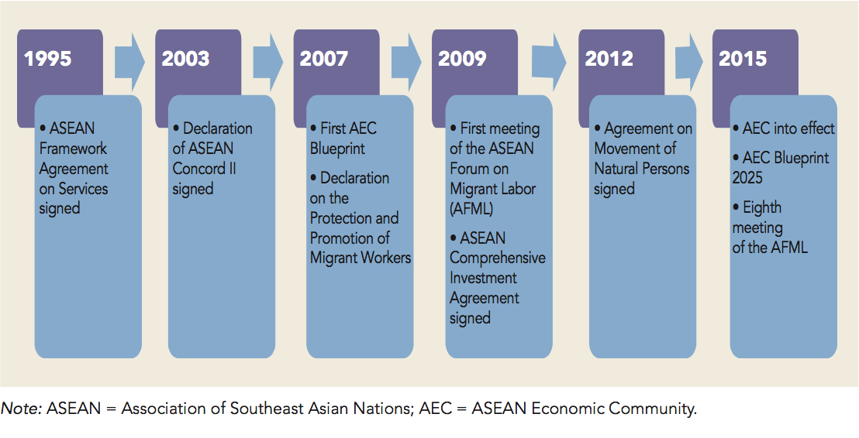
ASEAN actions to facilitate labor mobility, 1995-2015

Slide 9
Lower barriers to mobility would make the region’s workers better off
Increase the welfare gains workers receive from economic integration
Model of trade integration traditionally assume that workers are able to move seamlessly, between jobs as integration creates new economic opportunities
The economic modeling in this report shows that trade integration has a substantially larger positive effect across all ASEAN countries when barriers to mobility are lowered for skilled workers, as AEC currently envisions

Slide 10
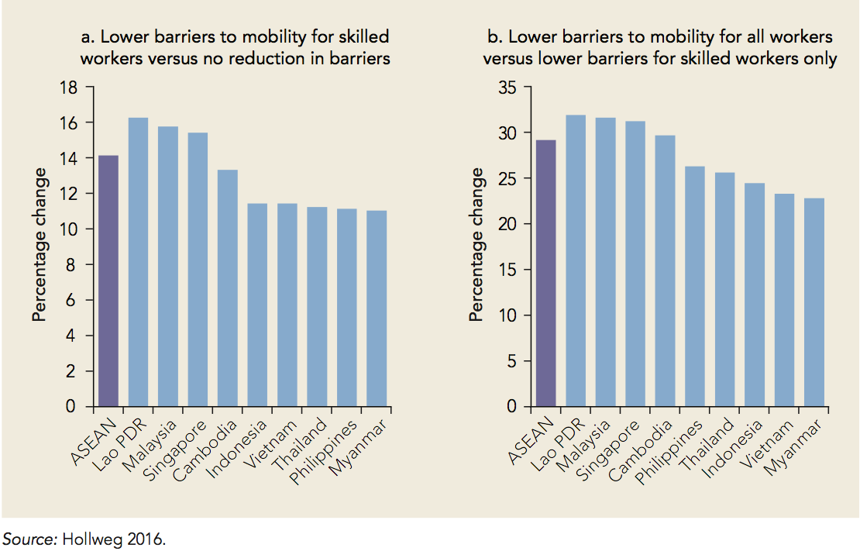
Estimated change in welfare under asean trade integration, by country

Slide 11
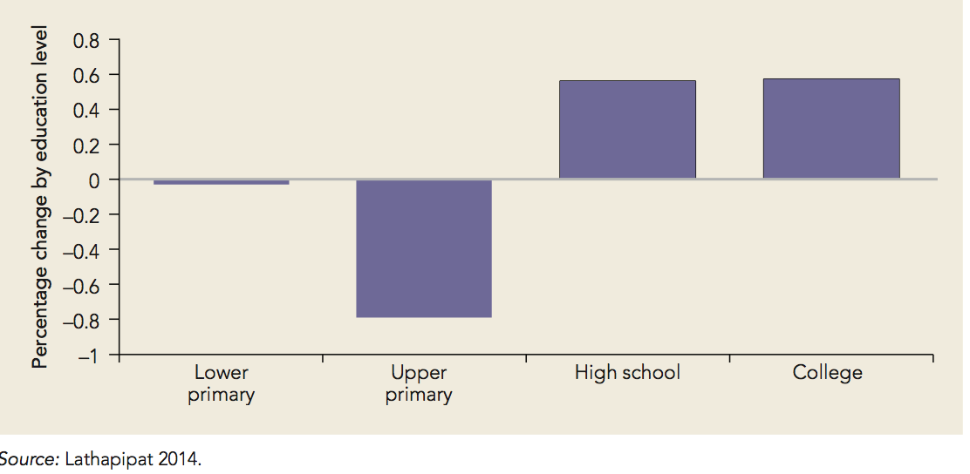
How labor mobility affects the welfare of workers in migrant destination countries, of workers in migrant origin countries, and of migrant workers themselves
Migrants can have positive impacts on the employment and wages of workers in destination countries, although these effects are generally small
Certain groups of local workers in destination countries, particularly low-skilled ones, can be negatively affected by immigration
Change in the wages of Thai workers due to the doubling of the size of the immigration workforce in five immigration-intensive provinces

Slide 12
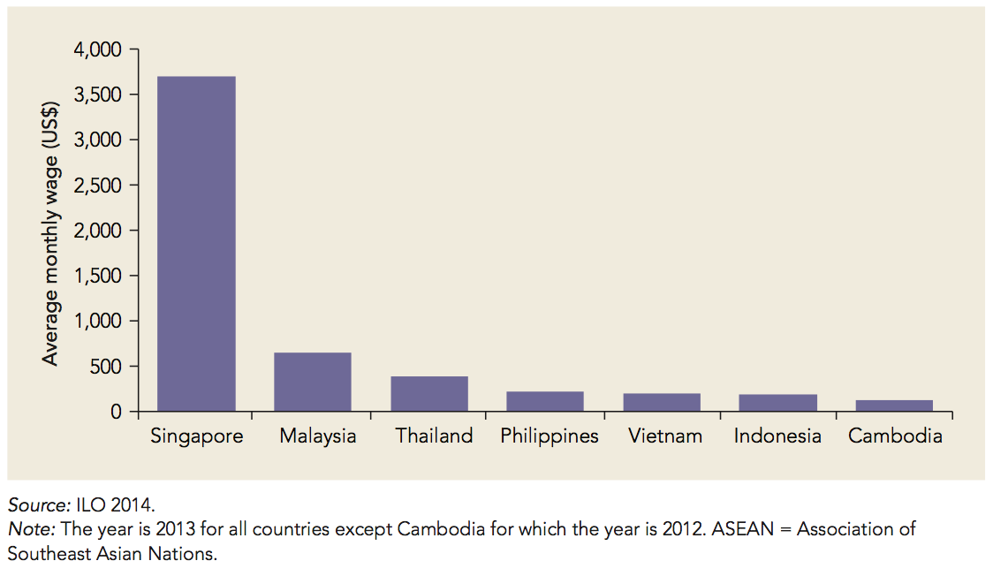
Average monthly wages in ASEAN countries
Migrant workers themselves benefit from migration because of significant differences in wage across ASEAN countries, which create opportunities for workers in countries with lower wages to gain significantly by moving across borders

Slide 13
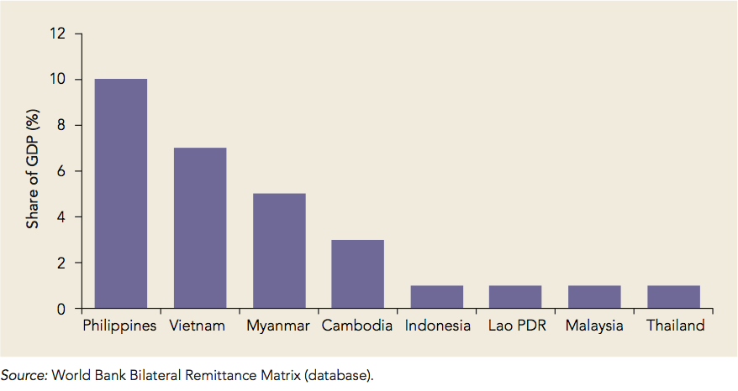
Remittances received as a percentage of gdp in asean countries in 2015

Slide 14
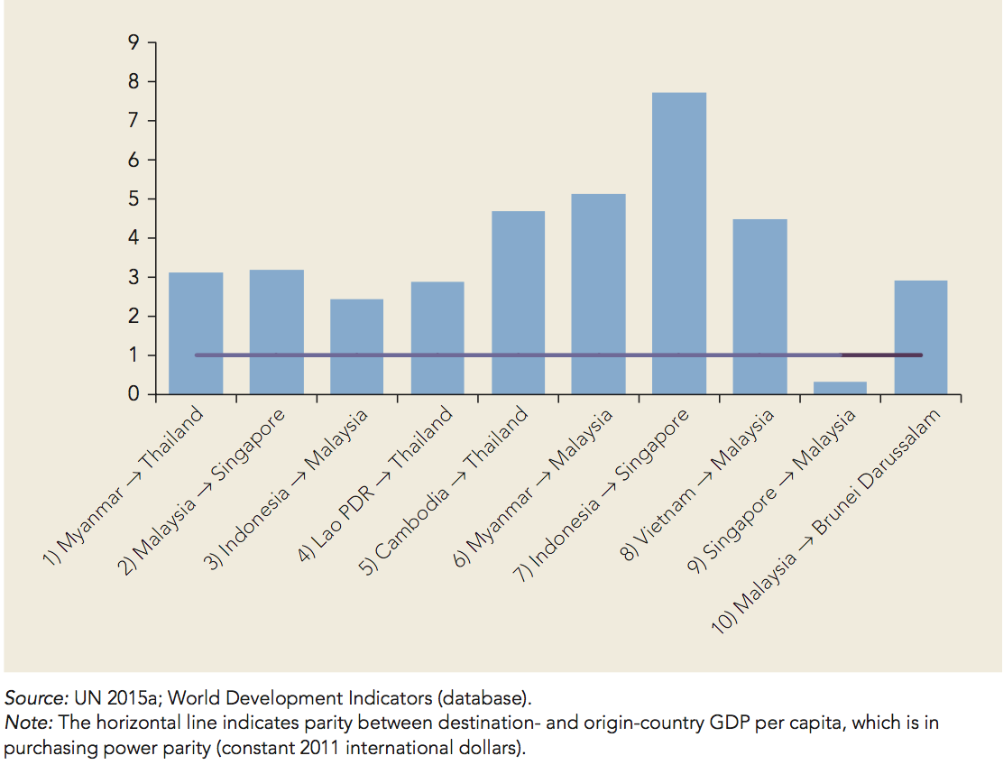
Ratio of destination-to-origin gdp per capita in asean’s 10 largest migration corridors in 2015
Notes:
GDP per capita ratio between destination and origin is more than 1

Slide 15
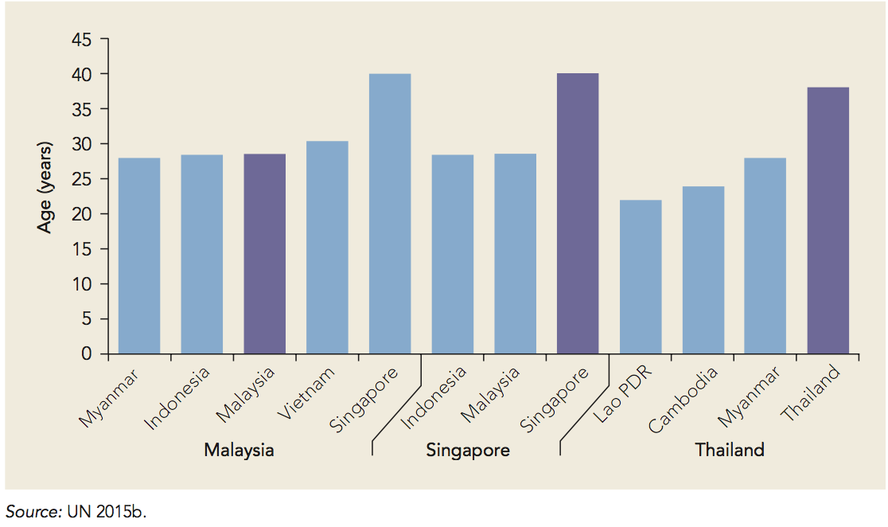
Median age in asean’s major migration corridors in 2015

Slide 16
Workers still face significant costs to move
The costliness of international migration can mean that the poorest households are unable to afford migration
Migration processes that are overly procedural and require significant time and resources can lead migrants to seek out informal channels
Migrants avoid excessive time and monetary costs by crossing borders unofficially, entering countries to work with nonwork visas, and overstaying work passes

Slide 17
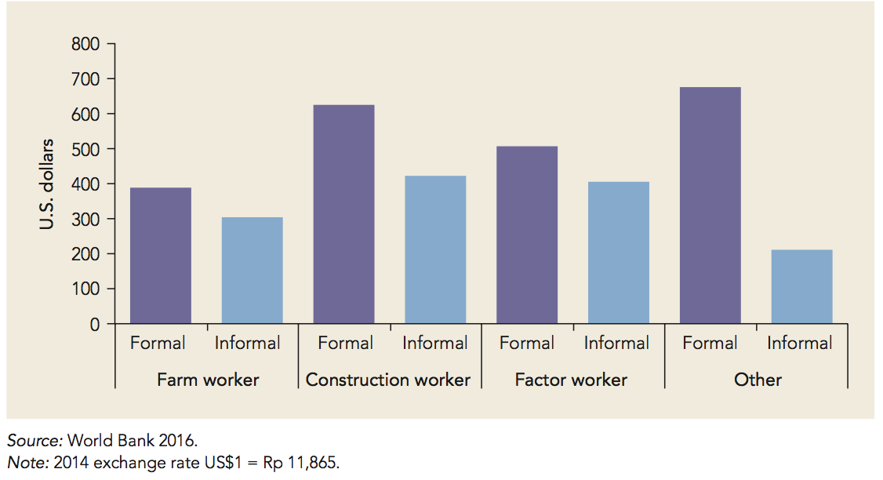
Average monetary migration costs for male indonesian migrants in malaysia

Slide 18
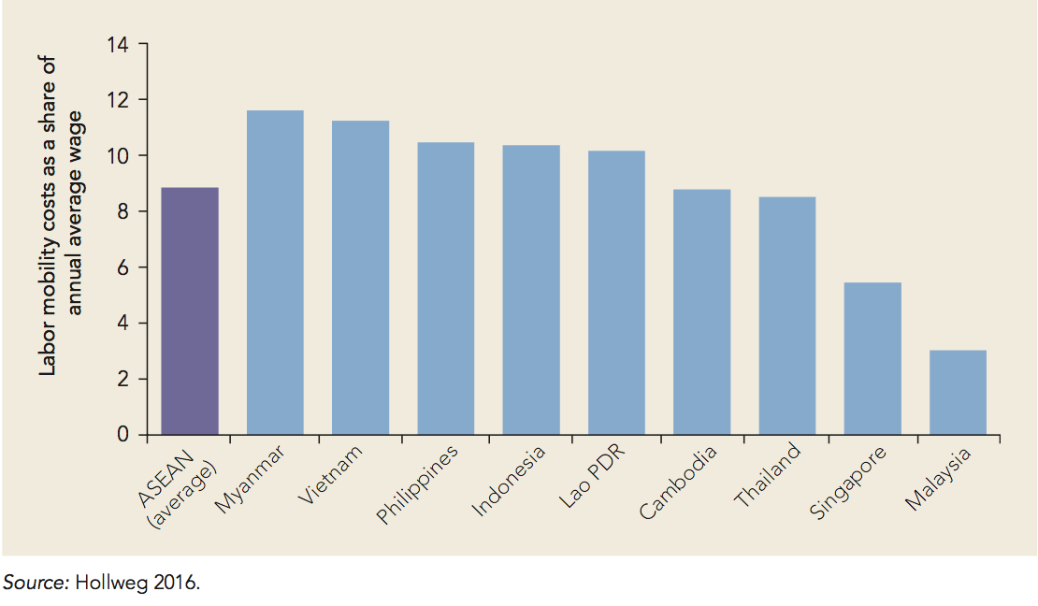
International labor mobility costs in asean in the 2000s

Slide 19
Weaknesses in migration systems increase migration costs
Governance
Admission component
Employment component
Exit component
Enforcement component

Slide 20
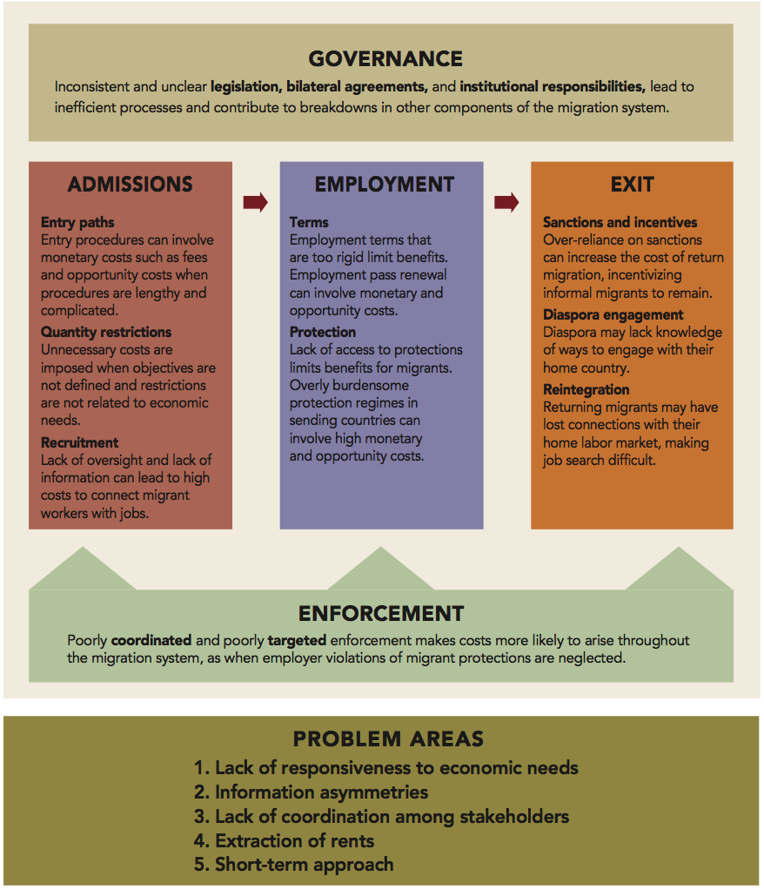
The migration system and costs arising in each of its components

Slide 21
Breakdowns and weaknesses in the migration system
Migration systems often have difficulty responding to economic needs
Information asymmetries arise among migrants and employers
Employers are recruitment agencies are able to exploit these information asymmetries to extract rents from the migration system
There is a lack of coordination within sending and receiving countries as well as among these countries, employers, trade unions, workers, and migrants
Both sending and receiving countries tend to focus on the short-term benefits and costs of migration

Slide 22
Better policies can lower the barriers to labor mobility
Governance
National migration strategies
Institutional framework
Bilateral agreements

Slide 23
Better policies can lower the barriers to labor mobility
Admissions
Entry paths
Quantity restrictions
Recruitment
Employment
Employment terms
Protections for migrant workers

Slide 24
Better policies can lower the barriers to labor mobility
Exit
Sanctions and incentives
Diaspora engagement
Reintegration
Enforcement
Coordination of enforcement
Targeting of enforcement

Slide 25
Country-specific priorities: Destination countries
With very low levels of informal migration and a sophisticated system of productivity-linked entry paths, Singapore will need to continue working to build public trust in the migration system and to improve protections for migrant workers
With high levels of informal migration but a less sophisticated admissions system than Singapore, Malaysia will need to work to make its immigration system more responsive to economic needs and to collaborate more closely with both employers and sending countries

Slide 26
With high levels of informal migration, Thailand will need to work to formalize its large population of undocumented migrants, rationalize entry procedures that are costly and time-consuming, and rethink immigration policies such as levies and a repatriation fund, which exist in law but not in practice, undermining the credibility of the migration system
As the sultanate seeks to encourage private sector employment among locals, Brunei Darussalam will need to ensure that a relatively complex system of quotas and levies based on geography, sector, and employer supports this goal, while also meeting economic needs.

Slide 27
Country-specific priorities: Sending countries
The Philippines has a highly developed support system for migrant workers that is a model for other sending countries. To build on this status, the country should continue to evaluate and improve its migration management system, including oversight of recruitment agencies, programs for returned migrants, and data sharing and interoperability.
Indonesia should work to improve coordination among the agencies responsible for managing labor migration and to streamline exit procedures for migrants to encourage documented migration.

Slide 28
Vietnam will need to evaluate its current policies for incentivizing out-migration to determine whether they are meeting the country’s needs. While the intention of these policies is laudable, other reforms are also necessary, including review of recruitment agencies’ frequent and at least tacitly sanctioned practice of requiring migrant workers to pay a security deposit to guarantee their return, which is frequently not repaid
Lower-capacity Cambodia, Lao PDR, and Myanmar should continue considering how migration can fit into their economic development strategies, shaping programs to make out-migration less costly and more formal, and creating connections with diaspora to facilitate the transfer of knowledge and capital accordingly

Slide 29
Extending the coverage and portability of social security
The right to social security is included in the Universal Declaration of Human Rights (1948), Article 22, and was recalled in the Cebu Declaration on Migrant Workers
Ensuring that migrant workers – in both formal and informal employment- enjoy equal access to social security benefits under contributory and non-contributory scheme is important

Slide 30
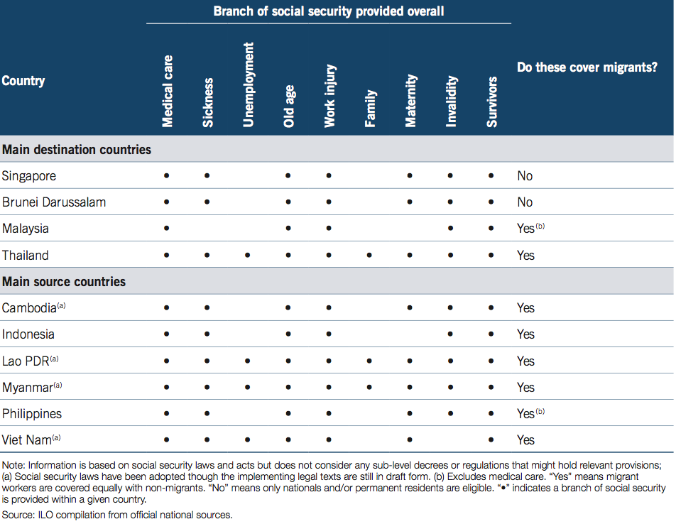
coverage OF MIGRANT WORKERS UNDER SOCIAL SECURITY BY COUNTRY AND BRANCH, 2014

Slide 31
Source
Migrating to Opportunity
Overcoming Barriers to Labor Mobility in Southeast Asia
2017 International Bank for Reconstruction and Development/ The World Bank

