Slide 1
Health Psychology: Stress, Coping, and Well-Being
PY211/ PY200
General Psychology

Slide 2
Introduction
Health psychology:
Investigates the psychological factors related to wellness and illness, including the prevention, diagnosis, and treatment of medical problems
Examine the psychological principles underlying treatments for disease and illness
Prevention - how healthier behaviour can help people avoid and reduce health problems such as stress and heart disease
*body-mind issue
Immune system - the complex system of organs, glands, and cells that constitute our bodies’ natural line of defense in fighting disease
Notes:
In their view, the mind and the body are clearly linked rather than representing two distinct systems. They have paid particular attention to the immune system, the complex system of organs, glands, and cells that constitute our bodies’ natural line of defense in fighting disease.

Slide 3
Psychoneuroimmunology
Psychoneuroimmunology (PNI): Study of the relationship among psychological factors, the immune system, and the brain
Example - the existence of an association between a person’s emotional state and the success of the immune system in fighting disease
Notes:
Health psychologists are among the primary investigators in a growing field called psychoneuroimmunology, or PNI, the study of the relationship among psychological factors, the immune system, and the brain. PNI has led to discoveries such as the existence of an association between a person’s emotional state and the success of the immune system in fighting disease. In sum, health psychologists view the mind and the body as two parts of a whole human being that cannot be considered independently.

Slide 4
Stress: Reacting to Threat and Challenge
A person’s response to events that are threatening or challenging
  Stressors
    Circumstances and events in life
    Stressors produce threats to our well-being
  Daily life as repeated sequence of
    Perceiving a threat
    Considering ways to cope
    Adapting to the threat with greater or lesser success

Slide 5
The Nature of Stressors: My Stress Is Your Pleasure
Stress varies according to individuals
  Bungee jumping example
For people to consider an event stressful, they must:
  Perceive it as threatening or challenging
  Lack all the resources to deal with it effectively

Slide 6
Transaction Model of Stress
Transaction – perception of potential stressors
Threat appraisal process – the evaluation of potential stressors in term of their threat potential and our ability to cope with them.
Three appraisals of the potential stressor
  Primary appraisal – determine if the stressor is a threat
  Secondary appraisal – the individual is capable of coping with the threat
  Cognitive reappraisal – draws on the information from the first two appraisals to determine whether the stressor is a real stressor

Slide 7
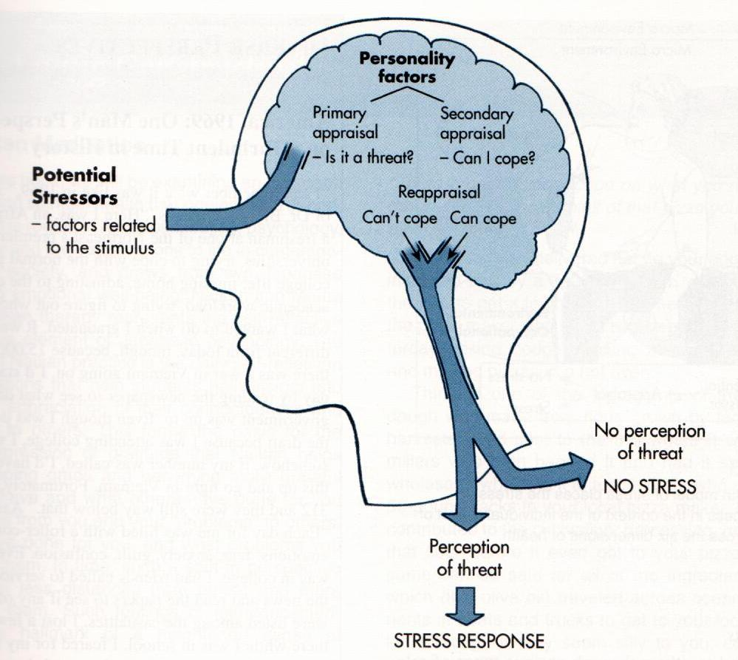
The Perception of Threat

Slide 8
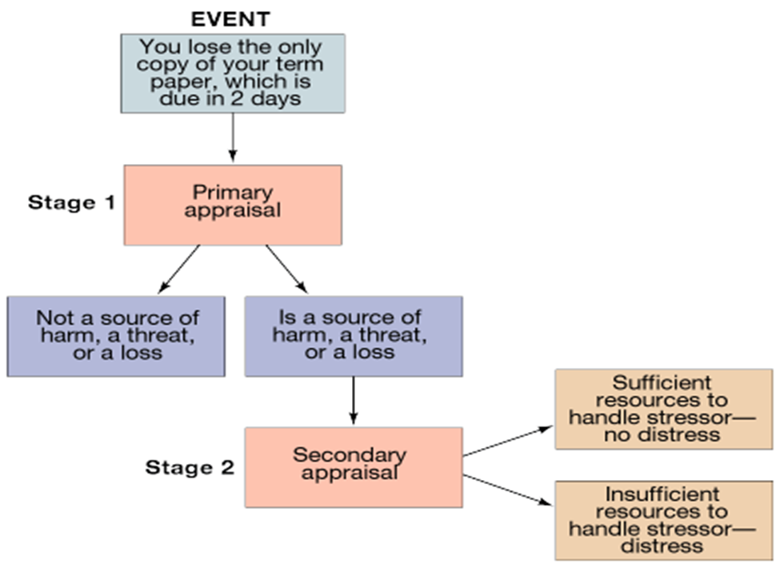

Slide 9
Categorizing Stressors
Cataclysmic events
  Strong stressors that occur suddenly and typically affect many people at once - earthquake
Personal stressors
  Major life events, that have immediate negative consequences that generally fade with time – death of parents or spouse, lose job, personal failure, getting married
Background stressors
  Everyday annoyances that cause minor irritation and may have long-term ill effects – daily hassles

Slide 10
Categorizing Stressors
Posttraumatic stress disorder (PTSD): Victims of major catastrophes or strong personal stressors feel long-lasting effects that may include
Re-experiencing the event in vivid flashbacks or dreams

Slide 11
The High Cost of Stress
Stress produces both biological and psychological consequences
Exposure to stressors generates a rise in hormone secretions by the adrenal glands, an increase in heart rate and blood pressure, and changes in how well the skin conducts electrical impulses
On a short-term basis, these responses may be adaptive because they produce an “emergency reaction” in which the body prepares to defend itself through activation of the sympathetic nervous system
Those responses may allow more effective coping with the stressful situation

Slide 12
The High Cost of Stress
continued exposure to stress results in a decline in the body’s overall level of biological functioning because of the constant secretion of stress-related hormones.
Psychophysiological disorders: Medical problems influenced by an interaction of psychological, emotional, and physical difficulties
Stress affects us in multiple ways
Increases the risk of illness
May hurt our ability to recover from diseases
Reduces our ability to cope with future stress

Slide 13
The General Adaptation Syndrome Model: The Course of Stress
Theory developed by Selye
Physiological response to stress follows the same set pattern regardless of the cause of stress
Consists of three phases
  Alarm and mobilization
  Resistance
  Exhaustion

Slide 14
Alarm Reaction of the GAS
Triggered by perception of a stressor
Arouses the body
When we are surprised or threatened, we have an immediate physical reaction, often called the Fight-or-Flight reaction.
This prepares the body for life-threatening situations, channeling away resources from such as the digestive and immune system to more immediate muscular and emotional needs.
This leads to the immune system being depressed, making us susceptible to disease.
The sympathetic ANS activation leads to an increased adrenaline and noradrenalin being secreted from the adrenal medulla
Corticosteroids help protect the body
  Combat allergic reactions and produce inflammation
  Essential for cognitive performance
Notes:
Adrenaline is released which provides fuel for the fight-or-flight reaction
Corticosteroid hormones secreted by the adrenal cortex protect the brain against adverse events and are essential for cognitive performance

Slide 15
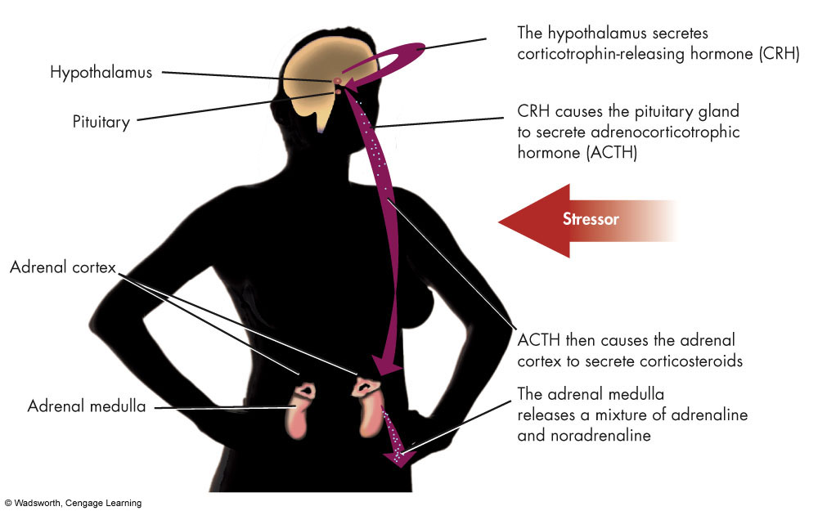
Stress and the Endocrine System
Notes:
Figure 10.5 Stress and the Endocrine System. Stress has a domino effect on the endocrine system, leading to the release of corticosteroids and a mixture of adrenaline and noradrenaline. Corticosteroids combat allergic reactions (such as difficulty in breathing) and cause inflammation. Adrenaline and noradrenaline arouse the body to cope by accelerating the heart rate and providing energy for the fight-or flight reaction.

Slide 16
Resistance Stage of the GAS
If alarm reaction mobilizes the body and the stressor is not removed
Endocrine and sympathetic activity continues higher than normal
As we become used to the stress levels, we initially become more resistance to disease, which leads us to believe we can easily adapt to these more stressful situations.
However, this is only the immune system fighting to keep up with demands and expectations, but requires it to work at abnormally high levels.

Slide 17
Exhaustion Stage of the GAS
This only happens when the stressor is long lasting or chronic.
Eventually reality kicks in and our bodies give up on trying to maintain a high level of stress. Parts of the body literally start to break down
Muscles become fatigued
Corticosteroids – damaging and disruptive to memory formation
Shrinkage of parts of the immune system, raised blood pressure, ulcers and anxiety’s may develop
Parasympathetic division of ANS dominates
Continued stress may lead to diseases of adaptation
  Allergies, hives, coronary heart disease, ultimately death
Notes:
Stressor is not dealt with adequately
Corticosteroid effects on cognition can, however, turn from adaptive into maladaptive, when actions via the two corticosteroid-receptor types are imbalanced for a prolonged period of time. in recent literature, the central action of corticosteroids has mostly been portrayed as damaging and disruptive to memory formation

Slide 18
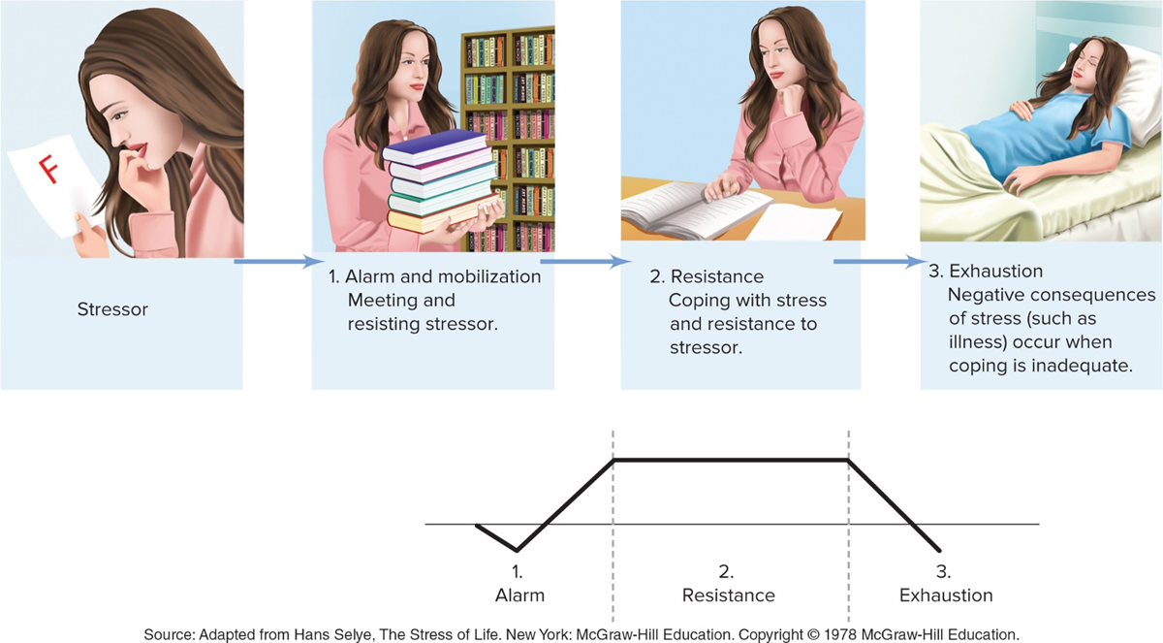
Stages of the General Adaptation Syndrome (GAS) Model

Slide 19
Psychoneuroimmunology (PNI) and Stress
Focuses on the outcomes of stress
Main consequences of stress:
  Physiological results - including an increase in blood pressure, an increase in hormonal activity, and an overall decline in the functioning of the immune system
  Harmful behaviors - increased nicotine, drug, and alcohol use; poor eating habits; and decreased sleep.
  Indirect health-related behaviors - a reduction in the likelihood of obtaining health care and decreased compliance with medical advice when it is sought

Slide 20
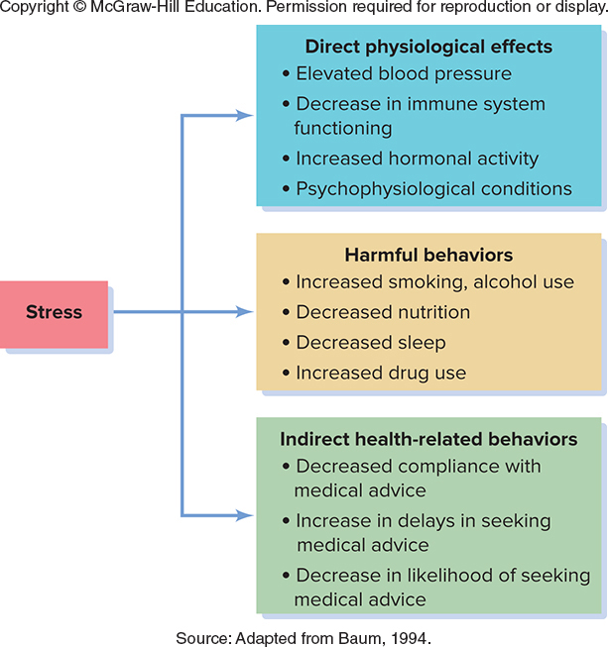

Slide 21
Coping with Stress
Emotion-focused coping
  Managing emotions in the face of stress, seeking to change the way one feels about or perceives a problem
Problem-focused coping
  Attempting to modify the stressful problem or source of stress
Avoidant coping
  Use more direct escape routes, such as drug or alcohol use
  Least effective

Slide 22
Learned Helplessness
Occurs when people conclude that unpleasant or aversive stimuli cannot be controlled
  Cease trying to remedy the aversive circumstances even if they actually can exert some influence on the situation
Victims conclude that there is no link between the responses they make and the outcomes that occur
Experience more physical symptoms and depression
  Compared to those who feel that they have a sense of control over a situation

Slide 23
Coping Styles: Hardiness and Resilience
Hardiness: Personality trait characterized by a sense of commitment, the perception of problems of challenges, and a sense of control
  Three components
    Commitment: see activities as important and meaningful
    Challenge: see change as positive, not a threat
    Control: perceive that they can influence life events
Resilience: Ability to withstand, overcome, and actually thrive after profound diversity

Slide 24
Social Support: Turning to Others
Mutual network of caring, interested others
  Enables us to
    Experience lower levels of stress
    Be better able to cope with stress we do undergo
  Brain activation in areas reflecting stress was reduced when the participant was able to hold another’s hand
Spirituality also provides health-related benefits
  Example: attending religious services

Slide 25
Psychological Aspects of Illness and Well-being

Slide 26
The As, Bs, and Ds of Coronary
Heart Disease
Type A behavior pattern: Cluster of behaviors involving hostility, competitiveness, time urgency, and feeling driven
Type B behavior pattern: Characterized by a patient, cooperative, noncompetitive, and nonaggressive manner
Type D behavior pattern: Insecurity, anxiety, and negative outlook puts them at risk for repeated heart attacks

Slide 27
The As, Bs, and Ds of Coronary
Heart Disease
The importance of the Type A behavior pattern lies in its links to coronary heart disease.
Men who display the Type A pattern develop coronary heart disease twice as often and suffer significantly more fatal heart attacks than those classified as having the Type B pattern.
Hostility is the key component of the Type A behavior pattern that is related to heart disease.
Hostility is very toxic as it produces excessive physiological arousal in stressful situations.
That arousal, in turn, results in increased production of the hormones epinephrine and norepinephrine as well as increases in heart rate and blood pressure

