Slide 1
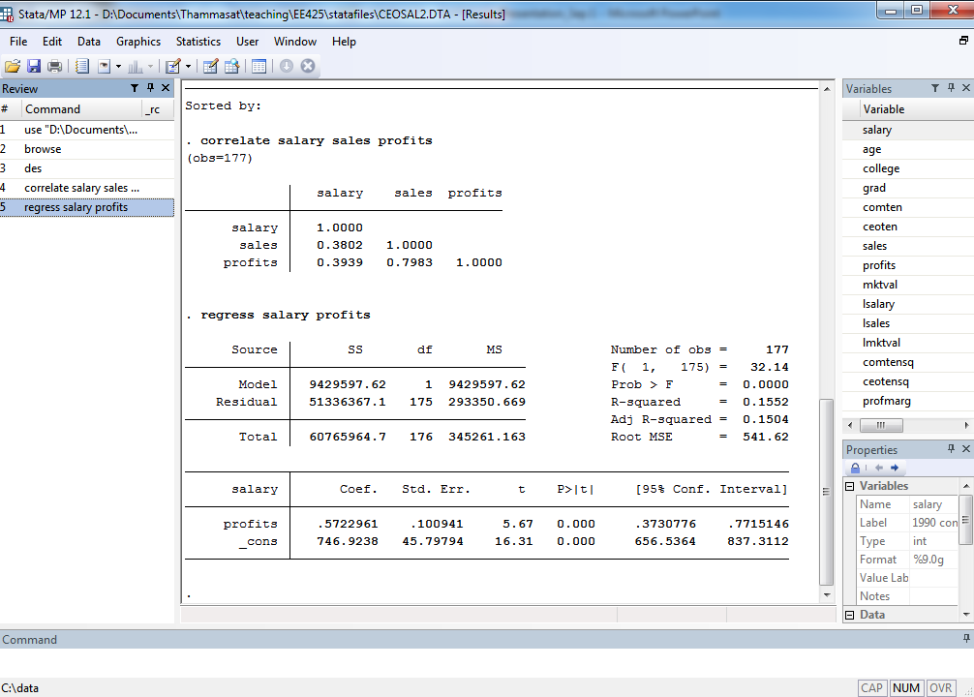
Population Regression Function:
Salaryi = Β0 + Β1 Profitsi + ui
Salary = Β0 + Β1 Profits
Sample Regression Function
Β0 = intercept
Β1 = slope

Slide 2
Salary = 746.92 + 0.572* Profits
Β1 = slope
Β0 = intercept

Slide 3
t = t-statistics. Tests the null hypothesis that the coefficient = 0, i.e.
Β0 = 0 , B1 = 0.
Std. Err. = Standard Error
Which is an estimate of the standard deviation
of Β0 and B1
P > |t|
Is the 2-tailed p-value for testing the null hypothesis that the coefficient = 0.
The chance that this interval can capture the true Β0 or Β1 is 95%

Slide 4
Number of observations (N)
R-squared, Adj. R-squared are assessments of the goodness of fit.
0 ≤ R-squared ≤ 1
F-test, test for the null hypothesis that all the coefficients = 0

Slide 5
Y-axis = Salary
Salary = 746.92 + 0.572* Profits
Intercept = 746.92
Slope = 0.572
X-axis = Profits

