Slide 1




“What Do We Really Know About
Whether Health Insurance Affects Health?”
Helen Levy and David Meltzer
University of Chicago
December 20, 2001
Thammasat University,
Faculty of Economics, EE474 Health Economics

Slide 2


“Health Insurance is believed to contribute to better Health by utilizing the Medical Care”
?? ??
Uninsured Vs. Insured
Which side you choose?
Why?
?? ??
Thammasat University,
Faculty of Economics, EE474 Health Economics

Slide 3

Goal
Goal: “To review the evidence on the causal
effect of Health Insurance on Health”
Thammasat University,
Faculty of Economics, EE474 Health Economics

Slide 4
Outline
Outline:
1. Observational Studies-Observational
literature
2. Quasi-Experimental Experiments Studies
3. Experimental Studies-RAND
Health Insurance Experiment(HIE)
Thammasat University,
Faculty of Economics, EE474 Health Economics

Slide 5
Three Obstacles
- Health Insurance is complex, multi-dimensional good.
Different insurance policy leads to different effect on Health.
- Health itself is also complex, multidimensional construct. Our ability to measure is imperfect.
- Medical Care is the intermediate factor resulting to an effect of Health Insurance on Health.
Thammasat University,
Faculty of Economics, EE474 Health Economics

Slide 6
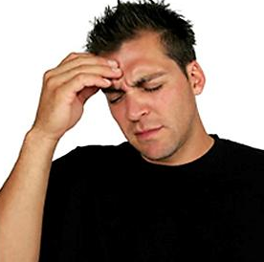
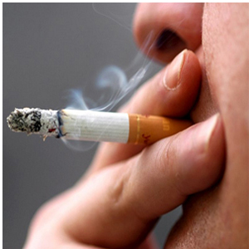

“Health Production”
Belief
Medical Care
Stress
Drinking
Smoking
Behavior
Income
“Health Insurance”
Thammasat University,
Faculty of Economics, EE474 Health Economics

Slide 7


Classification of Studies
1. Observational studies
: These methods of study the researcher collects the data by not influencing the sample's behavior. The data would be the information of the sample under the condition
of the observation and some related behaviors.
Thammasat University,
Faculty of Economics, EE474 Health Economics

Slide 8



How popular of a singer
- Suppose we would like to know how popular the singer is. By using observational studies, the researcher will collect the data from what has happened, which is the applause of the audience in the halls, or how much the tickets are sold out. We can see that the data collected does not influence the sample. In this case both singer and audience together influence the data he collected.
Thammasat University,
Faculty of Economics, EE474 Health Economics

Slide 9
2. Quasi-experimental experiments studies
: are sometimes called natural experiments because membership in the treatment level is determined by both
the conditions within the control and beyond the control of the experimenter. It allows researcher to analyze on how a change in insurance policies or some other exogenous
events affect health insurance coverage, which in turn
affects health.
3. Experimental studies-Randomized experiments
: is a true social experiment, subjects are randomly assigned to the treatment conditions. True experiments are excellent for showing a cause-and-effect relationship. In this case, the researcher would assign insurance coverage randomly and see subsequence health outcome across experiment group.
Thammasat University,
Faculty of Economics, EE474 Health Economics

Slide 10
Observational Studies
- Examine the association between health insurance and health status.
- Typically, focus on important methodologies such as how the sample of individual with or without insurance is identified and how health utilization and health outcomes are measured.
- Find out that an increase in health utilization does not always translates into health improvement.
Thammasat University,
Faculty of Economics, EE474 Health Economics

Slide 11


- Observable aspects of socioeconomic status such as education, income are associated with insurance, and lead to different health outcomes.
- These variables are recommended to be control and let only one of them to be vary and see how would it affects insurance status. Thus, we would determine which variable has significant effect on health outcomes.
Thammasat University,
Faculty of Economics, EE474 Health Economics

Slide 12
Example of Observational
Studies
- Relationship between health insurance and health of people age around 65.
- One sees a marked improvement in health when those people are eligible for Medicare. This suggested that there is a positive correlation between the two.
- Unobservable can also determine this association, but still somehow complicate the relationship. This includes the belief in efficacy of health care. In short, it could affect the care-seeking behavior among people.
Thammasat University,
Faculty of Economics, EE474 Health Economics

Slide 13
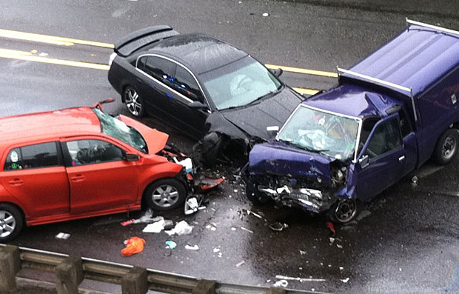

- Unobservable exogenous health shock like serious motor vehicle accident is considered.
- Using data from police report, it found that the uninsured are more likely to die following the accident compared to those with publicly or privately insured .
Thammasat University,
Faculty of Economics, EE474 Health Economics

Slide 14
Quasi-Experimental
Experiment Studies
- Relies on the situation in the real world that approximates what might be achieved in a social experiment, so called natural experiment.
- Aware mainly on credible evidences that provide the causal effect of insurance coverage on health.
- Classify the experiment into two groups:
small and large scale.
- Pay some attention on medical care utilization.
Thammasat University,
Faculty of Economics, EE474 Health Economics

Slide 15
Small scale
Medi-care cutbacks
- In 1982, California terminated Medi-care benefit for all 270,000 medically indigent, those with in need of medical care, but not eligible for assistance from federal program.
- The authors examine change in health outcomes for 186 patients whose Medicare were terminated and compared them with 109 patients who were continuously covered by Medi-care.
Thammasat University,
Faculty of Economics, EE474 Health Economics

Slide 16

- Those who lost benefits experienced an increase in diastolic blood pressure.
- While another group experienced no significant effect on health outcome at all.
- There is a 45% decrease in outpatients service among a group who lost the benefits, which might contribute to
these decline in health outcome.
- In the bottom line, this case study offers evidences that losing health insurance coverage would lead to a deterioration in health outcome.
Thammasat University,
Faculty of Economics, EE474 Health Economics

Slide 17
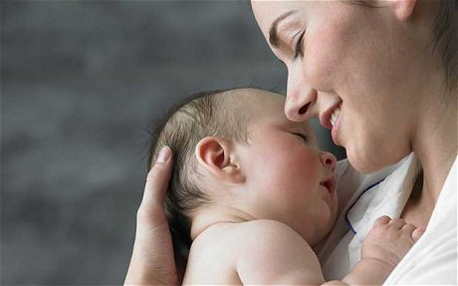

Healthy Start Expansion
- Aimed to examine the impact of Massachusetts Healthy Start program, an insurance coverage of maternal health
in 1985.
- From the research, the author found that 54% of women who gave birth and had neither private coverage nor Medicaid were covered by this program.
- The research strategy is to compare a change in medical care use, maternal and infant health of these 54% with to those who were covered by either private coverage or Medicaid.
Thammasat University,
Faculty of Economics, EE474 Health Economics

Slide 18
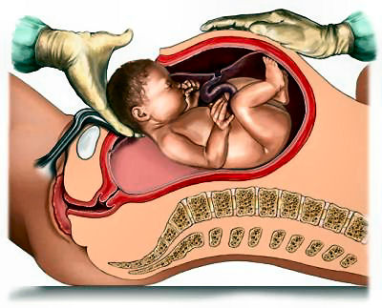
- The author found no significant change in the following outcome from the comparison, for instance there is no incidence of adverse outcomes on both infant and mother health(low birth weight, prematurity, decline in mothers’ health outcomes).
- Nevertheless, the only differential the author found was
an increase in cesarean section rates. Approximately, 5% for those who were covered by this program and 3% for those who were covered by private insurance.
Thammasat University,
Faculty of Economics, EE474 Health Economics

Slide 19



Large-scale-The
Enactment of Medicare
- To examine the effects of Medicare on the health of older Americans by looking for evidences of abrupt discontinuities in health care utilization and outcomes at age 65.
- Note the age of 65 is typically the age of becoming eligible for Medicare.
Thammasat University,
Faculty of Economics, EE474 Health Economics

Slide 20


- The author found evidence that utilization of ambulatory care and inpatient care increase abruptly at age 65.
- Also examine whether there is a reduction in morbidity and mortality rate at this age and get a result showing a 13% reduction in the days spent in bed and another 13% reduction of probability of death after age 65 compared to what they would have been in the absence of Medicare.
Thammasat University,
Faculty of Economics, EE474 Health Economics

Slide 21



- Furthermore, he also examined whether an increase in health care utilization and the improvement in health outcomes around this age are associated with each other by using elasticity.
- Using the elasticity of the death rate with respect to the number of physician visit. He got a negative 0.095 in short run and negative 0.497 in long run.
- Thus, a 10% increase in the number of physician visits would reduce the death rate by 5%.
Thammasat University,
Faculty of Economics, EE474 Health Economics

Slide 22


- Another interesting finding is that there is an increase in consumption of hospital service at age 65, this was supposed to cause from a postponement of health utilization at age 63-64.
- The powerful evidence that had high possibility was that 65 was a common age of retirement, which in turn resulted more time available for health care and thus improved health.
Thammasat University,
Faculty of Economics, EE474 Health Economics

Slide 23

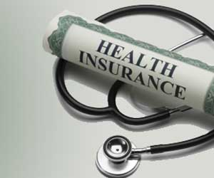
- He found an evidence reflecting that the discontinuity of mortality rate after Medicare implementation were significantly related to each other.
- However, this might also a result from more time available after retirement, in which they reinforced each other.
- Therefore, this preliminary finding suggested that there was a significant effect of health insurance on health for person after retirement.
Thammasat University,
Faculty of Economics, EE474 Health Economics

Slide 24


Experimental Studies-RAND
Health Insurance Experiment
- Studied 2,005 families with 3,958 people age 14 – 61 who were free of disability that precluded work.
- This group were randomly assigned to free care or care with copayment.
Thammasat University,
Faculty of Economics, EE474 Health Economics

Slide 25
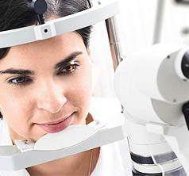

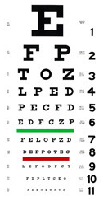
- No significant effect on Health status from average patients.
- However, health benefit were found on patient with poor
vision and with elevated blood pressure.
- Vision acuity increases and hypertension is relieved.
Thammasat University,
Faculty of Economics, EE474 Health Economics

Slide 26

RAND Health Insurance Experiment (HIE) Implication
“Relative risk estimation of dying
based on epidemiological”
- Cost sharing plan
group faces an
annual risk of
dying of “2.11”.
- Free care plan
group faces an
annual risk of
dying of “1.9”.
The difference was due to
a reduction in hypertension !
Thammasat University,
Faculty of Economics, EE474 Health Economics

Slide 27
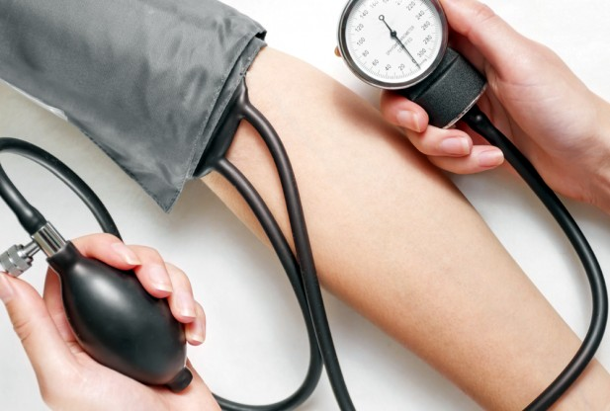

- A reduction in hypertension among low-income people in free care plan occurred because they were more likely to visit the doctor than those with a cost-sharing plan.
- Thus, they are more likely to have previously undetected hypertension diagnosed.
Thammasat University,
Faculty of Economics, EE474 Health Economics

Slide 28



Control of Hypertension
A reduction in cardiovascular
mortality
A reduction in mortality rate
Thammasat University,
Faculty of Economics, EE474 Health Economics

Slide 29
Conclusion
- Observational studies suggested that there is an association between health insurance and health, but providing just a little evidence on whether relationship is causal.
- Small quasi-experiment studies provided only a mixed evidences that health insurance affects health, while larger scale quasi-experiment studies and the RAND HIE provided consistent evidence that health insurance improves health.
Thammasat University,
Faculty of Economics, EE474 Health Economics

Slide 30




- These studies also implies that the expansion of health insurance help promoting health.
Thammasat University,
Faculty of Economics, EE474 Health Economics

Slide 31


How would the paper is
related with our materials
- Whose health that we are talking about?
Vulnerable group i.e. Low-income, infant
Gain so much benefit from health insurance
Thammasat University,
Faculty of Economics, EE474 Health Economics

Slide 32


High-income group i.e. billionaire
Gain from health insurance seems to be smaller relatively to the to vulnerable group
Thammasat University,
Faculty of Economics, EE474 Health Economics

Slide 33

Health
- Point A represents the
vulnerable group, whose
utility increases at an
increasing rate.
B
- Point B represents the high-
income group, whose utility
increases at a decreasing
rate.
A
Health Insurance
Law of diminishing in marginal utility !
Thammasat University,
Faculty of Economics, EE474 Health Economics

Slide 34


Future Studies
- The studies should be based on the same level of insurance policy so that the outcomes in health benefit are look more reliable, otherwise it would be difficult to say what independent effect or what element in policy is the cause of health benefit.
Thammasat University,
Faculty of Economics, EE474 Health Economics

Slide 35


Health Insurance
Vs. Health
Q&A
Thammasat University,
Faculty of Economics, EE474 Health Economics

