Slide 1
AEC: ASEAN Economic Community

Slide 2
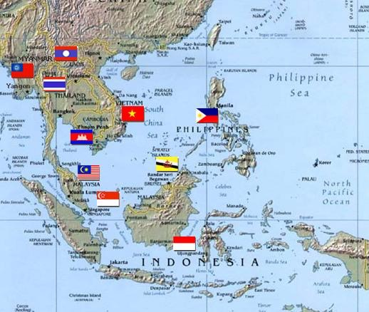
What is ASEAN?
Created in 1967, originally not inclusive
Originally a force against Communism
Ten Countries, including
Brunei Darussalam
Cambodia
Indonesia
Laos
Malaysia
Myanmar
Philippines
Singapore
Thailand
Vietnam
Population of 600,000
GDP of roughly 2.5 Trillion
Notes:
Was originally Indonesia, Malaysia, Thailand, Singapore and Philippines. The LCMV countries were added between 1995-1999. They’re poorer then the other countries in Asean.

Slide 3
Country | Industries
Indonesia | Petroleum, Mining, Rubber and Rubber Products, Palm Oil
Malaysia | Petroleum, Foods, Electrical and Electronics (Computers, TVs), Base Chemicals, Iron & Base Metal, Rubber and Plastic
Philippines | Foods, Electrical and Electronics (Semiconductors, Microcircuits), Electrical Machinery, Garment and Mining
Brunei | Petroleum (Oil and Gas)
Thailand | Electrical and Electronics (Computer Parts, Air-Conditioners, TVs), Automotive, Foods, Rubber and Rubber Products, Petrochemicals
Singapore | Services (Wholesale-Retail Trade, Business Service, Financial Service, Transportation& Storage, Information & Communication) Biomedical Product, Electronics, High-tech component
Vietnam | Foods (Rice, Rubber, Sugar, Fisheries) Pet Foods, Textiles and Apparels, Footwear
Cambodia | Textiles and Apparels, Tobacco, Construction
Laos | Electricity, Garments, Mining (Gold, Copper, Lead)
Myanmar | Petroleum (Oil and Gas), Precious Stone, Mining, Wood Furniture

Slide 4

ASEAN Economic Community
Aim to be complete by December 31st, 2015
The blueprint was signed in 2007
  Goals: “to establish a single market and production base with the goal of making ASEAN more dynamic and competitive”
  What does that mean?
4 Main Goals:
  Single Market and Production Base
  A Highly Competitive Economic Region
  Equitable Economic Development
  Integration into the Global Economy

Slide 5
    Single Market and Production Base:
The free flow of goods
  No Tariffs, by 2015 for ASEAN-6 Countries, and later for LCMV countries
  Reduction in Non-Tariff Barriers
  The eventual formation of a ASEAN Single Window
The free flow of services and skilled labor.
  Commitment to allow professionals to move through the region through certification
The free flow of Investment
The freer flow of capital

Slide 6
Progress?
In some respects, yes
  Tariffs are lower, with commitments to reach zero from the few laggard countries.
  Yet, non-tariff barriers to trade still exist
  There’s a range of Certification programs that have been set up
    For instance, AUN-QA, for universities
  The formation of ASEAN Exchanges
  Yet countries, like Thailand, still have investment restrictions that prevent investment in certain industries, or above a certain percentage. Often defended as necessary for national security.
Notes:
There’s the Asean Non-Tariff Measures Database that can be accessed to find out what trade barriers do still exist.

Slide 7
A highly competitive economic region
Increasing the ability of businesses to compete across borders.
  The idea that competition will create a more competitive area.
Includes consumer protection
Promotes infrastructure development
Emphasizes the importance of protecting intellectual property
Promoting connectivity between the different members of ASEAN

Slide 8
Progress?
Some of these issues are more delicate than ASEAN makes it seem. Many countries in the region have defended their right to make generic drugs, are have hesitated to crack down on counterfeit goods because of national concerns.
At my bank, there’s been a lot of talk about the importance of Thailand as a logistics center. There’s been talk about establishing a railway system to connect the region.

Slide 9
Equitable Economic Development
The promotion of growth throughout the region to help the poorest countries in LCMV reach a certain level of wealth.
Often includes the development of Small and Medium Enterprises, SME’s.
Promotion of FDI, both from other ASEAN members and outside nations, into the less wealthy countries in ASEAN.

Slide 10
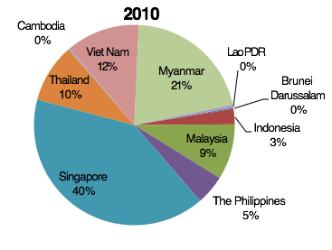
Progress?
ASEAN-6 = 88%
CLMV=12%
ASEAN-6 = 66%
CLMV=33%

Slide 11
Key Investors and Ranking (2010)
 | 1 | 2 | 3 | 4 | 5 | Others
Cambodia | China | Taiwan | Vietnam | South Korea | Malaysia
% of Total FDI | 15.5 | 14.4 | 10.0 | 9.8 | 6.7
Laos | China | Vietnam | Japan | Singapore | Thailand
% of Total FDI | 80.1 | 11.6 | 1.9 | 1.2 | 0.9
Myanmar | Hong Kong | China | Thailand | South Korea
% of Total FDI | 33.9 | 32.0 | 18.5 | 15.6
Vietnam | Taiwan | South Korea | Singapore | Japan | Malaysia | China (No.15)
% of Total FDI | 11.8 | 11.5 | 11.3 | 10.8 | 9.5 | 1.6
Indonesia | Singapore | U.K. | U.S.
% of Total FDI | 30.9 | 11.7 | 5.7
Malaysia | U.S. | Netherland | Singapore | Japan | S. Korea | China (No.18)
% of Total FDI | 18.0 | 12.0 | 11.2 | 10.8 | 5.7 | 1.2
Philippines | Japan | Netherland | South Korea | British Virgin Island | Singapore
% of Total FDI | 29.9 | 19.0 | 15.6 | 4.0 | 3.6
Thailand | Japan | Netherland | Camay Island (U.S.) | Singapore | China
% of Total FDI | 35.9 | 9.2 | 7.6 | 6.9 | 6.2
Singapore (2009) | Netherland | U.S. | Japan | U.K. | Norway | China (No.12)
% of Total FDI | 11.3 | 10.5 | 9.6 | 9.0 | 4.3 | 1.7
Source: CEIC, investment authority of each countries, KResearch

Slide 12
Integration into the global economy
Opening up ASEAN to the global economy.
Promotion of free trade agreements between ASEAN and other countries, like the ASEAN + 3 Agreements.

Slide 13
Progress?
Well, there’s been a lot of free trade agreements, but there’s always going to be competition over trade.
An example is TPP, and how Vietnam is going to get better trade agreements with the US outside of ASEAN

Slide 14
Global Share of ASEAN Exports Is Increasing
Share of ASEAN's Export Value to World 2000-2010
Bil. USD
%
Source: WTO Statistics Database, KResearch

Slide 15
Expected Benefits of AEC
Sources of Raw material and Labors
CLMV
Large Market
ASEAN is a market of 596 million consumers.
Economy of scale
A number of countries interested to be investment and trade partners.
Greater Bargaining Power
Ten heads are better than one.
More negotiating partners working together in the WTO Forum.
Other countries planning to enter into FTA negotiations with ASEAN.
Larger Sources of Raw Material
Availability of plentiful natural resources in ASEAN.
Lower costs with increasing competitiveness.
The best comparative advantages.
Sources of High Technology
Singapore, Malaysia,
Thailand
Production Bases
Thailand, Malaysia,
Indonesia, Vietnam
33

Slide 16
Impacts of AEC on Thai Economy
More Opportunities
More Threats
New and larger market (10 countries with 596 million people)
Lower cost of production, leading to more supply chain connectivity within ASEAN
Intra-ASEAN trade to increase to more than 50% from 25% in 2010
Average growth of ASEAN countries higher than the world economy, leading to expansionary market
Attracting more ASEAN and Non-ASEAN FDI
Thailand is located at the center of region providing opportunities as distribution center
Other measures would be implemented e.g. Non-Tariff Barrier, Quality Control Measures
Severe competition from multinational companies and lower cost production firms
Rotation of skilled labors to foreign companies
Problem of shortage of skilled labors with English proficiency
Lack of awareness and more defensive strategy among Thai entrepreneurs toward the inception of AEC

Slide 17
Potential problems AEC will run into
Free movement of skilled labor is difficult when each country is anxious to promote education in their own populations.
The region is extremely diverse.
Thailand is immensely afraid of being surpassed by its LCMV neighbors when it comes to producing, as it has traditionally been the low-wage labor supplier of the region.
Finally, you’ll see in the next activity it’s hard to reconcile the different priorities of different nations with one larger

