Slide 1
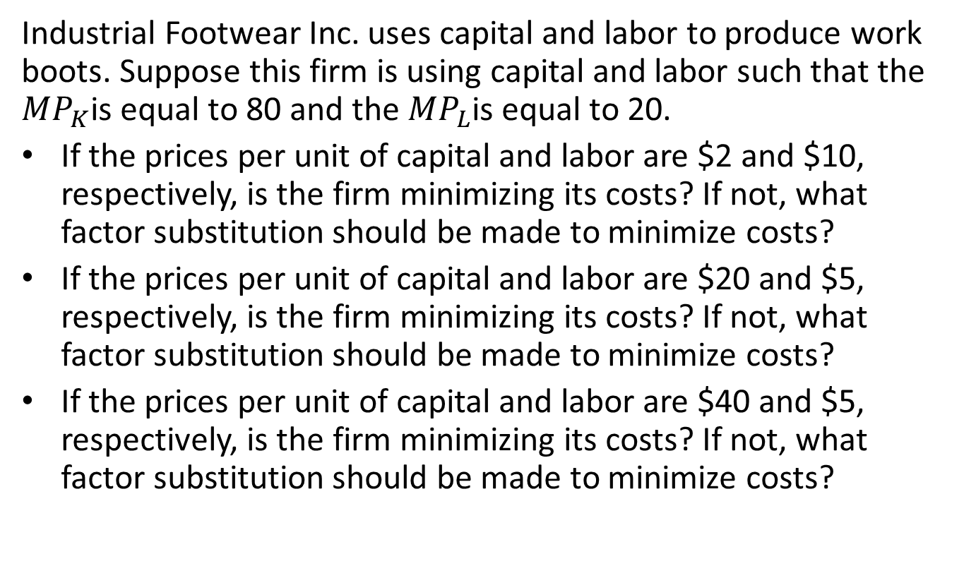
Practice I
Industrial Footwear Inc. uses capital and labor to produce work boots. Suppose this firm is using capital and labor such that the ${MP}_{K}$is equal to 80 and the ${MP}_{L}$is equal to 20.
If the prices per unit of capital and labor are $2 and $10, respectively, is the firm minimizing its costs? If not, what factor substitution should be made to minimize costs?
If the prices per unit of capital and labor are $20 and $5, respectively, is the firm minimizing its costs? If not, what factor substitution should be made to minimize costs?
If the prices per unit of capital and labor are $40 and $5, respectively, is the firm minimizing its costs? If not, what factor substitution should be made to minimize costs?

Slide 2
Practice II
Explain the difference between diseconomies of scale and diminishing marginal product of the variable factor.
Explain the difference between economies of scale and spreading overhead.

Slide 3
Practice III
Draw a diagram with short-run and long-run average cost curves that illustrates for the same level of output economies of scale in the long run but diminishing marginal product for the variable factor in the short run.
Draw a diagram with short-run and long-run average cost curves that illustrates for the same level of output diseconomies of scale in the long run but falling average total costs in the short run.

Slide 4
The following table shows several methods of producing 500 rubber tires per day. There are two factors labor and capital, with prices per unit of $3 and $6, respectively.
Production Method | Units of Labor | Units of Capital | Total Cost
A | 110 | 20
B | 90 | 25
C | 70 | 33
D | 50 | 43
E | 30 | 55
F | 10 | 70

Slide 5
Compute the total cost for each production method and fill in the Table
Which production method minimize costs for producing 500 tires?
Plot the isoquant for 500 tires.
Given the factor prices, draw the isocost line that corresponds to the cost-minimizing production method.
Now suppose that the price of labor rises to $5 per unit but the firm still wants to produce 500 tires per day. Explain how a cost-minimizing firm adjusts to this change (with no change in technology).

