Slide 1
Macroeconomics:
The Basics (week 3)
Thorn Pitidol
Faculty of Economics, Thammasat University
EE212, Semester 2/2556

Slide 2
Agendas
Mapping the circular flow of macro-economy
GDP and its measurement
Nominal/real GDP, GDP growth, and GDP per capita
Price indexes and inflation rates
Unemployment rates

Slide 3
Questions
If you are the government, what information do you need to make decisions on macro-economic policies?
  What indicators?
    In macroeconomics, the big 3 are “GDP, inflation, and unemployment”
  What do the indicators reflect?
  How useful are the indicators?

Slide 4
Mapping the circular flow of macro-economy
The measurement of macroeconomic indicators is geared toward measuring the “aggregate behaviours” of economic agents
  For example; households, firms, government
In the Thai context, measurements are carried out by different government units
  For example: BOT, NESDB, NSO, and MOF
  Note that the detailed calculation techniques constantly evolves.

Slide 5
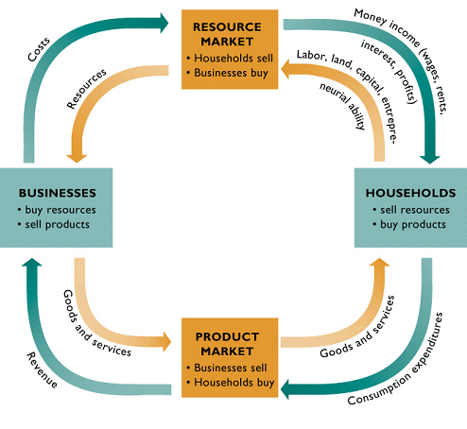
Mapping the circular flow of macro-economy
The “circular flow” diagram captures the important aspects of “aggregate behaviours” in the economy
Basic circular flow diagram (without the government,
financial institutions, and the foreign sector)

Slide 6
Mapping the circular flow of macro-economy
The “circular flow” diagram captures the important aspects of “aggregate behaviours” in the economy
Circular flow diagram with the government,
financial institutions, and the foreign sector

Slide 7
GDP and its measurement
GDP = a measure of the total value of final goods and services newly produced in a country over a period of time (usually one year)
  Final goods and services = goods and services ready for uses. They don’t require further production activities before they can be consumed.
  Question: Is GDP a flow or a stock variable? Does the product from the previous year or period count?
  Question: Is GDP a good measure?

Slide 8
GDP and its measurement
GDP = a measure of the total value of “final goods and services newly produced” in a country over a period of time
What are not included in the GDP!
  Intermediate goods
  Non-marketed goods and services
  Informal sector, and illegal products
  Goods produced in previous years
  Capital gains
Measuring the GDP, how?
  The circular-flow shows the way!

Slide 9
GDP and its measurement
Three approaches to GDP measurement
  What did you learn from the circular flow diagram?
    The relationship between aggregate production, aggregate expenditure, and aggregate income within an economic system
  In a simple economy (as reflected by the circular flow diagram)
    Total value of production = Total value of expenditure = Total value of income
  GDP, therefore, can be measured from three sides: production side, expenditure side, and income side

Slide 10
GDP and its measurement
GDP measurement: production side
  This is the most direct method
    Summing up the value of all “final” goods and services produced in each sector
      Sector = each type of product.
        For example, farming, mining, manufacturing etc.
  GDP = Value of production from all the sectors

Slide 11
GDP and its measurement
GDP measurement: production side
  The presence of intermediate goods represent a major problem for calculating GDP from the production side.
    If we count the value of an intermediate goods, its value will be counted more than once, as the value is also included in the final product.
    We can avoid this problem by using the value-added method in finding the value of production for each final goods.

Slide 12
GDP and its measurement
GDP measurement: production side
  Value added method:
    Value for each of the good can be calculated through summing up the “value added” from each production stage of a certain goods.
    For example: The value of production for grilled meatballs = Value of production stage 1 (pork meat) + Value of production stage 2 (pork-meatballs) + …..+ Value of production in the final stage (grilled pork-meatballs)

Slide 13
Calculating GDP Production Side
Value-added method
Example: Finding the value of pork-meatball noodle using the value added method
 | Pork | Noodle | Pork-meatballs | Pork-meatball Noodle
Input Costs | 0 | 0 | Pork | Noodle & Pork-meatballs
Value of output | 20 | 30 | 40 | 200

Slide 14
GDP of Thailand (Production Side) (Unit: Million Baht)
Table 3 Gross domestic product
at current market prices by economic activities
 |  |  |  |  |  |  |  | (Millions of Baht)
 | 2004 | 2005 | 2006 | 2007 | 2008r | 2009r | 2010r | 2011p
Agriculture | 646,344 | 700,380 | 790,175 | 848,688 | 978,015 | 940,559 | 1,129,222 | 1,271,524
Agriculture, hunting and forestry | 538,264 | 594,289 | 681,162 | 750,109 | 881,238 | 839,862 | 1,027,228 | 1,168,409
Fishing | 108,080 | 106,091 | 109,013 | 98,579 | 96,777 | 100,697 | 101,994 | 103,115
Non-agriculture | 6,297,555 | 6,885,947 | 7,575,167 | 8,189,087 | 8,681,620 | 8,650,163 | 9,580,592 | 9,848,994
Mining and quarrying | 175,486 | 222,124 | 257,607 | 278,906 | 315,185 | 305,700 | 339,692 | 366,608
Manufacturing | 2,058,746 | 2,268,623 | 2,548,507 | 2,790,778 | 2,980,979 | 2,859,089 | 3,358,410 | 3,297,910
Electricity, gas and water supply | 213,348 | 222,359 | 241,130 | 249,938 | 265,431 | 282,870 | 298,675 | 304,693
Construction | 197,014 | 226,654 | 245,217 | 263,388 | 266,943 | 271,297 | 303,008 | 281,877
Wholesale and retail trade; repair of motor vehicles,
motorcycles and personal and household goods | 1,057,009 | 1,135,238 | 1,219,311 | 1,311,135 | 1,388,318 | 1,430,697 | 1,568,885 | 1,630,226
Hotels and restaurants | 229,937 | 231,321 | 255,239 | 277,778 | 298,874 | 285,537 | 311,346 | 338,644
Transport, storage and communications | 546,587 | 566,820 | 620,610 | 690,709 | 701,781 | 701,195 | 734,884 | 743,791
Financial intermediation | 367,364 | 417,155 | 448,643 | 493,043 | 523,609 | 543,844 | 561,392 | 640,996
Real estate, renting and business activities | 515,545 | 563,549 | 620,819 | 642,703 | 667,114 | 642,744 | 703,633 | 741,957
Public administration and defence; compulsory social security | 393,384 | 437,976 | 482,560 | 530,042 | 577,397 | 614,852 | 652,464 | 703,436
Education | 261,662 | 289,227 | 319,071 | 349,617 | 372,103 | 391,702 | 410,474 | 435,803
Health and social work | 114,850 | 125,326 | 135,858 | 143,781 | 149,829 | 152,178 | 156,987 | 166,112
Other community, social and personal service activities | 158,401 | 171,043 | 171,857 | 158,057 | 164,375 | 158,323 | 170,593 | 186,207
Private households with employed persons | 8,222 | 8,532 | 8,738 | 9,212 | 9,682 | 10,135 | 10,149 | 10,734
Gross domestic product, (GDP) | 6,943,899 | 7,586,327 | 8,365,342 | 9,037,775 | 9,659,635 | 9,590,722 | 10,709,814 | 11,120,518
plus : Net primary income from the rest of the wold | -302,148 | -341,440 | -312,290 | -305,508 | -313,144 | -331,321 | -476,313 | -344,427
Gross national product, (GNP) 1/ | 6,641,751 | 7,244,887 | 8,053,052 | 8,732,267 | 9,346,491 | 9,259,401 | 10,233,501 | 10,776,091
less : Consumption of fixed capital | 1,019,111 | 1,134,099 | 1,226,298 | 1,289,666 | 1,463,103 | 1,486,739 | 1,590,776 | 1,732,667
Taxes on production and imports less subsidies | 699,545 | 774,442 | 867,824 | 895,447 | 884,048 | 934,664 | 1,102,521 | 1,104,693
National income, (NI) 2/ | 4,923,095 | 5,336,346 | 5,958,930 | 6,547,154 | 6,999,340 | 6,837,998 | 7,540,204 | 7,938,731
Per capita GDP (Baht) | 107,606 | 116,535 | 127,571 | 136,851 | 145,297 | 143,353 | 159,105 | 164,512
Per capita GNP (Baht) | 102,923 | 111,290 | 122,809 | 132,225 | 140,587 | 138,400 | 152,029 | 159,417
Per capita NI (Baht) | 76,290 | 81,973 | 90,873 | 99,138 | 105,282 | 102,208 | 112,017 | 117,442
Population (1,000 Heads) | 64,531 | 65,099 | 65,574 | 66,041 | 66,482 | 66,903 | 67,313 | 67,597
Note : 1/ GNP = GNI (Gross national income)
2/ NI = NNP (Net national product) at factor cost

Slide 15
GDP of Thailand (Production Side) (Unit: Million Baht)
Table 3 Gross domestic product
at current market prices by economic activities
 | (Millions of Baht)
 | 2011p | Percentage of total
Agriculture | 1,271,524 | 11.4
Mining and quarrying | 366,608 | 3.3
Manufacturing | 3,297,910 | 29.7
Electricity, gas and water supply | 304,693 | 2.7
Construction | 281,877 | 2.5
Wholesale and retail trade; repair of motor vehicles, motorcycles and personal and household goods | 1,630,226 | 14.7
Hotels and restaurants | 338,644 | 3.0
Transport, storage and communications | 743,791 | 6.7
Financial intermediation | 640,996 | 5.8
Real estate, renting and business activities | 741,957 | 6.7
Public administration and defence; compulsory social security | 703,436 | 6.3
Education | 435,803 | 3.9
Health and social work | 166,112 | 1.5
Other community, social and personal service activities | 186,207 | 1.7
Private households with employed persons | 10,734 | 0.1
Gross domestic product, (GDP) | 11,120,518 | 100

Slide 16
British GDP (Production Side) 2011
 | Millions Pounds | Percentage of Total
Agriculture, forestry and fishing | 9438 | 0.7
Industry, including energy | 205210 | 15.1
Construction | 86789 | 6.4
Distributive trade, repairs; transport; accommod., food serv. | 247518 | 18.2
Information and communication | 88034 | 6.5
Financial and insurance activities | 116358 | 8.5
Real estate activities | 143641 | 10.6
Prof., scientific, techn.; admin., support serv. Activities | 158812 | 11.7
Public admin.; compulsory social security.; education; human health | 258983 | 19.0
Other service activities | 46142 | 3.4
Total | 1360925 | 100.0
Source: OECD

Slide 17
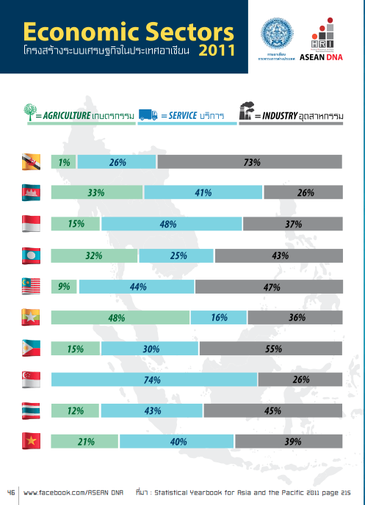

Slide 18
GDP and its measurement
GDP measurement: expenditure side
  Total value of all categories of expenditure on “final” goods and services
    Categories are divided according to types of spender
      Each type of spender designates “who” spends
    GDP = household consumption spending + business spending + government spending + net foreign sector spending
      Or simply GDP = C + I + G + (X-M)

Slide 19
GDP and its measurement
GDP measurement: expenditure side
  More details on C + I + G + (X-M)
Component | Meaning
Private Consumption Expenditure (C) | Total value of spending on final consumption of goods and services, as spent by households or non-profit seeking organisations.
Government Consumption Expenditure (G) | Total government spending on final goods and services

Slide 20
2.3.3 Expenditure Approach
Component of GDP | Meaning
Gross Capital Formation (I)
Gross Fixed Capital Formation | Investments in constructions and equipments that are used in the production process and last longer than 1 year.
Change in Inventories | Difference between demand and supply of goods within one accounting year. ***A convenient way to think of this is to think of goods that have been produced but have not yet been sold.

Slide 21
2.3.3 Expenditure Approach
Component of GDP | Meaning
Exports and Imports of Goods and Services (X-M) | Export of goods: values of final goods exported to foreign countries. Export of services: value of services in transportation and tourism, and other services such as communication services, insurance services, sold to foreign countries. Import of goods: values of final goods imported from foreign countries Import of services: values of services bought from foreign countries.

Slide 22
GDP of Thailand (Expenditure Side) 2009-2011 (Unit: Million Baht)
 | 2009 | 2010 | 2011
Private Consumption Expenditure | 5,117,711 | 5,590,151 | 5,922,912
General Government Consumption Expenditure | 1,520,219 | 1,678,702 | 1,781,186
Gross Fixed Capital Formation | 2,232,018 | 2,593,168 | 2,897,315
Change in Inventories | -238,816 | 149,393 | 54,664
Plus : Exports of Goods and Services | 6,190,058 | 7,145,554 | 7,942,726
Exports of Goods | 5,157,644 | 6,060,184 | 6,675,068
Exports of Services | 1,032,414 | 1,085,370 | 1,267,658
Less : Imports of Goods and Services | 5,286,372 | 6,547,273 | 7,749,631
Imports of Goods | 4,036,590 | 5,122,935 | 6,160,220
Imports of Services | 1,249,782 | 1,424,338 | 1,589,411
Expenditure on Gross Domestic Product | 9,534,818 | 10,609,695 | 10,849,172
Plus : Statistical Discrepancy | 55,904 | 100,119 | 271,346
Gross Domestic Product, (GDP) | 9,590,722 | 10,709,814 | 11,120,518

Slide 23
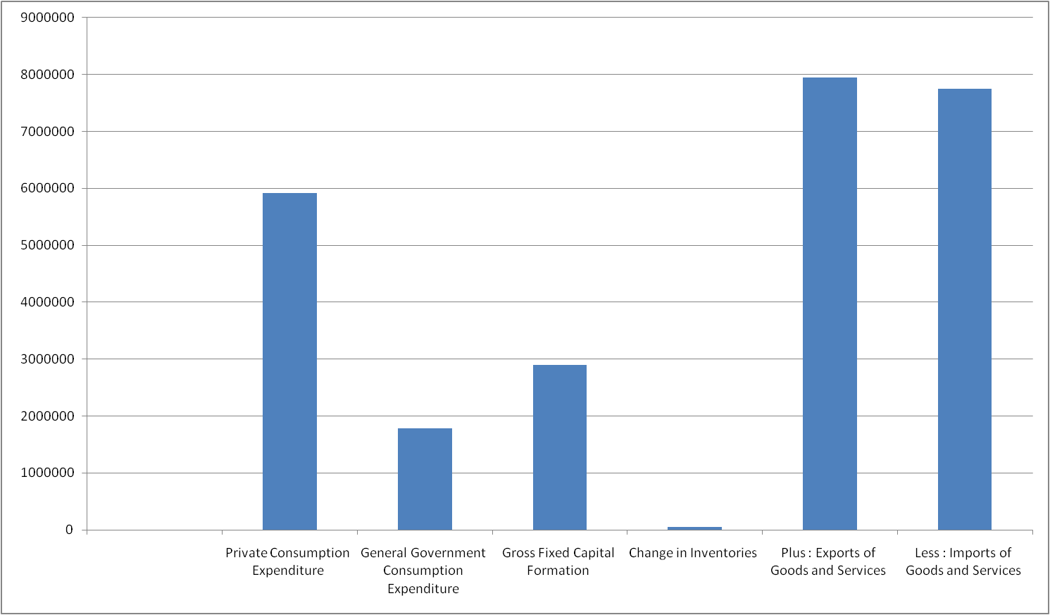
GDP of Thailand (Expenditure Side) 2011 (Unit: Million Baht)
Source: NESDB, Thailand

Slide 24
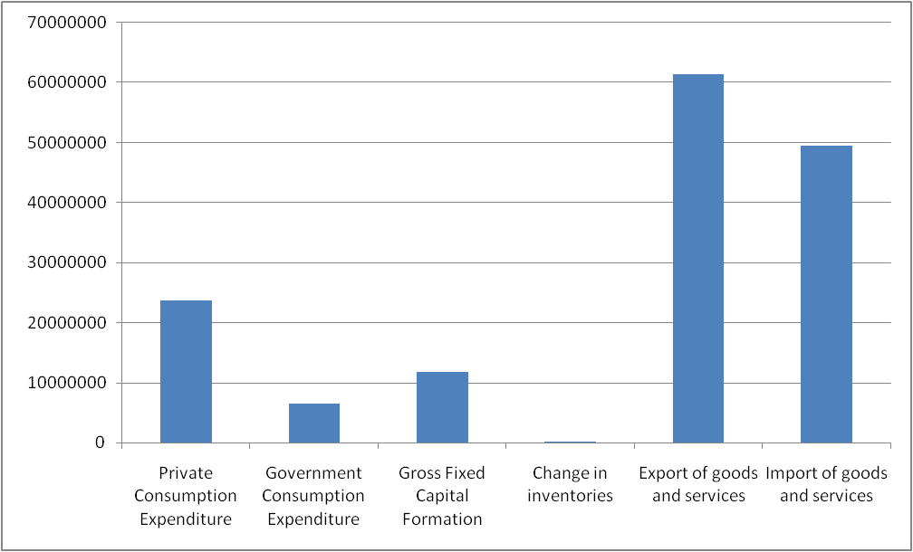
GDP of Malaysia (Expenditure Side), 2005 (Unit: Thousands RM)
Source: National Statistical Office of Malaysia

Slide 25
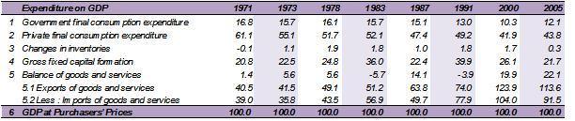
GDP of Malaysia (Expenditure Side)
Source: National Statistical Office of Malaysia

Slide 26
Calculating GDP Expenditure Side
Example:
 | 2009
Private Consumption Expenditure | 5,000,000
General Government Consumption Expenditure | 1,500,000
Gross Fixed Capital Formation | 2,200,000
Change in Inventories | -200,000
Plus : Exports of Goods and Services | 6,000,000
Exports of Goods | 5,000,000
Exports of Services | 1,000,000
Less : Imports of Goods and Services | 5,000,000
Imports of Goods | 4,000,000
Imports of Services | 1,000,000
Expenditure on Gross Domestic Product
Plus : Statistical Discrepancy | 0
Gross Domestic Product, (GDP)

Slide 27
Calculating GDP Expenditure Side
Example:
 | 2009
Private Consumption Expenditure | 5,000,000
General Government Consumption Expenditure | 1,500,000
Gross Fixed Capital Formation | 2,200,000
Change in Inventories | -200,000
Plus : Exports of Goods and Services | 6,000,000
Exports of Goods | 5,000,000
Exports of Services | 1,000,000
Less : Imports of Goods and Services | 5,000,000
Imports of Goods | 4,000,000
Imports of Services | 1,000,000
Expenditure on Gross Domestic Product | 9,500,000
Plus : Statistical Discrepancy | 0
Gross Domestic Product, (GDP) | 9,500,000

Slide 28
GDP and its measurement
GDP measurement: income side
  Summing up the production related income earned by all people and organisations
  But in order to get to the number of GDP, the calculation needs further steps
    Within GDP, there are components of income not earned by people within a country.
    There needs to be a conversion from GDP to GNP
    And even from GNP, there are income not earned by factors of production, due to depreciation.

Slide 29
GDP and its measurement
GDP vs GNP
  GDP measures the total value of goods and services newly produced within the “geographical boundary” of a nation
  GNP measures the same thing, but within the boundary of a nationality of economic agents.
    Can you imagine the case in which the two measurements for the same nation can be largely different?
  GNP = GDP + Net Income Payment from Abroad
    Net Income Payment from Abroad = Receipts of Income from Abroad – Payments of Income to Abroad

Slide 30
Japan GDP and GNP (Unit: Billion Yen)
 | 2009 | 2010 | 2011
Gross domestic product | 473,933.9 | 480,098.0 | 473,282.6
Net primary income from the rest of the world | 13,069.9 | 13,258.8 | 14,768.8
Gross national product | 487,003.8 | 493,356.8 | 488,051.4
Thailand's GDP and GNP (Unit: Million Baht)
 | 2009 | 2010 | 2011
Gross domestic product | 9,590,722 | 10,709,814 | 11,120,518
Net primary income from the rest of the world | -331,321 | -476,313 | -344,427
Gross national product | 9,259,401 | 10,233,501 | 10,776,091
Sources: Statistics Bureau of Japan and NESDB of Thailand

Slide 31
GDP and its measurement
GDP measurement: additional measures (in relation to GDP)
  GDP → GNP
  Net National Product (NNP): GNP less depreciation
  National Income (NI): Total income earned by factors of production
    **In case statistical discrepancy is zero, NNP equals NI
  Personal Income (PI): Total income accrued to households
  Disposable Personal Income: Total income available for household to spend
  How to get from GDP to other measurements?

Slide 32
GDP and its measurement
GDP measurement: additional measures (in relation to GDP)
    GDP
      Plus: Receipts of factor income from the rest of the world
      Less: Payments of factor income from the rest of the world
    Equals: GNP
      Less: Depreciation
    Equals: Net National Product (NNP)
      Less: Statistical Discrepency
    Equals: National Income

Slide 33
GDP and its measurement
GDP measurement: additional measures (in relation to GDP)
    National income
      Less: Amount of national income not going to households
    Equals: Personal income
      Less: Personal Income Taxes
    Equals: Disposable personal income
      Less: Personal consumption expenditures, personal interest payments, and transfer payments made by households
    Equals: Personal saving

Slide 34
Calculating GDP Income Side
Example:
 | 2009
Gross Domestic Product, (GDP) | 9,000,000
Net Income Payment from Abroad | -500,000
Gross National Product (GNP)
Depreciation | 1,500,000
NNP (Net National Product)
Statistical Discrepancy | 0
NI (National Income)
 | 2009
Compensation to employees | 3,000,000
Household mixed income/operating surplus | 2,500,000
Household property income (rent + interest) | 500,000
Government property income (rent + interest) | -10,000
Corporate profit | 1,010,000
NI (Net Income)
Statistical Discrepancy | 0
NNP (Net National Product)
Depreciation | 1,500,000
Gross National Product (GNP)
Net Income Payment from Abroad | -500,000
Gross Domestic Product, (GDP)
 | 2009
NI (National Income) | 7,000,000
Income not going to household | 2,000,000
PI (Personal Income)
Personal income taxes | 1,000,000
Disposable personal income

Slide 35
Calculating GDP Income Side
Example:
 | 2009
Gross Domestic Product, (GDP) | 9,000,000
Net Income Payment from Abroad | -500,000
Gross National Product (GNP) | 8,500,000
Depreciation | 1,500,000
NNP (Net National Product) | 7,000,000
Statistical Discrepancy | 0
NI (National Income) | 7,000,000
 | 2009
Compensation to employees | 3,000,000
Household mixed income/operating surplus | 2,500,000
Household property income (rent + interest) | 500,000
Government property income (rent + interest) | -10,000
Corporate profit | 1,010,000
NI (Net Income) | 7,000,000
Statistical Discrepancy | 0
NNP (Net National Product) | 7,000,000
Depreciation | 1,500,000
Gross National Product (GNP) | 8,500,000
Net Income Payment from Abroad | -500,000
Gross Domestic Product, (GDP) | 9,000,000
 | 2009
NI (National Income) | 7,000,000
Income not going to household | 2,000,000
PI (Personal Income) | 5,000,000
Personal income taxes | 1,000,000
Disposable personal income | 4,000,000

Slide 36
GDP of Thailand (Income Side) 2009-2011 (Unit: Million Baht)
 | 2009 | 2010 | 2011
Compensation of employees | 2,943,149 | 3,169,279 | 3,386,816
Households mixed income and operating surplus | 2,438,626 | 2,722,930 | 2,876,830
Households property income | 305,623 | 370,102 | 339,761
Interest | -11,179 | -24,745 | -22,239
Distributed income of corporations | 236,168 | 311,149 | 280,760
Investment income disbursments | 101,439 | 107,625 | 109,435
Rent | - | - | -
General government property income | -12,152 | -15,597 | -1,225
Interest | -87,588 | -98,343 | -105,964
Distributed income of corporations | 65,489 | 71,075 | 89,442
Investment income disbursments | - | - | -
Rent | 9,947 | 11,671 | 15,297
Appropriated corporation profit | 1,162,752 | 1,293,490 | 1,336,549
Net national product at factor cost, (NNP) | 6,837,998 | 7,540,204 | 7,938,731
Plus : Consumption of fixed capital (depreciation) | 1,486,739 | 1,590,776 | 1,732,667
Taxes on production and imports less subsidies | 934,664 | 1,102,521 | 1,104,693
Gross national product, (GNP) 1/ | 9,259,401 | 10,233,501 | 10,776,091
Less : Net primary income from the rest of the world | -331,321 | -476,313 | -344,427
Gross domestic product, (GDP) | 9,590,722 | 10,709,814 | 11,120,518

Slide 37
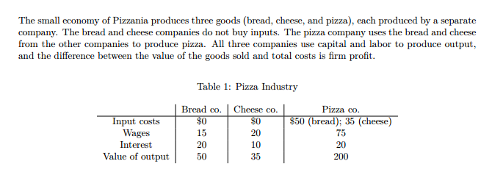
GDP and its measurement
GDP measurement: calculation exercise
Calculate GDP from production side (value added approach), expenditure side, and income side

Slide 38
GDP growth, Nominal/Real GDP, and GDP per capita
Measuring the GDP growth
  Can we simply compare the value of GDP from each year?
    Complications arise as prices keep on changing every year. The change in GDP can be due to change in price rather than in the real value of goods and services.
    Thus, the distinction has to made between nominal VS real GDP before the reliable measurement of growth in GDP can be obtained
      Nominal GDP = GDP at current price
      Real GDP = GDP measured using past price of a certain period

Slide 39
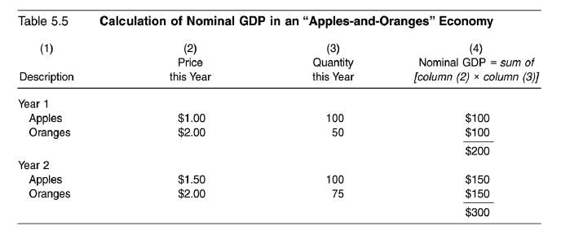
GDP growth, Nominal/Real GDP, and GDP per capita
Nominal GDP = GDP at current price

Slide 40
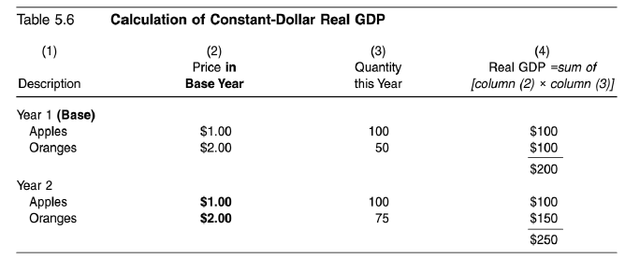
GDP growth, Nominal/Real GDP, and GDP per capita
Real GDP = GDP at base year price

Slide 41
GDP growth, Nominal/Real GDP, and GDP per capita
GDP Deflator
GDP Growth
GDP per capita

Slide 42
Nominal/Real GDP
GDP Deflator
  Indicator of the level of prices of all new, domestically produced, final goods and services in an economy.
  GDP deflator is calculated to indicate how the overall price level has changed through a period of time (i.e. from the base year until the current year).

Slide 43
Nominal/Real GDP
GDP Deflator
  Example
    In 2014, Thailand’s Nominal GDP is 5 billions, the GDP deflator (base year 2013) is 125. In 2013, Thailand’s Nominal GDP is 4 billions, with the GDP deflator of 100. Calculate the growth in real GDP.

Slide 44
GDP growth, Nominal/Real GDP, and GDP per capita
Exercise: calculate real GDP growth
 | Quantity |  | Price |  | Nominal GDP₁ | Nominal GDP₂ | Real GDP₁ (Base Year = Y1) | Real GDP₂ (Base Year = Y1
 | Year 1 (Q₁) | Year 2 (Q₂) | Year 1 (P₁) | Year 2 (P₂) | Q₁ x P₁ | Q₂ x P₂ | Q₁ x P₁ | Q₂ x P₁
Goods A | 6 | 6 | 5 | 6 | 30 | 36 | 30 | 30
Goods B | 7 | 7 | 3 | 5 | 21 | 35 | 21 | 21
Goods C | 10 | 12 | 7 | 9 | 70 | 108 | 70 | 84
 |  |  |  |  | 121 | 179 | 121 | 135

Slide 45
Thailand Real and Nominal GDP (US Dollars), 1980-2012

Slide 46
Thailand GDP per capita (local currency unit: Baht), 1980-2012

Slide 47
GDP per capita 2012, PPP (constant 2005 international)
Unit: 1,000 US Dollars
Source: World Bank

Slide 48
GDP per capita 2012, PPP (constant 2005 international)
Unit: 1,000 US Dollars
Source: World Bank

Slide 49
Thailand GDP growth and GDP per capita growth, 1980-2012
Source: World Bank

Slide 50
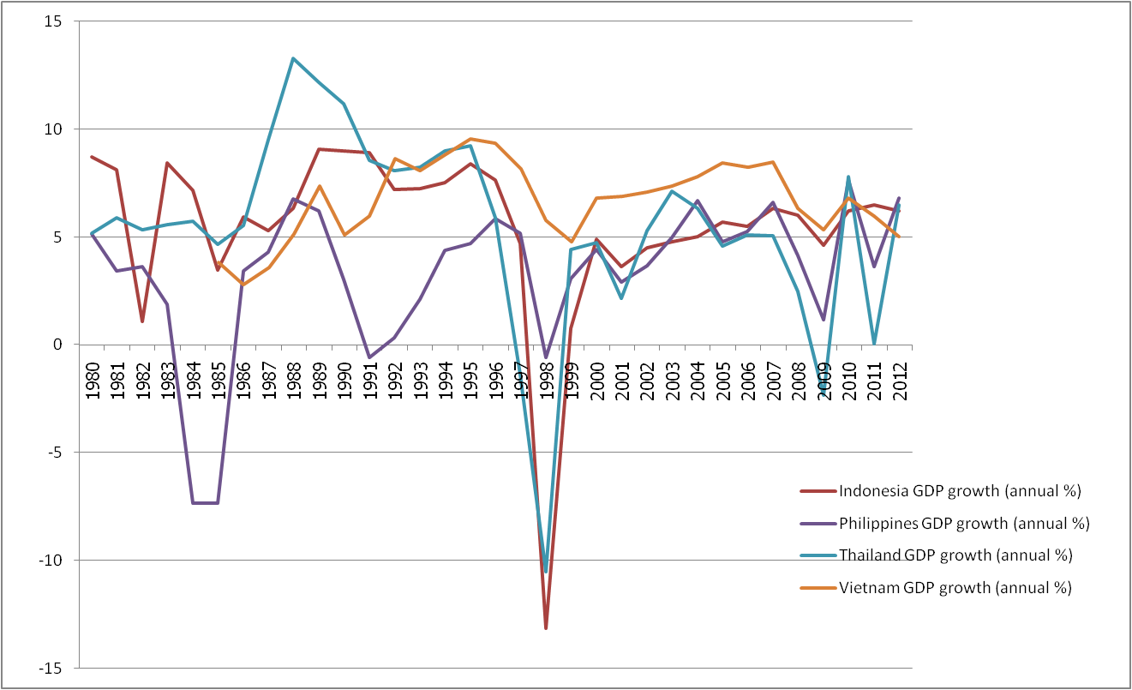
GDP growth, selected countries, 1980-2012
Source: World Bank

Slide 51
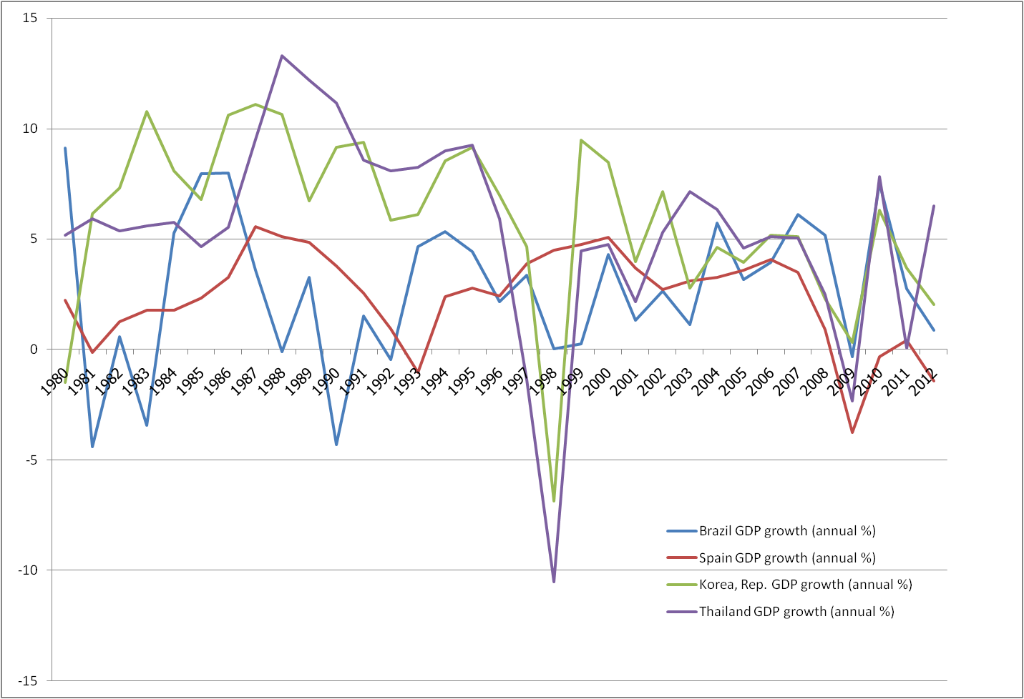
GDP growth, selected countries, 1980-2012
Source: World Bank

Slide 52
Price indexes and inflation rates
Why measuring the changes in price?
  Price change in itself has crucial implications for the economy
    Inflation = a rise in the overall price level
    Deflation = a decline in the overall price level
  Inflation leads to a decline in the value of money
    Question: How would inflation affect the following parties?
      Debtors, employers, salary earners

Slide 53
Price indexes and inflation rates
Measurement of price changes
  Price Indexes (measuring change in prices for the same basket of goods and services)
Value of Spending on Basket X for Year A
Price Index for Year A =
x100
Value of Spending on Basket X for Base Year
Price Index for period A – Price Index for Base Period
Inflation for Period A =
x 100
Price Index for Base Period

Slide 54
Price indexes and inflation rates
Examples of calculation
 | 2010 (Base Year) |  |  | 2011
 | Quantity (Q₁) | Price (P₁) | Spending = P₁xQ₁ | Price (P₂) | Spending = P₂xQ₁
Goods A | 12 | 15 | 180 | 17 | 204
Goods B | 4 | 45 | 180 | 60 | 240
Goods C | 18 | 15 | 270 | 15 | 270
Total value of spending |  |  | 630 |  | 714
Price Index |  |  | 100 |  | 113.33
Price Index for 2011 =
Inflation Rate for 2011 =

Slide 55
Price indexes and inflation rates
Types of price indexes
  Consumer Price Index (CPI): the price index computed using a bundle of goods meant to represent the “market basket” purchased by the typical urban consumer.
  Producer Price Index (PPI): the price index of prices that producers receive for products at all stages in the production process, not just the final stage.

Slide 56
Price indexes and inflation rates
CPI vs GDP Deflator
  GDP Deflator concerns prices of all goods and services in the economy, whereas CPI takes into account only prices of goods and services bought by consumers.
  CPI takes into account prices of imported products, while GDP Deflator does not.
  Finally, CPI is computed using a fixed basket of goods and services. GDP Deflator, on the other hand, allows the goods and services that its calculation takes into account to change over time.

Slide 57
Price indexes and inflation rates
Real interest rate
  The difference between the interest rate on a loan and the inflation rate
  Why using the real interest rate to calculate the return from loans?
    Example: You lend 100 bath to a friend. The inflation rate will be 10 percent. The interest rate you charge is 15 percent. What return from your loan will you actually receive?

Slide 58
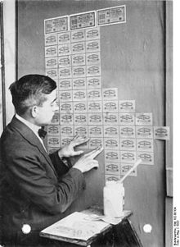
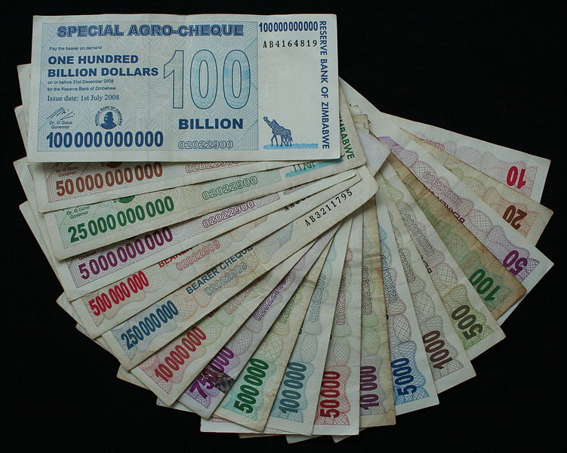
Price indexes and inflation rates
Hyper-inflation
Weimar Republic
Zimbabwe

Slide 59
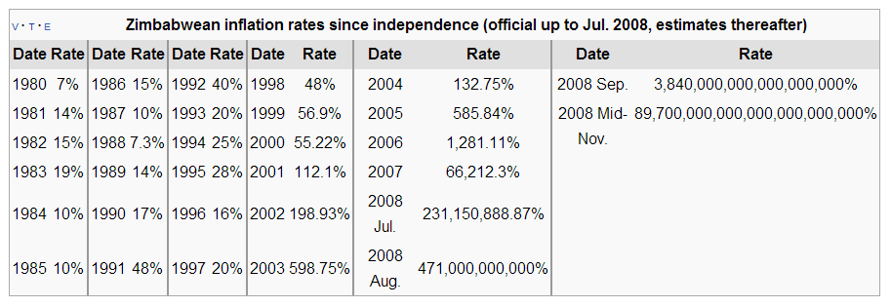
Price indexes and inflation rates
Zimbabwe hyperinflation

Slide 60
Price indexes and inflation rates
CPI and PPI for Thailand, 2000-2010
CPI Year Base 2007, PPI Year Base 2000

Slide 61
CPI, Thailand, 2013 (Base Year = 2011)
Description | weight | Jan. | Feb. | Mar. | Apr. | May. | Jun. | Jul. | Aug. | Sep. | Oct.
ALL COMMODITIES | 100 | 104.44 | 104.66 | 104.73 | 104.9 | 105.15 | 105.31 | 105.42 | 105.41 | 105.58 | 105.76
FOOD AND NON - ALCOHOLIC BEVERAGES | 33.48 | 106.59 | 106.51 | 106.79 | 107.99 | 108.93 | 108.85 | 108.62 | 108.79 | 108.96 | 109.62
RICE, FLOUR AND CEREAL PRODUCTS | 3.44 | 102.45 | 102.59 | 102.62 | 102.89 | 103.1 | 103.24 | 103.3 | 103.36 | 103.58 | 103.8
MEATS, POULTRY AND FISH | 6.35 | 103.07 | 105.13 | 105.16 | 106.45 | 107.09 | 107.49 | 108.06 | 109.49 | 109.73 | 109.5
EGGS AND DAIRY PRODUCTS | 1.77 | 101.02 | 102.18 | 101.68 | 101.7 | 104.3 | 106.18 | 104.35 | 105.35 | 107.71 | 107.56
VEGETABLES AND FRUITS | 3.95 | 116.49 | 110.46 | 113.55 | 120.7 | 126 | 123.05 | 120.97 | 118.82 | 117.91 | 123.03
SEASONINGS AND CONDIMENTS | 1.77 | 105.92 | 105.89 | 105.85 | 105.87 | 105.81 | 106.05 | 105.97 | 105.9 | 106.38 | 106.91
NON-ALCOHOLIC BEVERAGES | 1.76 | 103.65 | 103.76 | 103.75 | 103.63 | 103.81 | 103.81 | 103.91 | 103.98 | 103.9 | 104.14
PREPARED FOOD AT HOME | 8.97 | 107.94 | 108.26 | 108.21 | 108.49 | 108.66 | 108.72 | 108.48 | 108.76 | 108.88 | 108.99
FOOD AWAY FROM HOME | 5.46 | 104.73 | 104.99 | 104.8 | 105.05 | 105.07 | 105.26 | 105.6 | 105.65 | 105.8 | 106.02
APPAREL AND FOOTWARE | 3.06 | 101.29 | 101.29 | 101.3 | 101.42 | 101.9 | 102.01 | 102.02 | 102.03 | 102.11 | 102.15
HOUSING AND FURNISHING | 24.14 | 104.53 | 104.55 | 104.55 | 104.58 | 104.36 | 104.45 | 104.47 | 104.49 | 104.91 | 104.97
MEDICAL AND PERSONAL CARE | 6.54 | 101.76 | 101.85 | 101.82 | 101.83 | 101.84 | 101.93 | 101.92 | 102.02 | 102.07 | 102.11
TRANSPORTATION AND COMMUNICATION | 25.54 | 102.41 | 103.33 | 103.2 | 102.28 | 102.18 | 102.75 | 103.47 | 103.15 | 103.1 | 102.75
RECREATION AND EDUCATION | 6.03 | 100.66 | 100.71 | 100.8 | 100.75 | 100.74 | 100.94 | 100.94 | 100.98 | 100.98 | 101.11
TOBACCO AND ALCOHOLIC BEVERAGES | 1.2 | 107.78 | 107.78 | 107.85 | 107.84 | 107.84 | 107.94 | 107.95 | 107.95 | 109.21 | 111.49
NON-FOOD AND BEVERAGES | 66.52 | 103.05 | 103.42 | 103.38 | 103.04 | 102.94 | 103.22 | 103.51 | 103.41 | 103.57 | 103.52
RAW FOOD AND ENERGY | 26.91 | 108.55 | 109.13 | 109.42 | 109.9 | 110.69 | 111.05 | 111.46 | 111.26 | 111.62 | 111.99
RAW FOOD | 15.52 | 107.03 | 106.56 | 107.28 | 109.66 | 111.59 | 111.28 | 110.8 | 110.99 | 111.2 | 112.4
ENERGY | 11.4 | 111.28 | 113.25 | 112.96 | 110.92 | 110.21 | 111.45 | 113.05 | 112.32 | 112.89 | 112.16
EXCLUDE RAW FOOD AND ENERGY | 73.09 | 102.79 | 102.88 | 102.87 | 102.93 | 102.98 | 103.07 | 103.07 | 103.14 | 103.23 | 103.35
Source : Bureau of Trade and Economic Indices, Ministry of Commerce

Slide 62
PPI, Thailand, 2013 (Base Year = 2005)
Description | weight | Jan. | Feb. | Mar. | Apr. | May. | Jun. | Jul. | Aug. | Sep. | Oct.
Total Index | 100 | 139.6 | 139.9 | 139.5 | 139.5 | 141 | 139.4 | 138.5 | 138.7 | 140.1 | 139.7
Products of agriculture | 10.14 | 211.6 | 212 | 214.7 | 224.5 | 238.4 | 219.7 | 207.4 | 206.2 | 214.9 | 218.1
Crops | 7.05 | 244.9 | 243.9 | 247.2 | 258.8 | 276.8 | 249.4 | 231.5 | 228.9 | 240.5 | 244
Live-stocks | 1.7 | 130.3 | 133.4 | 133.6 | 139.5 | 145.2 | 146.9 | 146.6 | 148.6 | 148.2 | 144.9
Product of forestry | 0.05 | 135.2 | 135.2 | 135.2 | 135.2 | 135.2 | 135.2 | 135.2 | 135.2 | 135.2 | 135.2
Fish and other fishinng products | 1.34 | 121.5 | 125.1 | 127.4 | 132.6 | 134.3 | 136.9 | 139 | 141.1 | 145.6 | 154.6
Mining products | 2.92 | 103.9 | 105.3 | 102.1 | 98.9 | 99.7 | 101.9 | 105.3 | 106.9 | 108.4 | 106
Lignite, petroleum & natural gas | 2.44 | 90.4 | 91.9 | 88.2 | 84.8 | 85.7 | 88 | 91.7 | 93.5 | 95.1 | 92.5
Metal ores and other mining | 0.49 | 141.5 | 141.7 | 142.7 | 142.1 | 142.1 | 142.7 | 142.8 | 142.9 | 143.2 | 143
Manufactured products | 86.94 | 129.5 | 129.7 | 129 | 128 | 128.1 | 128.4 | 128.8 | 129 | 129.5 | 128.8
Food products,beverages & tobacco | 14.5 | 154.4 | 154.9 | 154.9 | 155.8 | 155.9 | 156.5 | 156.9 | 156.8 | 155.9 | 156
Textiles and textiles products | 7.59 | 115 | 115 | 113.9 | 114 | 114.4 | 114.7 | 115.2 | 114.9 | 114.9 | 114.9
Leather, leather products and footwears | 1.81 | 103.3 | 103.3 | 103.3 | 103.1 | 103.2 | 103.7 | 103.7 | 103.9 | 103.9 | 104
Wood and wood products | 1.08 | 127.5 | 127 | 127.9 | 126.9 | 127.1 | 127.5 | 128 | 127.7 | 127.8 | 127.6
Pulp, paper, paper products and printing | 1.85 | 110.7 | 110.7 | 111 | 110.9 | 111 | 111.1 | 111.2 | 111.2 | 111.4 | 111.5
Petroleum products | 9.09 | 146.2 | 148.7 | 145.7 | 140.4 | 142.2 | 145.7 | 149.2 | 150.9 | 154.1 | 149.6
Chemicals and chemical products | 5.06 | 113.5 | 113.8 | 114.1 | 113.3 | 112 | 112.1 | 112.7 | 112.9 | 113.9 | 113.8
Rubber and plastic products | 3.72 | 142.9 | 140.4 | 138 | 134.5 | 136.9 | 135.8 | 133.1 | 132.9 | 135.5 | 133
Non metallic mineral products | 2.87 | 121.4 | 121.6 | 121.8 | 121.9 | 122 | 122.2 | 122.3 | 122.6 | 122.6 | 122.7
Basic metals and fabricated metal products | 4.73 | 119.4 | 119.7 | 119.8 | 118.7 | 117.8 | 115.7 | 117.8 | 115.9 | 116.4 | 117.7
Machinery and equipment N.E.C. | 5.22 | 105.6 | 105.6 | 105.1 | 105.3 | 105.4 | 105.6 | 105.7 | 105.7 | 105.7 | 105.7
Electrical equipment N.E.C. | 15.7 | 99.3 | 99.3 | 99.3 | 99.2 | 99.1 | 99.1 | 99 | 98.9 | 98.9 | 98.9
Transpor equipment | 8.66 | 108.9 | 109.3 | 109.5 | 109.5 | 109.5 | 109.5 | 109.6 | 109.6 | 109.6 | 109.6
Other manufactured goods | 5.03 | 204.8 | 202.3 | 198.7 | 192 | 189 | 188 | 184.6 | 188.5 | 190.4 | 186.7
Source : Bureau of Trade and Economic Indices, Ministry of Commerce

Slide 63
Inflation rate in Asean countries, 2011
ร้อยละต่อปี
18.68
7.58
5.48
5.36
5.24
5.02
4.65
3.81
3.17
2.02

Slide 64
Unemployment Rate
Unemployment
What is wrong with unemployment?
No. of Unemployed
Unemployment Rate =
X 100
Total labour fource

Slide 65
Unemployment Rate
Types of unemployment
  Frictional: occurs because it takes time for workers to move from one job to another.
  Cyclical: occurs through the recession of the economy.
  Structural: occurs when a labour market is unable to provide jobs for everyone who wants one because there is a mismatch between the skills of the unemployed and the skills needed.
    With structural unemployment, markets cannot adapt to correct the unemployment problem.
  Seasonal: occurs through a change of season, can be thought of as a less problematic form of structural unemployment.

Slide 66
Unemployment Rate
Actual calculation (Thai case)
Total Population (age > 15)
In the labour force
Not in the labour force
Housewives
Studying
Others
Employed
Seasonal unemployed
Unemployed
Unemployment = (Unemployed/Total Labour Force) x 100

Slide 67
Unemployment: Actual Calculation in Thailand
Term | Definition
Employed | Anyone age 15 or above, who in the week of survey, has the following characteristics 1) Work 1 hour or more and earn returns in the form of money or goods 2) Work 1 hour or more in an enterprise or a farm that belongs to a household or more, without receiving returns 3) Has not been working or work less than 1 hour (despite having been working before), but 3.1) still receives return from business or jobs while out of work 3.2) receiving no return from business or jobs, but will return to business or work
Unemployed | Anyone age 15 or above, who in the week of survey, has the following characteristics 1) Has not been working and has no permanent job for 30 days before the survey

Slide 68
Unemployment: Actual Calculation in Thailand
Term | Definition
Seasonal unemployed | Anyone age 15 or above, who in the week of survey, cannot be categorised as employed or unemployed. The person waits for appropriate season to work, and will usually work in farming or business that occurs seasonally.
Labour force | Anyone age 15 or above, who in the week of survey, is not categerised as being outside of the labour force and is also not categorised as seasonal unemployment.
Not in the labour force | Anyone with the following characteristics 1) Age under 15 2) Age 15 or above, but is not ready to work because 2.1 work as a housewife 2.2 studying 2.3 Too old (age above 60) 2.4 Cannot work due to disability or illness 2.5 Work for someone not in the household without receiving returns 2.6 Work for a non-profit organisation without receiving returns 2.7 Is not willing to work due to other reasons

Slide 69
Unemployment in Thailand, 2011
Population age above 15
(54.87 millions)
In the labour force
39.35 millions (71.7 percent)
Not in the labour force
15.52 millions (28.3 percent)
Employed
38.75 mil.
Seasonal
0.33 mil.
Unemployed
0.27 Mil.
Housewives
(4.68 Mil.)
Studying
(4.36 Mil.)
Others
(6.4 Mil.)
Unemployed
0.27
Unemployment =
X 100
Unemployment =
X 100 = 0.68
Labour force
39.35

Slide 70
Thailand Unemployment Rate (%) (1998-2010)
Source: BOT

Slide 71
Unemployment rate in Thailand according to the educational level
Educational level |  | 2010 | 2011 | 2012
Total |  | 1.04 | 0.68 | 0.66
Primary Education and Below |  | 0.51 | 0.34 | 0.27
Mattayom 1-3 |  | 1.49 | 0.93 | 0.93
Mattayom 4-6 |  | 1.25 | 0.8 | 0.84
Vocational education |  | 1.61 | 1.02 | 1.01
High Vocational Certificate |  | 1.98 | 1.33 | 1.47
Higher education |  | 2.3 | 1.37 | 1.35
Source: NESDB

Slide 72
Unemployment Rate 2011
% of total labour force

Slide 73
Unemployment Rate 2011
% of total labour force

Slide 74
Thailand among the countries with the lowest unemployment rate in the world, why?

