Slide 1
Lessons on economies of clmv
EE361 ECONOMIES of CLMV
Faculty of economics
Thammasat university

Slide 2
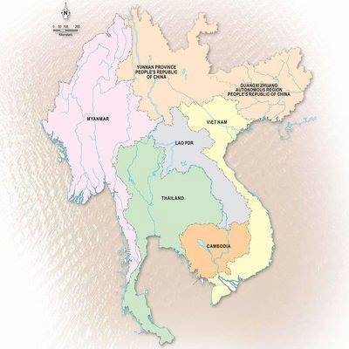
The Greater Mekong
subregion
Commonalities across countries
Mekong river
Use of waterways for transportation and livelihoods
History of collaboration and conflict
Buddhism
Differences
Population and land area
Culture and traditions
Urbanization rate
Economic development

Slide 3
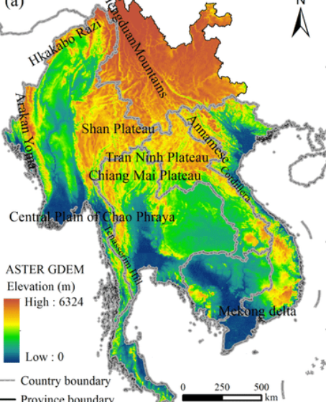
Geography of CLMV
The Mekong river and waterways
Flat, fertile land: centers of agricultural production and human habitatr
Mountainous areas: less accessible, home of ethnic groups
Key cities are located on flat, fertile land with access to waterways to transport goods and people

Slide 4
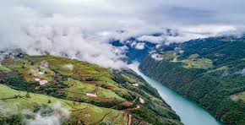

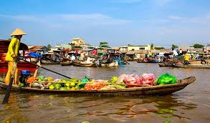
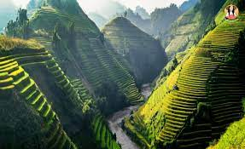
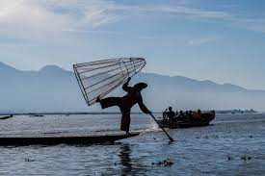
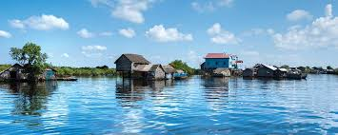
Geography of CLMV
Clockwise from top left:
Nong Khiaw (Lao PDR); Mekong delta; Xayaboury, Sapa (Vietnam, Tonle Sap lake (Cambodia), Inle lake (Myanmar)

Slide 5
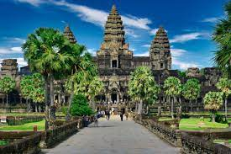
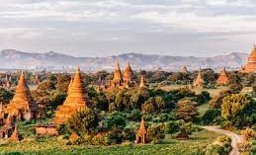

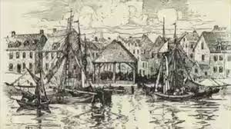
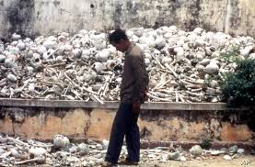
Characteristics of CLMV countries are shaped by their histories of territorials shifts, colonization, and post WWII independence, including war and social conflicts up to the 1980s

Slide 6
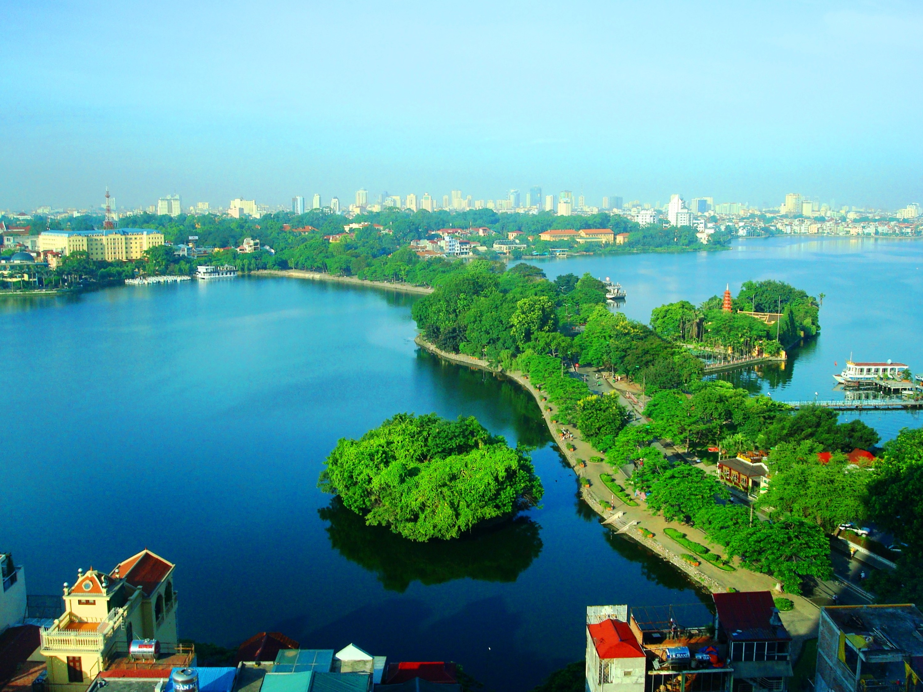
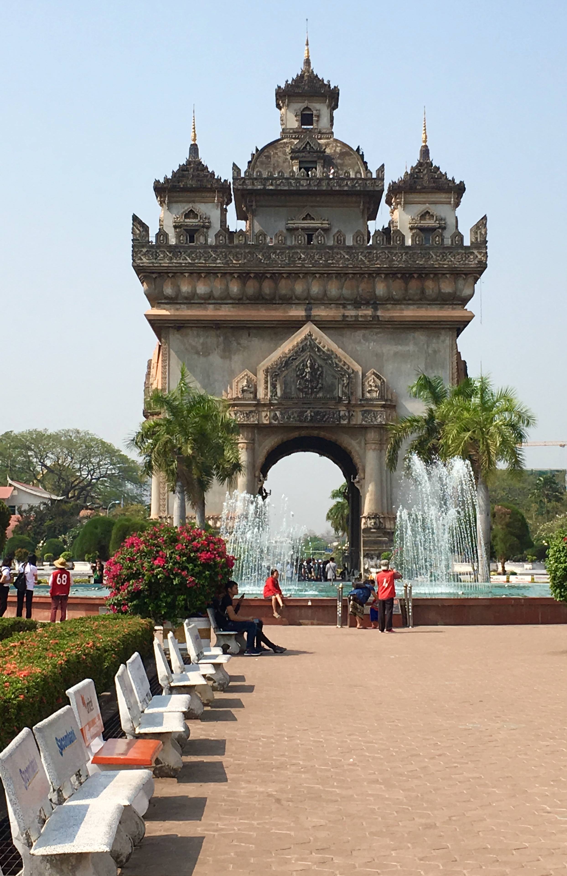
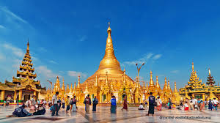
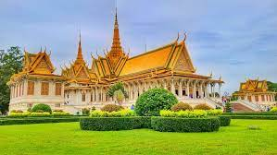
cities
Clockwise from top left: Hanoi; Vientiane; Phnom Penh, Yangon

Slide 7
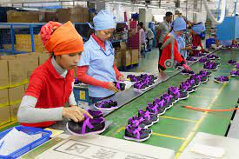

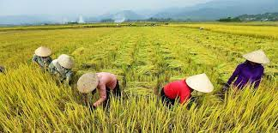
s
Transition in the 1980
CLMV maintained relative peace and political stability in the 1980s; however, poor economic performance led to reforms:
Shift from central-command to market-based economy
Shift from agriculture to industry and services
Increased deregulation, openness and trade liberalization
Reform of state-owned enterprises

Slide 8
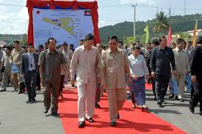
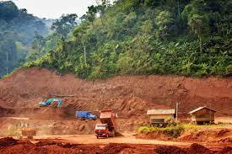
Economic reform
Economic reform: short-term macroeconomic stability; medium-term: create conducive investment climate; long-term structural adjustment
Benefits: increased foreign currency, strengthened government institutions, accelerate socioeconomic development

Slide 9
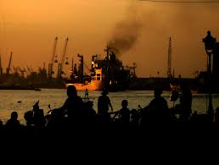
Outcomes of reforms
Short term: financial instability; however in time, improved balance of payment
Increased foreign investment and exports: mostly low value goods (extractive and labor intensive manufacturing)
Need for improved human skills, capital and technology to produce higher value goods; however supply is limited
Increased environmental degradation and pollution
Increased inequality

Slide 10
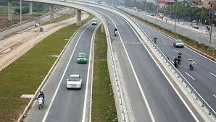
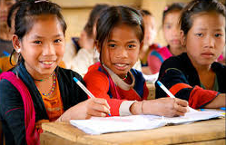
Needed government response and strategies
Develop critical infrastructure: transport, irrigation, energy, water supply, sanitation
Develop human capital and increase productivity and ensure competitiveness
Education: universal primary education, improved secondary education enrollment and retention, higher education, vocational training and research & development
Health programs to improve access to health facilities, improving health care quality and universal health coverage

Slide 11
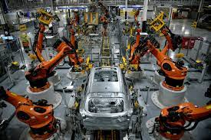
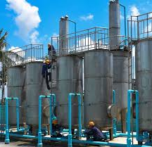
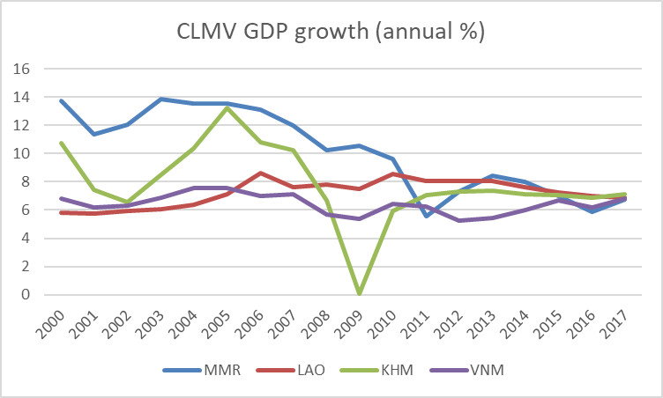
GDP Growth Performance
As a result of reforms and increasing openness, CLMV countries have averaged around 7% annual GDP growth over the past 15 years

Slide 12
Trends in urban development
Continued dominance of primary cities. The largest cities will continue to grow as centers of finance, business and administration
Development of small and medium towns as potential engines of growth
Increased urban-rural linkages will intensify well in the future.
Emerging urban growth centers. Several types of towns are expected to grow quickly while others will decline

Slide 13
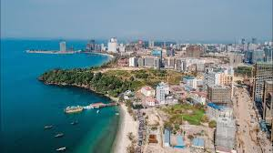

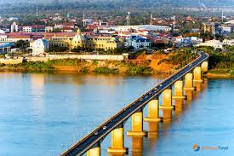
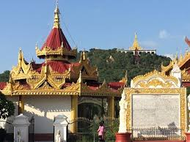

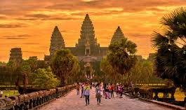
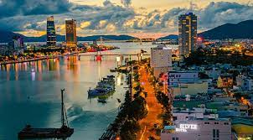
Secondary cities
Clockwise from upper top right: Sihanoukville, Luang Prabang, Da Nang, Siem Reap, Ho Chi Minh City, Pakse and Mandalay

Slide 14
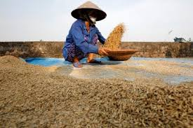

agriculture
Although employment in the agriculture is around 50%-70% of the total workforce, the share GDP is around 30%-40%. This means the sector has low productivity
Many rural farmers live on subsistence producing for their own consumption or are laborers on other people’s land
Productivity can be increased, but will require investments
Government must have policies in place to address the above issues

Slide 15
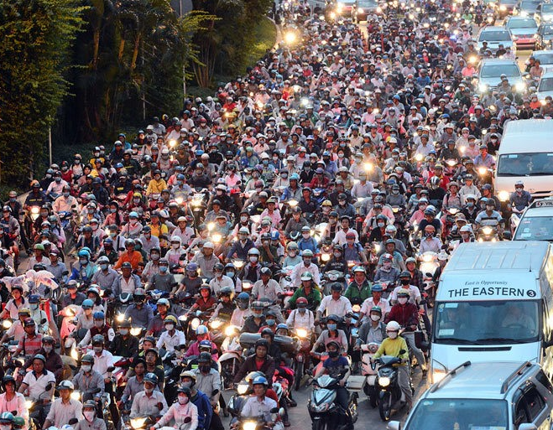
transportation
Lack of connectivity: poor quality of roads, incomplete road networks; missing railway links; inadequate maritime and port infrastructure; increased traffic jams increase travel time and fuel costs
Lack of awareness towards public safety when operating vehicles
Lack of coordination on how to better facilitate transportation of goods

Slide 16
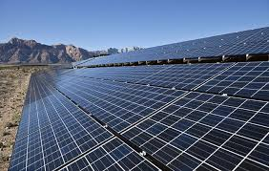
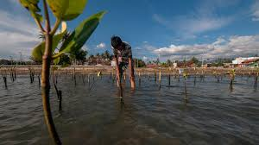
Environment and climate change
Economic growth could have adverse impacts on the environment. Sustainable environmental management is key
Destruction forests and gas emissions from industries and cars contribute to climate change caused by global warming through the greenhouse effect
Therefore governments should undertake adaptation and mitigation measures to address climate change

Slide 17

gender
Improving the status of women is important not only for reasons of equity but also makes economic sense to include the other half of the population in enabling economic development
Investments in women are therefore recognized as crucial to achieving sustainable development
Gender mainstreaming seeks to avoid the creation or reinforcement of inequalities, which can have adverse effects on both women and men

Slide 18
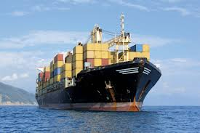
trade
Trade is important for CLMV countries as it generates revenues and foreign currency for economic growth and poverty reduction
CLMV trade has grown rapidly; more has been intra-regional trade compared to overall global trade
Exports of Cambodia, Lao PDR, and Myanmar consists largely of low value added goods such as textiles, apparels, and of primary products, while Vietnam is moving towards higher value goods
Policies have been pursued by governments in CLMV to promote trade such as reducing trade barriers and improving trade facilitation

Slide 19
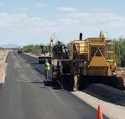
Foreign aid
Foreign aid stimulate economic growth through building infrastructure, supporting productive sectors or bringing in new ideas or technologies
It promotes other development objectives, such as strengthening education, health, environment, or political systems, provides emergency relief and stabilizes an economy after economic shocks
Three views on foreign aid: it helps support developing countries; it is not effective and creates debt burdens; its effectiveness is conditional upon recipient government

Slide 20
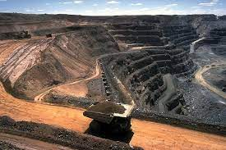
Foreign Investment
Multinational corporations (MNCs) provide foreign direct investments and foreign portfolio investments
Historically MNCs focused on extractive and primary industries; then shifted to export-oriented agriculture, food processing, and now on manufacturing operations, finance and services
Impacts of FDI: MNCs crowd out private businesses; reduced foreign exchange earnings in the long run; less-than-expected contribution to public revenues; and MNCs use their economic power to influence government policies

