Slide 1

BA 291 – Starting up a business
By Aj. Parichat Jantori
Notes:
http://www.rd.go.th/publish/6045.0.html

Slide 2

Brain Storming
You got an idea. You want to set up a business.
Which factors do you have to consider?

Slide 3
Basic definitions
A natural person: a real human being
A legal person (Juristic person): characteristic of a non-living entity regarded by law to have the status of personhood.
Legal personality allows one or more natural persons to act as a single entity (a composite person) for legal purposes. In many jurisdictions, legal personality allows that composite to be considered under law separately from its individual members or shareholders. They may sue and be sued, enter contracts, incur debt, and own property.

Slide 4
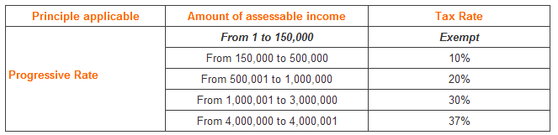
Basic definitions
Personal income tax: a tax levied on the total income of individuals (with some deductions permitted)
Corporate tax: a direct tax levied on the profits made by companies or associations and often includes capital gains of a company. The corporate tax in Thailand is 23%.
Notes:
http://www.rd.go.th/publish/6045.0.html

Slide 5
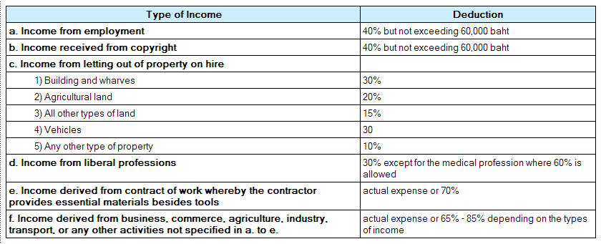
Basic definitions
Tax Deduction: Personal Income Tax
Notes:
http://www.rd.go.th/publish/6044.0.html

Slide 6
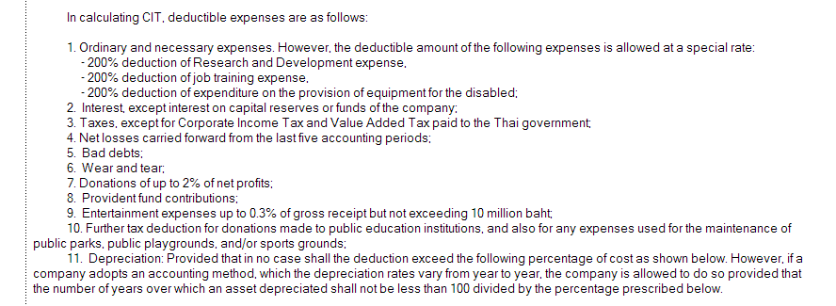
Basic definitions
Tax Deduction: Corporate Income Tax
Notes:
http://www.rd.go.th/publish/6044.0.html

Slide 7
Basic definitions
Limited liability: a form of business ownership in which business owners are legally responsible for no more than the amount that they have contributed to a venture. If for example, a business goes bankrupt an owner with limited liability will not lose unrelated assets such as a personal residence (assuming they do not give personal guarantees).
Unlimited liability: A type of investment in which a partner or investor can lose an unlimited amount of money.

Slide 8
Basic definitions:
Joint liability: the result of two or more parties applying jointly for credit as co-borrowers, which is implied in a general partnership. By doing this, any partner entering into a contract with or without the knowledge of other partners automatically binds all partners to that contract.
Joint and several liability: a person who was harmed or wronged by several parties could be awarded damages and collect from any one, several, or all of the liable parties.
Notes:
http://smallbusiness.chron.com/difference-between-jointly-liable-joint-several-liability-38704.html

Slide 9

Business organizations in Thailand
There are 3 kinds of business organizations in Thailand:
Sole proprietorships
Partnerships
  Unregistered ordinary partnership
  Ordinary partnership
  Limited partnership
Limited companies
  Private Company
  Public company

Slide 10
Sole proprietorships
unincorporated business owned by individual, that is not incorporated
no legal distinction between the owner and the business
the owner receives all profits (subject to taxation specific to the business) and has unlimited responsibility for all losses and debts
Typically small business with less than 50 employees
Example: small retail store, restaurants, hair salon, grocery store

Slide 11
Commercial registration (ทะเบียนพาณิชย์)
Individual or groups (partnership, corporations) who want to do the business activities have to register the business
Business that has to be registered must have a sales volume from 20 baht per day or the total of goods from 500 baht
The registration must be done within 30 days from the start date
Peddler, social enterprise do not have to register
Online services at: http://www.dbd.go.th
Notes:
http://www.doingbusiness.org/data/exploreeconomies/thailand/starting-a-business/

Slide 12
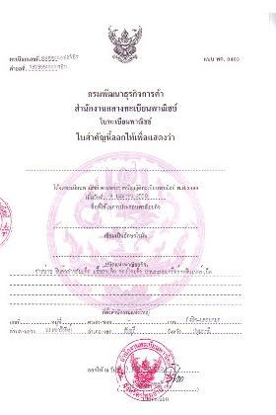
Commercial registration

Slide 13
Sole Proprietorship
Advantages of a Sole Proprietorship
Ease and cost of formation
Secrecy
Distribution and use of profits
Flexibility and control of the business
Government regulation
Taxation (pay income tax)
Disadvantages of a Sole Proprietorship
Unlimited liability
Limited sources of funds
Limited skills
Lack of continuity
Lack of qualified employees
Taxation (deduction max. 60,000 Baht)

Slide 14

Partnership
A form of business organization defined by the Uniform Partnership Act as “an association of two or more persons who carry on as co-owners of a business for profit”
3 Forms of partnership
Unregistered ordinary partnership (ห้างหุ้นส่วนสามัญไม่จดทะเบียน)
Ordinary partnership (ห้างหุ้นส่วนสามัญ)
Limited partnership (ห้างหุ้นส่วนจำกัด)

Slide 15
Unregistered ordinary partnership
- not registered by law as incorporate
- no legal entity (ไม่เป็นนิติบุคคล)
- consists of at least 2 members
partnership is based on a contractual relationship. Partners must make a contribution in form of money, properties or services for the partnership
not allowed to own property, to sue or be sued in the name of partnership
aim of the partnership is to invest and undertake a business with a view of sharing profits and loss
all partners are jointly and without limit liable for all the obligations of the partnership (jointly & several liability)

Slide 16
(Registered) ordinary partnership
- after registration, ordinary partnership can become incorporated as a juristic person (have legal entity).
entitle to own property, sue or be sued in the name of the partnership.
pay tax as corporate entity (corporate tax 23%*)
assets of the partnership have to be examined before creditors can claim debt payment from the partners (Second obligor, ลูกหนี้ชั้นที่ 2).
This is unlike an unregistered ordinary partnership, in which each partner is directly liable for debts incurred by the partnership.

Slide 17
Limited partnership
A business organization that has at least one general partner, who assumes unlimited liability, and at least one limited partner whose liability is limited to his or her investment in the business
General partner
- assumes unlimited liability
- able to manage
- usually receive larger share of profits
Limited partner
- assumes limited liability
- liability is limited to initial investment
- do not directly participate in management.
- function as an investor
Notes:
(1) A limited partnership consists of two types of partner:
(a) one whose liability is limited to the specific amount which he has contributed to the partnership, and
(b) one whose has unlimited liability for all debts incurred by the partnership.
(2) A limited partnership must be registered and is regarded as a separate entity.
(3) It should only be managed by a partner who has unlimited liability.
(4) If the business of the partnership is managed by a partner whose liability is limited, that partner will become unlimitedly liable for all debts incurred by the partnership.
(5) Partners with limited liability are entitled to carry on business of the same nature as that of the partnership and are free to transfer their shares without prior consent of the other partners.
(6) Creditors of the partnership are not entitled to sue partners with limited liability unless the partnership is dissolved. Even then, creditor can claim only the following amounts:
(i) part of the undelivered contribution,
(ii) part of the contribution which has been withdrawn,
(iii) divined or interest received in bad faith or contrary to the law.
(7) New partners cannot be introduced into the partnership without the consent of all other partners. A new partner is liable for any of the partnership’s debts from time of his becoming a partner. Similarly, an ex-partner is liable for debts incurred by the partnership up to the termination of his right as a partner.

Slide 18
Articles of Partnership
Articles of partnership (หนังสือบริคณสนธิ): Legal documents that set forth the basic agreement between partners which contains
Name, purpose, location of the partnership
Duration of the agreement
Authority and responsibility of each partner
Character of partners (i.e., general or limited, active or silent)
Amount of contribution from each partner
Division of profits or losses
Salaries of each partner

Slide 19
Articles of Partnership (con‘t)
How much each partner is allowed to withdraw
Death of partner
Sale of partnership interest
Arbitration of disputes
Required and prohibited actions
Absence and disability
Restrictive covenants
Buying and selling agreements

Slide 20
Advantages and disadvantages of partnership
Disadvantages
Unlimited liability (for general partner)
Business responsibility – all partners are responsible for business actions of all others
Life of the partnership (= life of the general partnership, 2-persons partnership terminated when partner dies or withdraws)
Distribution of profits – profits are distribute to partners by share or as specified in article of partnership
Limited sources of funds – shares are not sold to public
Taxation of partnerships (income + corporate)
Advantages
Ease of organization- requires articles of partnership
Availability of capital & credit- greater earning power and credit rating
combined knowledge & skills
Decision making
Regulatory controls – few regulations controls affecting its activities

Slide 21
Dissolution of partnership
Terms of contract of partnership provide for it.
A definite period of time descried in the terms of partnership has expired.
The partnership was formed for a single undertaking, which has been completed.
Any of the partners gives due notice to the others (withdrawal)
Upon death, bankruptcy or incapacity of a partner (general partner)
exception: the partnership can continue to exist if the remaining partners buy the shares of the withdrawing partner.

Slide 22
Keys to Success in Business Partnership
Keep profit sharing and ownership at 50-50
Partners should have different & complementary skill sets
Honest is critical
Maintain face-to-face communications
Transparency – sharing information
Awareness of funding constraints and limited resources
To be successful, you need experience
Family is priority; limit associated problems
Do not become too infatuated with “the idea” think implementation
Couple optimism with realism in sales and growth expectations

Slide 23
Limited corporation (Ltd.)
the most common structure for conduction business in Thailand
established by at least 3 people (Private company), 15 people (Public company)
must be registered as juristic person
able to own property and carry on the business under its name
typically owned by many individuals or organizations who own shares of the business (stockholder, shareholder)
Stockholders can buy, sell, give or receive share as gifts or inherit them.
Stockholders are entitled to all profits may be distributed (dividends)
liability to the third parties is separate from individual liability of its shareholders
liability of the shareholders is limited to the value of an individual shareholder‘s unpaid share capital
Notes:
กฎหมายบังคับให้จ่ายค่าหุ้นเบื้องต้น 25% ของมูลค่าหุ้นทั้งหมด

Slide 24
Stock & Dividends
Stock – shares of a corporation that may be bought or sold
Preferred stock – a special type of stock whose owners, though not generally having a say in running the company, have a claim to profits before other stockholders do.
Common Stock – stock whose owners have voting rights in the corporation, yet do not receive preferential treatment regarding dividends.
Dividends – profits of a corporation that are distributed in the form of cash payments to stockholders

Slide 25

Private company (Plc.)
also called company limited (co. Ltd.)
consists of at least 3 establisher
formed through a process that leads to the registration of a Memorandum of Association (Articles of Incorporation)
Share price must be equal and value at least 5 baht per share
Share are not sold on public market
Shareholders enjoy limited liability, i.e. limited to the remaining unpaid amount, if any, of the par value of their shares

Slide 26
Public company (company limited)
a minimum of 15 promoters is required for the formation and registration of a public limited company
there is no restriction on the transfer of shares
can offer its shares to public - the stock of public company can be sold, bought and traded to anyone
at least 50% of the directors must reside in Thailand; and board meetings must be held at least once every three months.
Initial Public Offering (IPO) – A private corporation who wishes to go “public” to raise additional capital and expand. The IPO is selling a corporation’s stock on public markets for the first time.

Slide 27
Establishment of limited company
The procedure for forming a limited private company is as follows:
(1) The promoters of the company must file a memorandum of association. The memorandum of association shall contain the following information:
- the full name and intended location of the company,
- the objectives of the company,
- the intended location of the head office of the company,
- a declaration of the shareholder’s limited liability,
- the amount of share capital, and the value of each share,
- the name, address, occupation, and signature of each of the promoters together with the number of shares subscribed to by each.
(2) The official in charge of company registration will review the memorandum of association, Once satisfied, registration will be granted.
(3) After registration, the company promoters will try to have all shares subscribed to. A private company is not permit to invite the public to subscribe to the shares.

Slide 28
Establishment of limited company
(4) After all shares have been subscribed, the promoters of the company must immediately call a general meeting of subscribers. This meeting is the statutory meeting, which should call :
(a) adoption of the company regulations,
(b) rectification of any transactions or expenses made by the company promoters during the formation of the company,
(c) determining and fixing the amount to be paid to promoters,
(d) fixing the number of preference shares, if any,
(e) fixing the number of ordinary and preference shares to be allocated as fully or partly paid up in place of money, and determining the amount at which they shall be considered as paid up, and
(f) appointment of directors and auditors and establishment of their respective power.
(5) After the statutory meeting, the promoters shall hand the business over to the directors.
(6) The directors shall cause the promoters and subscribers to pay up each share in money at an amount of not less than twenty-five prevent of the par value.
(7) When the above mentioned amount has been paid, and within three months of the statutory meeting, the directors must apply for registration of the company.

Slide 29
Management of limited company
The company’s business is to be managed by the directors of the company as appointed at the meeting of the shareholders
Inside Directors – individuals who serve on the board and are employed by the corporation (usually executives of the corporation).
Outside Directors – individuals who serve on the board who are not directly affiliated with the corporation (usually Executives of other corporations).
A supervisory board is a group of individuals chosen by the stockholders of a company to promote their interests through the governance of the company and to hire and supervise the executive directors and CEO (two-tier board system e.g. Germany)
Notes:
One tier board, two-tier board (board of director, supervisory board)

Slide 30
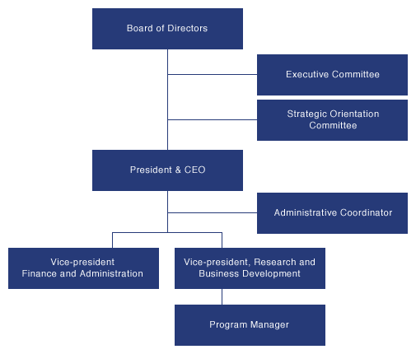
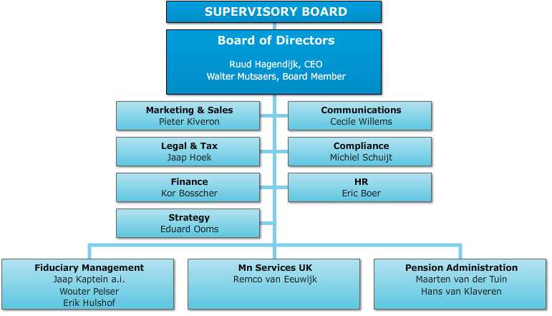
Board system

Slide 31
Duties of limited company
prepare their financial statement at least once in every 12 months and has at least one auditor and present it to the general meeting of the shareholder for the approval
hold a general meeting within 6 months from the date it is registered as a juristic person and hold this meeting as least once in every 12 month
give its share certificates to the shareholders and arrange shareholder registration book
In case that there is any change in the registered items, the company has to register the new information to the registrar at the partnership/company registration office where the head office is situated
Notes:
http://www.thailandlawonline.com/article-blog/duties-company-limited.html

Slide 32
Dissolution of a company
The company shall be dissolved in any of cases as follows:
(1) when the meeting of shareholders resolved to dissolve the company with votes not less than three-fourths of the total number of votes of the shareholders attending the meeting and having the right to vote;
(2) when the company becomes bankrupt;
(3) when the court orders dissolution of the company under Section 155 and the order is final.

Slide 33
Advantages and disadvantages
Advantages:
  Limited liability
  Transfer of ownership
  Perpetual life
  External sources of funds
  Expansion potential
Disadvantages:
  Double taxation
  Forming a corporation
  Disclosure of information
  Employee-owner separation

Slide 34
Other Types of Business Ownership
Joint-venture
The cooperation of two or more individuals or businesses in which each agrees to share profit, loss and control in a specific enterprise.
Merger – the combination of two companies (usually corporations) to form a new company
Acquisition – the purchase of one company by another, usually by buying its stock and/or assuming its debt.

Slide 35
Leveraged buyout (LBO)
Leveraged buyout (LBO) – A form of acquisition in which a group of investors borrows money from banks and other institutions to acquire a company (or a division of one) using the assets of the purchased company to guarantee repayment of the loan.

Slide 36
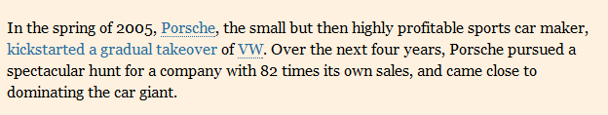
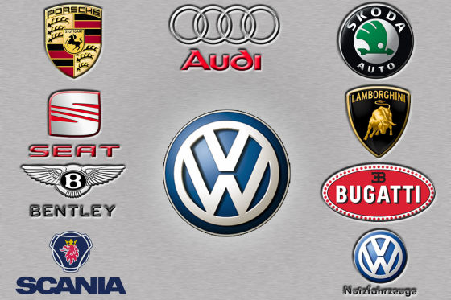
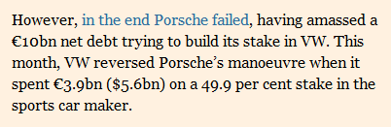

Example of fail LBO
Source: Financial times, Dec. 30, 2009

Slide 37
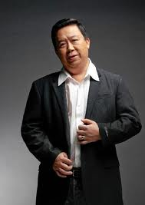

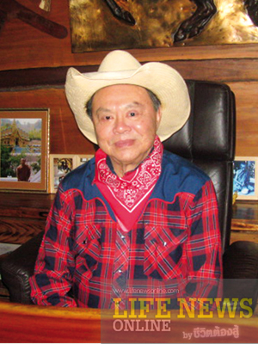
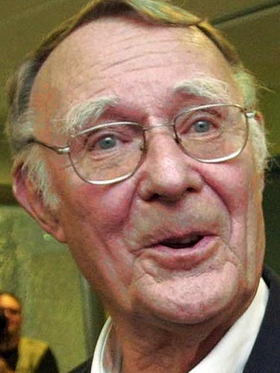
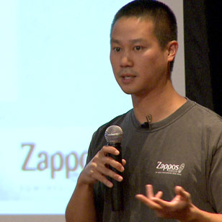
Entrepreneurship
Initiative Risk taking Persisting

Slide 38

Entrepreneurship and small business
Entrepreneurship
- A process of creating and managing a business to achieved desired objectives
Many large business all began as small business based on the vision of their founders

Slide 39

Amazon.com
Jeff Bezos founded Amazon.com, Inc. in 1994 and the site went online in 1995. The company was originally named Cadabra, Inc., but the name was changed when it was discovered that people sometimes heard the name as "Cadaver". The name Amazon.com was chosen because the Amazon River is one of the largest rivers in the world and so the name suggests large size, and also in part because it starts with "A" and therefore would show up near the beginning of alphabetical lists. Amazon.com started as an online bookstore, but soon diversified, selling almost everything.
Notes:
Internet gold rush, dot-com bubble
The meaning of logo
Since 2000, Amazon's logotype is an arrow leading from A to Z, representing customer satisfaction (as it forms a smile); a goal was to have every product in the alphabet.^{[7]}

Slide 40
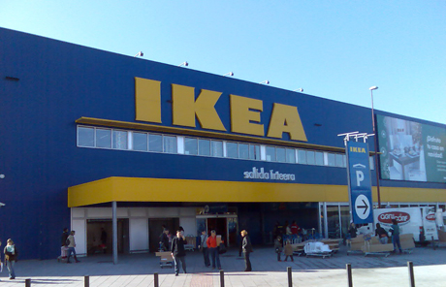
IKEA
The founder of IKEA, Ingvar Kamprad, was born in Småland, in the south of Sweden. He was raised on a farm, near the small village of Agunnaryd. Even as a young boy his entrepreneurial skills were showing. He started by selling matches to neighbors when he discovered that matches could be purchased inexpensively in bulk and resold at a lower price but still with a profit. From matches, he expanded to selling fish, Christmas tree decorations, seeds and later ball-point pens and pencils.
In 1943, when Ingvar was 17, his father gave him a gift for succeeding in his studies, he used this to establish his own business
which is selling the furniture.
Notes:
Der damals 17-jährige Ingvar Kamprad gründete das Unternehmen 1943 in Schweden. Das Akronym IKEA setzt sich aus den Anfangsbuchstaben von Ingvar Kamprad, des elterlichen Bauernhofs Elmtaryd und des Dorfes Agunnaryd zusammen, in dem der Hof lag.^{[2]}Zunächst verkaufte die Firma diverse Konsumgüter, darunter Kugelschreiber, Brieftaschen, Bilderrahmen, Tischdecken, Uhren, Streichhölzer, Schmuck und Nylonstrümpfe.
1947 begann Kamprad auch Möbel per Versand zu verkaufen, besonders an die Bauern der historischen Provinz Småland. So konnte er die Kosten vom Hersteller bis zum Kunden niedrig halten.
1951 erschien der erste IKEA-Katalog. Das Geschäft konzentrierte sich nun nur noch auf Möbel. In IKEA-Katalogen wurden bald Möbel nicht nur als einzelne Objekte, sondern als Teil eines gesamten, fertig eingerichteten Zimmers abgebildet. Diese Darstellungen waren zur damaligen Zeit ungewöhnlich. Die Kataloge wurden zum Bindeglied zu den Kunden und zum wichtigsten Marketinginstrument des Unternehmens.
Ab 1955 bot Kamprad erstmal eigens für IKEA entworfene Möbel an. Die Möbel wurden um Montage- und Versandkosten zu sparen, ab 1956 als Bausatz verschickt.
IKEA-Möbelhaus in Älmhult
Am 28. Oktober 1958 eröffnete in Älmhult das erste IKEA-Möbelhaus.

Slide 41
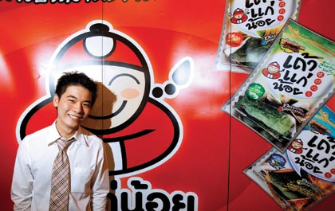
เถ้าแก่น้อย
Founded by Ittipan Kulpongvanich
His first business was selling the items on game-online. But as the popularity of the online-game decreased, he started doing something else.
His next idea was operating a franchise for chestnut. He later added others product line into his franchise and one of that is seaweed. But his business didn’t run smooth at first, but he kept trying. Now his products has 70% of the market shares. He is a young millionaire.

Slide 42
Small business and SMEs
Definition:
small business is any independently owned and operated business, not dominant in its competitive area, employing less than 500 people.
Definition from EU
An enterprise which employs fewer than 250 persons and has an annual turnover not exceeding EUR 50 million and/or an annual balance sheet total not exceeding EUR 43 million

Slide 43
SME
According to Thai Law, SME is…
Type of business | Number of employees |  | Asset in million baht
 | Small | Middle | Small | medium
Production | Less than 50 | 51-200 | Less than 50 | 51-200
Wholsalers Retailers | Less than 25 Less than 15 | 26-50 16-30 | Less than 50 Less than 30 | 51-100 31-60
Service | Less than 50 | 51-200 | Less than 50 | 51-200

Slide 44
Impact of Small Business
80% of all new jobs, annually, created by small business in the last 10 years
boost domestic consume, reduce export
Small businesses responsible for 37% of GDP
Account for 44% of all sales in the country
Initial of potential business
Create value for domestic product and resources
provide wide variety of quality products

Slide 45
Advantages and disadvantage to small business
Advantages
Independence
Cost
Flexibility
Focus (Market niche)
Reputation
Disadvantages
High stress level
High failure rate (Roughly 90 % of all new business fail within the first 5 years)
Undercapitalization (lack of funds)
Managerial inexperience or incompetence
Inability to cope with growth

Slide 46
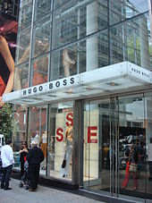
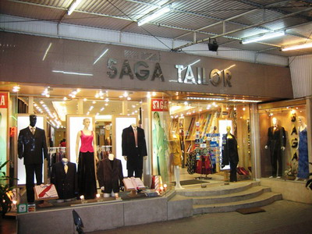
SME vs. the big name

Slide 47
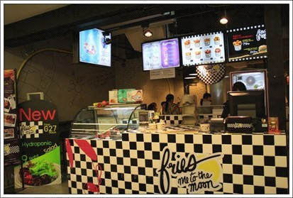
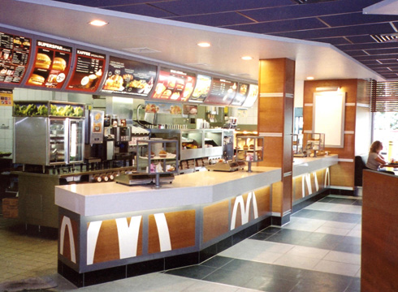
SME vs. the big name

Slide 48
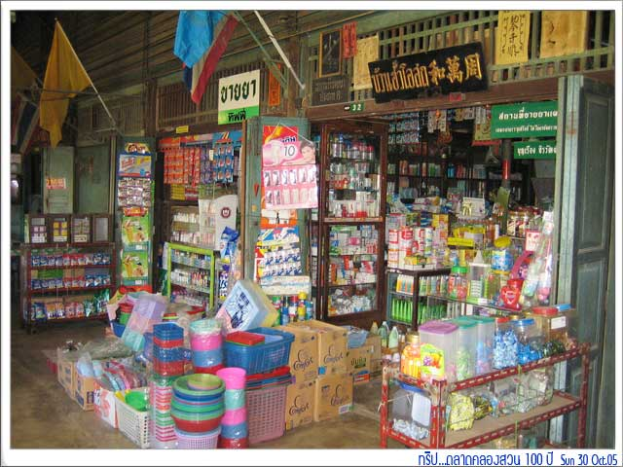
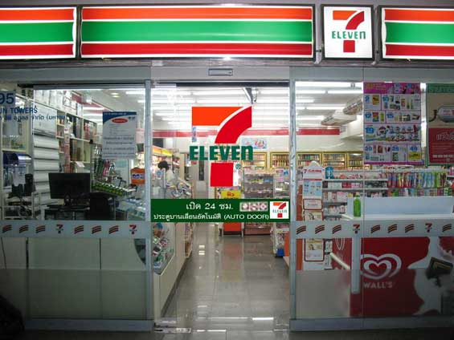
SME vs. the big name

Slide 49
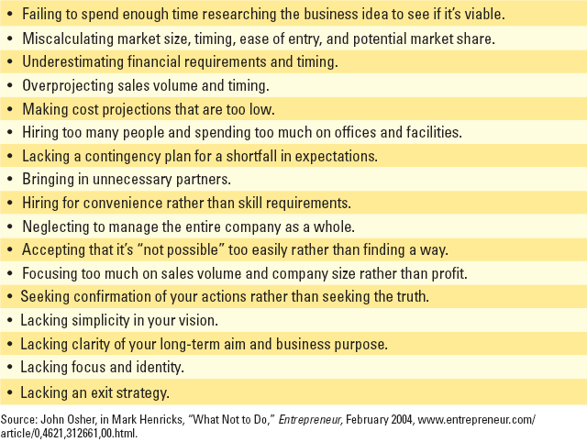
Most Common Mistakes Made by Startup Businesses

