Slide 1
Learning
PY211 General Psychology

Slide 2
Definition
Any relatively permanent change in behavior brought about through experience.
  Not due to biological causes such as drugs, fatigue, maturation, and injury
  Not always immediately obvious

Slide 3
Classical conditioning
Ivan Pavlov – Russian physiologist, study in the role saliva in digestion
Accidentally discover the classical conditioning phenomenon
Association: First mentioned by Aristotle
  Ex. if you have ever had lunch at a specific restaurant with your ex-girlfriend, visiting or passing by that restaurant again may trigger memories about your ex-girlfriend.

Slide 4
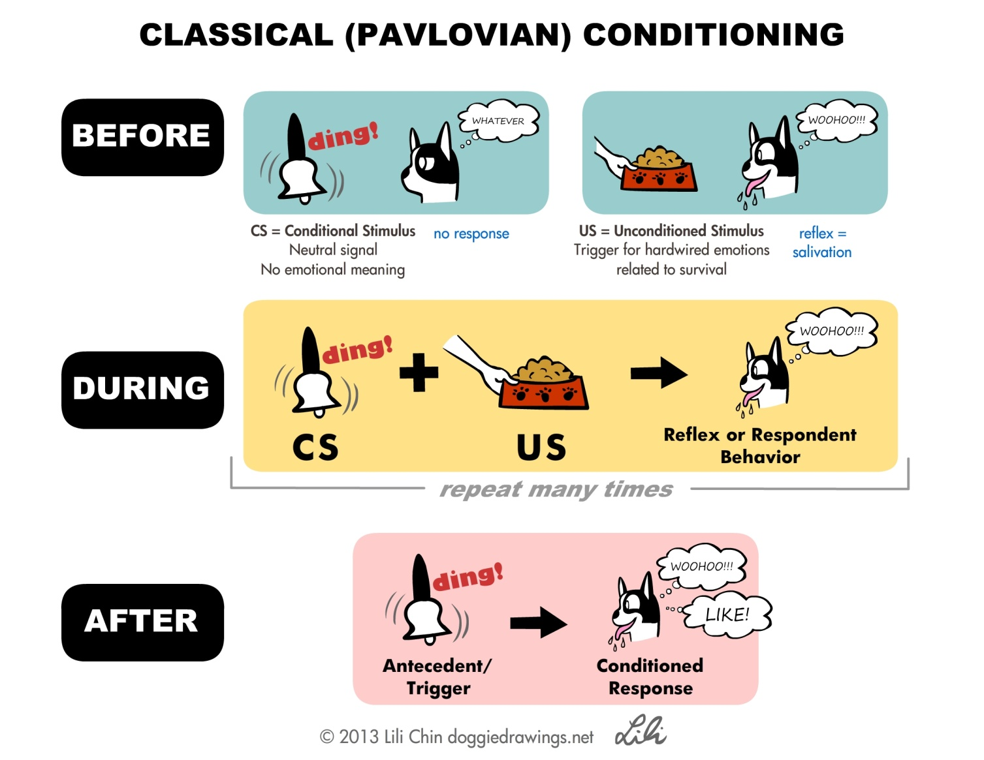
Classical conditioning

Slide 5
Classical conditioning
Basic terms
  Neutral stimulus (NS): A stimulus that does not elicit any specific response
  Unconditioned stimulus (UCS): A stimulus that can elicit the inborn response without any learning
  Unconditioned response (UCR): An unlearned, inborn reaction to the UCS
  Conditioned stimulus (CS): A stimulus that comes to elicit responses as a result of being paired with an UCS
  Conditioned response (CR): Response that is similar or identical to the unconditioned response that is elicited by a CS

Slide 6
Classical conditioning
NS No response
UCS UCR
UCS + NS (CS) UCR
CS CR

Slide 7
Classical conditioning
Classical conditioning is “a form of learning in which a previously neutral stimulus (NS) is followed by a stimulus (UCS) that elicited an unconditioned response (UCR). As a result of these pairings of the CS and UCS, the CS comes to elicit a conditioned response (CR) that, in most case, is identical or very similar to the UCR” (Lahey, 2009, p.207).
It occurs frequently without conscious awareness.
  Praise, fermented fish sauce, syringe, etc.

Slide 8
Importance of classical conditioning
Little Albert experiment (1920) by John B. Waston and Rosalie Rayner
  9 to 11-month-old child
  Fear is acquired through classical conditioning.
  White rat + loud noise
  Unethical
Jones’ (1924) experiment
  Successfully reduced Little Albert’s fear of rabbits
  Counterconditioning: A process of eliminating a classical conditioned response by pairing new stimuli

Slide 9
Classical conditioning: examples
Sexual fetishes
  Objects, clothes, body parts, situations + Seductive person
Phobia
  Phobic objects/situations + Very frightening or traumatic event
Taste aversion
  Food + Intoxication

Slide 10
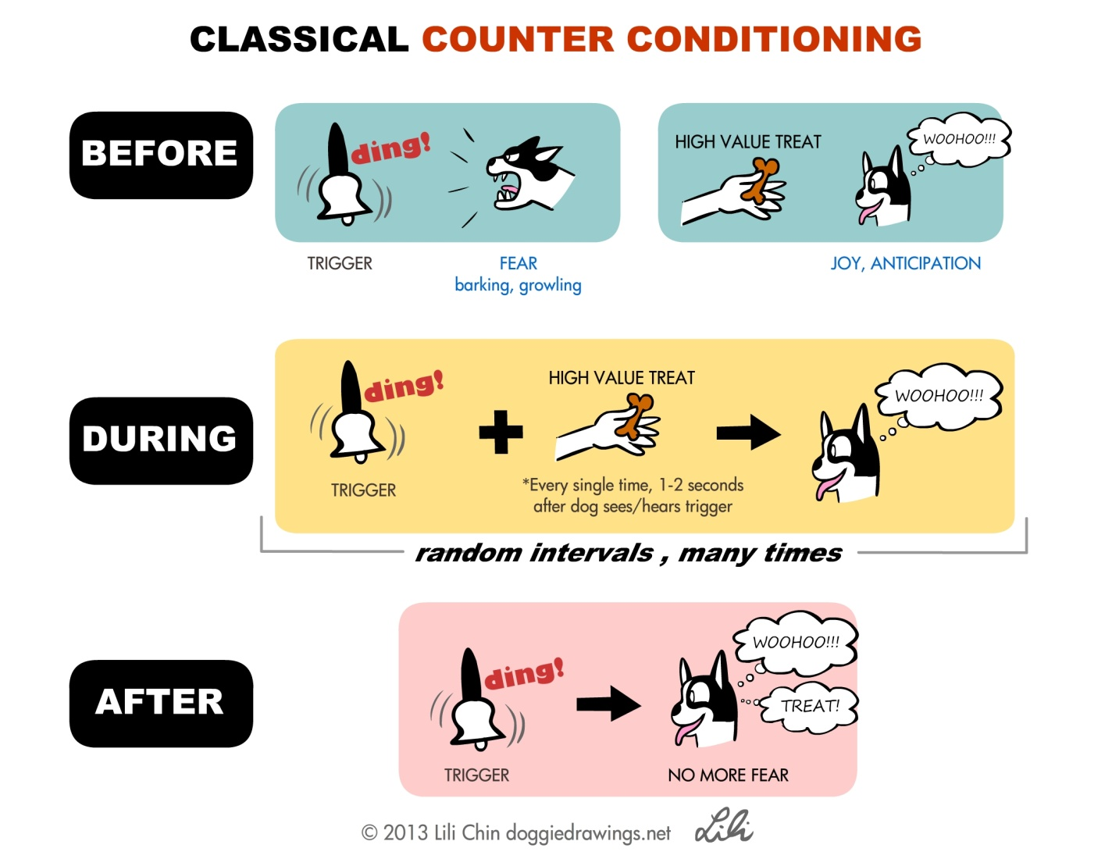
Counterconditioning

Slide 11
Operant conditioning
Learning in which the consequences of behavior lead to changes in probability of its occurrence
Thorndike’s (1911) law of effect
  A hungry cat + a puzzle box + food outside the box
  The cat became more efficient at opening the door of the box.
  The consequences of a response will determine whether the response will be performed in the future.
Skinner’s operant conditioning chamber (Skinner box)

Slide 12
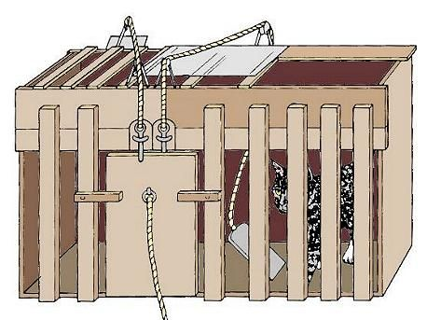
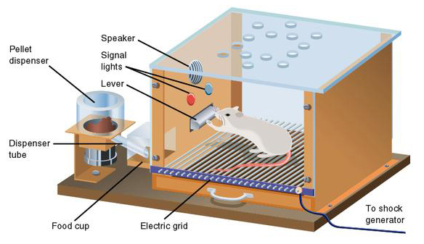
Operant conditioning
http://www.simplypsychology.org/operant-conditioning.html
http://study.com/academy/lesson/edward-thorndike-puzzle-box-lesson-quiz.html

Slide 13
Reinforcement
Reinforcement
  Aim to increase a probability of an occurrence of a target behavior
  Positive reinforcement: Giving or rewarding a desirable stimulus/consequence (reinforcer) when a target behavior is done
  Negative reinforcement: Removing an unpleasant stimulus when a target behavior is done
    Escape conditioning: The behavior causes a negative event to stop.
    Avoidance conditioning: The behavior causes something negative not to happen when it otherwise would have happened.

Slide 14
Reinforcement
Reinforcement
  Shaping: Strategy of positively reinforcing behaviors that are successively more similar to desired behaviors.
  Examples
    A mother gives her baby sweets when he says “mama.”
    A broken-hearted girl goes shopping which makes her forget her ex-boyfriend.
    A student takes an umbrella to school everyday in rainy season.

Slide 15
Reinforcement
Primary & secondary reinforcers
  Primary reinforcers: Innate positive reinforcers that do not have to be acquired though learning
    Food, water, warmth, sexual gratification, etc.
  Secondary reinforcers: Learned positive reinforcers (which are often acquired through association)
    Praise, social acceptance, money, etc.

Slide 16
Reinforcement
Schedules of reinforcement
  Continuous: Every response is always followed by a reinforcer.
  Fixed ratio: The reinforcer is given only after a specified number of responses.
  Variable ratio: The reinforcer is obtained only after a variable number of responses have been made.
  Fixed interval: The reinforcer is given after a predetermined period of time.
  Variable interval: The reinforcer is given after a variable amount of time.

Slide 17
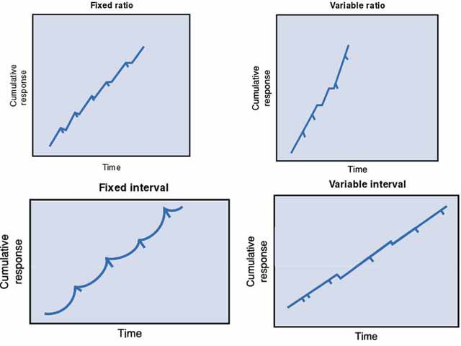
Reinforcement
Schedules of reinforcement

Slide 18
Reinforcement
Schedules of reinforcement: examples
  A pay rate of 10 THB per piece
  Monthly salary
  Random quiz
  7-11 Rilakkuma stamps
  Slot machine
  Quality control
  Fishing

Slide 19
Punishment
Punishment
  Aim to reduce the frequency of a target behavior.
  Positive punishment: Giving an unpleasant stimulus/consequence to reduce the frequency of a target behavior
  Negative punishment (punishment by removal): Removing a pleasant stimulus to reduce the occurrence of a target behavior

Slide 20
Punishment
Punishment
  Examples
    Parents hit or berate their children when they do something wrong.
    A sergeant orders his subordinates to do squats after they broke a minor army regulation.
    A mother gives less money to her son because he didn’t obey her.
    A nanny takes away child’s toys after he yelled at her.

Slide 21
Punishment
Dangers of punishment
  Reinforcing to the punisher: It increases the frequency and the intensity of punishment.
  Generalized inhibiting effect: It may inhibit other behaviors as well.
  Learning to dislike and react aggressively
  It may be interpreted as a positive reinforcer.
  It does not teach how to act more appropriately.

Slide 22
Reinforcement & punishment
Any reinforcer or punisher should be given right after a targeted behavior is performed.
 | Reinforcement (+ behavior) | Punishment (- behavior)
Positive (adding) | Adding what they like, to increase the frequency of a behavior | Adding what they don’t like, to decrease the frequency of a behavior
Negative (removing) | Removing what they don’t like, to increase the frequency of a behavior | Removing what they like, to decrease the frequency of a behavior

Slide 23
Discrimination & generalization
Stimulus discrimination
  The tendency for responses to occur more often in the presence of one stimulus than other
  Ex. A rat starts to distinguish that it will get food after pressing a lever only when the light is on.
Stimulus generalization
  The tendency for similar stimuli to elicit the same response
  Ex. Little Albert were afraid of white rabbits as well, even though the experimental stimulus was white rats.

Slide 24
Extinction
Process of unlearning a learned response because of the removal of the original source of learning
  If you present CS without pairing it with UCS for a long time.
  It a response is no longer reinforced.
  Partial reinforcement effect: Responses reinforced on schedules (esp. variable) are extinguished more slowly than responses that have been reinforced continuously.
  The most difficult responses to extinguish are responses learned through avoidance learning.

Slide 25
Extinction
Spontaneous recovery: Temporary increase in the strength of conditioned response, which is likely to occur during extinction after the passage of time
  Ex. Dentists had ever feared you because, once, a dentist made you painful during a dental operation, but it has been extinguished a few years ago because, at that time, you went to the dentist frequently and she never made you painful again. But today you have to go see the dentist again and you are feeling fear.

Slide 26
Extinction
Disinhibition: Temporary increase in the strength of an extinguished response caused by an unrelated stimulus event.
  Ex. If a dentist’s assistant drops a tray of dental instruments while you are sitting in the chair, your fear response might come back for a while.
  https://www.youtube.com/watch?v=e8bF_zf6UBU

Slide 27
Classical & operant conditioning
https://www.youtube.com/watch?v=H6LEcM0E0io

Slide 28
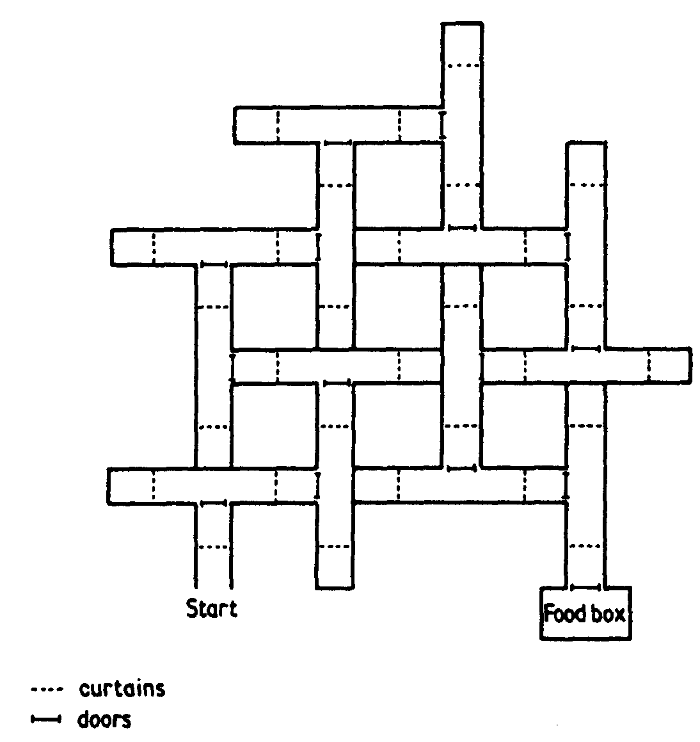
Latent learning
Tolman’s experiment (Tolman & Henzik, 1930)

Slide 29
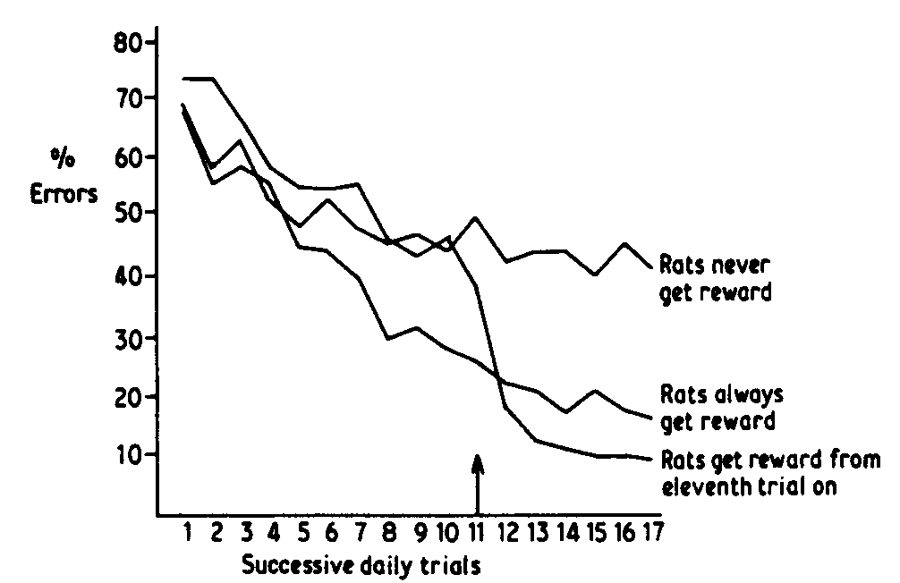
Latent learning
Tolman’s experiment (Tolman & Henzik, 1930)
  Three groups of hungry rats
  Learning may occur without reinforcement.

Slide 30
Insight learning
A form of cognitive change that involves recognition of previously unseen relationships.
  Köhler’s experiment: https://www.youtube.com/watch?v=FwDhYUlbxiQ

Slide 31
Observational learning
Modeling (Bandura, 1977): Learning based on observation of the behavior of another
  Bobo doll experiment (Bandura, Ross, & Ross, 1963): https://www.youtube.com/watch?v=eqNaLerMNOE
  Watching dramas
  Observing parents and friends

Slide 32
Observational learning
Stages of social cognitive learning
  Attention
    An observer pay attention to a model.
    Identification and characteristics of the model
  Retention
    Memory of events and behaviors
    Repeated exposures
  Initiation
    The observer produces the observed action.
    Skills and situations
  Motivation
    Whether the action is reinforced or punished.

