Slide 1
Topic 3
Human Development

Slide 2
Journey Questions
3.1 How do heredity and environment affect development?
3.2 Of what significance is a child’s emotional bond with adults?
3.3 How important are parenting styles?
3.4 How do children acquire language?
3.5 How do children learn to think?
3.6 Why is the transition from adolescence to adulthood especially challenging?

Slide 3
Journey Questions
3.7 How do we develop morals and values?
3.8 What are the typical tasks and dilemmas through the life span?
3.9 What is involved in well-being during middle and later adulthood?
3.10 What factors contribute most to a happy and fulfilling life?

Slide 4
Developmental Psychology
The study of progressive changes in behavior and abilities from conception to death.

Slide 5
Reaction Range
The Effects of Heredity and Environment on Human Development?
Reaction Range: The limits environment places on the effects of heredity.

Slide 6
Nature and Nurture
Reaction Range (cont.)
The Whole Person
The person’s development is determined by three factors: heredity, environment, and the person’s behavior.

Slide 7
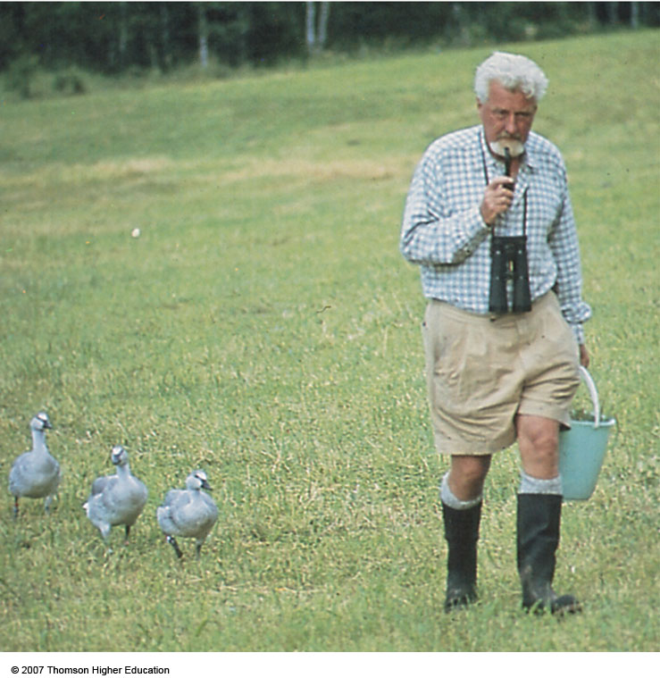
Imprinting (Lorenz)
p. 96
Notes:
“Mother” Lorenz leads his charges. The goslings have imprinted on Lorenz because he was the first moving object they saw after they hatched.

Slide 8
Nature and Nurture
Environment (cont.)
Sensitive Period
Sensitive Periods: A period of increased sensitivity to environmental influences; also, a time when certain events must occur for normal development to take place e.g. language development, attachment.

Slide 9
Nature and Nurture
Reaction Range (cont.)
The whole Peron (cont.)
New Born Temperament
Easy Children: 40 %; relaxed and agreeable
Difficult Children: 10 %; moody, intense, easily angered
Slow-to-Warm-Up Children: 15 % restrained, unexpressive, shy
Remaining Children: Do not fit into any specific category

Slide 10
Social Development
Social Development: Development of self-awareness, attachment to parents or caregivers, and relationships with other children and adults

Slide 11
Social Development (cont.)
Attachment
Emotional Attachment:
Close emotional bond that infants form with their parents, caregivers, or others.
  Separation Anxiety
Crying and signs of fear when a child is left alone or is with a stranger; generally appears around 8-12 months.

Slide 12
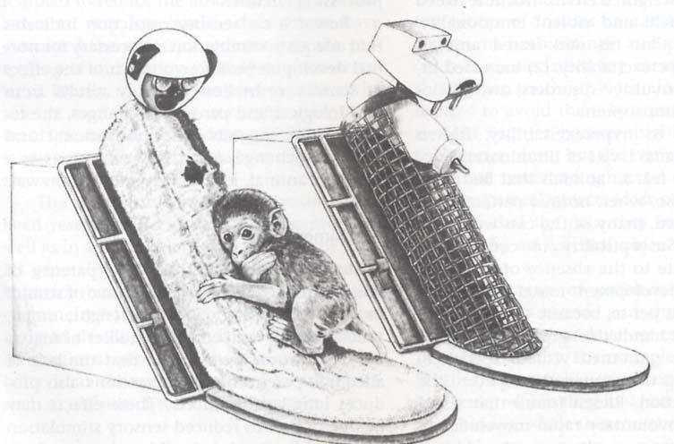

Slide 13
Social Development
Attachment (cont.)
Attachment Quality (Mary Ainsworth)
  Secure: Stable and positive emotional bond
  Insecure-Avoidant: Tendency to avoid reunion with parent or caregiver; anxious or emotional bond

Slide 14
Social Development
Attachment (cont.)
  Quality of Attachment (Mary Ainsworth)
  Insecure-Ambivalent: Desire to be with parent or caregiver and some resistance to being reunited; also anxious emotional bond

Slide 15
Parental Influences
Parenting Styles (Baumrind-1991, 2005)
1.Authoritarian Parents: Enforce rigid rules and demand strict obedience to authority; children tend to be emotionally stiff and lacking in curiosity.
2.Overly Permissive: Give little guidance, allow too much freedom, or don’t hold children accountable for their actions; children tend to be dependent and immature and frequently misbehave

Slide 16
Parental Influences
Parenting Styles (cont.)
3.Authoritative: Provide firm and consistent guidance combined with love and affection; children tend to be competent, self-controlled, independent, and assertive

Slide 17
Language Development
Cooing:
  Spontaneous repetition of vowel sounds by infants; at 6-8 weeks
Babbling:
  Repetition of meaningless language sounds (e.g., babababa); 7 months

Slide 18
Language Development
Single-Word Stage:
  The child says one word at a time
Telegraphic Speech:
  Two word sentences that communicate a single idea (e.g., “Want yogurt”)

Slide 19
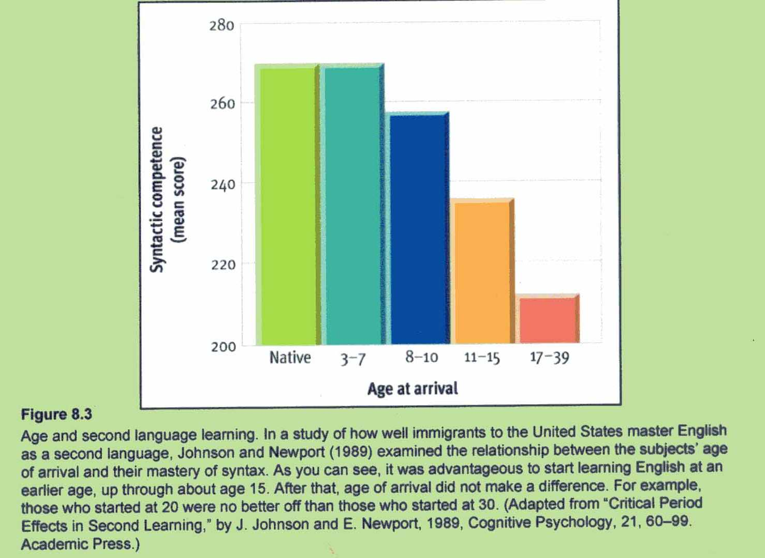
Learning Second Language

Slide 20
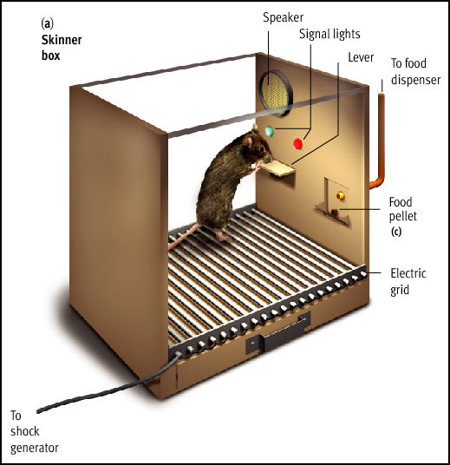
Explaining Language Development
1. Skinner - Learning Theory
- association, imitation, reinforcement

Slide 21
2. Language – acquisition Device (Linguist - Noam Chomsky)
Environment
provides input to
Genes design Psychological Behavior
mechanisms, (e.g.language)
including language
mechanism

Slide 22
Cognitive Development : Think Like a Child
Piaget’s Theory of Cognitive Development
Piaget believed that all children pass through a set series of stages during their cognitive development.

Slide 23
Cognitive Development : Think Like a Child
Piaget’s Theory of Cognitive Development (Cont.)
1.Sensorimotor (0-2 Years): All sensory input and motor responses are coordinated; most intellectual development here is nonverbal
  Object Permanence: After 8 months old, children know that objects still exist when they are out of sight.

Slide 24
Cognitive Development : Think Like a Child
Piaget’s Theory of Cognitive Development (Cont.)
2.Preoperational Stage (2-7 Years): Children begin to use language and think symbolically, BUT their thinking is still intuitive and egocentric.

Slide 25
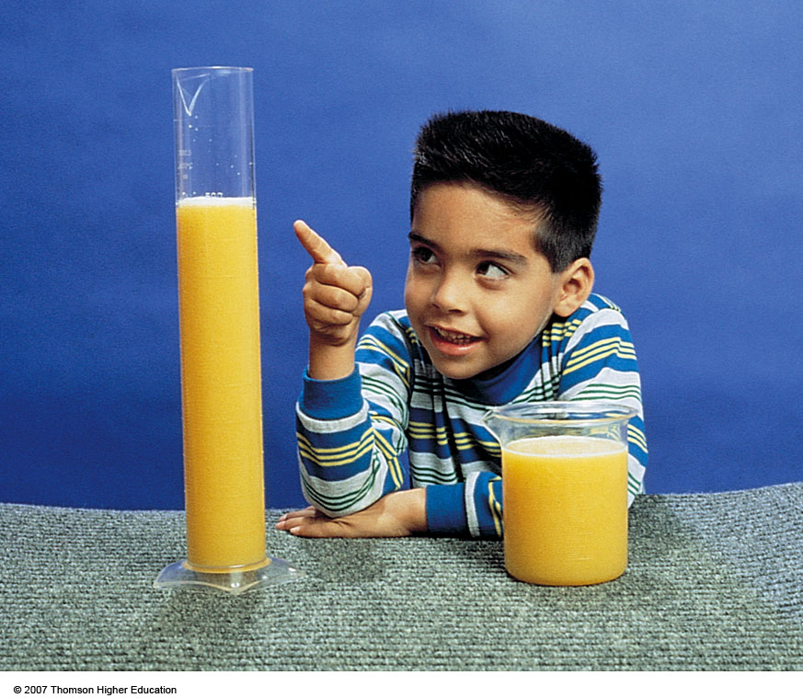
Fig. 3-17, p. 109
Notes:
Figure 3.17: Children younger than age 7 intuitively assume that a volume of liquid increases when it is poured from a short, wide container into a taller, thinner one. This boy thinks the tall container holds more than the short one. Actually each holds the same amount of liquid. Children make such judgments based on the height of the liquid, not its volume.

Slide 26
Cognitive Development : Think Like a Child
Piaget’s Theory of Cognitive Development (Cont.)
3.Concrete Operational Stage (7-11Years)
Children become able to use concepts of time, space, volume, and number BUT in ways that remain simplified and concrete, not abstract

Slide 27
Cognitive Development : Think Like a Child
Piaget’s Theory of Cognitive Development (Cont.)
  3.Concrete Operational Stage (Cont.)
  Reversibility of Thought: Relationships involving equality or identity can be reversed.
Conservation: Mass, weight, and volume remain unchanged when the shape or appearance of objects changes.

Slide 28
Cognitive Development : Think Like a Child
Piaget’s Theory of Cognitive Development (Cont.)
4.Formal Operations Stage (11 Years and Up)
Thinking now includes abstract, theoretical, and hypothetical ideas

Slide 29
Cognitive Development : Think Like a Child
Lev Vygotsky’s Sociocultural Theory
Children’s cognitive development is heavily influenced by social and cultural factors.
A child’s thinking develops through dialogues with more capable persons.

Slide 30
Cognitive Development : Think Like a Child
Lev Vygotsky’s Sociocultural Theory (Cont.)
Zone of Proximal Development
Range of tasks a child cannot master alone even though they are close to having the necessary mental skills; they need guidance from a skilled partner in order to complete the task.

Slide 31
Cognitive Development : Think Like a Child
Lev Vygotsky’s Sociocultural Theory (Cont.) Scaffolding
Framework or temporary support. Adults help children learn how to think by scaffolding, or supporting, their attempts to solve a problem or to discover principles
  Scaffolding must be responsive to a child’s needs

Slide 32
Adolescence and Young Adulthood Lawrence Kohlberg and Moral Development
Moral Development: When we acquire values, beliefs, and thinking abilities that guide responsible behavior
Stage theorist, like Freud and Erikson

Slide 33
Moral Development(cont.)
Basic Stages of Moral Development
Level 1: Pre-conventional Morality
Stage 1: Obedient and Punishment Orientation
Stage 2: Reward Orientation

Slide 34
Moral Development
Basic Stages of Moral Development (Cont.)
Level 2: Conventional Morality
Stage 3: “Good Boy” Morality
Stage 4: “Right” is what society defines as right. (conform to rules and laws)

Slide 35
Moral Development
Basic Stages of Moral Development (Cont.)
Level 3: Post-Conventional Morality
Stage 5: Individual Right, Self respect
Stage 6: Individual Principles & Conscience

Slide 36
The Story of a Lifetime
Etrikson’s Stages of Psychosocial Development
Stage
Trust and mistrust
Autonomy vs.shame and doubt
Initiative vs. guilt
Approx. Ages
Birth – 1½ yrs
1½ - 3
3 - 6

Slide 37
Erikson’s Stages of Psychosocial Development
Stage
Industry vs. inferiority
Identity vs. role-confusion
Intimacy vs. isolation
Approx. Ages
6 - 12
Adolescence (13-19)
Early adulthood

Slide 38
Erikson’s Stages of Psychosocial Development
Stage
Generativity vs. Stagnation
Ego integrity vs. despair
Approx. Ages
Middle adulthood
Late adulthood

Slide 39
Erik Erikson’s Eight Stages of Psychosocial Dilemmas

Slide 40
Stage One: Trust versus
Mistrust (Birth-1)
Trust: Established when babies given adequate warmth, touch, love, and physical care
  Mistrust: Caused by inadequate or unpredictable care and by cold, indifferent, and rejecting parents

Slide 41
Stage Two: Autonomy versus Shame and Doubt (1-3)
Autonomy: Doing things for themselves
Overprotective parents may cause children to doubt abilities and feel shameful about their actions

Slide 42
Stage Three: Initiative versus Guilt (3-5)
Initiative: Parents reinforce via giving children freedom to play, use imagination, and ask questions
Guilt: May occur if parents criticize, prevent play, or discourage a child’s questions

Slide 43
Stage Four: Industry versus Inferiority (6-12)
Industry: Occurs when child is praised for productive activities
Inferiority: Occurs if child’s efforts are regarded as messy or inadequate

Slide 44
Stage Five (Adolescence): Identity versus Role Confusion
Identity: For adolescents; problems answering, “Who am I?”
Role Confusion: Occurs when adolescents are unsure of where they are going and who they are

Slide 45
Stage Six (Young Adulthood): Intimacy versus Isolation
Intimacy: Ability to care about others and to share experiences with them
Isolation: Feeling alone and uncared for in life

Slide 46
Stage Seven (Middle Adulthood): Generativity versus Stagnation
Generativity: Interest in guiding the next generation
Stagnation: When one is only concerned with one’s own needs and comforts

Slide 47
Stage Eight (Late Adulthood): Integrity versus Despair
Integrity: Self-respect; developed when people have lived richly and responsibly
Despair: Occurs when previous life events are viewed with regret; experiences heartache and remorse

Slide 48
Death and Dying
Reaction to Impending Death
Kubler-Ross was a thanatologist: One who studies emotional and behavioral reactions to death and dying

Slide 49
Death and Dying
Reaction to Impending Death (Cont.)
1.Denial and Isolation: Denying death’s reality and isolating oneself from information confirming that death will occur: “It’s a mistake; the doctors are wrong.”
2. Anger: Asking “Why me?” Anger may then be projected onto the living.

Slide 50
Death and Dying
Reaction to Impending Death (Cont.)
3.Bargaining: Terminally ill will bargain with God or with themselves: “If I can live longer I’ll be a better person.”
4.Depression: Feelings of futility, exhaustion, and deep sadness
5.Acceptance: If death is not sudden, many will accept death calmly: person is at peace finally with the concept of death.

Slide 51
Reading Assignment
Well-Being and Happiness—What Makes a Good Life? pp. 105 – 107.

