Slide 1
THE DEBACLE
OF LTCM

Slide 2
OVERVIEW
What is LTCM?
A hedge fund called Long Term Capital Management founded in 1994

Slide 3
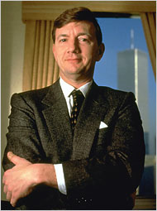
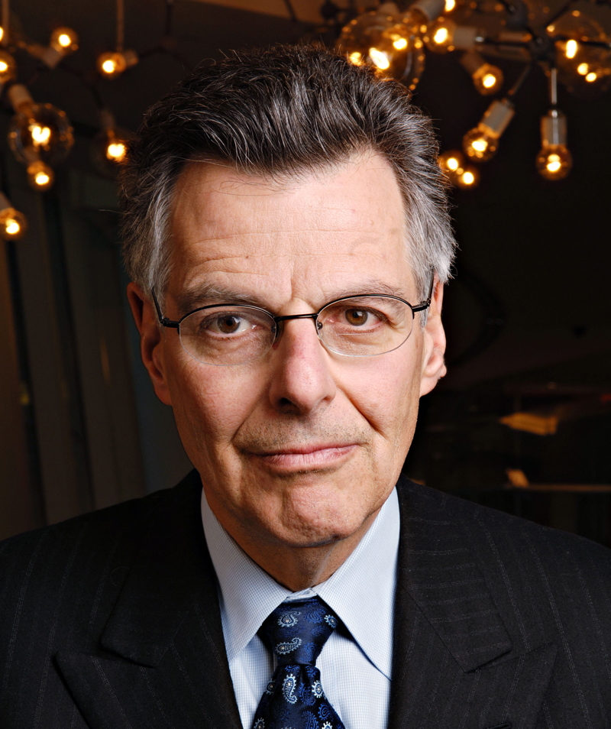
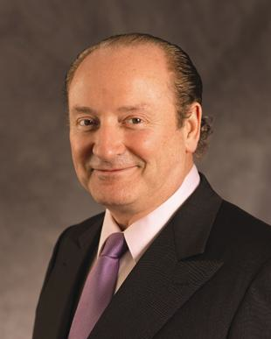
FOUNDERS
John Meriwether
Myron Scholes
Robert Merton
Famous Bond
Trader
Nobel-Prize Winner
Nobel-Prize Winner
Seemingly Credible
Attracted Sophisticated Investors

Slide 4
PERFORMANCE
Performed well up until early 1998
- Portfolio Value > $100 Billion
- NAV around $4 Billion
The portfolio under LTCM's control amounts to well over $100 billion, while net asset value stands at some $4 billion; its swaps position is valued at some $1.25 trillion notional, equal to 5% of the entire global market.
t had become a major supplier of index volatility to investment banks, was active in mortgage-backed securities and was dabbling in emerging markets such as Russia
Big player in the global market
Swap position around $1.25 trillion notional
Major supplier of index volatility to IBs
Presented in emerging market e.g. Russia
Notes:
The fund was profitable pre 1980.
The portfolio under LTCM's control amounts to well over $100 billion, while net asset value stands at some $4 billion;
its swaps position is valued at some $1.25 trillion notional, equal to 5% of the entire global market

Slide 5
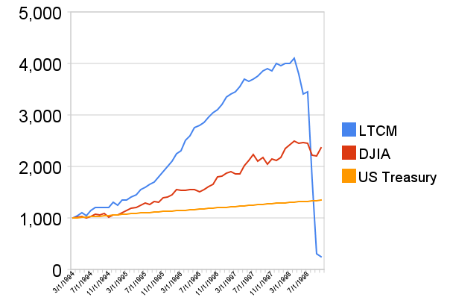
THE DEBACLE
Aug 98
Russia devalued the Ruble
and declared a moratorium
Flight to quality
The Value of $1000 Investment
E
Severe
liquidity crisis
Equity
Fed arranged for banks to inject the fund and take over management
Dissolve in Early 2000s
Notes:
17 August 1998: Russia devalues the ruble and declares a moratorium on 281 billion rubles ($13.5 billion) of its Treasury debt. The result is a massive "flight to quality", with investors flooding out of any remotely risky market and into the most secure instruments within the already "risk-free" government bond market. Ultimately, this results in a liquidity crisis of enormous proportions, dealing a severe blow to LTCM's portfolio.

Slide 6
KEY ISSUES

Slide 7
LTCM’S MAIN STRATEGY:
CONVERGENCE TRADE
Find Securities that were mispriced relative
to one another
Long the underpriced securities
Short the overpriced securities
Spread are often tiny.
Took large and highly leveraged positions
to make significant profit~ 30-40 times
Debt-to-equity ratio over 25:1
Notes:
Buy underprices + sell overprice and hope that price converges to true price by the time asset must be delivered
EXAMPLE: U.S., Japan and European bonds, IR swaps, equity options
4 main types:
1 Convergence among US, Jap, European sovereign bond
2 “------------------------” European Sovereign bond
3 “------------------------” on-the-run, off-the-run US govt bond
4 Long position in emerging markets sovereign, hedged back to dollar

Slide 8
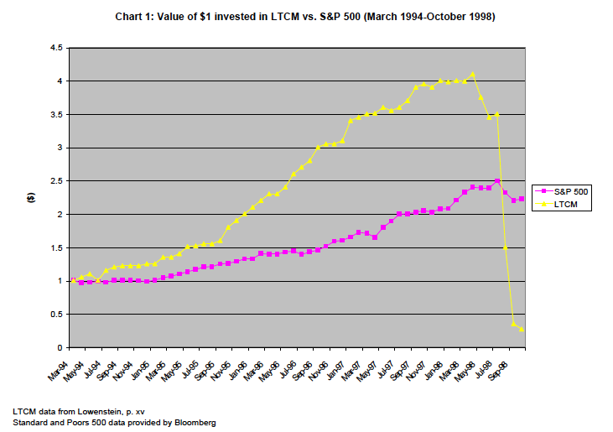
THE TURNING POINT

Slide 9
THE TURNING POINT
In Aug 1998, Russia suddenly devalued its currency and declared default on its debt.
Triggering a widespread disruption in the global
financial market.
Investors seek for safer and more liquid investments
Faced difficulty liquidating its illiquid positions
The fund lost 44% of its capital in August alone
D/E ratio was 45:1 and

Slide 10
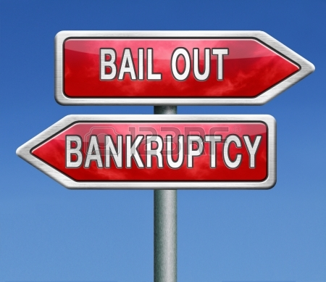
THE COLLAPSE
This leads to the collapse of the Long-Term Capital Portfolio L.P., in the late 1990s
  $3.6 billion bailout under the supervision of the Federal Reserve.

Slide 11
Breakdown of
Root of the Problem
Investor/Counterparties
LTCM
Regulators

Slide 12
INVESTOR/COUNTERPARTIES
Blinded by reputation….
noble laureates and another big name in FN
  Insufficient risk management and too heavy reliance on collateral
    LTCM was not required to put initial margin
    They did not take into account ‘other’ counter parties position and compromised the risk management measures
  Relationship between investors and LTCM
  Both institution’s money and top level people’s
  Attacked by other parties in attempt to buy (e.g. AIG)

Slide 13
LTCM
Very Highly Leveraged!
No need for initial margin and thus are essentially able to leverage up to infinity!
    Off balance sheet of $1 trillion (use swap to reverse swap position, nor unwind)
    $125 billion in asset on capital of $4 billion (leverage of ~30 times!)
Excessive Risk
  Go for everything
  >> MBS, Equities, Emerging Market

Slide 14
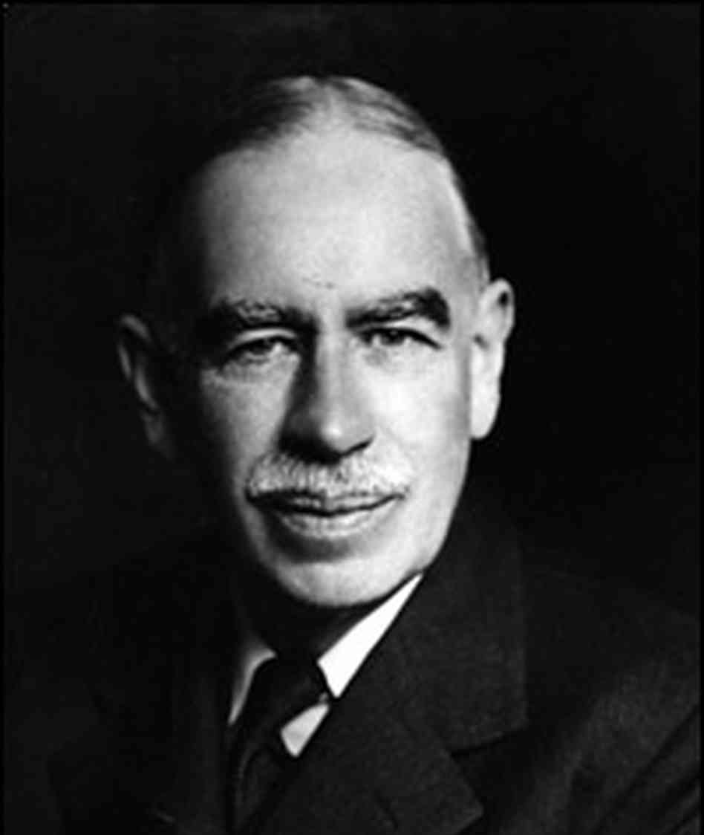
LTCM
Rely too heavily on the model & theory
  Actually not flawless, market can be distorted for a long time
    Model cannot really predict such irrational behavior where market is so highly correlated (sufficiently diversified assumption)
    Should have relied more on stress test
“Markets can stay irrational longer than you can stay liquid.”
-John Maynard Keynes

Slide 15
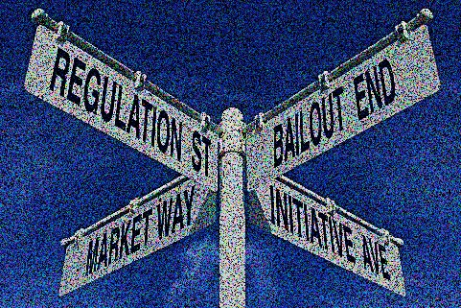
REGULATOR
Very lightly regulated
(more or less unregulated)
  Operated in virtually every market they wanted without capital charges
  Only little report requirement to SEC
  Implication of Moral Hazard?
  >>Because of its size, LTCM might expect fed
  to bail them out

Slide 16
WHAT HAVE BEEN DONE SO FAR?

Slide 17
TWO ALTERNATIVES FOR LTCM
1st Offer: Buffett’s Deal
Fund manager need to be fired
2nd Offer: FED’s
Consortium Deal
REFUSED
Existing shareholders lost everything
Managers remain their positions
3.5 billion as capital
10% retain holding
250 million dollars for shareholder
400 million dollars for the fund

Slide 18
WHAT HAVE BEEN DONE SO FAR?
Federal Reserve Bank of New York President William J. McDonough convinced 15 banks to bail out LTCM
  >> $3.5 billion, in return for a 90% ownerships
  of the fund
>> Helped by recovering financial markets, the
portfolio gained 13% to December 1998.

Slide 19
WHAT HAVE BEEN DONE SO FAR?
Since the bailout, the risk profile has been halved.
LTCM is now operating under the control of a 14-member consortium; formally known as Oversight Partners I LLC.

Slide 20
WHAT HAVE BEEN DONE SO FAR?
Fed started lowering the Fed funds rate as a reassurance to investors
>>Between September and November 1998,
Fed cut rates by 75 basis points.

Slide 21
CRITIQUE ON
COURSES OF ACTION

Slide 22
PRIVATE SECTOR OR FED BAILOUT?
FOR
AGAINST
  Fragile financial markets in Sept 1998
  If it is private sector, why did Fed get involved at all?
  Greenspan’s error: 1907 crisis was resolved by private-sector parties operating on their own
  McDonough: Private sector solution as not one penny of public money was spent or committed
Notes:
McDonough defended the rescue package as “a private sector solution to a private-sector problem, involving an investment of new equity by Long-Term Capital’s creditors and counterparties.”
Greenspan echoed that argument and claimed that the LTCM episode was one of those “rare occasions” when financial markets seize up and “temporary ad hoc responses” are required.

Slide 23
THE NECEESSITY OF FED INTERVENTION
AGAINST
FOR
Without Fed,
Buffett ‘s offer will be accepted.
To prevent adverse effects on financial markets
negative impact on derivatives
≠ global liquidity crisis
unsettled global economy
“Throwing LTCM to the wolves would have strengthened financial markets rather than weakened them”
creditors fire-sale liquidation
severe drying up of market liquidity
JUSTIFIED BUT NOT NECESSARY

Slide 24
Critique on courses of action
Krugman’s Criticism
  Rate cuts during the LTCM collapse were implemented when the real economy showed no signs of stress.
LTCM Spokesman:
“THE BOYS ARE VERY HAPPY TODAY”
  Fed had an intention of helping wealthy speculators out of a hole and the shareholders emerge unscathed.

Slide 25
CONSEQUENCES
1. Massive Extension Responsibilities
Fed accepts responsibility for hedge funds but no power over them
“Heads they win, tails the Federal Reserve loses.”
2. The Return of Too Big to FAIL “Moral Hazard Problem”
- disincentive to maintain their own financial health
- shortly calm markets with long run undermines financial
stability
“Federal Reserve lost faith to take their own medicine”

Slide 26
WHAT WAS THE BETTER ALTERNATIVE?
>>PRIVATE SOLUTION

Slide 27
NO ECONOMIC MELTDOWN
Financial markets could have absorbed the shock of LTCM without collapse.
  The amount of capital in the markets was in the trillions of dollars.
  Big derivatives players’ loss would have an impact only on the markets in which they was very active.
  Firms’ “true” exposures may be only a small fraction of what they appear to be.

Slide 28
REDUCE MORAL HARZARD
Send out the message that no firm could expect to be rescued from its own mistakes.
  Ensure the strong incentives to promote their own financial health and to avoid excessive risk taking
  The best incentive of all is the fear of dire consequences.
Notes:
“Throwing LTCM to the wolves would have strengthened financial markets rather than weakened them”

Slide 29
RAISE AWARENESS
Throwing LTCM to the wolves would also raise awareness among creditors.
  They would learn to limit the loan issued to investment firm.
  Also, more caution would be exercised before giving a credit to ensure quality.

Slide 30
Promote MARKET efficiency
If there had been no other offers, LTCM would probably had to accepted the Buffett offer.
  The net effect was a better deal for LTCM at the expense of Buffett to make a profit.
“Hence, if Fed let private sector do its job, lower resource would be used to solve the problem; encouraging market efficiency.”

Slide 31
THANK
YOU

Slide 32
MEMBERS
1. Miss Kamolmas Kantaopas 5404640343
2. Miss Koranit Chomchan 5404640376
3. Miss Natthacha Thongkham 5404640566
4. Mr. Phattaris Sittikul 5404640780
5. Miss Pimala Thitadilok 5404640855
6. Miss Thitiporn Siricururatana 5404641374

