Slide 1
AD-AS Model
Part 2

Slide 2
Revision – Aggregate Demand
AD is the total demand for final goods and services in an economy at a given time. It specifies the amounts of output that will be purchased at all possible price levels.
Why is AD downward-sloping? It is due to “interest rate”.
P↑ >> M/P↓ >> i↑ >> I↓ >> AE↓ >> Y↓
What causes shifts in AD?
Any “non-price” factor that shifts IS-LM, shifts AD.
  Autonomous C and I
  Fiscal Policy (G and T) and Monetary Policy (M)

Slide 3
Aggregate Supply (AS)
AS is the total supply of output that firms in an economy plan to sell during a specific time period.
It specifies the amounts of output that will be supplied at all possible price levels.
AS is a relationship between P and Y.
P is Price Level.
Y is Real Output.

Slide 4
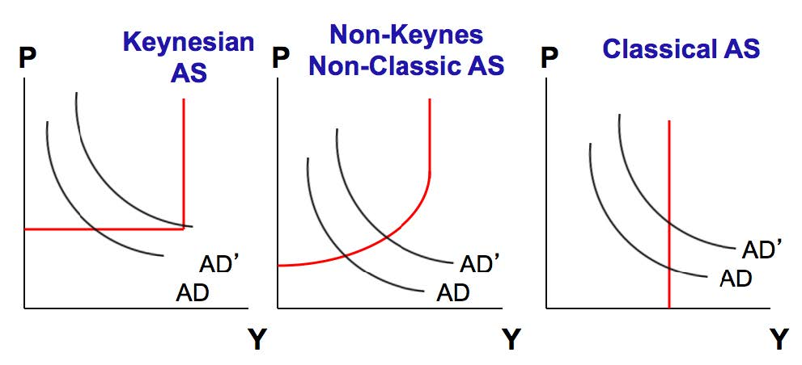
Three “Original” AS Curves
To remove differences from these three concepts, economists have merged their ideas together to form
1) Short-run AS and 2) Long-run AS.

Slide 5
EXTRA – The Three AS Curves
(LEFT DIAGRAM) The Keynesian AS curve assumes that prices and wages are fixed until full employment is reached. Over the ‘Keynesian range’, there is spare capacity in the economy, the price level is stable, and real output can expand as a result of increases in AD without any inflationary pressure (i.e. price level does not rise).
(RIGHT DIAGRAM) The Classical view of real output was that it was fixed at a particular level. At this level, all the factors of production in the economy would be fully employed.

Slide 6
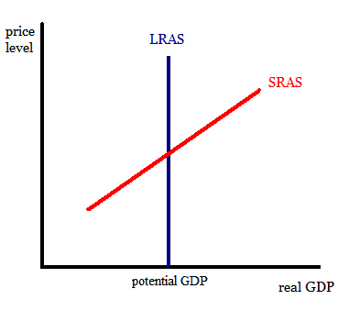
Two “current” AS curves
Note that LRAS = Classical AS.

Slide 7
Short-run and Long-run
In Short Run, at least one factor of production is fixed.
  Output is NOT at the full-employment level.
  Price and wage are sticky >> unemployment.
In Long Run, all factors of production are variable
  Output is at the full-employment level.
  Price and wage can change.

Slide 8
Short-run Aggregate Supply
There are three theories that can be used to derived the SRAS curve:
  Sticky price theory
  Sticky wage theory (we will study this one)
  Misperceptions theory
All of these theories explain why SRAS is upward-sloping.

Slide 9
Deriving SRAS – Sticky Wage
In short run, “NOMINAL” wage is sticky (due to labor contracts), and there is unemployment.
How many people are employed depends on “Labor Demand” which is then determined by the profit-maximizing firms.
Profit Maximization: MC = MR.
Labor Demand: W = P x MPL or W/P = MPL
W = Nominal Wage and MPL = Marginal Product of Labor
Note that W is CONSTANT.

Slide 10
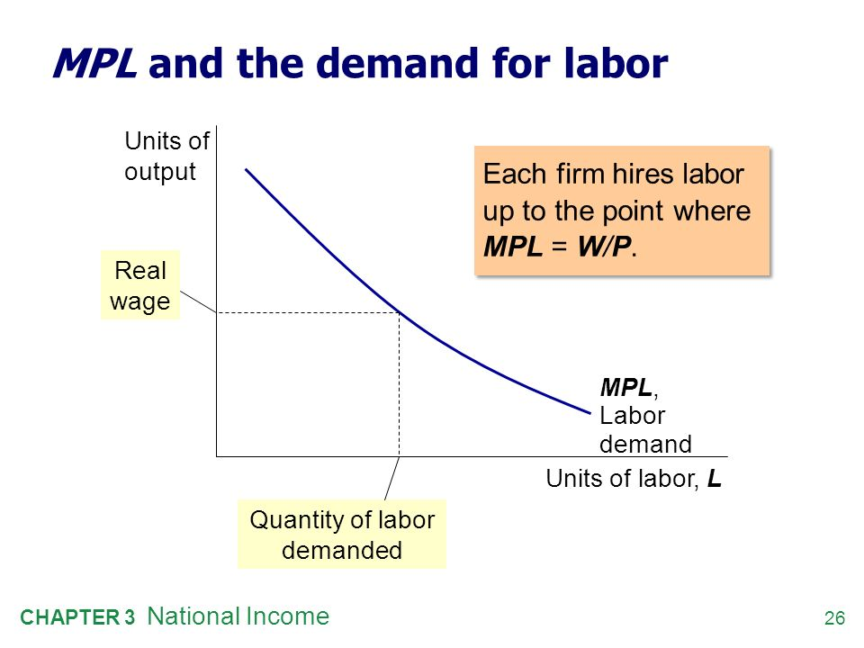
Real wage,
W/P
High MPL
at Low L

Slide 11
EXTRA – MPL
MPL or Marginal Product of Labor tells us about the “productivity” of labor.
It is the change in output that results from employing an additional unit of labor.
When few workers is hired, adding one extra worker gives a lot of additional output.
That is, at low L, we have high MPL (see Previous Page).
MPL is characterized by the “Law of Diminishing Return”.

Slide 12
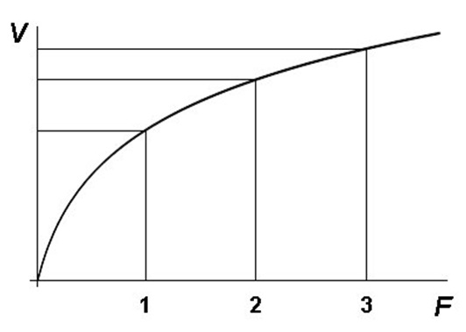
EXTRA – MPL
MPL is characterized by the “Law of Diminishing Return”.
Law of Diminishing Return states that
  In short run (where capital is fixed), when additional labor is hired, the addition output from the extra labor will increase at the decreasing rate.
Output
Additional output from additional labor
Labor

Slide 13
Deriving SRAS – Sticky Wage
The profit-maximizing firms choose how many people to employ according to W/P = MPL.
Given the FIXED capital (due to being in Short Run), the number of labor determines output of the economy.
N = L
= Labor

Slide 14
Deriving SRAS – Sticky Wage
As Price increases, Real Wage falls, inducing firms to hire more labor and increase Output.
P↑ >> W/P↓ >> Labor Demand↑ >> L↑ >> Y↑
Thus, SRAS shows the positive relationship P and Y.
N = L
= Labor

Slide 15
Shifts in the SRAS
The SRAS can shift from the following factors:
Nominal Wage (higher W >> SRAS shifts left)
  W↑ >> W/P↑ >> Labor Demand↓ >> L↓ >> Y↓
Capital Stock (including human capital)
Natural Resource
Technology (i.e. higher productivity of labor raises demand for labor)

Slide 16
Long-run Aggregate Supply
In long run, output is at the full employment level.
LRAS does not depend on Price, and hence is vertical.

Slide 17
Long-run Aggregate Supply
In long run, wage is no longer sticky.
Wage adjusts to clear the labor market.
When price increases, nominal wage also increases (workers can negotiate for higher wages), leaving the real wage and hence demand for labor unchanged.
Given that the firms do not hire additional labor, the output remains the same.
Thus, Price Level does not affect Output.

Slide 18
Shifts in the LRAS
The LRAS can shift from the following factors:
Population and Labor
Capital Stock (including human capital)
Natural Resource
Technology

Slide 19
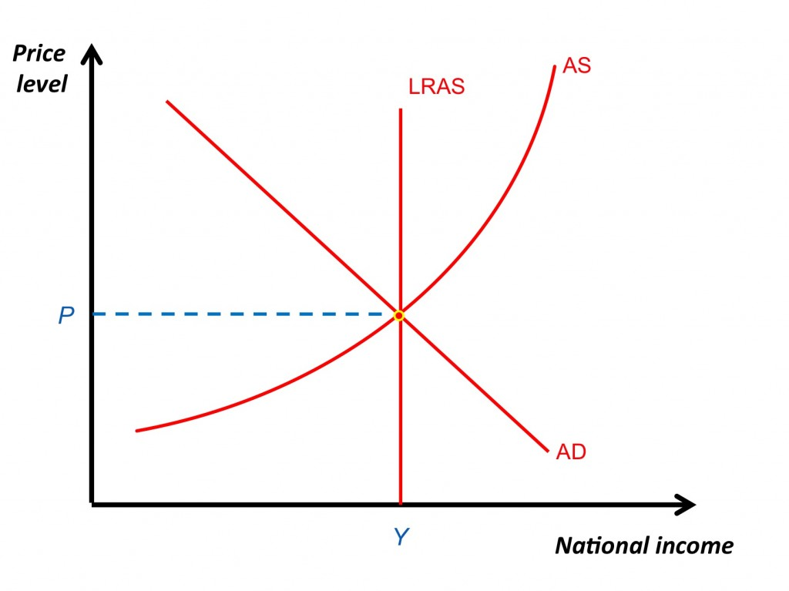
Equilibrium of AS-AD Model

