Slide 1

Team members:
1. 5504640748 Nattachon Chujiravong
2. 5504641480 Runn Decharit
3. 5504641597 Sawaros Sasanarakkij
4. 5504641605 Shusidth Volyarngosol
5. 5504641654 Siritipa Suwanpol
6. 5504641977 Theenida Mahathanapat

Slide 2
What is Bancassurance?
Banque (Bank) + Assurance (Insurance)
An arrangement in which a bank and an insurance company form a partnership so that the insurance company can sell its products to the bank's client base

Slide 3
Types of Bancassurance
1. Sales alliance
- Bank acts as an intermediary for an insurance company.
Insurance
Bank

Slide 4
Types of Bancassurance
2. Affiliated company
- Banks establish an insurance affiliated company on their own, and also run the insurance business.
Bank
Insurance
(Affiliated company)

Slide 5
Types of Bancassurance
3. Joint venture
- The creation of new insurance company by the cooperation of existing insurance company and the bank.
Insurance company
Establish insurance company
Bank

Slide 6
Benefits of Bancassurance
Bank
Insurance company
Make more customers or clients
Customers
More value products
Be more attractive
Optimizes the use of the network
Strengthen competitive pressure
Reducing risk and increase opportunities
Bank images
Quickly establish : existing banking network
Saving time
Earn more profit

Slide 7
Products of
Bancassurance
Bancassurance
Life
insurance
Non-life insurance

Slide 8


Slide 9
Life Insurance
3 Kinds of life insurance
Ordinary Life
-> Term Life Insurance
-> Endowment
-> Whole Life Insurance
-> Annuities Insurance
Industrial Life Insurance
Group Life Insurance

Slide 10
Kinds of life insurance:
Ordinary Life
Insurance on the life of the insured for a fixed amount at a definite premium that is paid each year in the same amount during the entire lifetime of the insured
Need high amount of sum insured
Suitable for people with medium level of income

Slide 11
Ordinary Life Insurance:
Term Life Insurance
Both short term and long term maturity.
Paying back the sum insured to the beneficiary if the insured passes away during the contract.
Suitable to people who concern about premature death or who have to work abroad for a number of years.
Premium can be paid at a low price.
Covers for medical care.

Slide 12
Ordinary Life Insurance:
Endowment Life Insurance
Similar to savings.
Numbers years to pay premium are less than the coverage maturity, but some are paid equally.
Receive payments as returns for numbers of periods and a lump sum until its maturity or on premature death.

Slide 13
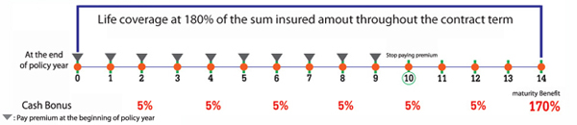
Kasikorn Pro Saving 10/14 from Kasikorn Bank
Main Example of
Endowment Insurance

Slide 14
Ordinary Life Insurance:
Whole Life Insurance
Remain in force for the insured's whole life
Requires premiums to be paid every period into the policy.
Mostly the money will be paid back
-> To the Beneficiary when the insured has already passed away or
-> To the insured when he or she has an age according to each policy
Suitable for pillar of the family

Slide 15
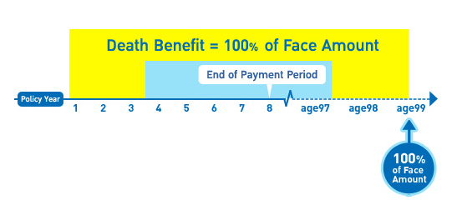
TMB Better Life 99/8 from Thai Military Bank
Main Example of
Whole Life Insurance

Slide 16
Ordinary Life Insurance:
Annuities Insurance
Annuitant pays into the annuity on a periodic basis when he or she is still working.
When the annuitant retires , the annuity will periodic payout money until the death of annuitant.
However, annuitant may also buy the annuity product in one large purchase.

Slide 17
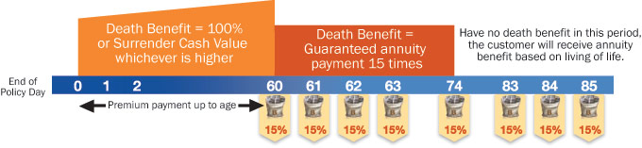
Krungthai-AXA Bumnan Suk (SI85) from Krungthai-AXA
Main Example of
Annuities Insurance

Slide 18
Ordinary Life Insurance:
Annuities Insurance
The premium calculation of annuity insurance is not the same as the premium calculation of other type of life insurances.
The company or bank needs to use different rate for annuity insurance by considering both age and gender.
As female tends to live longer than male so female tends to get more annuity.

Slide 19
Kinds of Life Insurance:
Industrial Life Insurance
It is a policy on the life of an individual.
The premiums are collected regularly by the agent of the assurance company.
Suitable for people who works in the factory since it requires low amount of sum insured and already includes the accidental insurance
No need for medical checkup but instead it has a condition about the waiting period
Notes:
The coverage will not start immediately but the person needs to wait for 180 days. If that person has passed away during the waiting period, the assurance company needs to pay back the premium to the heir.

Slide 20
Kinds of Life Insurance:
Group Insurance
A contract for the members or employees of the firm.
Contract held by a firm or employer.
Equally premium level to all members in the group.
Every cause of death is covered, except the suicide in first year of the contract or intentionally killed by the beneficiary.

Slide 21
Coverage for each type of life insurance
Coverage /Type | Term Life | Endowment | Whole Life | Annuities | Group Insurance
Pass away | / | / | / | / | /
Cost of medical care | / | X | X | X | X
Handicapped/ disabled | / | X | X | X | X
Hospital benefit | depends | X | X | X | X
Return during the contract | X | / | depends | X | X
Full Face Amount + accrued Bonus | X | / | / | / | X
Pension | X | X | X | / | X
Tax deduction | / | / | / | / | /

Slide 22
Summary
Needs | Suitable insurance
Death coverage Short term coverage No money return Low premium payment | Term life insurance
Death coverage with savings Long term coverage Money return | Endowment
Death coverage Whole life coverage Low premium payment Money return | Whole life insurance
Emphasize on coverage on life until the retirement Have fund to use after the retirement | Annuities

Slide 23


Slide 24

Kinds of Non-Life Insurance:
Motor Insurance
purchased for cars, trucks, motorcycles, and other road vehicles.
provide financial protection
- physical damage and/or bodily injury resulting from traffic collisions
- liability that could also arise there from the specific terms of vehicle insurance vary with legal regulations in each region.

Slide 25
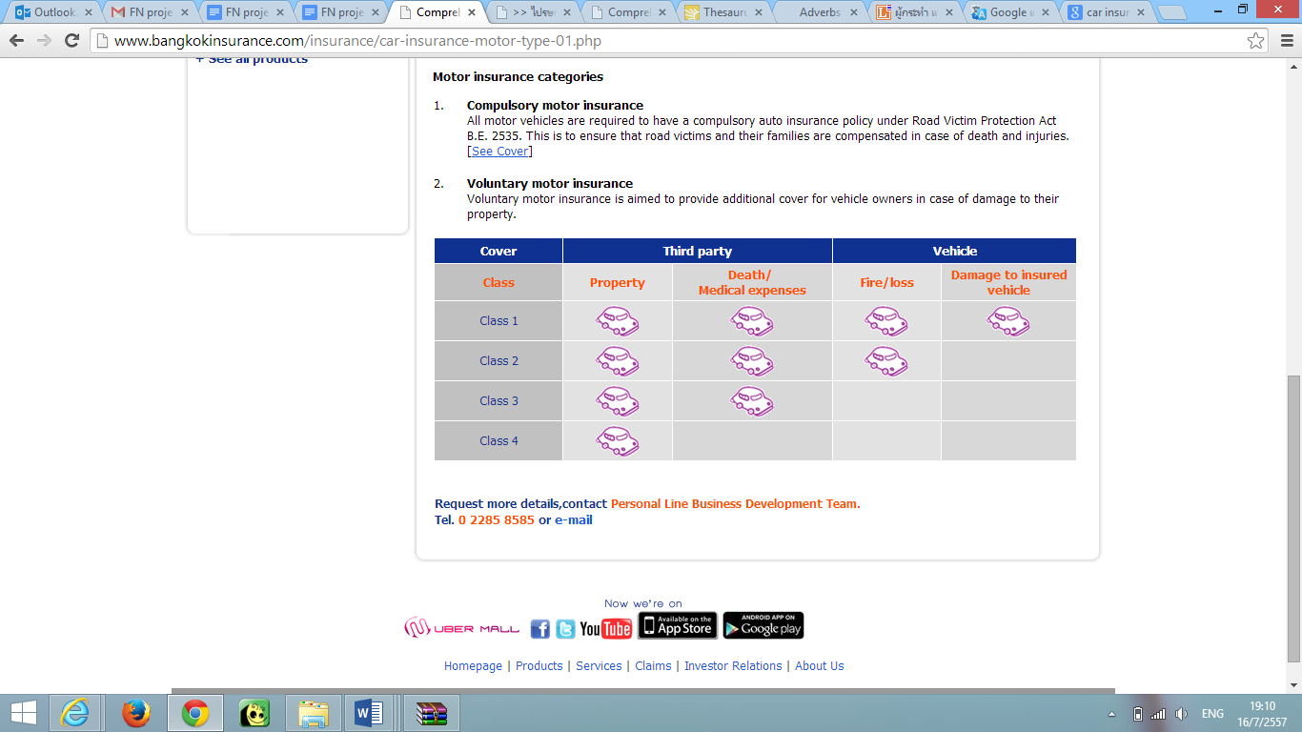
Types of Motor
Insurance Coverage

Slide 26
Kinds of Non-Life Insurance:
Motor Insurance

Slide 27

Main Example of
Motor Insurance
Thanachart Bank → Thanachart Insurance
“First Class”
“One Lite”
“Two Plus”
“Two Plus Gold”

Slide 28

Kinds of Non-Life Insurance:
Health Insurance
Insurance against the risk of incurring medical expenses among individuals.

Slide 29

Main Example of
Health Insurance
Bualuang Rak Khun from Bangkok Bank
Age of insured person: 16-65 years
‘Enjoy financial peace-of-mind while recovering as every time you are admitted to hospital we will compensate you for loss of income. Premiums start from 750Bt.’

Slide 30
Main Example of
Health Insurance
Great Features
- Pays compensation when you are admitted to hospital due to an accident for a maximum of 30 days per accident, with an unlimited number of admittances each year
- Covers you in case of loss or injury from natural disasters

Slide 31

Main Example of
Health Insurance
Cancer Protection 1st
provides cover for illness due to cancer
Payment of 100% of the sum insured is paid promptly
need to be insured for no less than 90 days before making a claim
must not have been diagnosed with cancer previously.

Slide 32
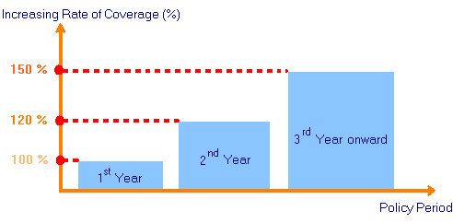
Main Example of
Health Insurance
Coverage can be increased to 120% of the sum insured in the second year and to 150% in the third year.

Slide 33

Kinds of Non-Life Insurance:
Property Insurance
Contract or Policy
Risk reduction on specific thing
Compensation
Replacement value or actual value
Depend on the contract

Slide 34

Kinds of Non-Life Insurance:
Property Insurance
Type of property insurance
All-Risks Insurance
Named Perils Insurance
Fire Insurance
    Industrial Fire Insurance
    Residential Fire Insurance
Business Interruption Insurance

Slide 35
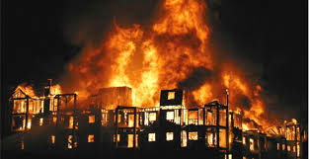
Property Insurance:
Fire Insurance

Slide 36
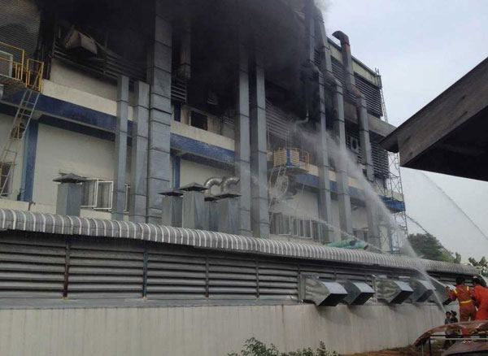
Property Insurance:
All risk and Named Perils

Slide 37

Property Insurance:
Business Interruption Insurance

Slide 38
Example of Fire Insurance by
Kasikorn Bank
Coverage
    Fire, Lightning, Explosion, Water Damage, and etc.
    Theft: Compensation less than 100,000 per year
Indemnity: 300,000 baht
Credit Shield: Indemnify the outstanding debt by 50,000 baht
Compensation for funeral expenses: 10,000 baht

Slide 39
Kinds of Non-Life Insurance:
Marine Insurance
Definition: Coverage against loss of or damage to a ship; and in-transit cargo loss or damage over waterways, land, and air.
2 types:
  1. All risk insurance: Cover all accidental loss included Cargo Insurance
  2. Named Perils Insurance: Cover only accidental loss of insured asset from collision, fire, and etc.

Slide 40
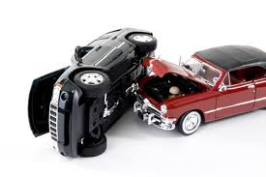
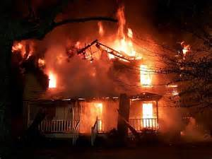

Kinds of Non-Life Insurance:
Miscellaneous Insurance
Definition: It includes various kinds of insurance other than Motor, Fire and Marine Insurance.
A special feature: cover many unrelated branches.

Slide 41

Main Example of
Miscellaneous Insurance
Asset Protect from Kasikorn Bank
Coverage
  Loss or damage to the insured premises, including homes, home offices, offices in buildings and stores across the country caused by Theft.

Slide 42

Main Example of
Miscellaneous Insurance
Travel Protection from Kasikorn Bank
Strong points:
1. 24-hours coverage during the trip
2. Person age between 1-70 years is insurable
3. Not cover in some countries such as NORTH KOREA, CUBA, SYRIA, AFGHANISTAN
4. No medical examination required

Slide 43

Main Example of
Miscellaneous Insurance
CIMB Thai ATM Card Jeb Mai Tong Jai with Personal Accident Insurance
ATM card with personal accident and medical expenses
Coverage worldwide
Available 24 hours
No advance payment

Slide 44
Card Type | Basic (THB) | Premium (THB)
Loss of life, organ eyesight, permanent disability from general accidents | 100,000 | 1,000,000
Death, dismemberment loss of sight, speech, or hearing, or permanent disability caused by riding or being a passenger of motorcycle | 100,000 | 500,000
Death, dismemberment loss of sight, speech, or hearing, or permanent disability caused by murder and ambush | 100,000 | 500,000
Medical expense per accident | 10,000 | 20,000
Daily Hospital Benefit for admission in hospital (in-patient) from accident. (Max 365 days per accident) | - | 1,000

Slide 45


Slide 46


