Slide 1

BA 291 – Business Plan
By Aj. Parichat Jantori

Slide 2

Business Plan
A business plan is…
“A comprehensive planning document which clearly describes the developmental objectives of an existing or proposed business. The plan outlines what and from where the resources needed to accomplish with the objective will be obtained and utilized.”

Slide 3
The benefits of a business plan
For external use
Business plan is a key document when you are looking for business funding - whether applying for an overdraft or looking for new investment or capital. It helps investors and lenders understand your business, explain how you are going to spend the invested or borrowed money and set out how this will benefit both them and the business
For internal use
Business plan guides direction. It commits the entire management to the same goals and provides the roadmaps what to be done and how the resource should be allocated.

Slide 4

The initial of business plan
The fundamental questions
What are the long-term goals of your company? And the near-term?
What do you wish to gain form your business plan?
Who is your audience and what do they need?
A business plan serves a number of purposes and you may have to modify information depending on your target audience

Slide 5
Tailor your business plan to the target audience
Your bank will be interested in:
how you intend to repay a loan or overdraft
what you are going to do with the money
how the loan will help the business to grow
what other loan or debt commitments you have
Your investment funds will be interested in:
Your management track records – the company, the market, the key executives
The feasibility of achieving business goals and profits
The expected return

Slide 6
Tailor your business plan to the target audience
Common reasons why business plans and loan applications fail include:
a weak management team
a flawed marketing plan
unrealistic forecasts
incomplete financial history
poor presentation
Keep in mind: Business plan must be clear, concise and convincing.

Slide 7
Preparation steps for writing business plan
Gathering the right data
Business plans are only effective as the data on which they are based
The writing process will becomes much easier and quicker, if certain data is available before writing begins
The key data include
company description, management and organization, market and competitors, products and services, financial information
Where can I get these data?
use primary source, secondary source

Slide 8
Preparation steps for writing business plan
2. Outline the plan
The business plan should be well organized.
A clearly defined sections covering the different aspects of the company is necessary
Outlining also requires to the executive to understand the level of detail

Slide 9
Preparation steps for writing business plan
3. Determining the scope of the business plan
The length of the business plan
The depth of the business plan
There are 3 kinds of business plan
A summery plan: contain the business information which enough to convince investors, 10-15 pages
A full business plan: spell out a company’s operation and projects in details, 20-40 pages, typically for financial purposes
Operational business plan: serve as a blueprint for company operations and used as a guidance for managers

Slide 10
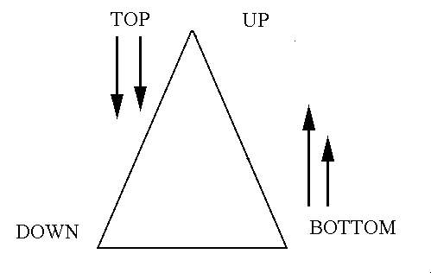
Preparation steps for writing business plan
4. Designing the responsibility
- Design how to prepare the business plan – use top-down approach or bottom-up approach

Slide 11
The key elements of business plan
Executive summery
Company description
Management and organization
Industry and market analysis
Competitor analysis
Product and services (operational issues)
Marketing strategy
Financial plan

Slide 12
The executive summery
The most significant single section of the business plan
describes all of the key elements of business plan into 2-3 pages
appears first, but should be written at last.
If the executive summery suggests a promising business for investment loans funds, then the expert will read further. If not they will quickly reject the plan.

Slide 13
The executive summery
Effective executive summary must include
A synopsis of the company’s strategy for succeeding
A concise information about management teams and qualifications
A brief description of the market, product and service
Key historical and forecasted financial data (the revenue, net income)
An estimate of the amount of the funds you need – how you will use the money and how lenders or investors will get their money back
An executive summery that is concise, well-written and convincing will capture attention. It makes the plan stand out from the crown and thus will make readers eager to learn more about the company.

Slide 14
Company description
A story telling about your company
Business mission (the reason for existing)
Company background – motivating factors
Past – present - future
historical success
A company description provides an overview about business establishment, the background of the business. Interesting story will encourage the reader to read the next chapters of the plan.

Slide 15
Management and organization
Describe how the company is organized and what each individual’s duties and responsibility are
Introduce the management team – who they are and what are their qualifications and key competence
Describe the compensation package offered to the key management team
Describe the current and future human resources plan – recruiting, developing and retaining human resources plan

Slide 16
The product and service
Describe products or services and explain how they are produced or delivered
Pinpoint how your product or service differs from that of the competition
Describe the product development process, the manufacture process, how do you plan the production – site selection, capacity, manufacturing processes and suppliers and how about your quality control policy
Identify manufacturing cost
Explain any government regulations or risks that may effect your business

Slide 17


The market and competitors
You can create such a fantastic and brilliant product, but it is worthless,
unless there is a market for your product.
Your business must be commercial.

Slide 18
The market and competitors
Identify the market
The recent trend in the industry
What is your market segment and target market? Who are yours customers?
Why should people buy your products?
How do you position your business?
How is the competition? Who are competitor? What are their strength and weakness?
Identify the future market trend – the risk and opportunities that might take place
Notes:
Emphasize the need of market research

Slide 19
Marketing and sales
Marketing involves increasing customer awareness, delivering message about your product or service and identify customer prospects.
Selling involve the efforts to convince those potential customers to buy.
So we do the marketing to provide product information to customers and use sales promotion to make them decide for our product.
Identify marketing strategies (product, price, promotion, distribution): how you will position your product and service and promote
Identify selling strategies: how you will sell and deliver product
Explain why you use these strategies and determine your marketing budget

Slide 20
The financial information
It is written last , after key data on cost and potential revenues have been assembled.
The financial plan should be realistic and comply with the other plans.
The financial information includes balance sheet, the statement of cash-flow, the income statement, ratio analysis
Time frame of the financial forecast should be over 3 years
identify sales, costs and revenue

Slide 21
Check your business plan
Is your business concept solid and feasible?
Is your management experience and capable?
Does your product or service create value to the customer?
Does a real market exist?
What are your target markets and are they large enough to support your business plan?
Have you thoroughly and honestly evaluate your business and your competitors?
Are your goals focused and are your strategy competitive?
Is your financial plan realistic?
How and when will the investors get their investment back?

Slide 22
Characters of effective business plan
Business plan
communicate
commercial
competitive
Correct
clear

Slide 23
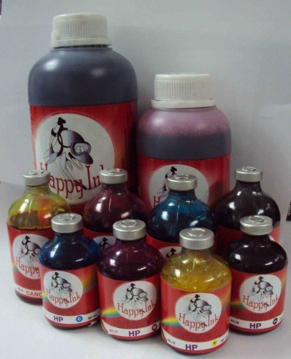

Example
High school student groups from Sukhothai won a business plan contest organized by Krung Thai Bank. They create the self-made ink-jet which costs only 20% of the market price.

Slide 24
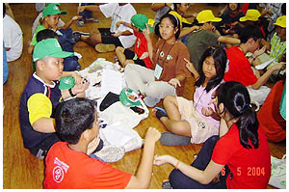
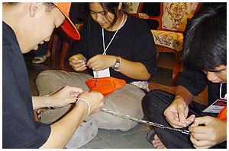
Example
A summer camp run by Cubic creative, a student groups from Kasetsart university laboratory school won a business plan prize from Krungthai Bank. These students use their competence in mathematic and science and their creative idea to organize a summer camp for primary and lower-secondary school students. They earn 240000 bath from a camp.

Slide 25

Example
Power Prawns: The Winning Team from Thammasat Asia Moot Corp 2007 and the second prize in Global moot crop.
Power Prawns uses a specialized technology to breed the most sought-after larger 100% male offspring prawns. The production can be faster, cheaper and with greater yields than other competitors. With this new technology the export of the Thai prawns to the world market should rise rapidly and the country should become once more one of the world's biggest prawn exporters which has the value of more than two hundred thousand million baht.

Slide 26


Example
Idyl life – the winner of Thammasat Asia Moot Corp 2005
They created a business aimed to manufacture a pure all natural, zero calorie, high intensity sweetener centered on new extraction processes for stevia, a locally harvested “sweet” plant.

Slide 27
Example
XZell Laboratory" The Winner in 2011 Asia Venture Challenge XZell
Laboratory's business plan is for production of dengue diagnostic kit called DenkiTector. The diagnostic kit provides more effective and faster dengue diagnosis and evaluation. Apart from diagnosis, the kit can also assist physicians to be aware of level of patients' symptom. Patients will be provided prompt treatment. The kit is already patented in Thailand, the US and Germany.
"We create the business plan because of an inspiration that dengue fever mostly occurs in tropical areas and it is likely to widely spread, especially when the earth is getting warmer due to greenhouse effect. In addition, current diagnosis is done in some extent, so we think that if we can boost more confidence to physicians in diagnosing the disease more promptly, patients will be immediately remedied",

