Slide 1
Cash Management
Jatuporn Jittapirom 5504640326
Lalipat Tachapattarawat 5504640607
Pemika Thitipermpong 5504641084
Sahawut Aunanant 5504641514
Tanyaporn Simasanti 5504641837
Tirawit Disphanurat 5504641985

Slide 2
Overview
What is Cash Management?
Why it has to be Cash?
Objective of Cash Management
Types of Cash Management
  Payment Management
  Collection Management
  Liquidity Management
  Electronic Information
Benefits of Cash Management Service

Slide 3

What is Cash Management?
Cash management is the service by the banks to facilitate their customers in assuring predictability in the cash flows of the customers by helping them adjust their balance sheets.

Slide 4

Why it has to be Cash?
Transaction Motive
Precautionary Motive
Speculative Motive
Compensating Motive

Slide 5
Objective of Cash Management
To avoid insolvency
To reduce days in account receivable
To increase collecting rates
To select appropriate short-term investment vehicles
To increase days cash on hand to improve a company's overall financial profitability

Slide 6
Benefits of Cash Management Service
Assured credit : Availability of cleared funds variable
Pooling of funds : Funds collected and deposited in Central Account
Control benefits : Corporate to maintain better control over its various Banking and treasury related activities

Slide 7
Types of Cash Management
Payment Management
Collection management
Liquidity Management
Liquidity Management
Deposit and Investment Solutions

Slide 8
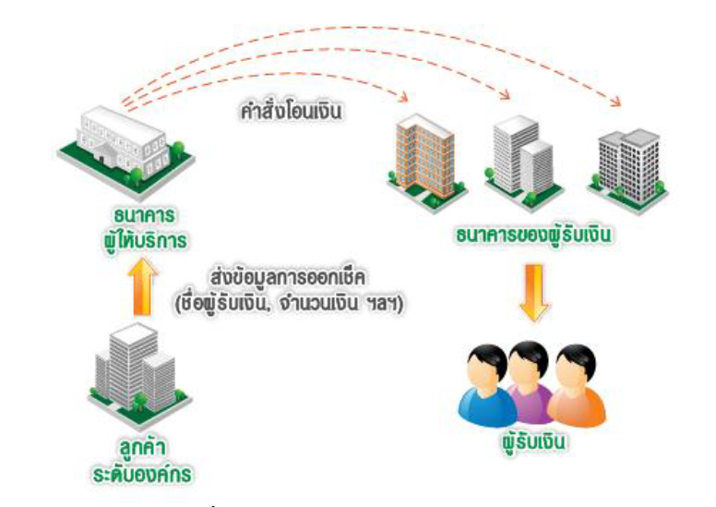
Payment Management
Order for money transfer
Banking Service
Payee’s Bank
Transfer information of issuing cheque (Payee’s name, amount of money, etc.)
Large Organization
Payee
Service for any payment

Slide 9


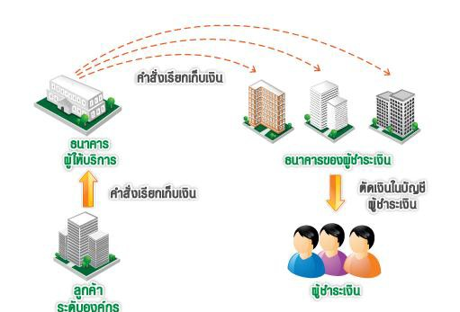
Collection Management
Send order for collection
Banking Service
Payer’s Bank
Send order for collection
Debit to payer’s account
Large Organization
Payer
Service for any receivable

Slide 10
Liquidity Management
Helps enhancing the efficiency of the client’s fund by providing accurate reports and maximizing interest returns. The service links all of the client’s bank accounts so that the fund can flow freely in structural manner.
Service for using money efficiently

Slide 11
Electronic Information
This service provides a wide range of services that used to be available only at the bank’s branch via internet. For an instance, the client can access his own bank account information which includes the available balance, financial history, transaction records anywhere and anytime. The client can also make transaction online using electronic information service such as scheduling future dates for payment, fund transfer, and etc.
Provide information of market change and keep track of your finance online

Slide 12
Deposit and Investment Solutions
This provides channel for clients to generate additional income from their deposit in terms of interest which is less risky than investing in equity market or etc.
Example: from Kasikorn Bank
  Savings Deposit Account
  Special Saving Deposit
  Fixed Deposit
  Current Deposit
  Business Deposit - FCD
Help managing business finance with a number of deposit service

Slide 13
Thanks you for your attention

