Slide 1

Integrated Marketing Communications:
Connecting with Consumers in the Seamless World
Alisara R. CHARINSARN
Thammasat Business School
Notes:
Analyze msg of each ex.

Slide 2

The Message Strategy: The Key Connector
Integrated Marketing Communications: Connecting with Consumers in the Seamless World
Alisara R. CHARINSARN
Thammasat Business School

Slide 3

Review
AVATAR and Communications objective
  Importance
  Types
  Source
  Level
  AVATAR
  SMART Objective
Brief
Group Work Assignment
© Alisara R. CHARINSARN

Slide 4
Agenda
Review and admin
Message
  Intro
  Role in IMC
  Concept in message design
  Message design techniques
  Receiver
  Sender
© Alisara R. CHARINSARN

Slide 5

Admin
© Alisara R. CHARINSARN

Slide 6
Group Work Assignment for Message Class
Gr. | Bring one Ad each
 | Message Design Technique: Message structure -- Message sidedness (p.g133 แง่มุมของสาร) One-sided Two-sided e.g. refutation
 | Message Design Technique: Message structure -- Message conclusion (p.g133 การสรุปสาร) Conclusion drawing: Explicit Conclusion drawing: Allow consumers to draw their own conclusion
 | Message Design Technique: Message attractiveness (p.g134 ความดึงดูดเชิงอารมณ์ความรู้สึกส่วนตัว, เกี่ยวเนื่องกับผู้อื่น) - - Personal feeling e.g. pride, fear Social-related feeling e.g. belonging, self-esteem
 | Message sender selection: Reference group (p.g137-138 ผู้ที่มีอิธิพลต่อการสื่อสารฯ) Membership group: Primary (e.g. family, close friend), Secondary (e.g. classmate, online product reviewer Reference group: e.g. celebrity

Slide 7
Message: Intro
© Alisara R. CHARINSARN

Slide 8

The “Messenger” Game
Notes:
Game โทรฯตกกระป๋อง
Count 1-5 (or fewer) to set group – around 10+ persons/gr
Aj. Gives envelope to the first student of each group.
Open at the same time
and whisper.

Slide 9
The “Messenger” Game
Part 1
2 groups
5 good things about product in a couple sentences
  Confidential – only within your group
  Write those sentences
Notes:
Game โทรฯตกกระป๋อง
Count 1-5 (or fewer) to set group – around 10+ persons/gr
Aj. Gives envelope to the first student of each group.
Open at the same time
and whisper.

Slide 10
The “Messenger” Game
Part 2
Each group to line up
Whisper the sentence
Notes:
Game โทรฯตกกระป๋อง
Count 1-5 (or fewer) to set group – around 10+ persons/gr
Aj. Gives envelope to the first student of each group.
Open at the same time
and whisper.

Slide 11
The “Messenger” Game
How could this communication be
more effective?
Notes:
Learning
S
M
C
R

Slide 12
The “Messenger” Game
“When the customers arrive, please make sure they feel welcome. Invite them to sit, then serve them some delicious almond cookies and cappuccino frappe”

Slide 13
The “Messenger” Game
“พอลูกค้ามาถึงแล้ว ต้อนรับพวกเขาให้ดี เชิญลูกค้านั่ง เสริฟคุ้กกี้อัลมอนด์ให้ทานและเสริฟคาปูชิโน่เฟรปเป้ให้ดื่มด้วย”

Slide 14
Example:
Different Field of Reference
I borrow my kid’s camera to record voice for my work.
She accidentally deleted my file.
I was furious!
…
The following pages are her perspective!

Slide 15
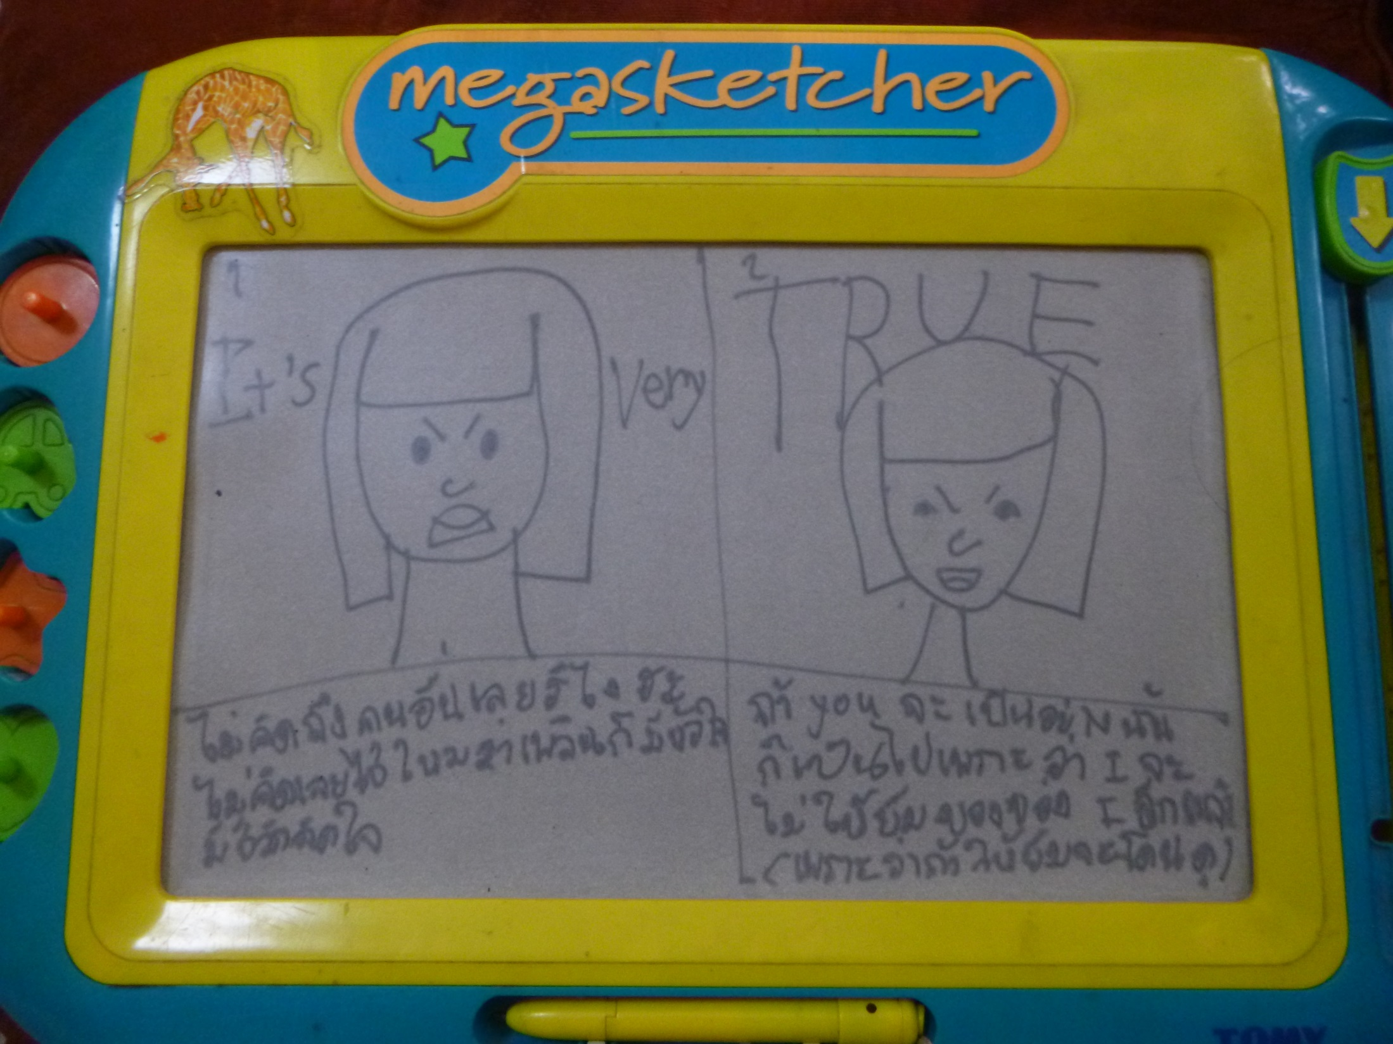

Slide 16
Message role in IMC
© Alisara R. CHARINSARN

Slide 17
Connecting with Consumers
Which box is “What to Say” and “How to Say”?
Connecting with the landscape (ch.1)
Consumer (Ch.2)
Key Issue & Objective (Ch.4)
Brand (Ch.3)
Message
(Ch.5)
Connecting Today and in the Future
(Ch.10)
Creative + Media + IMC Platform
(Ch.6-8)
Exploring, Measuring, Optimizing
(Ch.9)
© Alisara R. CHARINSARN

Slide 18
Turning Consumer Understanding into IMC
Message
(Ch.5)
Message &
Execution that
Resonate with
Consumer
Creative +
Media +
IMC Platform
(Ch.6-8)
Reaching Consumer --
Media Habit of
Consumer

Slide 19
Concept in message design
© Alisara R. CHARINSARN

Slide 20
Concept in Message Design
Answer objective
Resonate with consumers
Reflect brand positioning
Has big idea/ story in the message: e.g. “Just do it”, SK-II

Slide 21
The Big Idea (Major Selling Idea)
The Big Idea: Major Selling Idea/ Campaign Theme
“A big idea attracts the consumer’s attention, gets a reaction, and sets the advertiser’s product or service apart from the competition’s.” For example,
We try harder (Avis)
Intel inside
Just do it

Slide 22
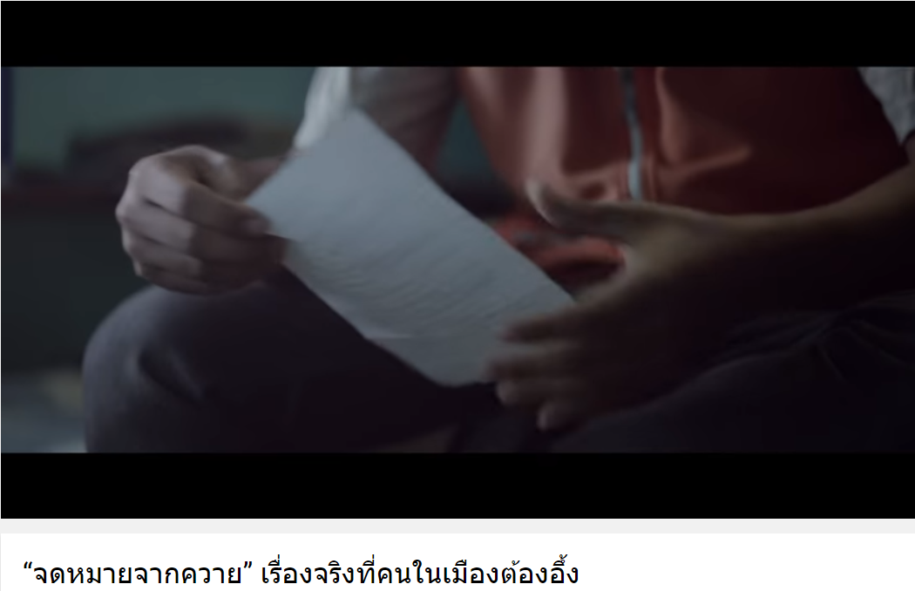

Slide 23
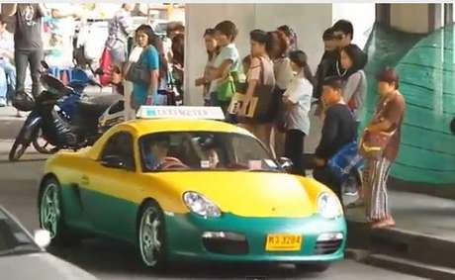

Slide 24

Notes:
Memorable
โฆษณาไทยประกันชีวิต เชื่อในความดี

Slide 25

IBM as a Provider of Business Consulting Services
Notes:
Relation to text
This slide relates to the material pp. 274-276 of the text.
Summary Overview
This slide shows an IBM print ad used to position IBM as a provider of business and consulting services. The ad campaign, which includes print, television, and online ads, sponsorships, and a micro website, is designed to reveal a side of IBM that is largely unknown to potential business consulting and services clients.
Use of this slide
This slide can be used to discuss the use of positioning for companies as well as brands. “The other IBM” campaign is designed to position the company as more than just a technology provider.

Slide 26
Message design techniques
© Alisara R. CHARINSARN

Slide 27
Techniques in Message Design
Message structure
Presentation sequence

Slide 28
Recall and Presentation Order
Recall
Beginning
Middle
End
Notes:
Relation to text
This slide relates to material on pp. 179-180 and Figure 6-5 of the text.
Summary Overview
Message structure is very important to overall communication effectiveness. A basic consideration in the design of a persuasive message is the order of presentation of message arguments. Research on learning and memory generally indicate that items presented first and last are remembered better than those presented in the middle. This chart shows that the strongest arguments should be placed at the beginning or end of the message, but not in the middle.
Use of this slide
This slide can be used to explain message recall as a function of order of presentation. Presenting the strongest arguments at the beginning of the message assumes a primacy effect is operating whereby information presented first is most effective. Putting the strong points at the end assumes a recency effect, whereby the last arguments are most persuasive.

Slide 29
Techniques in Message Design
Message structure
Presentation sequence
Message sidedness
  One-sided
  Two-sided e.g. refutation
Message conclusion
  Conclusion drawing: Explicit
  Conclusion drawing: Allow consumers to draw their own conclusion

Slide 30
Techniques in Message Design
Message attractiveness
Cognitive
Affective
  - Personal feeling e.g. pride, fear
  Social-related feeling e.g. belonging, self-esteem
Combination

Slide 31
Techniques in Message Design
Verbal and non-verbal communication
Verbal
Nonverbal

Slide 32
Message: Receiver
© Alisara R. CHARINSARN

Slide 33
Consumer’s Readiness in receiving message
Consumer background (field of reference) e.g. SES
Motivation and willingness

Slide 34
Message: Sender
© Alisara R. CHARINSARN

Slide 35
Message’s Sender
Influencer
  Membership group
    Primary group e.g. family
    Secondary group e.g. classmate, chat room member
  Reference group e.g. celeb

Slide 36

Applying Likability: Decorative Models
M
Notes:
Relation to text
This slide relates to material on pp. 190-191 and Exhibit 6-8 of the text.
Summary Overview
Advertisers often draw attention to their ads by featuring a physically attractive person who serves as a passive or decorative model, rather than as an active communication. Research shows that physically attractive communicators generally generate more favorable evaluations of both ads and products than less attractive models. Recent studies, however, show that some women experience negative feelings when comparing themselves with beautiful models used in ads and the images of physical perfection they represent.
In response, some companies have developed advertising campaigns that tell women, as well as young girls, that they’re beautiful just the way they are. This ad for Dove’s Firming lotion, cream, and body wash, features “real women.” Unilever’s Dove brand has long eschewed the use of supermodels, preferring to use everyday women and girls who resemble its typical consumers.
Use of this slide
This slide can be used to show an example of how some companies are taking a non-traditional approach to advertising by using less-attractive models.

Slide 37
Message’s Sender
Sender’s attribute
  Credibility
  Attractiveness
  Power

Slide 38

What is the sender attribute of this Ad?
Notes:
Relation to text
This slide relates to material on p. 179 and Exhibit 6-2 of the text.
Summary Overview
This slide shows an ad for Dove soap, which promotes the fact that it recommended by dermatologists who are experts in skin care. This is an example of the use of source credibility where companies use endorsements from individuals or groups recognized as experts.
Use of this slide
This slide can be used to demonstrate how advertisers apply the concept of source expertise in their advertising messages.

Slide 39
Notes:
Relation to text
This slide relates to Exhibit 6-1, found on page 178 of the text.
Summary Overview
The term source means the person involved in communicating a marketing message, either directly or indirectly. A direct source is a spokesperson who delivers a message and/or endorses a product or service, like across Hayden Panettiere, who appears in this ad sponsored by The Milk Processor Education Program.
An indirect source doesn’t actually deliver a message, but draws attention to and/or enhances the appearance of the ad.
Some ads use neither a direct nor an indirect source.
Use of this slide
This slide can be used as part of a discussion of X

Slide 40
Message’s Sender
Celebrity Sender
  Choosing criteria
  Risk

Slide 41
Message’s Sender
Celebrity Sender
  Choosing criteria
    Fit with target group
    Fit with brand
    Influential
    Positive image
    Value for money

Slide 42
Message’s Sender
Celebrity Sender
  Risk
    Not acceptable (by target group)
    Over-exposed
    Over-shadow
    Celebrity’s behavior

Slide 43

Energy & Power – The Athlete and the Product
Notes:
Relation to text
This slide relates to material on pp. 186-187 and Exhibit 6-6 of the text.
Summary Overview
This slide shows an ad for PowerBar, which uses champion cyclist Lance Armstrong as a celebrity endorser. Armstrong has a variety of meanings he brings to the endorsement process. He has a developed a very favorable image as a fierce competitor and an All-American superhero by winning the grueling Tour de France cycling race seven times after overcoming a life-threatening form of cancer. PowerBar takes advantage of Armstrong’s image as a competitor and champion with great determination in ads such as this. He brings his own meanings and image to the product through his endorsement, which is then transferred from the product to the consumer.
Use of this slide
This slide can be used to explain stage 1 of the meaning movement and endorsement model. According to McCracken, celebrities draw powerful meanings from the roles they assume in their lives and careers. Each new dramatic role brings the celebrity into contact with a range of objects, persons, and contexts. Out of the objects, persons, and contexts, are meanings, which are transferred to and reside in the celebrity.

Slide 44


Energy & Power – The Athlete and the Product
Lance Armstrong
Fierce competitor
And US Superhero
--Winning seven times after overcoming cancer
Notes:
Relation to text
This slide relates to material on pp. 186-187 and Exhibit 6-6 of the text.
Summary Overview
This slide shows an ad for PowerBar, which uses champion cyclist Lance Armstrong as a celebrity endorser. Armstrong has a variety of meanings he brings to the endorsement process. He has a developed a very favorable image as a fierce competitor and an All-American superhero by winning the grueling Tour de France cycling race seven times after overcoming a life-threatening form of cancer. PowerBar takes advantage of Armstrong’s image as a competitor and champion with great determination in ads such as this. He brings his own meanings and image to the product through his endorsement, which is then transferred from the product to the consumer.
ARC: doping (drug – enhance performance). Banned from all sp competition
Use of this slide
This slide can be used to explain stage 1 of the meaning movement and endorsement model. According to McCracken, celebrities draw powerful meanings from the roles they assume in their lives and careers. Each new dramatic role brings the celebrity into contact with a range of objects, persons, and contexts. Out of the objects, persons, and contexts, are meanings, which are transferred to and reside in the celebrity.

Slide 45
Message: Last but not least…
© Alisara R. CHARINSARN

Slide 46
Conveying the Message
In order to …
Role of Advertising (Ad)
Inform
Persuade
Create image, change image
entertain
How brand (convey the message to) solve the issue/ create desire

Slide 47
Your Message: The Key Connector

Slide 48
Conclusion

Slide 49
What did we cover today?
Review and admin
Message
  Intro
  Role in IMC
  Concept in message design
  Message design techniques
  Receiver
  Sender
© Alisara R. CHARINSARN

Slide 50
Q & A

