Slide 1
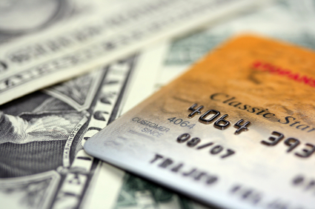

CREDIT & DEBIT CARD

Slide 2



Slide 3
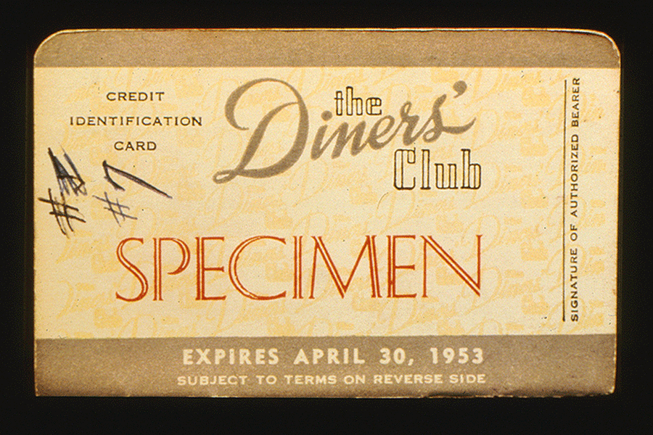

Slide 4
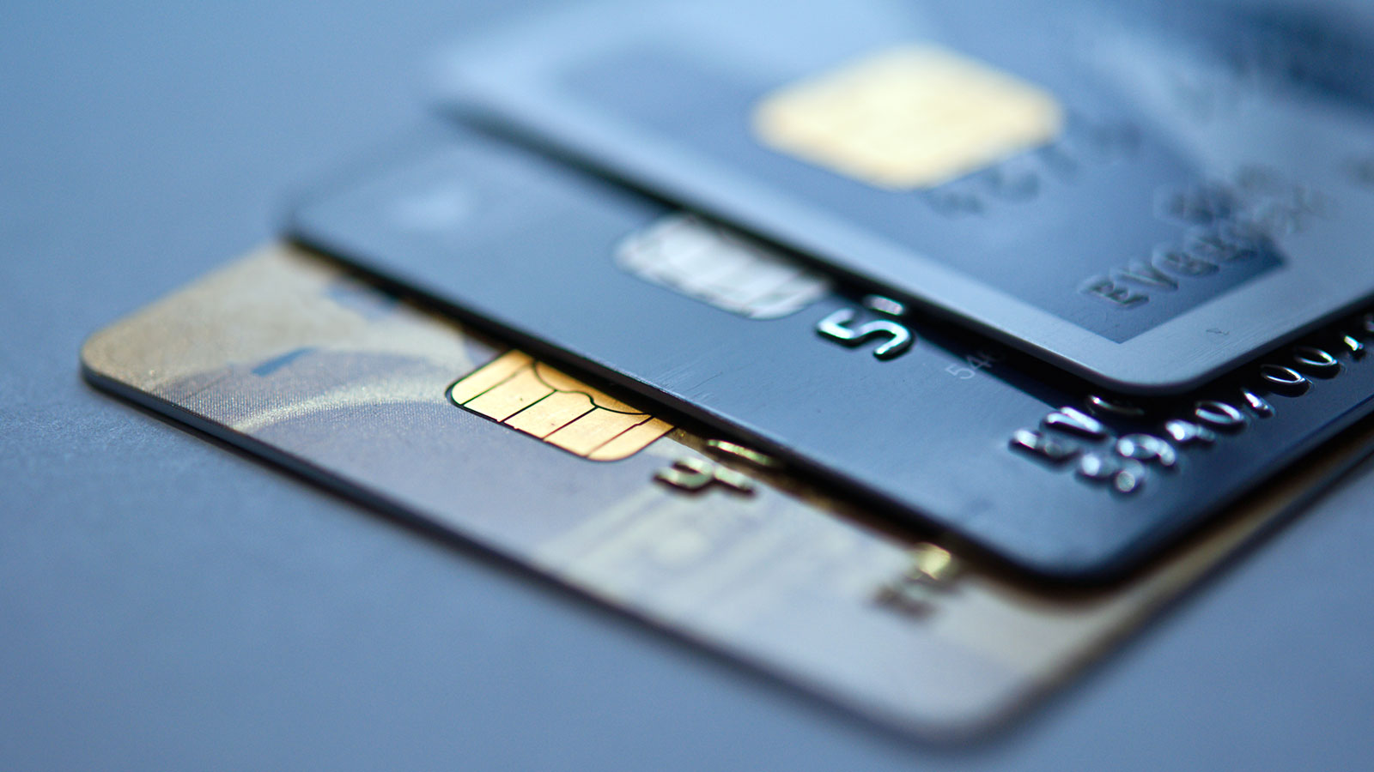
What is Credit Card?
A card issued by a bank allowing the holder to purchase goods or services on credit.

Slide 5
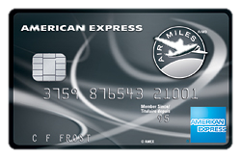
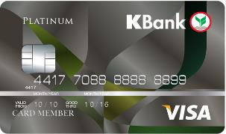
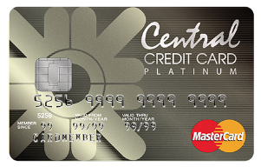
Type of Credit Card
International Credit Card
Local Credit Card
Store Card or Private Label

Slide 6
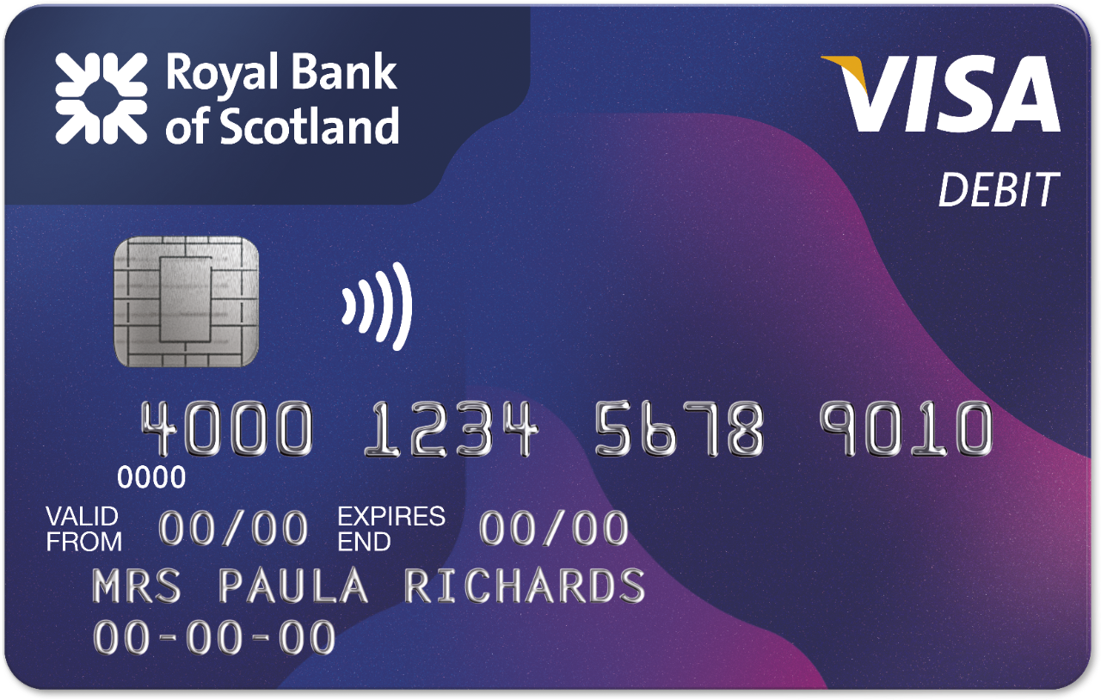

Slide 7
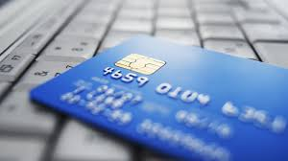
What is Debit Card?
A card issued by a bank allowing the holder to transfer money electronically to another bank account when making a purchase.

Slide 8
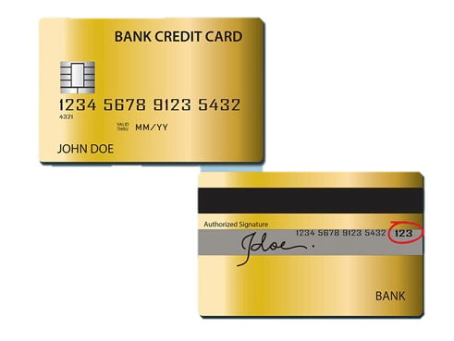


Smart Chip
Expire Date
Card Number
Card Network Logo
Member Name
Magnetic Stripe
Security Hologram
Member Signature
Card Security Code

Slide 9
Credit Card VS Debit Card
 | Credit Card | Debit Card
Requirement | Age > 21 Monthly Income > 15,000 - Financial Status History | Age > 15 Saving or Checking account
Spending Limit | Depend on credit line | Depend on your deposit in that account
Payment | At the end of period | Debited from the user’s account
Monthly Bills | Yes | No
Interest Charged | Paid in time, no interest rate charge If not, the interest is usually high | No

Slide 10
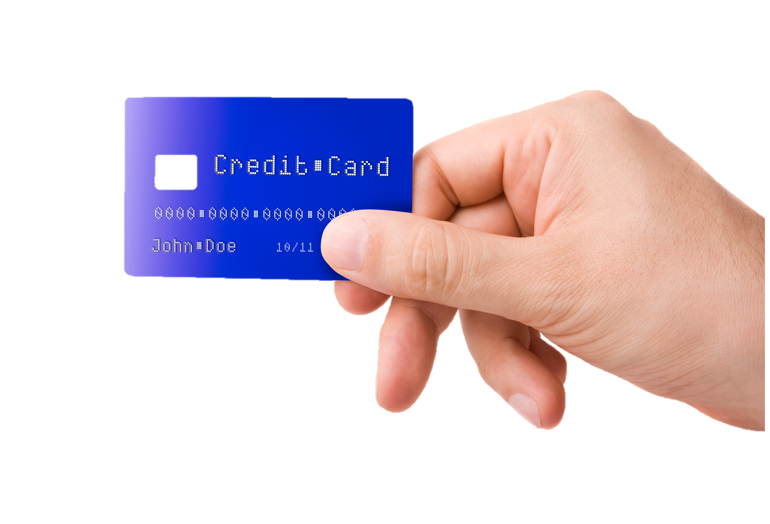
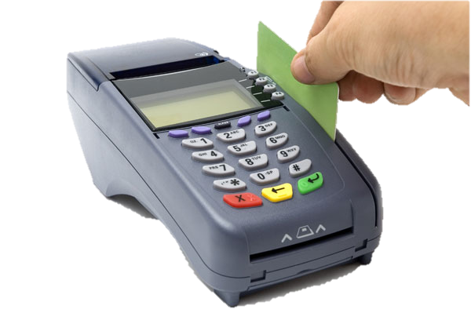


Credit Card
Purchase using credit card
Get product or service
Approve/Decline transaction
Issuing card
Make payment at the end of period
Submit authorization request
Card Issuing Bank
Acquiring Bank

Slide 11
Debit Card
Debit Card
Purchase using credit card
Purchase using credit card
Get product or service
Get product or service
Approve/Decline transaction
Approve/Decline transaction
Issuing card
Issuing card
Debited from the user’s account
Debited from the user’s account
Submit authorization request
Submit authorization request
Card Issuing Bank
Acquiring Bank
Card Issuing Bank
Acquiring Bank

Slide 12
Credit card
PROs | CONs
- Convenience | - Charge high interest rate
- Allow withhold payments | - Compound interest for unpaid debt
- Provide financial backup | - Cash advance fee
- Privilege
Debit card
PROs | CONs
- Convenience | - Cannot use in some countries
- Can control the amount of spending | - No credit score
- Can withdraw cash without fee | - Limited amount of usage

Slide 13

Which one match you?

Slide 14


Credit Card
- Strong financial status
- Online shopper
- Regular income
- Privilege

Slide 15

Debit Card
- Limit amount of spending
- Cash withdrawal
- Irregular income

Slide 16
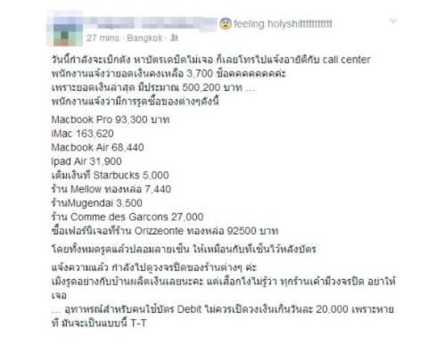
The real world…

Slide 17
The real world…
- Does not have Pin system
- Require only signature
- Security code can be copied easily

Slide 18

Q & A

Slide 19
Group member
1. Petch Manomaiwongse ID : 5604641125
2. Piyapat Inchayanunth ID : 5604641265
3. Pusit Vittayanugool ID : 5604641364
4. Raiwin Suwannaparisut ID : 5604641372
5. Swiss Pongpipattanakul ID : 5604641729
6. Thanapon Sanaeha ID : 5604641836
7. Thiti Setthachinda ID : 5604641919

