Slide 1
PART 2

Slide 2
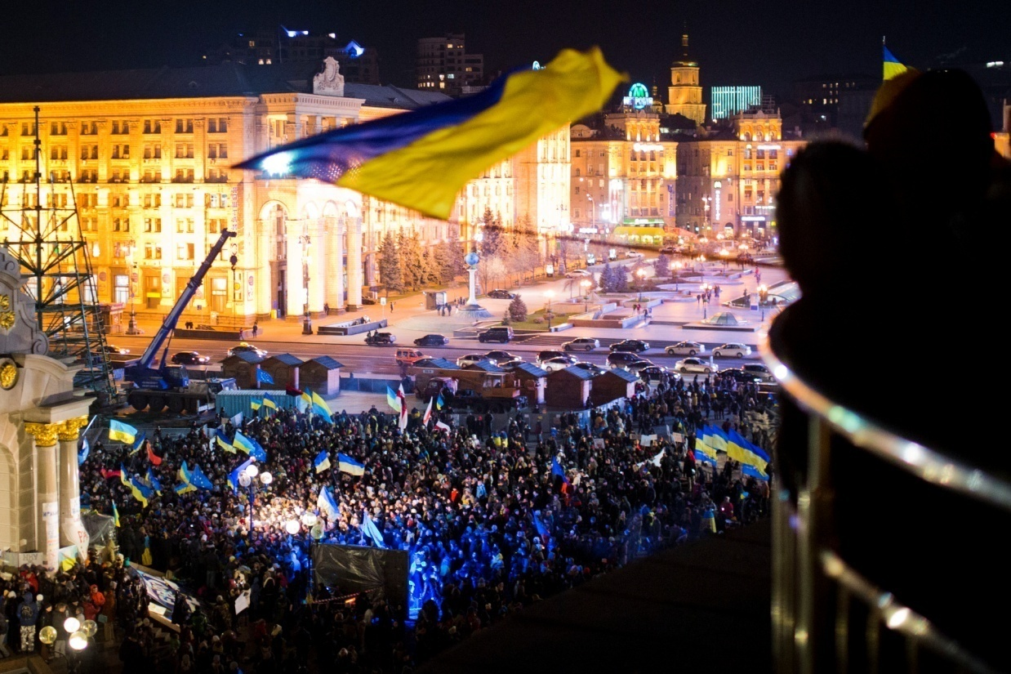
The Euromaidan

Slide 3
Immediate Cause
EU
(Association Agreement)
(DCFTA)
Russia
Viktor Yanukovych

Slide 4
Immediate Cause
EU
Russia
Small number of loans
With heavy strings attached
The austerity measures
$15 billion in soft loans; cheaper natural gas
No strings attached
Viktor Yanukovych

Slide 5
The Euromaidan: Timeline
Late Nov. 2013: the emergence of the Euromaidan
Late Nov. 2013-Feb. 2014: the ongoing protest
18-21/22 Feb 2014: the state violence – The “February Revolution”
  82 dead and many wounded
21 Feb 2014: a deal?

Slide 6
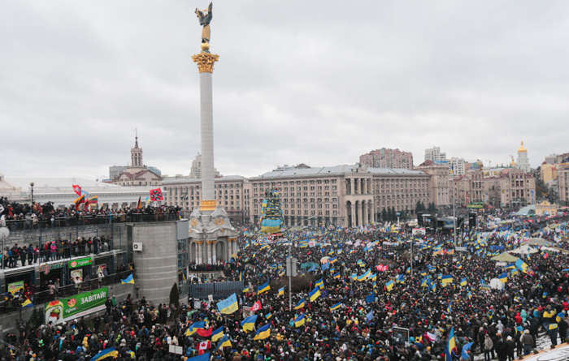
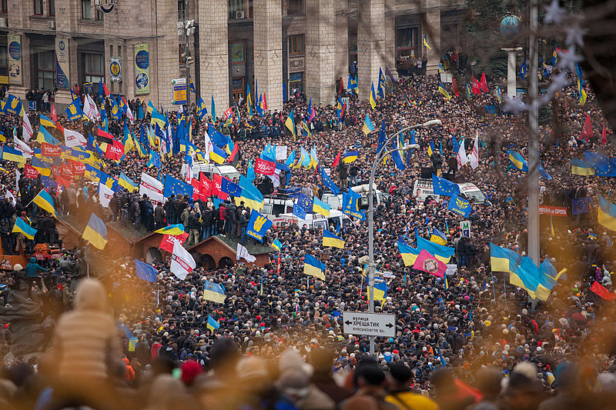
Maidan Nezalezhnosti

Slide 7
The Euromaidan: Two Interpretations
Horizontalism – peoples’ participation
Elite politics
  Opposition parties
  mass mobilization

Slide 8
Opposition Elites in the Euromaidan
Fatherland (Batkivshchyna) – Yulia Timoshenko
UDAR (“Punch”) (Ukrainian Democratic Alliance for Reforms) – Vitali Klischko (“Dr. Ironfist”)
Svoboda (fascist Nazi) – Oleh Tyahnybok
  Right Sector (Pravy Sektor)

Slide 9
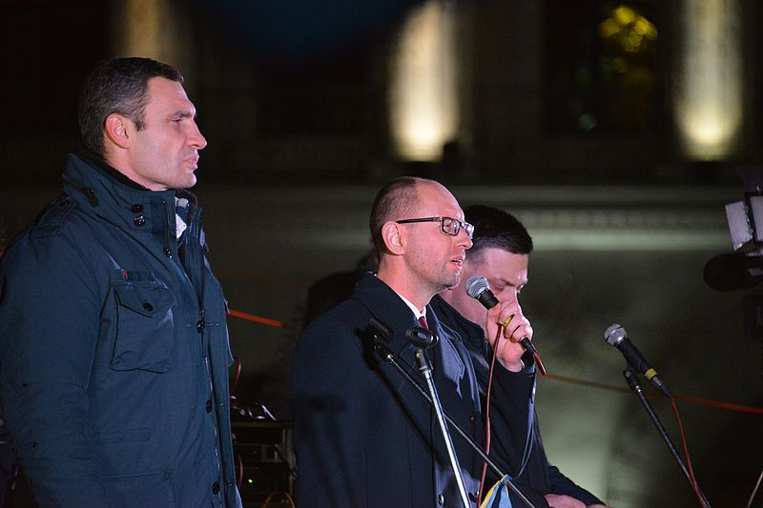
Opposition leaders Vitali Klitschko, Arseniy Yatsenyuk and Oleh Tyahnybok

Slide 10
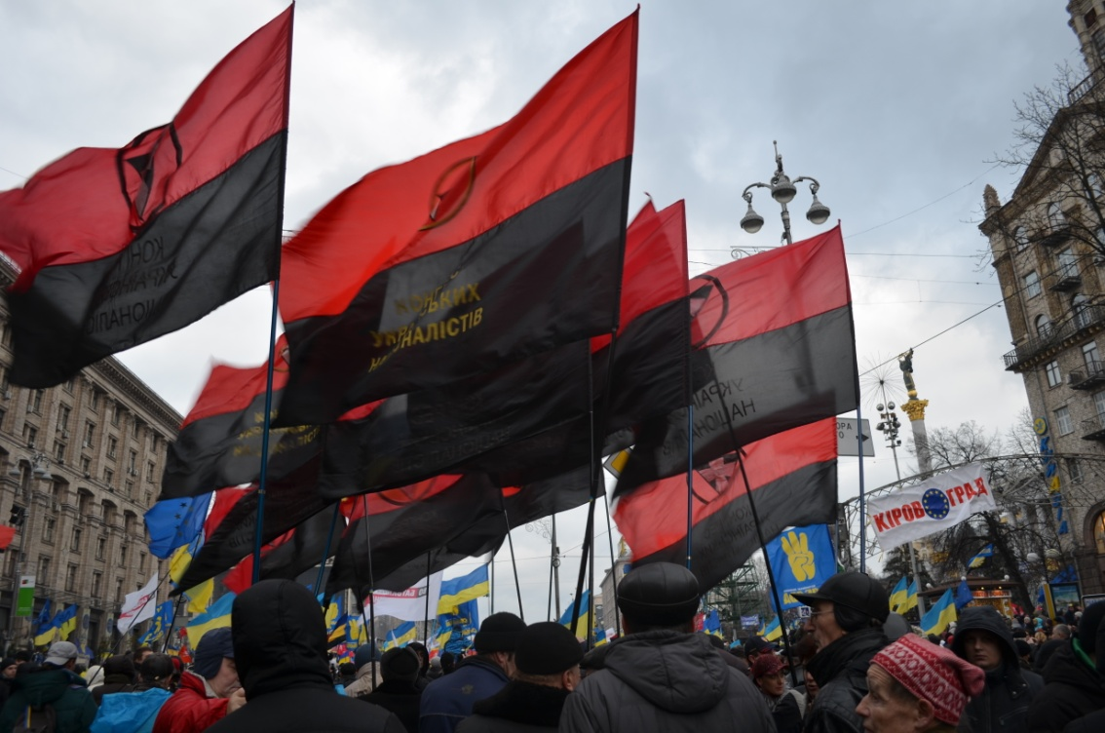
Fascist Movement
Militarization of the protest
  Self Defence (Samooborona)
  Right Sector (Pravy Sektor)
Symbols: the black-and-red flag (Ukrainian Nazi)

Slide 11
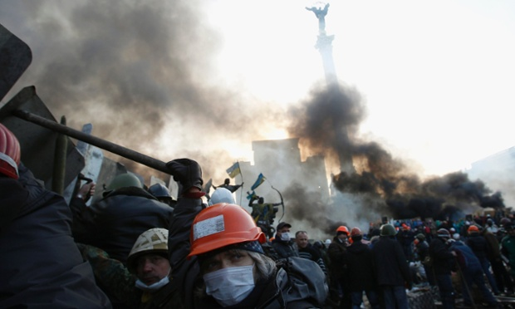
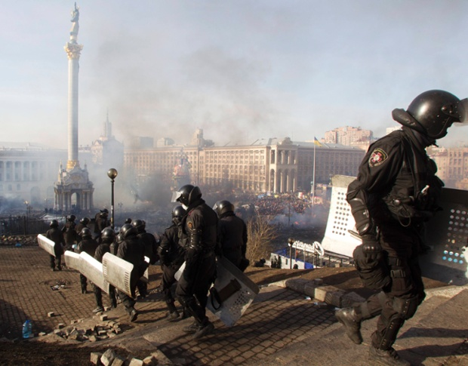
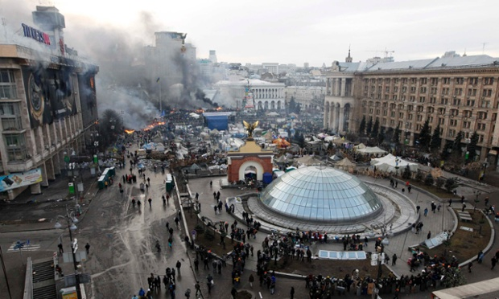
Notes:
Anti-government protesters in Independence Square, in the morning of 19 February; Smoke rises above Independence Square in Kiev on 19 February

Slide 12
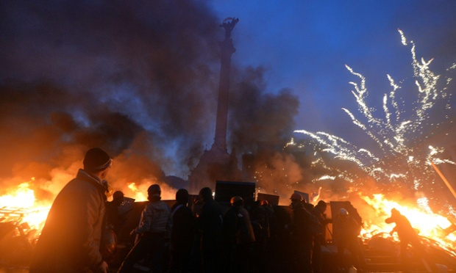
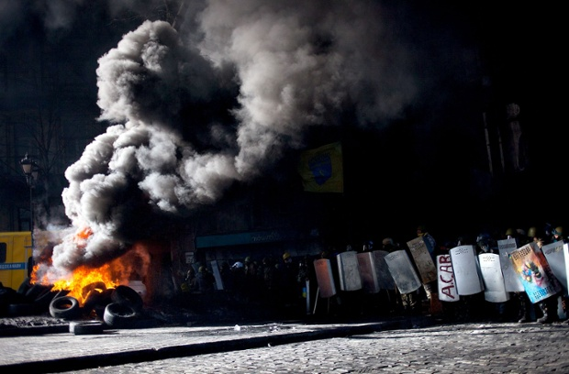
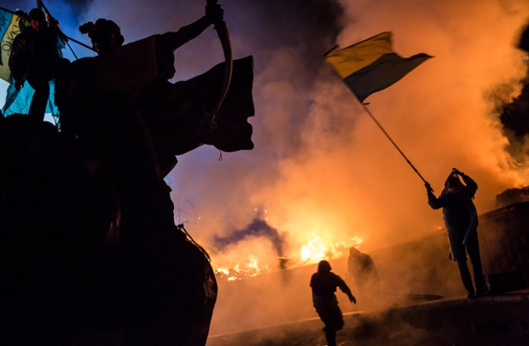
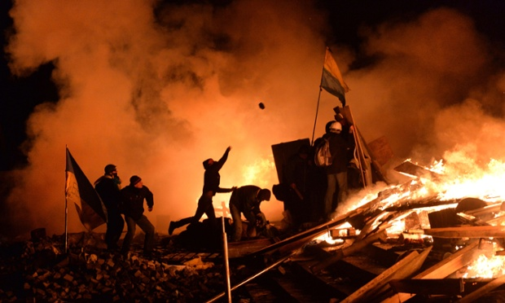

Slide 13
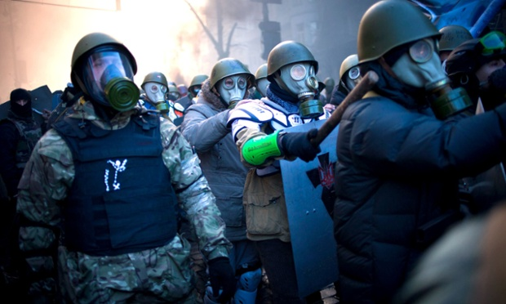
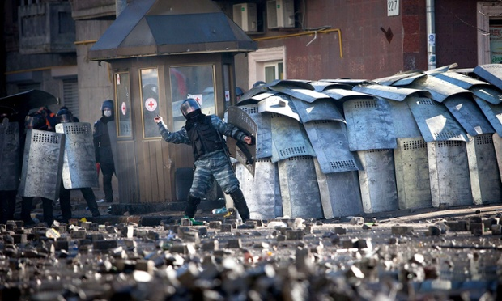
Protesters
Berkut riot police
Notes:
Protesters wear gas masks during the clashes with police; Riot police protect themselves behind shields from rocks being thrown by anti-government protesters.

Slide 14
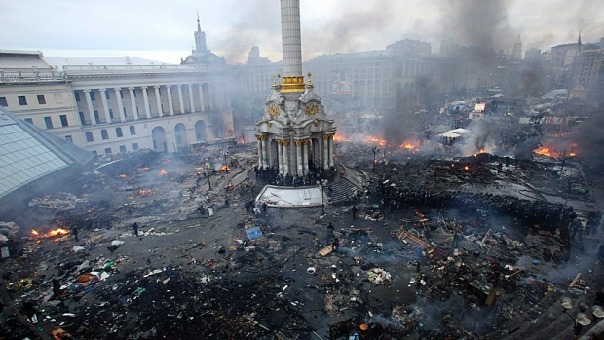

Slide 15
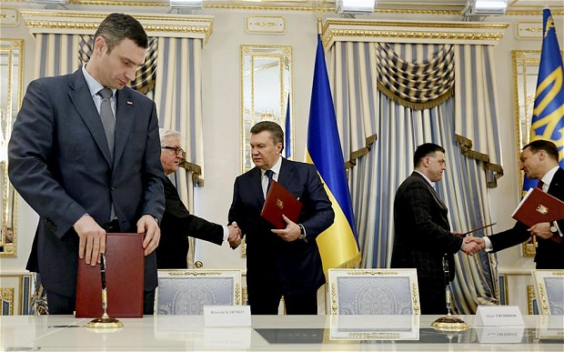
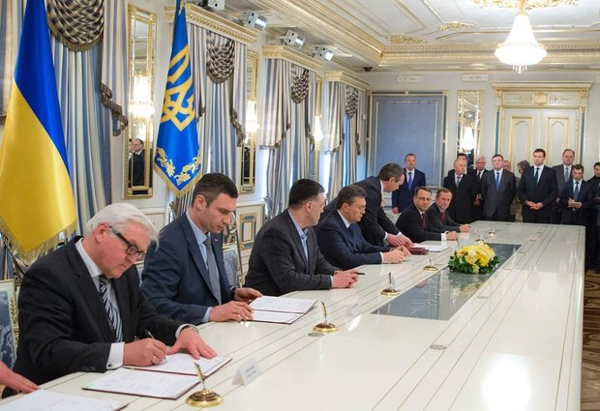
Notes:
L-R: Vitali Klitschko, leader of Ukraine's UDAR opposition party, German Foreign Minister Frank-Walter Steinmeier, Ukrainian President Viktor Yanukovych, leader of All-Ukrainian Union 'Svoboda' Olej Tjahnybok, and Polish Foreign Minister Radoslaw Sikorski after the signing of the agreement in the Blue Hall at the Presidential Palace in Kiev, Ukraine

Slide 16
A Deal (21 Feb)?
Talks between government and opposition
Mediators: foreign ministers of Germany, Poland and France
An agreement
  A return to the 2004 Constitution (parliamentary system)
  Increasing the power of the Rada
  Calling presidential election by December 2014

Slide 17
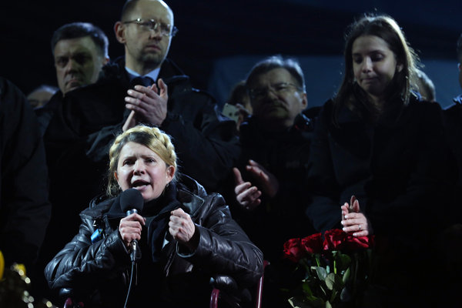
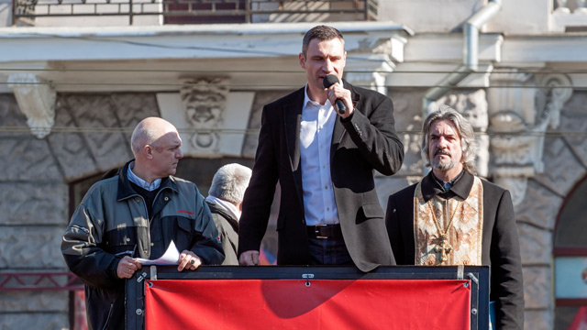
Yulia Tymoshenko - Vitali Klitschko

Slide 18
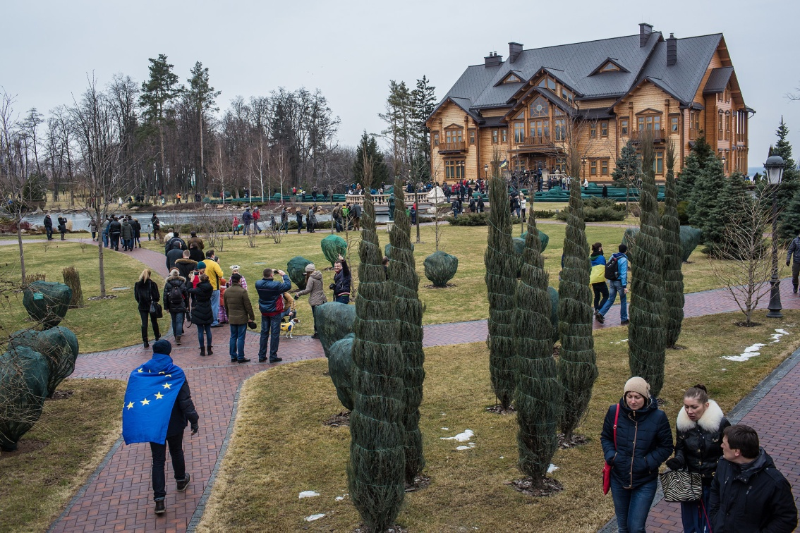
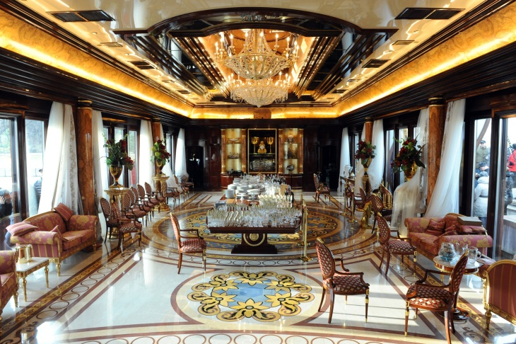
Yanukovych – Estate in Mezhigorye

Slide 19
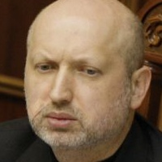
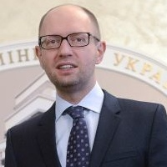
New Interim Government:
Fatherland + Svoboda
President Olexander Turchynov
PM Arseniy Yatsenyuk

Slide 20
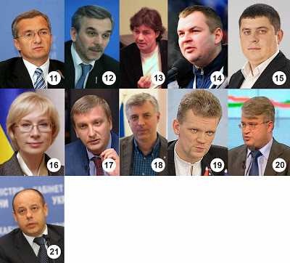
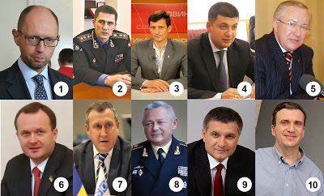
A “Kamikaze Government”?
Corrupt or politician-as-usual ministers?
No trust from the Maidan protesters
Notes:
Arseny Yatsenyuk (1). The new interim government, which has gathered well-known politicians and prominent figures of the anti-government protests, was supported by 331 lawmakers of the 411 present in the parliament. Earlier in the day, 358 legislators supported a bill to dismiss the former government. The parliament approved Vitaly Yarema (2), a lawmaker from the "Fatherland" party, as first deputy prime minister. Meanwhile, far-right politician Alexandr Such (3) and businessman Vladimir Groysman (4) were appointed deputy prime ministers. Former Foreign Minister Borys Tarasyuk (5) was named deputy prime minister for European integration, while Ostap Semerak (6), a former adviser to Yatsenyuk, became minister of the cabinet. Andriy Deshchytsya (7), a veteran diplomat, was given the foreign affairs portfolio, while Admiral Igor Tenyukh (8), former commander of the Naval Forces of Ukraine, became defense minister. Interior Minister Arsen Avakov (9), who was appointed earlier this week, has kept his post. Pavlo Sheremeta (10), a well-known political analyst and founder of the Kiev-Mohyla Business School, was made economy minister, while Alexandr Shlapack (11) took the post of finance minister. Oleg Musiy (12), the coordinator of the protesters' medical camp, was named health minister; actor Eugene Nischuk (13), a narrator who was cheering protesters from the stage during the anti-government rallies, became culture minister, while Dmytro Bulatov (14), an activist who was severely beaten during the protests, was appointed as youth and sports minister. Maksym Burbak (15), a lawmaker from the "Fatherland" Party, was approved as infrastructure minister and his comrade Lyudmyla Denysova (16) became social policy minister. Lawmaker Pavlo Petrenko (17) was appointed as justice minister and Sergiy Kvit (18), president of the National University of Kiev-Mohyla Academy, took the post of education and science minister. Lawmaker from "Svoboda" party Igor Shvaika (19) became agriculture minister, his party ally Adnriy Mokhnyk (20) became ecology minister, while Yury Prodan (21), who served as energy minister in 2007-2010, was appointed as minister of fuel and energy.

Slide 21
A Breakdown of the Deal?
Impeachment of Yanukovych
Criminalization of Yanukovych and his comrades (of Party of Regions) -- > ICC
Early presidential election: 25 May 2014
New laws
  banning the Russian language as a second language
  Disbanding the Berkut riot police
Challenging the status of Russia’s Black Sea Fleet

Slide 22
Causes – Consequences?
Protest: Euromaidan
A temporary deal
A Breakdown of the Deal: Marginalizing the Russians
Russian Responses -- > military presence
State violence by the Yanukovych government

Slide 23
The Protests?
The rise of Ukrainian nationalism
The localization of the protests
The militarization of the protesters
The rise of the anti-Maidan movements in the East and the South
  Symbols: Russian flags, regional flags
  A battle between protesters – Crimea’s Tatars

Slide 24
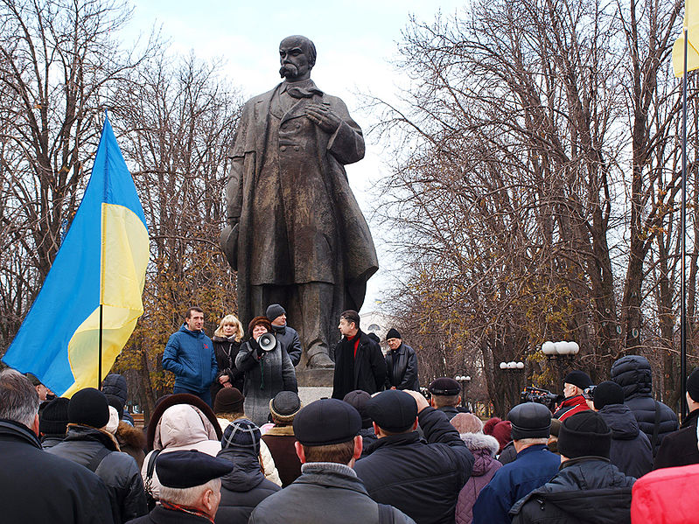
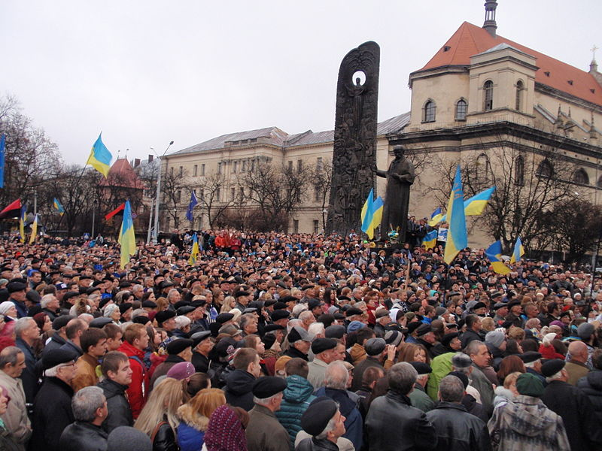
The localization of the protests:
Luhansk (left) – Lviv (Right)

Slide 25
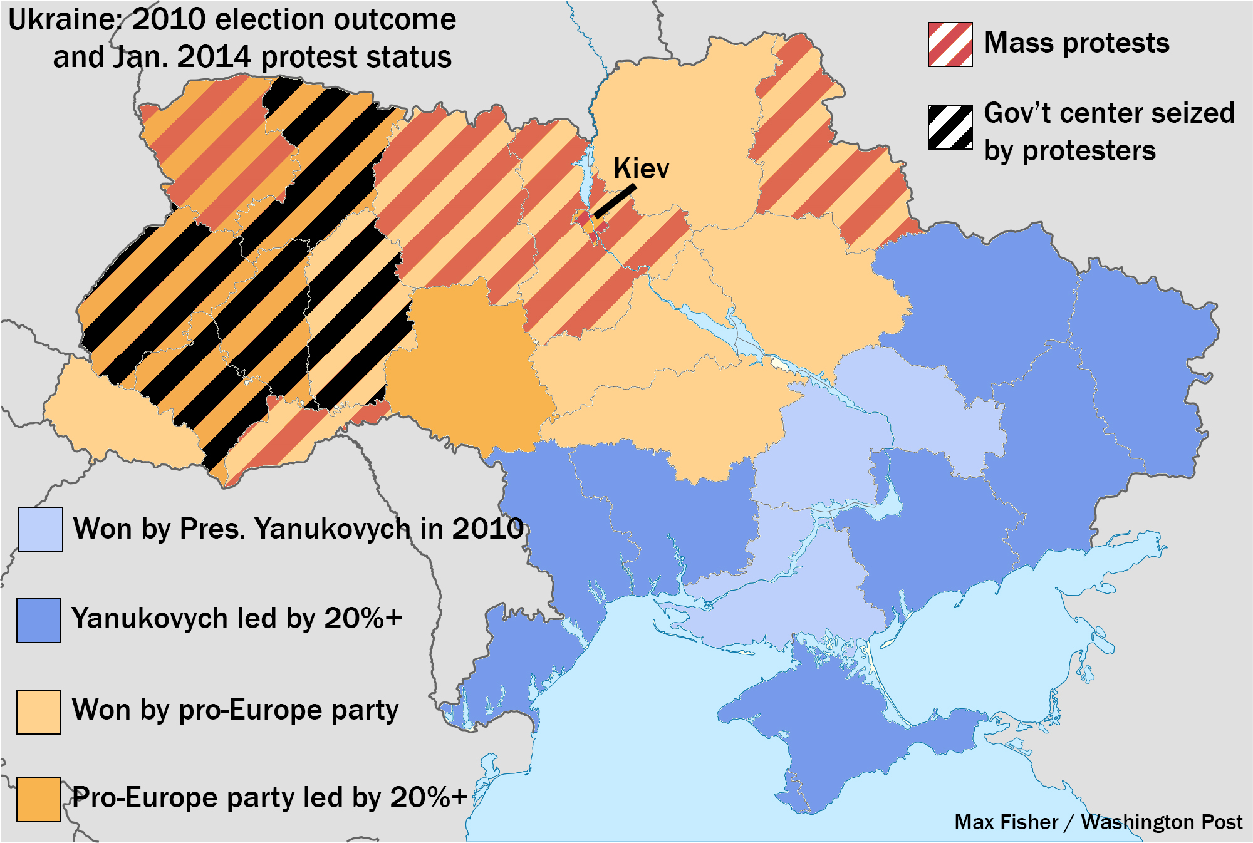

Slide 26
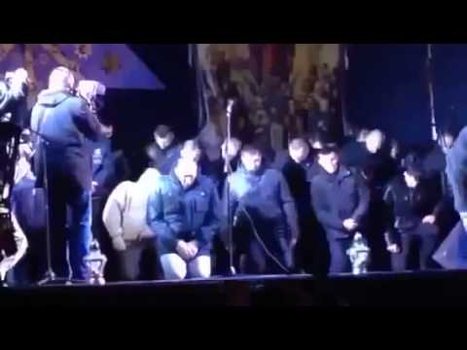
Berkut: Hero/ Villain?
West: Berkut as a villian
East and South: Berkut as a hero
Notes:
Armed Nazis forced Riot police "Berkut" to beg for forgiveness on their knees in Lviv

Slide 27
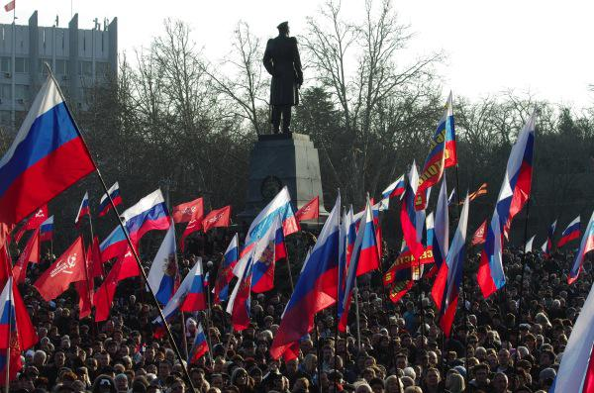
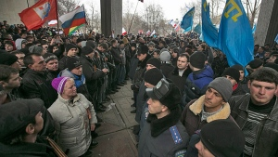
Crimea – Simferopol/ Sevastopol
Pro-Russian protesters vs. Tatars
26 Feb. confrontation in front of the local parliament

Slide 28
Peoples’ Politics
No tears for Yanukovych
No cheers for new regime
  Arseniy Yatsenyuk was booed on the Maidan when his name was read out as Prime Minister-designate.
Very skeptical of fascists

Slide 29
Politics of Debts
A tendency to bankruptcy
Western aids: a mini-Marshall Plan?
  IMF loans
  Heavy strings attached – austerity programs

Slide 30
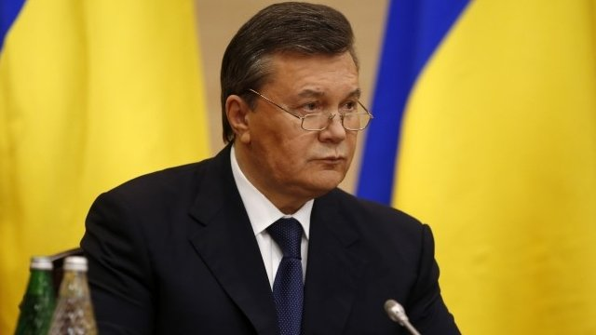
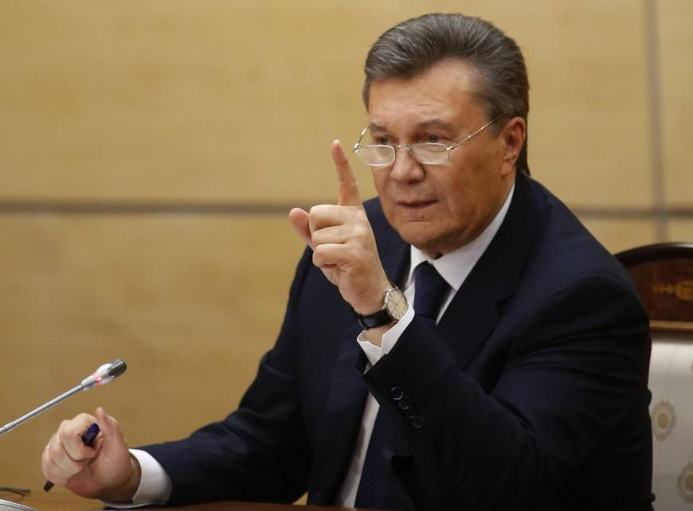
Viktor Yanukovych – I’m still the acting president of Ukraine.
Notes:
A news conference in Rostov-on-Don, Russia (28 February)

Slide 31
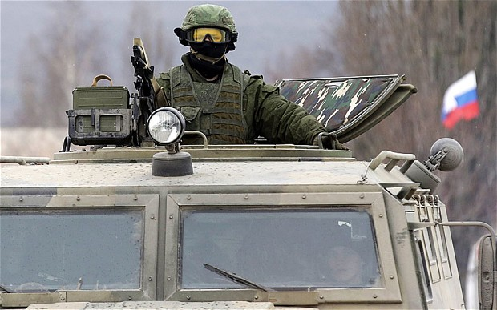
Russian Military Intervention?

Slide 32
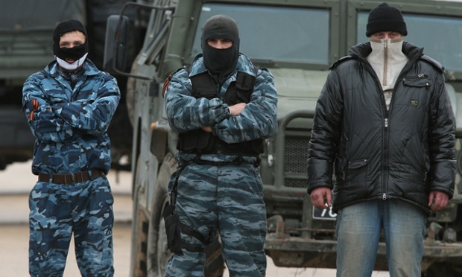
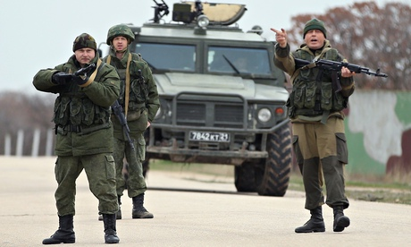
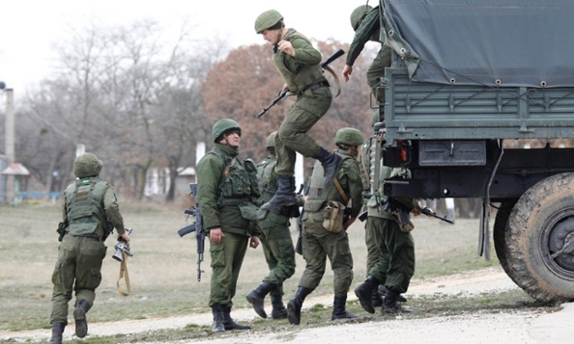
Notes:
(left) A line of pro-Russian militants guard the Russian occupied Belbek airbase as Russian-led troops blockade a number of Ukrainian military bases across Crimea, in Lubimovka, Ukraine. (Right) Russian servicemen disembark from a vehicle at the Belbek airport in the Crimea region.

Slide 33
Russian Responses
26 Feb: Putin ordered military exercises near border to prepare for a potential “crisis situation”
1 March: Russian Parliament unanimously votes to send troops to Ukraine; Russian troops will stay in Ukraine until “normalization of the situation” there.
More than 13,000 Russian naval personnel in Sevastopol

Slide 34
Russian Responses
Russian Parliament introduced a law allowing for regions to join Russia by referendum if its host country does not have a “legitimate government”.

Slide 35
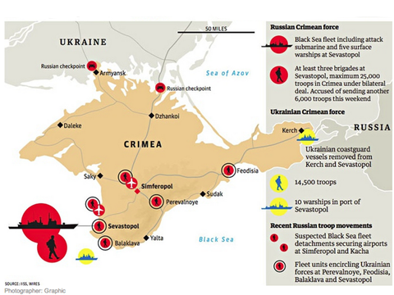

Slide 36
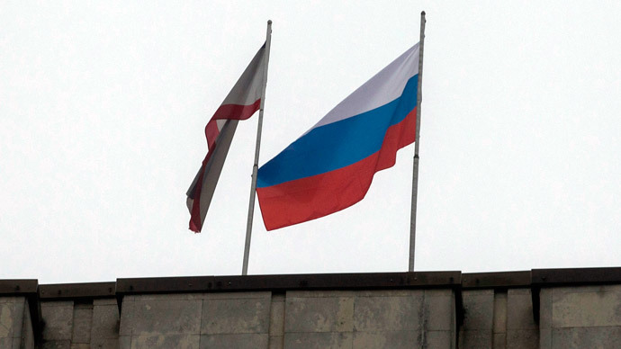
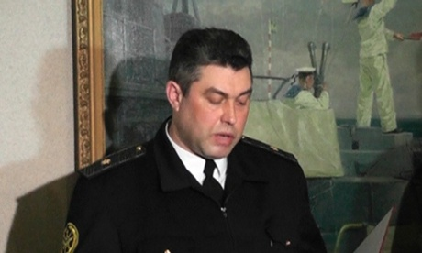
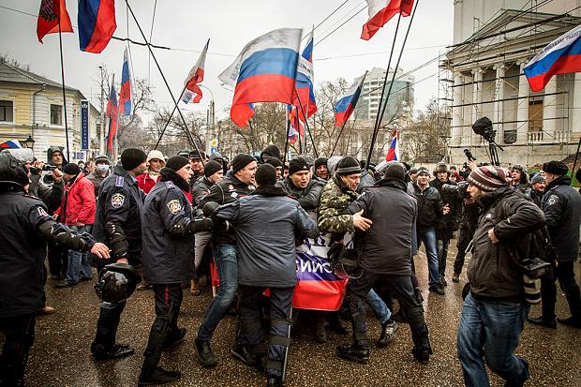
Notes:
Ukrainian navy chief Denis Berezovsky swears allegiance to the pro-Russian regional leaders of Crimea in Sevastopol on 2 March, 2014 in this still image taken from video. Photograph: Reuters

Slide 37
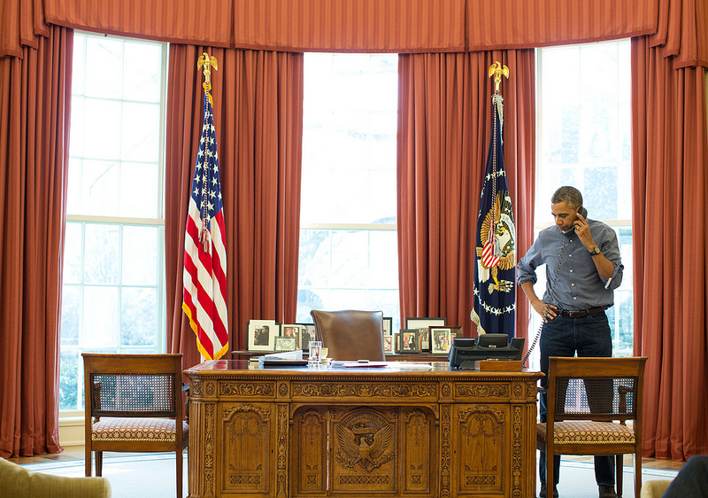
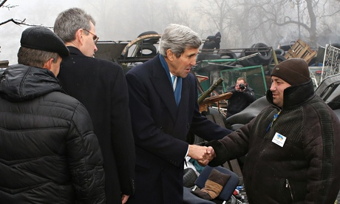
Obama’s Call –
Russia’s “grave mistake” (John Kerry)

Slide 38
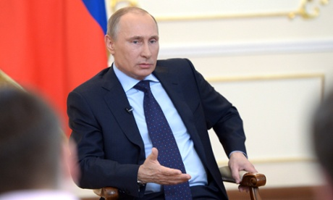
Putin’s Speech (4 March)
An “unconstitutional coup”
Russian troops as “self-defence groups”
A “humanitarian mission” to protect Russian peoples
Yanukovych as the legitimate president; no political future

